Slide 1
Language development in school-age children

Slide 2
Shifting Sources of Language input
Children’s sole source of language input is oral. However, once children learn to read, they can acquire language input from text as well.
Beginning at around age 8–10 years, children shift to gaining more and more of their language input from text.
Reading helps build children’s lexical knowledge and the phonological, semantic, and pragmatic aspects of oral language. Symbiotic relationship with reading and writing development
The pre-reading stage, period from birth to the beginning of formal education, include most critical developments, including oral language, print awareness, and phonological awareness.

Slide 3
Shifting Sources of Language input
(chall, 1996) scheme for reading development:
Initial reading, or decoding
Confirmation, fluency, and ungluing from print
Reading to learn the new
Multiple viewpoints—high school
Construction and reconstruction—a world view

Slide 4
Shifting Sources of Language input
Initial reading, or decoding:
From KG through first grade when children are about 5–7 years old.
Decode words by associating letters with corresponding sounds in spoken words.
This stage has three phases:
Making errors semantically and syntactically, (growling-barking).
Making errors graphically. (substituting for the word a word that looks similar “letters, pronouncing..” but does not make sense semantically.), (growing-green).
Making errors graphically but semantically related, (growing-going).
children who are more proficient at reading move through these phases more quickly than do children who are less proficient.

Slide 5
Shifting Sources of Language input
Confirmation, fluency, and ungluing from print:
Second to third grade 7-8 years old
confirmation as they become more confident in the reading skills they have gained; particularly proficient with high-frequency words and use the repetition of language to gain fluency and speed in reading.
Fluency refers to reading that is efficient, well paced and free of errors
Ungluing from prints become more confident and fluent in their reading abilities and reading become automatic and for learn.
they gradually begin to transition from learning to read to reading to learn.

Slide 6
Shifting Sources of Language input
Reading to learn the new :
-grade 4 to 8 or 9, age 9-14 years old
Read to gain new information
There is two phases:
Stage 3A (grades 4–6, or ages 9–11 years): read beyond egocentric purposes, can read works of typical adult length but not at the adult level of reading difficulty
Stage 3B (grades 7–8 or 9 and ages 12–14 years),: read on a general adult level
Reading during Stage 3 helps expand children’s vocabularies, build background and world knowledge, and develop strategic reading habits

Slide 7
Shifting Sources of Language input
Multiple viewpoints—high school
-high school period 14-18years old
-children are able to read more difficult texts with multiple sets of facts, theories, and viewpoints.
-children can consider multiple viewpoints on an issue

Slide 8
Shifting Sources of Language input
Construction and reconstruction—a world view:
College From age 18 on
Can read selectively
Make judgments about what to read, how much to read, and at what level of detail to achieve comprehension.
Using analysis, synthesis and prediction

Slide 9
Examples:
Stage 4: I don’t know. One of the authors I read said it was true; the other said it was not. I think there may be no true answer on the subject
Stage 5: there are different views on the matter, but one of the view seems to have the best evidence supporting it, and I would tend to go along with that view.
Stage 3: yes I read in a book, the author said it was true

Slide 10
Acquisition of metalinguistic competence
1. Phonological Awareness
the later-developing abilities in phonological awareness involve awareness of the smallest units of sound (phonemes) phonemic awareness
include:
blending sounds to make syllables and words, segmenting sounds from words : kindergarten or first grade (around age 5–6years).
manipulating sounds: second grade (at around age 7 years).

Slide 11
2. Figurative Language: use nonliteral Language and often abstract ways
Metaphor
A metaphor conveys similarity between two ideas or objects by stating that those two ideas or objects are the same.
metaphors consist of a term called the topic or the target, which is compared to another term called the vehicle or the base. Those share features and form the basis of comparison called the ground.
children understand basic-level metaphors (e.g., the girl in the pool is a fish) before they understand subordinate-level metaphors (e.g., the girl in the pool is a dolphin).

Slide 12
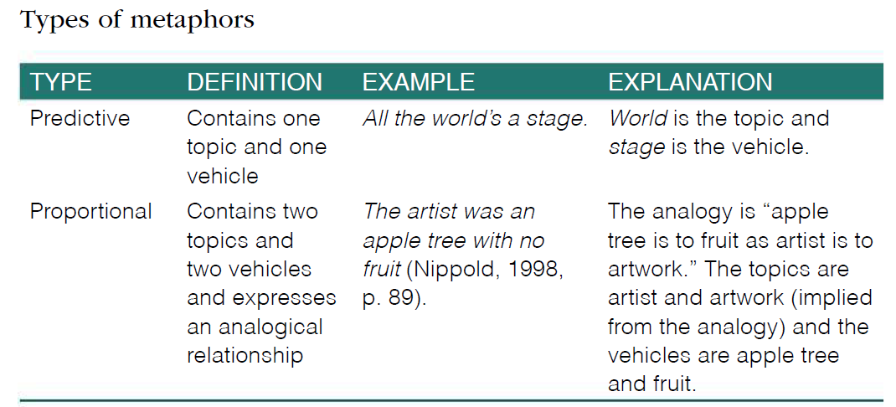
metaphors

Slide 13
Similes
Similes are similar to predictive metaphors by containing a topic, a vehicle, and the ground. But they make the comparison between the topic and vehicle explicit by using the word like or as.
Examples :
she acts like a queen.
quiet as a mouse and flat as a pancake.

Slide 14
Hyperboles
Hyperbole is a form of figurative language that uses exaggeration for emphasis or effect.
Examples
I’m so hungry, I could eat a horse.

Slide 15
Idioms
idioms are expressions containing both a literal and a figurative meaning.
Example: We’re in the same boat are examples of idioms
There are two types:
Transparent idioms: the figurative meaning is an extension of the literal meaning (e.g., hold one’s tongue).
Opaque idioms: demonstrate little relationship between the literal interpretation and the figurative interpretation (e.g., drive someone up the wall).

Slide 16
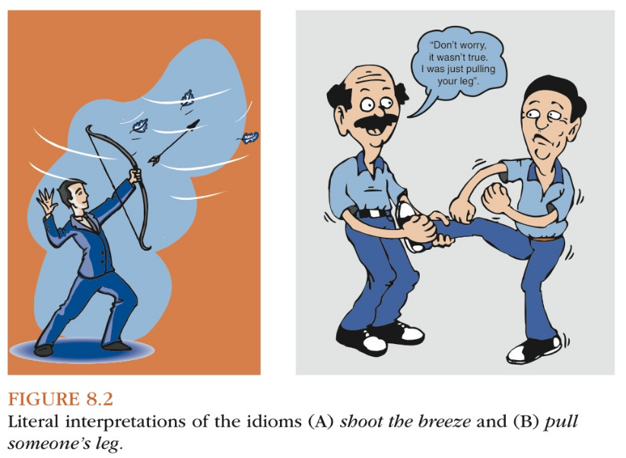
idioms
=Go through the motions
=Skating on thin ice
= hold one’s tongue
=Take down a peg
=Vote with one’s feet
=Drive someone up the wall

Slide 17
Irony and Sarcasm.
Irony and sarcasm are types of figurative language for which a speaker’s intentions differ from the literal meaning of the words he or she uses.
Irony refers to unmet general expectations that are not the fault of an individual, whereas sarcasm refers to a specific individual’s failure to meet an expectation.
Examples
Looking at her son's messy room, Mom says, "Wow, you could win an award for cleanliness!“
tim and jan walk to the park to have a picnic. As they unpack their food, it begins to rain. jan comments, “What perfect weather for a picnic.”

Slide 18
Proverbs.
Proverbs are statements expressing the conventional values, beliefs, and wisdom of a society.
proverbs serve a variety of communicative functions:
commenting: Blood is thicker than water.
interpreting: His bark is worse than his bite.
Advising: Don’t count your chickens before they hatch.
Warning: It’s better to be safe than sorry.
encouraging: Every cloud has a silver lining

Slide 19
WHAt mAjOr AcHievementS in LAnguAge FOrm, cOntent, AnD uSe cHArActerize tHe ScHOOL-Age YeArS AnD BeYOnD?

Slide 20
phonological development
morphophonemic development relates to development in the interaction between morphological and phonological processes:
1- at around age 5 or 6 years, children correctly use the plural ending /iz/, as in matches and watches.
2- vowel shifting occurs when the form class of a word (e.g., noun, verb, adjective) changes when adding a derivational suffix. examples of vowel shifting include /aI/ to /I/ (decide–decision) children usually master vowel shifting until about 17 years of age.
3- use stress and emphasis to distinguish phrases from compound words (hot dog vs. Hotdog) and nouns from verbs (present vs. present). children usually master stress and emphasis by 12 years of age.

Slide 21
morphological Development
The use of derivational prefixes and derivational suffixes.
-When we add a derivational prefix to the beginning of a word, it changes the word’s meaning ( healthy –unhealthy).
-When we add a derivational suffix to the end of a word, it can change the word’s form class, meaning, or both. ( child-childhood / jealous-jealousy).

Slide 22
Complex Syntax Development
Complex syntax refers to developmentally advanced grammatical structures that mark a “literate,” or decontextualized, language style.
Examples: noun-phrase post modification with past participles (a dance called the waltz), complex verb phrases using the perfective aspect (Stephanie has arrived from Vancouver), adverbial conjunctions (only, consequently), and passive voice construction (The fish were caught by an experienced fisherman).
We can measure these skills through:
1- persuasive writing : the goal is to adopt a particular point of view and convince the reader to adopt the same point or to take action consistent with that point of view. Examples, letters to support the re-election of a political official, and e-mail messages to persuade colleagues to help with an important project
2- narrative tasks: particularly those involving fables include complex story content .

Slide 23
Language content
(a) lexical development
(b) understanding of multiple meanings
(c) understanding of lexical and sentential ambiguity
(d) development of literate language.

Slide 24
Lexical Development
school-age children learn new words in at least three ways:
1- direct instruction involves learning the meaning of a word directly from a more knowledgeable source. This source may be another person or a reference such as a dictionary.(children do not begin to use dictionaries to learn the meanings of words until about second grade (age 7 or 8 years).
2- contextual abstraction involves using context clues in both spoken and written forms of language to determine the meanings of unfamiliar words. Pragmatic inferences (use for storybook) Using individual’s personal knowledge of the world or background knowledge of a text to determine the meaning. Logical inferences (use for textbooks) use only the information the text provides and are more difficult to make than pragmatic inferences
3- morphological analysis involves analyzing the lexical, inflectional, and derivational morphemes of unfamiliar words to infer their meanings.

Slide 25
Understanding of multiple meanings
As students develop, they become able to provide multiple definitions for words with several similar meanings, but they have particular difficulty understanding the secondary meanings of words if it not related to the primary meaning.
Being able to supply multiple meanings for words requires lexical knowledge and metalinguistic knowledge

Slide 26
Understanding of Lexical and Sentential Ambiguity
******Lexical ambiguity occurs for words and phrases with multiple meanings. It may take one of three forms:
1. Homophones are words that sound alike but have different meanings. Homophones may be spelled alike (brown bear vs. I can't bear seeing you cry) or may be spelled differently (brown bear vs. bare hands).
2. Homographs are words that are spelled the same way but have different meanings. Homographs may sound alike (row a boat vs. row of homes)
3. Homonyms are words that are alike in spelling and pronunciation but differ in meaning (brown bear vs. I can't bear seeing you cry)
****Sentential Ambiguity, involve:
1. Phonological ambiguity: occurs with a sound sequence that carries more than one interpretation “confuses the boundaries between words” (I can’t wait for the weekend vs. I can’t wait for the weak end).
2. Surface-structure ambiguity: occurs when words within a sentence can be grouped in two different ways with two different interpretation (I fed her bird seed vs. I fed her bird seed).
2. Deep-structure ambiguity: a noun in the sentence serves as the subject in one interpretation and as an object in another (e.g., The duck is ready to eat can mean “the duck is hungry” or “the duck is ready to be eaten

Slide 27
Development of Literate Language
language that is highly decontextualized, use for reflecting, reasoning, planning, and hypothesizing.
Four specific features of literate language that children learn to use :
1. Elaborated noun phrase: is a group of words consisting of a noun and one or more modifiers providing additional information about the noun, including articles (a, an, the), possessives (my, his, their) and so on. children’s elaborated noun phrases become increasingly complex as they age:
-By age 5, simple designating noun phrases include a determiner + noun (e.g., the boy, some candy).
-By age 8, simple descriptive noun phrases consist of a determiner + descriptive element + noun (e.g., the garage door, a small toy).
-By age 11, elaborated noun phrases with post modification, which consist of a determiner+ noun + prepositional phrase or a clause (e.g., a boy named Dillon, a girl with red hair)
2. Adverbs: is a syntactic form that modifies verbs and enhances the explicitness of action and event descriptions. Adverbs provide additional information about time ,manner ,degree ,place ,reason ,and affirmation or negation
3. Conjunctions: are words that organize information and clarify relationships among elements. Coordinating conjunctions include and, for, or, yet, but, nor, so. Subordinating conjunctions are more numerous and include after, although, as, because, and therefore.
4. Mental and linguistic verbs: Mental verbs include think, know, believe, imagine, feel, consider, suppose, decide, forget, and remember. Linguistic verbs include say, tell, speak, shout, answer, call, reply, and yell.

Slide 28
Language use
(a) functional flexibility
(b) conversational skills
(c) narrative development

Slide 29
functional flexibility
refers to the ability to use language for multiple communicative purposes or functions. two specific language functions that exhibit notable development during the school-age years:
1. expository discourse is language used to convey information. three important factors related to the comprehension of expository text domain-specific topic knowledge, text coherence (relationships between pieces of information are clear) is generally easier to comprehend than text that is not as coherent. text cohesion (the text is explicit with regard to relations within and across sentences) is generally easier to comprehend than text that is less cohesive.
2. persuasive discourse seven skills required for successful persuasion: Adjust to listener characteristics (age, authority, familiarity), State advantages as a reason to comply, Anticipate and reply to counterarguments, use positive techniques such as politeness to increase compliance, Avoid negative techniques, generate a large number and variety of arguments and control the discourse assertively.

Slide 30
conversational skills
1. Staying on topic longer and shifting smoothly from one topic to another
2. Having extended dialogues with other people who last for several conversational turns
3. making a larger number of relevant and factual comments
4. Adjusting the content and style of their speech to the listener’s thoughts and feelings
By about age 7 years, they begin to use indirect language, including hints, and they recognize other people’s indirect requests for action (e.g., “Do you know what time it is?”).
at around age 9 years, school-age children begin to use more sophisticated strategies, such as providing additional background information and defining terms to repair breakdowns when they occur.

Slide 31
narrative development
Types of Narratives. Younger children (about 5–6 years old) can produce at least four types of narratives:
1. Recounts also called personal narratives involve telling a story about personal experiences, or retelling a story the person has heard or read.
2. Accounts a type of personal narrative they are spontaneous. Accounts are thus highly individualized because adults cannot prompt the child or supply missing information.
3. Event casts describe a current situation or event as it is happening .
4. Fictionalized stories also called fictional narratives are invented narratives and usually have a main character who must overcome a challenge or solve a problem.

Slide 32
narrative development
Elements of Mature Narratives: school-age children learn how to move both forward and backward in time as they narrate, also begin to describe other individuals’ physical and mental states and motivations for actions, their narratives grow to include multiple episodes (includes a problem or challenge and all the elements that relate to solving the problem or challenge). Story grammar refers to the components of a narrative (e.g., characters, setting, episodes and the rules that govern how these components are organized.)
Expressive elaboration adds to a narrative’s story grammar and enhances its overall expressive quality. the development of children’s expressive elaboration in three main categories:
1. Appendages: cues that a narrator is telling or ending a story (e.g., a formal introduction to a story, “Once upon a time” ; a formal ending to a story, such as “the end”)
2. Orientations: elements that provide more detail to the setting and characters (e.g., characters’ names, relations between characters, personal attributes of characters)
3. Evaluations: Ways to convey narrator or character perspectives (e.g., using interesting modifiers, repetition for emphasis, internal-state words, or dialogue)

