Slide 1
Lecture 11
NUTD 343
Dr. Emilia Rappocciolo

Slide 2
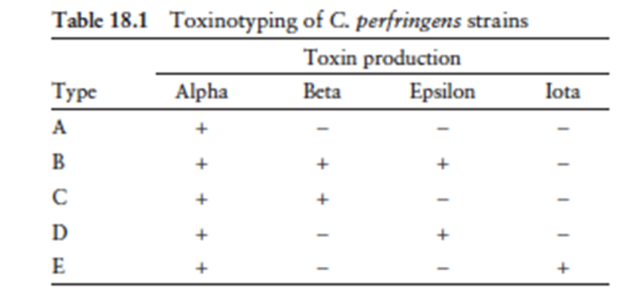
Clostridium perifringens
Characteristics : Gram-positive, rod-shaped, encapsulated, non-motile C. perfringens enterotoxin (CPE) and b-toxin – have activity on the human GI tract.
Toxin typing: classifies C. perfringens isolates into five types (A through E) according to production of 4 major enterotoxins: alpha, beta, epsilon, and iota (multiplex PCR)
Anaerobe
Virulence: due to toxin production

Slide 3
disease
Toxin types are associated with 2 foodborne diseases:
Type C isolates producing beta toxin: necrotizing enterocolitis, life threatening illness
Type A food poisoning: self-limiting, associated with type A isolates producing CPE (Clostridium Perifringens Enterotoxin)
toxins active in the GI tract
Cells have exceptional short doubling time (Type A <10 m at 43°C). Rapid growth in foods to reach a pathogenic burden.
Forms spores tolerant of food environment stresses such as radiation, desiccation, freezing, refrigeration, and heat- favours survival in incompletely cooked/inadequately held foods.

Slide 4
Type A foodborne disease
Toxin is responsible for causing the illness
Toxicoinfection (foodborne illness caused by ingesting bacteria that produce toxins within the digestive tract).
For spore producing bacteria like C. perifringens: ingestion of large numbers of live vegetative cells. Vegetative cells do not multiply in the digestive tract, but sporulate and release toxins
Toxicoinfection for Gram-negative bacteria: live cells are ingested in moderate numbers, cells rapidly multiply in the digestive tract and release toxins

Slide 5
Type A foodborne disease
Toxicoinfection develops 8-16 h after consumption of contaminated food and last 12 – 24 h
Victims suffer from diarrhea and severe abdominal cramps
Illness occurs as follows:
  Temperature abuse allows spores to germinate to vegetative cells
  Rapidly divide in foods
  Enough numbers will survive the acidity in the stomach
  In small intestine where they multiply, sporulate and release enterotoxin during sporulation
  Toxin quickly adhere and damage small intestinal cells, result in fluid loss

Slide 6
Type A foodborne disease
Infectious dosage
Cells are killed by acid in stomach
Toxicoinfection develops when heavily contaminated food is eaten
Dose = 1x10⁶ – 1x10⁷ cells/g
Toxin is produced during sporulation
Disease is mild because continuous flushing of intestine removes unbound toxin
Infection is more serious in elderly and debilitated people
Antibodies to toxin is produced, but there is no evidence that previous exposure provides protection

Slide 7
Susceptibility to temperature
Spores survive in undercooked foods
Survive boiling for several hours
Incomplete cooking of foods
  Fail to kill spores
  Favor the development of Type A toxicoinfection by inducing spore germination
  Vegetative cells are not thermophilic but their optimal growth Temp is 43 – 45°C, may reach 50°C,
Vegetative cells of toxicoinfection are 2 fold more heat resistant than other isolates
Cells are not tolerant to refrigeration, NG at 6°C,
Spores are cold resistant

Slide 8
Susceptibility to aw, ph
The cells need several amino acids for growth so they can grow very well in many protein rich foods
Aw: 0.93 – 0.97,
Do not require extremely reduced environment for growth
pH: optimal is 6 -7
Poor growth or not at all at pH < 5 or > 8.3
Growth is also affected by the presence of curing agents such as nitrates - The cells fail to grow well at:
  pH < 5.0,
  NaCl > 5%
  Aw <0.93,
  500 ppm nitrite

Slide 9
outbreaks
1st outbreak: From corned beef
Boiled 3 hrs, cooled to RT, then refrigerated
4 days later – warmed to 48 C and served
Sandwiches were left at RT from morning till afternoon then eaten
2nd outbreak: Precooked/frozen corned beef
Thawed and cooked in 5 kg pieces
Stored in the fridge
Reheated under a heat lamp for 90 minutes before serving
When tested – it contained large numbers of C. perfringenes
Conclusion: meat + Temp abuse are significant in outbreaks of C. perfringenes type A

Slide 10
prevention
Keep the cell numbers low by using proper sanitation during food preparation and handling
Cook food to the highest temperature recommended to kill the cells and as many spores as possible
Cool food quickly and uniformly (within 1 h) to refrigerated temperature <10°C
Reheat refrigerated foods quickly and uniformly (to kill vegetative cells)
Keep reheated food hot above 60°C while being served

Slide 11
Bacillus cereus
Gram positive, spore forming bacillus.
Related to B. thuringiensis, and B. anthracis. All carry toxin producing genes on plasmids (can be transferred)
The disease is short and self solving so often not reported.
There are two types of B. cereus foodborne illness. The first type, caused by an emetic toxin, results in vomiting. The second type, caused by an enterotoxin(s), results in diarrhea.
A few B. cereus strains make both toxins and cause both symptoms. The incubation time (>6 h; average, 12 h) for diarrheal illness is too long for the illness to be caused by a toxin premade in the food. However, the emetic toxin can be formed in food when the B. cereus population is at least 100-fold higher than that necessary for causing the diarrheal illness

Slide 12
Bacillus cereus
The emetic toxin cereulide causes emesis (vomiting). Cereulide is not a conventional protein.
Cereulide has a ring structure of three repeats of four amino acids and/or oxyacids: [D-O-Leu–D-Ala–L-OVal–L-Val]3. The structure suggests that cereulide is an enzymatically synthesized peptide and not a gene product.
The emetic toxin itself is resistant to autoclaving, a wide range of pH values (2 to 11), and digestion by proteases. It is not antigenic, so immunology-based methods cannot be used for its detection.

Slide 13
Bacillus cereus

Slide 14
Potential ecological niche for emetic B. cereus strains. Specific strains may contaminate roots and tops of crops and enter the human or animal food supply. Spores from emetic strains are more resistant to heat and may be enriched for in cooked or heat-processed foods

