Slide 1
Organizational Behavior 15th Ed
Chapter 13
Robbins and Judge
Power and Politics

Slide 2
Chapter 12 Learning Objectives
After studying this chapter you should be able to:
Define power and contrast leadership and power.
Contrast the five bases of power.
Explain the role of dependence in power relationships.
Identify nine power or influence tactics and their contingencies.
Show the connection between sexual harassment and the abuse of power.
Identify the causes and consequences of political behavior.
Apply impression management techniques.
Determine whether a political action is ethical.

Slide 3
Define power and contrast leadership and power
LO 1
Power refers to a capacity that A has to influence the behavior of B, so that B acts in accordance with A’s wishes.
Power may exist but not be used.
Probably the most important aspect of power is that it is a function of dependency.
A person can have power over you only if he or she controls something you desire.
1

Slide 4
Define power and contrast leadership and power
LO 1
Contrasting Leadership and Power
Leaders use power as a means of attaining group goals.
Leaders achieve goals, and power is a means of facilitating their achievement.
1

Slide 5
Define power and contrast leadership and power
LO 1
Differences between Leadership and Power:
Goal compatibility
Power does not require goal compatibility, merely dependence.
The direction of influence
Leadership focuses on the downward influence on one’s followers.
1

Slide 6
Contrast the five bases of power
LO 2
Coercive Power
Reward Power
Legitimate Power
Expert Power
Referent Power
1

Slide 7
Contrast the five bases of power
LO 2
Which Bases of Power Are Most Effective?
Personal sources are most effective.
Both expert and referent power are positively related to employees’ satisfaction with supervision, their organizational commitment, and their performance, whereas reward and legitimate power seem to be unrelated to these outcomes.
Coercive power usually backfires.
1

Slide 8
Contrast the five bases of power
LO 2
Individuals in positions of power tend to be blamed for their failures and credited for their successes to a greater degree than those who have less power.
In the same way, studies suggest that leaders and managers in positions of power pay greater costs for unfairness and reap greater benefits for fairness.
1

Slide 9
Explain the role of dependence in power relationships
LO 3
The General Dependency Postulate
When you possess anything that others require but that you alone control, you make them dependent upon you and, therefore, you gain power over them.
Dependency, then, is inversely proportional to the alternative sources of supply.
1

Slide 10
Explain the role of dependence in power relationships
LO 3
What Creates Dependency?
Importance
Scarcity
Nonsubstitutability
1

Slide 11
Identify nine power or influence tactics and their contingencies
LO 4
Legitimacy
Rational Persuasion
Inspirational Appeals
Consultation
Exchange
Personal Appeals
Ingratiaing
Pressure
Coalitions

Slide 12
Identify nine power or influence tactics and their contingencies
LO 4
Some tactics are more effective than others.
Rational persuasion, inspirational appeals, and consultation are most effective when the audience is highly interested in the outcomes.
Pressure tends to backfire.
Both ingratiation and legitimacy can lessen the negative reactions from appearing to “dictate” outcomes.
1

Slide 13
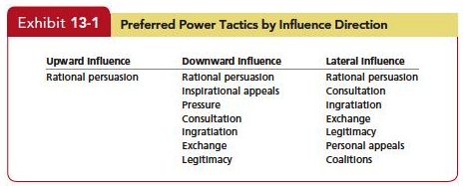
Identify nine power or influence tactics and their contingencies
LO 4
1

Slide 14
Identify nine power or influence tactics and their contingencies
LO 4
People in different countries prefer different power tactics.
Individualistic countries see power in personalized terms and as a legitimate means of advancing their personal ends.
Collectivistic countries see power in social terms and as a legitimate means of helping others.
1

Slide 15
Identify nine power or influence tactics and their contingencies
LO 4
Extraverts are more influential in team-oriented organizations, and highly conscientious people are more influential in organizations that value working alone on technical tasks.
Cultures within organizations differ markedly—some are warm, relaxed, and supportive; others are formal and conservative.
The organizational culture will have a bearing on which tactics are considered appropriate.
1

Slide 16
Show the connection between sexual harassment and the abuse of power
LO 5
Sexual harassment is wrong.
It can also be costly to employers.
Mitsubishi paid $34 million to settle a sexual harassment case.
A former UPS manager won an $80 million suit against UPS on her claims it fostered a hostile work environment.
It can have a negative impact on the work environment, too.
1

Slide 17
Show the connection between sexual harassment and the abuse of power
LO 5
Sexual harassment is defined as any unwanted activity of a sexual nature that affects an individual’s employment and creates a hostile work environment.
The U.S. Supreme Court helped to clarify this definition by adding a key test for determining whether sexual harassment has occurred—when comments or behavior in a work environment “would reasonably be perceived, and [are] perceived, as hostile or abusive.”
1

Slide 18
Show the connection between sexual harassment and the abuse of power
LO 5
Most studies confirm that the concept of power is central to understanding sexual harassment.
Sexual harassment is more likely to occur when there are large power differentials.
Thus sexual harassment by the boss typically creates the greatest difficulty for those being harassed.
1

Slide 19
Show the connection between sexual harassment and the abuse of power
LO 5
A recent review of the literature shows the damage caused by sexual harassment.
Individuals who are sexually harassed report lower job satisfaction and diminished organizational commitment as a result.
1

Slide 20
Show the connection between sexual harassment and the abuse of power
LO 5
Managers have a responsibility to protect their employees from a hostile work environment, but they also need to protect themselves.
Managers may be unaware of sexual harassment, but being unaware does not protect them or their organization.
If investigators believe a manager could have known about the harassment, both the manager and the company can be held liable.
1

Slide 21
Identify the causes and consequences of political behavior
LO 6
Politics-Those activities that are not required as part of one’s formal role in the organization, but that influence the distribution of advantages within the organization.
It encompasses efforts to influence decision-making goals, criteria, or processes.
It includes such behaviors as withholding information, whistle blowing, spreading rumors, leaking confidential information.
1

Slide 22
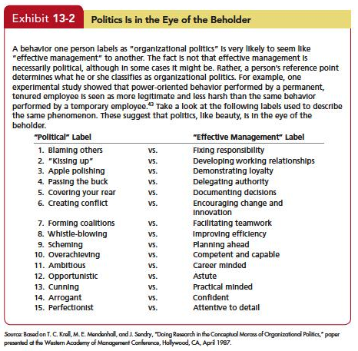
Identify the causes and consequences of political behavior
LO 6
1

Slide 23
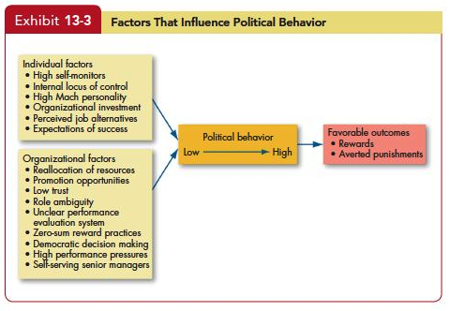
Identify the causes and consequences of political behavior
LO 6
1

Slide 24
Identify the causes and consequences of political behavior
LO 6
1

Slide 25
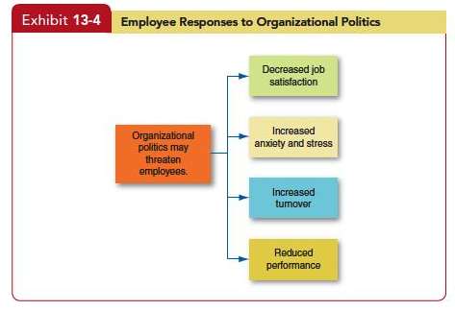
Identify the causes and consequences of political behavior
LO 6
1

Slide 26
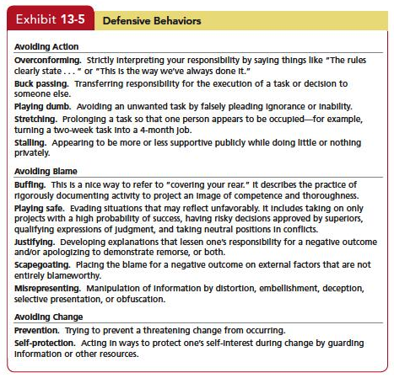
Identify the causes and consequences of political behavior
LO 6
1

Slide 27
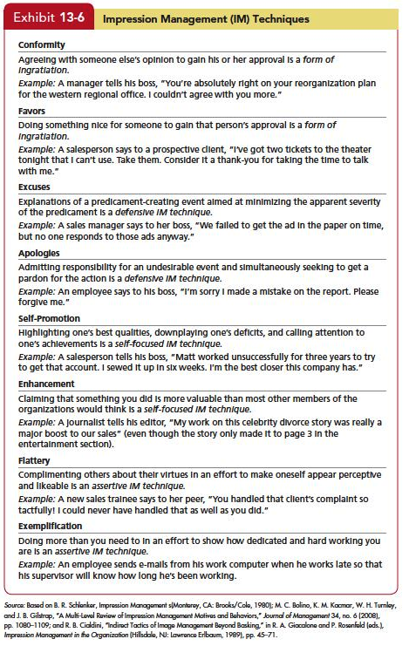
Apply impression management techniques
LO 7
1

Slide 28
Apply impression management techniques
LO 7
Most job applicants use IM.
Some IM techniques work better than others in the interview.
In general, applicants appear to use self-promotion more than ingratiation.
Ingratiating always works because everyone—both interviewers and supervisors—likes to be treated nicely.
1

Slide 29
Apply impression management techniques
LO 7
Almost all our conclusions on employee reactions to organizational politics are based on studies conducted in North America.
The few studies that have included other countries suggest some minor modifications.
1

Slide 30
Determine whether a political action is ethical
LO 8
Although there are no clear-cut ways to differentiate ethical from unethical politicking, there are some questions you should consider.
What is the utility of engaging in politicking?
Is it worth the risk?
Does the political activity conform to standards of equity and justice?
1

Slide 31
Determine whether a political action is ethical
LO 8
When faced with an ethical dilemma regarding organizational politics, try to consider whether playing politics is worth the risk and whether others might be harmed in the process.
If you have a strong power base, recognize the ability of power to corrupt.
Remember that it’s a lot easier for the powerless to act ethically, if for no other reason than they typically have very little political discretion to exploit.
1

Slide 32
Summary and Implications for Managers
If you want to get things done in a group or an organization, it helps to have power. Here are several suggestions for how to deal with power in your own work life:
As a manager who wants to maximize your power, you will want to increase others’ dependence on you.
1

Slide 33
Summary and Implications for Managers
Few employees relish being powerless in their job and organization.
Try to avoid putting others in a position where they feel they have no power.
People respond differently to the various power bases.
1

Slide 34
Summary and Implications for Managers
An effective manager accepts the political nature of organizations.
By assessing behavior in a political framework, you can better predict the actions of others and use that information to formulate political strategies that will gain advantages for you and your work unit.
1

Slide 35
Summary and Implications for Managers
Some people are significantly more politically astute than others, meaning that they are aware of the underlying politics and can manage impressions.
Those who are good at playing politics can be expected to get higher performance evaluations and, hence, larger salary increases and more promotions than the politically naïve or inept.
The politically astute are also likely to exhibit higher job satisfaction and be better able to neutralize job stressors.
1

Slide 36
Summary and Implications for Managers
Employees who have poor political skills or are unwilling to play the politics game generally relate perceived organizational politics to lower job satisfaction and self-reported performance, increased anxiety, and higher turnover.
1

Slide 37
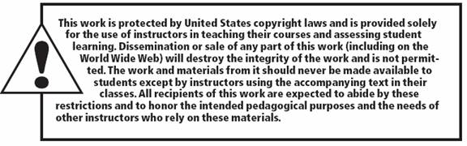
All rights reserved. No part of this publication may be reproduced, stored in a retrieval system, or transmitted, in any form or by any means, electronic, mechanical, photocopying, recording, or otherwise, without the prior written permission of the publisher. Printed in the United States of America.
Copyright © 2013 Pearson Education, Inc. publishing as Prentice Hall
Notes:
All rights reserved. No part of this publication may be reproduced, stored in a retrieval system, or transmitted, in any form or by any means, electronic, mechanical, photocopying, recording, or otherwise, without the prior written permission of the publisher. Printed in the United States of America.

