Slide 1
Cancer and HIV Infection
BOOK: CHAPTER 29, HIGHLIGHTS 11 & 17

Slide 2
Although cancers and human immunodeficiency virus (HIV) infections are distinct disorders, from a nutritional standpoint they share some similarities.
Both disorders can lead to severe wasting in advanced cases
Individualized nutrition therapy based on the symptoms manifested and the tissues or organs involved.

Slide 3
Cancer
We will discuss
How cancer develops
Factors that influence cancer risk
The effects of cancer on nutrition status
Main approaches to cancer treatment.

Slide 4
Cancers: diseases characterized by the uncontrolled growth of a group of cells, which can destroy adjacent tissues and spread to other areas of the body via lymph or blood.
Cancer: the growth of malignant tissue (tumor, which can injure healthy tissue and spread cancer to other regions of the bod )
Malignant: describes a cancerous cell or tumor, which can injure healthy tissue and spread cancer to other regions of the body.
There are many kinds of malignant growths
The various types of cancer have different characteristics, occur in different locations in the body, take different courses, and require different treatment
An isolated, non-spreading type of skin cancer may be removed- may have no effect on nutrition status
Advanced cancers— especially those of the gastrointestinal (GI) tract and pancreas—can seriously impair nutrition status.

Slide 5
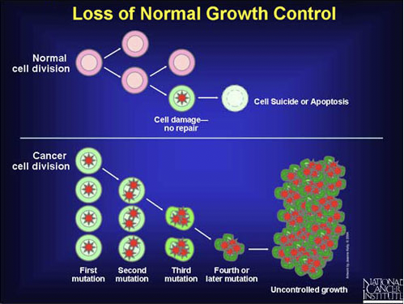
Carcinogenesis: The development of cancer which develops slowly, and continue for several decades
Cells grow and divide in a controlled way as part of normal cell turnover
A cancer usually arises from genetic mutations that alter gene expression in a single cell
two major types of genes that are thought to influence the development of cancer: oncogenes ( Produce growth factors and influence cell proliferation) and tumor- suppressor genes.
Tumor suppressor genes normally cause cell death (apoptosis) but in a mutated form they may lose this function
When DNA is damaged, producing mutations that affect normal cell growth and division
Cells do not undergo apoptosis (cell death) are not cleared normally by immune system
Mutated cells form a mass of tissue called a tumor

Slide 6
The Tumor (the abnormal mass of cells-grows), a network of blood vessels forms to supply the tumor with the nutrients it needs to support its growth
Some tumor cells may metastasize (spreading to other regions in the body)
Why cancers develop??
Genetic susceptibility (when a person is born with a genetic defect that alters DNA structure, function, or repair)
Certain metabolic processes may initiate carcinogenesis, as when phagocytes (immune cells) produce oxidants that cause DNA damage
Chronic inflammation may increases the rate of cell division and the risk of a damaging mutation
Interaction between a person’s genes and the environment
Carcinogens

Slide 7
Carcinogens
Chemicals (aflatoxins, engine exhaust, chemicals used in manufacturing)
Physical agents (ionizing/UV radiation)
Infectious microorganisms (Bacterial: H. pylori
Viral: HPV, hepatitis B & C, HIV ) – may interact with genetic material of cells and disturb normal cellular function)

Slide 8
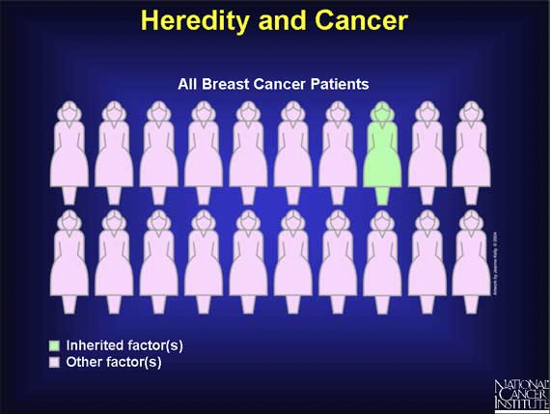
Genetics
A person's chances of developing cancer can be influenced by inheritance of certain genetic alterations
These alterations increase susceptibility for cancer
Inherited genetic mutations play a major role in about 5 to 10 percent of all cancers.
Example
polymorphisms in BRCA1 or BRCA2 ( tumor suppressor gene
Polymorphism in these genes is associated with breast and ovarian cancer)
https://www.cancer.gov/about-cancer/causes-prevention/genetics

Slide 9
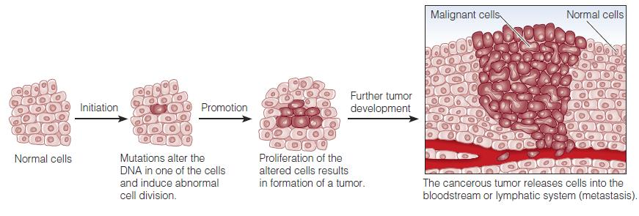
A cancer arises from mutations in the genes that control cell division in a single cell. These mutations may:
Promote cellular growth
Interfere with growth restraint
Prevent cellular death.

Slide 10
Nutrition & Cancer Risk
Diet and lifestyle strongly influence cancer risk. Various food components can alter processes of DNA repair, gene expression, or cell differentiation in ways that affect cancer development.
World Cancer Research Fund (2014): 1⁄4 - 1⁄3 of cancers in high income countries are due to poor nutrition, physical inactivity, and excess weight.
Diets contain both inhibitors and enhancers of carcinogenesis. Certain food components may:
Directly damage DNA
Inhibit the formation of carcinogens in the body
Alter carcinogen metabolism
Krause’s food and the nutrition care process, 14th edition

Slide 11
obesity is a risk factor for a number of different cancers, including some relatively common cancers such as colon cancer and postmenopausal breast cancer.
Obesity increases cancer risk, in part, by altering the levels of hormones that influence cell growth, such as insulin, the sex hormones, and several kinds of growth factors.
For example: post-menopausal women and BC- Adipose tissue is the main source of estrogen hormones post-menopause
Insulin-like growth factor-1 (IGF-1): increased with increased insulin levels. May promote development of prostate, breast, lung, and colon cancers.
About 1 in 30 cancer deaths can be attributed to alcohol consumption
Cancer risk increases for individuals who consume alcohol if they smoke

Slide 12
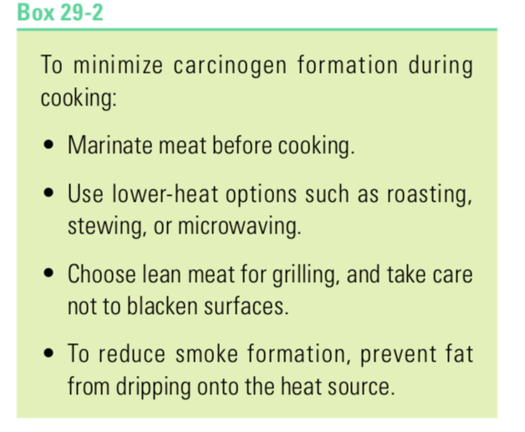
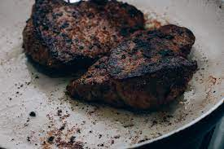
Food preparation methods can influence the production of carcinogens
Cooking meat, poultry, and fish at high temperatures causes the amino acids and creatine (also nitrites) in these foods to react together and form carcinogens (heterocyclic amines and Nitrosamines).
Carcinogens also accompany the smoke that adheres to food during grilling, and they are present in the charred surfaces of grilled meat and fish (Polycyclic aromatic hydrocarbons PAHs)
The cancer risk from eating such foods is unclear because the biological effects of these carcinogens are modulated by other dietary components

Slide 13

Nutrition and Decreased Cancer Risk
Consuming fruits and vegetables- Reduce Risk
Contain nutrients and phytochemicals with antioxidant activity-may prevent or reduce the oxidative reactions in cells that cause DNA damage.
Phytochemicals may inhibit carcinogen production in the body, enhance immune responses that protect against cancer development, or promote enzyme reactions that inactivate carcinogens
Folate plays roles in DNA synthesis and repair; thus, inadequate folate intakes may allow DNA damage to accumulate. (Adequate folate intake is associated with decreased risk of colon & pancreatic cancers)
Dietary fiber, which may help to protect against colon and rectal cancers by diluting potential carcinogens in fecal matter and accelerating their removal from the GI tract.

Slide 14
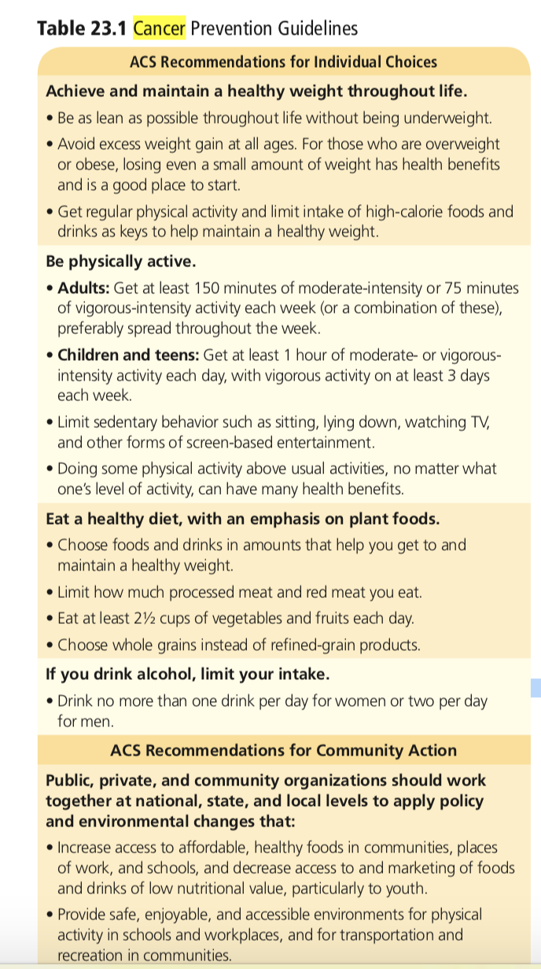

Slide 15
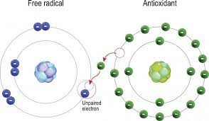
HIGHLIGHT 11
Antioxidant
Oxygen reacts with body compounds and produces highly unstable molecules known as free radicals. In addition to normal body processes, environmental factors such as ultraviolet radiation, air pollution, and tobacco smoke generate free radicals
A free radical is a molecule with one or more unpaired electrons.
unstable and highly reactive
an electron-snatching chain reaction is under way with free radicals producing more free radicals
Antioxidants neutralize free radicals by donating one of their own electrons

Slide 16
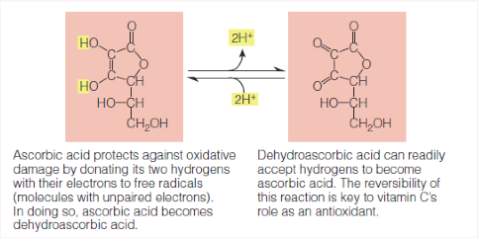
Antioxidants do not become free radicals because they are stable in either form
Most often, however, free-radical attacks cause widespread damage. They commonly damage the polyunsaturated fatty acids in lipoproteins and in cell membranes, disrupting the transport of substances into and out of cells. Free radicals also alter DNA, RNA, and proteins, creating excesses and deficiencies of specific proteins, impairing cell functions, and eliciting an inflammatory response.

Slide 17
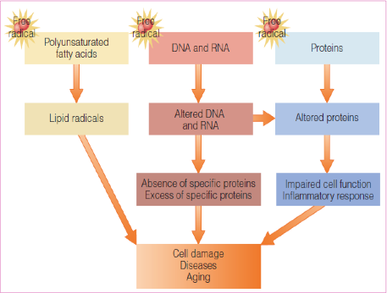

Slide 18
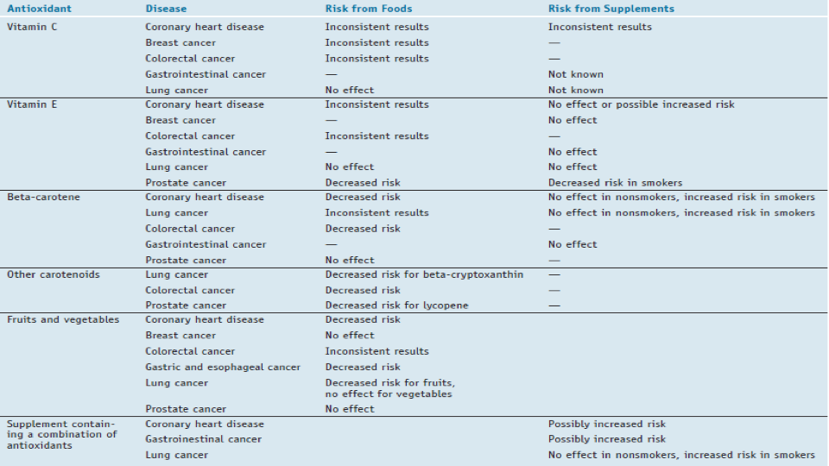

Slide 19
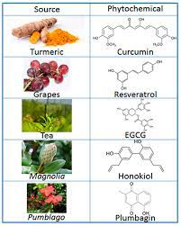
Dietary Antioxidants also include some of the phytochemicals (compounds found in plant-derived foods that have biological activity in the body)
In foods, phytochemicals impart tastes, aromas, colors, and other characteristics. They give hot peppers their burning sensation, garlic its pungent flavor, and tomatoes their red color
In the body, phytochemicals can have profound physiological effects—acting as antioxidants, mimicking hormones, stimulating enzymes, interfering with DNA replication, suppressing inflammation, destroying bacteria, and binding to cell walls
Phytochemicals with antioxidant activity minimize damage and prevent disease in the following ways
Limiting free-radical formation
Destroying free radicals or their precursors
Stimulating antioxidant enzyme activity

Slide 20
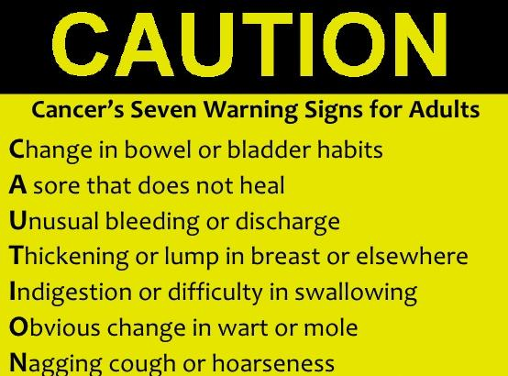
Cancer Prevention & Screening
Primary prevention
Specific factors identified as part of cancer process acted upon to decrease their potential as carcinogens
Personal and community-wide efforts (e.g. smoking)
Secondary prevention
Early detection and intervention (e.g. colonoscopy)
Chemoprevention
Specific agents to reverse, suppress, prevent carcinogenesis (The use of drugs, vitamins, or other agents to try to reduce the risk of, or delay the development or recurrence of, cancer)

Slide 21
Consequences of Cancer
Once cancer develops, its consequences depend on the location of the cancer, its severity, and the treatment
Nonspecific effects of cancer include anorexia, fatigue, unexplained weight loss, fever, night sweats, skin lesions, and hyperpigmented (darkened) skin.
During the early stages, many cancers produce no symptoms, and the person may be unaware of the threat to health.

Slide 22
Consequences of Cancer
Anorexia and Reduced Food Intake
Metabolic Changes
Cancer Cachexia

Slide 23
Consequences of Cancer
Anorexia and Reduced Food Intake
Major contributor to the weight loss often associated with cancer. Some factors that contribute to anorexia or otherwise reduce food intake include:
Mental stress: Depression , anxiety - reducing appetite
Chronic nausea and early satiety.
Fatigue- People with cancer may tire easily and lack the energy to prepare and eat meals
Pain
Gastrointestinal obstructions. A tumor may partially or completely obstruct a portion of the GI tract, causing complications such as nausea and vomiting, early satiety etc.
Effects of cancer therapies. Chemotherapy and radiation treatments for cancer frequently have side effects that make food consumption difficult, such as nausea, vomiting, dry mouth, altered taste perceptions, dysphagia, abdominal pain

Slide 24
Metabolic Changes
The metabolic changes that arise in cancer contribute to weight loss and nutrient depletion
Cytokines- released by both tumor cells and immune cells, induce an inflammatory and catabolic state
Increased rate of protein turnover, but reduced muscle protein synthesis.
Muscle breakdown for gluconeogenesis
Triglyceride breakdown increases, elevating serum lipids
Insulin resistance
These metabolic changes make it challenging for people with cancer to regain lean tissue or maintain healthy body weights even when they are consuming adequate energy and nutrients.

Slide 25
Cancer Cachexia
Generalized weakness, weight loss, fever, tissue wasting, anorexia
Metabolic alterations attributable to increased energy expenditure, increased acute phase proteins such as CRP, fibrinogen, WBC, pro-inflammatory cytokines (indicate systemic inflammation)
Low appetite due to the effects of treatments and medications.
Diversion of nutrients to support tumor growth (Abnormalities in Carbohydrate, Protein, and Lipid Metabolism)

Slide 26
Cancer cachexia—characterized by anorexia, weight loss, muscle wasting, anemia, and fatigue—develops in up to 50 percent of cancer patients and is responsible for as many as 20 percent of cancer deaths.
Cachexia may be indicated by an involuntary weight loss of more than 5 percent of body weight.
Unintentional weight loss may be occurring in overweight or obese patients

Slide 27
Treatment Options
Goal: Remove cancer cells, prevent further tumor growth, and alleviate symptoms.
The primary medical treatments for cancer
Surgery
Chemotherapy
Radiation therapy
or any combination of the three
Other treatment options:
Hematopoietic Stem Cell Transplantation
Biological Therapies
Alternative Therapies

Slide 28
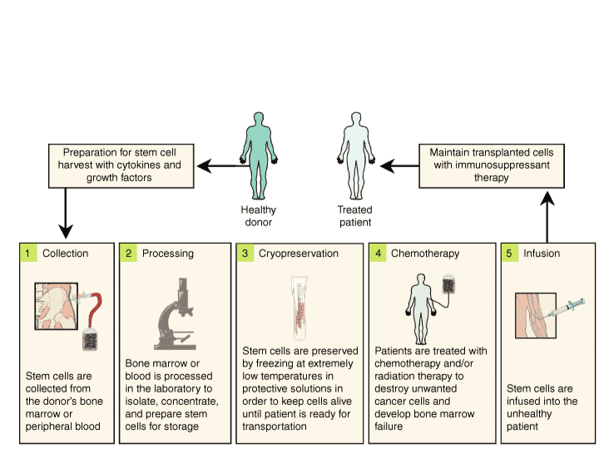
Treatment Options
Hematopoietic Stem Cell Transplantation

Slide 29
Surgery
Surgery is performed to: (1) Remove tumors (2) Determine the extent of cancer (3) Protect nearby tissues.
Often, surgery must be followed by other cancer treatments to prevent growth of new tumors.
Effect on nutritional status:
Acute metabolic stress (increase protein and energy needs)
Surgery contributes to pain, fatigue, and anorexia (reduce food intake)
Blood loss contributes to nutrient losses

Slide 30
Surgery
Additional specific nutrition-related concerns:
Head and Neck Surgeries: Aspiration, Dry or sore mouth, Reduced chewing or swallowing ability,
Reduced sense of taste or smell
Esophageal Resection: Acid reflux, Altered gastric motility, Reduced swallowing ability
Gastric Resection: Dumping syndrome, Early satiety, Inadequate gastric acid secretion, Malabsorption of iron, and vitamin B12.
Intestinal Resection: Bile insufficiency, Diarrhea, Fluid and electrolyte imbalances, General malabsorption.
Pancreatic Resection: Diabetes mellitus, General malabsorption

Slide 31
Radiation
Treatment by bombarding cancer cells with X-rays, gamma rays, or various atomic particles.
These treatments generate reactive forms of oxygen, which can damage cellular DNA and cause cell death.
Compared with surgery: radiation can shrink tumors while preserving organ structure and function. Compared with chemotherapy: radiation therapy is better able to target specific regions.
Radiation can damage healthy tissues and sometimes has long-term detrimental effects on nutrition status. Radiation causes both acute and long-term effects

Slide 32
Side Effects
Radiation to the head and neck can damage the salivary glands and taste buds, causing inflammation, dry mouth, and a reduced sense of taste; in severe cases, the damage may be permanent
Radiation treatment in the lower abdomen can cause Radiation enteritis
  An inflammatory condition of the small intestine that causes nausea, vomiting, and diarrhea
  The condition may persist for months or years and lead to chronic malabsorption
toxicity of RT is localized to the region being irradiated
Notes:
cells that are continually proliferat- ing are the cells most sensitive to the effects of radiation. As discussed earlier, these include epithelial cells, bone marrow cells, lymph tissue, and hair cells

Slide 33
Effect on Nutritional Status/ Radiation Therapy
Effect on Nutritional Status:
Reduce nutrient intake: Anorexia, Damage to teeth, jaws, or salivary glands, Dysphagia, Esophagitis, Mouth sores, Nausea and vomiting, Reduced salivary secretions, Reduced taste sensation
Accelerate nutrient loss: Blood loss from intestine, and bladder, Diarrhea, Fistulas, Intestinal obstructions, Malabsorption, Radiation enteritis, Vomiting
Fluid and electrolyte imbalances as a consequence, of vomiting, diarrhea, or malabsorption, Secondary effects of malnutrition, altered metabolism due to infection, or inflammation

Slide 34
Chemotherapy
The use of drugs to treat cancer, and is used to:
Inhibit tumor growth
Shrink tumors before surgery
Prevent or eradicate metastasis.
Side effects
most of these drugs have toxic effects on normal cells as well and are especially damaging to rapidly dividing cells, such as those of the GI tract, skin, and bone marrow
The bone marrow damage can suppress the production of
  Red blood cells (causing anemia)
  White blood cells (causing neutropenia).

Slide 35
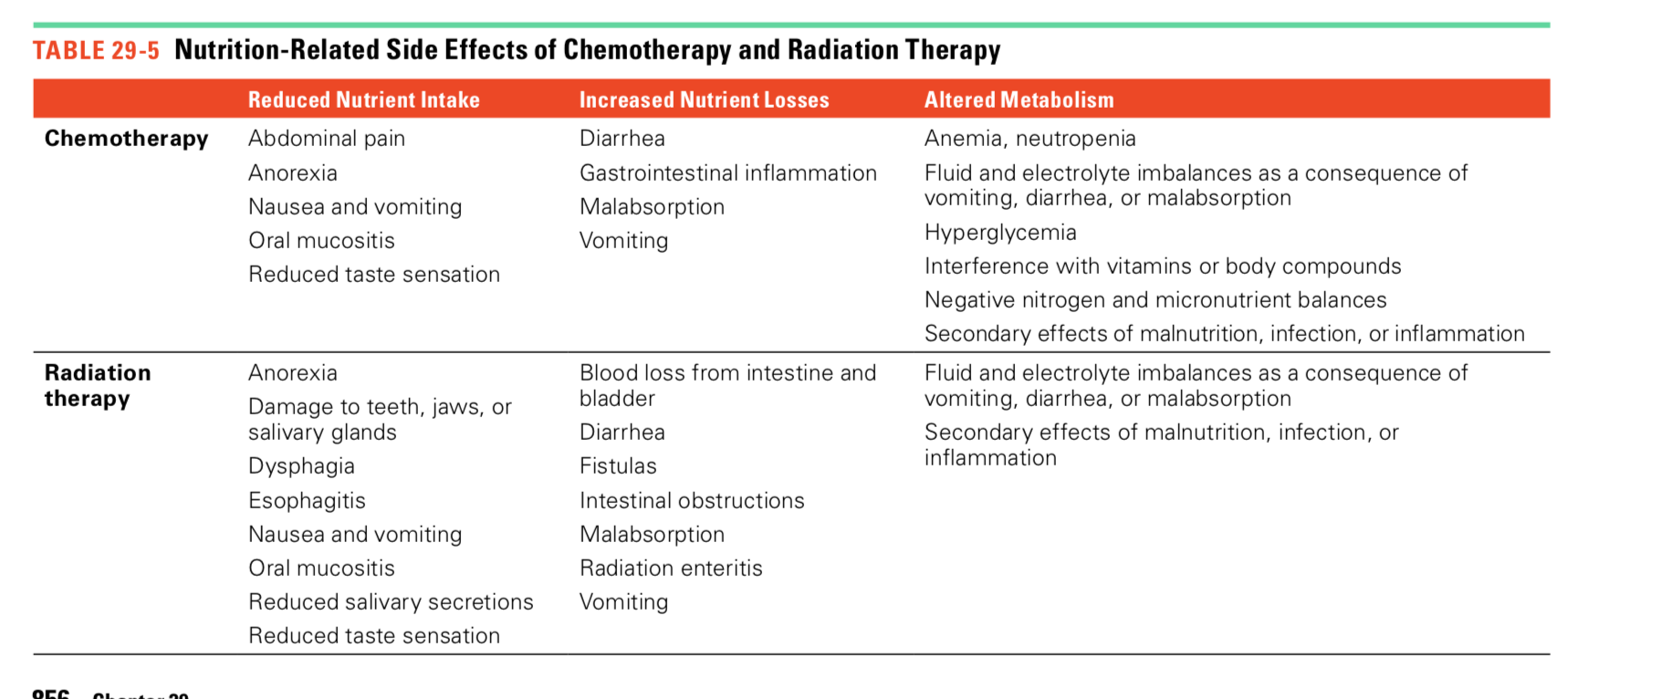
Nutrition Side effects of treatment
Nutrition-related side effects that may result from chemo and Radiation Therapy

Slide 36
Treatment Options
Cancer immunotherapy (a type of biological therapy) refers to treatments that enable a person’s own immune system to fight their cancer
  Improve general immune responses that fight cancer
  Specific ( targeting specific proteins on cancer cells)
Medications to Combat Anorexia and Wasting
  Medications prescribed to stimulate the appetite and promote weight gain
Alternative Therapies
  Complementary and alternative medicine (CAM) to assist them in their fight against cancer
    Multivitamin and herbal supplements
    Patients should consult with physicians about use because some may have adverse effects or interfere with effectiveness of some anticancer drugs

Slide 37
Nutrition Therapy for Cancer
Goals
Maintain a healthy weight
Preserve muscle tissue
Prevent or correct nutrient deficiencies
  Help the immune system fight infection
  Decrease side effects of cancer treatment and problems that affect nutrition
Provide a diet that patients can tolerate and enjoy despite the complications of illness.
Malnourished cancer patients develop more complications and have shorter survival times than patients who maintain good nutrition status

Slide 38
Nutrition Therapy for Cancer
Nutritional needs among cancer patients vary considerably. Furthermore
a person’s needs may change at different stages of illness
The goals of nutrition therapy for patients who have advanced cancer:
Control side effects
Lower the risk of infection
Keep up strength and energy
Improve or maintain quality of life

Slide 39
Energy
Cancer, nutritional repletion, weight gain: 30-35 kcal/kg/day
Cancer, inactive, non- stressed: 25-30 kcal/kg/day
Cancer, hypermetabolic, stressed: 35 kcal/kg/day
Hematopoietic cell transplant: 30-35 kcal/kg/day
Monitor weight changes.
Breast cancer patients often gain weight. (help to avoid unnecessary weight gain)

Slide 40
Protein
Protein requirements are often between 1.0 and 1.6 grams per kilogram of body weight/ day
The degree of malnutrition, extent of disease, degree of stress, and ability to metabolize and use protein are factors in determining protein requirements

Slide 41
Food Safety Concerns
Low-Microbial (Neutropenic) Diet
To minimize the risk of foodborne illness and other infectious complications, patients with suppressed immunity or neutropenia
Low-Microbial (Neutropenic) Diet
Allowed: Foods unlikely contaminated with microbes (well-cooked meats and eggs, pasteurized products, well-washed foods, and shelf-stable packaged foods)
Avoid: unwashed foods; unpasteurized products; undercooked meats and eggs; leftover foods; and foods from street vendors.

Slide 42
Enteral and Parenteral Nutrition Support
Provided to patients who have long-term or permanent GI impairment or are experiencing complications that interfere with food intake.
Whenever possible, enteral nutrition is strongly preferred over parenteral nutrition, to preserve GI function and avoid infection.

Slide 43
Who needs nutrition support
Patients who undergo radiation therapy for head and neck cancers develop dysphagia or oral mucositis and may benefit from tube feeding
Patients who have undergone bone marrow transplants often require some type of nutrition support because of the high protein and energy requirements or GI complications associated with the treatments
Parenteral nutrition is reserved for patients who have inadequate GI function, such as those with certain types of GI obstructions, prolonged nausea and vomiting, and severe radiation enteritis.

Slide 44
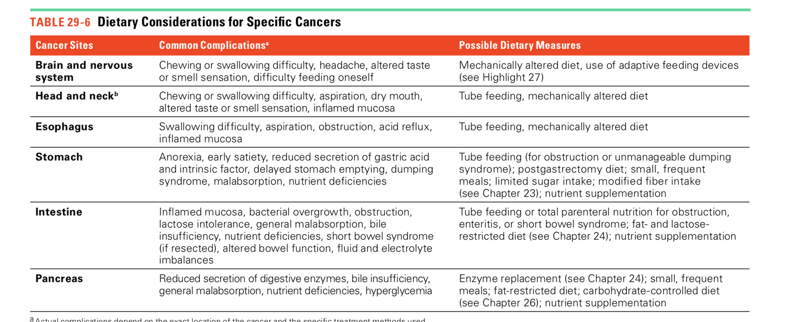

Slide 45
How to increase the energy content of meals?
Meat. Choose high-fat meat instead of lean meat
Sauté or pan-fry meat instead of baking or roasting it, and use sauces or gravies liberally
Cheese. Include cheese slices or cream cheese in sandwiches made with cold cuts spread cream cheese on raw vegetables, toast, and crackers
Half-and-half and cream
Replace milk
or water with half-and-half or cream in breakfast cereals, soup, mashed potatoes, sauces, hot chocolate, and desserts.
Breads and cereals. Choose high-fat grain products such as granola, pancakes, waffles, French toast, and biscuits
Nuts. Add chopped nuts to stir-fried vegetables, pasta dishes, fruit salad
Fruit use fruits with high kcal content like avocado
Butter or margarine. Melt on pasta, potatoes, rice, and cooked vegetables. Add to hot cereal, soup, and casseroles.
Mayonnaise or salad dressing. Add to pasta, tuna, and potato salads
Beverages. Replace water and non-kcaloric beverages with sweetened drinks, fruit juices, and milkshakes ( Use whole milk)

Slide 46
Suggestions to increase Protein
Meat. Add small chunks of meat to soup, potato salad, egg dishes, bean dishes, and casseroles. Add chunks of chicken or turkey to green salad. Add minced meat to pasta sauce and vegetable dishes.
Eggs. Add raw eggs when preparing foods like burgers, and add cooked eggs to salads, sandwiches etc.
Cheese. Melt on scrambled eggs, vegetable dishes, potatoes, hamburgers, meat loaf, and casseroles. Add cottage cheese to egg dishes, pasta recipes. Sprinkle cheese on dishes
Milk. Use in place of water when preparing cereal or soup.
Powdered milk (use full-fat milk powder
if available). Add to recipes that include milk.
Protein supplements. Snack on protein bars between meals. Add protein powder to beverages and shakes

Slide 47
Tips to help patients with food related problems
I just don’t have an appetite
Eat small meals and snacks at regular times each day.
Eat the largest meal at the time of day when you feel the best.
Include nutrient-dense foods in meals, and consume them before other foods.
Indulge in favorite foods throughout the day.
Serve foods attractively.
Avoid drinking large amounts of liquids before or with meals.
Eat in a pleasant and relaxed environment
Eat with family and friends when possible
Listen to your favorite music or enjoy a TV or radio program while you eat.
Ask your doctor about appetite-enhancing medications.

Slide 48
“I am too tired to fix meals and eat.”
Let family members and friends prepare food for you.
Obtain foods that are easy to prepare and easy to eat, such as sandwiches, frozen dinners, take- out meals from restaurants, instant breakfast drinks, liquid formulas, and energy bars.
Find time to rest before you attempt to prepare a large meal.
Prepare soups, stews, and casserole dishes in sufficient quantity to provide enough for several meals, so that you will have enough to eat at times when you are too tired to cook.

Slide 49
“Foods just don’t taste right.”
Brush your teeth or use mouthwash before you eat.
Consume foods chilled or at room temperature.
Use plastic, rather than metal, eating utensils.
Choose eggs, fish, poultry, and milk products instead of meats.
Experiment with sauces, seasonings, herbs, spices, and sweeteners to improve food taste and flavor.
Save your favorite foods for times when you are not feeling nauseated.

Slide 50
“I am nauseated a lot of the time, and sometimes I need to vomit.”
Consume liquids throughout the day to replace fluids.
If you become nauseated from chemotherapy treatments, avoid eating for at least two hours before treatments.
Consume your largest meal at a time when you are least likely to feel nauseous.
Try consuming smaller meals, and eat slowly. Experiment with foods to see if some foods cause nausea more than others.
Avoid foods and meals that have strong odors or are fatty, greasy, or gas forming.

Slide 51
“I have problems chewing and swallowing food”
Experiment with food consistencies to find the ones you can manage best. Thin liquids, dry foods, and sticky foods (such as peanut butter) are often difficult to swallow.
Add sauces and gravies to dry foods.
Drink fluids during meals to ease chewing and swallowing.
Try using a straw to drink liquids. Experiment with beverage thickeners if you cannot tolerate thin beverages.
Tilt your head forward and backward to see if you can swallow more easily when your head is positioned differently.

Slide 52
“I have sores in my mouth, and they hurt when I eat. “
Try eating chilled or frozen foods; they are often soothing.
Try soft foods such as ice cream, milk shakes, bananas, applesauce, mashed potatoes, cottage
cheese, and macaroni and cheese. Mix dry foods with sauces or gravies.
Cut foods into smaller pieces, so they are less likely to irritate the mouth.
Avoid foods that irritate mouth sores, such as citrus fruits and juices, tomatoes and tomato- based products, spicy foods, foods that are very salty, foods with seeds (such as poppy seeds and sesame seeds) that can scrape the sores, and coarse foods such as raw vegetables, crackers, corn chips, and toast.
Ask your doctor about using a local anesthetic solution such as lidocaine before eating to reduce pain.
Use a straw for drinking liquids, in order to bypass the sores.

Slide 53
“My mouth is really dry.”
Rinse your mouth with warm salt water or mouthwash frequently. Avoid using mouthwash that contains alcohol.
Drink small amounts of liquid frequently between meals.
Ask your doctor or pharmacist about medications or saliva substitutes that can help a dry mouth condition.
Use sour candy or chewing gum to stimulate the flow of saliva.
Sip fluids frequently while eating. Add broth, sauces, gravies, mayonnaise, butter, or margarine to dry foods.
Make sure you brush your teeth and floss regularly to prevent tooth decay and oral infections.

Slide 54
“I am having trouble with constipation"
Drink plenty of fluids. Try warm fluids, especially in the morning.
Eat whole-grain breads and cereals, nuts, fresh fruits and vegetables, prunes, and prune juice.
Avoid refined carbohydrate foods such as white bread, white rice, and pasta.
Engage in physical activity regularly.
Try an over-the-counter bulk-forming agent, such as methylcellulose (Citrucel), psyllium (Metamucil or Fiberall), or polycarbophil (Fiber-Lax).

Slide 55
"I am having trouble with diarrhea”
To avoid dehydration, drink plenty of fluids throughout the day. Salty broths and soups, diluted fruit juices, and sports drinks are good choices. Avoid caffeine- and alcohol-containing beverages. For severe diarrhea, try oral rehydration formulas that are commercially prepared.
Avoid foods and beverages that increase gas, such as legumes, onions, vegetables of the cabbage family, foods that contain sorbitol or mannitol, and carbonated beverages.
Try using lactase enzyme replacements when you use milk products in case you are experiencing lactose intolerance. Yogurt and aged cheeses may be easier to tolerate than milk and fresh cheeses.
Avoid fatty foods if you are fat intolerant. Try reducing your intake of whole-grain breads and cereals if they worsen the diarrhea.
Eat small, frequent meals instead of large ones. Try consuming cool or lukewarm foods instead of very cold or hot foods.
Ask your doctor about using a bulk-forming agent or antidiarrheal medication.

Slide 56
Monitoring and Evaluation of Adult Oncology Patients
Anthropometric measurements: weight change; BMI
Food/nutrition-related history: energy and protein intake; changes in food and fluid intake; adequacy and appropriateness of nutrition intake/ nutrient administration; actual intake from EN and PN; changes in type, texture, or temperature of foods and fluids; use of medical food supplements; meal/snack pattern changes; prescription medications, over-the-counter medications, herbal preparations and integrative medicine products; factors affecting access to food; and feeding method or need for placement (e.g. oral, enteral, parenteral)
Biochemical data, medical tests and procedures
Nutrition-focused physical findings: vital signs; loss of muscle mass; loss of subcutaneous fat; nausea, vomiting, diarrhea, constipation, stomatitis, mucositis, alterations in taste and smell, and anxiety; presence of pressure ulcers or wounds; functional indicators (e.g. grip strength); and localized or generalized fluid accumulation
Client history including patient/family/client medical/health history and social history

Slide 57
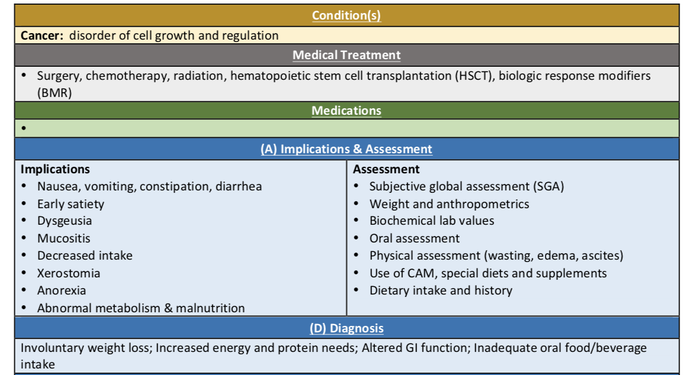
Summary

Slide 58
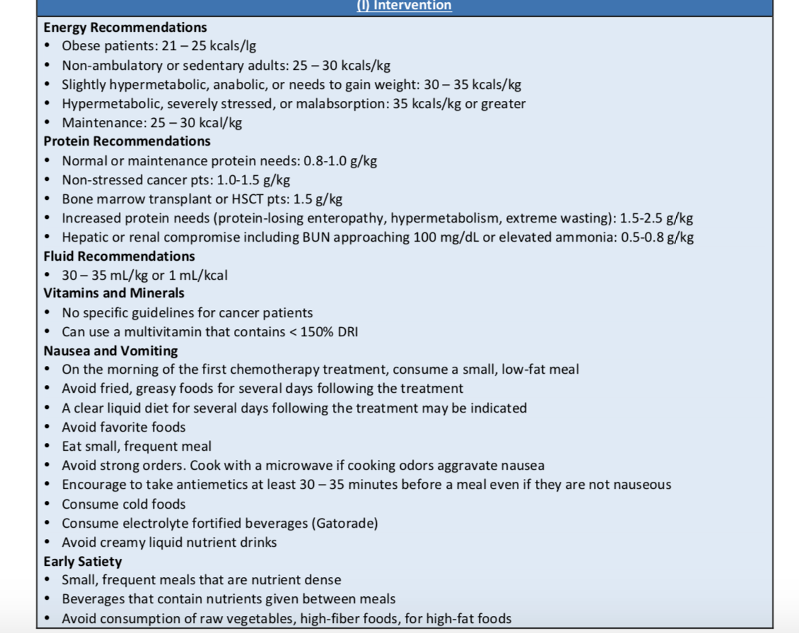

Slide 59
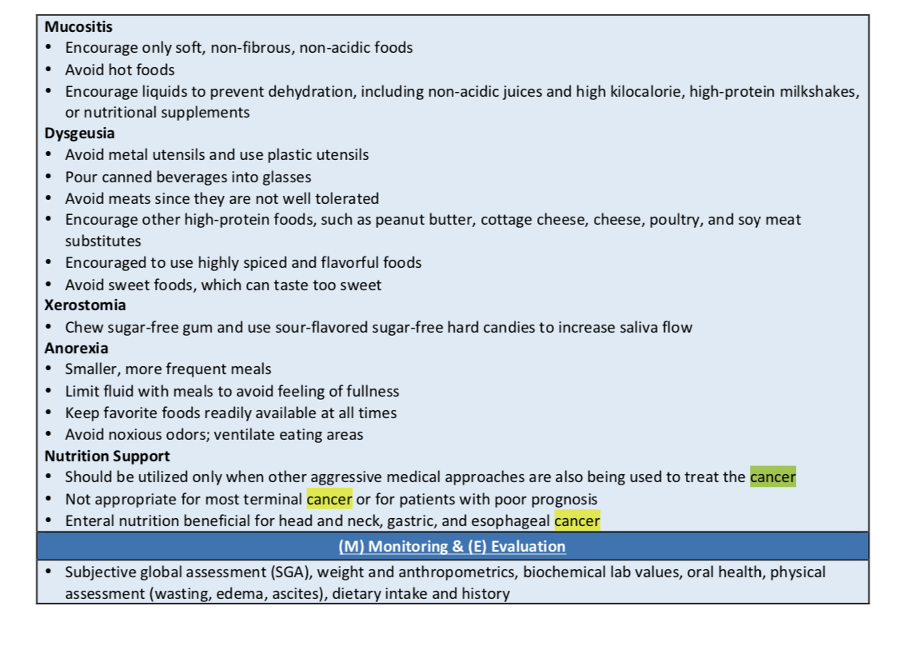

Slide 60
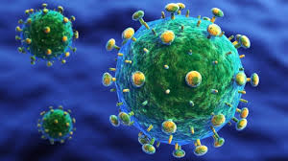
HIV Infection

Slide 61
The most infamous infectious disease today is acquired immunodeficiency syndrome (AIDS). AIDS develops from infection with human immunodeficiency virus (HIV), which attacks the immune system and disables a person’s defenses against other diseases, including infections and certain cancers.
Diseases—which would produce mild, if any, illness in people with healthy immune systems—destroy health and life
Prevalence continues to be high in sub-Saharan Africa, where it affects nearly 5 percent of the adult population

Slide 62
Prevention of HIV Infection
No cure for AIDS
How HIV spreads?
Sexually transmitted
Can be spread by direct contact with contaminated body fluids like
  Blood
  Semen
  Vaginal secretion
  Breast milk

Slide 63
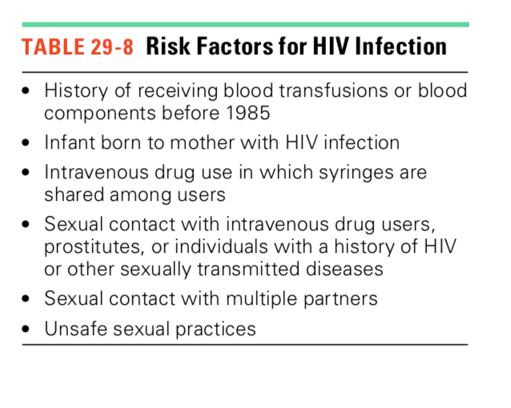
Many people remain symptom-free during the early stages of infection (they may not realize that they can pass the infection to others)
To reduce the spread of HIV infection, individuals at risk are encouraged to undergo testing.

Slide 64
Individuals at risk are encouraged to undergo testing.
A blood test can usually detect HIV antibodies within several months after exposure.
Antiretroviral drug combination (a combination of three or more drugs to treat HIV infection/stops the virus from making copies of itself in the body) is prescribed for individuals at high risk
  Shown to prevent up to two-thirds of potential HIV infections

Slide 65
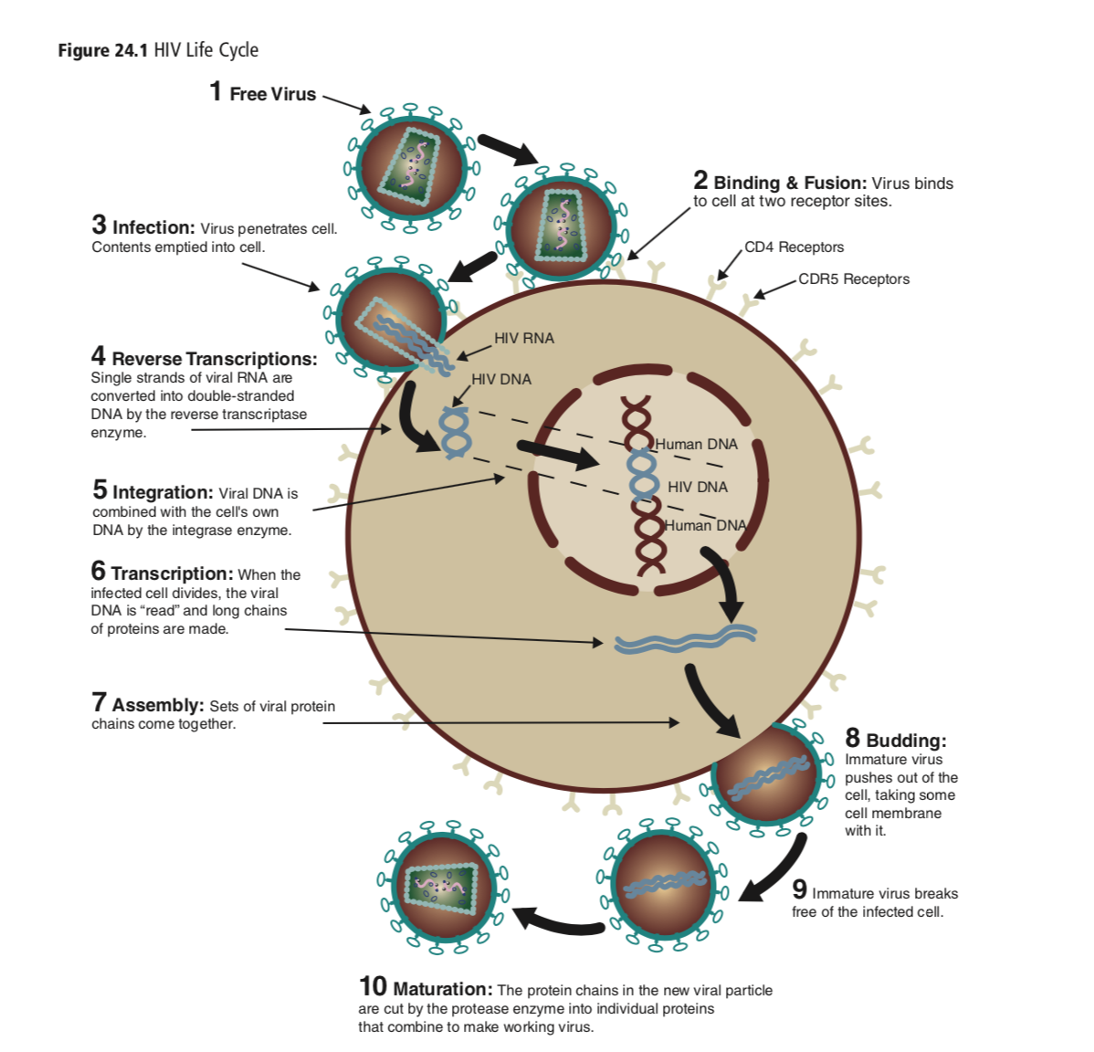
Consequences of HIV Infection
HIV infection destroys immune cells that have a protein called CD4 on their surfaces.
Most effected are the helper T cells, also called CD41 T cells
HIV is able to enter helper T cells and induce them to produce additional copies of the virus → amplifying the infection
HIV enters the cell by fusing the viral and cellular membranes
https://sites.google.com/site/hiv1gp120pracheta/home/receptor-interactions

Slide 66
Consequences of HIV Infection
Other cells that have the CD4 protein (and can be infected by HIV)
Tissue macrophages
certain cells of the central nervous system
Early symptoms of HIV infection are nonspecific and may include fever, sore throat, malaise, swollen lymph nodes, skin rashes, muscle and joint pain, and diarrhea.
After experiencing early symptoms, many people remain symptom-free for 5 to 10 years or even longer
In time, T cells get depleted and an infected individual has a much higher susceptibility to opportunistic infections—that is, infections caused by microorganisms that normally do not cause disease in healthy individuals.

Slide 67
The term AIDS applies to the advanced stages of HIV infection, in which the inability to fight illness allows a number of serious diseases such as
  Severe infections
  Certain cancers
  Wasting of muscle tissue
Without treatment, AIDS develops in most HIV- infected persons within 7 to 10 years

Slide 68
Consequences: Weight Loss and Wasting
Weight Loss and Wasting are common issues among infected people with HIV
Wasting associated with accelerated disease progression, reduced strength, and fatigue and increases the risk of death in individuals at advanced stages
Causes of wasting?
Anorexia and inadequate food intake
Nutrient malabsorption
Altered metabolism
Various diet-drug interactions

Slide 69
Consequences: The AIDS-wasting syndrome
Involuntary weight loss > 10 percent of initial body weight
AND either chronic diarrhea or chronic weakness and fever for more than 30 days.

Slide 70
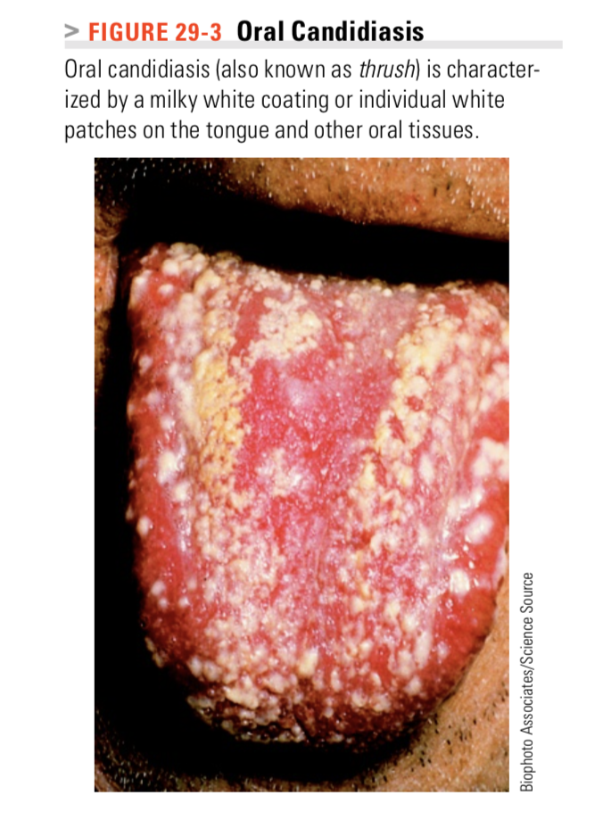
Consequences: Reduced Food Intake
Poor food intake may result from
Oral infections
cause discomfort and interfere with food consumption
Common infections include candidiasis and herpes simplex virus infection. Oral candidiasis can cause mouth pain, dysphagia (difficulty swallowing), and altered taste sensation
Herpes simplex virus may cause painful lesions around the lips and in the mouth.

Slide 71
Consequences: Reduced Food Intake
Cancer: cancer leads to anorexia
Medications: The medications given to treat HIV infection, , and cancer often cause anorexia, nausea and vomiting, altered taste sensation, food aversions, and diarrhea
Respiratory disorders: Respiratory infections cause chest pain, shortness of breath, and cough, which interfere with eating and contribute to anorexia
Emotional distress, pain, and fatigue: Physical and social problems fear, anxiety, and depression

Slide 72
Consequences: GI Complications
Causes:
  In advanced stages AIDS enteropathy may develop
  changes in the small intestinal lining: the villi appear shortened and flattened→ reduction in the intestinal absorptive area and cause malabsorption, diarrhea and weight loss
  Medications: may cause nausea, vomiting, and diarrhea.
  Medications that treat the viral, parasitic, and fungal infections in the GI tract contribute to bacterial overgrowth.
(GI discomfort, bacterial overgrowth, malabsorption, and nutrient losses)

Slide 73
Lipodystrophy
Drug therapies increase risk of development of abnormalities in glucose and fat metabolism. (HIV- lipodystrophy syndrome). The reasons for the development of lipodystrophy are unknown. This includes:
Body fat redistribution: abdominal fat accumulation and loss from the face and extremities, breast enlargement, a buffalo hump
Abnormal blood lipid: high levels of triglycerides and LDL, and low levels of HDL
Insulin resistance

Slide 74
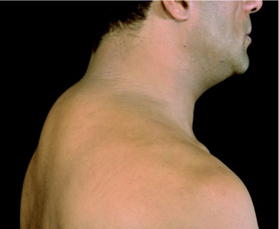
HIV-associated lipodystrophy is sometimes evident by the accumulation of fatty tissue at the base of the neck, referred to as buffalo hump.

Slide 75
Consequences: Neurological Complications
Cause: HIV infection, HIV medications, or immune suppression (which may lead to cancers and infections that target brain tissue)
Symptoms: mild to severe dementia; muscle weakness and gait disturbances; and pain, numbness, and tingling in the legs and feet.

Slide 76
Other Complications
Anemia due to nutrient malabsorption
Blood loss
Disturbed bone marrow function
Medication side effects
Skin disorders (rashes, infections, cancers)
kidney diseases
Coronary heart disease.

Slide 77
Treatment Option
Treatments help to slow HIV progression, reduce complications, and alleviate pain. The standard treatment: highly active antiretroviral therapy (HAART)
Modes of action:
Prevent HIV from entering cells by blocking a membrane receptor on the host cell or binding a viral protein needed for its entry.
Impair the function of HIV’s integrase enzyme, which incorporates viral DNA into the host cell’s genome
Impair the ability of HIV’s reverse transcriptase enzyme to produce usable copies of DNA
Inhibit HIV’s protease enzyme, which cleaves HIV’s gene products into usable structural proteins.

Slide 78
Treatment
Control of Anorexia and Wasting
Anabolic hormone: Testosterone and human growth hormone have demonstrated positive effects on
Nitrogen balance and lean tissue content, especially in combination with resistance training.
Physical activity: A regular program of resistance exercise improves muscle mass and strength and corrects some of the metabolic abnormalities
Appetite stimulants: To improve weight gain (although much of the weight increase is attributable to a gain of fat)

Slide 79
Lipodystrophy management
Aerobic activity and resistance training may help to reduce abdominal fat
Cosmetic surgery
Alternative antiretroviral drugs to alleviate symptoms
Medications may be prescribed to treat abnormal blood lipid levels and insulin resistance.

Slide 80
Nutrition Therapy for HIV Infection
GOAL: Maintain a healthy body weight, preserve muscle mass, prevent malnutrition, and cope with nutrition-related side effects of medications
Since the development of successful drug therapies for HIV infection, overweight and obesity ARE becoming more prevalent than wasting among HIV-infected individuals in certain areas
moderate weight loss may be recommended for patients with HIV infection who are overweight or obese.

Slide 81
MNT
Protein and Energy
Obesity?
Wasting: 30- 40 kcal/kg BW & 1.2-2 g protein/kg BW.
Small, frequent feedings
Use nutrient- dense snacks & supplements

Slide 82
MNT
Metabolic Complications
Dietary adjustments for Insulin resistance and elevated triglyceride and LDL levels.
Regular physical activity can improve both IR and blood lipid levels
Vitamins and Minerals
Deficiencies causes:
reduced intake, malabsorption , diet-drug interactions, and nutrient losses
Maintain intakes that are close to DRI

Slide 83
MNT
Symptoms Management
Discomfort, opportunistic GI infections, and malabsorption symptoms can make food consumption difficult and contribute to fluid and electrolyte losses.
Food Safety
Low-microbial diet
Water can also be a source of foodborne illness (consult local health departments). If unsafe, water should be boiled for one minute

Slide 84
MNT
Nutrition Support
Tube feedings are preferred (may supply at night)
PN is reserved when unable to tolerate EN
For individuals with severe malabsorption, orally administered hydrolyzed formulas containing medium-chain triglycerides may be as effective as parenteral nutrition for reversing weight loss and wasting.

