Slide 1
Drug calculation

Slide 2
Systems of medication measurement;
Metric system: a decimal system, each unit can be divided into multiple of ten.
The basic units of measurement in metric system:
The meter; for length
The liter; for volume
The gram; for weight.

Slide 3
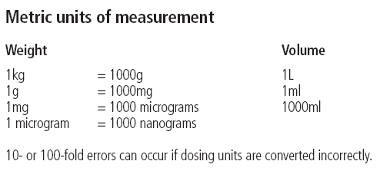

Slide 4
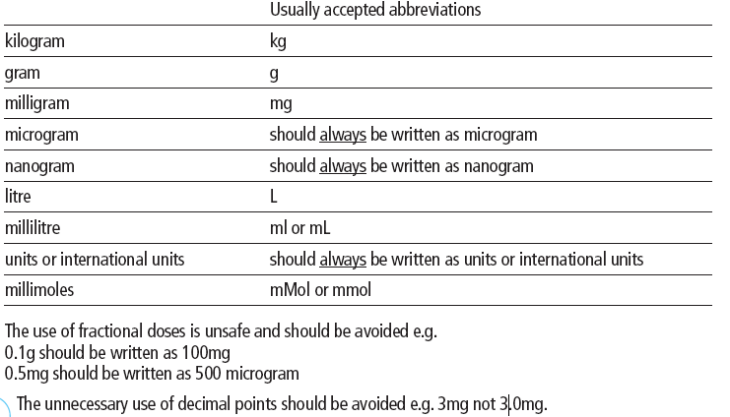

Slide 5
Household
1ml= 15drops (gtt)
Tea spoon (tsp) = 5ml
Table spoon (tbsp)= 15ml
Tea cup © = 240ml
Their disadvantage is their inaccuracy.
The advantage of household measurements is their convenient and familiarity.

Slide 6
Solutions
Its used for; injections, irrigations,& infusion.
A solution; is a given mass of solid substance dissolved in a known volume of fluid or a given volume of liquid dissolved in a known volume of another fluid.

Slide 7
Clinical calculation
Conversion within one system:
To convert grams to milligrams multiply by 1000
1g = 1 x 1000 = 1000mg
To convert milligrams to grams divide by 1000
100mg= 1 g
350mg= 0.35g
To convert litters to milliliters multiply by 1000 or move the decimal 3 points to the right.
1 litter = 1000ml
0.25 l = 250 ml.

Slide 8
Example ; A patient is prescribed 0.0625mg digoxin. How many micrograms is this?
To convert milligrams to micrograms multiply by 1000
0.0625mg = 0.0625 x 1000 micrograms = 62.5 micrograms

Slide 9
Dose calculation
Ratio and proportion:
Ratio indicates the relationship between two numbers separated by a colon(:)
Example
Order: Keflex 750 mg
On hand: Keflex 250 mg capsules

Slide 10
Formula method
Dose ordered X amount on hand = amount to be administered
Dose on hand
Example; medication available is 125mg per 5ml.
125 is the dose on hand
5ml is the amount on hand
Example; Morphine sulfate 2mg IV is ordered. The medication is available in a vial containing 10mg/ml

Slide 11
Calculating oral doses in tablets
The number of tablets/capsules needed for each dose.
Number of tablets = ___Dose______
Strength of tablet

Slide 12
Examples of oral medication
Example 1; Amoxicillin 500mg three times a day p.o. is prescribed.
Amoxicillin capsules 250mg are available.
The number of capsules needed for each dose=
500mg = 2 capsules
250mg
Example 2; Levomepromazine 6.25mg three times a day p.o. is prescribed.
Levomepromazine tablets 25mg are available.
The number of tablets needed for each dose =
6.25mg = 0.25 or ¼ of a tablet
25mg
Another way of looking at this is: Half a tablet = 25mg = 12.5mg
2
Quarter of a tablet = 25mg = 6.25mg
4

Slide 13
Doses may be calculated by bodyweight
Example: Amiodarone 5mg per kg body weight in 100ml 5% Glucose over 20 minutes is prescribed.
The patient weighs 60kg.
To calculate the dose.
Dose = 5(mg) x 60(kg) = 300mg

Slide 14
Questions;
Atropine 0.6 mg = ?mcg
Gentamycin 360mg = ?gm
Digoxin 125mcg = ? mg

Slide 15
Dimensional analysis
Identify the unit of measure that you need to administer.
Estimate the answer.
Place appropriate abbreviation
Place available information in a fraction on the Rt side of the equation
Look at the medication order and add other factors into the problem.
Cancel out like units of measurement on the Rt side of the equation
Reduce to the lowest terms if possible and solve the problem.

Slide 16
example
The prescriber order 0.45g penicillin V potassium through a gastric tube, the bottle says; penicillin V potassium 125mg/5ml.
The unit of measurement to be used is ( ml)
The estimated answer is >15ml but<20 ml.
Appropriate abbreviation Xml
Available information; Xml= 5ml
125mg
5. Add other factors; Xml= 5ml x 1000mg X 0.45g
125mg 1gm 1
6. Cancel out like units; Xml= 5ml x 1000mg X 0.45g
125mg 1g 1
7. Reduce to the lowest terms if possible
X= 5x 1000x 0.45 = 2250 = 18ml
125 125

Slide 17
Calculating concentrations
Example 1
The prescribed dose is 1g magnesium sulphate. Magnesium sulphate 50% injection is available.
50% = 50g in 100ml.
How many mls contains 1g magnesium sulphate?
Number of ml containing 1g = 100ml x1g = 2ml
50g
Another way of thinking about this is: 50g in 100ml = 5g in 10ml = 1g in 2ml

Slide 18
Example 2
Thiopentone 2.5% infusion is prescribed. What volume is required to administer a dose of 100mg?
2.5% = 2.5g in 100ml
100mg is contained in 100mg x 100ml = 4ml
2500mg
Another way of thinking about this is:
Thiopentone 2.5% = 2.5g in 100ml = 2500mg in 100ml = 25mg in 1ml = 100mg in 4ml

Slide 19
Pediatric doses
Medication errors in children occurs for the following reasons:
Confusion between formulations for adults & children.
Availability of multiple pediatric concentrations
Inaccurate preparation of medication that need to be diluted
Similar packaging of medications and names of medications that look a like and sound a like
Parents who do not how to correctly prepare and administer medication
Errors in calculation and use of inaccurate measuring devices ( household)

Slide 20
Guidelines when calculating pediatric doses
Pediatric medication is ordered in mg/kg.
Pediatric doses is smaller than adult doses, use small syringes
IM doses are very small usually not exceed 1ml in small children and 0.5 ml in infants
Subcutaneous dosage is very small and doesn’t exceed 0.5 ml
Most medications are not rounded off to the nearest tenth instead they are rounded to the nearest thousands.
Measure medication that are less than 1ml in syringes that are marked in tenths of milliliters
Estimate the pt dose before beginning the calculation lable and compare the answer.
evaluate the amount of medication ordered over 24 hours.

Slide 21
CALCULATION OF DOSE μicrogram /KG/MIN;
The doctor ordered Dopamine at 5mcg/kg/minute for a patient weigh: 50kg
Ordered dose x patient weight in kilograms x 60 minutes divided by the solution concentration.
(5mcg x 50kg x 60 minute) =15000.
Divide this result by the medication concentration (400mg/250ml)= 1.6 mg/ml
Convert mg to microgram : 1.6x 1000= 1600mcg/ml =
5mcg x 50kg x 60 minute = 9.375 ml/h (round up to 9.4ml/hr).
1600

Slide 22
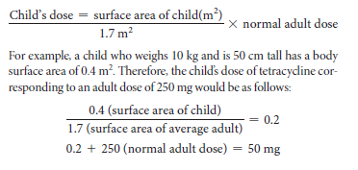
Body surface area

