Slide 1
Artificial Intelligence ENCS 3340
Constraint Satisfaction Problems (Local Search)

Slide 2
Constraint Satisfaction
Specifies structural properties of the problem
may depend on the representation of the problem
The problem is defined through a set of variables and a set of domains
variables can have possible values specified by the problem
constraints describe allowable combinations of values for a subset of the variables
state in a CSP
defined by an assignment of values to some or all variables
solution to a CSP
must assign values to ALL variables
must satisfy ALL constraints
solutions may be ranked according to an objective function

Slide 3
Example1: 3-SAT
Variables:
x₁, x₂ , x₃ , x₄ , x₅
Domains:
{True, False}
Constraints:,=and
(x₁ ∨ x₂ ∨ x₄),
(x₂ ∨ x₄ ∨ ¬x₅),
(x₃ ∨ ¬x₄ ∨ ¬x₅)
Suggest a solution!
(x₁ ∨ x₂ ∨ x₄) ∧ (x₂ ∨ x₄ ∨ ¬x₅) ∧ (x₃ ∨ ¬x₄ ∨ ¬x₅)

Slide 4
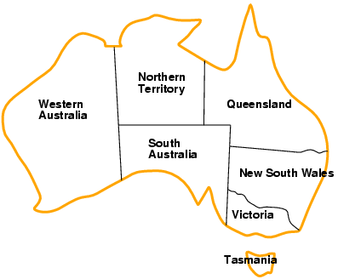
Example2: Map-Coloring Problem
Variables WA, NT, Q, NSW, V, SA, T
Domain D_{i} = {red, green, blue}
Constraints: adjacent regions must have different colors
e.g., Color(WA) ≠ Color(NT) or in short WA ≠ NT
(WA, NT) ϵ {(red, green), (red, blue), (green, red), (green, blue), (blue, red), (blue, green)} OR
(WA, NT) ϵ/{(red, red), (blue, blue), (green, green)}
Graph Coloring Problem (more general)!

Slide 5
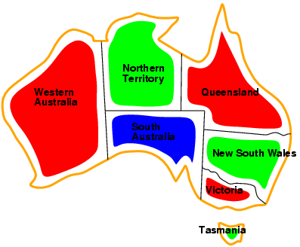
Example: Map-Coloring
Solutions are complete and consistent assignments, e.g.,
WA = red, NT = green, Q = red, NSW = green, V = red, SA = blue, T = green
Complete: all are assigned, consistent: obeys the constraints.
A state may be incomplete e.g., just WA=red

Slide 6
Constraint graph
It is helpful to visualize a CSP as a constraint graph
Binary CSP: each constraint relates two variables [here states]
Constraint graph: nodes are variables, arcs are constraints (e.g. color different)
NT
Q
Color(Q)/=Color(NS)
WA
NSW
SA
Color(SA)/=Color(WA)
V
T

Slide 7
Varieties of CSPs
Discrete variables
finite domains:
n variables, domain size d , O(dn) complete assignments
e.g., Boolean CSPs, incl.~Boolean satisfiability (NP-complete)
infinite domains:
integers, strings, etc.
e.g., job scheduling, variables are start/end days for each job
need a constraint language, e.g., StartJob1 + 5 ≤ StartJob3
Continuous variables
e.g., Time: start/end times for Hubble Space Telescope observations
linear constraints solvable in polynomial time by linear programming

Slide 8
CSP as Incremental Search Problem
initial state
all (or at least some) variables UNassigned
successor function
assign a value to an UNassigned variable
must not conflict with previously assigned variables
goal test
all variables have values assigned
no conflicts exist (in the assignments)
path cost
e.g. constant for each step [some colors may be expensive]
may be problem-specific

Slide 9
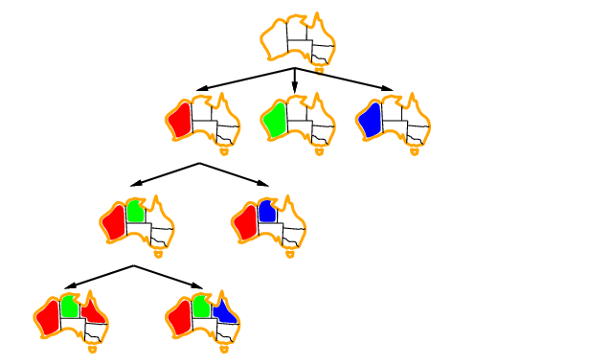
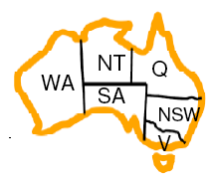
Example

Slide 10
CSPs and Search
In principle, any search algorithm can be used to solve a CSP, but:
awful branching factor
n*d for n variables with d values at the top level, (n-1)*d at the next level, etc.
not very efficient, since they neglect some CSP properties
commutativity: the order in which values are assigned to variables is irrelevant, since the outcome is the same

Slide 11
Backtracking Search for CSPs
A variation of depth-first search that is often used for CSPs
values are chosen for one variable at a time
if no legal values are left, the algorithm backs up and changes a previous assignment
very easy to implement
initial state, successor function, goal test are standardized
not very efficient
can be improved by trying to select more suitable unassigned variables first

Slide 12
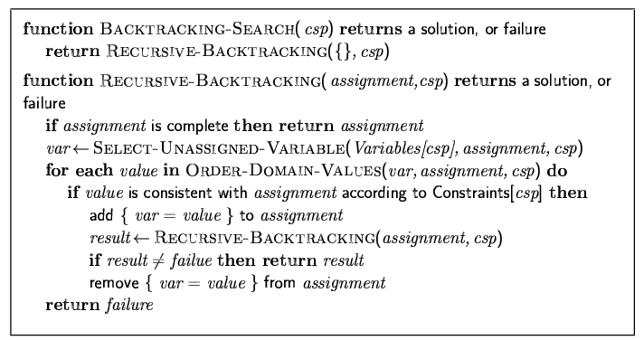
Backtracking search Algorithm

Slide 13

Backtracking example

Slide 14
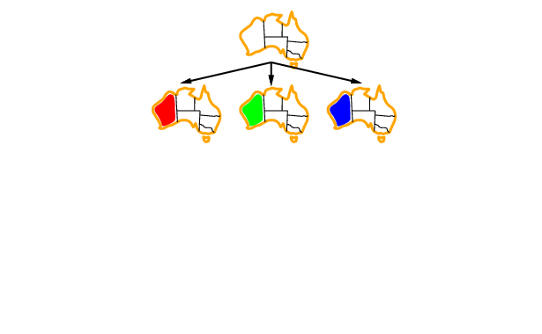
Backtracking example

Slide 15
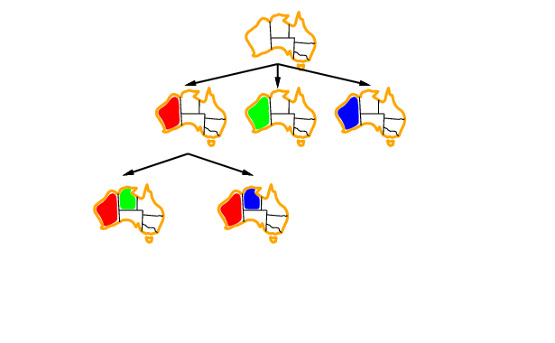
Backtracking example

Slide 16
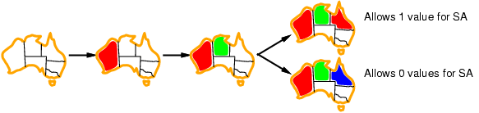
Backtracking example
1
2
If we start with 2, backtrack to 1 as no choices for SA
1
Which assignment for Q should we choose?
2

Slide 17
Improving backtracking efficiency
General-purpose methods can give huge gains in speed:
Which variable should be assigned next? {WA, NT, Q, NSW, V, SA, T }
In what order should its values be tried? [R,B,G], [R, G, B],…
Can we detect inevitable failure early? Case 2 below
2

Slide 18


Heuristics for CSP
most-constrained variable (Minimum Remaining Values: MRV, “fail-first”)
variable with the fewest possible values is selected
tends to minimize the branching factor
most-constraining variable MCV
variable with the largest number of constraints on other unassigned variables
least-constraining value LCV
for a selected variable, choose the value that leaves more freedom for future choices

Slide 19
Most constrained variable Minimum Remaining Values (MRV)
Most constrained variable:
choose the variable with the fewest legal values
Called minimum remaining values (MRV) heuristic
“fail-first” heuristic: Picks a variable which will cause failure as soon as possible, allowing the tree to be pruned.

Slide 20
Backpropagation - MRV
[R,B,G]
[R,B,G]
[R]
[R,B,G]
[R,B,G]

Slide 21
Backpropagation – MRV minimum remaining values
[R,B,G]
[R,B,G]
[R]
[R,B,G]
[R,B,G]

Slide 22
Backpropagation - MRVminimum remaining values
[R,B,G]
[R,B,G]
[R]
[R,B,G]
[R,B,G]

Slide 23
Backpropagation - MRV
[R,B,G]
[R,B,G]
[R]
[R,B,G]
[R,B,G]

Slide 24
Backpropagation - MRV
[R,B,G]
[R,B,G]
[R]
[R,B,G]
[R,B,G]

Slide 25
Backpropagation - MRVminimum remaining values
[R,B,G]
[R,B,G]
[R]
[R,B,G]
[R,B,G]
Solution !!!

Slide 26
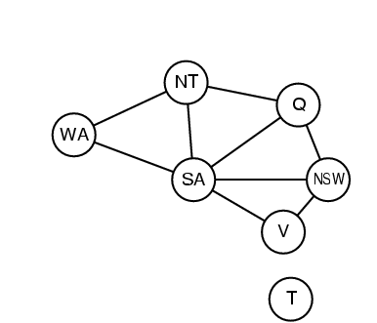
Most constraining variable - MCV
Tie-breaker among most constrained
variables (MRV)
Most constraining variable:
choose the variable with the most constraints on remaining variables (select variable that is involved in the largest number of constraints - edges in graph on other unassigned variables: SA:5, WA:2, NT:3, Q:3, NSW:3, V:2 then:
WA:1, NT:2, Q:2, NSW:2, V:1 then
Q:1, NSW:2, V:1 then WA:0, NSW:1, V:1 ?? Which?

Slide 27
Backpropagation - MCV Most constraining variable
[R,B,G]
[R,B,G]
4 arcs
2 arcs
2 arcs
[R]
3 arcs
3 arcs
[R,B,G]
[R,B,G]

Slide 28
Backpropagation – MCV Most constraining variable
[R,B,G]
[R,B,G]
4 arcs
2 arcs
2 arcs
[R]
3 arcs
3 arcs
[R,B,G]
[R,B,G]

Slide 29
Backpropagation – MCV Most constraining variable
[R,B,G]
[R,B,G]
4 arcs
2 arcs
2 arcs
[R]
3 arcs
3 arcs
[R,B,G]
[R,B,G]

Slide 30
Backpropagation - MCV Most constraining variable
[R,B,G]
[R,B,G]
4 arcs
2 arcs
2 arcs
[R]
3 arcs
3 arcs
[R,B,G]
[R,B,G]

Slide 31
Backpropagation - MCV Most constraining variable
[R,B,G]
[R,B,G]
4 arcs
2 arcs
2 arcs
[R]
Dead End
3 arcs
3 arcs
[R,B,G]
[R,B,G]

Slide 32
Backpropagation - MCV Most constraining variable
[R,B,G]
[R,B,G]
4 arcs
2 arcs
2 arcs
[R]
3 arcs
3 arcs
[R,B,G]
[R,B,G]

Slide 33
Backpropagation - MCV Most constraining variable
[R,B,G]
[R,B,G]
4 arcs
2 arcs
2 arcs
[R]
3 arcs
3 arcs
[R,B,G]
[R,B,G]

Slide 34
Backpropagation – MCV Most constraining variable
[R,B,G]
[R,B,G]
4 arcs
2 arcs
2 arcs
[R]
3 arcs
3 arcs
[R,B,G]
[R,B,G]

Slide 35
Backpropagation - MCV Most constraining variable
[R,B,G]
[R,B,G]
4 arcs
2 arcs
2 arcs
[R]
Dead End
3 arcs
3 arcs
[R,B,G]
[R,B,G]

Slide 36
Backpropagation - MCV Most constraining variable
[R,B,G]
[R,B,G]
4 arcs
2 arcs
2 arcs
[R]
3 arcs
3 arcs
[R,B,G]
[R,B,G]

Slide 37
Backpropagation - MCV Most constraining variable
[R,B,G]
[R,B,G]
4 arcs
2 arcs
2 arcs
[R]
3 arcs
3 arcs
[R,B,G]
[R,B,G]

Slide 38
Backpropagation - MCV Most constraining variable
[R,B,G]
[R,B,G]
4 arcs
2 arcs
2 arcs
[R]
3 arcs
3 arcs
[R,B,G]
[R,B,G]

Slide 39
Backpropagation - MCV Most constraining variable
[R,B,G]
[R,B,G]
4 arcs
2 arcs
2 arcs
[R]
3 arcs
3 arcs
[R,B,G]
[R,B,G]

Slide 40
Backpropagation - MCV Most constraining variable
[R,B,G]
[R,B,G]
4 arcs
2 arcs
2 arcs
[R]
3 arcs
3 arcs
[R,B,G]
[R,B,G]
Solution !!!

Slide 41
Least constraining value - LCV
Given a variable, choose the least constraining value:
the one that rules out/eliminates the fewest values in the remaining variables (keeps the most)
Combining these heuristics makes 1000 queens feasible

Slide 42
Backpropagation – LCV Least constraining value
[R,B,G]
[R,B,G]
4 arcs
2 arcs
2 arcs
[R]
3 arcs
3 arcs
[R,B,G]
[R,B,G]

Slide 43
Backpropagation – LCV Least constraining value
[R,B,G]
[R,B,G]
4 arcs
2 arcs
2 arcs
[R]
3 arcs
3 arcs
[R,B,G]
[R,B,G]

Slide 44
Backpropagation - LCV Least constraining value
[R,B,G]
[R,B,G]
4 arcs
2 arcs
2 arcs
[R]
3 arcs
3 arcs
[R,B,G]
[R,B,G]

Slide 45
Backpropagation - LCV Least constraining value
[R,B,G]
[R,B,G]
4 arcs
2 arcs
2 arcs
[R]
3 arcs
3 arcs
[R,B,G]
[R,B,G]

Slide 46
Backpropagation - LCV Least constraining value
[R,B,G]
[R,B,G]
4 arcs
2 arcs
2 arcs
[R]
3 arcs
3 arcs
[R,B,G]
[R,B,G]

Slide 47
Backpropagation - LCV Least constraining value
[R,B,G]
[R,B,G]
4 arcs
2 arcs
2 arcs
[R]
3 arcs
3 arcs
[R,B,G]
[R,B,G]
Dead End

Slide 48
Backpropagation - LCV Least constraining value
[R,B,G]
[R,B,G]
4 arcs
2 arcs
2 arcs
[R]
3 arcs
3 arcs
[R,B,G]
[R,B,G]

Slide 49
Backpropagation – LCV Least constraining value
[R,B,G]
[R,B,G]
4 arcs
2 arcs
2 arcs
[R]
3 arcs
3 arcs
[R,B,G]
[R,B,G]

Slide 50
Backpropagation – LCV Least constraining value
[R,B,G]
[R,B,G]
4 arcs
2 arcs
2 arcs
[R]
3 arcs
3 arcs
[R,B,G]
[R,B,G]

Slide 51
Backpropagation - LCV Least constraining value
[R,B,G]
[R,B,G]
4 arcs
2 arcs
2 arcs
[R]
3 arcs
3 arcs
Solution !!!
[R,B,G]
[R,B,G]

Slide 52
Analyzing Constraints
forward checking
when a value X is assigned to a variable, inconsistent values are eliminated for all variables connected to X [remove conflicting values]
identifies “dead” branches of the tree before they are visited
constraint propagation
analyses interdependencies between variable assignments via arc consistency
an arc between X and Y is consistent if for every possible value x of X, there is some value y of Y that is consistent with x
more powerful than forward checking, but still reasonably efficient
but does not reveal every possible inconsistency

Slide 53
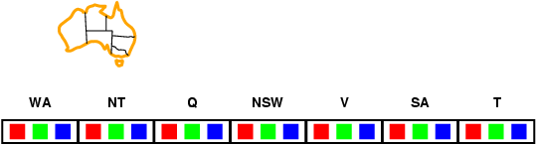
Forward checking
Idea:
Keep track of remaining legal values for unassigned variables
Terminate search when any variable has no legal values

Slide 54
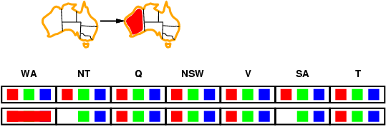
Forward checking
Idea:
Keep track of remaining legal values for unassigned variables
Terminate search when any variable has no legal values

Slide 55
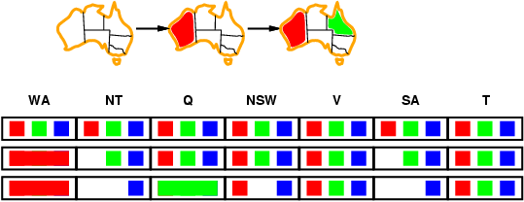
Forward checking
Idea:
Keep track of remaining legal values for unassigned variables
Terminate search when any variable has no legal values

Slide 56
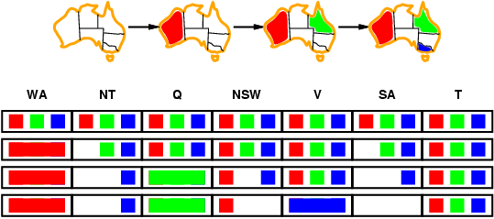
Forward checking
Idea:
Keep track of remaining legal values for unassigned variables
Terminate search when any variable has no legal values

Slide 57
Forward Checking
[R,B,G]
[R,B,G]
[R]
[R,B,G]
[R,B,G]

Slide 58
Forward Checking
[ ,B,G]
[R,B,G]
[R]
[ ,B,G]
[R,B,G]

Slide 59
Forward Checking
[ ,B,G]
[R,B,G]
[R]
[ ,B,G]
[R,B,G]

Slide 60
Forward Checking
[ ,B,G]
[R, ,G]
[R]
[ , ,G]
[R, ,G]

Slide 61
Forward Checking
[ ,B,G]
[R, ,G]
[R]
[ , ,G]
[R, ,G]

Slide 62
Forward Checking
[ ,B,G]
[R, ,G]
[R]
[ , ,G]
[ , ,G]

Slide 63
Forward Checking
[ ,B,G]
[R, ,G]
[R]
[ , ,G]
[ , ,G]

Slide 64
Forward Checking
[ ,B,G]
[R, ,G]
[R]
[ , , ]
[ , ,G]

Slide 65
Forward Checking
[ ,B,G]
[R, ,G]
[R]
[ , , ]
[ , ,G]
Dead End

Slide 66
Forward Checking
[ ,B,G]
[R, ,G]
[R]
[ , ,G]
[R, ,G]

Slide 67
Forward Checking
[ ,B,G]
[R, ,G]
[R]
[ , ,G]
[R, , ]

Slide 68
Forward Checking
[ ,B,G]
[R, ,G]
[R]
[ , ,G]
[R, , ]

Slide 69
Forward Checking
[ ,B,G]
[R, ,G]
[R]
[ , ,G]
[R, , ]
Solution !!!

Slide 70
Example: 4-Queens Problem
X1
{1,2,3,4}
X2
{1,2,3,4}
1
2
3
4
1
2
3
4
X3
{1,2,3,4}
X4
{1,2,3,4}

Slide 71
Example: 4-Queens Problem
X1
{1,2,3,4}
X2
{1,2,3,4}
1
2
3
4
1
2
3
4
X3
{1,2,3,4}
X4
{1,2,3,4}

Slide 72
Example: 4-Queens Problem
X1
{1,2,3,4}
X2
{ , ,3,4}
1
2
3
4
1
2
3
4
X3
{ ,2, ,4}
X4
{ ,2,3, }

Slide 73
Example: 4-Queens Problem
X1
{1,2,3,4}
X2
{ , ,3,4}
1
2
3
4
1
2
3
4
X3
{ ,2, ,4}
X4
{ ,2,3, }

Slide 74
Example: 4-Queens Problem
X1
{1,2,3,4}
X2
{ , ,3,4}
1
2
3
4
1
2
3
4
X3
{ , , , }
X4
{ ,2, , }
Dead End → Backtrack

Slide 75
Example: 4-Queens Problem
X1
{1,2,3,4}
X2
{ , , ,4}
1
2
3
4
1
2
3
4
X3
{ , 2 , , }
X4
{ , ,3, }

Slide 76
Example: 4-Queens Problem
X1
{1,2,3,4}
X2
{ , , ,4}
1
2
3
4
1
2
3
4
X3
{ , 2 , , }
X4
{ , , , }
Dead End → Backtrack

Slide 77
Example: 4-Queens Problem
X1
{ ,2,3,4}
X2
{1,2,3,4}
1
2
3
4
1
2
3
4
X3
{1,2,3,4}
X4
{1,2,3,4}

Slide 78
Example: 4-Queens Problem
X1
{ ,2,3,4}
X2
{ , , ,4}
1
2
3
4
1
2
3
4
X3
{1, ,3, }
X4
{1, ,3,4}

Slide 79
Example: 4-Queens Problem
X1
{ ,2,3,4}
X2
{ , , ,4}
1
2
3
4
1
2
3
4
X3
{1, ,3, }
X4
{1, ,3,4}

Slide 80
Example: 4-Queens Problem
X1
{ ,2,3,4}
X2
{ , , ,4}
1
2
3
4
1
2
3
4
X3
{1, , , }
X4
{1, ,3, }

Slide 81
Example: 4-Queens Problem
X1
{ ,2,3,4}
X2
{ , , ,4}
1
2
3
4
1
2
3
4
X3
{1, , , }
X4
{1, ,3, }

Slide 82
Example: 4-Queens Problem
X1
{ ,2,3,4}
X2
{ , , ,4}
1
2
3
4
1
2
3
4
X3
{1, , , }
X4
{ , ,3, }

Slide 83
Example: 4-Queens Problem
X1
{ ,2,3,4}
X2
{ , , ,4}
1
2
3
4
1
2
3
4
X3
{1, , , }
X4
{ , ,3, }
Solution !!!!

Slide 84
Constraint propagation
Forward checking propagates information from assigned to unassigned variables, but doesn't provide early detection for all failures:
NT and SA cannot both be blue!
Constraint propagation repeatedly enforces constraints locally

Slide 85
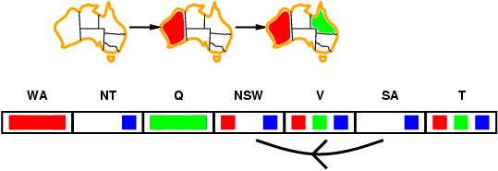
Arc consistency
Simplest form of propagation makes each arc consistent
X →Y is consistent iff
for every value x of X there is some allowed y

Slide 86
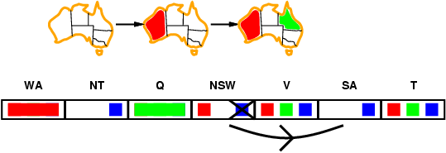
Arc consistency
Simplest form of propagation makes each arc consistent
X →Y is consistent iff
for every value x of X there is some allowed y

Slide 87
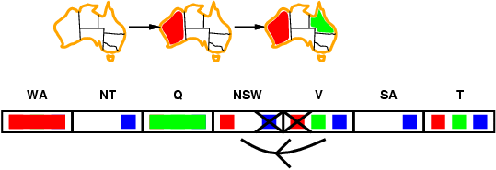
Arc consistency
Simplest form of propagation makes each arc consistent
X →Y is consistent iff
for every value x of X there is some allowed y
If X loses a value, neighbors of X need to be rechecked

Slide 88
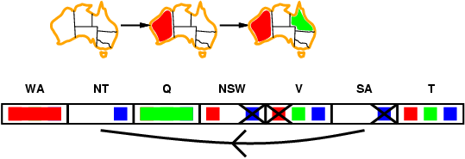
Arc consistency
Simplest form of propagation makes each arc consistent
X →Y is consistent iff
for every value x of X there is some allowed y
If X loses a value, neighbors of X need to be rechecked
Arc consistency detects failure earlier than forward checking
Can be run as a preprocessor or after each assignment

Slide 89
Arc Consistency: AC3
[R,B,G]
[R,B,G]
[R]
[R,B,G]
[R,B,G]

Slide 90
Arc Consistency: AC3
[ ,B,G]
[R,B,G]
[R]
[R,B,G]
[R,B,G]

Slide 91
Arc Consistency: AC3
[ ,B,G]
[R,B,G]
[R]
[ ,B,G]
[R,B,G]

Slide 92
Arc Consistency: AC3
[ ,B,G]
[R,B,G]
[R]
[ ,B,G]
[R,B,G]

Slide 93
Arc Consistency: AC3
[ ,B,G]
[R,B,G]
[R]
[ ,B,G]
[R,B,G]

Slide 94
Arc Consistency: AC3
[ ,B,G]
[R,B,G]
[R]
[ ,B,G]
[R,B,G]

Slide 95
Arc Consistency: AC3
[ ,B,G]
[R,B,G]
[R]
[ ,B,G]
[R,B,G]

Slide 96
Arc Consistency: AC3
[ ,B,G]
[R,B,G]
[R]
[ ,B,G]
[R,B,G]

Slide 97
Arc Consistency: AC3
[ ,B,G]
[R,B,G]
[R]
[ ,B,G]
[R,B,G]

Slide 98
Arc Consistency: AC3
[ ,B,G]
[R, ,G]
[R]
[ ,B,G]
[R,B,G]

Slide 99
Arc Consistency: AC3
[ ,B,G]
[R, ,G]
[R]
[ ,B,G]
[R, ,G]

Slide 100
Arc Consistency: AC3
[ ,B,G]
[R, ,G]
[R]
[ , ,G]
[R, ,G]

Slide 101
Arc Consistency: AC3
[ ,B,G]
[R, ,G]
[R]
[ , ,G]
[R, , ]

Slide 102
Arc Consistency: AC3
[ ,B,G]
[ , ,G]
[R]
[ , ,G]
[R, , ]

Slide 103
Arc Consistency: AC3
[ ,B,G]
[ , ,G]
[R]
[ , ,G]
[R, , ]

Slide 104
Arc Consistency: AC3
[ ,B,G]
[ , ,G]
[R]
[ , ,G]
[R, , ]

Slide 105
Arc Consistency: AC3
[ ,B,G]
[ , ,G]
[R]
[ , ,G]
[R, , ]
Solution !!!

Slide 106
Local Search and CSP
local search (iterative improvement) is frequently used for constraint satisfaction problems
values are assigned to all variables
modification operators move the configuration towards a solution
often called heuristic repair methods
repair inconsistencies in the current configuration
simple strategy: min-conflicts
minimizes the number of conflicts with other variables
solves many problems very quickly
million-queens problem in less than 50 steps
can be run as online algorithm
use the current state as new initial state

Slide 107
Local search for CSPs
Hill-climbing, simulated annealing typically work with "complete" states, i.e., all variables assigned
To apply to CSPs:
allow states with unsatisfied constraints
operators reassign variable values
Variable selection: randomly select any conflicted variable
Value selection by min-conflicts heuristic:
choose value that violates the fewest constraints
i.e., hill-climb with h(n) = total number of violated constraints

Slide 108
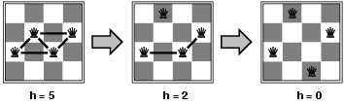
Example: 4-Queens
States: 4 queens in 4 columns (4⁴ = 256 states)
Actions: move queen in column
Goal test: no attacks
Evaluation: h(n) = number of attacks
Given random initial state, can solve n-queens in almost constant time for arbitrary n with high probability (e.g., n = 10,000,000)

Slide 109
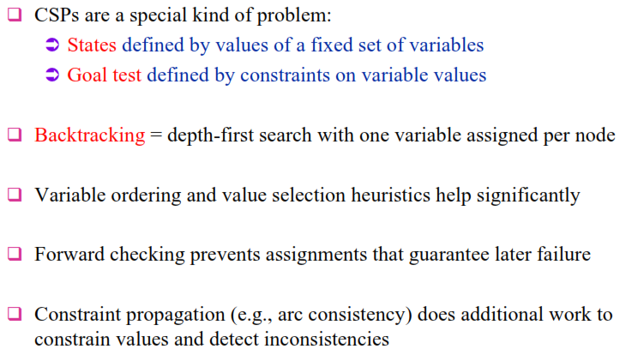
Chapter Summary

