Slide 1
Chapter 17
Equilibrium:
The Extent of Chemical Reactions
Copyright ©The McGraw-Hill Companies, Inc. Permission required for reproduction or display.
Notes:
‹#›

Slide 2
Equilibrium: The Extent of Chemical Reactions
17.1 The Equilibrium State and the Equilibrium Constant
17.2 The Reaction Quotient and the Equilibrium Constant
17.3 Expressing Equilibria with Pressure Terms:
Relation Between K_{c} and K_{p}
17.4 Reaction Direction: Comparing Q and K
17.5 How to Solve Equilibrium Problems
17.6 Reaction Conditions and the Equilibrium State:
Le Châtelier’s Principle
Notes:
‹#›

Slide 3
Kinetics applies to the speed (or rate) of a reaction, the concentration of product that appears (or of reactant that disappears) per unit time.
Equilibrium applies to the extent (or yield) of a reaction, the concentrations of reactant and product present after an unlimited time, or once no further change occurs.
At equilibrium: rate_{forward} = rate_{reverse}
A system at equilibrium is dynamic on the molecular level; no further net change is observed because changes in one direction are balanced by changes in the other.
Notes:
‹#›

Slide 4
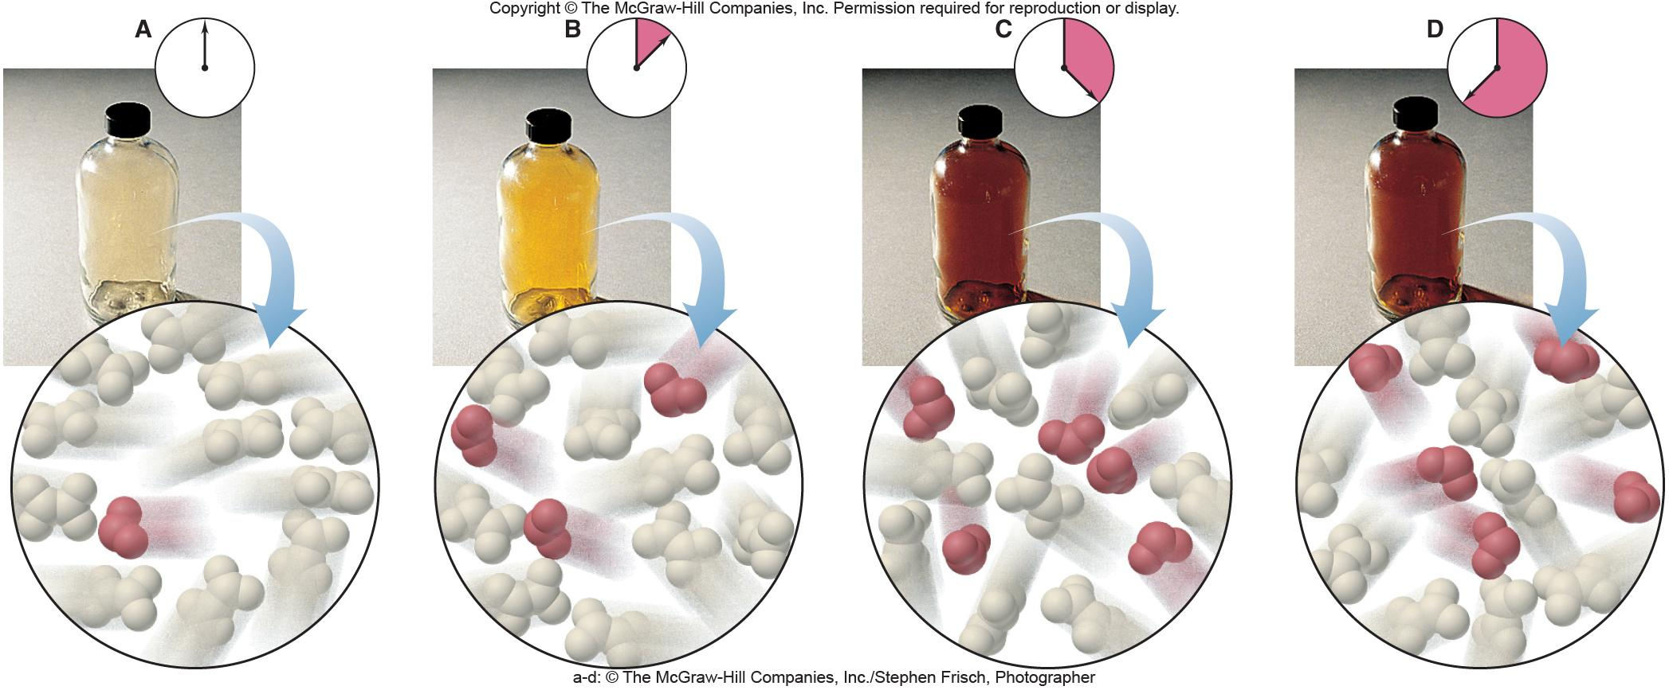
Figure 17.1
Reaching equilibrium on the macroscopic and molecular levels.
N₂O₄(g) 2NO₂(g)
Notes:
‹#›

Slide 5
If rate_{forward} = rate_{reverse} then
k_{forward}[reactants]^{m} = k_{reverse}[products]^{n}
k_{forward}
[products]^{n}
=
= K
the equilibrium constant
k_{reverse}
[reactants]^{m}
This is also known as the LAW OF MASS ACTION.
The values of m and n are those of the coefficients in the balanced chemical equation. Note that this is equilibrium, not kinetics. The rates of the forward and reverse reactions are equal, NOT the concentrations of reactants and products.
Notes:
‹#›

Slide 6
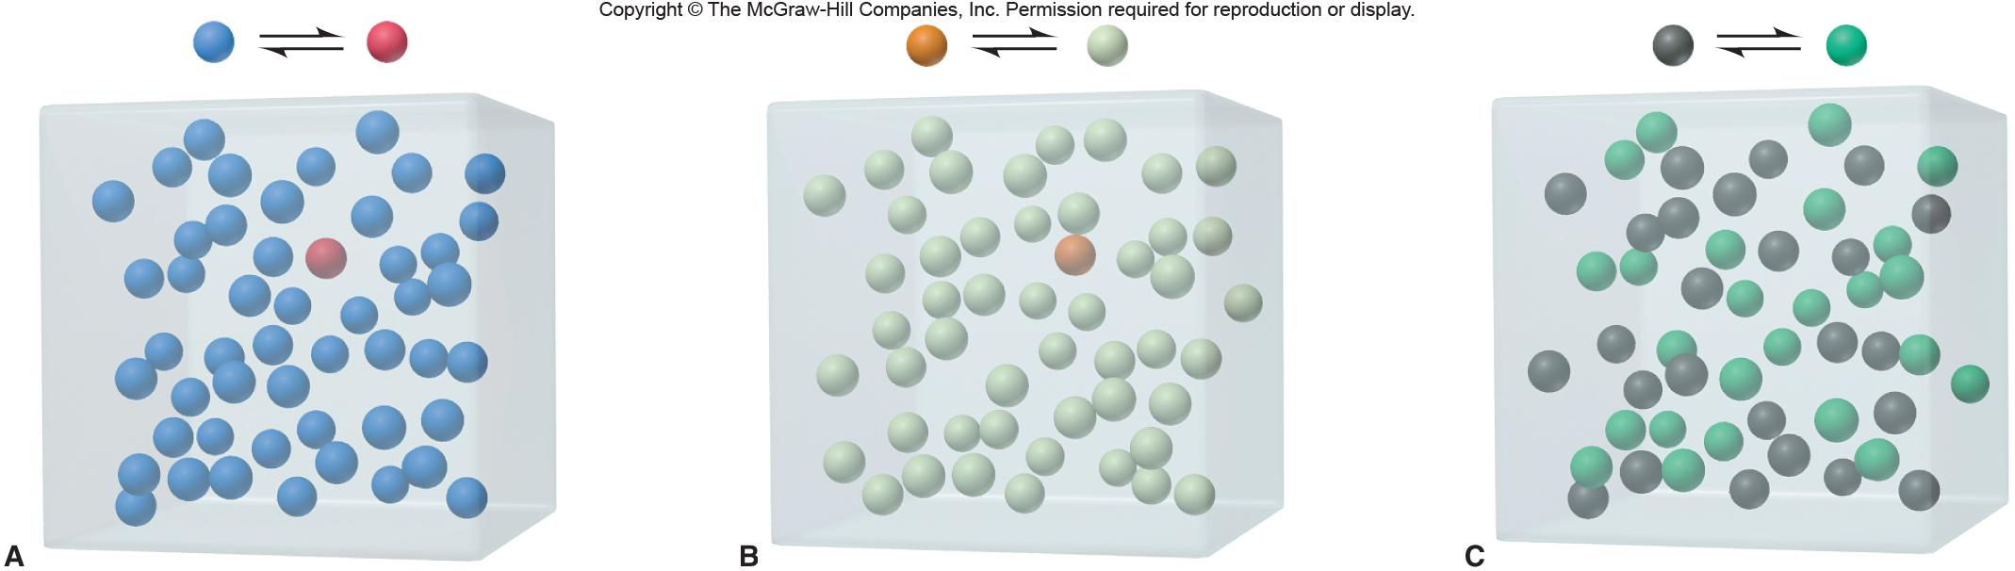
Figure 17.2
The range of equilibrium constants.
small K
large K
intermediate K
Notes:
‹#›

Slide 7

Q - The Reaction Quotient
At any time, t, the system can be sampled to determine the amounts of reactants and products present. A ratio of products to reactants, calculated in the same manner as K, tells us whether the system has come to equilibrium (Q = K) or whether the reaction has to proceed further from reactants to products (Q < K) or in the reverse direction from products to reactants (Q > K) in order to reach equilibrium.
We use the molar concentrations of the substances in the reaction. This is symbolized by using square brackets - [ ].
For a general reaction aA + bB cC + dD where a, b, c, and d are the numerical coefficients in the balanced equation, Q (and K) can be calculated as
[C]^{c} [D]^{d}
Q_{c} =
[A]ª [B]^{b}
Notes:
‹#›

Slide 8
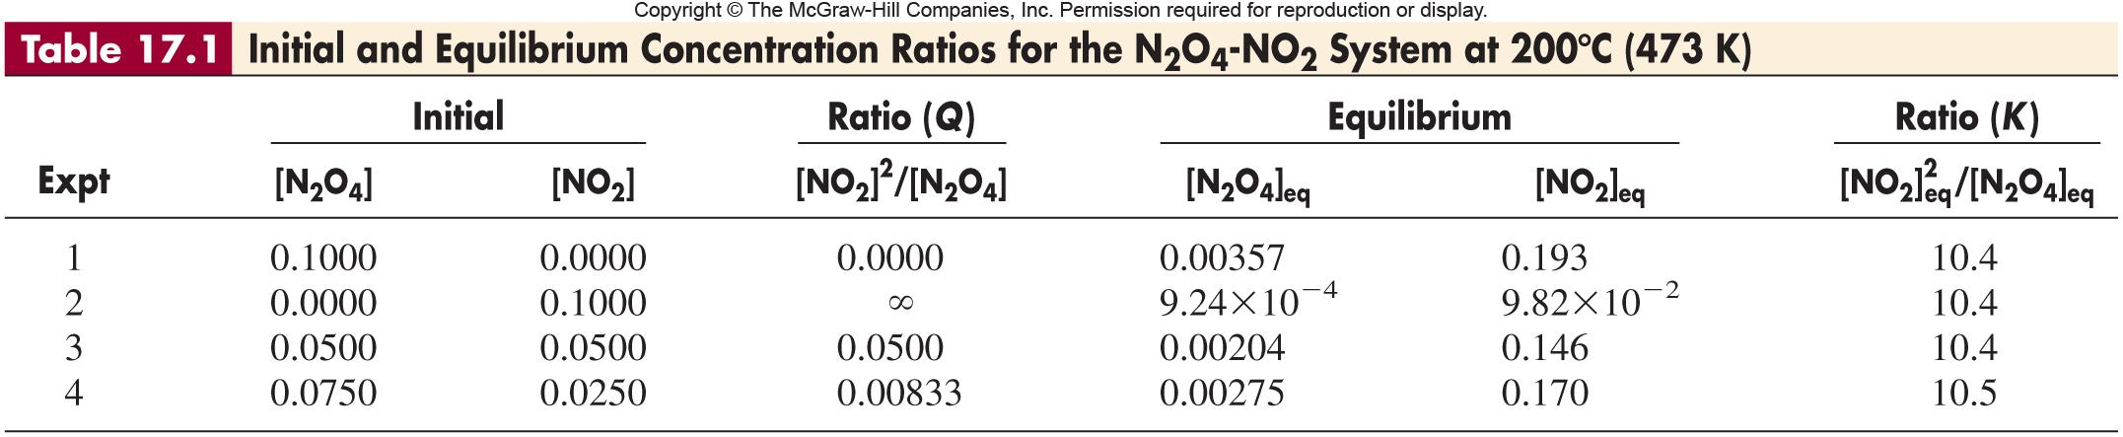
Notes:
‹#›

Slide 9
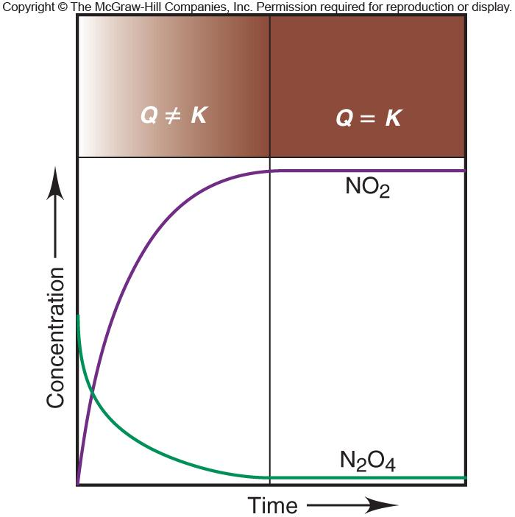
Figure 17.3
The change in Q during the N₂O₄-NO₂ reaction.
Notes:
‹#›

Slide 10

Sample Problem 17.1
Writing the Reaction Quotient from the Balanced Equation
PROBLEM:
Write the reaction quotient, Q_{c}, for each of the following reactions:
(a) The decomposition of dinitrogen pentaoxide, N₂O₅(g) NO₂(g) + O₂(g)
(b) The combustion of propane gas, C₃H₈(g) + O₂(g) CO₂(g) + H₂O(g)
PLAN:
Be sure to balance the equations before writing the Q_{c} expression.
SOLUTION:
[NO₂]⁴[O₂]
(a) N₂O₅(g) NO₂(g) + O₂(g)
2
4
Q_{c} =
[N₂O₅]²
[CO₂]³[H₂O]⁴
5
3
4
Q_{c} =
(b) C₃H₈(g) + O₂(g) CO₂(g) + H₂O(g)
[C₃H₈][O₂]⁵
Notes:
‹#›

Slide 11
Calculating Variations on Q and K
[C]^{c} [D]^{d}
aA + bB cC + dD
Q_{c} =
[A]ª [B]^{b}
cC + dD aA + bB
Q’ = 1/Q_{c}
n
aA + bB cC + dD
Q_{c}’ = (Q_{c})^{n}
For a sequence of equilibria, K_{overall} = K₁ x K₂ x K₃ x …
Notes:
‹#›

Slide 12
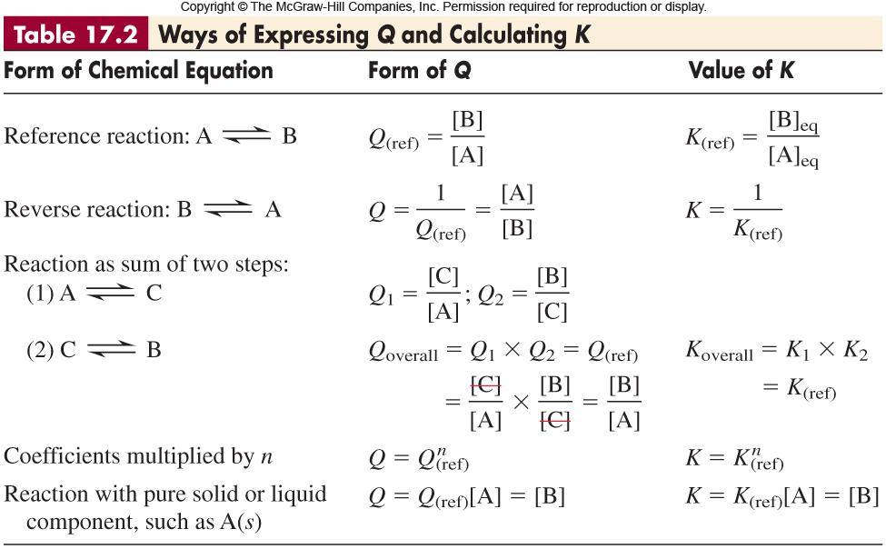
Notes:
‹#›

Slide 13
Expressing Equilibria with Pressure Terms
K_{c} and K_{p}
n
P
n
PV = nRT
P =
RT
=
= M
V
RT
V
P α M so for 2NO(g) + O₂(g) 2NO₂(g)
P²_{NO2}
[NO₂]²
Q_{p} =
Q_{c} =
P²_{NO} x P_{O2}
[NO]²[O₂]
K_{p} = K_{c} (RT)^{Δn(gas)}
Notes:
‹#›

Slide 14
Sample Problem 17.2
Converting Between K_{c} and K_{p}
PROBLEM:
A chemical engineer injects limestone (CaCO₃) into the hot flue gas of a coal-burning power plant for form lime (CaO), which scrubs SO₂ from the gas and forms gypsum (CaSO₄•2H₂O). Find K_{c} for the following reaction, if CO₂ pressure is in atmospheres:
CaCO₃(s) CaO(s) + CO₂(g) K_{p} = 2.1 x 10⁻⁴ (at 1000. K)
PLAN:
We know K_{p} and can calculate K_{c} after finding Δn_{gas}. R = 0.0821 atm•L/mol•K.
SOLUTION:
Δn_{gas} = 1 - 0 = 1, since there is only a gaseous product and no gaseous reactants.
K_{p} = K_{c}(RT)^{Δn}
K_{c} = K_{p}/(RT)^{Δn} = (2.1 x 10⁻⁴)(0.0821 x 1000.)⁻¹ =
2.6 x 10⁻⁶
Notes:
‹#›

Slide 15
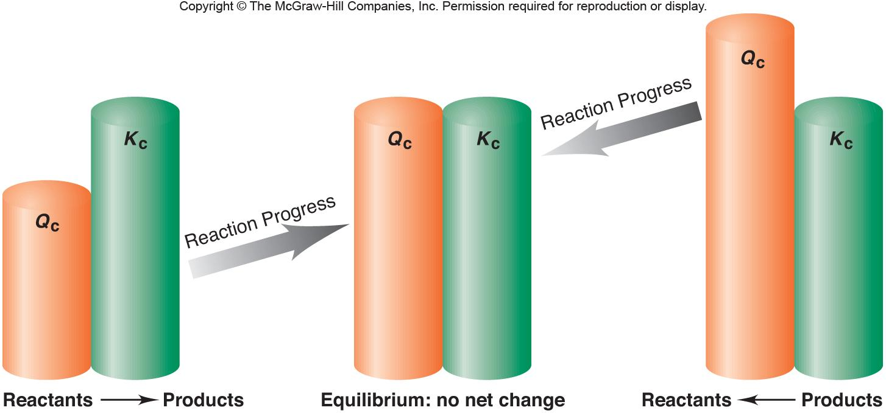
Figure 17.4
Reaction direction and the relative sizes of Q and K.
Notes:
‹#›

Slide 16
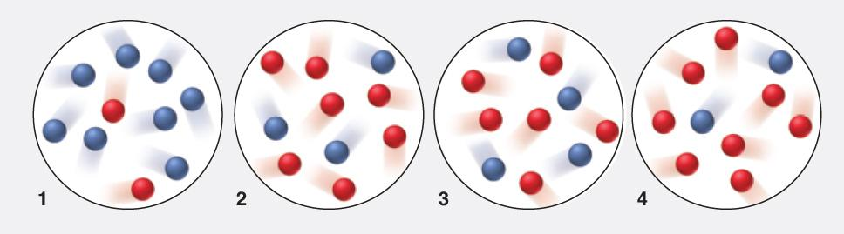
Sample Problem 17.3
Using Molecular Scenes to Determine Reaction Direction
PROBLEM:
During one run of the reaction A(g) B(g), the equilibrium mixture at 175ºC had the following composition: [A] = 2.8 x 10⁻⁴ M and [B] = 1.2 x 10⁻⁴ M. The molecular scenes below represent mixtures at various times during runs 1-4 of the reaction at 175ºC (A is red; B is blue). In which direction, if any, does the reaction shift for each mixture to reach equilibrium?
PLAN:
Calculate K_{c} then count the number of A and B in each scene to calculate Q_{c} for each. Compare Q_{c} with K_{c}. If Q_{c} > K_{c} reaction will shift towards reactants; if Q_{c} < K_{c} reaction will shift towards products.
Notes:
‹#›

Slide 17
Sample Problem 17.3
Using Molecular Scenes to Determine Reaction Direction
continued
[B]
(1.2 x 10⁻⁴)
SOLUTION:
Q_{c} =
=
= 0.43 = K_{c}
[A]
(2.8 x 10⁻⁴)
Q_{c} = 8/2 = 4.0; Q_{c} > K_{c}, left
Q_{c} = 3/7 = 0.43; Q_{c} = K_{c}, no change
3. Q_{c} = 4/6 = 0.67; Q_{c} > K_{c}, left
Q_{c} = 2/8 = 0.25; Q_{c} < K_{c}, right
Notes:
‹#›

Slide 18
Sample Problem 17.4
Comparing Q and K to Determine Reaction Direction
PROBLEM:
For the reaction N₂O₄(g) 2NO₂(g), K_{c} = 0.21 at 100ºC. At a point during the reaction, [N₂O₄] = 0.12 M and [NO₂] = 0.55 M. Is the reaction at equilibrium? If not, in which direction is it progressing?
PLAN:
Write an expression for Q_{c}, substitute with the values given, and compare the Q_{c} with the given K_{c}.
SOLUTION:
[NO₂]²
0.55²
Q_{c} =
=
= 2.5
[N₂O₄]
0.12
Q_{c} is > K_{c}, therefore, the reaction is not at equilibrium and will proceed from right to left, from products to reactants, until Q_{c} = K_{c}.
Notes:
‹#›

Slide 19
Sample Problem 17.5
Calculating K_{c} from Concentration Data
PROBLEM:
In order to study hydrogen halide decomposition, a researcher fills an evacuated 2.00-L flask with 0.200 mol of HI gas and allows the reaction to proceed at 453ºC:
2HI(g) H₂(g) + I₂(g)
At equilibrium, [HI] = 0.078 M. Calculate K_{c}.
PLAN:
First find the molar concentration of the starting material and then find the amount of each component, reactants and products, at equilibrium.
SOLUTION:
[HI] =
0.200 mol
= 0.100 M
2.00 L
Let x be the amount of [H₂] at equilibrium. Then x will also be the concentration of [I₂] and the change in [HI] will be the original concentration minus the stoichiometric amount that reacted, 2x, or 0.078 M.
Notes:
‹#›

Slide 20
Sample Problem 17.5
Calculating K_{c} from Concentration Data
continued
Concentration (M)
2HI(g) H₂(g) + I₂(g)
Initial
0.100
0
0
Change
-2x
+ x
+ x
Equilibrium
0.100 - 2x
x
x
[HI] = 0.078 = 0.100 - 2x ; x = 0.011 M
[H₂] [I₂]
(0.011)(0.011)
Q_{c} =
=
= 0.020 = K_{c}
[HI]²
0.078²
Notes:
‹#›

Slide 21

Sample Problem 17.6
Determining Equilibrium Concentrations from K_{c}
PROBLEM:
In a study concerning the conversion of methane to other fuels, a chemical engineer mixes gaseous CH₄ and H₂O in a 0.32-L flask at 1200 K. At equilibrium, the flask contains 0.26 mol of CO, 0.091 mol of H₂, and 0.041 mol of CH₄. What is the [H₂O] at equilibrium? K_{c} = 0.26 for the equation
CH₄(g) + H₂O(g) CO(g) + 3H₂(g)
PLAN:
Use the balanced equation to write the reaction quotient and then substitute values for each component.
[CO][H₂]³
SOLUTION:
CH₄(g) + H₂O(g) CO(g) + 3H₂(g)
Q_{c} =
[CH₄][H₂O]
0.041mol
0.26mol
[CH₄]_{eq} =
= 0.13 M
[CO]_{eq} =
= 0.81 M
0.32 L
0.32 L
0.091mol
[H₂]_{eq} =
= 0.28 M
0.32 L
[CO][H₂]³
(0.81)(0.28)³
[H₂O] =
=
= 0.53 M
[CH₄] K_{c}
(0.13)(0.26)
Notes:
‹#›

Slide 22
Sample Problem 17.7
Determining Equilibrium Concentrations from Initial Concentrations and K_{c}
PROBLEM:
Fuel engineers use the extent of the change from CO and H₂O to CO₂ and H₂ to regulate the proportions of synthetic fuel mixtures. If 0.250 mol of CO and 0.250 mol of H₂O are placed in a 125-mL flask at 900 K, what is the composition of the equilibrium mixture? At this temperature, K_{c} is 1.56 for the equation
CO(g) + H₂O(g) CO₂(g) + H₂(g)
PLAN:
We have to find the concentrations of all species at equilibrium and then substitute into a K_{c} expression.
0.250
SOLUTION:
All concentrations must be recalculated as M, so [CO] =
0.125 L
Concentration
CO(g) + H₂O(g) CO₂(g) + H₂(g)
Initial
2.00
2.00
0
0
Change
-x
-x
+x
+x
Equilibrium
2.00 - x
2.00 - x
x
x
Notes:
‹#›

Slide 23
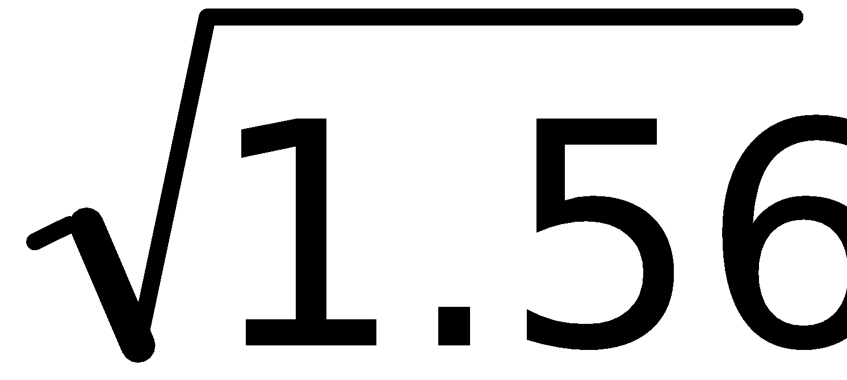
Sample Problem 17.6
Determining Equilibrium Concentrations from Initial Concentrations and K_{c}
continued
[CO][H₂]
(x)
(x)
(x)²
Q_{c} = K_{c} =
=
=
[CO₂][H₂O]
(2.00 - x) (2.00 - x)
(2.00 - x)²
x
=
= +/- 1.25
2.00 - x
x = 1.11 M
[CO] = [H₂O] = 0.89 M
2.00 - x = 0.89 M
[CO₂] = [H₂] = 1.11 M
Notes:
‹#›

Slide 24
Sample Problem 17.8
Calculating Equilibrium Concentrations with Simplifying Assumptions
PROBLEM:
Phosgene is a potent chemical warfare agent that is now outlawed by international agreement. It decomposes by the reaction
COCl₂(g) CO(g) + Cl₂(g) K_{c} = 8.3 x 10⁻⁴ (at 360ºC)
Calculate [CO], [Cl₂], and [COCl₂] when the following amounts of phosgene decompose and reach equilibrium in a 10.0-L flask:
(a) 5.00 mol of COCl₂ (b) 0.100 mol of COCl₂
PLAN:
After finding the concentration of starting material, write the expressions for the equilibrium concentrations. When solving for the remaining amount of reactant, see if you can make an assumption about the initial and final concentrations which could simplify the calculation by ignoring the solution to a quadratic equation.
Notes:
‹#›

Slide 25
Sample Problem 17.8
Calculating Equilibrium Concentrations with Simplifying Assumptions
continued
SOLUTION:
(a) 5.00 mol/10.0 L = 0.500 M
Let x = [CO]_{eq} = [Cl₂]_{eq} and (0.500 – x) = [COCl₂]_{eq}
(x) (x)
[CO][Cl₂]
(a)
K_{c} = 8.3 x 10⁻⁴ =
K_{c} =
(0.500 - x)
[COCl₂]
assume x is << 0.500 so that we can drop x in the denominator
(x) (x)
4.15 x 10⁻⁴ = x²
x ≈ 2 x 10⁻²
8.3 x 10⁻⁴ =
(0.500)
(0.500 - x) = 4.8 x 10⁻²
CHECK: 0.020/0.500 = 0.04 or 4% percent error
Notes:
‹#›

Slide 26
Sample Problem 17.8
Calculating Equilibrium Concentration with Simplifying Assumptions
continued
(b) 0.100 mol/10.0 L = 0.0100 M
Let x = [CO]_{eq} = [Cl₂]_{eq} and (0.0100 – x) = [COCl₂]_{eq}
(x) (x)
K_{c} = 8.3x10⁻⁴ =
(0.010 - x)
Dropping the -x will give a value for x = 2.9 x 10⁻³ M.
(0.010 - x) ≈ 0.0071 M
CHECK: 0.0029/0.010 = 0.29 or 29% percent error; we cannot approximate in this case. We must use the quadratic equation.
Using the quadratic equation produces
x = [CO]_{eq} = [Cl₂]_{eq} = 2.5 x 10⁻³ M and (0.0100 – x) = [COCl₂]_{eq} = 7.5 x 10⁻³ M
Notes:
‹#›

Slide 27
Sample Problem 17.9
Predicting Reaction Direction and Calculating Equilibrium Concentrations
PROBLEM:
The research and development unit of a chemical company is studying the reaction of CH₄ and H₂S, two components of natural gas:
CH₄(g) + 2H₂S(g) CS₂(g) + 4H₂(g)
In one experiment, 1.00 mol of CH₄, 1.00 mol of CS₂, 2.00 mol of H₂S, and 2.00 mol of H₂ are mixed in a 250-mL vessel at 960ºC. At this temperature, K_{c} = 0.036.
(a) In which direction will the reaction proceed to reach equilibrium?
(b) If [CH₄] = 5.56 M at equilibrium, what are the equilibrium concentrations of the other substances?
PLAN:
(a) Find the initial molar concentrations of all components and use these to calculate Q_{c}. Compare Q_{c} to K_{c}, determine in which direction the reaction will progress, and (b) write expressions for equilibrium concentrations.
Notes:
‹#›

Slide 28
Sample Problem 17.9
Predicting Reaction Direction and Calculating Equilibrium Concentrations
continued
SOLUTION:
1.00 mol
[CH₄]_{initial} = = 4.00 M
0.250 L
2.00 mol
[H₂S]_{initial} = = 8.00 M
0.250 L
1.00 mol
[CS₂]_{initial} = = 4.00 M
0.250 L
2.00 mol
[H₂]_{initial} = = 8.00 M
0.250 L
Notes:
‹#›

Slide 29
Sample Problem 17.9
Predicting Reaction Direction and Calculating Equilibrium Concentrations
continued
[CS₂][H₂]⁴
[4.00][8.00]⁴
A Q_{c} of 64.0 is >> than K_{c} = 0.036
Q_{c} =
=
= 64.0
[CH₄][H₂S]²
[4.00][8.00]²
The reaction will progress to the left.
Concentrations
CH₄(g) + 2H₂S(g) CS₂(g) + 4H₂(g)
Initial
4.00
8.00
4.00
8.00
Change
+ x
+ 2x
- x
- 4x
Equilibrium
4.00 + x
8.00 + 2x
4.00 - x
8.00 - 4x
At equilibrium [CH₄] = 5.56 M, so 5.56 = 4.00 M + x and x = 1.56 M
Therefore,
[H₂S] = 8.00 + 2x = 8.00 M + 2(1.56 M) = 11.12 M
[CS₂] = 4.00 - x = 2.44 M
[H₂] = 8.00 - 4x = 1.76 M
Notes:
‹#›

Slide 30
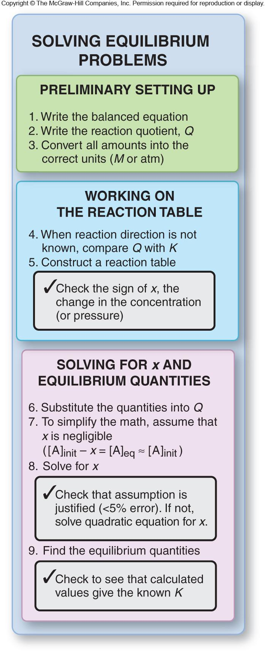
Figure 17.5
Steps in solving equilibrium problems.
Notes:
‹#›

Slide 31
Le Châtelier’s Principle
When a chemical system at equilibrium
is subjected to a stress,
the system will return to an equilibrium
state by shifting to reduce the stress.
If the concentration of a reaction component increases,
the system reacts to consume some of it.
If the concentration of a reaction component decreases,
the system reacts to produce more of it.
Notes:
‹#›

Slide 32
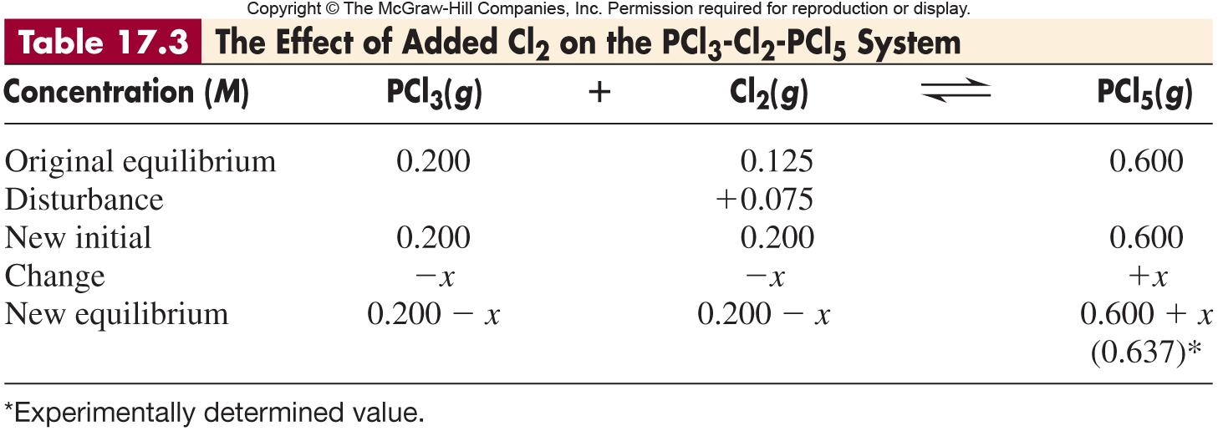
Notes:
‹#›

Slide 33
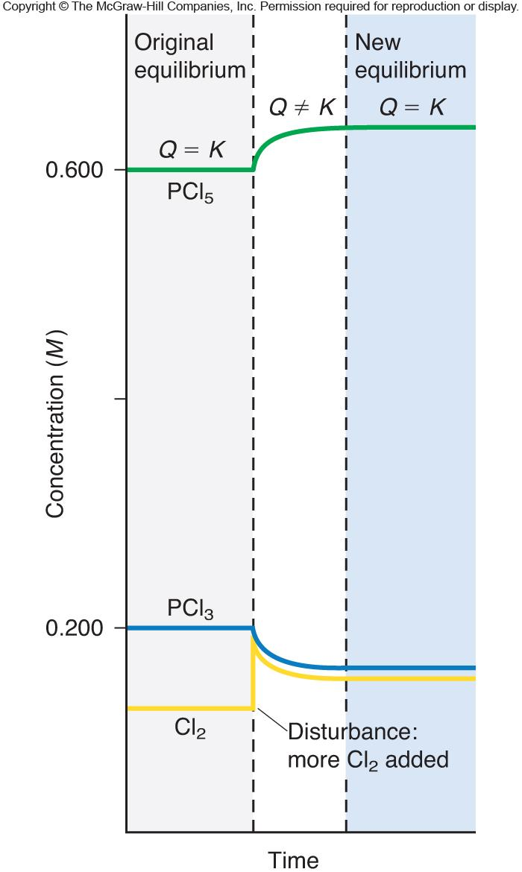
Figure 17.7
The effect of added Cl₂ on the PCl₃-Cl₂-PCl₅ system.
PCl₃(g) + Cl₂(g) PCl₅(g)
Notes:
‹#›

Slide 34
Sample Problem 17.10
Predicting the Effect of a Change in Concentration on the Equilibrium Position
PROBLEM:
To improve air quality and obtain a useful product, chemists often remove sulfur from coal and natural gas by treating the fuel contaminant hydrogen sulfide with O₂:
2H₂S(g) + O₂(g) 2S(s) + 2H₂O(g)
What happens to
(a) [H₂O] if O₂ is added?
(b) [H₂S] if O₂ is added?
(c) [O₂] if H₂S is removed?
(d) [H₂S] if sulfur is added?
PLAN:
Write an expression for Q and compare it to K when the system is disturbed to see in which direction the reaction will progress.
SOLUTION:
Q_{c} =
[H₂O]²
[H₂S]²[O₂]
(a) When O₂ is added, Q decreases and the reaction progresses to the right to come back to K. Hence, [H₂O] increases.
Notes:
‹#›

Slide 35
Sample Problem 17.10
Predicting the Effect of a Change in Concentration on the Equilibrium Position
continued
Q_{c} =
[H₂O]²
[H₂S]²[O₂]
(b) When O₂ is added, Q decreases and the reaction progresses to the right to come back to K. Hence, [H₂S] decreases.
(c) When H₂S is removed, Q increases and the reaction progresses to the left to come back to K. Hence, [O₂] increases.
(d) Sulfur is not part of the Q (K) expression because it is a solid. Therefore, as long as some sulfur is present the reaction is unaffected. [H₂S] is unchanged.
Notes:
‹#›

Slide 36
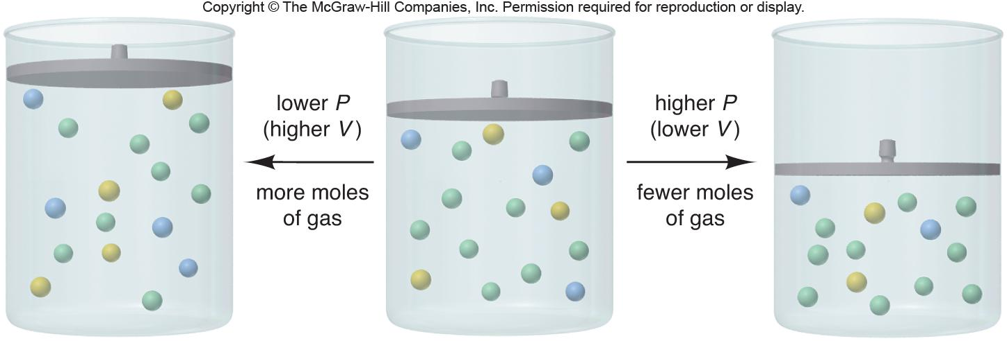
Figure 17.8
The effect of pressure (volume) on a system at equilibrium.
Notes:
‹#›

Slide 37

Sample Problem 17.11
Predicting the Effect of a Change in Volume (Pressure) on the Equilibrium Position
PROBLEM:
How would you change the volume of each of the following reactions to increase the yield of the products?
(a) CaCO₃(s) CaO(s) + CO₂(g)
(b) S(s) + 3F₂(g) SF₆(g)
(c) Cl₂(g) + I₂(g) 2ICl(g)
PLAN:
When gases are present a change in volume will affect the concentration of the gas. If the volume decreases (pressure increases), the reaction will shift to fewer moles of gas and vice versa.
SOLUTION:
(a) CO₂ is the only gas present. To increase its yield, we should increase the volume (decrease the pressure).
(b) There are more moles of gaseous reactants than products, so we should decrease the volume (increase the pressure) to shift the reaction to the right.
(c) There are an equal number of moles of gases on both sides of the reaction, therefore, a change in volume will have no effect.
Notes:
‹#›

Slide 38
The Effect of a Change in Temperature on an Equilibrium
Only temperature changes can alter K.
Consider heat as a product or a reactant.
In an exothermic reaction, heat is a product.
In an endothermic reaction, heat is a reactant.
A temperature rise will increase K for a system with a positive ΔH⁰_{rxn}.
A temperature rise will decrease K for a system with a negative ΔH⁰_{rxn}.
What effect(s) will decreases in temperature have on K?
Notes:
‹#›

Slide 39
Sample Problem 17.12
Predicting the Effect of a Change in Temperature on the Equilibrium Position
PROBLEM:
How does an increase in temperature affect the equilibrium concentration of the underlined substance and K for the following reactions?
(a) CaO(s) + H₂O(l) Ca(OH)₂(aq) ΔHº = -82 kJ
(b) CaCO₃(s) CaO(s) + CO₂(g) ΔHº = 178 kJ
(c) SO₂(g) S(s) + O₂(g) ΔHº = 297 kJ
PLAN:
Express the heat of reaction as a reactant or a product. Then consider the increase in temperature and its effect on K.
SOLUTION:
(a) CaO(s) + H₂O(l) Ca(OH)₂(aq) + heat
An increase in temperature will shift the reaction to the left, decreasing [Ca(OH)₂] and K.
(b) CaCO₃(s) + heat CaO(s) + CO₂(g)
The reaction will shift right resulting in an increase in [CO₂] and K.
(c) SO₂(g) + heat S(s) + O₂(g)
The reaction will shift right resulting in a decrease in [SO₂] and increase in K.
Notes:
‹#›

Slide 40
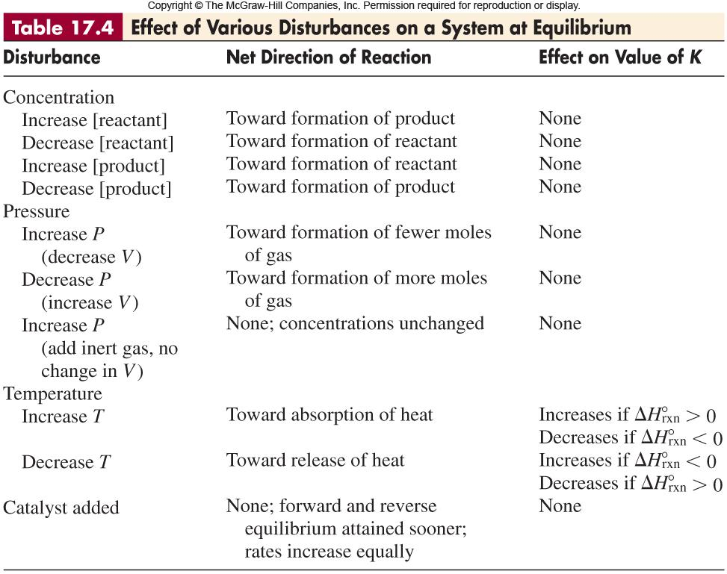
Notes:
‹#›

Slide 41

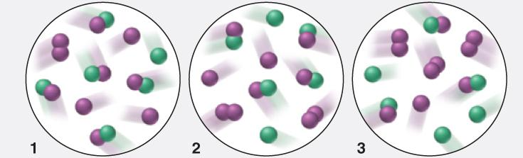
Sample Problem 17.13
Determining Equilibrium Parameters from
Molecular Scenes
PROBLEM:
For the reaction X(g) + Y₂(g) XY(g) + Y(g) ΔH > 0
the following molecular scenes depict different reaction mixtures
(X is green, Y is purple).
(a) If K = 2 at the temperature of the reaction, which scene represents the mixture at equilibrium?
Will the reaction mixtures in the other two scenes proceed toward reactant or toward products to reach equilibrium?
For the mixture at equilibrium, how will a rise in temperature affect [Y₂]?
PLAN:
Count the number of each species in the pictures, calculate Q, (a) and (b) compare with K. Knowing the reaction is endothermic, (c) determine the effect of temperature on the equilibrium.
Notes:
‹#›

Slide 42
Sample Problem 17.13
Determining Equilibrium Parameters from
Molecular Scenes
continued
[XY][Y]
SOLUTION:
The equilibrium constant, K, is
.
[X][Y₂]
(5)(3)
scene 1: Q = = 15
(1)(1)
(4)(2)
scene 2: Q = = 2
(2)(2)
(3)(1)
1
scene 3: Q = =
(3)(3)
3
Notes:
‹#›

Slide 43
Sample Problem 17.13
Determining Equilibrium Parameters from
Molecular Species
continued
Q = 15
Q = 2
Q = 1/3
(a) For scene 2, Q = K, so it represents the system at equilibrium.
(b) For scene 1, Q > K, so the system will proceed toward reactants to reach equilibrium while in scene 3, Q < K, so the system will proceed toward products.
(c) If ΔH > 0, heat is a reactant (endothermic). A rise in temperature will favor products and [Y₂] will decrease as the system shifts to products.
Notes:
‹#›

Slide 44
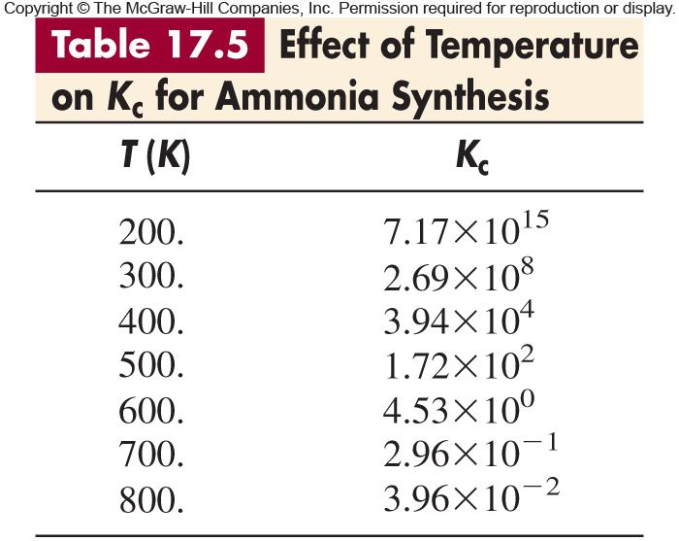
Notes:
‹#›

Slide 45
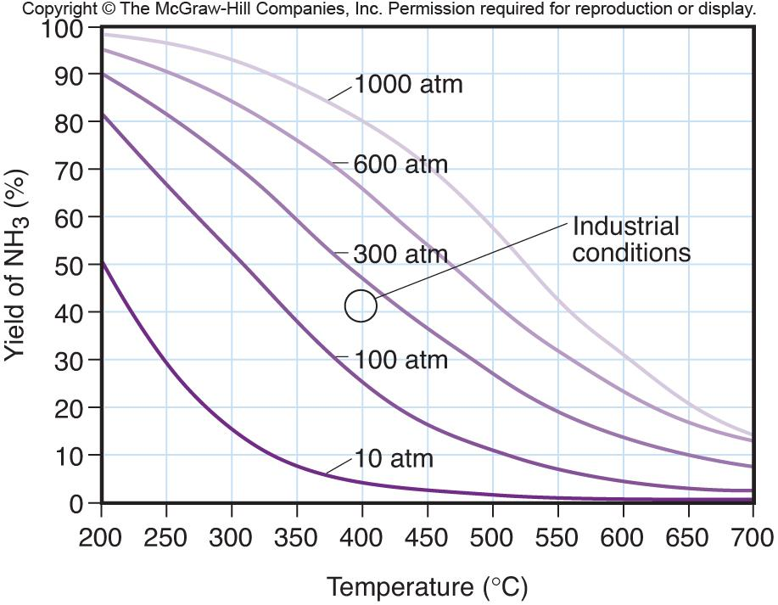
Figure 17.9
Percent yield of ammonia vs. temperature (ºC) at five different operating pressures.
Notes:
‹#›

