Slide 1
Chapter Sixteen
Personal Selling
and
Sales Promotion

Slide 2
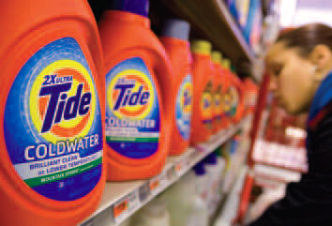
Personal Selling and
Sales Promotion
Topic Outline
Personal Selling
Managing the Sales Force
The Personal Selling Process
Sales Promotion

Slide 3

Personal Selling
Personal Selling
Personal selling is the interpersonal part of the promotion mix and can include:
Face-to-face communication
Telephone communication
Video or Web conferencing
Notes:
Note to Instructor
This Web link is to one of many professional sales organizations—it is important to mention what a well respected field sales is as students often think of in-store retail sales only.
Discussion Question
Who has held a sales position? What were your responsibilities?
You can the ask them to describe the job so you can use it as an example in future slides. Many students will have worked at inside sales positions and many of them have cold called extensively as part of their jobs. You can also ask them how they were paid—salary, commission, bonus? This will tie into future slides.

Slide 4
Personal Selling
The Nature of Personal Selling
Salespeople are an effective link between the company and its customers to produce customer value and company profit by:
Representing the company to customers
Representing customers to the company
Working closely with marketing
Notes:
Note to Instructor
Examples of people who do the selling include:
Salespeople
Sales representatives
District managers
Account executives
Sales engineers
Agents
Account development reps

Slide 5
Managing the Sales Force
Sales force management is the analysis, planning, implementation, and control of sales force activities

Slide 6
Managing the Sales Force
Designing Sales Force Structure
Notes:
Note to Instructor
These are the four ways that sales responsibilities can be divided.
Discussion Question
How will a company decide which structure is best for them?
The decision is based on how many product lines, how many industries, the size of the sales force, and the number of buyers.

Slide 7
Managing the Sales Force
Sales Force Structure
Territorial sales force structure refers to a structure where each salesperson is assigned an exclusive geographic area and sells the company’s full line of products and services to all customers in that territory
Defines salesperson’s job
Fixes accountability
Lowers sales expenses
Improves relationship building and selling effectiveness

Slide 8
Managing the Sales Force
Sales Force Structure
Product sales force structure refers to a structure where each salesperson sells along product lines
Improves product knowledge
Can lead to territorial conflicts

Slide 9
Managing the Sales Force
Sales Force Structure
Customer sales force structure refers to a structure where each salesperson sells along customer or industry lines
Improves customer relationships

Slide 10
Managing the Sales Force
Sales Force Structure
Complex sales force structure refers to a structure where a wide variety of products is sold to many types of customers over a broad geographic area and combines several types of sales force structures

Slide 11
Managing the Sales Force
Sales Force Size
Salespeople are one of the company’s most productive and expensive assets.
Increases in sales force size can increase sales and costs
Workload approach to sales forces size refers to grouping accounts into different classes to determine the number of salespeople needed

Slide 12
Managing the Sales Force
Other Sales Force Strategy and Structure Issues
Outside salespeople call on customers in the field
Inside salespeople conduct business from their offices and often provide support for the outside salespeople
  Technical sales support people
  Sales assistants
Team selling is used to service large, complex accounts
Notes:
Note to Instructor
Challenges of team selling include:
Confusing and overwhelming customers used to working with one salesperson.
Salespeople used to working alone can have difficulties working with and trusting teams.
Evaluating individual contributions can lead to compensation issues.

Slide 13
Managing the Sales Force
Recruiting and Selecting Salespeople
Issues in Recruiting and Selecting
Careful selection and training increases sales performance
Poor selection
Increases recruiting and training costs
  Lost sales
  Disrupts customer relationships
Notes:
Note to Instructor
This Web site link is to salesjobs.com. This is one of the largest online sales recruiting Web sites. It might be interesting to explore listings, salaries, and job requirements with the students.
In slideshow view, click on movie icon to launch Principal Financial Group video snippet. See accompanying DVD for full video segment.

Slide 14

Managing the Sales Force
Salesperson compensation based on
Notes:
Note to Instructor
To attract good salespeople, a company must have an appealing compensation plan. Compensation is made up of several elements—a fixed amount, a variable amount, expenses, and fringe benefits. The fixed amount, usually a salary, gives the salesperson some stable income. The variable amount, which might be commissions or bonuses based on sales performance, rewards the salesperson for greater effort and success. This Web link ties to a survey of salesperson salaries.

Slide 15
Managing the Sales Force
Supervising and Motivating Salespeople
The goal of supervision is to help salespeople work smart by doing the right things in the right ways
The goal of motivation is to encourage salespeople to work hard and energetically toward sales force goals

Slide 16
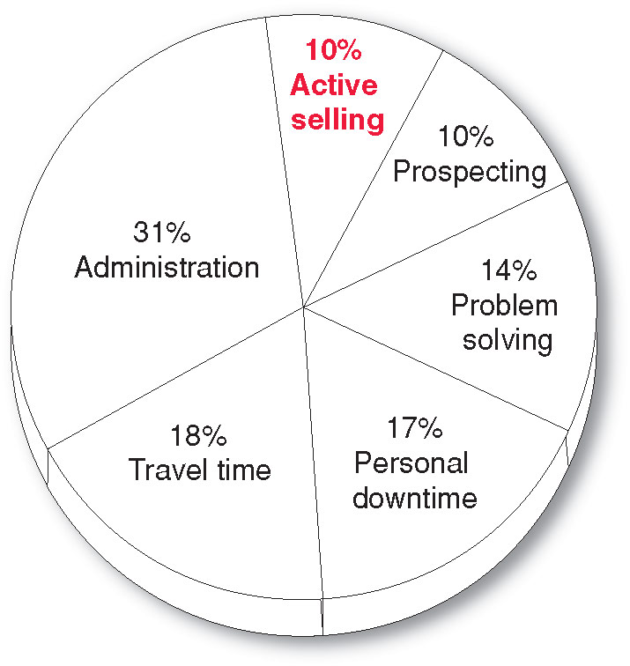

Managing the Sales Force
How Salespeople Spend Their Time
Notes:
sales force automation systems: computerized, digitized sales
force operations that let salespeople work more effectively anytime, anywhere. The result is better time management, improved customer service, lower sales costs, and higher sales performance.

Slide 17
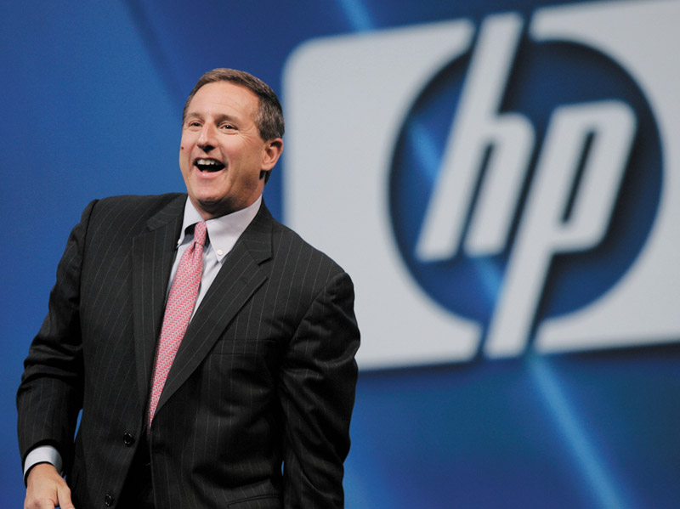
Managing the Sales Force
Selling and the Internet
Major tool to support salespeople
Notes:
Note to Instructor
Sales 2.0
Social networking

Slide 18
Managing the Sales Force
Supervising and Motivating Salespeople
Sales morale and performance can be increased through:
  Organizational climate
  Sales quotas
  Positive incentives
Notes:
Note to Instructor
This link is to the Mary Kay Web site. This page lists the rewards that are available to Mary Kay salespeople including a pink Cadillac for the highest seller.
Organizational climate describes the feeling that salespeople have about their opportunities, value, and rewards for good performance.
Sales quota
A standard that states the amount a
salesperson should sell and how sales
should be divided among the company’s
products.

Slide 19

Managing the Sales Force
Evaluating Salespeople and Sales Force Performance

Slide 20
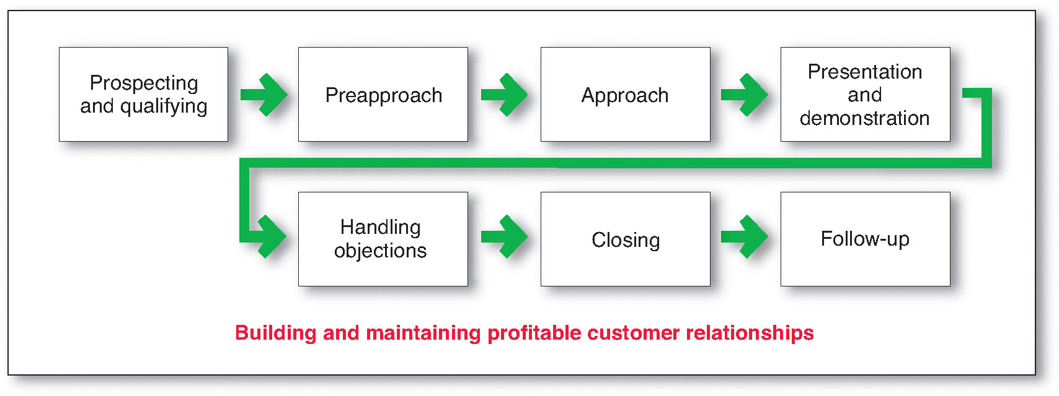
The Personal Selling Process
The goal of the personal selling process is to get new customers and obtain orders from them

Slide 21
The Personal Selling Process
Steps in the Personal Selling Process
Prospecting identifies qualified potential customers through referrals from:
Customers
Suppliers
Dealers
Internet

Slide 22
The Personal Selling Process
Steps in the Personal Selling Process
Qualifying is identifying good customers and screening out poor ones by looking at:
  Financial ability
  Volume of business
  Needs
  Location
  Growth potential

Slide 23
The Personal Selling Process
Steps in the Personal Selling Process
Pre-approach is the process of learning as much as possible about a prospect, including needs, who is involved in the buying, and the characteristics and styles of the buyers
Notes:
Note to Instructor
In the pre-approach stage, the salesperson sets call objectives and the best approach.

Slide 24
The Personal Selling Process
Steps in the Personal Selling Process
Approach is the process where the salesperson meets and greets the buyer and gets the relationship off to a good start and involves the salesperson’s:
Appearance
Opening lines
Follow-up remarks

Slide 25
The Personal Selling Process
Steps in the Personal Selling Process
Opening lines should be positive, build goodwill, and be followed by key questions to learn about the customer’s needs or showing a display or sample to attract the buyer’s attention and curiosity
The most important attribute is for the salesperson to: listen

Slide 26
The Personal Selling Process
Steps in the Personal Selling Process
Presentation is when the salesperson tells the product story to the buyer, presenting customer benefits and showing how the product solves the customer’s problems
Need-satisfaction approach: Buyers want solutions and salespeople should listen and respond with the right products and services to solve customer problems

Slide 27
The Personal Selling Process
Steps in the Personal Selling Process
Bad Traits
Good traits
Notes:
Note to Instructor
Before advancing to second set of traits—ask students what qualities buyers like in a salesperson.

Slide 28
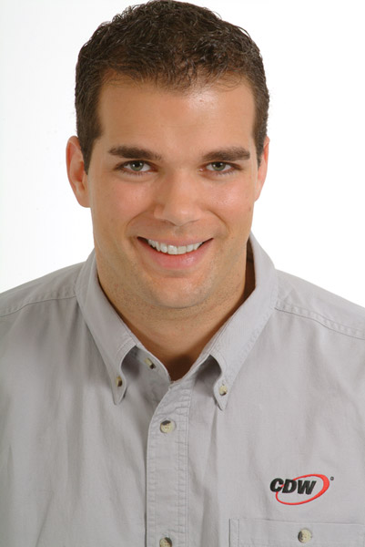
The Personal Selling Process
Steps in the Personal Selling Process
Handling objections is the process where salespeople resolve problems that are logical, psychological, or unspoken
Notes:
Note to Instructor
When handling objections from buyers, salespeople should:
Be positive
Seek out hidden objections
Ask the buyer to clarify any objections
Take objections as opportunities to provide more information
Turn objections into reasons for buying

Slide 29
The Personal Selling Process
Steps in the Personal Selling Process
Closing is the process where salespeople should recognize signals from the buyer—including physical actions, comments, and questions—to close the sale
Notes:
Note to Instructor
Discussion Question
How does a salesperson can close a sale?
Closing techniques can include:
Asking for the order
Reviewing points of agreement
Offering to help write up the order
Asking if the buyer wants this model or another one
Making note that the buyer will lose out if the order is not placed now
Offering incentives to buy, including lower price or additional quantity

Slide 30
The Personal Selling Process
Steps in the Personal Selling Process
Follow-up is the last step in which the salesperson follows up after the sale to ensure customer satisfaction and repeat business

Slide 31
The Personal Selling Process
Personal Selling and Managing Customer Relationships
Personal selling is transaction-oriented to close a specific sale with a specific customer
The long-term goal is to develop a mutually profitable relationship

Slide 32
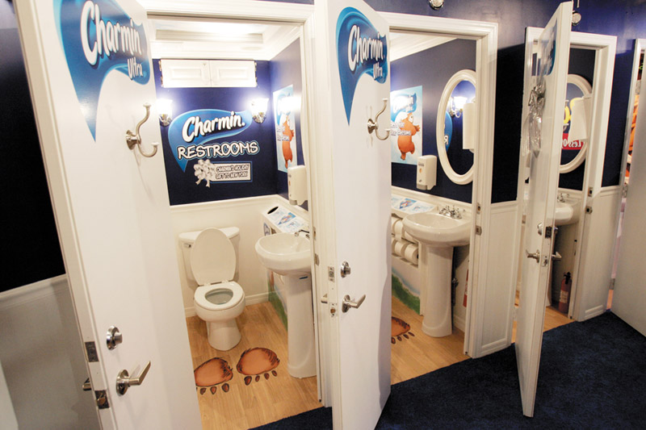
Sales Promotion
Sales promotion refers to the short-term incentives to encourage purchases or sales of a product or service:
  Consumer promotions
  Trade promotions
  Sales force promotions
Notes:
Note to Instructor
This is a Web link to promomagazine.com. It is worth exploring with the students as it give excellent current examples of promotions.

Slide 33
Sales Promotion
Rapid Growth of Sales Promotions
Product managers are under pressure to increase current sales
Companies face more competition
Competing brands offer less differentiation
Advertising efficiency has declined due to rising costs, clutter, and legal constraints
Consumers have become more deal-oriented

Slide 34
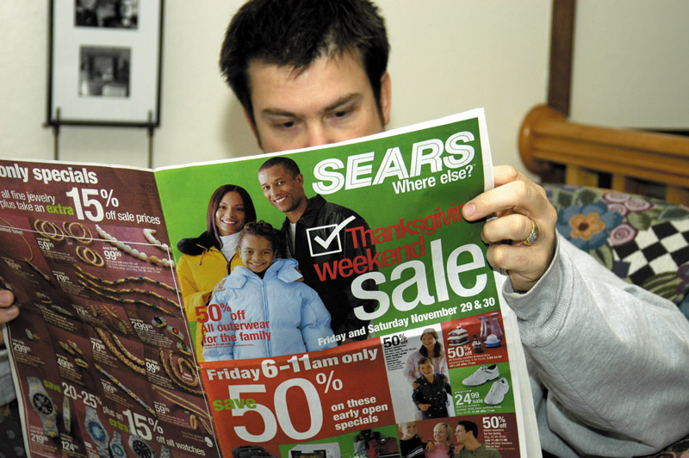
Sales Promotion
Sales Promotion Objectives
Setting sales promotion objectives includes using:
  Consumer promotions
  Trade promotions
  Sales force promotions
Notes:
Note to Instructor
Consumer promotion objectives:
Urge short-term customer buying
Enhance long-term customer relationships
Trade promotions urge retailers to:
Carry new items or more inventory
Buy in advance
Advertise company products
Get more shelf space
Sales force objectives include getting:
More sales force support for new or current products
Salespeople to sign up new accounts

Slide 35
Sales Promotion
Major Sales Promotion Tools

Slide 36
Sales Promotion
Major Sales Promotion Tools
Consumer Promotion Tools
Samples offer a trial amount of a product
Coupons are certificates that give buyers a saving when they purchase specified products
Cash refunds are similar to coupons except that the price reduction occurs after the purchase
Price packs offer consumers savings off the regular price of a product

Slide 37
Sales Promotion
Major Sales Promotion Tools
Consumer Promotion Tools
Premiums are goods offered either for free or at a low price
Advertising specialties are useful articles imprinted with the advertiser’s name, logo, or message that are given as gifts to consumers
Point-of-purchase promotions include displays and demonstrations that take place at the point of sales

Slide 38
Sales Promotion
Major Sales Promotion Tools
Consumer Promotion Tools
Contests, sweepstakes, and games give consumers the chance to win something—such as cash, trips, or goods—by luck or through extra effort
Contests require an entry by a consumer
Sweepstakes require consumers to submit their names for a drawing
Games present consumers with something that may or may not help them win a prize
Event marketing
Notes:
Note to Instructor
Event marketing is on the rise. The text gives an example of Charmin:
P&G recently sponsored a holiday event promotion for its Charmin brand in New York’s Times Square, where it can be very difficult to find a public restroom. For the second year running, P&G set up 20 sparkling clean Charmin-themed mini-bathrooms, each with its own sink and a bountiful supply of Charmin. The event turned out to be the ultimate in experiential marketing—touching people in places advertising wouldn’t dare to go. More than 420,000 people gratefully used the facilities and privately voted for the Charmin they preferred (Charmin Ultra Soft or Ultra Strong).

Slide 39
Sales Promotion
Major Sales Promotion Tools
Trade Promotion Tools
Notes:
Note to Instructor
Trade promotion tools persuade resellers to:
Carry a brand
Give the brand more shelf space
Promote the brand in advertising
Push the brand to consumers

Slide 40
Sales Promotion
Major Sales Promotion Tools
Business Promotion Tools
Conventions and trade shows are effective to reach many customers not reached with the regular sales force
Sales contests are effective in motivating salespeople or dealers to increase performance over a given period
Notes:
Note to Instructor
Business promotion tools are used to:
Generate leads
Stimulate purchases
Reward customers
Motivate salespeople
This Web link is to the International Boston Seafood show which is held annually for three days in Boston. It is worth exploring this sight to learn more about the trade show industry.

Slide 41
Sales Promotion
Developing the Sales Promotion Program
Size of the incentive
Conditions for participation
Promote and distribute the program
Length of the program
Evaluation of the program

Slide 42
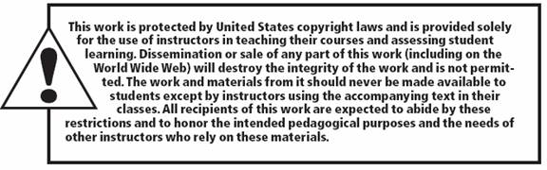
All rights reserved. No part of this publication may be reproduced, stored in a retrieval system, or transmitted, in any form or by any means, electronic, mechanical, photocopying, recording, or otherwise, without the prior written permission of the publisher. Printed in the United States of America.
Copyright © 2012 Pearson Education, Inc.
Publishing as Prentice Hall

