Slide 1

Chapter 10
Audit Evidence and Working Papers
Internal Audit (ACCT 337)
Internal Audit & Risk Management
ACCT 337

Slide 2
Introduction
Gathering and documenting audit evidence is a very significant component of all internal audit engagements.
The quality of internal auditors’ conclusions and advice depends on their ability to gather and appropriately evaluate sufficient appropriate audit evidence.
Audit procedures are performed throughout the audit process to gather the evidence needed to achieve the prescribed engagement objectives.
Audit working papers, which serve as the principal record of the procedures completed, evidence obtained, conclusions reached, and recommendations formulated by the internal auditors assigned to an engagement (that is, the internal audit team).
The working papers also serve as the primary support for the internal audit team’s communications to the auditee, senior management, the board of directors, and other stakeholders.

Slide 3
Practical Example: Employee Attendance and Swipe Card Audit
"Imagine you are the internal auditor of a company, and the management has asked you to provide assurance as to whether employees are following the company’s attendance policies. The objective of this engagement is to assess the accuracy, effectiveness, and compliance of the swipe card system in managing employee attendance and supporting payroll processes. How would you gather evidence to check this?"

Slide 4

What is Audit Evidence in Internal Audit?
Audit evidence in internal audit refers to the information gathered by an internal auditor to evaluate the effectiveness, efficiency, and compliance of an organization’s processes, systems, and controls.
It serves as the foundation for internal audit findings, conclusions, and recommendations, ensuring that issues are addressed, risks are mitigated, and objectives are achieved.
Internal auditors rely extensively on seasoned, professional judgment when they formulate conclusions and advice based on evidence they gather and evaluate.
The quality of internal auditors’ conclusions and advice depends on their ability to gather and evaluate sufficient appropriate evidence to support their conclusions and advice.

Slide 5

Professional Skepticism and Reasonable Assurance (1/2)
Professional Skepticism: IAs take nothing for granted
Open-minded
Critically assess audit evidence
Auditee: honest or dishonest?
Reasonable Assurance: level of assurance that is supported by generally accepted auditing procedures and judgements.
Reasonable not absolute
Persuasive rather than asbolutely convincing audit evidence

Slide 6
Professional Skepticism and Reasonable Assurance (2/2)
The internal auditor must always remember to apply a healthy level of professional skepticism when evaluating audit evidence.
  Professional skepticism means that internal auditors take nothing for granted; they continuously question what they hear and see and critically assess audit evidence. They do not assume by default that auditee personnel are either honest or dishonest.
  Applying professional skepticism throughout the engagement helps internal auditors remain unbiased and maintain an open mind to form judgments based on the preponderance of evidence gained during an engagement
Internal auditors are rarely, if ever, in a position to provide absolute assurance regarding management’s assertions regarding the system of internal controls and performance.
Reasonable assurance refers to the level of confidence that internal auditors can provide to stakeholders that the organization's objectives are being achieved, risks are effectively managed, and controls are functioning as intended.
  Internal auditors’ conclusions and advice must be formed at a reasonable cost within a reasonable length of time to add economic value. Accordingly, internal auditors strive to obtain sufficient appropriate evidence to provide a reasonable basis for formulating conclusions and advice.

Slide 7
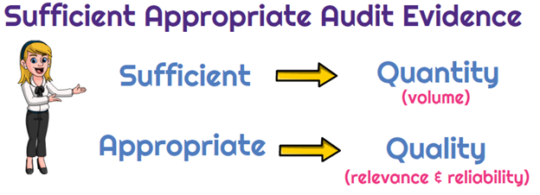
Persuasiveness of Audit Evidence
Audit evidence is persuasive if it enables the internal auditor to formulate well-founded conclusions and advice confidently. To be persuasive, evidence must be:
  Relevant: Is the evidence pertinent to the audit objective? Does it logically support the internal auditor’s conclusion or advice?
  Reliable: Did the evidence come from a credible source? Did the internal auditor directly obtain the evidence?
  Sufficient: Has the internal auditor obtained enough evidence? Do different, but related, pieces of evidence corroborate each other?
Audit Risk: The risk of reaching invalid audit conclusions and/or providing faulty advice based on the audit work conducted. Audit risk arises when the evidence is insufficient, irrelevant, or unreliable.

Slide 8
Practical Example: Employee Attendance and Swipe Card Audit (Persuasiveness of Audit Evidence)
Relevance:
  Reviewing swipe card logs is relevant to the objective of verifying attendance compliance.
  Reviewing unrelated data, like employee performance reviews, is irrelevant.
Reliability:
  System-generated logs from a secured attendance system are reliable.
  Employee-reported hours without supporting documentation are less reliable.
Sufficiency:
  Reviewing attendance logs for one department or one week is insufficient.
  Examining logs for multiple departments over several months ensures sufficiency.
Appropriateness:
  System-generated logs verified through observation and system testing are both relevant and reliable, making them appropriate.
Audit Risk:
  If the auditor bases their conclusions solely on unreliable verbal evidence or insufficient sampling, they increase the risk of reaching invalid conclusions and providing faulty advice.

Slide 9
Relevance
Evidence is considered relevant if it directly pertains to the audit objectives and helps address the audit question being examined. It must logically support the auditor’s conclusions.
Example: Assume that an internal auditor wants to determine whether a particular vehicle included in the company’s fixed asset ledger exists and is owned by the company. The internal auditor locates the vehicle in the company’s parking lot. Can the internal auditor reasonably conclude that the vehicle exists just by seeing it? Yes. Can the internal auditor reasonably conclude that the company owns the vehicle just by seeing it? No. The internal auditor would need to inspect pertinent documentary evidence, such as a title of ownership.

Slide 10
Reliability & Sufficiency (1/2)
Evidence is reliable if it is trustworthy and credible. The reliability of evidence depends on its source, the method of collection, and whether it is free from bias or error.
Factors Affecting Reliability:
  Source: Evidence from independent external sources is more reliable than internal sources.
  Method of Collection: Evidence directly obtained by the auditor (e.g., observation or reperformance) is more reliable than evidence indirectly obtained from the auditee.
  Type of Evidence: Documentary evidence (e.g., system-generated logs) is generally more reliable than verbal explanations or testimonials.
  Example:
  A bank confirmation obtained directly by the auditor from the bank is highly reliable.
  A verbal statement from an employee explaining attendance discrepancies is less reliable.
Evidence is considered sufficient when enough evidence has been gathered to support the auditor’s conclusions. Sufficiency focuses on the quantity of evidence, ensuring that it is adequate to provide reasonable assurance.
Key Considerations:
  Is the sample size large enough to represent the population?
  Has evidence been collected from multiple sources to corroborate findings?
Example:
  Testing attendance logs for one week may not be sufficient to conclude whether attendance policies are consistently followed. Reviewing logs for multiple weeks or months increases sufficiency.

Slide 11
Reliability & Sufficiency (2/2)
Useful guidelines internal auditors can follow if they remember that guidelines are generally characterized by exceptions. Such guidelines include:
  Evidence obtained externally from independent third parties is more reliable than evidence obtained internally from auditee personnel.
  Evidence produced internally by a process or system with effective controls is more reliable than evidence produced by a process or system with ineffective controls.
  Evidence obtained directly by the internal auditor is more reliable than evidence obtained indirectly.
  Documented evidence is more reliable than undocumented evidence.
  Timely evidence is more reliable than untimely evidence.
  Corroborated evidence is more sufficient than uncorroborated or contradictory evidence.
  Larger samples produce more sufficient evidence than smaller samples.

Slide 12
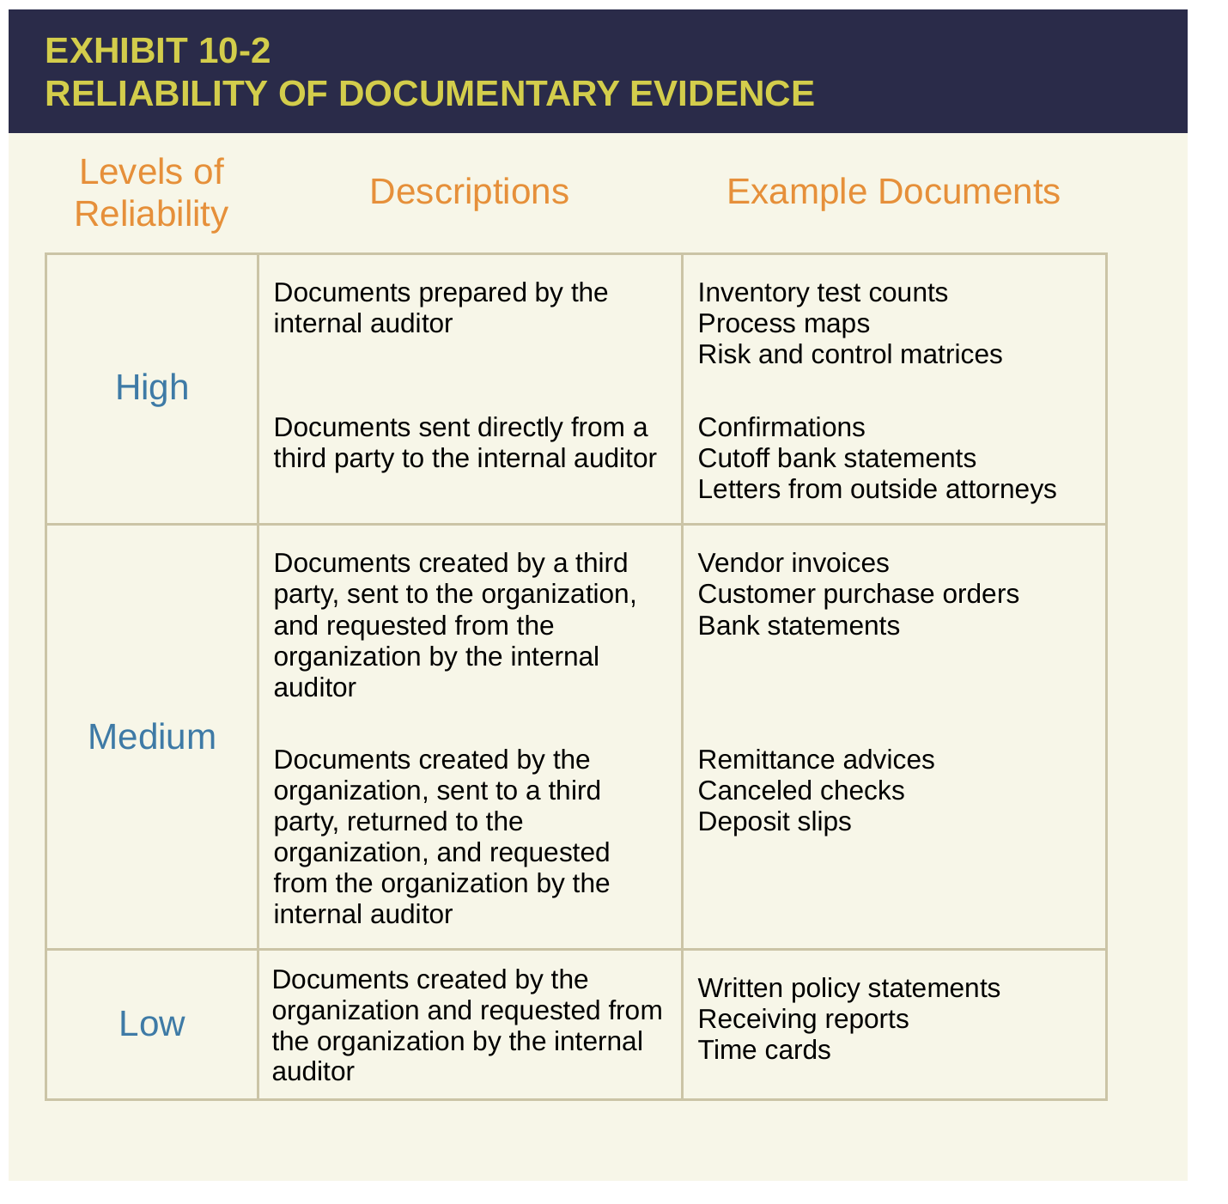

Slide 13
AUDIT PROCEDURES
Audit procedures are specific tasks performed by the internal auditor to gather the evidence required to achieve the prescribed audit objectives.
Obtaining sufficient appropriate audit evidence involves determining the following aspects for the audit procedures:
Determining three aspects for the audit procedures:
Nature
Extent
Timing

Slide 14
Nature of Audit Procedures
The nature of audit procedures relates to the types of procedures the internal auditor performs to gather evidence to achieve the engagement objectives.
In general, the internal auditor engages in:
  risk assessment procedures (to prioritize engagements)
  test of controls (to evaluate whether the process is well-managed and controls are functioning)
  substantive testing (to examine the records to verify accuracy and detect errors)
Depending on the nature of the engagement, an internal auditor may use manual audit procedures, computer-assisted audit techniques (CAATs), or a combination of the two to gather sufficient appropriate evidence.

Slide 15
Extent of Audit Procedures
The extent of audit procedures refers to the amount of evidence the internal auditor needs to collect to ensure the audit's objectives are met. It answers the question: "How much testing is enough?" (sufficiency).
The internal auditor might decide, for example, that some types of transactions should be tested 100 percent, whereas others may be tested on a sample basis.
The extent should be aligned with the risks, objectives, and population size to optimize efficiency and effectiveness.

Slide 16
Timing of Audit Procedures.
The timing of audit procedures pertains to when the tests are conducted and the period of time covered by the tests.
For example:
  An internal auditor testing the operating effectiveness of a manual control over a period of time on a sample basis must take appropriate steps to gain assurance that the sample selected is representative of the entire period.
  An internal auditor testing whether transactions are recorded in the appropriate fiscal year will focus his or her tests on transactions immediately before and after year-end.

Slide 17
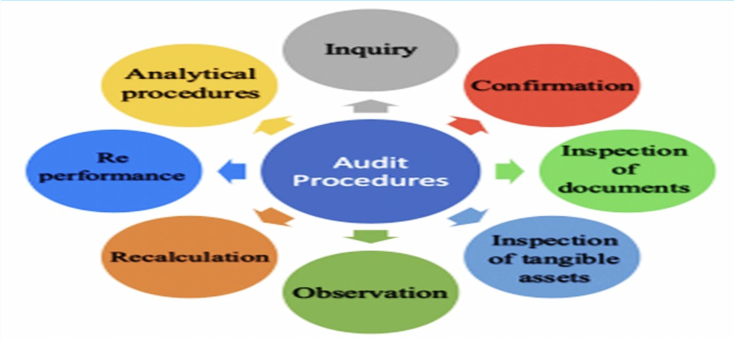
Audit Procedures

Slide 18
Scenario: Audit of Employee Attendance Management and Swipe Card System Controls- Audit Procedures
Reviewing swipe card logs = Inspection of Records/Documents
  Examine system-generated logs to verify clock-in and clock-out times for all employees.
Observing employees using the swipe card system = Observation
  Stand near the swipe card station during peak hours (e.g., start and end of the day) to ensure employees are using their own cards and not "buddy punching" (using someone else's card).
Inspecting swipe card devices and cards = Physical Inspection
  Check the card readers and sample employee cards for damage, tampering, or improper use.
Comparing swipe card data with payroll records = Analytical Procedures
  Analyze the attendance logs and compare them with payroll records to identify discrepancies between logged hours and paid hours.
Interviewing employees about the swipe card system = Inquiry
  Ask employees if they face any issues with the system, if it ever fails to register their attendance, or if they know of any misuse.
Testing the swipe card system = Reperformance
  Simulate swiping a card yourself or have a sample employee use the system to ensure it records attendance accurately.
Verifying leave applications = Inspection of Supporting Evidence
  Cross-check the attendance logs with leave requests to ensure that recorded absences align with approved leaves.
Recalculating total hours worked = Recalculation
  Manually calculate total hours worked for a sample of employees using the swipe card data and compare this with the system's calculations.
Walking through workstations = Physical Inspection
  During work hours, walk through the office to confirm that employees who swiped in are actually present and working at their stations.
Comparing with industry benchmarks = Analytical Procedures
  Compare the company's absenteeism and tardiness rates with industry standards to assess overall attendance performance.

Slide 19

Inquiry
Entails asking questions of auditee personnel or third parties and obtaining their oral or written responses.
Inquiry produces indirect evidence, which by itself is rarely persuasive.
This is especially true when inquiries are directed to auditee personnel from whom the internal auditor cannot count on receiving unbiased responses.
More formal types of inquiry include interviews and circulating surveys and questionnaires.

Slide 20

Observation
Entails watching people, procedures, or processes.
Observation is generally considered more persuasive than inquiry in the sense that the internal auditor is obtaining direct evidence.
For example, the internal auditor’s direct personal observation of an employee applying a control generally provides more assurance than simply asking the employee about the application of the control.
  Ex.: observe year end physical count
A significant limitation of observation is that it provides evidence at a certain time.

Slide 21

Inspection
Inspection entails studying documents and records and physically examining tangible resources.
  Ex.: inspection of selected inventory items
Inspection of documents and records provides direct evidence of their contents.
  Ex.: Reading Policies and procedures, inspecting invoices, purchase orders, receipts…
Likewise, physical examination of tangible resources (for example, a building or piece of equipment) provides the internal auditor with direct personal knowledge of the resources’ existence and physical condition.
However, for example, formulating valid conclusions about the value of precious gems based on inspection may be outside the scope of the internal auditor’s expertise. The internal auditor might, in this case, need to rely on the assistance of a precious gems expert to help validate the gems’ value.

Slide 22
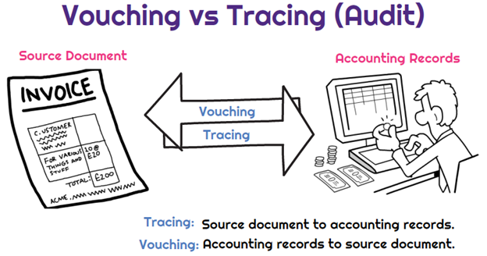
Vouching vs. Tracing
Existence/Occurrence/Validity
Testing for Overstatements
Completeness
Testing for Understatements

Slide 23
Vouching
Entails tracking information backward from one document or record to a previously prepared document or record, or to a tangible resource. Vouching is performed specifically to test the validity of documented or recorded information.
For example, a sale of goods typically should not be recorded unless the goods have been shipped. Vouching a sales invoice to a shipping document provides evidence that the shipment upon which the invoice is based actually occurred. Likewise, vouching the recording of a vehicle in the fixed asset ledger to the actual vehicle provides evidence that the vehicle really exists.
Within the context of financial audits, vouching is used to test for overstatements in recorded amounts.

Slide 24
Tracing
Entails tracking information forward from one document, record, or tangible resource to a subsequently prepared document or record.
Tracing is performed specifically to test the completeness of documented or recorded information.
For example, purchases of goods typically should be recorded when the goods are received. Tracing a receiving report for goods received near the end of the year to the accounting records provides evidence that both the asset and liability were recorded in the same year the goods were received.
Within the context of financial audits, tracing is used to test for understatements in recorded amounts.

Slide 25
Vouching vs. Tracing Example
You are auditing the purchase of office supplies worth $5,000, and you want to verify the transaction using vouching and tracing.
  Vouching: Start with the accounting record and check if it is backed by documents.
  Example: "Does the $5,000 in the ledger really exist?“
  You ask for: Invoice, Purchase Order and Receiving Report for this transaction.
  You cross-check the details in the source documents (vendor name, date, amount, description of items purchased) and compare it with the transaction.
  Tracing: Start with the documents and ensure they lead to the accounting record.
  Example: "Was the $5,000 purchase properly recorded?“
  You ask for: The receiving report
  You then check the accounting records to see whether the office supplies received were recorded.

Slide 26

Reperformance & Analytical Procedures
Reperformance
Redoing controls or other procedures
Reperforming a control provides direct audit evidence regarding its operating effectiveness. Reperforming calculations provides direct evidence as to whether the auditee’s calculations are correct.
  Reperforming controls: Bank Reconciliation, testing the system
  Reperforming calculations: Depreciation expense and Accumulated Depreciation
  Reperforming accounting estimates: Allowance for Doubtful Accounts
Analytical Procedures
Analytical procedures involve evaluating financial or operational information to assess the reasonableness of information by comparing it with expectations, trends, or benchmarks. These expectations can be derived from the auditor's knowledge, trends, historical data, or industry standards.
Examples:
  Analysis of common size FSs (vertical analysis): Example: If cost of goods sold consistently represents 40% of revenue but suddenly increases to 60%, this may indicate a problem.
  Ratio Analysis: Example: Comparing the current ratio over several years to assess short-term liquidity.
  Trend analysis (horizontal analysis): Example: Analyzing monthly sales revenue to detect a sudden drop in a typically strong sales period.
  Internal benchmarking: Example: Comparing production costs across different manufacturing plants.
  External benchmarking: Example: Comparing gross profit margins with competitors in the same sector.

Slide 27

Confirmations
Confirmations are requests sent to independent third parties (e.g., banks, customers, or legal counsel) to obtain direct written verification the accuracy of information that is relevant to the audit.
Ex:
  Bank: Cash Balance
  Customer: A/R balance
  Legal Counsel: Status of ongoing legal cases, potential liabilities, likelihood of financial losses.
3 Types of Confirmations
  Positive Confirmations:
    Definition: The recipient is asked to respond whether they agree or disagree with the information provided in the confirmation request.
    Purpose: Provides strong evidence because the auditor receives a direct response.
    Example: A bank is asked to confirm the balance in a client’s account, whether it matches the figure provided or not.
  Negative Confirmations:
    Definition: The recipient is asked to respond only if they disagree with the information provided.
    Purpose: Used when the risk of material misstatement is low and the population is large.
    Example: Customers are asked to confirm accounts receivable balances, but they only reply if the balance is incorrect.
  Blank Confirmations:
    Definition: The recipient is asked to provide the requested information without being given a pre-filled amount.
    Purpose: Reduces the risk of the recipient simply agreeing with incorrect information but requires more effort on the recipient’s part.
    Example: Instead of providing the customer with a pre-filled accounts receivable balance, the auditor asks them to state the balance they owe.

Slide 28

Computer-Assisted Audit Techniques (CAAT)
“In exercising due professional care, internal auditors must consider the use of technology-based audit and other data analysis techniques.” (Standard 1220.A2)
Example: An internal auditor uses generalized audit software to directly test whether any duplicate payments of invoices exist in the company’s cash disbursements transaction file. The internal auditor uncovers several duplicate payments made throughout the year. The internal auditor may correctly infer that controls to prevent and/or detect such payments on a timely basis did not exist, were designed inadequately, or did not operate effectively.
The two most widely used, commercially available, audit software programs are ACL and CaseWare IDEA.

Slide 29

WORKING PAPERS
IIA Standard 2330: Documenting Information requires internal auditors to record the evidence they accumulate as support for engagement outcomes.
Implementation Guide 2330: Documenting Information provides supplemental guidance regarding properly preparing and documenting information in the internal auditor’s working papers.

Slide 30
Types of Working Papers
A wide variety of working papers are prepared during an internal audit engagement.
The following list is intended to be illustrative rather than all-inclusive:
  Work programs used to document the nature, extent, and timing of the specific audit procedures.
  Engagement time budgets and resource allocation worksheets.
  Questionnaires used to obtain information about the auditee, including its objectives, risks, controls, operating activities, etc.
  Process maps or flowcharts used to document process activities, risks, and controls.
  Narrative memoranda used to document the results of interviews and other meetings with auditees.
  Copies of source documents, such as purchase requisitions, purchase orders, receiving reports, vendor invoices, vouchers, and checks.
  Evidence obtained from third parties, such as confirmation responses from customers and representations from outside legal counsel.
  Other types of working papers prepared by the internal auditor that reflect work performed (for example, analytical procedures, computerized data analysis, and direct tests of transactions, events, account balances, and performance measurements).
  Copies of other important documents, such as minutes of meetings and contracts

Slide 31
Guidelines for Working Paper Preparation
The chief audit executive (CAE) is responsible for establishing working paper policies and procedures.
Standardized working paper formats help to streamline the audit process and facilitate consistent, high-quality work across engagements.
Working paper files should be complete and well-organized. (reference number, signed & dated)

Slide 32
End of Chapter

