Slide 1
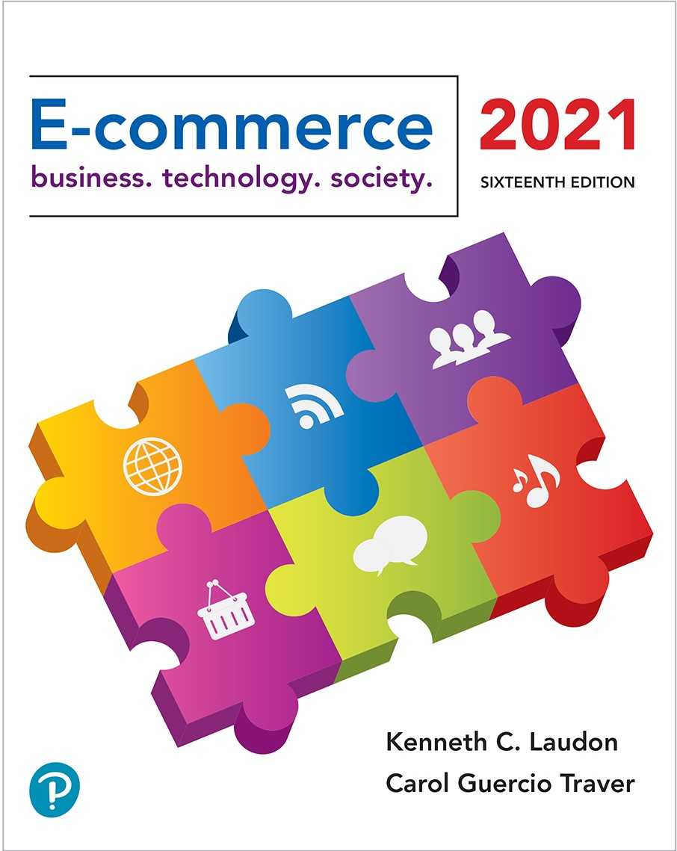

E-commerce 2021: Business. Technology. Society.
Sixteenth Edition
Chapter 6
E-commerce Marketing and Advertising Concepts
Copyright © 2022, 2019, 2018 Pearson Education, Inc. All Rights Reserved
Notes:
If this PowerPoint presentation contains mathematical equations, you may need to check that your computer has the following installed:
1) MathType Plugin
2) Math Player (free versions available)
3) NVDA Reader (free versions available)

Slide 2
Learning Objectives
6.1 Understand the key features of the Internet audience, the basic concepts of consumer behavior and purchasing, and how consumers behave online.
6.2 Identify and describe the basic digital commerce marketing and advertising strategies and tools.
6.3 Identify and describe the main technologies that support online marketing.
6.4 Understand the costs and benefits of online marketing communications.

Slide 3
Video Ads: Shoot, Click, Buy
Class Discussion
  What advantages do video ads have over traditional banner ads?
  Where do sites such as YouTube fit into a marketing strategy featuring video ads?
  What are some of the challenges and risks of placing video ads online?
  Do you think Internet users will ever develop “blindness” toward video ads as they have towards display ads?

Slide 4
Consumers Online: The Internet Audience and Consumer Behavior (1 of 3)
Around 290 million in the U.S. have Internet access in 2020
Growth rate has slowed
Intensity and scope of use both increasing
Some demographic groups have much higher percentages of online usage
  Income, education, age, ethnic dimensions
  A roughly equal percentage of men (88%) and women (85%) in the United States use the Internet today.
  Young adults (18–24) at over 98, teens (12–17) at 97%. , Adults in the 25–54 over 90%, Another fast-growing group online is the 65 and over segment, about 70% , The percentage of very young children (0–11 years) about 68%.
  About 98% of U.S. households with income levels above $75,000 used the Internet, compared to only 82% of households earning less than $30,000.
  Of those individuals with less than a high school education, only 71% went online in 2019, compared to 98% of individuals with a college degree or more.

Slide 5
Consumers Online: The Internet Audience and Consumer Behavior (2 of 3)
Broadband and mobile
  Significant inequalities in broadband access
  Older adults, lower income, lower educational levels
  Non-broadband household still accesses Internet via mobile or other locations
Community effects
For a physical retail store, the most important factor in shaping sales is location,
  Role of social emulation in consumption decisions
  “Connectedness”: so-called neighborhood effects
    Top 10-15% are more independent, iconoclasts.
    Middle 50% share more purchase patterns of friends keeping up with the Joneses.
  Recommender systems - co-purchase networks

Slide 6
Consumers Online: The Internet Audience and Consumer Behavior (3 of 3)
Consumer behavior models
  Study of consumer behavior; social science discipline that attempts to model and understand the behavior of humans in a marketplace
  Attempt to predict or explain wide range of consumer decisions
  Based on background demographic factors and other intervening, more immediate variables
  Research online, followed by purchase offline (sometimes referred to as ROPO or webrooming),
  Showrooming effect where consumers shop in stores and then purchase online. T
Profiles of online consumers
  Consumers shop online primarily for convenience: produced largely by saving them time. Overall transaction cost reduction appears to be a major motivator for choosing the online channel

Slide 7
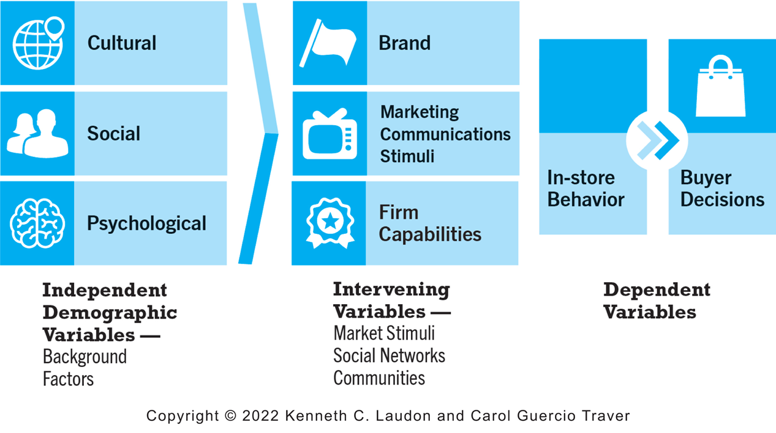
Figure 6.1 A General Model of Consumer Behavior
Notes:
Figure 6.1, Page 350.
Consumer behavior models try to predict the decisions that consumers make in the marketplace.
SOURCE: Based on Kotler and Armstrong, Principles of Marketing, 13e, 2009, Pearson Education.
Alt Text
Long description: An illustration depicts a general model of consumer behavior, as follows: Independent demographic variables such as cultural, social, and psychological variables are background factors. Intervening variables include brand, marketing communications stimuli and firm capabilities, and include other market stimuli, social networks, and communities. Dependent variables include in store behavior and buyer decisions.

Slide 8
The Online Purchasing Decision (1 of 2)
Purchasing Decision: why do consumers actually purchase a product or service at a specific site?
Five stages in consumer decision process
  Awareness of need
  Search for more information
  Evaluation of alternatives
  Actual purchase decision
  Post-purchase contact with firm

Slide 9
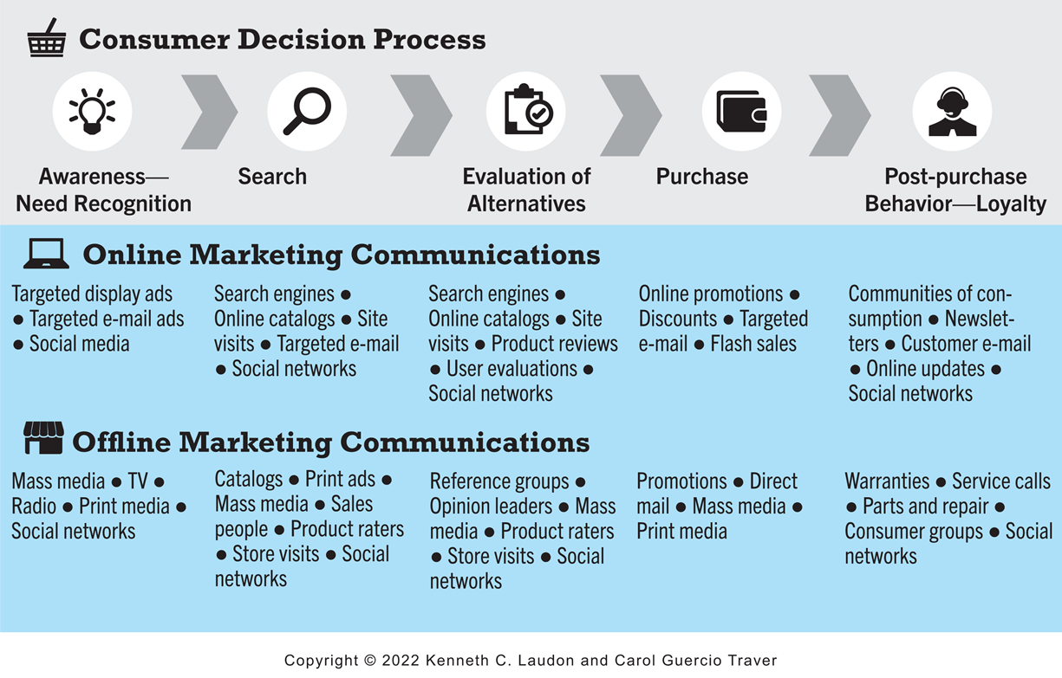
Figure 6.2 The Consumer Decision Process and Supporting Communications
Notes:
Figure 6.2, Page 351.
Alt Text
Long description: An illustration depicts the consumer decision process and supporting communications, as follows: The consumer decision process begins with awareness and need recognition, then search, then evaluation of alternatives, then purchase, and then post purchase behavior or loyalty. Online marketing communications tools supporting awareness and need recognition include targeted display ads, targeted e mail ads, and social media. Offline marketing communications supporting awareness and need recognition include mass media, T V, radio, print media, and social networks. Online marketing communications supporting search include search engines, online catalogs, site visits, targeted e mail, and social networks. Offline marketing communications supporting search include catalogs, print ads, mass media, salespeople, product raters, store visits, and social networks. Online marketing communications supporting evaluation of alternatives include search engines, online catalogs, site visits, product reviews, user evaluations, and social networks. Offline marketing communications supporting evaluation of alternatives include reference groups, opinion leaders, mass media, product raters, store visits, social networks. Online marketing communications supporting purchase include online promotions, discounts, targeted e mail, and flash sales. Offline marketing communications supporting purchase include promotions, direct mail, mass media, and print mail. Online marketing communications supporting post purchase behavior include communities of consumption, newsletters, customer e mail, online updates, and social networks. Offline communications for supporting post purchase behavior include warranties, service calls, parts and repair, consumer groups, social networks.

Slide 10
The Online Purchasing Decision (2 of 2)
Decision process similar for online and offline behavior
General online behavior model
  User characteristics
  Product characteristics
  Website features: latency, usability, security
  Attitudes toward online purchasing
  Perceptions about control over Web environment
Clickstream behavior: the transaction log that consumers establish as they move about the Web

Slide 11
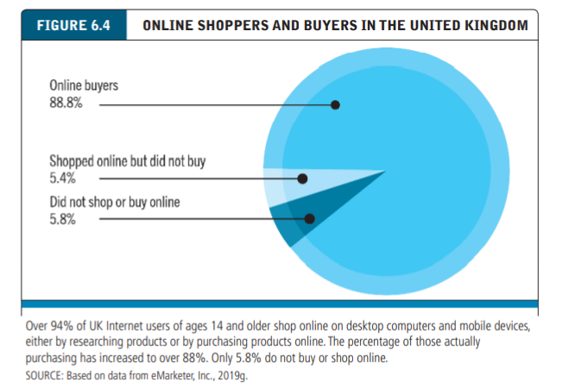
SHOPPERS: BROWSERS AND BUYERS

Slide 12
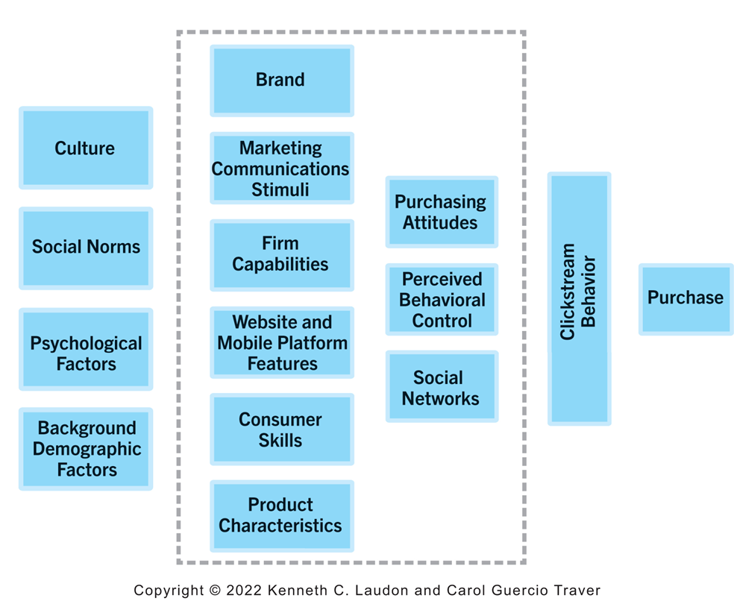
Figure 6.3 A Model of Online Consumer Behavior
Website and mobile platform features include latency (delay in downloads), navigability, and confidence in online security.
Consumer skills refers to the knowledge that consumers have about how to conduct online transactions
Product characteristics refers to the fact that some products can be easily described, packaged, and shipped online, whereas others cannot
Notes:
Figure 6.3, Page 352.
In this general model of online consumer behavior, the decision to purchase is shaped by background demographic factors, several intervening factors, and, finally, influenced greatly by clickstream behavior very near to the precise moment of purchase.
Alt Text
Long description: An illustration depicts a model of online consumer behavior, as follows: Background factors include culture, social norms, psychological factors and background demographic factors. Intervening factors include brand, marketing communications stimuli, firm capabilities, website and mobile platform features, consumer skills, product characteristics, purchasing attitudes, perceived behavioral control, and social networks. The final influence is clickstream behavior near to the precise moment of purchase.

Slide 13
Shoppers: Browsers and Buyers
Shoppers: Over 92% of Internet users
  Over 82% are buyers
  Around 10% are browsers (purchase offline)
Online research influenced about $2.6 trillion of retail purchases in 2018
Online traffic also influenced by offline brands and shopping
E-commerce and traditional commerce are coupled: Part of a continuum of consuming behavior

Slide 14
What Consumers Shop for and Buy Online
Big ticket items ($1000 or more)
  Travel, computer hardware, electronics
  Consumers now more confident in purchasing costlier items
Small ticket items ($100 or less)
  Apparel, books, office supplies, software, etc.
Sales of bulky goods, furniture and large appliances, rapidly expanding

Slide 15
How Consumers Shop
How shoppers find online vendors
  Highly intentional, goal-oriented
  Search engines
  Marketplaces (Amazon, e Bay)
  Specific retail site
About 7.5% of Internet users don’t shop online
  Trust factor (fear that online merchants will cheat you, lose your credit card information, or use personal information you give them to invade your personal privacy, bombarding you with unwanted e-mail and pop-up ads)
  Hassle factors (shipping costs, returns, etc.)

Slide 16
Trust, Utility, and Opportunism in Online Markets
Two most important factors shaping decision to purchase online:
  Utility:
    Better prices, convenience, speed
  Trust:
    Perception of credibility, ease of use, perceived risk
    Sellers develop trust by building strong reputations for honesty, fairness, delivery

Slide 17
Digital Commerce Marketing and Advertising: Strategies and Tools
Features of Internet marketing (versus traditional)
  More personalized
  More participatory
  More peer-to-peer
  More communal
The most effective Internet marketing has all four features

Slide 18
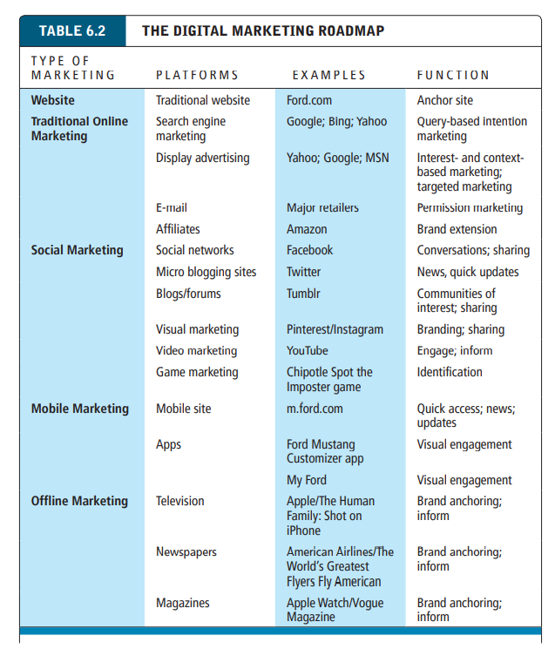
Multi-Channel Marketing Plan
Website
Traditional online marketing
  Search engine, display, e-mail, affiliate
Social marketing
  Social networks, blogs, video, game
Mobile marketing
  Mobile/tablet sites, apps
Offline marketing
  Television, radio, newspapers

Slide 19
Strategic Issues and Questions
Which part of the marketing plan should you focus on first?
How do you integrate the different platforms for a coherent message?
How do you allocate resources?
  How do you measure and compare metrics from different platforms?
  How do you link each to sales revenues?

Slide 20
Establishing the Customer Relationship
Website functions to:
  Establish brand identity and customer expectations
    Differentiating product: involves identifying for the consumer the differentiating features of the product or service in terms of quality, price, product support, and reliability.
    Identifying the differentiating features of the product on the website’s home page is intended to create expectations in the user of what it will be like to consume the product
  Anchor the brand online
    Central point for all marketing messages
  Inform and educate customer
  Shape customer experience: the totality of experiences that a customer has with a firm, including the search, informing, purchase, consumption, and after sales support for its products, services, and various retail channel

Slide 21
Online Marketing and Advertising
Online advertising: a paid message on a website, online service, or other interactive medium
  Display, search, mobile messaging, sponsorships, classifieds, lead generation, e-mail
  Advantages:
    Best way to reach the 18-to-34-year-old audience
    Ad targeting: the sending of market messages to specific subgroups in the population
    Price discrimination
    Personalization
  The primary disadvantages of online advertising are concerns about its cost versus its benefits, how to adequately measure its results, and the supply of good venues to display ads.

Slide 22
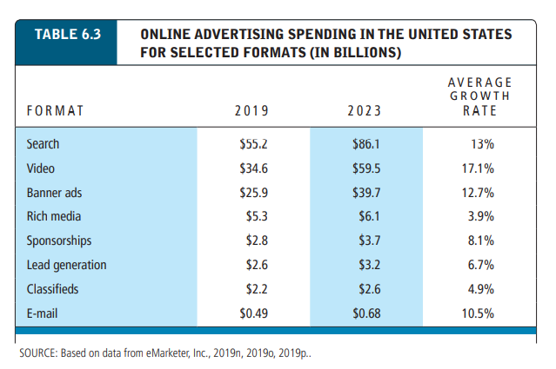
Online Marketing and Advertising

Slide 23
Traditional Online Marketing and Advertising Tools
Search engine marketing and advertising
  SEM: involves the use of search engines to build and sustain brands
  Search engine advertising: involves the use of search engines to support direct sales to online
Display ad marketing (including video ads)
E-mail marketing
Affiliate marketing: commissions paid by advertisers to affiliate websites for referring potential customers to their website
Viral marketing: the process of getting customers to pass along a company’s marketing message to friends, family, and colleagues
Lead generation marketing: uses multiple e-commerce presences to generate leads for businesses who later can be contacted and converted into customers

Slide 24
Search Engine Marketing and Advertising
Search engine marketing (S E M)
Search engine advertising
Types of search engine advertising
  Organic search: inclusion and ranking of sites depends on a more or less unbiased application of a set of rules imposed by the search engine
  Paid inclusion: for a fee, guarantees a website’s inclusion in its list of sites, more frequent visits by its web crawler, and suggestions for improving the results of organic searching
  Pay-per-click (P P C) search ads: primary type of search engine advertising
    Keyword advertising: merchants purchase keywords through a bidding process at search sites, and whenever a consumer searches for that word, their advertisement shows up somewhere on the page
    Google’s keyword advertising program is called Google Ads (formerly AdWords)
    Network keyword advertising (context advertising): publishers accept ads placed by Google on their websites, and receive a fee for any click-throughs from those ads

Slide 25
Search Engine Marketing and Advertising (2 of 2)
Search engine optimization (S E O): techniques to improve the ranking of web pages generated by search engine algorithms
Google search engine algorithms
Social search
  Utilizes social contacts and social graph to provide fewer and more relevant results
Search engine issues
  Paid inclusion and placement practices
  Link farms: groups of websites that link to one another, thereby boosting their ranking in search engines
  content farms: companies that generate large volumes of textual content for multiple websites designed to attract viewers and search engines
  Click fraud: occurs when a competitor clicks on search engine results and ads, forcing the advertiser to pay for the click even though the click is not legitimate

Slide 26
Display Ad Marketing (1 of 2)
Banner ads: displays a promotional message in a rectangular box at the top or bottom of a computer screen
Rich media ads: ad employing interactive features that engage the user
  Interstitial ads:
Video ads: TV-like advertisement that appears as an in-page video commercial or before, during, or after content
  Far more effective than other display formats
Sponsorships: a paid effort to tie an advertiser’s name to information, an event, or a venue in a way that reinforces its brand in a positive yet not overtly commercial manner
Native advertising: advertising that looks similar to editorial content

Slide 27
Display Ad Marketing (2 of 2)
Content marketing
Advertising networks
Ad exchanges, programmatic advertising, and real-time bidding (R T B)
Display advertising issues
  Ad fraud
  Viewability
  Ad blocking

Slide 28
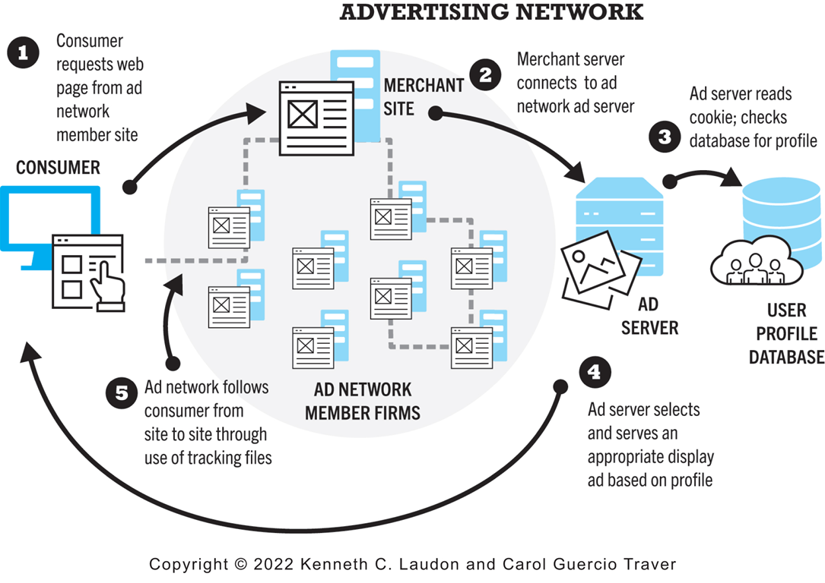
Figure 6.6 How an Advertising Network Works
Notes:
Figure 6.6, Page 370.
Millions of publishers have audiences to sell, and pages to fill with ads. Thousands of advertisers are looking for audiences. Ad networks are intermediaries that connect publishers with marketers.
Alt Text
Long description: An illustration depicts how an advertising network works, as follows: Step 1, consumer requests web page from ad network member site. 2, merchant server connects to ad network ad server. 3, ad server reads cookie, checks database for profile. 4, ad server selects and serves an appropriate display ad based in profile. 5, ad network follows consumer from site to site through use of tracking files.

Slide 29
E-mail Marketing
Direct e-mail marketing
  Messages sent directly to interested users
  Benefits include
    Inexpensive
    Average around 3% to 4% click-throughs
    Measuring and tracking responses
    Personalization and targeting
Three main challenges
  Spam
  Anti-spam software
  Poorly targeted purchased e-mail lists

Slide 30
Spam
Unsolicited commercial e-mail
Around 55% of all e-mail in 2020
Most originates from bot networks
Efforts to control spam have largely failed:
  Government regulation (C A N-S P A M Act)
  State laws
  Voluntary self-regulation by industries (D M A)
  Canada’s stringent anti-spam laws

Slide 31
Other Types of Traditional Online Marketing
Affiliate marketing
  Commission fee paid to other websites for sending customers to their website
Viral marketing
  Marketing designed to inspire customers to pass message to others
Lead generation marketing
  Services and tools for collecting, managing, and converting leads

Slide 32
Social, Mobile, and Local Marketing and Advertising
Social marketing and advertising
  Use of online social networks and communities
Mobile marketing and advertising
  Use of mobile platform
  Influence of mobile apps
Local marketing
  Geotargeting
  Display ads in hyperlocal publications
  Coupons

Slide 33
Multi-Channel Marketing
Integration of online and offline marketing
Increasing percentage of American media consumers use several media at once
Reinforce branding messages across media
Most effective multi-channel campaigns use consistent imagery across media

Slide 34
Insight on Business: Are the Very Rich Different From You and Me?
Class Discussion
  What distinguishes luxury marketing from ordinary retail marketing?
  What challenges do luxury retailers have in translating their brands and the look and feel of luxury shops into Web sites?
  How has social media affected luxury marketing?
  Visit the Net-a-Porter website. What do you find there?

Slide 35
Other Online Marketing Strategies
Customer retention strategies
  One-to-one marketing (personalization)
  Behavioral targeting (interest-based advertising)
  Retargeting
Customization and customer co-production
Customer service
  F A Q s
  Real-time customer service chat systems
  Automated response systems

Slide 36
Pricing Strategies (1 of 2)
Pricing: integral part of marketing strategy
Traditional pricing based on fixed costs, variable costs, demand curve
  Marginal costs
  Marginal revenue
Piggyback strategy
Price discrimination

Slide 37
Pricing Strategies (2 of 2)
Free and freemium
Versioning
Bundling
Dynamic pricing
  Auctions
  Yield management
  Surge pricing
  Flash marketing

Slide 38
Long Tail Marketing
Internet allows for sales of obscure products with little demand
Substantial revenue because
  Near zero inventory costs
  Little marketing costs
  Search and recommendation engines

Slide 39
Insight on Technology: The Long Tail: Big Hits and Big Misses
Class Discussion
  What are recommender systems? Give an example of one you have used.
  What is the Long Tail and how do recommender systems support sales of items in the Long Tail?
  How can human editors, including consumers, make recommender systems more helpful?

Slide 40
Internet Marketing Technologies
Internet’s main impacts on marketing:
  Scope of marketing communications broadened
  Richness of marketing communications increased
  Information intensity of marketplace expanded
  Always-on mobile environment expands marketing opportunities

Slide 41
Web Transaction Logs
Built into web server software
Record user activity at website
Provides much marketing data, especially combined with:
  Registration forms
  Shopping cart database
Answers questions such as:
  What are major patterns of interest and purchase?
  After home page, where do users go first? Second?

Slide 42
Cookies and Tracking Files
Types of tracking files
  Cookies
  Flash cookies
  Web beacons (“bugs”)
  Tracking headers (supercookies)
Other tracking methods
  Deterministic cross-device tracking
  Probabilistic cross-device tracking
Becoming less useful due to Apple’s Intelligent Tracking Prevention and similar technologies

Slide 43
Insight on Society: Every Move You Make, Every Click You Make, We’ll Be Tracking You
Class Discussion
  Are beacons innocuous or are they an invasion of personal privacy?
  Do you think your web browsing should be known to marketers?
  Should online shopping be allowed to be a private activity?
  What impact may the California Privacy Protection Act have on D N T?

Slide 44
Databases
Enable profiling
Store records and attributes
Database management system (D B M S):
S Q L (Structured Query Language):
  Industry-standard database query and manipulation language used in a relational database
Relational databases

Slide 45
Data Warehouses and Data Mining
Data warehouse:
  Collects firm’s transactional and customer data in single location for offline analysis by marketers and site managers
Data mining:
  Analytical techniques to find patterns in data, model behavior of customers, develop customer profiles
Query-driven data mining
Model-driven data mining
Rule-based data mining

Slide 46
Hadoop and the Challenge of Big Data
Big data
  Petabyte, exabyte range
  Web traffic, e-mail, social media, content
  Traditional D B M S unable to process the increasing volume of data
Hadoop
  Open-source software framework
  Processes any type of data, even unstructured
  Distributed processing

Slide 47
Marketing Automation and Customer Relationship Management (C R M) Systems
Marketing automation systems
  Track steps in lead generation
C R M systems
  Manage relationship with customers once purchase is made
  Create customer profiles
Customer data used to:
  Develop and sell additional products
  Identify profitable customers
  Optimize service delivery, and so on

Slide 48
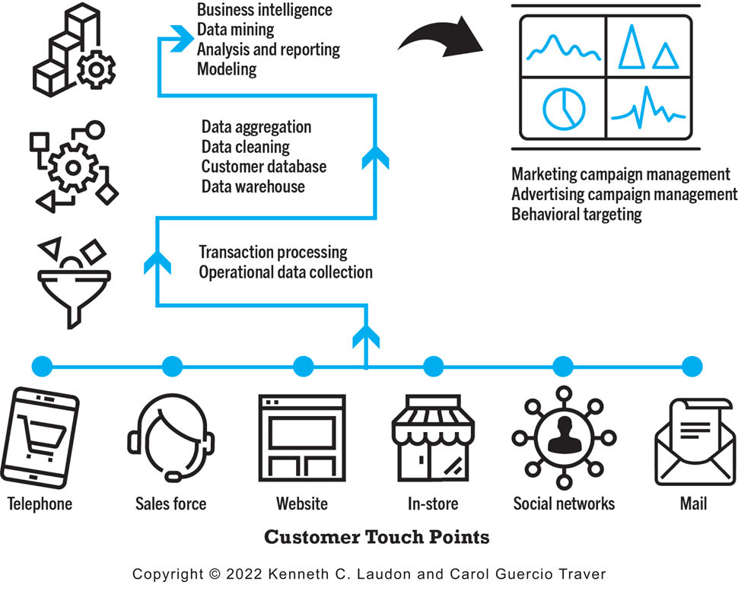
Figure 6.9 A Customer Relationship Management System
Notes:
Figure 6.9, Page 404.
This is an example of a CRM system. The system captures customer information from all customer touchpoints as well as other data sources, merges the data, and aggregates it into a single customer data repository or data warehouse where it can be used to provide better service, as well as to construct customer profiles for marketing purposes. Online analytical processing (OLAP) allows managers to dynamically analyze customer activities to spot trends or problems involving customers. Other analytical software programs analyze aggregate customer behavior to identify profitable and unprofitable customers as well as customer activities.
Alt Text
Long description: An illustration depicts a customer relationship management system, as follows: Customer touch points include the telephone, sales force, website, in store, social networks, and mail. The touch points generate the transaction processing and operational data collection, followed by data aggregation, data cleaning, and customer database and data warehouse, leading to business intelligence, data mining, analysis and reporting and modelling, which contributes to marketing campaign management, advertising campaign management, and behavioral targeting.

Slide 49
Online Marketing Metrics: Lexicon
Audience size/market share metrics
  Impressions, click-through rate (C T R), page views, viewability rate, stickiness, loyalty, reach, recency
Conversion to customer metrics
  Acquisition rate, conversion rate, browse-to-buy ratio, cart conversion rate, abandonment rate
Video ad metrics
  View time, completion rate
E-mail campaign metrics
  Open rate, delivery rate, click-through rate, bounce-back rate

Slide 50
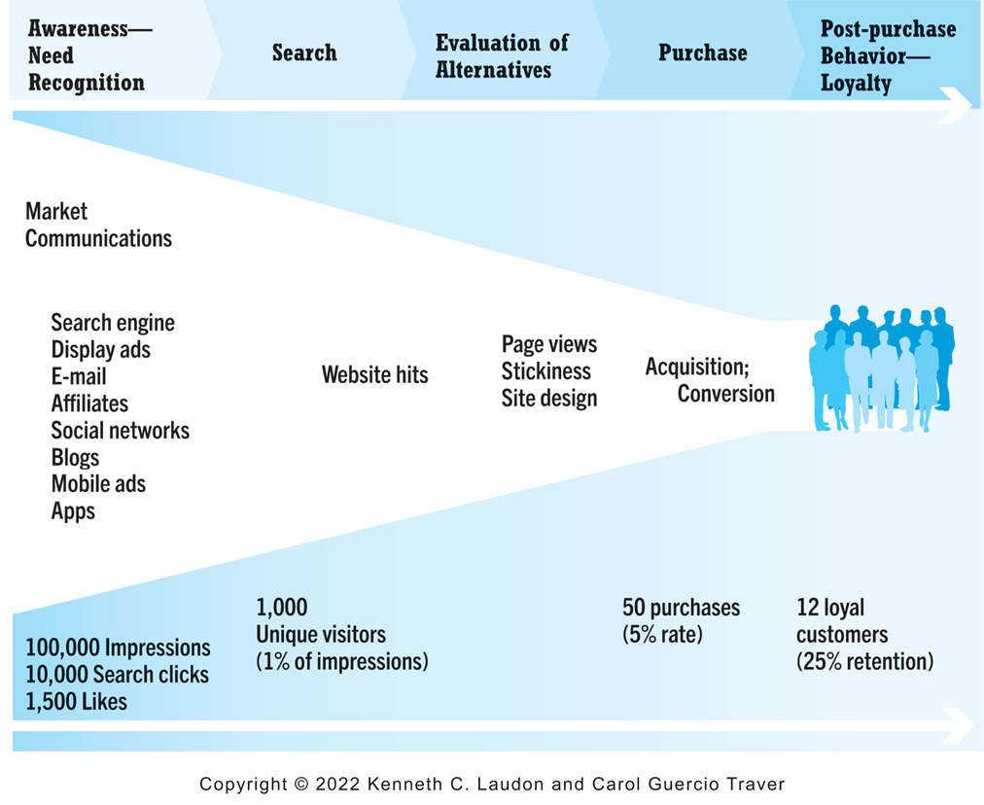
Figure 6.10 An Online Consumer Purchasing Model
Notes:
Figure 6.10, Page 408.
The conversion of visitors into customers, and then loyal customers, is a complex and long-term process that may take several months.
Alt Text
Long description: An illustration depicts an online consumer purchasing model, as follows: During the awareness and need recognition phase of the consumer decision making process, market communications like search engines, display ads, e mail, affiliates, social networks, blogs, mobile ads, and apps generate 100,000 impressions, 10,000 search clicks and 1,500 likes. During the search phase, website hits result in 1,000 unique visitors, 1 percent of the impressions. During the evaluation of alternatives, page views, stickiness and site design are used. During the purchase phase, acquisition, conversion leads to 50 purchases, a 5 percent rate. During the post purchase behavior and loyalty phase, 12 loyal customers were acquired, 25 percent retention.

Slide 51
How Well Does Online Advertising Work?
Use R O I to measure ad campaign
Difficulty of cross-platform attribution
Highest click-through rates: Search engine ads, permission e-mail campaigns
Online channels compare favorably with traditional
Most powerful marketing campaigns use multiple channels, including online, catalog, T V, radio, newspapers, stores

Slide 52
The Costs of Online Advertising
Pricing models
  Barter, cost per thousand (C P M), cost per click (C P C), cost per action (C P A), hybrid, sponsorship
Measuring issues
  Correlating online marketing to online or offline sales
In general, online marketing is more expensive on C P M basis, but more efficient in producing sales
Effective cost-per-thousand (e C P M)

Slide 53
Marketing Analytics
Software that analyzes data at each stage of the customer conversion process
  Awareness
  Engagement
  Interaction
  Purchase activity
  Loyalty and post-purchase
Helps managers
  Optimize R O I on website and marketing efforts
  Build detailed customer profiles
  Measure impact of marketing campaigns

Slide 54
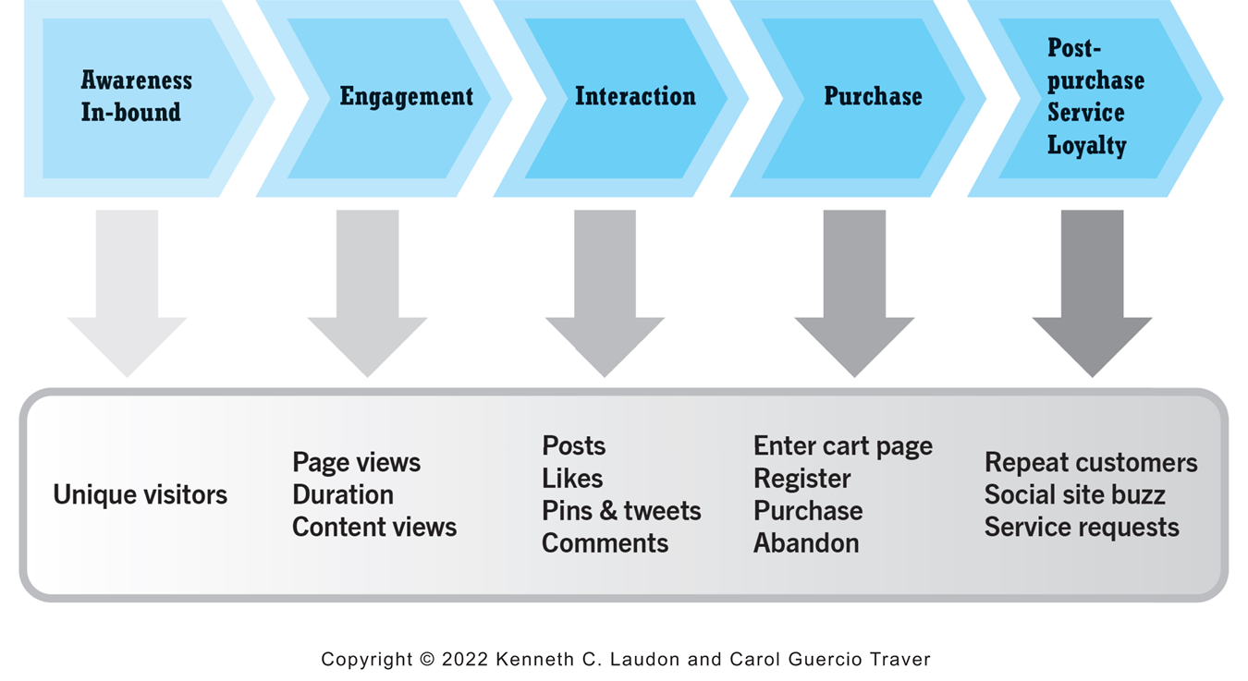
Figure 6.11 Web Analytics and the Online Purchasing Process
Notes:
Figure 6.11, Page 413.
Marketing analytics help e-commerce firms to better understand consumer behavior at each stage of the online purchasing process.
Alt Text
Long description: An illustration depicts the marketing analytics associated with the steps in the online purchasing process, as follows, as follows: During awareness inbound phase, unique visitors. During the engagement phase, page views, duration, and content views. During the interaction phase, posts, likes, pins and tweets, and comments. During purchase phase, enter cart page, register, purchase, and abandon. During the post purchase service or loyalty phase, repeat customers, social site buzz, and service requests.

Slide 55
Careers in E-commerce
Position: Digital Marketing Assistant
Qualification/Skills
Preparing for the Interview
Possible Interview Questions

Slide 56

Copyright
This work is protected by United States copyright laws and is provided solely for the use of instructors in teaching their courses and assessing student learning. Dissemination or sale of any part of this work (including on the World Wide Web) will destroy the integrity of the work and is not permitted. The work and materials from it should never be made available to students except by instructors using the accompanying text in their classes. All recipients of this work are expected to abide by these restrictions and to honor the intended pedagogical purposes and the needs of other instructors who rely on these materials.

