Slide 1
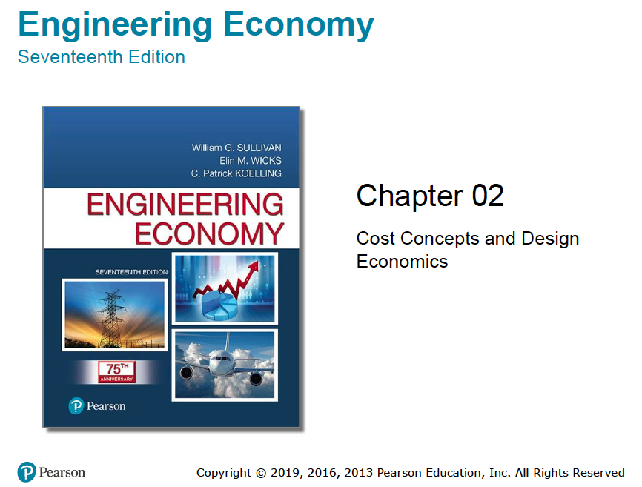

Slide 2
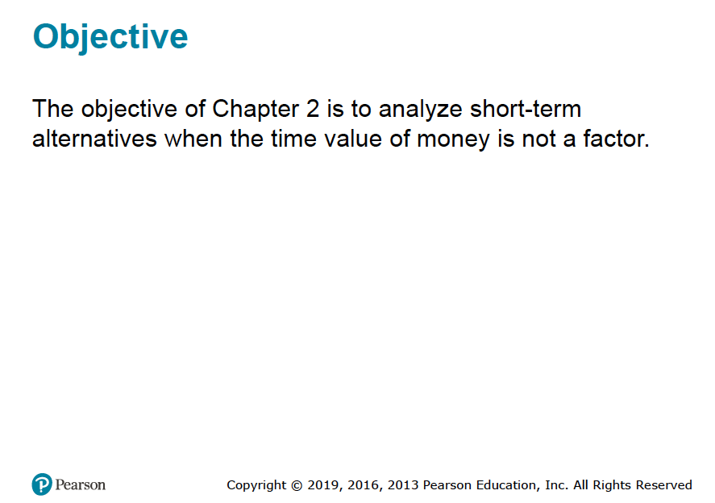

Slide 3
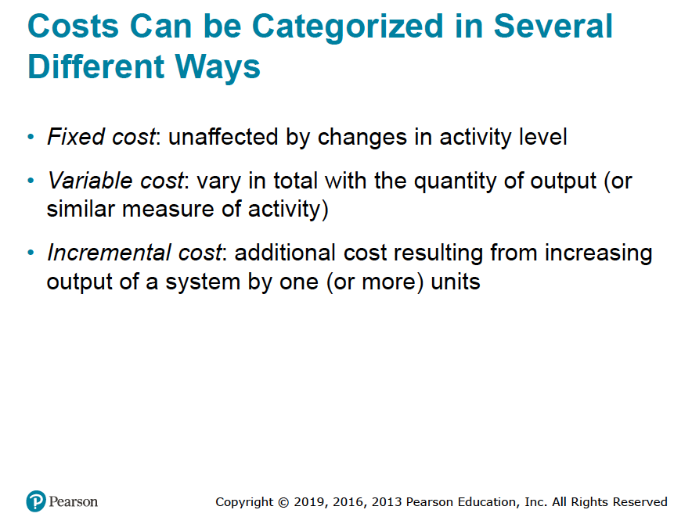

Slide 4
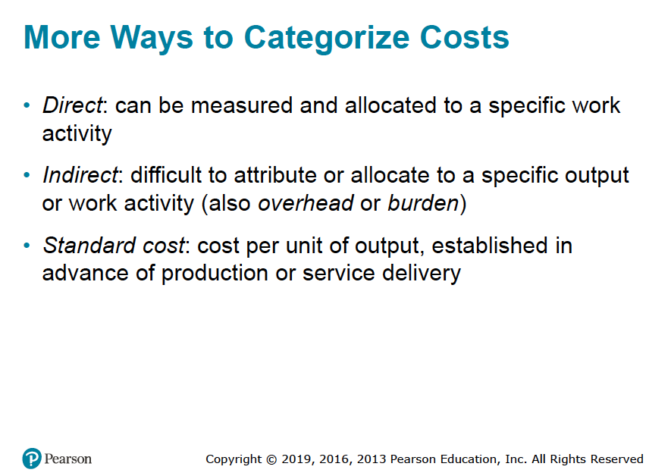

Slide 5
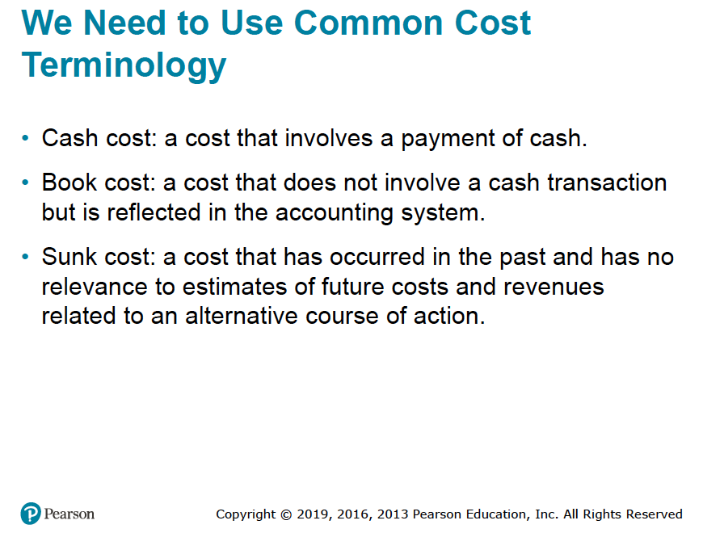

Slide 6
Sunk Cost & Opportunity Cost
The concept of an opportunity cost is often encountered in analyzing the replacement of a piece of equipment or other capital asset. Let us reconsider Example 2-2, in which your firm considered the replacement of an existing piece of equipment that originally cost $50,000, is presently shown on the company records with a value of $20,000 but has a present market value of only $5,000.
For purposes of replacement analysis, the $50,000 is a sunk cost and does not play a rule in the decision to replace the equipment.
Some considers the $20,000 book value – the present realizable selling price of the equipment 9i. E. $15,000) is the sunk cost.
However, neither the $50,000 nor the $15,000 should be considered in project evaluation analysis except for the manner in which the $15,000 may affect income tax.
For the purposes of project evaluation analysis of whether to replace the equipment, the opportunity cost of this piece of equipment is the $5,000 because by keeping the equipment, the firm is giving up the opportunity to obtain $5000 from its disposal.
Thus, the $5,000 immediate selling price is really the investment cost of not replacing it and this is based on the opportunity cost concept.

Slide 7
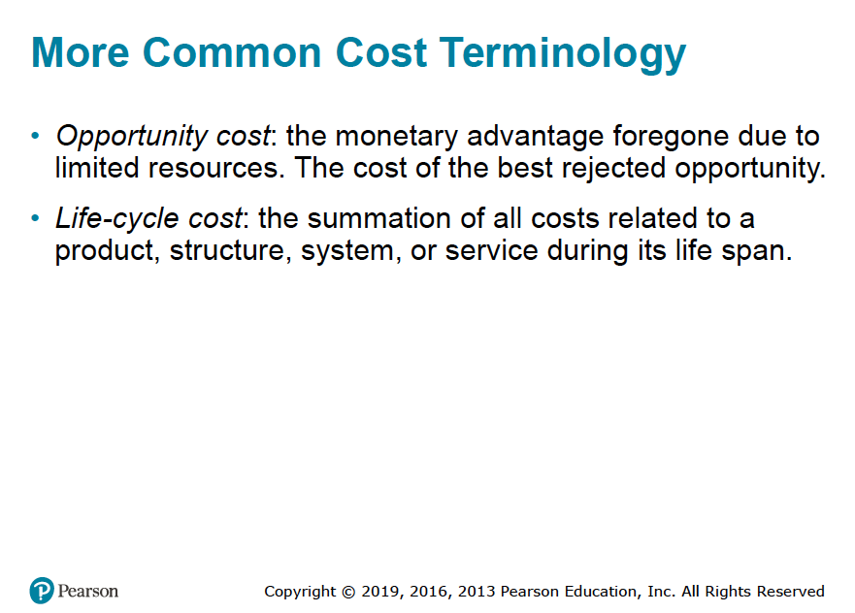

Slide 8
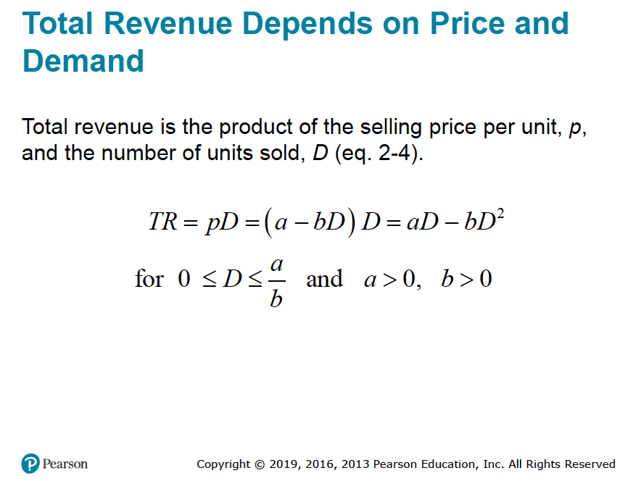

Slide 9
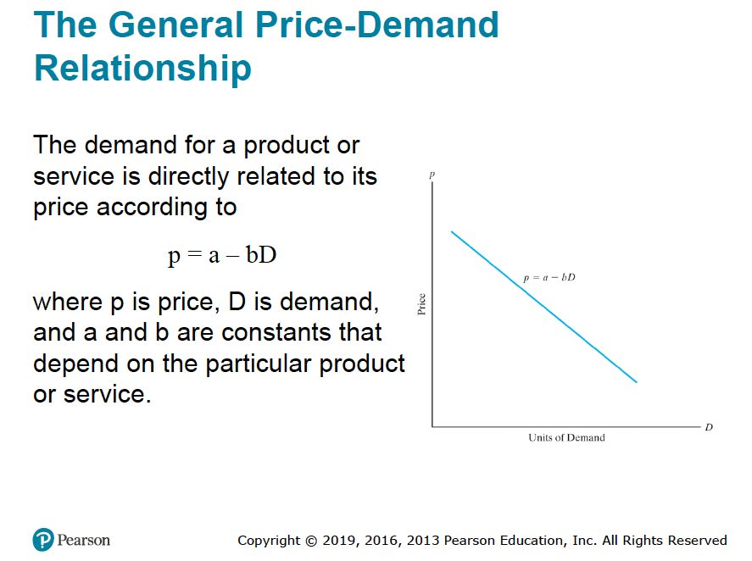

Slide 10
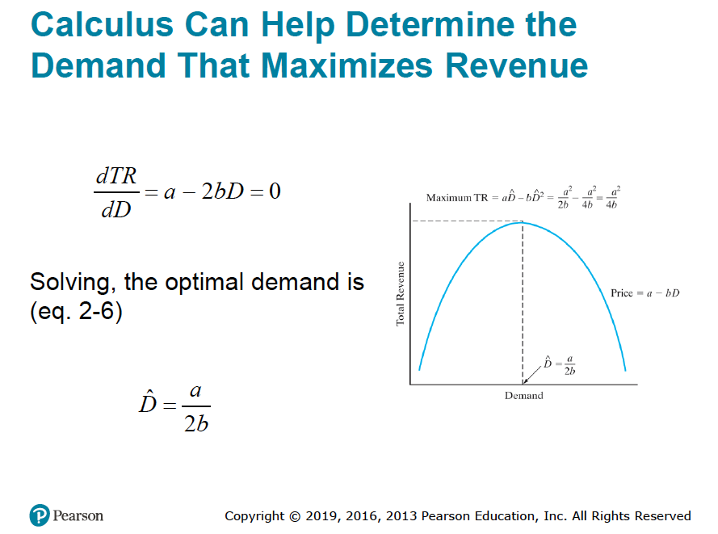


= $\frac{87.5}{2 ∗0.02}$ =2187.5 units if P = 87.5 – 0.02 D
And maximum TR in this case = $\frac{{87.5}^{2}}{4 ∗0.02}$ = $95,703.125

Slide 11
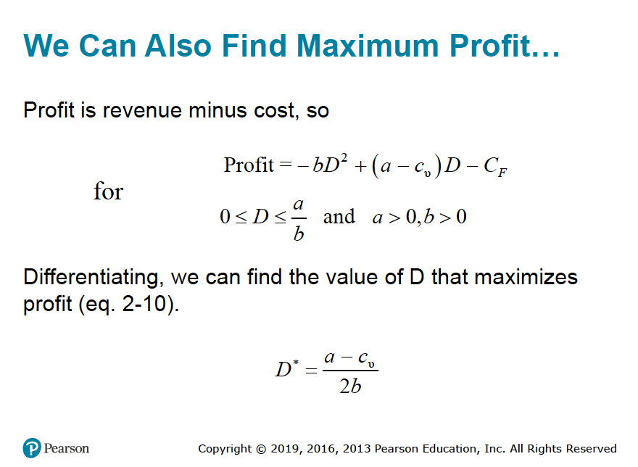

Slide 12
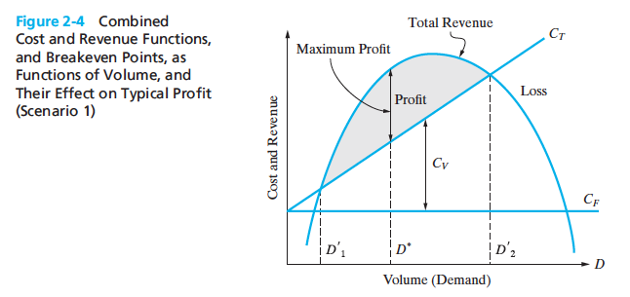

Slide 13
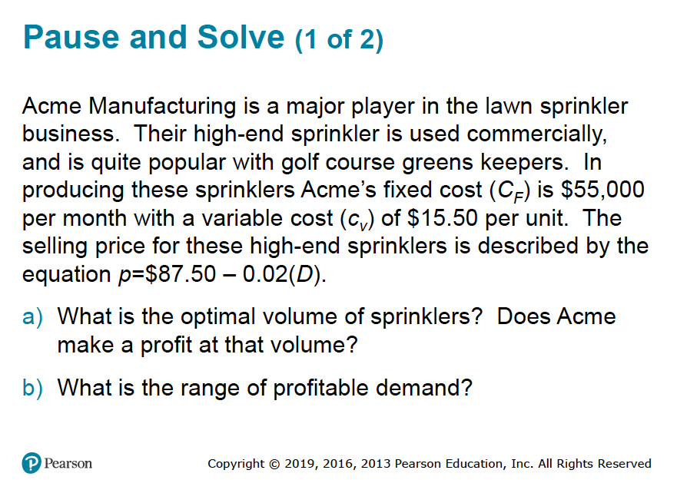

Slide 14
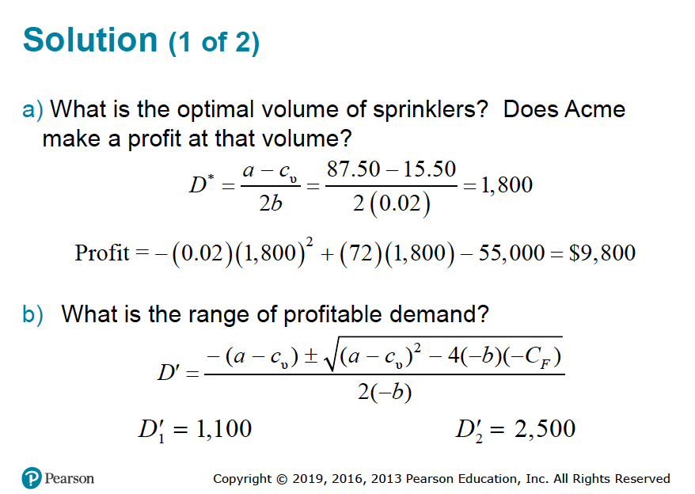

Slide 15
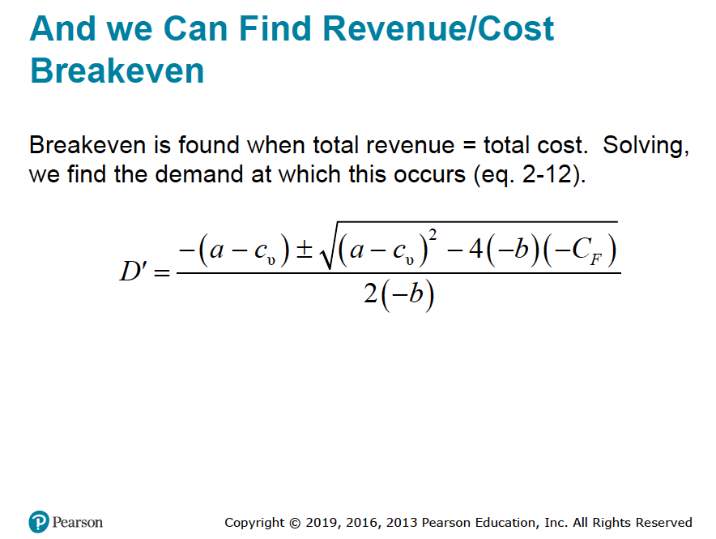

You can get the same answer by finding the profit function and setting it equal to zero and
solve for D’ by using the following formula based on the following quadratic equation:
aX² + bX + C = 0
The roots are given by:
X = $\frac{−b±\sqrt{b^{2}−4ac}}{2a}$
Example: 0.02 D² – 72 D + 55,000 = 0 solving for D gives 1100 < D’ < 2500

Slide 16
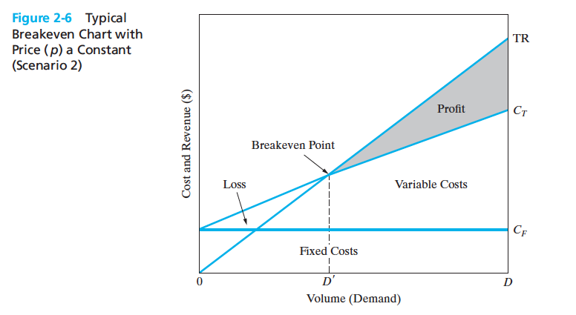

Slide 17
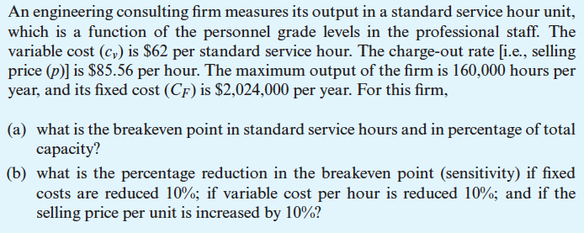
Example

Slide 18
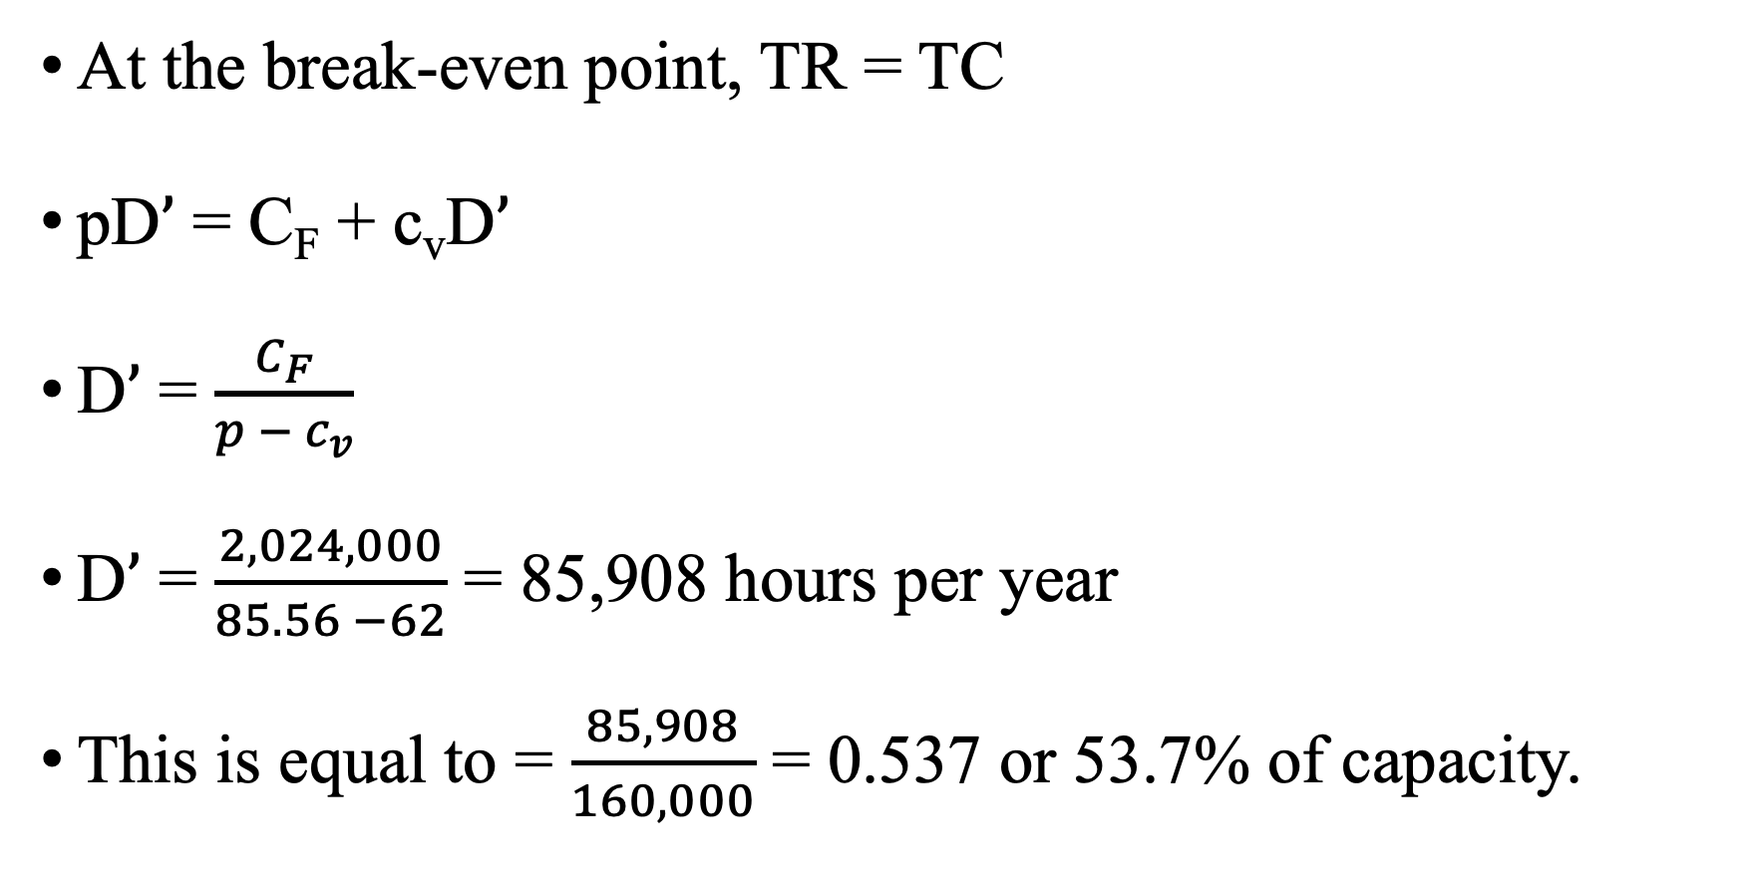
Solution of the Example Part (a)
At the break-even point, TR = TC
pD$’$ = C_{F} + c_{v}D$’$
D$’$ = $\frac{C_{F}}{{p − c}_{v}}$
D$’$ = $\frac{2,024,000}{85.56 −62}$ = 85,908 hours per year
This is equal to = $\frac{85,908}{160,000}$ = 0.537 or 53.7% of capacity.

Slide 19
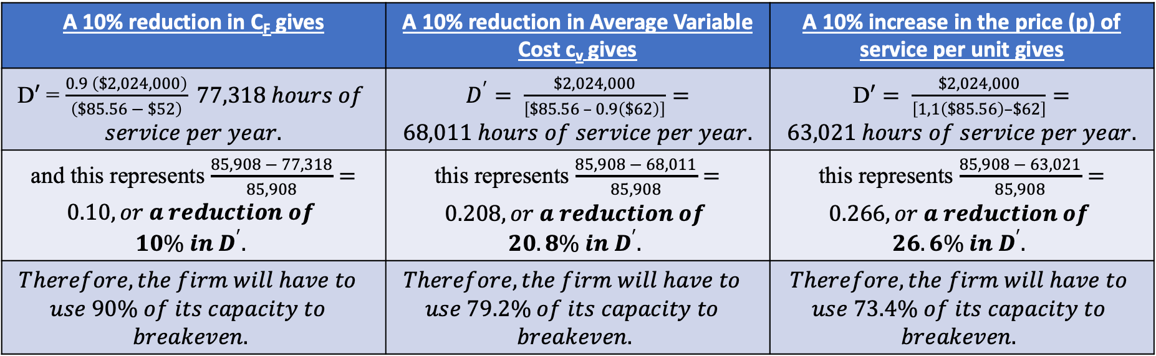
Solution of the Example Part (b)
A 10% reduction in C_{F} gives | A 10% reduction in Average Variable Cost c_{v} gives | A 10% increase in the price (p) of service per unit gives
D$′$ = $\frac{0.9 \left(\$2,024,000\right)}{\left(\$85.56 − \$52\right)} 77,318 hours of$ $service per year.$ | $D^{′}= \frac{\$2,024,000}{\left[\$85.56 – 0.9\left(\$62\right)\right]}=68,011 hours of service per year.$ | D$′= \frac{\$2,024,000}{\left[1,1\left(\$85.56\right)–\$62\right]}=63,021 hours of service per year.$
and this represents $\frac{85,908 − 77,318}{85,908}=0.10, or a reduction of$ $$10\% in D^{′}.$$ | this represents $\frac{85,908 − 68,011}{85,908}=0.208, or a reduction of$ $$20.8\% in D^{′}.$$ | this represents $\frac{85,908 − 63,021}{85,908}=0.266, or a reduction of$ $$26.6\% in D^{′}.$$
$$Therefore, the firm will have to$$ $$use 90\% of its capacity to$$ $$breakeven.$$ | $$Therefore, the firm will have to$$ $$use 79.2\% of its capacity to$$ $$breakeven.$$ | $$Therefore, the firm will have to$$ $$use 73.4\% of its capacity to$$ $$breakeven.$$
Thus, the breakeven point is more sensitive to a reduction in variable cost per hour than to the same percentage reduction in the fixed cost.
Furthermore, notice that the breakeven point in this example is highly sensitive to the selling price per unit, p.

Slide 20
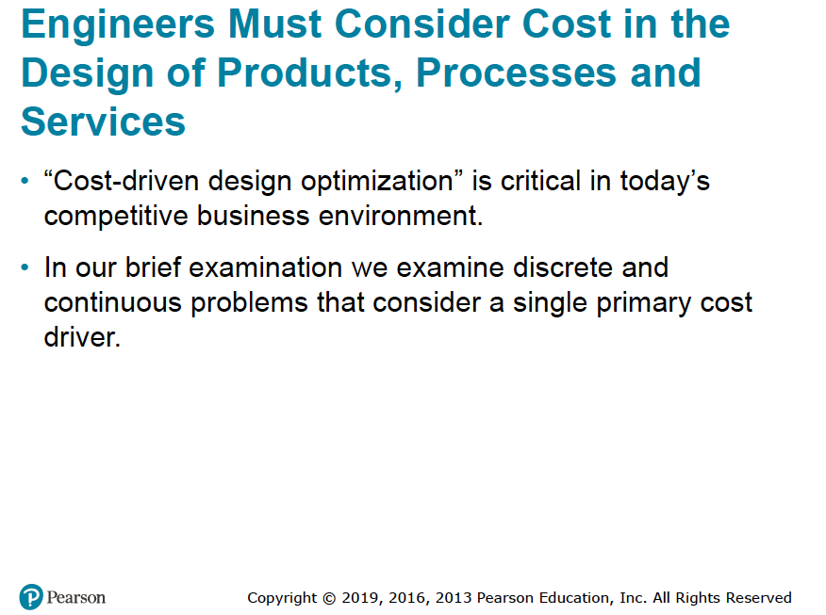

Slide 21
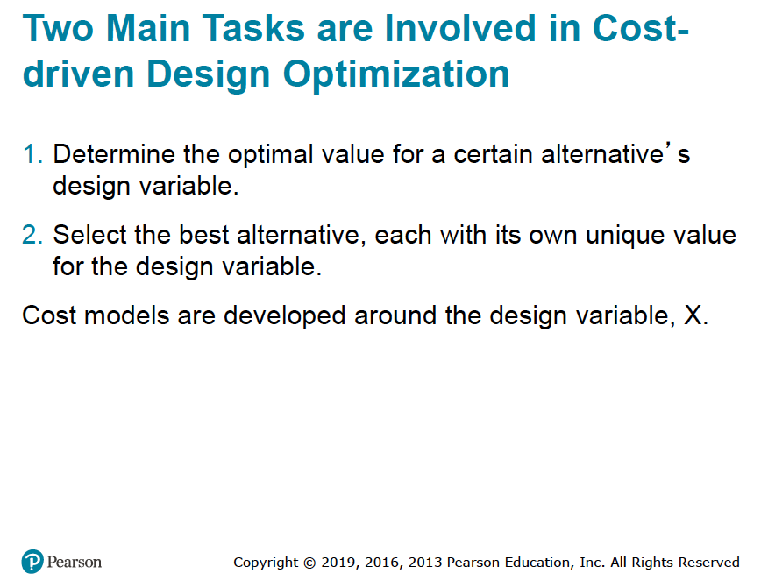

Slide 22
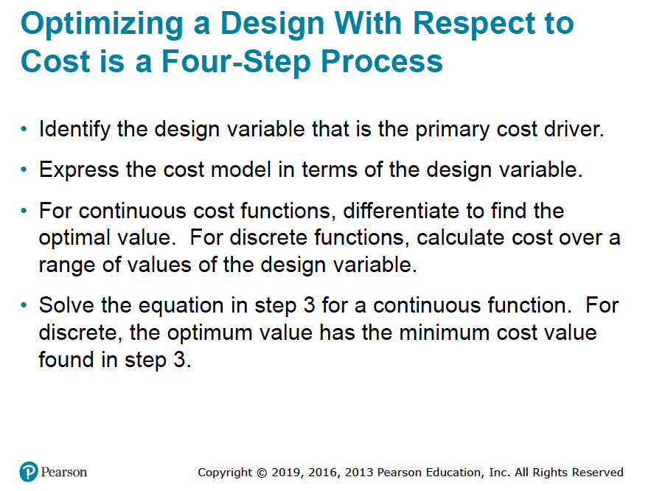

Slide 23
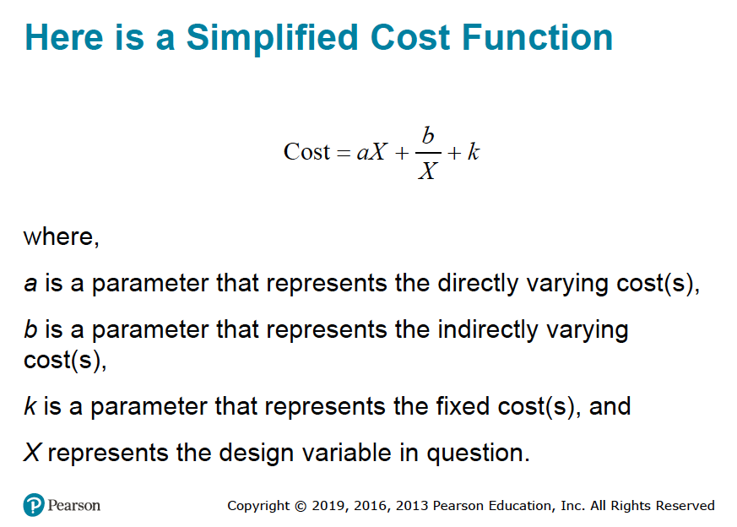

Slide 24
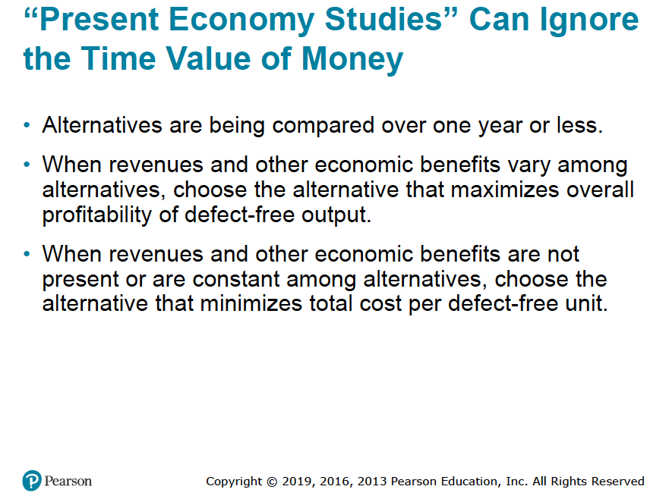
Rule 1
Rule 2

Slide 25
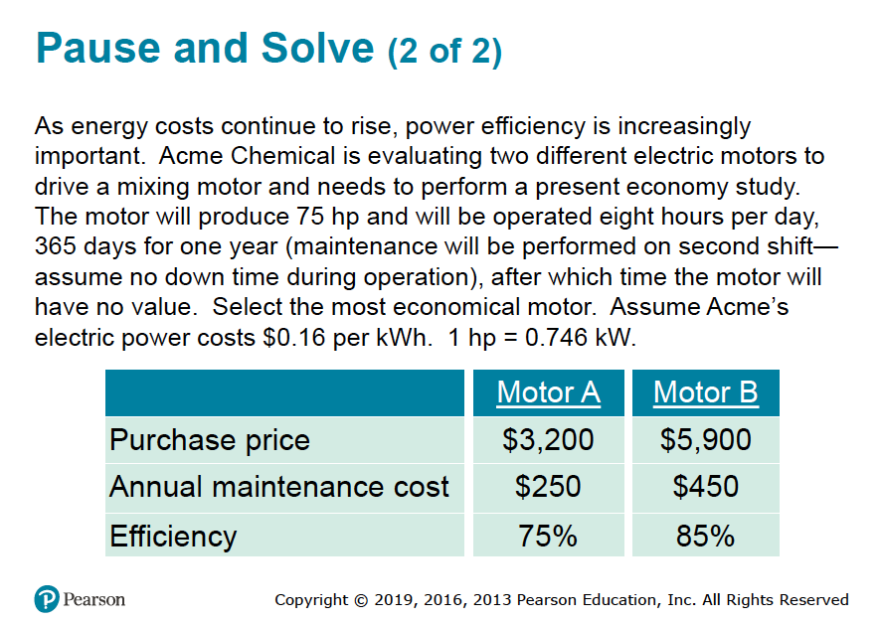

Slide 26
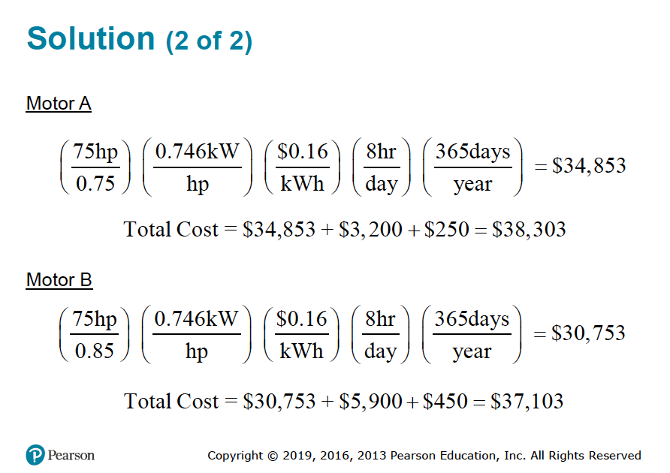

Slide 27


