Slide 1
Graph Databases:

Slide 2
Motivation
Imagine you are building a social network application similar to LinkedIn.
The application needs to handle complex relationships between users, such as friendships, professional connections, and common interests.
You want to be able to quickly find connections, suggest friends, and analyze the network structure.
How you build such application using relational database?

Slide 3
Database Schema Design
Here’s a basic schema:
Connections Table
- connection_id (Primary Key)
- user_id_1 (Foreign Key referencing Users)
- user_id_2 (Foreign Key referencing Users)
- connection_type (e.g., "friend", "colleague", "follow")
- created_at
Users Table
- user_id (Primary Key)
- name
- email
- profile_picture
- bio
User_Interests Table
- user_id (Foreign Key referencing Users)
- interest_id (Foreign Key referencing Interests)
- (Composite Primary Key: user_id , interest_id
Interests Table
- interest_id (Primary Key)
- interest_name
Relationships
- Users are connected to each other through the Connections table, which allows for multiple types of connections.
- Interests are linked to users through the User_Interests table, enabling users to have multiple interests.

Slide 4
Querying Connections
To find connections for a specific user, you could use a SQL query like this:
SELECT u2.name, c.connection_type
FROM Connections c
JOIN Users u1 ON c.user_id_1 = u1.user_id
JOIN Users u2 ON c.user_id_2 = u2.user_id
WHERE u1.user_id = ???; -- Replace ???? with the target user's ID

Slide 5
Suggesting Friends
To suggest friends based on mutual connections, you could use a query like this:
SELECT u2.user_id, u2.name, COUNT( ) AS mutual_connections
FROM Connections c1
JOIN Connections c2 ON c1.user_id_2 = c2.user_id_1
JOIN Users u1 ON c1.user_id_1 = u1.user_id
JOIN Users u2 ON c2.user_id_2 = u2.user_id
WHERE u1.user_id = ? AND u2.user_id != u1.user_id
GROUP BY u2.user_id
ORDER BY mutual_connections DESC;

Slide 6
Reflection
Complex Queries : As the network grows, complex queries involving multiple joins may become slower.
Regularly analyze and optimize queries for performance are required
Building a social network application using a relational database involves careful schema design to manage complex relationships effectively.
We can consider using a graph database for e.

Slide 7
Introduction to Graph Databases
Graph databases are a type of database designed to store and manage data in the form of graphs.
They are particularly effective for representing complex relationships between data points, making them ideal for applications where relationships are key.
Key Concepts
Nodes : The individual entities or objects in the graph. For example, in a social network, each user is a node.
Edges : The connections between nodes that represent relationships. In a social network, edges could represent friendships or professional connections.
Properties : Additional information attached to nodes and edges. For instance, a user node might have properties like name and email.

Slide 8
Introduction to Graph Databases ---Advantages
1. Flexible Structure : Graph databases allow for a more dynamic schema, easily accommodating changes and new relationships.
2. Efficient Queries : They can quickly traverse complex relationships, making them suitable for applications like social networks, recommendation engines, and fraud detection.
3. Intuitive Modeling : The graph structure aligns closely with how we naturally think about relationships, making data easier to visualize and understand.

Slide 9
Introduction to Graph Databases --- Use Cases
- Social Networks : Managing users and their connections.
- Recommendation Systems : Analyzing user behavior to suggest products or content.
- Fraud Detection : Identifying suspicious patterns in transactions.
In summary, graph databases provide a powerful way to model and query interconnected data, making them increasingly popular in various fields.

Slide 10
Why (or why not) graph databases
There are a number of typical data problems (and database system queries) that are an excellent match for a graph database, and there are a number of other types of data questions that are not specifically designed to be answered by such systems.

Slide 11
Why use a graph database?
Complex queries are the types of questions that you want to ask of your data that are inherently composed of a number of complex join operations.
An example of such a complex query would be:
“Find all the restaurants in a certain city neighborhood that serve Italian food, are open on Friday, and cater for kids.”

Slide 12
In relational terms, this would mean joining up data from the restaurant table, the food type table, the Opening hours table, the Caters for table, and the area-code table holding the city neighborhoods and then providing an answer.

Slide 13
In a graph database, a join operation will never need to be performed: all we need to do is to find a starting node in the database (for example, Ramallah), usually with an index lookup, and then just use the index free adjacency characteristic and hop from one node (Ramallah) to the next (Restaurant) over its connecting relationships (Restaurant-[LOCATED_IN]->Ramallah). Every hop along this path is, in effect, the equivalent of a join operation.
Pattern

Slide 14
This, actually, is one of the key performance characteristics of a graph database: as soon as you "grab" a starting node, the database will only explore the vicinity of that starting node and will be completely oblivious to anything that is not connected to the starting node.
Local search!

Slide 15
Graph global operations
While graph databases are powerful at answering "graph local" questions, they are not suited for answering graph global operations, i.e., operations that apply over the whole graph (e.g., centrality, in-betweeness measures).

Slide 16
An example*
Designing a Social Network Graph Database
Imagine you are starting a new social networking site designed for NoSQL database developers.
Let us assume this site will allow for developers to
• Join and leave the site
• Follow the postings of other developers
• Post questions for others with expertise in a particular area
• Suggest new connections with other developers based on shared interests
• Rank members according to their number of connections, posts, and answers

Slide 17
The model will start simple with just two entities: developers and posts.
Properties of developers include
• Name
• Location
• NoSQL databases used
• Years of experience with NoSQL databases

Slide 18
Posts have several properties as well, such as
• Date created
• Topic keywords
• Post type (for example, question, tip, news)
• Title
• Body of post

Slide 19
Next, we consider relations between entities.
The “follows” relation is a relation between developers in our simple model.
For example, if Robert follows Andrea, then Robert will see all of Andrea’s posts when he logs on to the NoSQL social network.

Slide 20
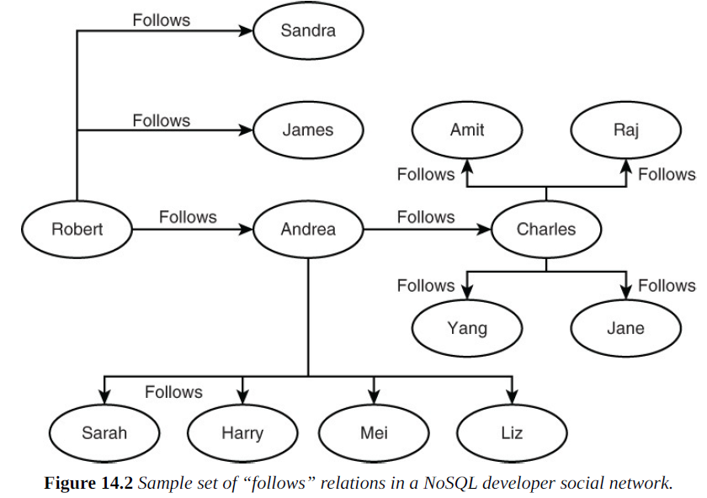

Slide 21
The relation between developers and posts is “created”; that is, developers create posts.
On the other hand, at first glance, the post-relation-post may not appear useful. After all, posts do not create other posts. However, a post may be created in response to another post. This is particularly useful for some queries.

Slide 22
Imagine that Robert posted a question.
Andrea and Charles might each reply with their own answers.
Robert then posts another question to clarify his understanding of Andrea’s response.
Andrea responds with additional details.
Meanwhile, Edith adds additional details to Charles’s post.
The resulting graph of posts is a tree with Robert’s initial post as the root and branches that follow the two parts of the conversation thread.

Slide 23
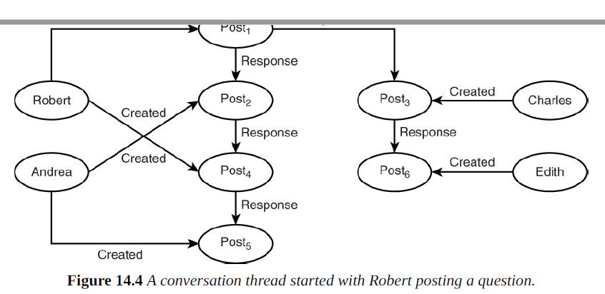
Root post
Created
Response

Slide 24
Querying a Graph
Next, we show some queries that reference vertices and edges and rewrite them in terms of the NoSQL social network example.
As next table shows, abstract queries map to useful queries about graph databases. Some queries are based on paths, such as the distance between two nodes; for example, “How many follows relations are between Developer A and Developer B?” Other queries consider the global structure of the graph, such as “If a developer left the social network, would there be disconnected groups of developers?”

