Slide 1

Exception Handling and I/O
Liang, Introduction to Java Programming and Data Structures,
Twelfth Edition, (c) 2020 Pearson Education, Inc. All rights reserved.
By: Mamoun Nawahdah (Ph.D.)
2022/2023

Slide 2
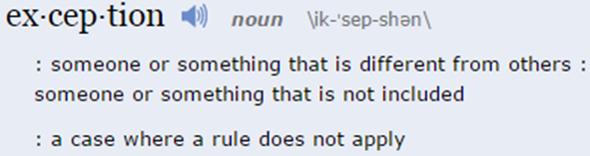
Exception Handling
Exception handling technique enables a method to throw an exception to its caller.
Without this capability, a method must handle the exception or terminate the program.

Slide 3
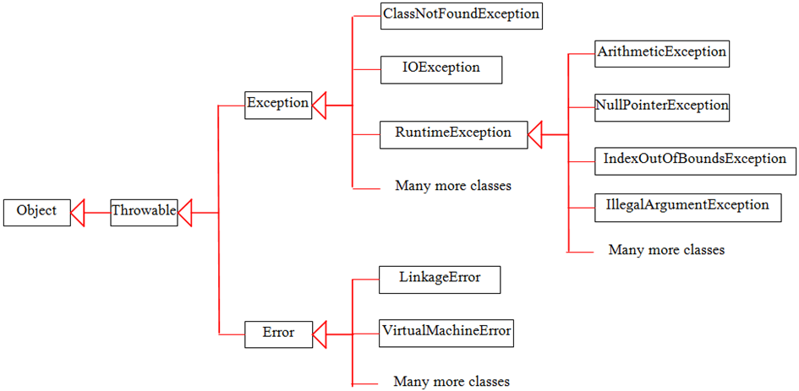
System Errors
System errors are thrown by JVM and represented in the Error class. The Error class describes internal system errors.
Notes:
Such errors rarely occur. If one does, there is little you can do beyond notifying the user and trying to terminate the program gracefully.

Slide 4
Exceptions
Exception describes errors caused by your program and external circumstances.
These errors can be caught and handled by your program.

Slide 5
Runtime Exceptions
RuntimeException is caused by programming errors, such as bad casting, accessing an out-of-bounds array, and numeric errors.

Slide 6
Checked Exceptions vs. Unchecked Exceptions
RuntimeException, Error and their subclasses are known as unchecked exceptions.
All other exceptions are known as checked exceptions, meaning that the compiler forces the programmer to check and deal with the exceptions.

Slide 7

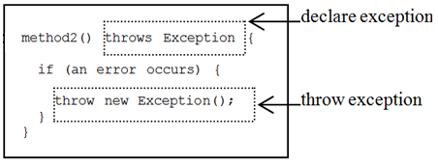

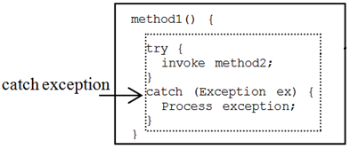

Declaring, Throwing, and Catching Exceptions

Slide 8
Declaring Exceptions
Every method must state the types of checked exceptions it might throw.
This is known as declaring exceptions.
public void x() throws IOException
public void y() throws IOException, OtherException

Slide 9
Throwing Exceptions
When the program detects an error, the program can create an instance of an appropriate exception type and throw it.
This is known as throwing an exception.
throw new IOException();
IOException ex = new IOException(); throw ex;

Slide 10
Throwing Exceptions Example
public void setRadius(double newRadius)
throws IllegalArgumentException {
if (newRadius >= 0)
radius = newRadius;
else
throw new IllegalArgumentException(
"Radius cannot be negative");
}

Slide 11

Catching Exceptions
try {
statements; // Statements that may throw exceptions
}
catch (Exception1 exVar1) {
handler for exception1;
}
catch (Exception2 exVar2) {
handler for exception2;
}
...
catch (ExceptionN exVar3) {
handler for exceptionN;
}
The order in which exceptions are specified in catch blocks is important.

Slide 12
JDK 7 multicatch
You can use the new JDK 7 multicatch feature to simplify coding for the exceptions with the same handling code. The syntax is:
try {
statements; // Statements that may throw exceptions
}
catch (Exception1 | Exception2 |ExceptionN ex) {
// handler exception;
}

Slide 13
Catch or Declare Checked Exceptions
Suppose p2 is defined as follow:

Slide 14
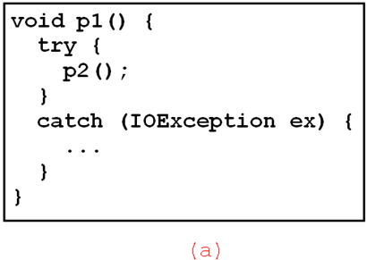
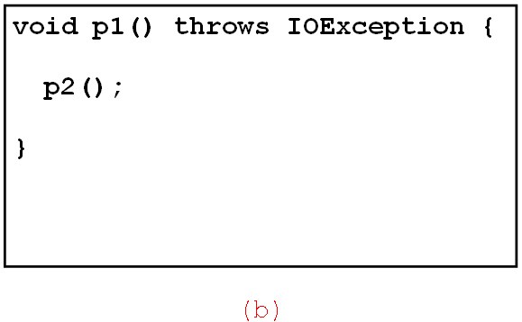
Catch or Declare Checked Exceptions
Java forces you to deal with checked exceptions.
You must invoke it in a try-catch block or
declare to throw the exception in the calling method.
For example, suppose that method p1 invokes method p2, you have to write the code as follow:

Slide 15
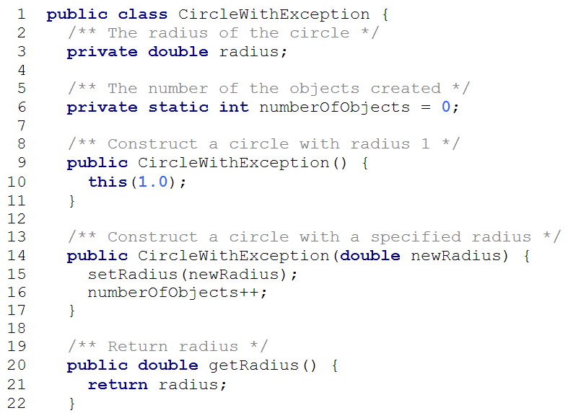

Slide 16
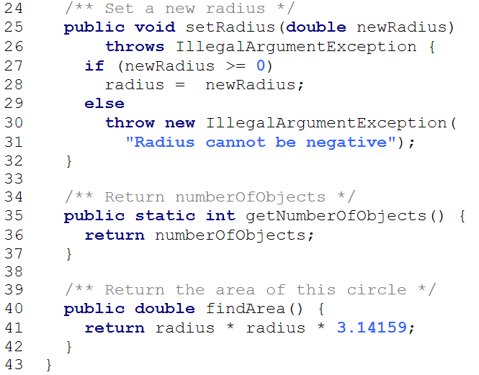

Slide 17
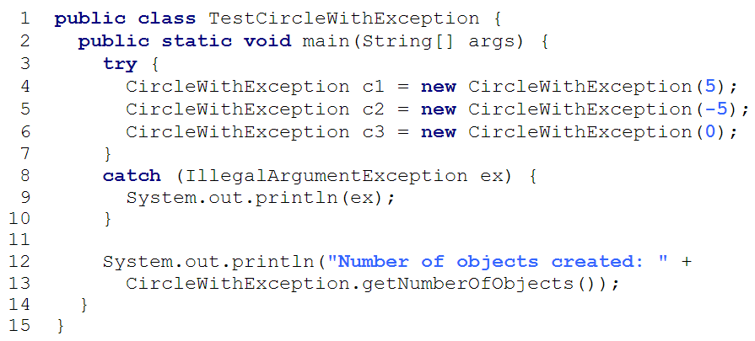

Slide 18

Rethrowing Exceptions
try {
statements;
}
catch(TheException ex) {
perform operations before exits;
throw ex;
}

Slide 19

The finally Clause
try {
statements;
}
catch(TheException ex) {
handling ex;
}
finally {
finalStatements;
}
Note: The catch block may be omitted when the finally clause is used

Slide 20
Trace a Program Execution
try {
statements;
}
catch(TheException ex) {
handling ex;
}
finally {
finalStatements;
}
Next statement;
Suppose no exceptions in the statements

Slide 21
Trace a Program Execution
try {
statements;
}
catch(TheException ex) {
handling ex;
}
finally {
finalStatements;
}
Next statement;
The final block is always executed

Slide 22
Trace a Program Execution
try {
statements;
}
catch(TheException ex) {
handling ex;
}
finally {
finalStatements;
}
Next statement;
Next statement in the method is executed

Slide 23
Trace a Program Execution
try {
statement1;
statement2;
statement3;
}
catch(Exception1 ex) {
handling ex;
}
finally {
finalStatements;
}
Next statement;
Suppose an exception of type Exception1 is thrown in statement2

Slide 24
Trace a Program Execution
try {
statement1;
statement2;
statement3;
}
catch(Exception1 ex) {
handling ex;
}
finally {
finalStatements;
}
Next statement;
The exception is handled.

Slide 25
Trace a Program Execution
try {
statement1;
statement2;
statement3;
}
catch(Exception1 ex) {
handling ex;
}
finally {
finalStatements;
}
Next statement;
The final block is always executed.

Slide 26
Trace a Program Execution
try {
statement1;
statement2;
statement3;
}
catch(Exception1 ex) {
handling ex;
}
finally {
finalStatements;
}
Next statement;
The next statement in the method is now executed.

Slide 27
Trace a Program Execution
try {
statement1;
statement2;
statement3;
}
catch(Exception1 ex) {
handling ex;
}
catch(Exception2 ex) {
handling ex;
throw ex;
}
finally {
finalStatements;
}
Next statement;
statement2 throws an exception of type Exception2.

Slide 28
Trace a Program Execution
try {
statement1;
statement2;
statement3;
}
catch(Exception1 ex) {
handling ex;
}
catch(Exception2 ex) {
handling ex;
throw ex;
}
finally {
finalStatements;
}
Next statement;
Handling exception

Slide 29
Trace a Program Execution
try {
statement1;
statement2;
statement3;
}
catch(Exception1 ex) {
handling ex;
}
catch(Exception2 ex) {
handling ex;
throw ex;
}
finally {
finalStatements;
}
Next statement;
Execute the final block

Slide 30
Trace a Program Execution
try {
statement1;
statement2;
statement3;
}
catch(Exception1 ex) {
handling ex;
}
catch(Exception2 ex) {
handling ex;
throw ex;
}
finally {
finalStatements;
}
Next statement;
Rethrow the exception and control is transferred to the caller

Slide 31
Cautions When Using Exceptions
The key benefit of exception handling is separating the detection of an error (done in a called method) from the handling of an error (done in the calling method).
Exception handling separates error-handling code from normal programming tasks, thus making programs easier to read and to modify.
Be aware, however, that exception handling usually requires more time and resources because it requires instantiating a new exception object, rolling back the call stack, and broadcasting the errors to the calling methods.

Slide 32
When to Throw Exceptions
An exception occurs in a method.
If you want the exception to be processed by its caller, you should create an exception object and throw it.
If you can handle the exception in the method where it occurs, there is no need to throw it.
When to Use Exceptions
You should use it to deal with unexpected error conditions.

Slide 33
Caution!
Do not use exception to deal with simple, expected situations.
For example, the following code:
try {
System.out.println(refVar.toString());
}
catch (NullPointerException ex) {
System.out.println("refVar is null");
}
is better to be replaced by:
if (refVar != null)
System.out.println(refVar.toString());
else
System.out.println("refVar is null");

Slide 34
Defining Custom Exception
Use the exception classes in the API whenever possible.
Define custom exception classes if the predefined classes are not sufficient.
Define custom exception classes by extending Exception or a subclass of Exception class.

Slide 35
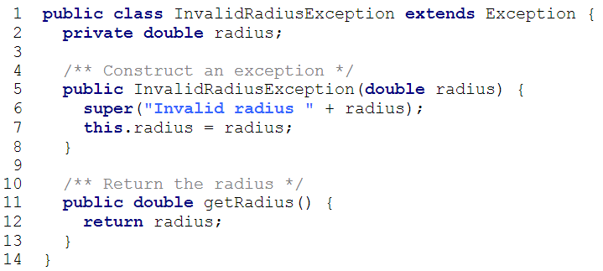
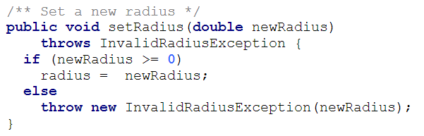
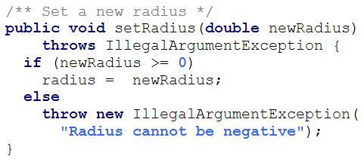
Custom Exception Class Example

Slide 36
The File Class
The File class is intended to provide an abstraction that deals with most of the machine-dependent complexities of files and path names in a machine-independent fashion.
The filename is a string.
The File class is a wrapper class for the file name and its directory path.

Slide 37
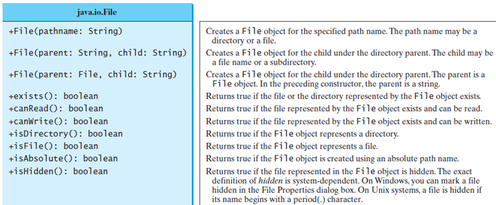
File class
The directory separator for Windows is a backslash (\). The backslash is a special character in Java and should be written as \\ in a string literal

Slide 38
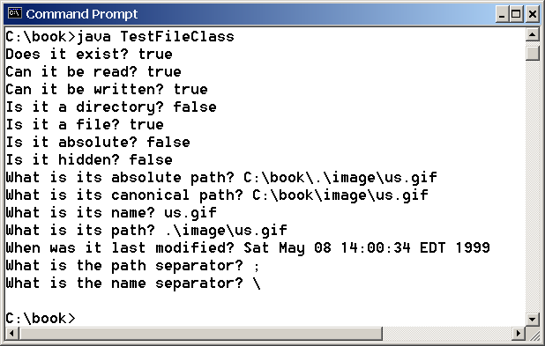
Explore File Properties
Write a program that demonstrates how to create files and use the methods in the File class to obtain their properties. The following figures show a sample run of the program:

Slide 39
Text File Input and Output
In order to perform I/O, you need to create objects using appropriate Java I/O classes.
There are two types of files: text and binary.
Text files are essentially characters on disk.
The objects contain the methods for reading/writing text data from/to a file.
This section introduces how to read/write strings and numeric values from/to a text file using the Scanner and PrintWriter classes.

Slide 40
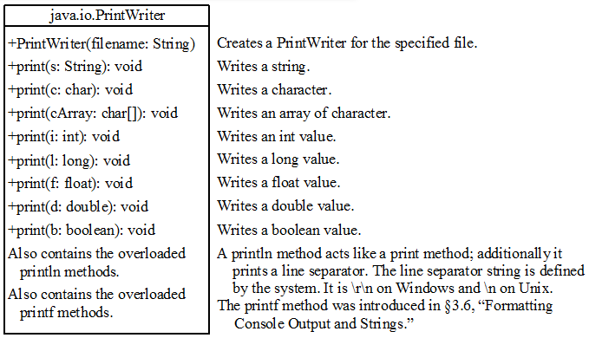
PrintWriter class
The close() method must be used to close the file. If this method is not invoked, the data may not be saved properly in the file.

Slide 41
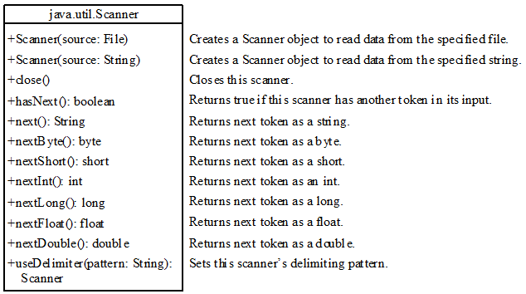
Scanner class

Slide 42
Try-with-resources
Programmers often forget to close the file.
JDK 7 provides the followings new try-with-resources syntax that automatically closes the files.
import java.io.*;
public class WriteDataWithAutoClose {
public static void main(String[] args) throws Exception {
File file = new File(“data.txt");
try ( PrintWriter output = new PrintWriter(file); ) {
output.println(“Mamoun Nawahdah");
output.println(“Birzeit University");
}
}
}

Slide 43
Problem: Replacing Text
Write a class named ReplaceText that replaces a string in a text file with a new string. The filename and strings are passed as command-line arguments as follows:
java ReplaceText sourceFile targetFile oldString newString

Slide 44
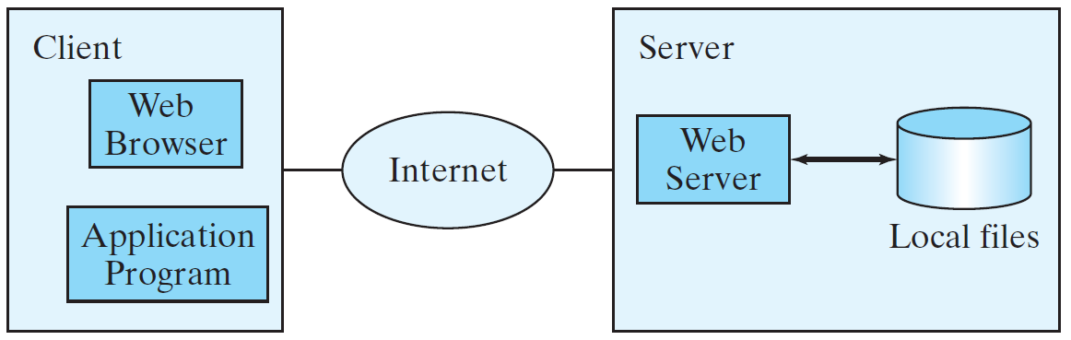
Reading Data from the Web
Just like you can read data from a file on your computer, you can read data from a file on the Web.

Slide 45
Reading Data from the Web
URL url = new URL("www.google.com/index.html");
After a URL object is created, you can use the openStream() method defined in the URL class to open an input stream and use this stream to create a Scanner object as follows:
Scanner input = new Scanner(url.openStream());

Slide 46
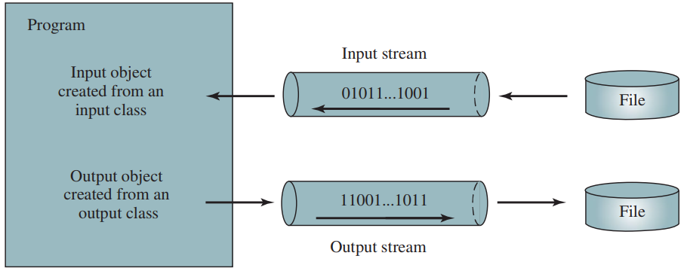
How is I/O Handled in Java?
In order to perform I/O, you need to create objects using appropriate Java I/O classes.
Scanner input = new Scanner(new File("temp.txt"));
System.out.println(input.nextLine());
PrintWriter output = new PrintWriter("temp.txt");
output.println(“Mamoun Nawahdah");
output.close();

Slide 47
Text File vs. Binary File
Data stored in a text file are represented in human-readable form.
Data stored in a binary file are represented in binary form.
For example, the Java source programs are stored in text files and can be read by a text editor, but the Java classes are stored in binary files and are read by the JVM.
The advantage of binary files is that they are more efficient to process than text files.

Slide 48
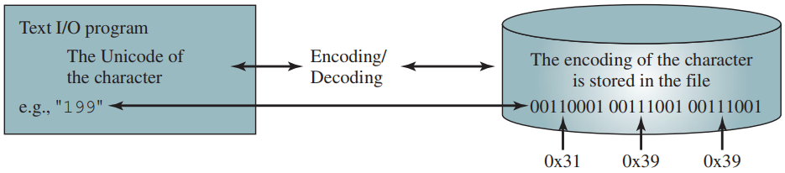
Text I/O
Text I/O requires encoding and decoding.
The JVM converts a Unicode to a file specific encoding when writing a character and coverts a file specific encoding to a Unicode when reading a character.

Slide 49
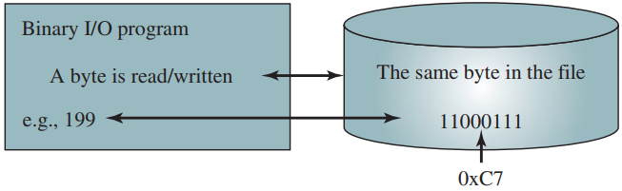
Binary I/O
Binary I/O does not require conversions.
When you write a byte to a file, the original byte is copied into the file.
When you read a byte from a file, the exact byte in the file is returned.

Slide 50
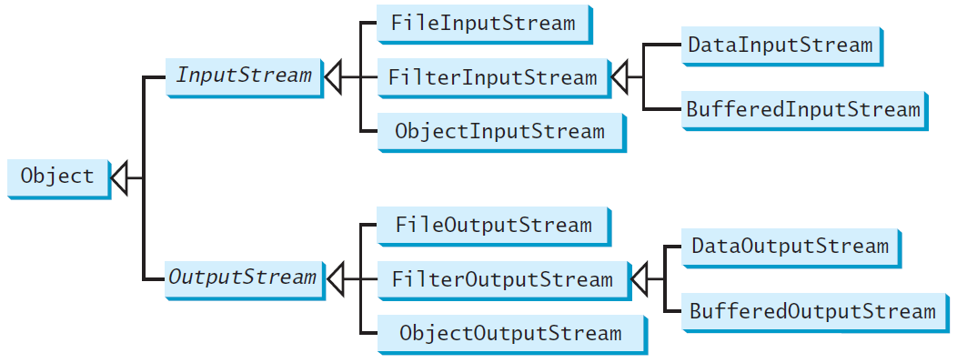
Binary I/O Classes

Slide 51
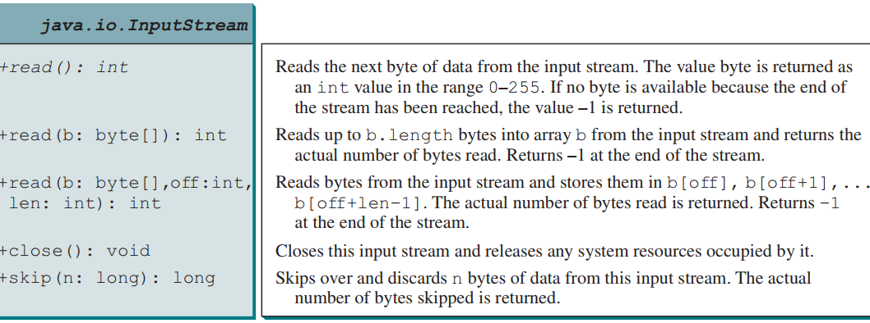
InputStream

Slide 52
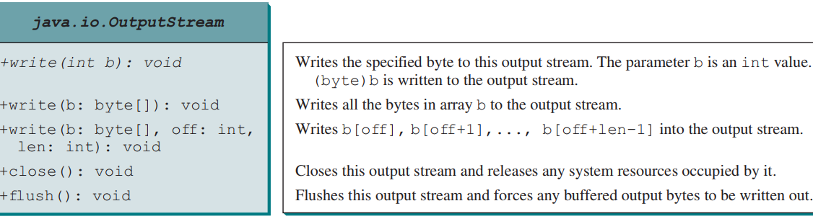
OutputStream

Slide 53
FileInputStream/FileOutputStream
FileInputStream/FileOutputStream associates a binary input/output stream with an external file.
All the methods in FileInputStream/FileOuptputStream are inherited from its superclasses.

Slide 54
FileInputStream
To construct a FileInputStream, use the following constructors:
public FileInputStream(String filename)
public FileInputStream(File file)
A java.io.FileNotFoundException would occur if you attempt to create a FileInputStream with a nonexistent file.

Slide 55
FileOutputStream
To construct a FileOutputStream, use the following constructors:
public FileOutputStream(String filename)
public FileOutputStream(File file)
public FileOutputStream(String filename, boolean append)
public FileOutputStream(File file, boolean append)
If the file does not exist, a new file would be created.
If the file already exists, the first two constructors would delete the current contents in the file.
To keep the current content and append new data into the file, use the last two constructors by passing true to the append parameter.

Slide 56
FilterInputStream/FilterOutputStream
Using a filter class enables you to read integers, doubles, and strings instead of bytes and characters.
FilterInputStream and FilterOutputStream are the base classes for filtering data.

Slide 57
DataInputStream/DataOutputStream
DataInputStream reads bytes from the stream and converts them into appropriate primitive type values or strings.
DataOutputStream converts primitive type values or strings into bytes and output the bytes to the stream.

Slide 58
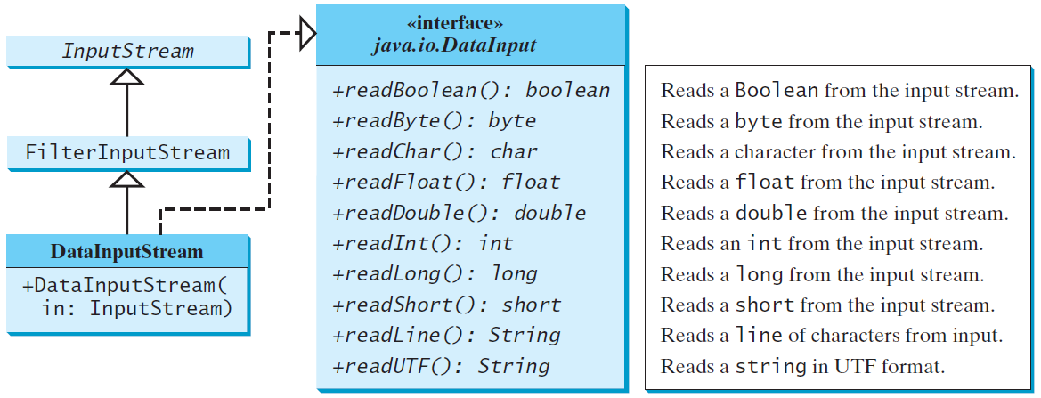
DataInputStream

Slide 59
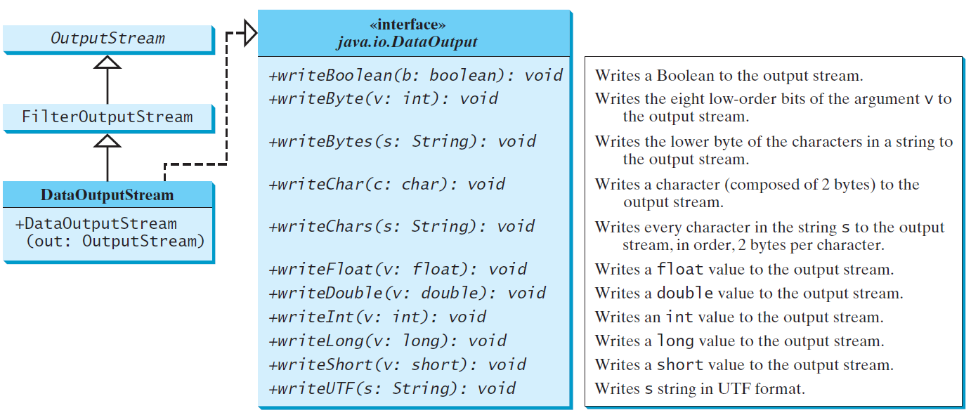
DataOutputStream

Slide 60
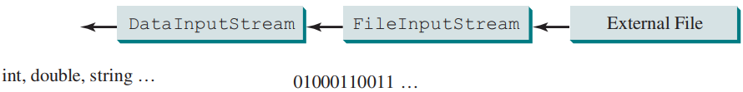
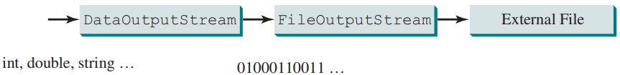
Using DataInputStream/DataOutputStream
DataInputStream infile =
new DataInputStream(new FileInputStream("in.dat"));
DataOutputStream outfile =
new DataOutputStream(new FileOutputStream("out.dat"));

Slide 61
Checking End of File
Order and Format
CAUTION: You have to read the data in the same order and same format in which they are stored.
For example, since names are written in UTF-8 using writeUTF, you must read names using readUTF.
If you keep reading data at the end of a stream, an EOFException would occur. So how do you check the end of a file?
You can use input.available() to check it.
input.available() == 0 indicates that it is the end of a file.

Slide 62
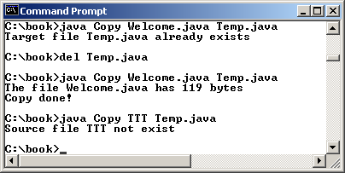
Case Studies: Copy File
This case study develops a program that copies files. The user needs to provide a source file and a target file as command-line arguments using the following command:
java Copy source target
The program copies a source file to a target file and displays the number of bytes in the file. If the source does not exist, tell the user the file is not found. If the target file already exists, tell the user the file already exists.

Slide 63
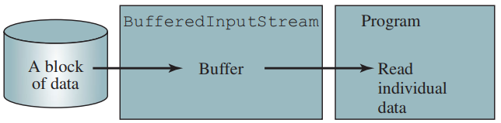
Self-Study
BufferedInputStream/BufferedOutputStream can be used to speed up input and output by reducing the number of disk reads and writes.

Slide 64
Self-Study
ObjectInputStream/ObjectOutputStream enables you to perform I/O for objects in addition to primitive-type values and strings.
try (FileOutputStream f = new FileOutputStream("data.dat");
ObjectOutputStream output = new ObjectOutputStream(f);) {
output.writeUTF("Mamoun");
output.writeDouble(55.5);
output.writeObject(new Date());
}

