Slide 1
Voice Material 2

Slide 2
Methods for viewing the Vocal Folds (VF)
Laryngoscopy = exam. of the interior of larynx
Problems:
Larynx is located deep in the neck
Larynx is dark
VF vibrate more than 100 cycles per sec.

Slide 3
Methods for viewing the Vocal Folds (VF) - Cont.
Indirect Laryngoscopy
Manuel Garcia (1855) France
Dental mirror pushed to the soft palate Only Larynx structures could be seen
Photography of the Lx (pp. 142, Fig 3-62)
Paul Moore (1937), MIT, UF High-speed motion pictures 4000 frames/sec

Slide 4
Methods for viewing the Vocal Folds (VF) - Cont.
Endoscopy (pp. 139, Fig 3-59-B) Direct laryngoscopy Rigid/Flexible
Fiberscope
View Lx using transnasal endoscope Better light and with optic fibers but still only structures

Slide 5
Methods for viewing the Vocal Folds (VF) - Cont.
Videostroboscopy
– allow humans to see the vibratory motion of the VF in slow motion
= scope light
Video recording the motion of the vocal folds

Slide 6
Retinal lag: the retina can perceive five images per second. Time lag = one fifth to one seventh of a second (Kallen, 1932). Thus, when an object is presented to a viewer in an intermittent manner, it appears to be moving slowly or standing still
uses the retinal lag to fuse illuminated points of the vocal folds during vibration, providing an average vibratory cycle based on several fused cycles

Slide 7
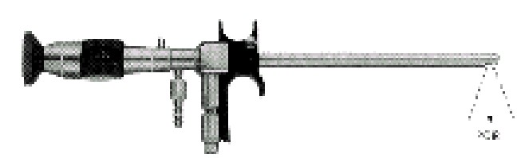
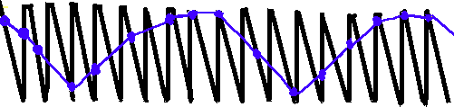
^{he}A^{re}c^{t}o^{in}m^{al}p^{l}oªs^{g}it^{t}eºc^{f}y^{u}c^{s}l^{e}e based ^{oc}oªn^{l} s^{fo}e^{l}v^{d}e^{s}ra^{d}l^{u}v^{r}o^{in}c^{g}al fold
Videostroboscopy uses t
illuminated points of the v vibration, providing an av
Amplitude
Time
Videostroboscopy uses the retinal lag to fuse illuminated points of the vocal folds during vibration, providing an average vibratory cycle base
on several fused cycles
based on several fused cycles
era_{v}g_{ib}e_{r}v_{a}i_{t}b_{io}ra_{n}to_{cy}ry_{cl}c_{e}y_{s}cle

Slide 8
Videostroboscopy
Directly observes the apparent motion of the larynx
Provides information about:
Nature of VF vibration
Presence or absence of pathology
Documents small changes in the vibratory structure or pattern of vibration

Slide 9

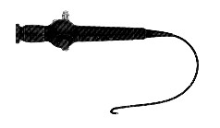
Rigid
Rigid
Flexible
Flexible

Slide 10
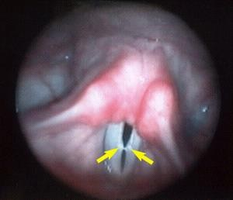
Vocal Nodules

Slide 11
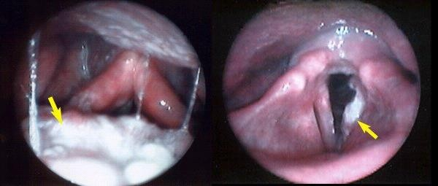
Laryngeal Cancer
http://www.med.jhu.edu/voice/cancer.html

Slide 12
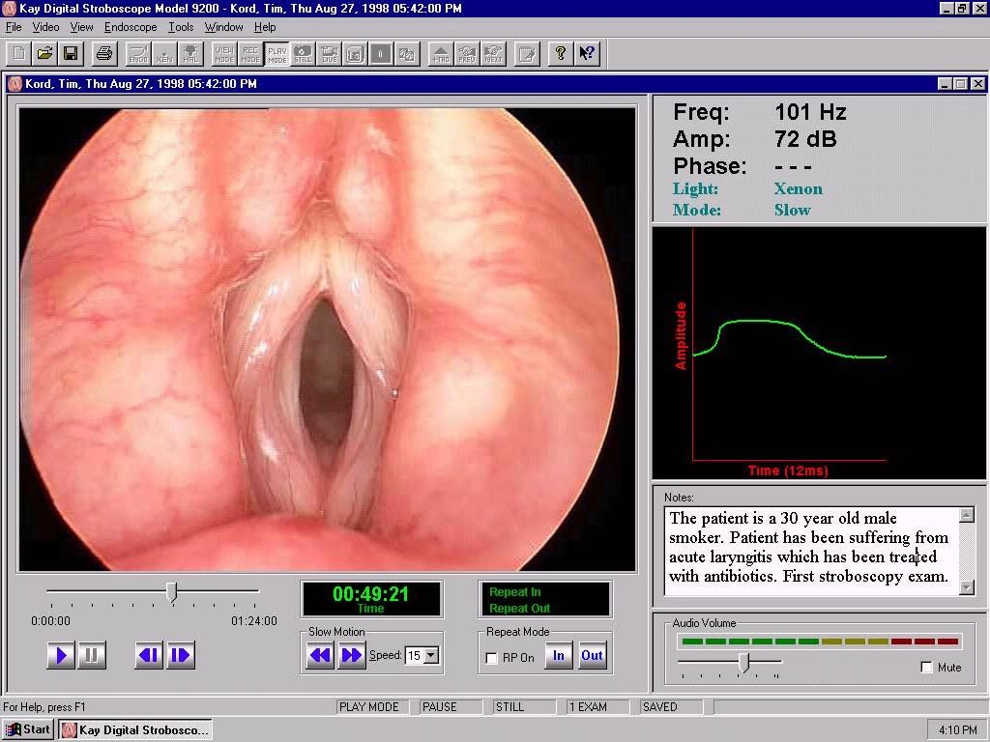
http://www.kayelemetrics.com/digital_strobe_sample_screens.htm

Slide 13
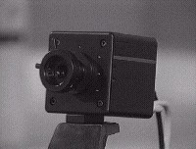
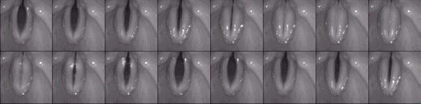
http://www.rrze.uni-erlangen.de/docs/FAU/ fakultaet/med/kli/kphno/phon/ppglotte.htm

Slide 14
Main Ligaments/ Membranes
There are more than five but for the purpose of this course:
Hyothyroid membrane
An extrinsic laryngeal connection between hyoid and thyroid
Middle Hyothyroid ligament
The thicker portion of the hyothyroid membrane and is also an extrinsic laryngeal ligament

Slide 15
Main Ligaments/ Membranes (Cont.)
Cricotracheal membrane
An extrinsic laryngeal connection between cricoid and 1st tracheal ring. Easy access to the VF
Posterior Cricoarytenoid Ligament
The largest intrinsic ligament restricting and dictating movements of the arytenoids
Conus elasticus
Membrane covering cricoid arch, thyroid and the VF

Slide 16
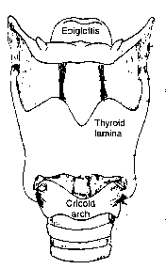
Hyothyroid
Middle hyothyroid Ligament
Membrane
Conus Elasticus
Cricotracheal
Memebrane

Slide 17
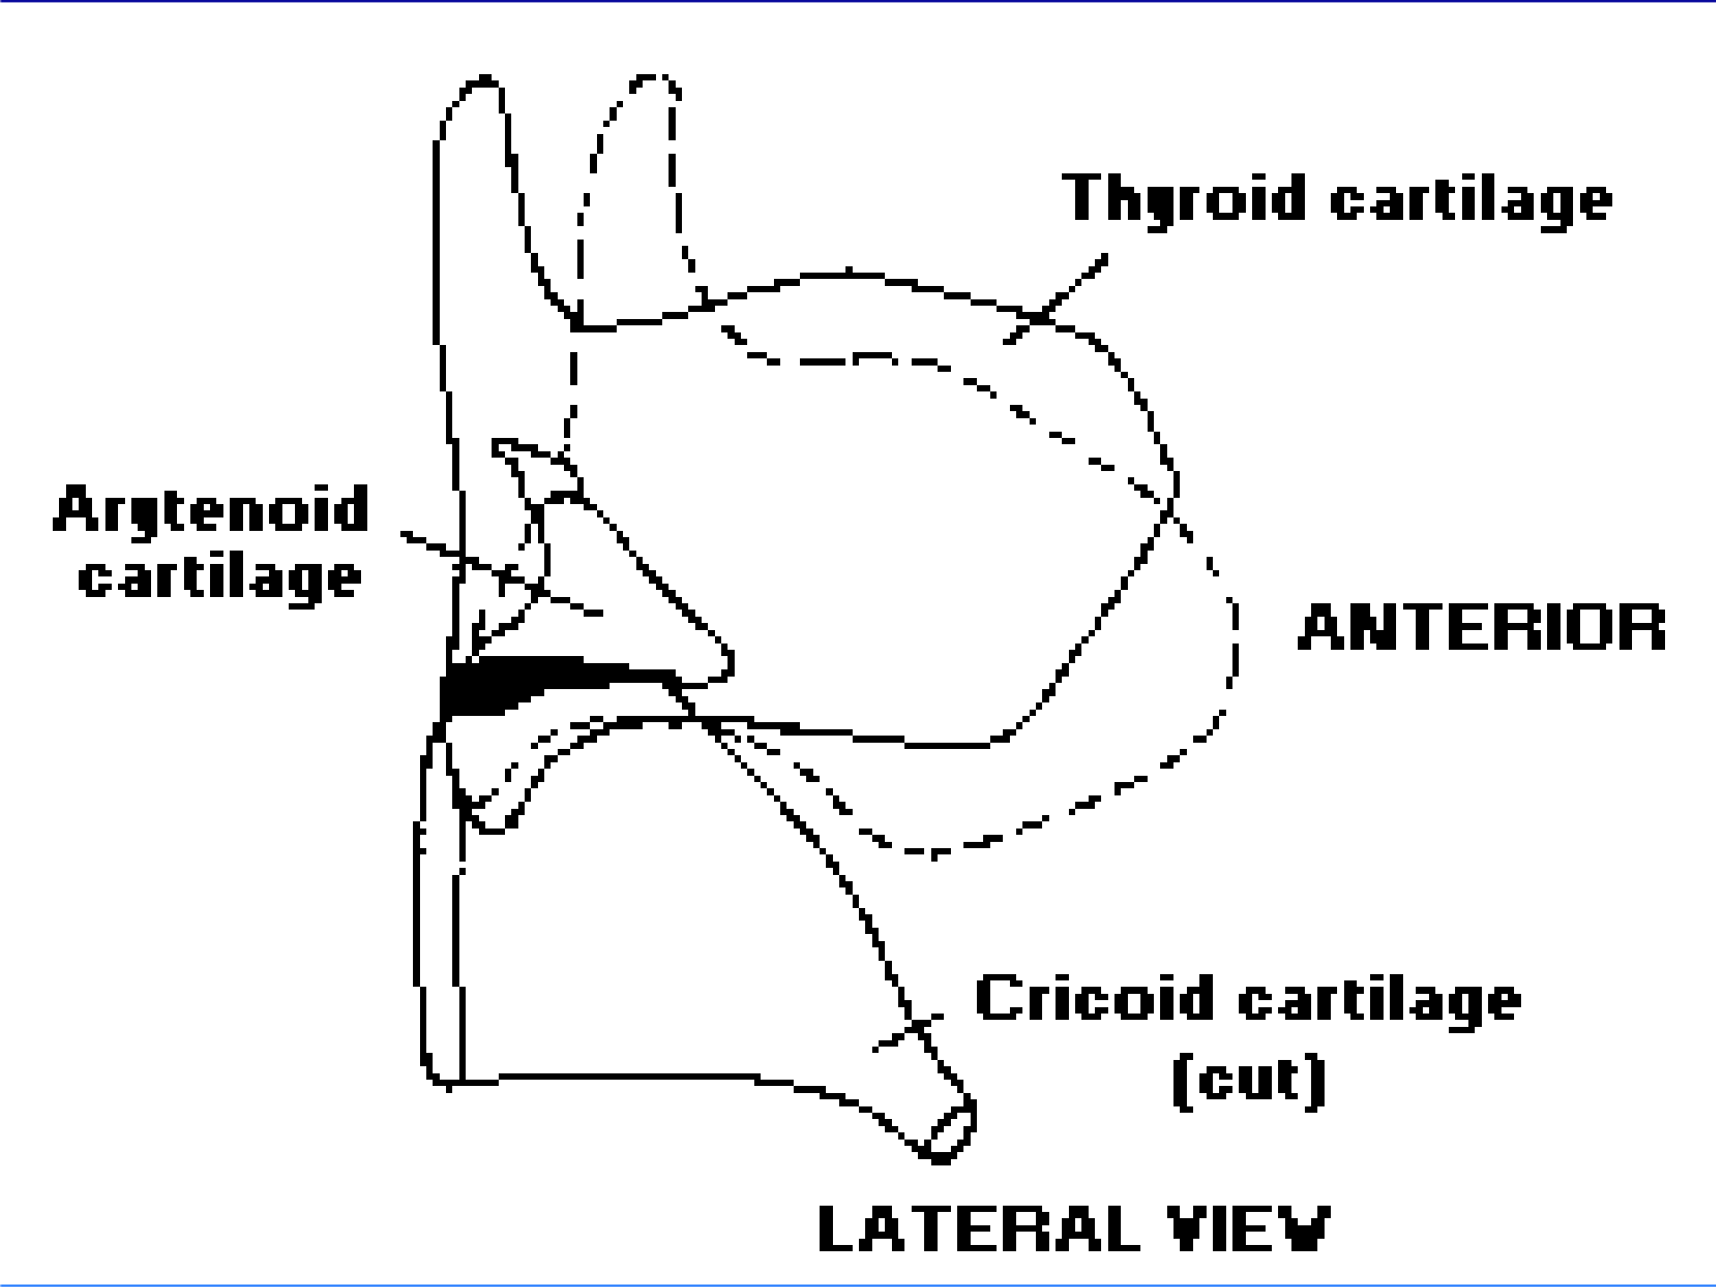
Posterior Cricoarytenoid Ligament

Slide 18
Anatomy of the Vocal Folds
Hirano (1974, 1981) proposed a 5 layer model:
Epithelium (outer layer)
stiff mosaic tissue for protection
Lamina propria (middle layer)
  Superficial layer (Reinke’s space) loose fibers w/ fluid spaces = “cobweb”; nodules

Slide 19
Anatomy of the Vocal
Folds(Cont.)
  Intermediate layer
elastic fibers w/ recoil features = rubber band
  Deep layer
thick collagenous fibers, less
elastic = “cotton thread”
3) Vocalis muscle = thyrovocalis
vibrates the VF for sound production length + tension

Slide 20

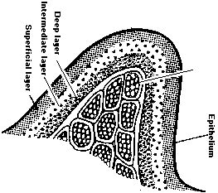
Lamina Propria
Vocalis m.

Slide 21
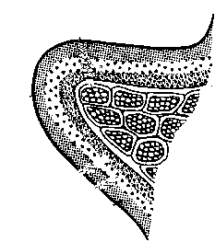
Epithelium
Superficial
TRANSITION
Intermediate L.
Deep L.
Vocalis

Slide 22
The combination of mechanical properties of the 5 layers determines the mode of VF vibration
i.e., Fundamental Frequency= Fo number of vibratory cycles/sec. = number of Hz
1 open + 1 close = 1 cycle
Ex. 120 Hz
• = Simple Harmonic Motion

Slide 23
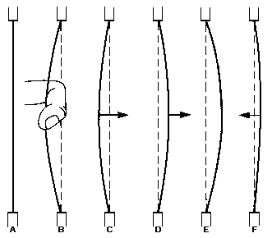
Rest
Force
Elasticity
Inertia Maximum
Elasticity
Displacement

Slide 24
Mechanical properties
Tension (stiffness): major determinant of Fo; increase tension (decrease elasticity) increase vibrations
Mass (thickness): distribution of the VF mass is related to length + tension
increase mass & decrease vibration
Length (source): male VF are longer and vibrate less; increasing length and decreasing vibration

Slide 25
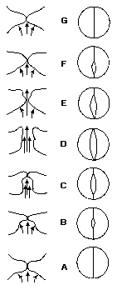

Slide 26
Theories to explain production of VF vibration
Neurochronaxic
Myoelastic-Aerodynamic

Slide 27
Neurochronaxic Theory
States that vocal fold vibration is almost totally dependent on the rate of neural impulses received by the laryngeal muscles
Even though nerves can fire (send impulses) quite fast, the rapid pattern of vibration observed during production of high frequencies can not be explained by the rate of nerve impulse

Slide 28
Myoelastic-Aerodynamic
Theory
Widely accepted
it takes into account laws of physics which regulates movement/control of air molecules (Aerodynamic) and muscle activity (Myoelastic)

Slide 29
Aerodynamic
Laws of physics are used to explain generation/control of air flow and pressure

Slide 30
Myoelastic
States that the laryngeal physical properties (positioning of structures,
tension, length, distribution of mass…) are controlled by the intrinsic laryngeal muscles (muscle contraction)

Slide 31
Assumptions of Myoelastic- Aerodynamic Theory of VF
vibration
vocal folds are appropriately positioned (postured) in a closed or semiclosed position
pressure is built up below the folds
folds repeatedly open and close automatically

Slide 32
Implications of Myoelastic- Aerodynamic Theory of VF
vibration
the vocal folds do not open and close during phonation because there is a separate muscle contraction for each opening/closing movement
the vocal folds open and close automatically, as long as the folds are in a position of closure or near closure, and there is sufficient buildup of pressure below them

Slide 33
Forces that cause the vocal
folds to open
1) buildup of air pressure on one side of the vocal folds (below)

Slide 34
Forces that cause the vocal
folds to close
1) drop in pressure along the glottal margin of folds
(explained by Bernoulli effect: high speed of airflow that occurs at the construction causes the walls of the vocal folds to be sucked together due to a drop in air pressure at the margin of the folds/ think on the “shower-curtain” example)

Slide 35
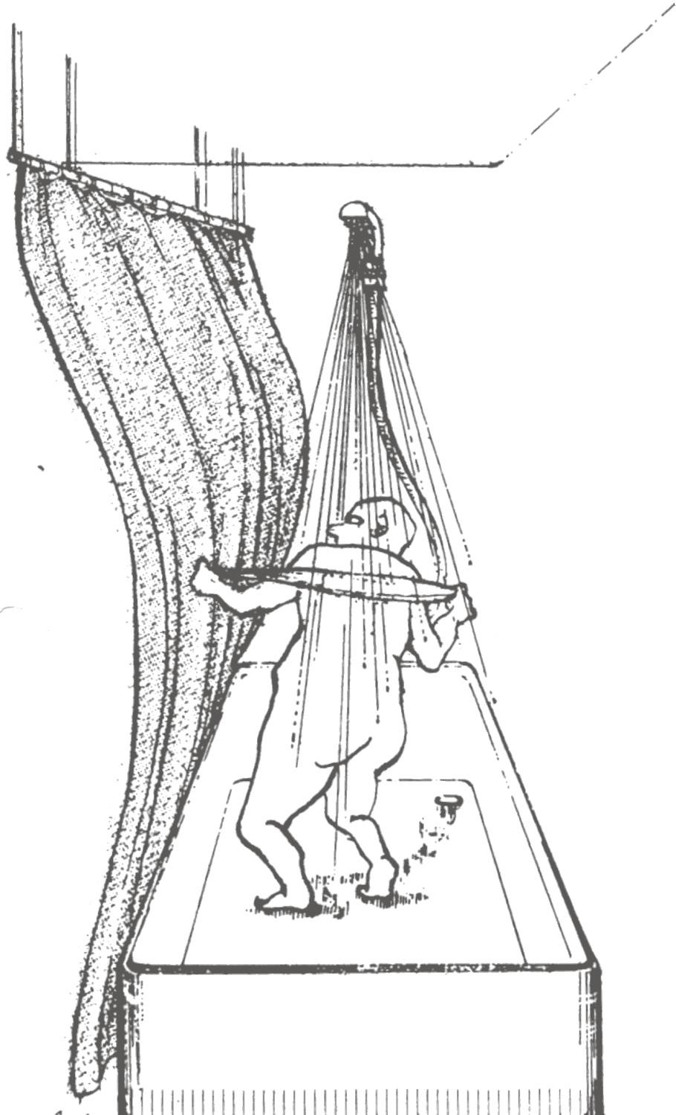
Bernoulli effect. A negative pressure develops perpendicular to the high speed flow sucking the surrounding substance toward it

Slide 36
Forces that cause the vocal folds to close (Cont.)
2) force of elastic recoil of the folds
(consider the adducted position of the folds its rest position, once the air pressure building below the folds is enough to blow them apart, the folds are “pushed away” from the rest position - opposing elastic recoil forces will tend to restore the folds to the original position/shape)

Slide 37
Important factors governing
vocal fold vibration
vocal fold position - degree of adduction glottal adductors: a) lateral cricoarytenoid m.
  transverse interarytenoid m.
  oblique interarytenoid m.
vocal fold myoelasticity - length + tension glottal tensors/relaxors: a) cricothyroid m.
  thyroarytenoid m.
“amount/size” of pressure drop along the folds

Slide 38
Mechanism of Vocal Frequency Change
1) By the amount of Tension, Mass, Length
(muscles…)
Open/close quotients or phases
Frequency (Hz) >>> Pitch
3 modes of vibration >>> 3 ranges of pitch Registers:
Modal (normal voice for talking and singing)
Falsetto (men to the high “feminine” quality sound)
Vocal fry ( the lowest vocal register and is produced through a loose glottal closure)
https://www.youtube.com/watch?v=9aKNwKHCMjk
2) By changing Airflow

Slide 39
Mechanism of Vocal Intensity Change
1) By the amount of glottal resistance
(increase medial compression; muscles… increase size of burst of air, increase impact collision of air molecules, increase displacement of acoustic vibration)
Intensity (Sound Pressure Level SPL) >>> Loudness

Slide 40
Mechanism of Vocal Intensity Change
Size and shape of vocal tract (laryngeal, pharyngeal, oral, & nasal)
Air pressure + air flow (speed)
Increase time of closure (LCA)

Slide 41
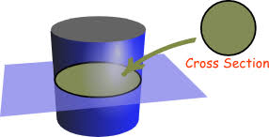
Mechanism of Vocal Quality Variation
Quality of the phonatory system (tissues, elasticity, age, smoking)
Coordination of the muscles (tremor)
Shape and configuration of the vocal tract (cleft palate)
length of the cross sectional area
size of resonators (oral, nasal, pharyngeal)
style of the articulators (high hard palate)
edge of the vibrating tissue (periodicity)

Slide 42
Some Etiologic Correlates
Voice disorders may arise from a wide array of possible etiologies.
The more aware the voice pathologist is of these possible causes, the more likely that efficient diagnoses and management plans may be established.

Slide 43
Etiologies of Vocal Misuse
Functional voicing behaviors that contribute to the development and maintenance of laryngeal pathologies.

Slide 44

Vocal Abuse Behaviors
shouting
loud talking
screaming
vocal noises
coughing
throat clearing

Slide 45
Inappropriate Vocal Components
type of breathing
phonatory habits
resonance
pitch
loudness
rate

Slide 46
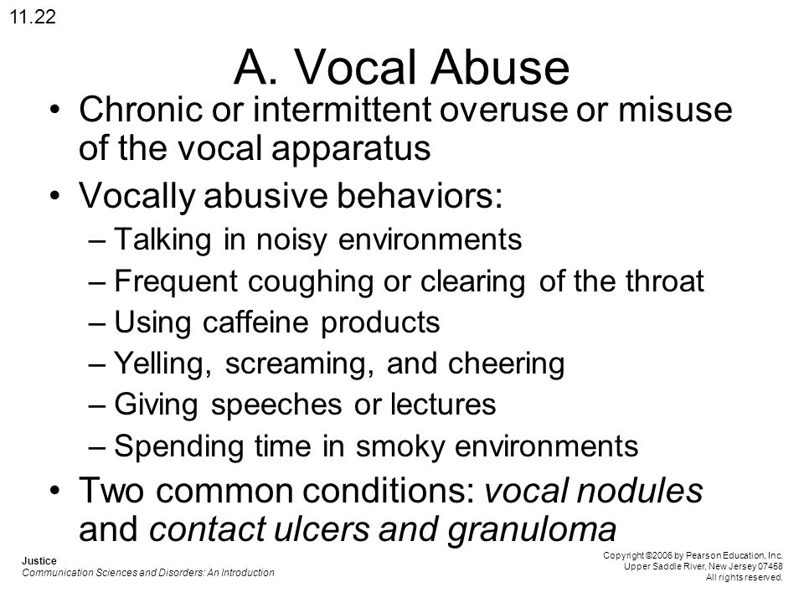

Slide 47
Medically-related Etiologies
Medical/surgical interventions which directly cause a voice disorder.
Medical/health conditions which may directly or indirectly contribute to the development of a voice disorder.

Slide 48

Surgical Trauma (Direct)
laryngectomy of any kind
glossectomy
mandibulectomy
palatal surgery
other head and neck combinations

Slide 49



Surgical Trauma (Indirect)
thyroidectomy
cardiac
carotid
laminectomy
lung
hysterectomy
any intubation

Slide 50

Chronic Illnesses/Disorders
“sinus”
allergies
respiratory illnesses (laryngeal dyskinesia)
frequent URI (upper Respiratory infection)
gastrointestinal disorders
emotional disorders
hormonal imbalance
arthritis
smoking
alcohol/drug abuse

Slide 51
Primary Disorder Etiologies
Major disorders with secondary vocal symptoms

Slide 52
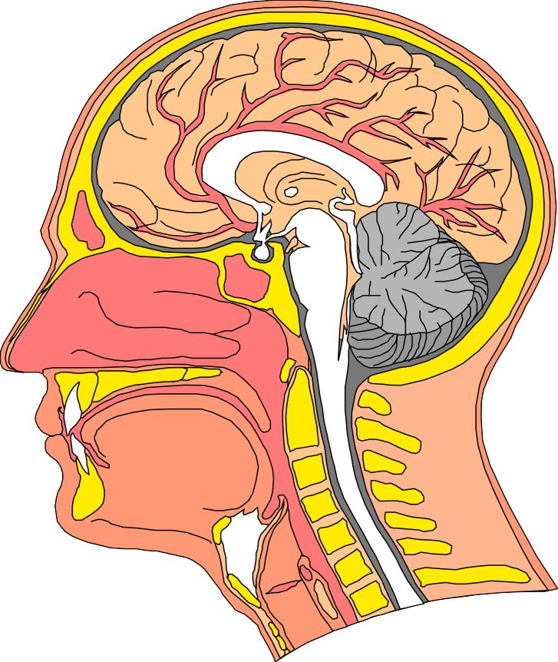
Primary Disorder Etiologies
cleft palate
velopharyngeal insufficiency
deafness/HOH
cerebral palsy
neurologic disorders

Slide 53
Personality-Related Etiologies
Tensions and stresses of daily life may contribute directly to the abnormal functioning of the sensitive vocal mechanism.

Slide 54

Personality-Related Etiologies
environmental stress
psychological conversions
identity conflict

Slide 55
Incidence of Laryngeal Pathologies Herrington-Hall et al (1988)
vocal nodules
edema
polyps
cancer
paralysis
no visible pathology
laryngitis
leukoplakia
psychogenic
21.6%
14.1%
11.4%
9.7%
8.1%
7.9%
4.2%
4.1%
2.6%

Slide 56
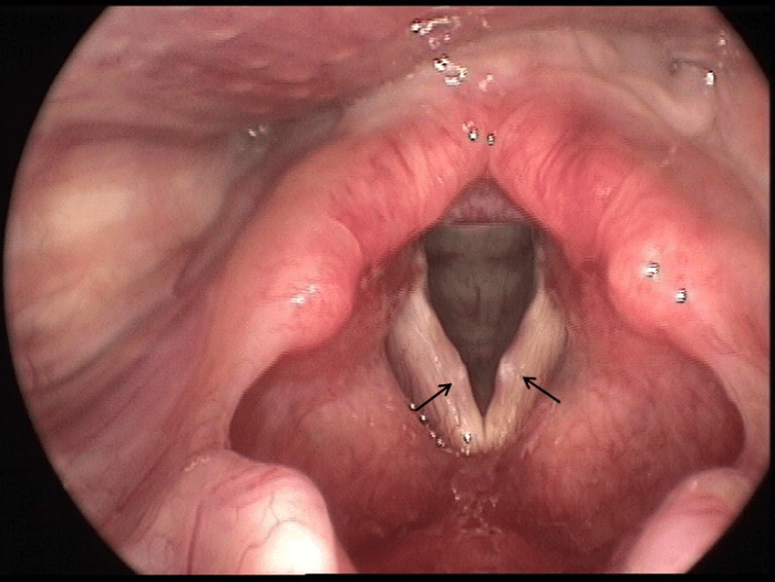
Vocal nodules

Slide 57
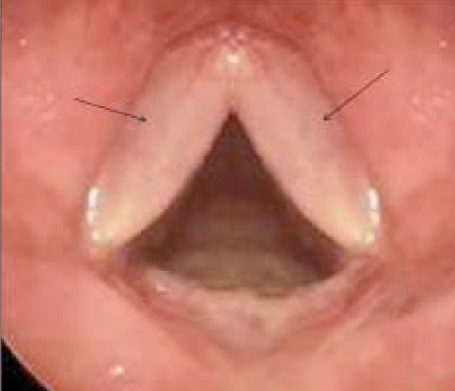
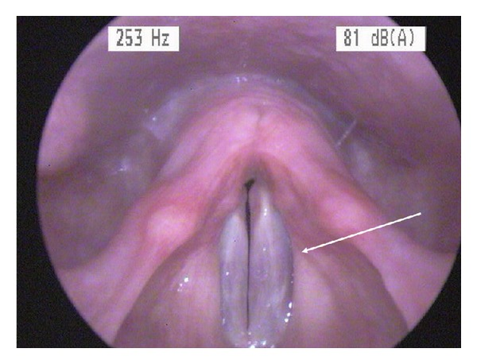
Edema
L eft VF

Slide 58
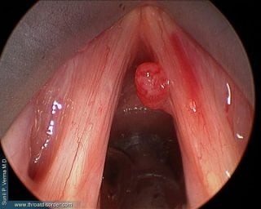
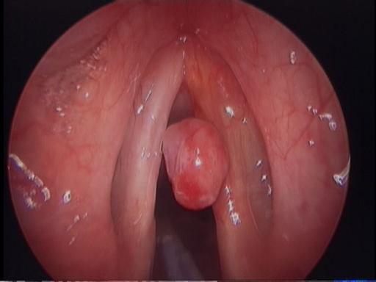
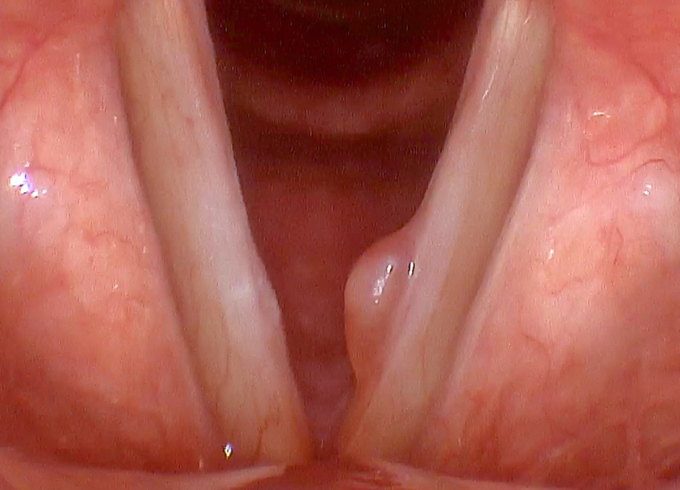
Polyps

Slide 59
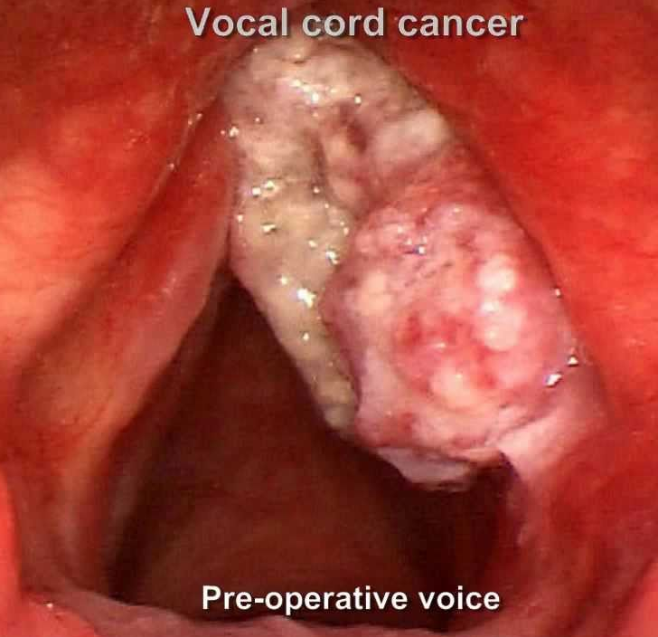
Cancer

Slide 60
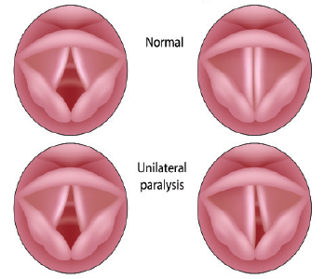
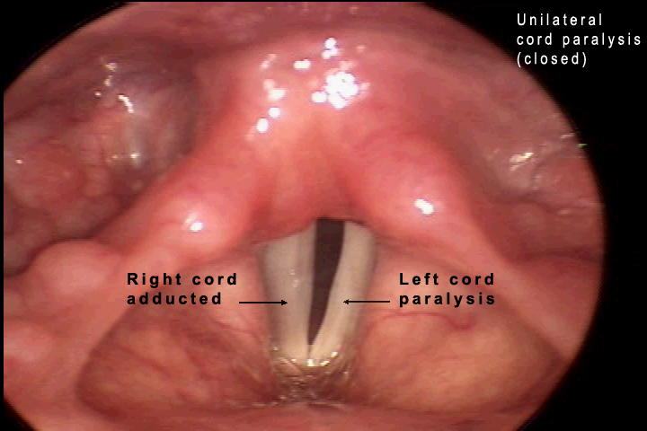
Paralysis

Slide 61
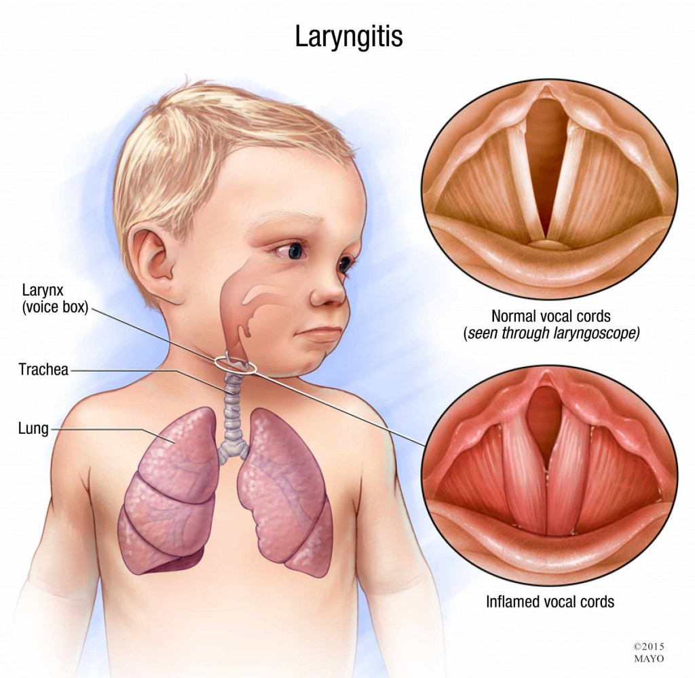
Laryngitis

Slide 62
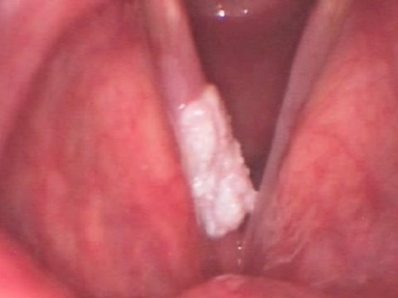
leukoplakia

Slide 63

Human papilloma virus HPV

Slide 64
Pathology Classifications
Congenital laryngeal pathologies
Pathologies of the vocal fold cover
Neurogenic laryngeal pathologies
Pathologies of muscular dysfunction

Slide 65
Congenital Laryngeal Pathologies
congenital web
congenital subglottic stenosis
congenital cyst
laryngomalacia
laryngotracheal cyst

Slide 66
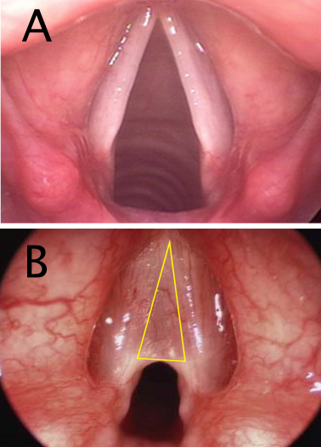
congenital web

Slide 67
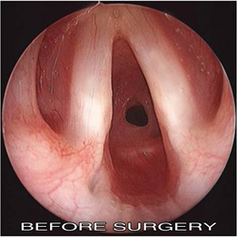
congenital subglottic stenosis

Slide 68
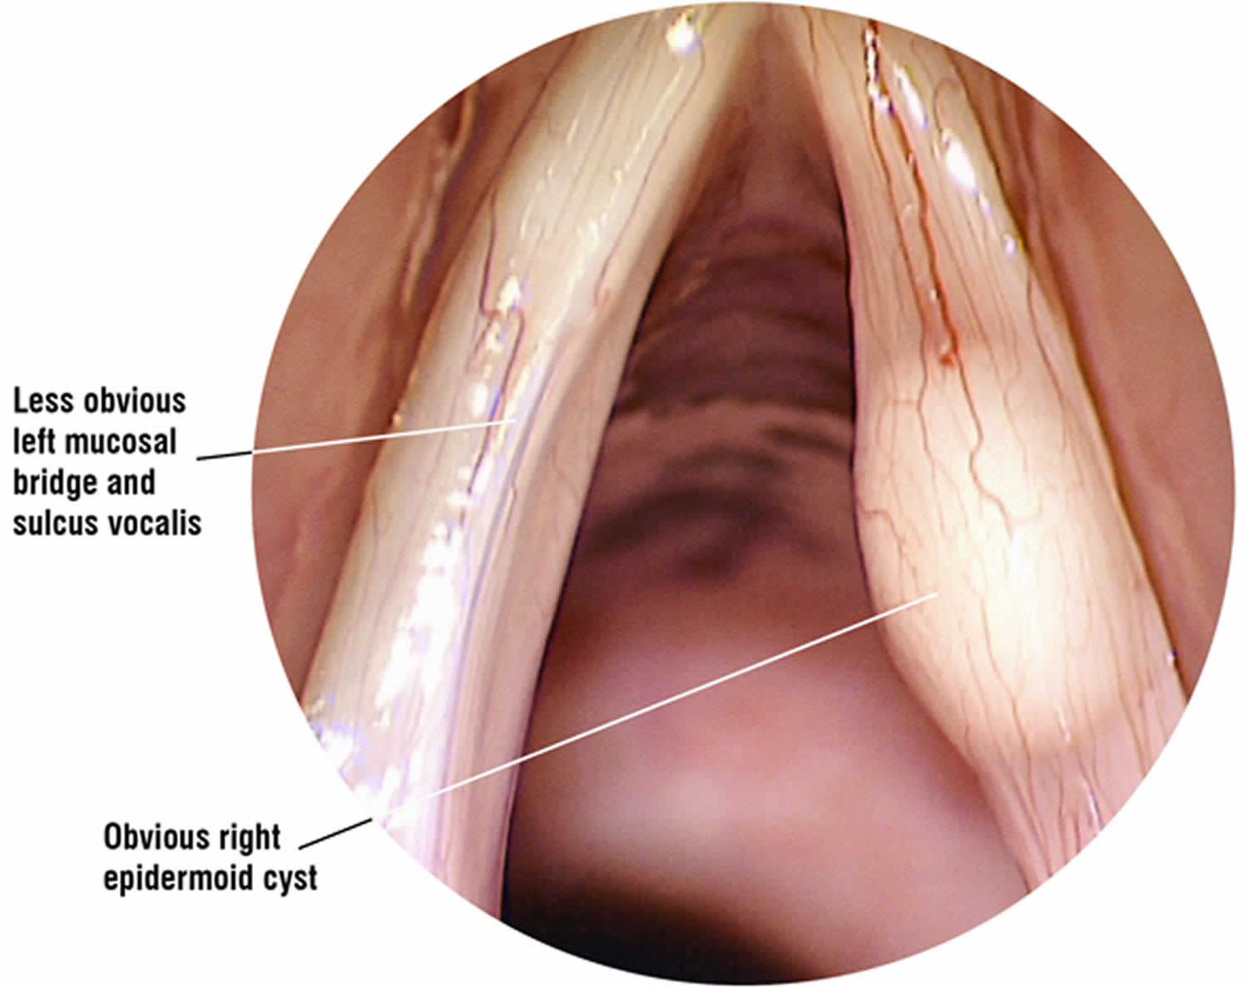
Congenital Cyst

Slide 69
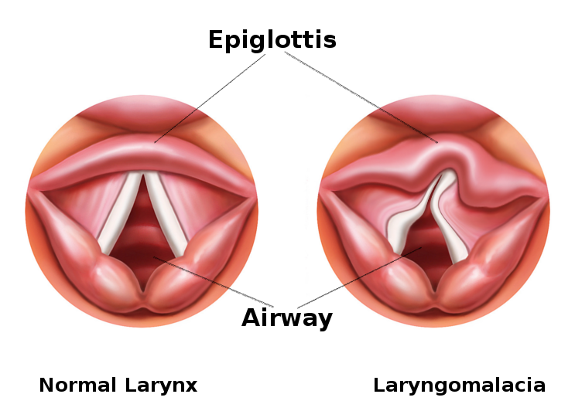
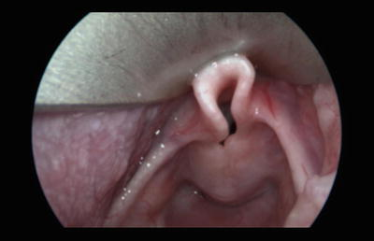
laryngomalacia

Slide 70
Pathologies of the Vocal fold Cover
acute laryngitis
chronic laryngitis
nodules
polyp
Reinke’s edema
cyst
contact ulcer
granuloma
papilloma
leukoplakia
hyperkeratosis
carcinoma
hemorrhage
varix
sulcus vocalis

Slide 71
Neurogenic Laryngeal Pathologies
spasmodic dysphonia
essential laryngeal tremor
vocal fold paralysis

Slide 72
Pathologies of Muscular Dysfunction
ventricular phonation
conversion aphonia/dysphonia
functional falsetto
juvenile voice
laryngeal myasthenia

Slide 73
THE DIAGNOSTIC VOICE
EVALUATION
The diagnostic voice evaluation is a primary therapy tool.
The effectiveness of the evaluation will dictate the success or failure of therapy.

Slide 74
Primary Objectives of the Voice
Evaluation
identify the causes
describe the present vocal components
develop the management plan

Slide 75
Secondary Objectives of the Voice
Evaluation
patient education
patient motivation
establish credibility of voice pathologist

Slide 76
Referral Sources
otolaryngologists
other medical specialists
speech-language pathologists
vocal coaches
singing teachers
former patients
family
friends

Slide 77

Professional Relationships
evolution of the voice team
complementary relationships
comments on medical speech pathology

Slide 78

The Medical Examination
indirect laryngoscopy
fiberoptic laryngoscopy
direct laryngoscopy
laryngeal videostroboscopy

Slide 79
The Voice Pathology Evaluation
patient interview
subjective voice assessment
instrumental assessment of vocal function
laryngeal videostroboscopy

Slide 80
INSTITUTE FOR VOICE ANALYSIS
AND REHABILITATION (Evaluation Form)
NAME:
AGE:
DOB:
DATE:
REFERRAL:
REASON FOR REFERRAL:
TYPE OF CASE:
ADDRESS:
TELEPHONE:
EXAMINER:
1. Establish referral source
Establish exact reason for patient referral
Establish patient under- standing for referral
Develop knowledge of the
voice disorder
Establish credibility of examiner

Slide 81
HISTORY OF THE PROBLEM:
1. Establish the chronology of the problem
Seek etiologic factors associated with the history
Determine patient motivation
MEDICAL HISTORY:
Seek medically-related etiologic factors
Establish awareness of patient
personality

Slide 82
SOCIAL HISTORY:1. Identify work, home, recreational environments
Discover emotional, social, family
difficulties
Seek more etiologic factors
ORAL-PERIPHERAL EXAMINATION:
Determine physical condition of oral
mechanism
Observe whole body tension
Observe laryngeal area tension
Check for swallowing difficulties
Check for laryngeal sensations

Slide 83
PERCEPTUAL EVALUATION
General Quality:
1. Describe voice quality using descriptive terms. May use scale system
2. Examine inappropriate use of voice component
Describe type of breathing pattern (supportive/non- supportive)
s/z ratio
Maximum phonation time
Respiration:
Phonation
Hard glottal attacks
Glottal fry
Breathiness
Diplophonia

Slide 84
Perceptual Evaluation cont.
Hypernasal
Hyponasal
Assimilative nasality
Cul de sac nasality
Inappropriate tone focus
Resonation:
Pitch:
Test present pitch range
Describe conversational inflection
Make subjective judgment of appropriateness (optimum pitch?????????)
Loudness:
Too loud, soft, appropriate
Check ability to shout/talk softly

Slide 85
Perceptual evaluation cont.
Rhythm and Rate:
Non-Speech Abuses:
Too fast
Too slow
Interrupted
Throat clearing
Coughing
Unusual laugh
IMPRESSIONS: Summarize the etiologic factors associated
with the development and maintenance of the voice disorder
PROGNOSIS: Analyze the probability of improvement through
voice therapy
RECOMMENDATIONS: Outline the management plan

Slide 86
Instrumental Measurement of Voice:
Clinical Utility
Detection
  identify the existence of a voice problem
Severity
  assess the severity or stage of progression of the voice problem
Diagnosis
  identify the differential source of the voice problem

Slide 87
Instrumental Measures in the Voice
Laboratory
laryngeal videostroboscopy
acoustic recording and analysis
aerodynamic assessment
electroglottography
electromyography

Slide 88
Laryngeal Videostroboscopy
demonstrates the gross movements of the laryngeal structures
provides immediate image of presence or absence of pathology and a permanent visual record
demonstrates the characteristics of vocal fold vibration and the integrity of the mucous membrane fold covering

Slide 89
Principles of Stroboscopy
Talbot’s Law
  images linger on the human retina for 0.2 seconds after exposure (persistence of vision)
  the eye can perceive no more than five distinct images per second
  when sequential images are produced at intervals shorter than 0.2 seconds, they persist on the retina with successive images to produce the optical illusion of apparent motion

Slide 90
Principles of Stroboscopy cont.
Stroboscopy and Talbot’s Law
  vocal fold vibration is too rapid to be perceived by the human eye
  strobe light flashes on the vibrating vocal folds
  each light pulse illuminates a point of the vibratory cycle
  illuminated points are visually fused providing an averaged vibratory pattern over successive cycles

Slide 91
Principles of Stroboscopy cont.
Stroboscopy and Talbot’s Law cont.
  when flashes are emitted at the same frequency as phonation, they optically occur at the same phase point in the successive cycles and the images appear frozen
  when flashes are slightly slower (2 Hz) than the frequency of phonation, they optically occur at different phase points in successive cycles yielding a simulated slow-motion effect of the vocal fold vibration

Slide 92
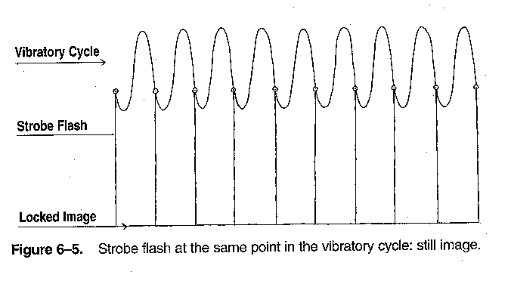

Slide 93
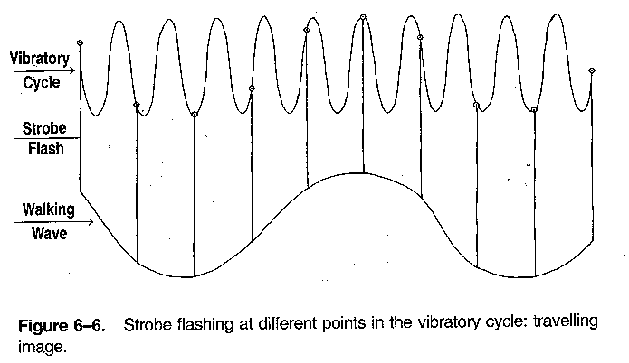

Slide 94
Instrumental Components of
Stroboscopy
stroboscope
rigid or flexible endoscope
video camera
video recorder
video monitor
video printer
computer interface

Slide 95
Assessment of Stroboscopy Parameters
glottic closure
  observed during vibration of the vocal folds
supraglottic activity
  ventricular fold compression
  anterior/posterior compression
vertical level approximation
  modified by superior laryngeal nerve paralysis
  modified by large mass lesion such as polypoid degeneration

Slide 96
Assessment of Stroboscopy
Parameters cont.
vocal fold edge
amplitude of vibration
  lateral excursion of the vocal folds
mucosal wave
  may be affected by pathology, scarring, pitch, loudness, hyperfunction, hypofunction, anxiety, subglottic driving force
non-vibrating portion
  scarring or lesion

Slide 97
Assessment of Stroboscopy
Parameters cont.
phase closure
  closed and open phase timing should be equal
phase symmetry
  mirror image

Slide 98
Stroboscopy Procedure
how to get a successful stroboscopic image
recording protocol
report writing
artifacts
  not real time
  image seen through optical devices
  speech sample may not be representative

