Slide 1


E-commerce 2021: Business. Technology. Society.
Sixteenth Edition
Chapter 2
E-commerce Business Models and Concepts
Copyright © 2022, 2019, 2018 Pearson Education, Inc. All Rights Reserved
Notes:
If this PowerPoint presentation contains mathematical equations, you may need to check that your computer has the following installed:
1) MathType Plugin
2) Math Player (free versions available)
3) NVDA Reader (free versions available)

Slide 2
Learning Objectives
2.1 Identify the key components of e-commerce business models.
2.2 Describe the major B2C business models.
2.3 Describe the major B2B business models.
2.4 Understand key business concepts and strategies applicable to e-commerce.

Slide 3
Coping with a Pandemic: Small Businesses Reinvent with E-commerce
Class Discussion
  Prior to the pandemic, did you physically shop at small businesses in your community?
  What steps have small businesses with which you are familiar taken to continue operating during the pandemic?
  How likely are you to continue new consumer behaviors instituted during the pandemic after it is over? For instance, if you ordered groceries online, will you continue to do so?

Slide 4
E-commerce Business Models
Business model
  Set of planned activities designed to result in a profit in a marketplace
Business plan
  Describes a firm’s business model
E-commerce business model
  Uses/leverages unique qualities of Internet and Web

Slide 5
Eight Key Elements of a Business Model
Value proposition
Revenue model
Market opportunity
Competitive environment
Competitive advantage
Market strategy
Organizational development
Management team

Slide 6
1. Value Proposition
“Why should the customer buy from you?”
Successful e-commerce value propositions:
  Personalization/customization
  Reduction of product search, price discovery costs
  Facilitation of transactions by managing product delivery

Slide 7
2. Revenue Model
“How will you earn money?”
Major types of revenue models:
  Advertising revenue model
  Subscription revenue model
    Freemium strategy
  Transaction fee revenue model
  Sales revenue model
  Affiliate revenue model

Slide 8
Insight on Society: Foursquare’s Evolving Business Model: Leveraging Your Location
Class discussion:
  Why has the shift in Foursquare’s business model been the key to success for Foursquare?
  How comfortable are you with the ability of Foursquare to characterize behavior into various personas?
  What is your opinion of Foursquare’s characterization of itself as one of the “good guys” in the location data industry?
  How is Foursquare attempting to cope with a more privacy-conscious business environment?

Slide 9
3. Market Opportunity
“What marketspace do you intend to serve and what is its size?”
  Marketspace: Area of actual or potential commercial value in which company intends to operate
  Realistic market opportunity: Defined by revenue potential in each market niche in which company hopes to compete
Market opportunity typically divided into smaller niches

Slide 10
4. Competitive Environment
“Who else occupies your intended marketspace?”
  Other companies selling similar products in the same marketspace
  Includes both direct and indirect competitors
Influenced by:
  Number and size of active competitors
  Each competitor’s market share
  Competitors’ profitability
  Competitors’ pricing

Slide 11
5. Competitive Advantage
“What special advantages does your firm bring to the marketspace?”
  Is your product superior to or cheaper to produce than your competitors’?
Important concepts:
  Asymmetries: exists whenever one participant in a market has more resources than other participants
  First-mover advantage: a competitive market advantage for a firm that results from being the first into a marketplace with a serviceable product or service
    complementary resources: resources and assets not directly involved in the production of the product but required for success, such as marketing, management, financial assets, and reputation

Slide 12
5. Competitive Advantage
          Unfair competitive advantage: occurs when one firm develops an advantage based on a factor that other firms cannot purchase
          Leverage: when a company uses its competitive advantages to achieve more advantage in surrounding markets
          Perfect markets: there are no competitive advantages or asymmetries because all firms have access to all the factors of production (including information and knowledge) equally. However, real markets are imperfect, and asymmetries leading to competitive advantages do exist,

Slide 13
6. Market Strategy
“How do you plan to promote your products or services to attract your target audience?”
Market Strategy: Plan that describes how the company will organize the work that needs to be accomplished
  Details how a company intends to enter market and attract customers
  Best business concepts will fail if not properly marketed to potential customers

Slide 14
7. Organizational Development
“What types of organizational structures within the firm are necessary to carry out the business plan?”
Describes how firm will organize work
  Typically, divided into functional departments
  As company grows, hiring moves from generalists to specialists

Slide 15
8. Management Team
“What kind of backgrounds should the company’s leaders have?”
Management Team: employees of the company responsible for making the business model work
A strong management team:
  Can make the business model work
  Can give credibility to outside investors
  Has market-specific knowledge
  Has experience in implementing business plans

Slide 16
Raising Capital
Seed capital: an entrepreneur’s personal funds derived from savings, credit card advances, home equity loans, or from family and friends
Elevator pitch: short two-to-three minute presentation aimed at convincing investors to invest
Traditional sources
  Incubators: provide a small amount of funding and also an array of services to start-up companies
  Angel investors: wealthy individuals or a group of individuals who invest their own money in exchange for an equity share in the stock of a business; often are the first outside investors in a start-up
  Commercial banks, venture capital firms : invest funds they manage for other investors; usually later-stage investors
  Strategic partners:
Equity crowdfunding: involves using the Internet to enable individuals to collectively contribute money to support a project
  J O B S Act

Slide 17
Insight on Business: Startups Turn to Crowdfunding
Class Discussion
  Would you feel comfortable investing in a startup that raises capital using equity crowdfunding? Why or why not?
  Why is it important to democratize access to capital?
  What obstacles are presented in the use of crowdfunding as a method to fund startups?

Slide 18
Categorizing E-commerce Business Models
No one correct way to categorize
Text categorizes according to:
  E-commerce sector (e.g., B2B)
  E-commerce technology (e.g., m-commerce)
Similar models appear in different sectors
Companies may use multiple business models (e.g., eBay)
E-commerce enablers

Slide 19
B2C Business Models
E-tailer
Community provider (social network)
Content provider
Portal
Transaction broker
Market creator
Service provider

Slide 20
B2C Models: E-Tailer
Online version of traditional retailer
Revenue model: Sales
Variations:
  Virtual merchant
  Bricks-and-clicks
  Catalog merchant
  Manufacturer-direct
Low barriers to entry: the total cost of entering a new marketplace

Slide 21
B2C Models: Community Provider
Provide online environment (social network) where people with similar interests can transact, share content, and communicate
  Examples: Facebook, LinkedIn, Twitter, Pinterest
The basic value proposition of community providers is to create a fast, convenient, one-stop platform where users can focus on their most important concerns and interests, share the experience with friends, and learn more about their own interests.
Revenue models:
  Typically hybrid, combining advertising, subscriptions, sales, transaction fees, and so on

Slide 22
B2C Models: Content Provider
Distributes information content, such as digital news, music, photos, video, and artwork
Revenue models:
  Use variety of models, including advertising, subscription; sales of digital goods
  Key to success is typically owning the content
Variations:
  Syndication: do not own content, but syndicate (aggregate) and then distribute content produced by others
  Aggregators: who collect information from a wide variety of sources and then add value to that information through post-aggregation services,
  Example: Shopzilla

Slide 23
Insight on Technology: Connected Cars and the Future of E-commerce
Class Discussion
  How are new connected car technologies also creating new business models?
  What is the potential impact on different forms of e-commerce, such as the content industry?
  Why are tech companies so interested in the connected car platform?
  Are there any issues with respect to “connected” cars?

Slide 24
B2C Business Models: Portal
Search plus an integrated package of content and services (such as news, e-mail, instant messaging, calendars, shopping, music downloads, video streaming, and more)
Revenue models:
  Advertising, referral fees, transaction fees, subscriptions for premium services
Variations:
  Horizontal/general (examples: Yahoo, A O L, M S N)
  Vertical/specialized (vortal) (example: Sailnet)
  Search (examples: Google, Bing)

Slide 25
B2C Models: Transaction Broker
Process online transactions for consumers
  Primary value proposition-saving time and money
Revenue model:
  Transaction fees
Industries using this model:
  Financial services
  Travel services
  Job placement services

Slide 26
B2C Models: Market Creator
Create digital environment where buyers and sellers can meet and transact (display and search for products and services, and establish prices)
  Examples: Priceline, eBay
  Revenue model: Transaction fees, fees to merchants for access
On-demand service companies (sharing economy): platforms that allow people to sell services
  Examples: Uber, Airbnb

Slide 27
B2C Models: Service Provider
Online services
  Examples: Google
    Google Maps, Gmail, and so on
Value proposition
  Valuable, convenient, time-saving, low-cost alternatives to traditional service providers
Revenue models:
  Sales of services, subscription fees, advertising, sales of marketing data

Slide 28
B2B Business Models
Net marketplaces
  E-distributor
  E-procurement
  Exchange
  Industry consortium
Private industrial network

Slide 29
B2B Models: E-distributor
A company that supplies products and services directly to individual businesses.
Version of retail and wholesale store, M R O goods, and indirect goods
Owned by one company seeking to serve many customers
Revenue model: Sales of goods
Example: Grainger

Slide 30
B2B Models: E-procurement
Creates digital markets where participants transact for indirect goods
  B2B service providers, S a a S and P a a S providers
  Scale economies: efficiencies that arise from increasing the size of a business
Revenue model:
  Service fees, supply-chain management, fulfillment services
Example: Ariba

Slide 31
B2B Models: Exchanges
An independent digital marketplace where suppliers and commercial purchasers can conduct transactions
Independently owned vertical digital marketplace for direct inputs
Revenue model: Transaction, commission fees
Create powerful competition between suppliers
Tend to force suppliers into powerful price competition; number of exchanges has dropped dramatically
Example: Go2Paper

Slide 32
B2B Models: Industry Consortia
Industry-owned vertical digital marketplace open to select suppliers
More successful than exchanges
  Sponsored by powerful industry players
  Strengthen traditional purchasing behavior
Revenue model: Transaction, commission fees
Example: SupplyOn

Slide 33
B2B Models: Private Industrial Networks
Digital network used to coordinate among firms engaged in business together
Typically evolve out of large company’s internal enterprise system
  Key, trusted, long-term suppliers invited to network
Example: Walmart’s network for suppliers

Slide 34
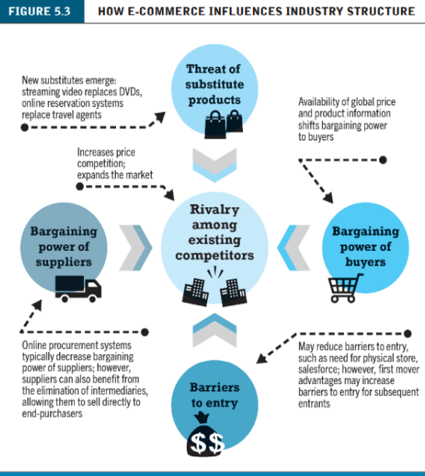
How E-commerce Changes Business
E-commerce changes industry structure by changing:
  Rivalry among existing competitors
  Barriers to entry
  Threat of new substitute products
  Strength of suppliers
  Bargaining power of buyers
Industry structural analysis

Slide 35
Industry Value Chains
Set of activities performed by suppliers, manufacturers, transporters, distributors, and retailers that transform raw inputs into final products and services
Internet reduces cost of information and other transactional costs
Leads to greater operational efficiencies, lowering cost, prices, adding value for customers

Slide 36
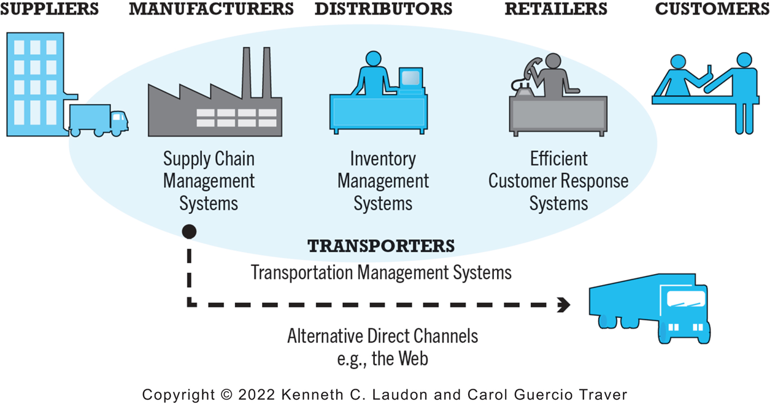
Figure 2.4 E-commerce and Industry Value Chains
Notes:
Figure 2.4, Page 89.
Every industry can be characterized by a set of value-adding activities performed by a variety of actors. E-commerce potentially affects the capabilities of each player as well as the overall operational efficiency of the industry.
Alt Text
Long description: An illustration depicts industry value chains, as follows: The value chain begins with suppliers. Manufacturers use supply chain management systems. Distributors use inventory management systems. Retailers use efficient customer response systems. Customers are the last link in the chain. Manufacturers can use transporters with transportation management systems to move inventory directly to customers via alternative direct channels such as the web.

Slide 37
Firm Value Chains
Activities that a firm engages in to create final products from raw inputs
Each step adds value
Effect of Internet:
  Increases operational efficiency
  Enables product differentiation
  Enables precise coordination of steps in chain

Slide 38
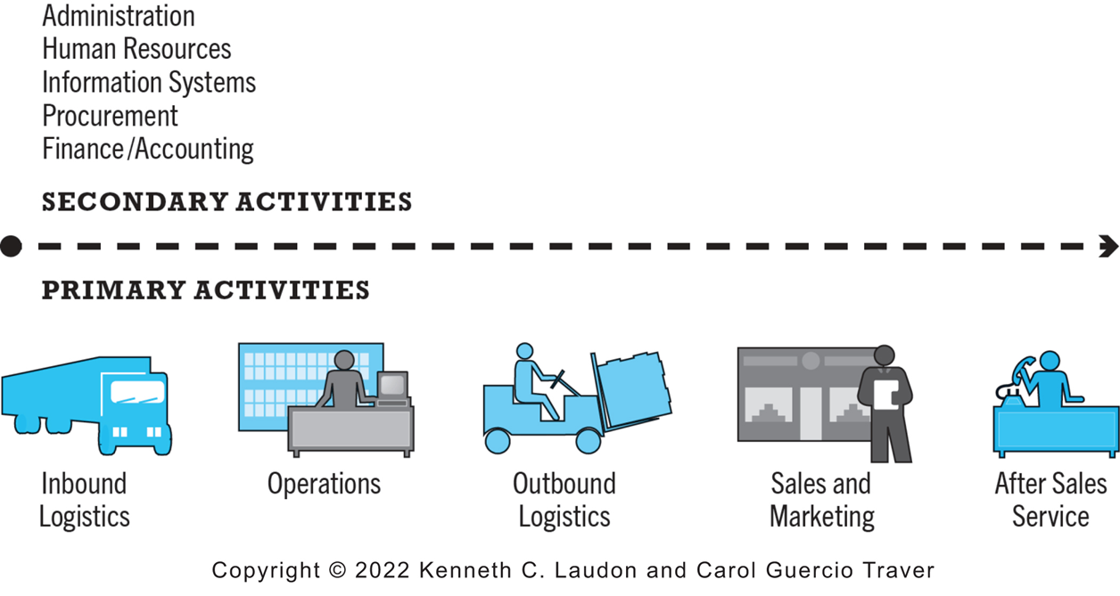
Figure 2.5 E-commerce and Firm Value Chains
Notes:
Figure 2.5, page 90.
Every firm can be characterized by a set of value-adding primary and secondary activities performed by a variety of actors in the firm. A simple firm value chain performs five primary value-adding steps: inbound logistics, operations, outbound logistics, sales and marketing, and after sales service.
Alt Text
Long description: An illustration depicts firm value chains, as follows: Primary activities in a firm value chain include inbound logistics, operations, outbound logistics, sales and marketing, and after sales service. Secondary activities include administration, human resources, information systems, procurement, and finance and accounting.

Slide 39
Firm Value Webs
Networked business ecosystem
Uses Internet technology to coordinate the value chains of business partners
Coordinates a firm’s suppliers with its own production needs using an Internet-based supply chain management system

Slide 40
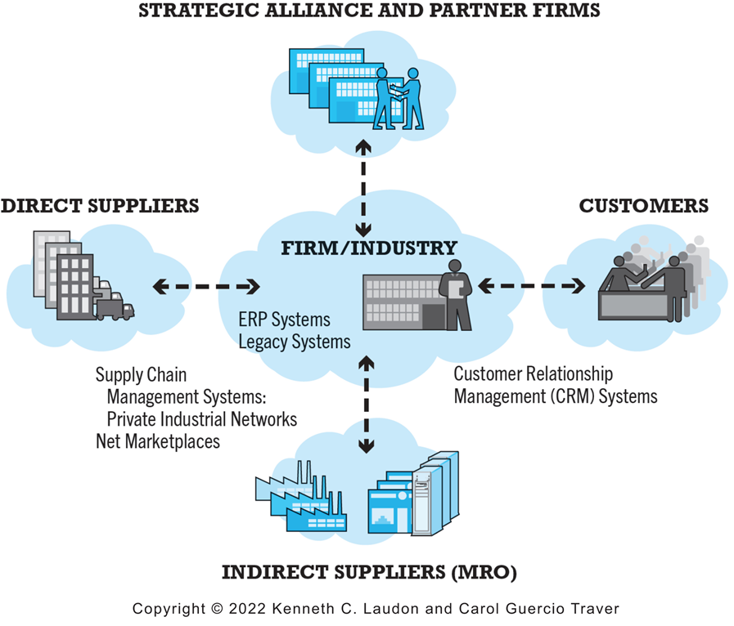
Figure 2.6 Internet-Enabled Value Web
Notes:
Figure 2.6, page 91.
Internet technology enables firms to create an enhanced value web in cooperation with their strategic alliance and partner firms, customers, and direct and indirect suppliers.
Alt Text
Long description: An illustration depicts an internet enabled value web, as follows: In a value web, a firm or industry uses e commerce technology to coordinate with strategic alliance and partner firms, customers through customer relationship management or C R M systems, and indirect suppliers or M R O and direct suppliers through E R P systems and legacy systems and supply chain management systems, private industrial networks and net marketplaces.

Slide 41
Business Strategy
Plan for achieving superior long-term returns on capital invested: that is, profit
Five generic strategies
  Product/service differentiation
  Cost competition
  Scope
  Focus/market niche
  Customer intimacy

Slide 42
E-commerce Technology and Business Model Disruption
Disruptive technologies
Digital disruption
Sustaining technology
Stages
  Disruptors introduce new products of lower quality
  Disruptors improve products
  New products become superior to existing products
  Incumbent companies lose market share

Slide 43
Careers in E-commerce
Position: Assistant Manager of E-business
Qualification/Skills
Preparing for the Interview
Possible Interview Questions

Slide 44

Copyright
This work is protected by United States copyright laws and is provided solely for the use of instructors in teaching their courses and assessing student learning. Dissemination or sale of any part of this work (including on the World Wide Web) will destroy the integrity of the work and is not permitted. The work and materials from it should never be made available to students except by instructors using the accompanying text in their classes. All recipients of this work are expected to abide by these restrictions and to honor the intended pedagogical purposes and the needs of other instructors who rely on these materials.

