Slide 1
Data Acquisition I
Architecture of DAQ systems
Signal conditioning
Aliasing

Slide 2
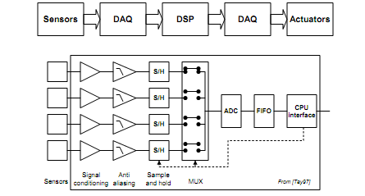
Architecture of data acquisition systems

Slide 3
Filters
Filters are used to remove unwanted bandwidths from a signal
Filter classification according to implementation
  Active filters include RC networks and op-amps
    Suitable for low frequency, small signal
    Active filters are preferred since avoid the bulk and non-linearity of inductors and can have gains greater than 0dB
    However, active filters require a power supply
  Passive filters consist of RCL networks
    Simple, more suitable for frequencies above audio range, where active filters are limited by the op-map bandwidth
Digital filters
  DSP is beyond the scope of this course

Slide 4
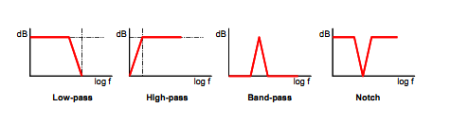
Filters
Filter classification according to frequency response
  Low-pass filter
  n High-pass filter
  Band-pass filter
  Band-stop (Notch)

Slide 5
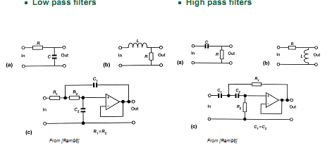
Low- and high-pass filters

Slide 6
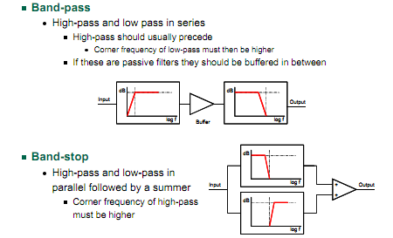
Band-pass and band-stop filters

Slide 7

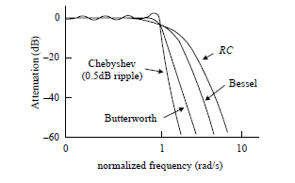
Types of Filters

Slide 8
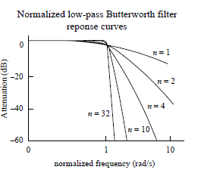

Slide 9
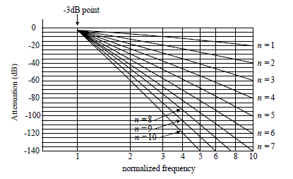
Attenuation curves for Butterworth LPF

Slide 10
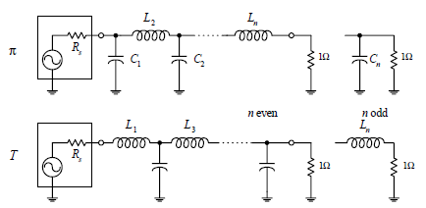
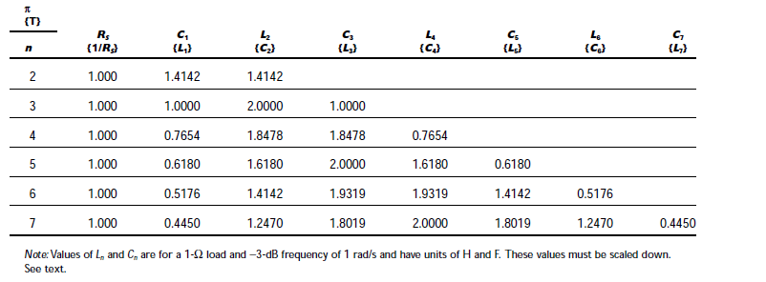
LC Low Pass Filter network

Slide 11

Example

Slide 12
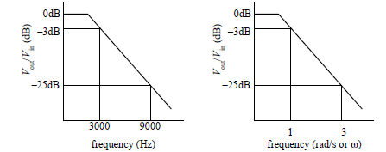
Step 1: Normalization
Step 2&3: Pick Response Curve and determine number of Poles
n=3 from the curve for Butterworth
Notes:
n=3 from the curve

Slide 13
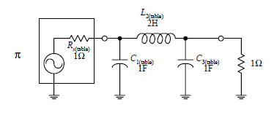
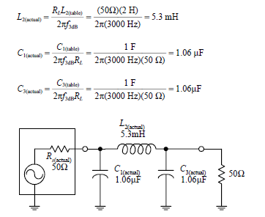
Step 4: Create Normalized Filter
Step 5: Frequency and Impedance Scaling

Slide 14
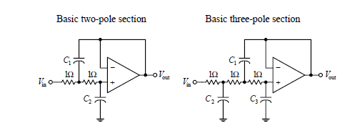
Active Filter Design

Slide 15
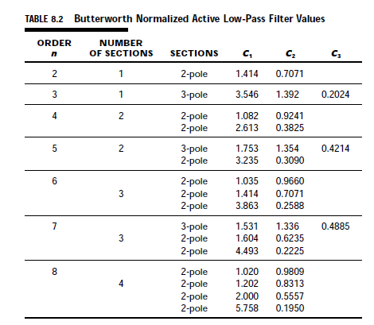
Normalized Curves

Slide 16

Exqample

Slide 17
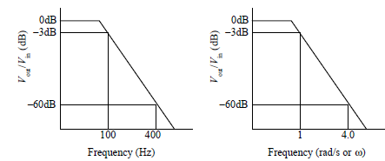

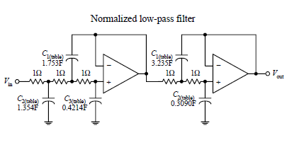
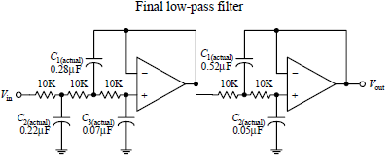

Solution
n=5 from the curves
Notes:
n=5 from the curves

Slide 18
High Pass Filter –Passive-
Suppose that you want to design a high-pass filter that has an f3dB = 1000 Hz and an
attenuation of at least −45 dB at 300 Hz—which we call the stop frequency fs. Assume
that the filter is hooked up to a source and load that both have impedances of 50 Ω
and that a Butterworth response is desired
How do you design the filter?

Slide 19
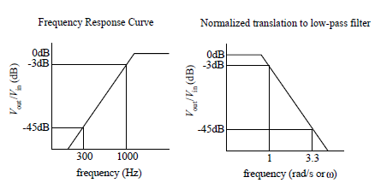
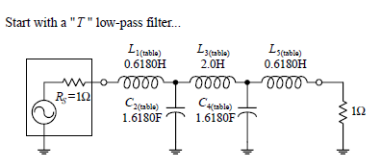

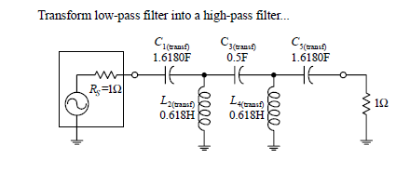
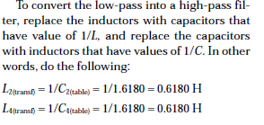

Solution
n=5 from the curves

Slide 20
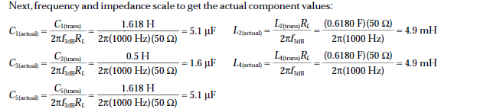
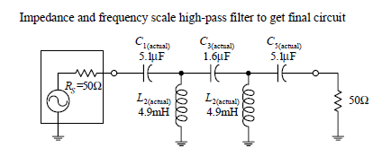
Now Scaling

Slide 21
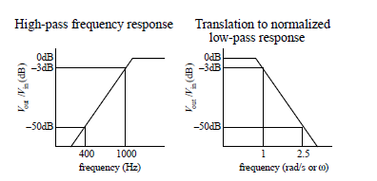
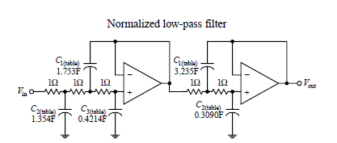

High Pass Filter-Active-
n=5 from the curves

Slide 22
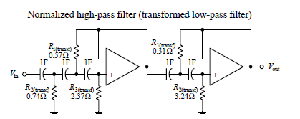

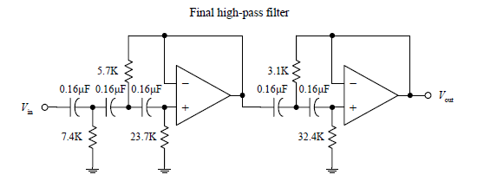
Follow…..

Slide 23
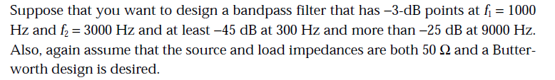
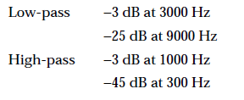
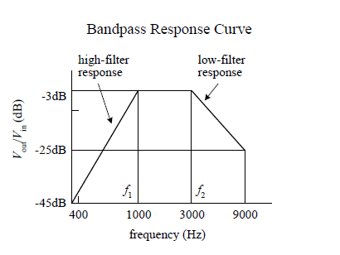
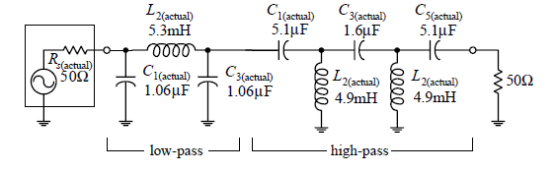
Bandpass Filter Design-Wide Band-Passive-
When is the filter wide band??
Just Cascade
Notes:
Just Cascade

Slide 24
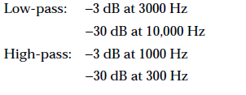

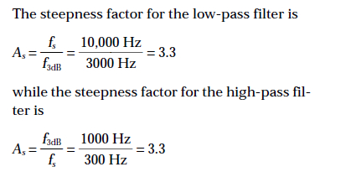
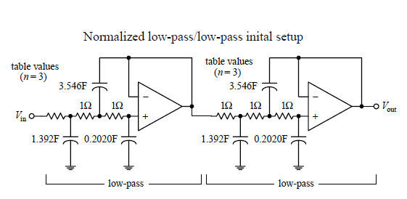
Bandpass Filter Design-Wide Band-Active-

Slide 25
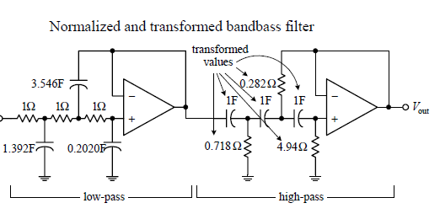
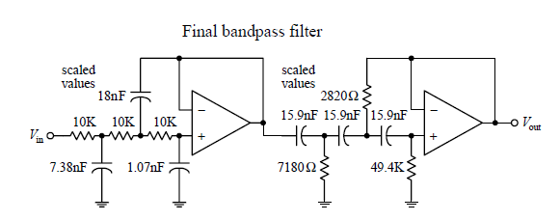


Follow…

Slide 26


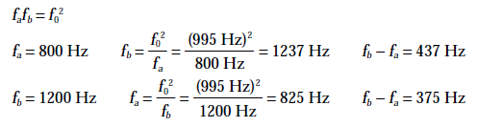
Narrow Bandwidth BPF-Passive (optional)
Choose the pair having the least separation, which represents more severe requirements-375 Hz
Notes:
Choose the pair have having the least separation, which represents more severe requirements-375 Hz

Slide 27
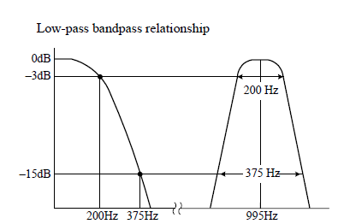

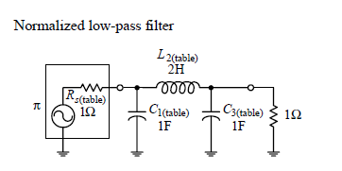
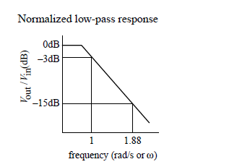
Follow…..
From the curve n=3
Notes:
From the curve n=3

Slide 28
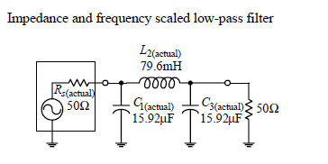
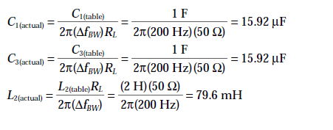
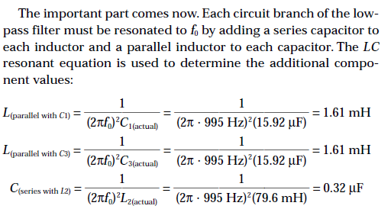

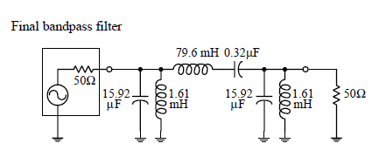
Follow……

Slide 29
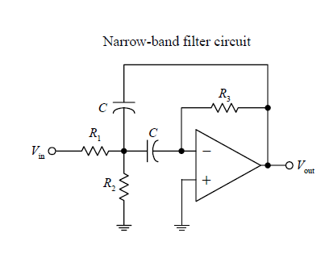


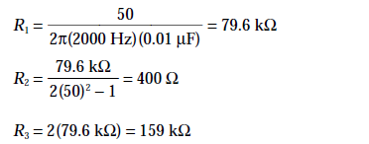
BPF-Narrow Band-Active Design
No Cascading
Choose convenient value of C, let it 0.01μF
Notes:
Choose convenient value of C, let it 0.01μF

Slide 30
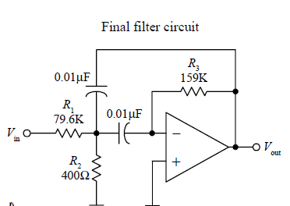
Final Design …

Slide 31
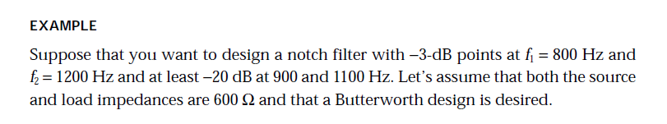

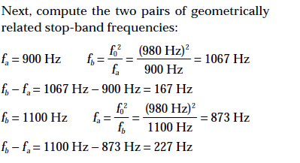

Passive Notch Filter (optional)

Slide 32
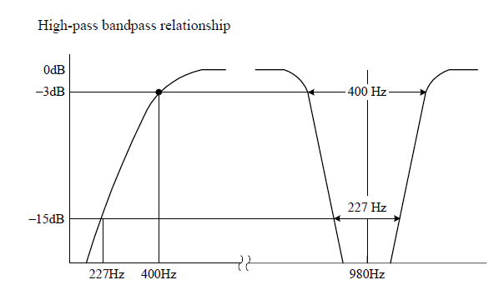




Follow….
n=3
Notes:
n=3

Slide 33




Follow…

Slide 34


Active Notch Filter –Wide-Band

Slide 35





Narrow-Band Notch Filter

Slide 36

Anti-aliasing
The sampling theorem
  A continuous signal can be represented completely by, and reconstructed from, a set of instantaneous measurements or samples of its voltage which are made at equally-spaced times. The interval T(=1/fS) between such samples must be less than one-half the period of the highest-frequency component fMAX in the signal
  In other words: you must sample at least twice the rate of the maximum frequency in your signal to prevent aliasing (FS≥2FMAX )
  The sampling rate FS=2FMAX is called the Nyquist rate

Slide 37

Anti-aliasing

Slide 38

Anti-aliasing filters
An anti-aliasing filter is a low-pass filter designed to filter out frequencies higher than the sampling frequency
  An anti-aliasing filter should have
    Steep cut-off and
    Flat response in the frequency band
Typical filters are:
  Butterworth: flattest response in the frequency band but phase shifts well below the break frequency
  Bessel: phase shift proportional to frequency, so the signal is not distorted by the filter
    Recommended for anti-aliasing if it is important to preserve the waveform
  Chebyshev: steepest cut-off but it has ripples in the band-pass

