Slide 1


Introductory Lecture
By:
Dr. Wasel Ghanem

Slide 2

 Digital designs for real, physical objects. A Universe
ThingIverse:http://www.thingiverse.com/
of Things!
 http://www.thingiverse.com/popular
3rd Industrial Revolution by Economies Magazine

Slide 3

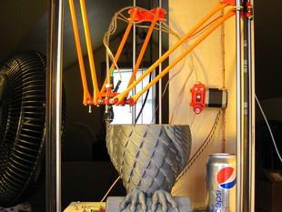
 Is the next revolution!!!!
The printer is open source : the hardware and the software are available
 http://www.thingiverse.com/thing:17175

Slide 4


 Heart of this printer is
Arduino
 http://www.arduino.cc/
 Pet-fooder
 All the design of the Arduino is available
Make magazine
:Technology on your Time
http://makezine.com/

Slide 5


 Instrucatable website
 http://www.instructabl es.com/
 Share What You Make

Slide 7

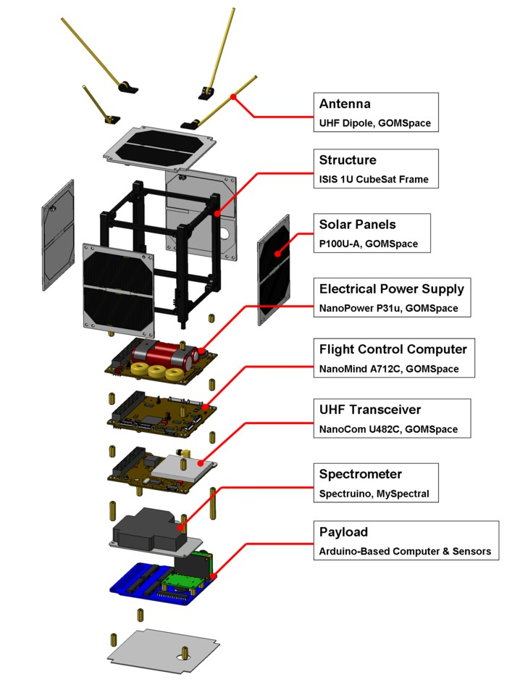
 http://www.kickstarter.com/project s/575960623/ardusat-your- arduino-experiment-in-space

Slide 8

 http://creativity-online.com/work/matt-richardson-the- enough-already/24181

Slide 9

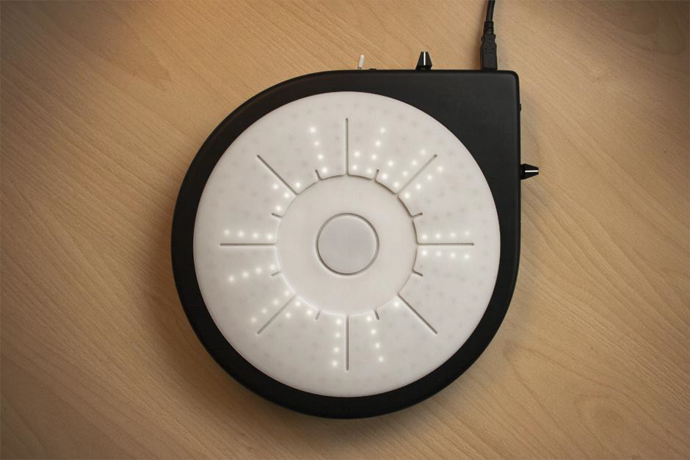
 http://www.lucaderosso.com/expo/
was an investigation into musical interfaces and on how to design new interfaces and hardwares for techniques generally used on the software side and then controlled by mouse and keyboard or universal MIDI controllers.The research was then applied to the development of a musical instrument for realtime and manual beat slicing — a well-developed technique which has never had a dedicated hardware interface.

Slide 10


 http://www.botanicalls.com/about/
Botanicalls opens a new channel of communication between plants and humans, in an effort to promote successful inter-species understanding.
The Botanicalls project is fundamentally about communication between plants and people. We are empowering both by inventing new avenues of interaction. Plants that might otherwise be neglected are given the ability to call and text message people to request assistance. People who are unsure of their ability to effectively care for growing things are given visual and aural clues using common human methods of communication.

Slide 11
4th Industrial Revolution

Slide 12
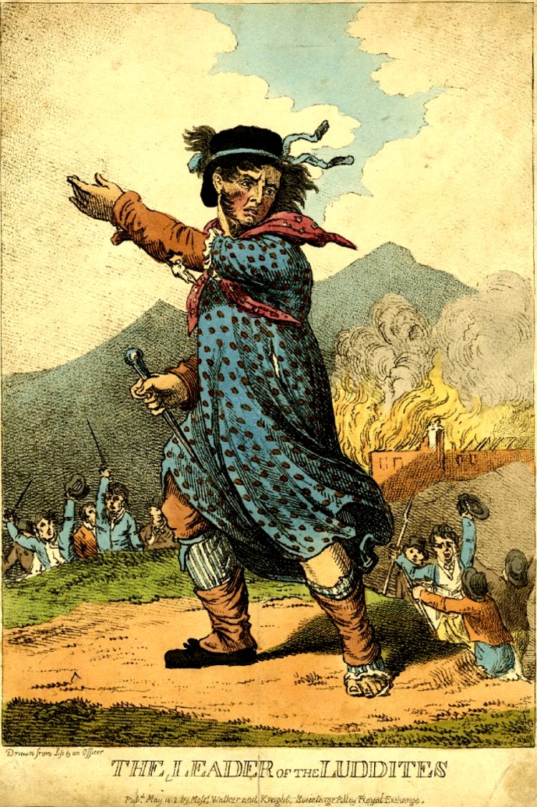
Notes:
The Luddites were a protest group that primarily operated between 1811 and 1816. They were primarily workers in the garment industry. They started riots and destroyed machinery. These days, the name Luddite is applied to anyone who struggles with or opposes new technology. However, the original Luddites however weren't so much opposed to technology as to it's effects. In particular they feared the loss of work from automation and the replacements of skilled labour with unskilled.
The Luddites were correct in their fears. The industrial revolution eventually resulted in better working conditions, better wages and an improved standard of living standard. However it took a long time to get there. On the way, it resulted in widespread pain and unemployment.

Slide 13
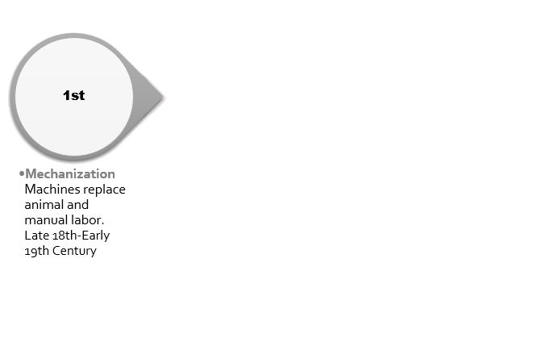
Notes:
I am not actually going to talk about the first industrial revolution, the one we learned about in school.

Slide 14
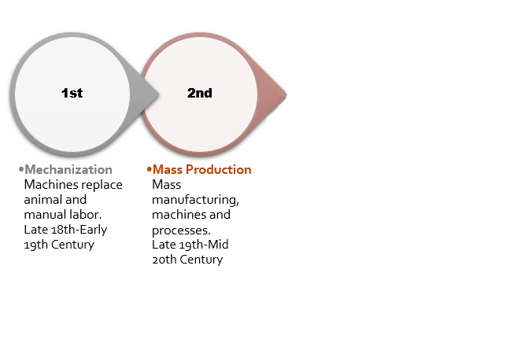
Notes:
Nor am I going to talk about the second one, exemplified by Henry Ford’s introduction of the assembly line

Slide 15
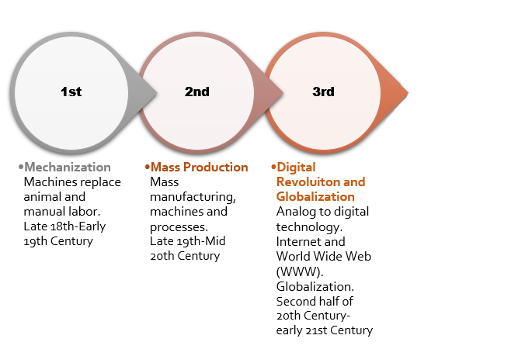
Notes:
The third revolution was the digital revolution. Most of us have lived through it. But I am not going to talk about it

Slide 16
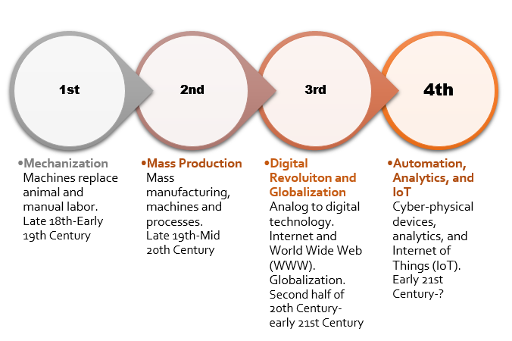
Notes:
I am going to talk about the one happening right now, the fourth industrial revolution.

Slide 17
revolution
What is it?
What is the impact?
What can be done?

Slide 18
What is it?
AI
Robotics
Automation
genetic engineering/biotechnology
Nano technology
AUTONOMOUS
Notes:
There area number of technologies making up IR4 such as
AI
Robotics
Automation
genetic engineering/biotechnology
Nano technology
Most of these are autonomous, things that happen without human intervention.
Individually any of these would have a large impact. together, it is a perfect storm of change.
Let me give you a few examples:

Slide 19
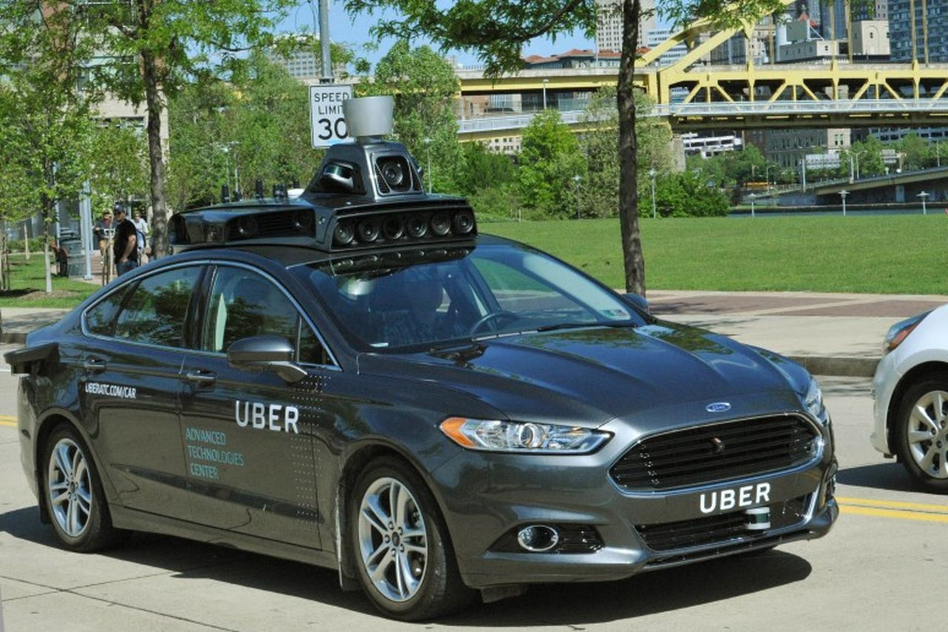
Notes:
Every major car manufacturer is working on self-driving cars. Tesla has one out now. Uber is trialling self driving cars in Pittsburgh this month.

Slide 20
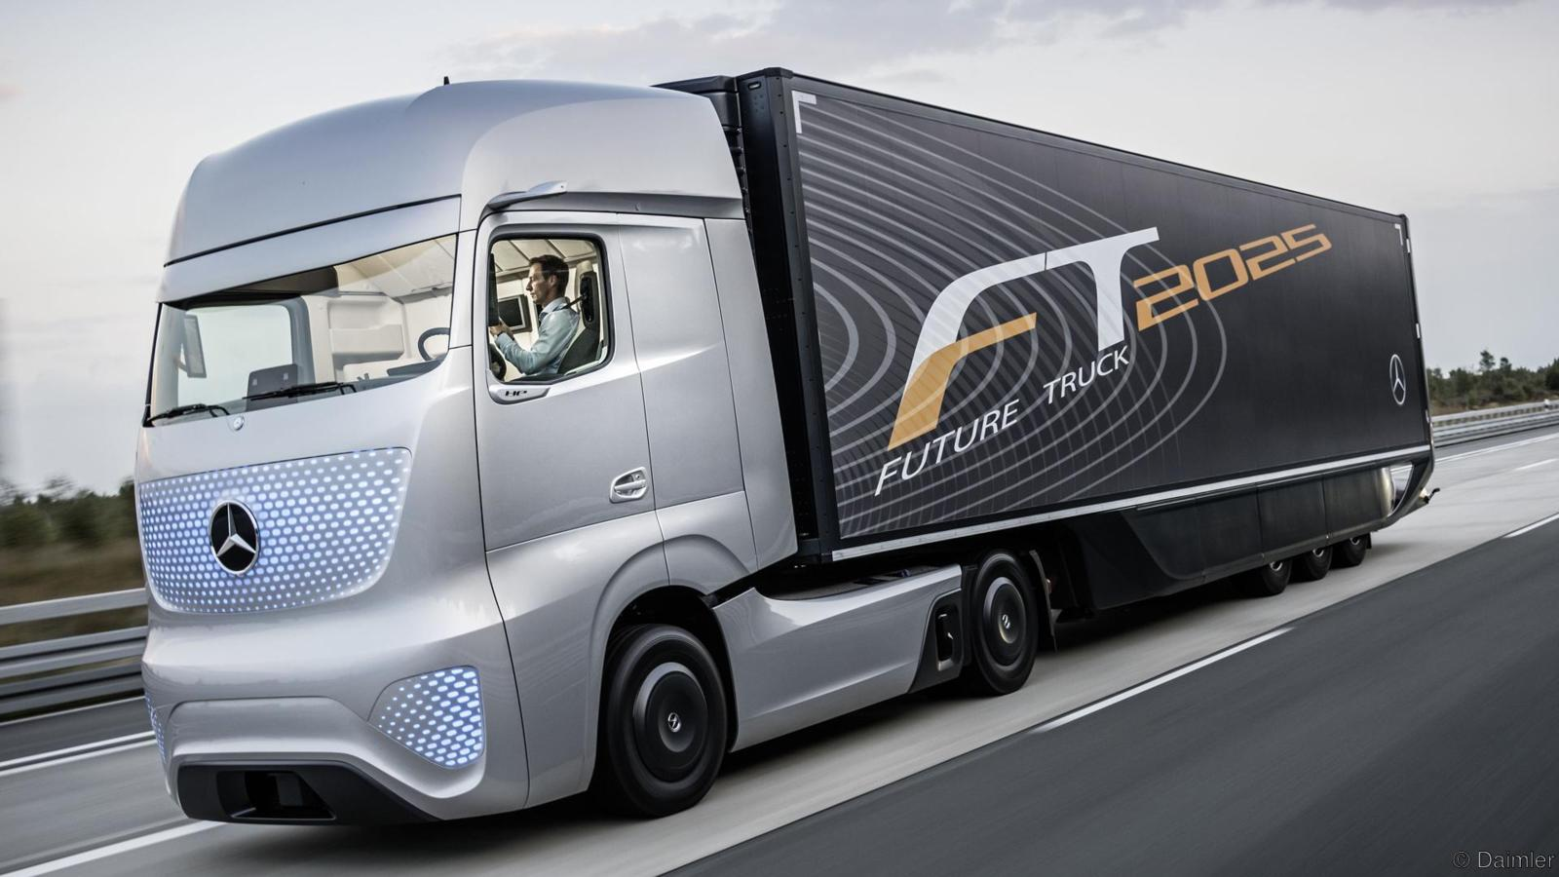
Notes:
Major truck manufacturers such as Mercedes Benz and Volvo are working on self driving trucks. The intention is that a local driver will drive the truck to a motorway, the truck will drive cross country to near it’s destination and then a second driver will handle driving the last few kilometres to the final destination. Long haul truckers will become short haul truckers

Slide 21
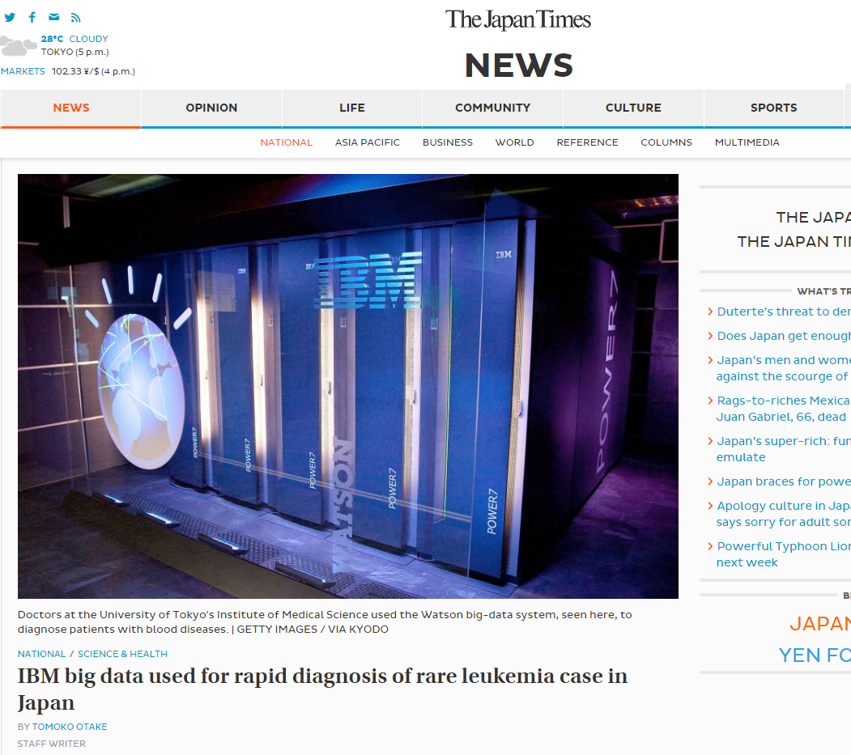
Notes:
IBM have been working on an AI called Watson. A few years ago it won the American game show Jeopardy, beating out previous champions.
Now it is being used in medicine

Slide 22
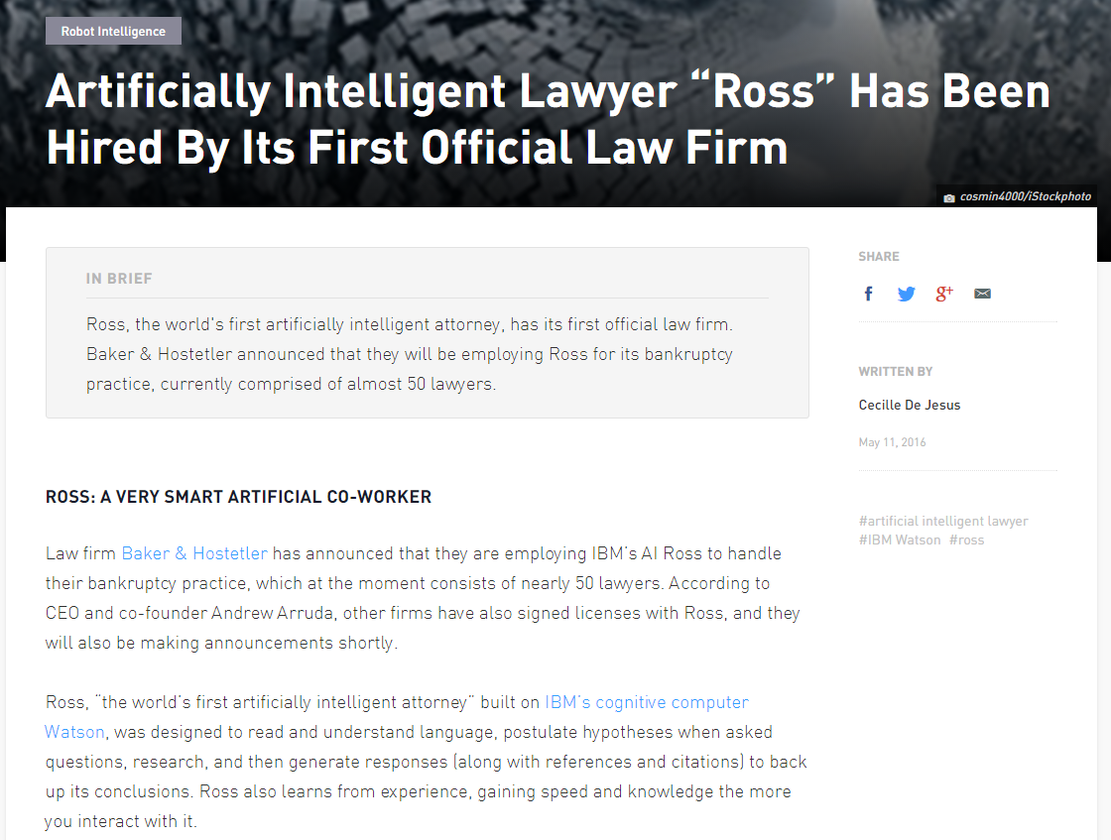
Notes:
As a laywer
And in other fields such as teaching

Slide 23
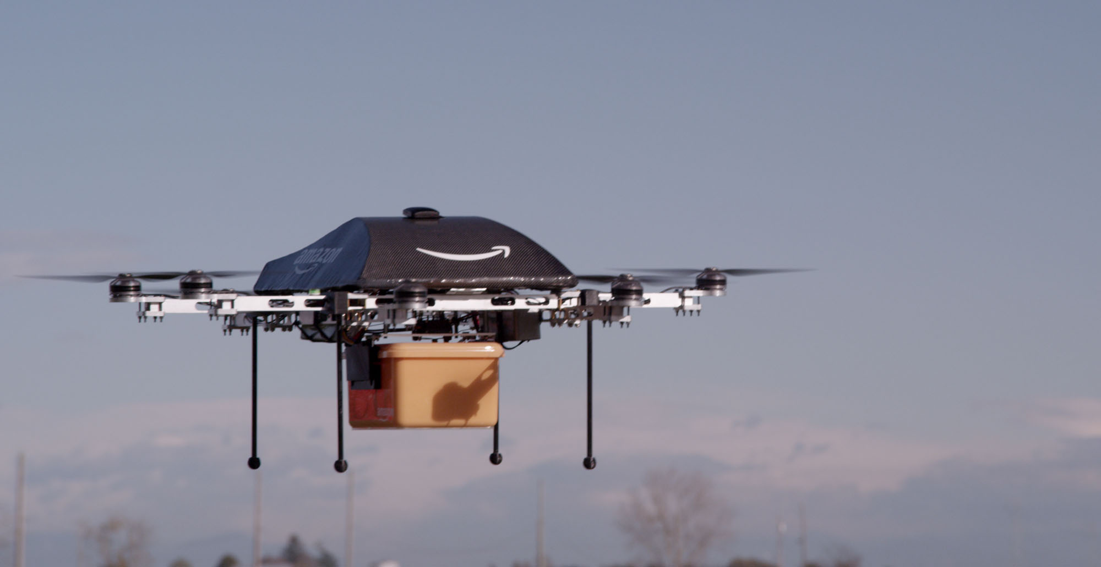
Notes:
Amazon is my poster child for IR4. They started out as a website bypassing physical stores to reduce prices. Now they have giant warehouses heavily using robots and autonomous delivery cart. Now they are working on using drones to deliver directly to purchasers.

Slide 24
What is the impact?
Notes:
There is going to be a big impact. Many job categories will disappear or become much smaller.

Slide 25
What is the impact?
Oxford: %47-81% of jobs under threat in 20 years

Slide 26
What is the impact?
Oxford: %47-81% of jobs under threat in 20 years
McKinsey Quarterly:
Almost half of current job activities can be automated.

Slide 27
What is the impact?
Oxford: %47-81% of jobs under threat in 20 years
McKinsey Quarterly:
Almost half of current job activities can be automated.
World Economic Forum:
Predicts loss of 5m jobs in the next 5 years

Slide 28
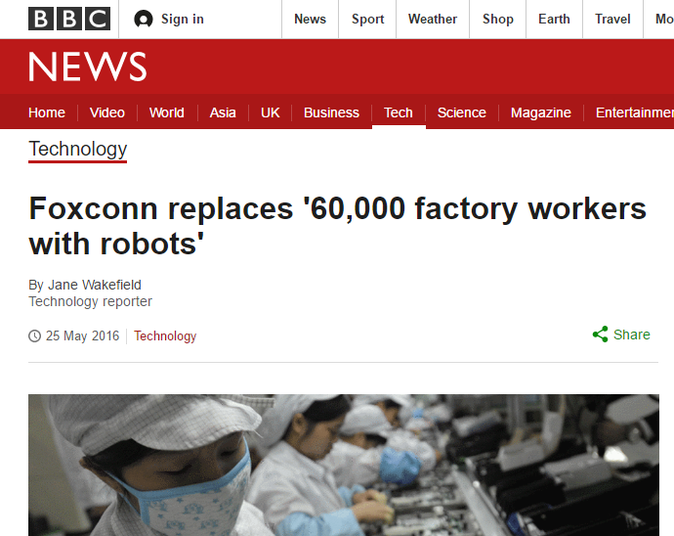
Notes:
Foxconn is the company that makes iPhones. They employ 480,000 people. Well they used to, now they employ about 420,000. These are people that make $5 per day, and it is still cheaper to use robots.

Slide 29
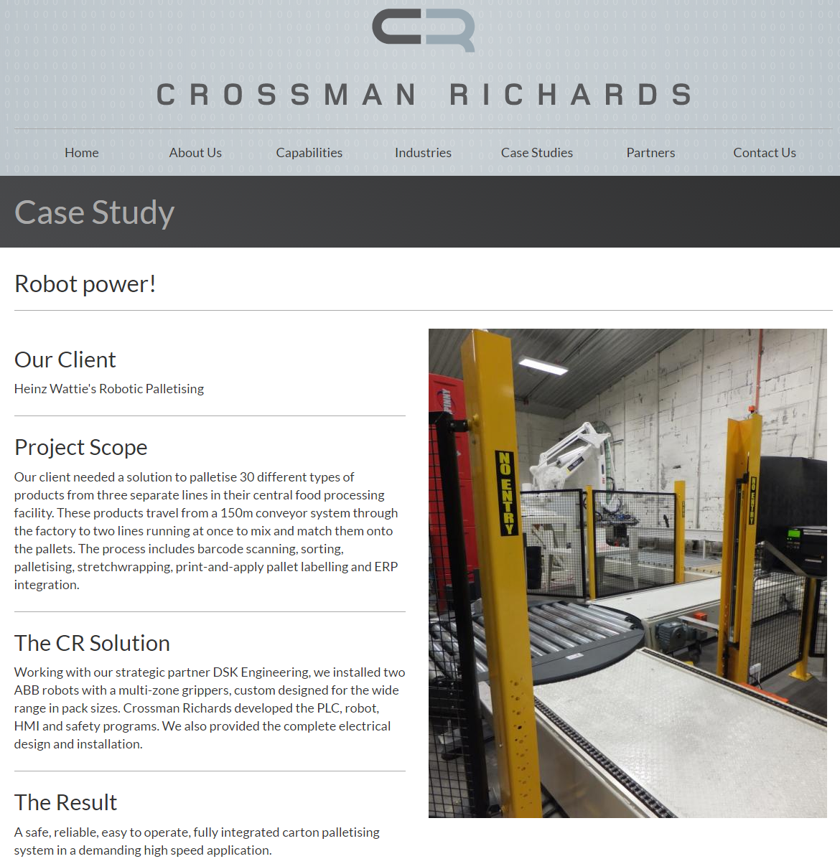
Notes:
If you think China is too far away to care about, Watties is right next door. They have been replacing workers with robots for the past 20 years

Slide 30
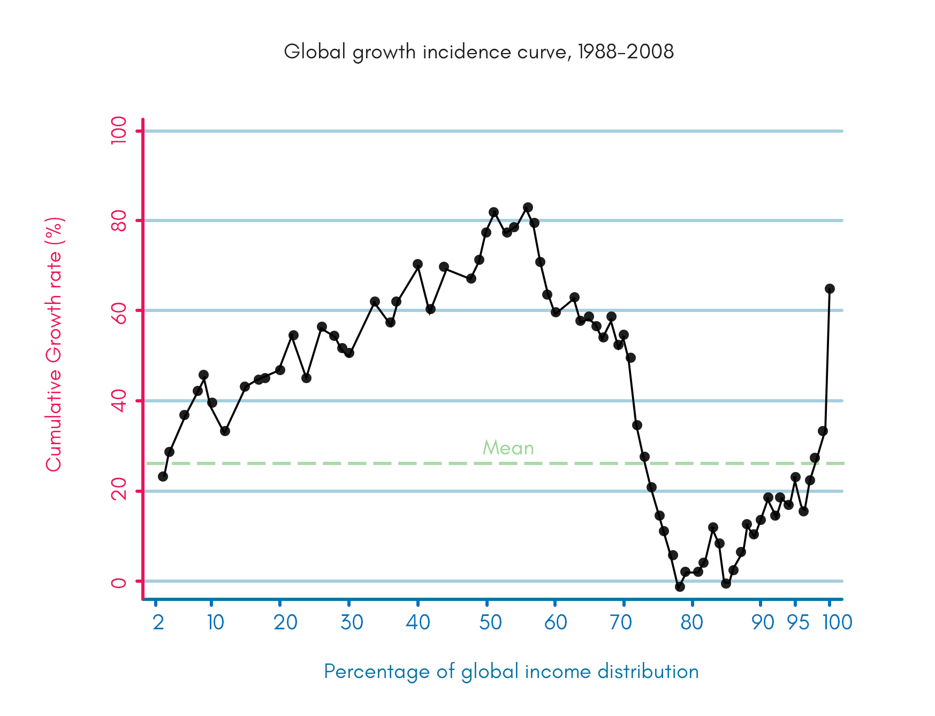
Notes:
This graph shows the change in income across the world from 88-2008. The poor are on the left, the rich on the right.
The area around 50-60% is mostly China and India. New Zealand and other rich countries are mostly from 75% - 100%.
This graph is both good news and bad news.
Good news. If you are rich, well you got even richer.
If you are poor, then it’s also good news. Offshoring and globalisation have made many of the poorer countries much better off.
But for those of us in the room, we mostly fall in the 80-95% range. And we haven’t seen much growth in our incomes.
IR4 may (and we don’t really know) make the dip even wider, as the rich keep getting richer but the drop in employment reducing incomes for the for the rest.

Slide 31
What can be done?

Slide 32
What can be done?
Shorter working hours
Notes:
Before the 1st IR, the average working week was about 70 hours. Now it’s more like 40. If half of the jobs disappear then perhaps we will only need a 20 hour week. The French have already started moving in this direction.

Slide 33
What can be done?
Shorter working hours
Universal Basic Income
Notes:
The UBI is a payment made to every adult in a jurisdiction with very few eligibility criteria. It provides enough money for people to live without working and replaces most government benefits. It’s much like National Superannuation if it had a starting date age of 18.
This is been trialled in many areas around the world.

Slide 34
What can be done?
Shorter working hours
Universal Basic Income
Education
Notes:
Education will be key, but it will be lifelong education as employment requirements change.

Slide 35
What can be done?
Shorter working hours
Universal Basic Income
Education
Adapt
Notes:
In the long term, the 1st industrial revolution was a good thing. It reduced working hours, lowered the cost, and raised the standard, of living . However there was a lot of pain along the way. We can expect this again, the trick will be to navigate the 20-50 years till we get there.

Slide 36
Links
@IntnlManOfCode
Links will be on
http://sourceitsoftware.blogspot.co.nz/

