Slide 1
Chapter 10 Thinking in Objects

Slide 2
Class Abstraction and Encapsulation
Class abstraction means to separate class implementation from the use of the class. The creator of the class provides a description of the class and let the user know how the class can be used. The user of the class does not need to know how the class is implemented. The detail of implementation is encapsulated and hidden from the user.

Slide 3
The BMI Class
BMI
UseBMIClass
Run

Slide 4
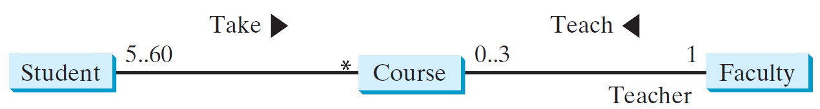
Class Relationships
Association
Aggregation
Composition
Inheritance (Chapter 13)
Association: is a general binary relationship that describes an activity between two classes.

Slide 5
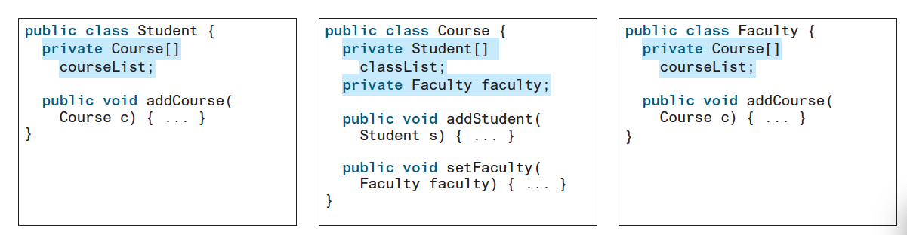
Programming Association

Slide 6
Object Composition
Composition is actually a special case of the aggregation relationship. Aggregation models has-a relationships and represents an ownership relationship between two objects. The owner object is called an aggregating object and its class an aggregating class. The subject object is called an aggregated object and its class an aggregated class.

Slide 7
Class Representation
An aggregation relationship is usually represented as a data field in the aggregating class. For example, the relationship in Figure 10.6 can be represented as follows:
Since aggregation and composition relationships are represented using classes in similar ways, many texts don’t differentiate them and call both compositions.

Slide 8
Aggregation Between Same Class
Aggregation may exist between objects of the same class. For example, a person may have a supervisor.
public class Person {
// The type for the data is the class itself
private Person supervisor;
...
}

Slide 9
Aggregation Between Same Class
What happens if a person has several supervisors?

Slide 10
Example: The Course Class
Course
TestCourse
Run

Slide 11
Example: The StackOfIntegers Class
TestStackOfIntegers
Run

Slide 12
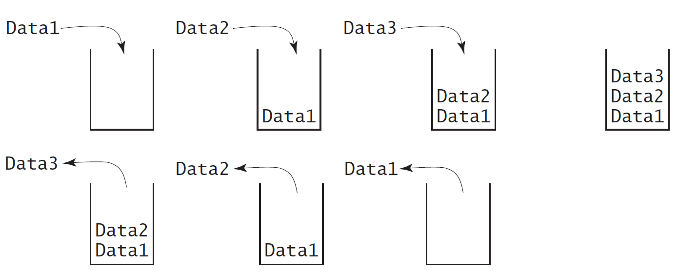
Designing the StackOfIntegers Class

Slide 13
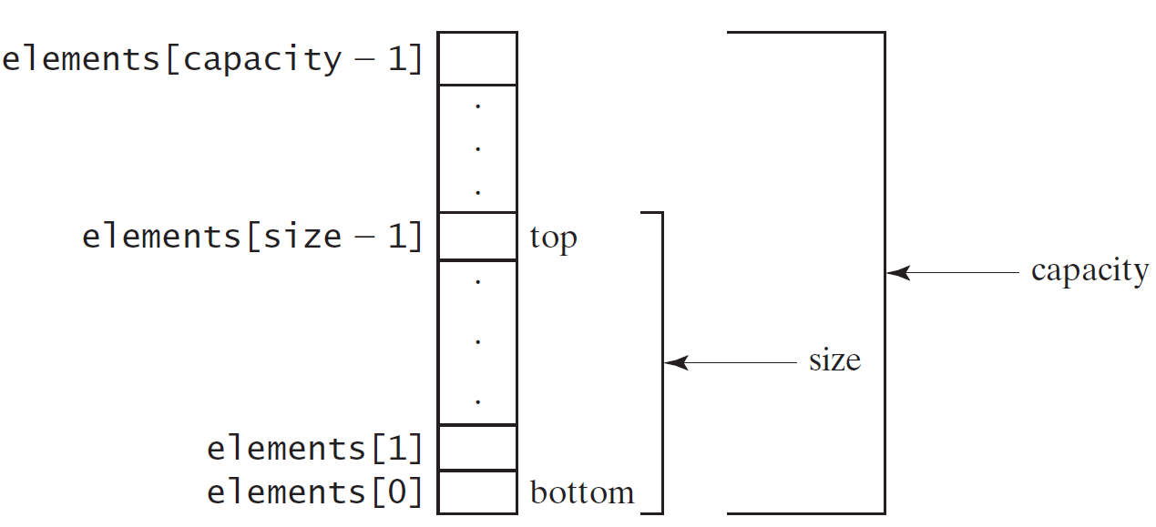
Implementing StackOfIntegers Class
StackOfIntegers

Slide 14
Wrapper Classes
Boolean
Character
Short
Byte
Integer
Long
Float
Double
NOTE: (1) The wrapper classes do not have no-arg constructors. (2) The instances of all wrapper classes are immutable, i.e., their internal values cannot be changed once the objects are created.
14

Slide 15
The Integer and Double Classes
15

Slide 16
The Integer Class and the Double Class
Constructors
Class Constants MAX_VALUE, MIN_VALUE
Conversion Methods
16

Slide 17
Numeric Wrapper Class Constructors
You can construct a wrapper object either from a primitive data type value or from a string representing the numeric value. The constructors for Integer and Double are:
public Integer(int value)
public Integer(String s)
public Double(double value)
public Double(String s)
17

Slide 18
Numeric Wrapper Class Constants
Each numerical wrapper class has the constants MAX_VALUE and MIN_VALUE. MAX_VALUE represents the maximum value of the corresponding primitive data type. For Byte, Short, Integer, and Long, MIN_VALUE represents the minimum byte, short, int, and long values. For Float and Double, MIN_VALUE represents the minimum positive float and double values. The following statements display the maximum integer (2,147,483,647), the minimum positive float (1.4E-45), and the maximum double floating-point number (1.79769313486231570e+308d).
18

Slide 19
Conversion Methods
Each numeric wrapper class implements the abstract methods doubleValue, floatValue, intValue, longValue, and shortValue, which are defined in the Number class. These methods “convert” objects into primitive type values.
19

Slide 20
The Static valueOf Methods
The numeric wrapper classes have a useful class method, valueOf(String s). This method creates a new object initialized to the value represented by the specified string. For example:
Double doubleObject = Double.valueOf("12.4");
Integer integerObject = Integer.valueOf("12");
20

Slide 21
The Methods for Parsing Strings into Numbers
You have used the parseInt method in the Integer class to parse a numeric string into an int value and the parseDouble method in the Double class to parse a numeric string into a double value. Each numeric wrapper class has two overloaded parsing methods to parse a numeric string into an appropriate numeric value.
21

Slide 22
Automatic Conversion Between Primitive Types and Wrapper Class Types
JDK 1.5 allows primitive type and wrapper classes to be converted automatically. For example, the following statement in (a) can be simplified as in (b):
Integer[] intArray = {1, 2, 3};
System.out.println(intArray[0] + intArray[1] + intArray[2]);
Unboxing
22

Slide 23
BigInteger and BigDecimal
If you need to compute with very large integers or high precision floating-point values, you can use the BigInteger and BigDecimal classes in the java.math package. Both are immutable. Both extend the Number class and implement the Comparable interface.
23

Slide 24
BigInteger and BigDecimal
BigInteger a = new BigInteger("9223372036854775807");
BigInteger b = new BigInteger("2");
BigInteger c = a.multiply(b); // 9223372036854775807 * 2
System.out.println(c);
LargeFactorial
Run
BigDecimal a = new BigDecimal(1.0);
BigDecimal b = new BigDecimal(3);
BigDecimal c = a.divide(b, 20, BigDecimal.ROUND_UP);
System.out.println(c);
24

