Slide 1
Chapter 14: Carbohydrates
By Vicki S. Freeman

Slide 2
General Description of Carbohydrates
Classification of Carbohydrates
Carbohydrates may be classified based on following:
1. Size of base carbon chain: triose (3 carbons), tetrose (4), pentose (5), hexose (6)
2. Location of CO function group
Aldose: terminal carbonyl group (aldehyde group)
Ketose: carbonyl group in middle, linked to 2 other carbon atoms (ketone group)

Slide 3
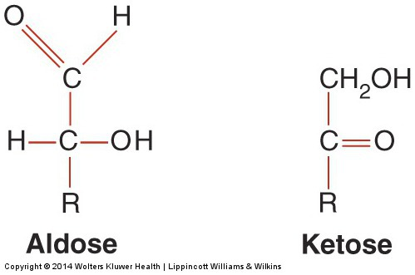
General Description of Carbohydrates (cont’d)
Two forms of carbohydrates

Slide 4
General Description of Carbohydrates (cont’d)
Classification of Carbohydrates
Carbohydrates may be classified based on following:
3. Stereochemistry of compound
Different spacial arrangements around each asymmetric carbon, forming stereoisomers
Two different series are possible: D and L.
4. Number of sugar units in chain
Monosaccharides: 1 unit (glucose, fructose, galactose)
Disaccharides: 2 units (maltose, lactose, sucrose)
Polysaccharides: >10 units (starch [glucose], glycogen)

Slide 5
General Description of Carbohydrates (cont’d)
Chemical Properties of Carbohydrates
Reducing carbohydrates
To reduce, carbohydrate must have ketone or aldehyde group.
All monosaccharides & many disaccharides = reducing agents
Examples: glucose, maltose, fructose, lactose, galactose
Nonreducing carbohydrates
Do not have ketone or aldehyde group & will not reduce
Glucose Metabolism
Primary source of energy for humans; nervous system totally depends on glucose from extracellular fluid

Slide 6
General Description of Carbohydrates (cont’d)
Fate of Glucose
Most ingested carbohydrates are polymers (starch, glycogen).
These are converted to disaccharides, & disaccharides are converted to monosaccharides by enzymes (amylase 🡪 dextrins and disaccharides; maltase 🡪 monosaccharides).
Monosaccharides are absorbed by gut & transported to liver.
Glucose is only carbohydrate directly used for energy or stored as glycogen; galactose & fructose must be converted to glucose.
Once glucose enters cell, it is shunted into 1 of 3 metabolic pathways.
Ultimate goal of cell is to convert glucose to carbon dioxide and water.

Slide 7
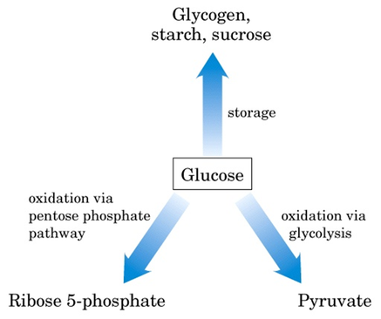

Slide 8
Steps of glucose metabolism
Glycolysis (Embden Meyerhof pathway)
Glucose 🡪 glucose 6-phosphate 🡪 pyruvate + 2ATP
Pentose Phosphate Pathway (PPP) (Hexose Monophosphate Shunt)
Production of NADPH and ribose 5-phosphate
Glycogenesis
Storage of excess glucose into glycogen via glycogen synthase
TCA cycle and Electron transport chain (ETC) complete the oxidation of glucose and provide for most ATP
Gluconeogensis and glycogenolysis contribute to raise blood glucose

Slide 9
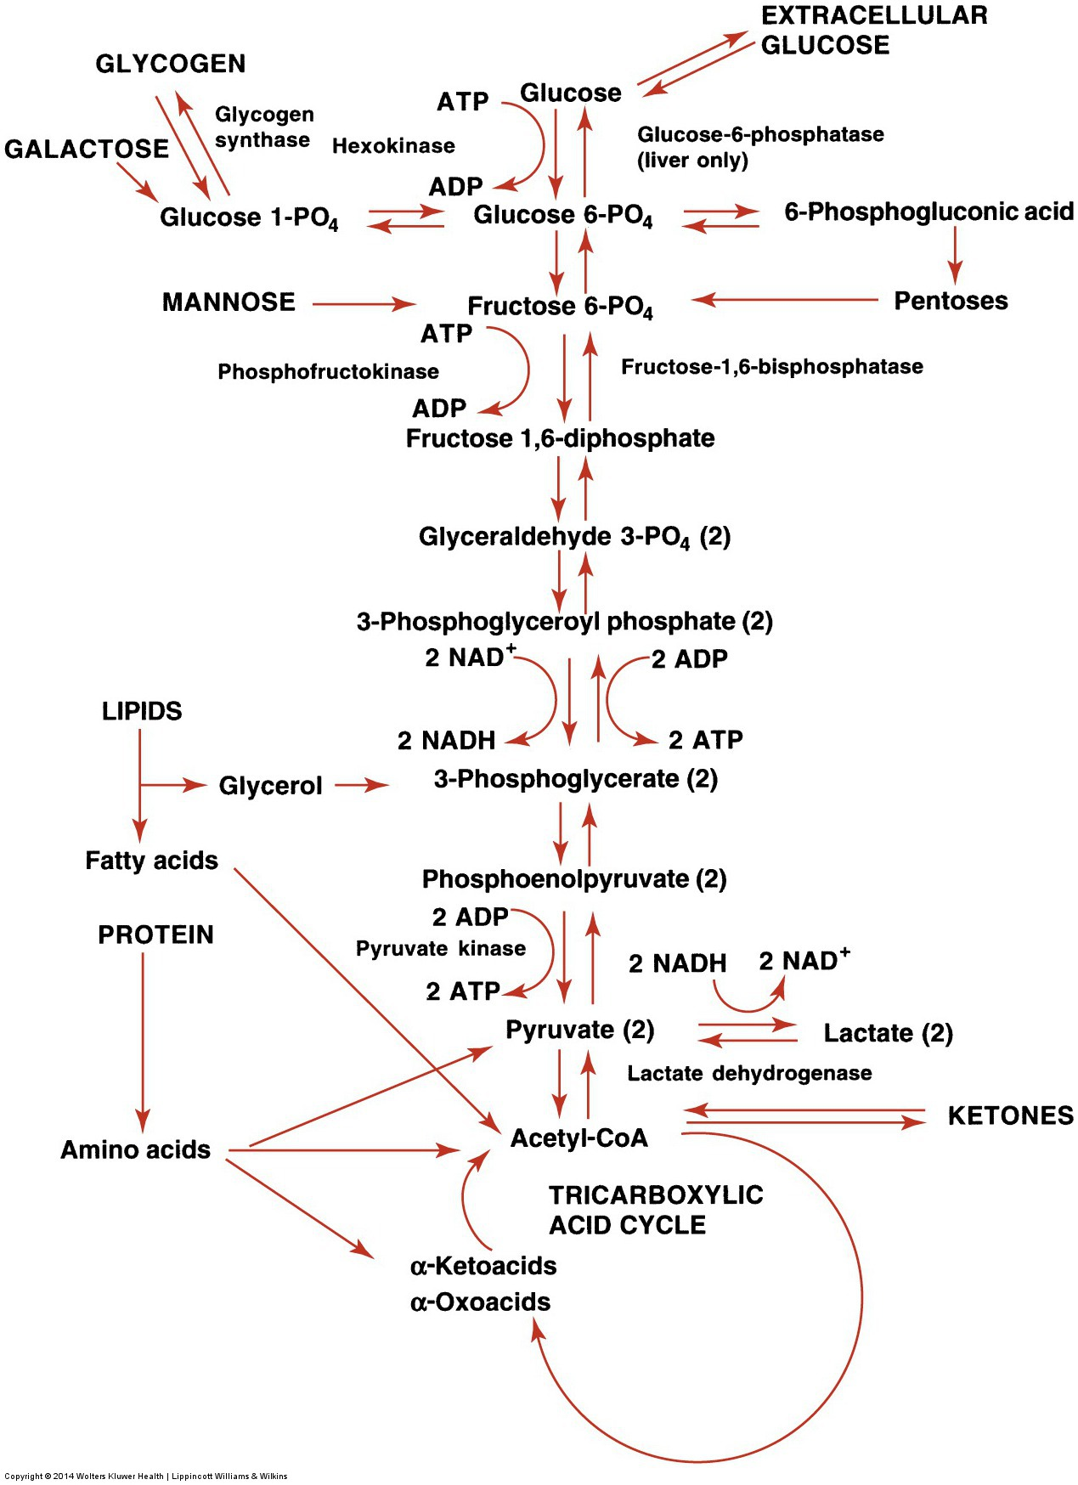

Slide 10
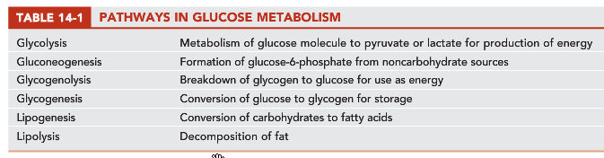

Slide 11
Regulation of Carbohydrate Metabolism
Liver, pancreas, & other endocrine glands control blood glucose concentrations within a narrow range.
Hormones that control glucose levels (gl):
Insulin: from pancreas; ↓ gl
Glucagon: from pancreas; ↑ gl
Epinephrine & glucocorticoids: from adrenal gland; ↑ gl
Growth hormone & ACTH: from anterior pituitary; ↑ gl
Thyroxine (thyroid gland) & somatostatin (pancreas): ↑ gl

Slide 12
Regulation of Carbohydrate Metabolism
Liver, pancreas and other endocrine glands are involved in controlling blood glucose conc within a narrow range
Brief fasting: glycogenolysis >> Glucose
Fasting > 1 day: gluconeogenesis from other sources

Slide 13
Insulin
Primary hormone responsible for entry of Glucose into the cell
Produced by β-cells of islets of Langerhans in pancreas
Release of insulin causes an increased movement of glucose into the cells and increased glucose metabolism
Released when glucose levels are HIGH
Increases uptake of glucose by muscle and adipocytes

Slide 14
Insulin (cont’d)
It is anabolic hormone: stimulates uptake of glucose by muscle and fat cells, promotes conversion of glucose to glycogen or fat for storage, inhibits glucose production by liver, stimulates protein synthesis, & inhibits protein breakdown
The only hormone that decreases glucose levels & can be referred to as hypoglycemic agent
Notes:
Insulin increases glycogenesis, lipogenesis, & glycolysis and inhibiting glycogenolysis

Slide 15
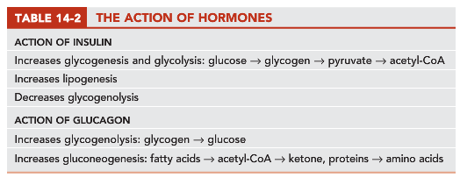

Slide 16
Insulin: chemistry
Human insulin is made of 51 amino acids in two chains (A and B) joined by 2 disulfide bonds plus a 3rd disulfide bond within A-chain
Produced as preproinsulin (100 amino acids)
Stored in secretory granules in Golgi complex of β-cells, where proteolytic cleavage to insulin and connecting peptide (C-peptide) occurs

Slide 17
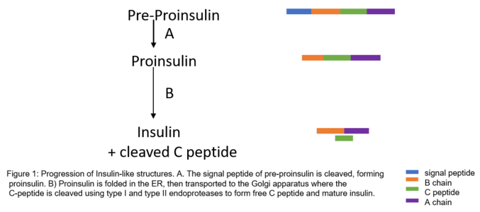

Slide 18
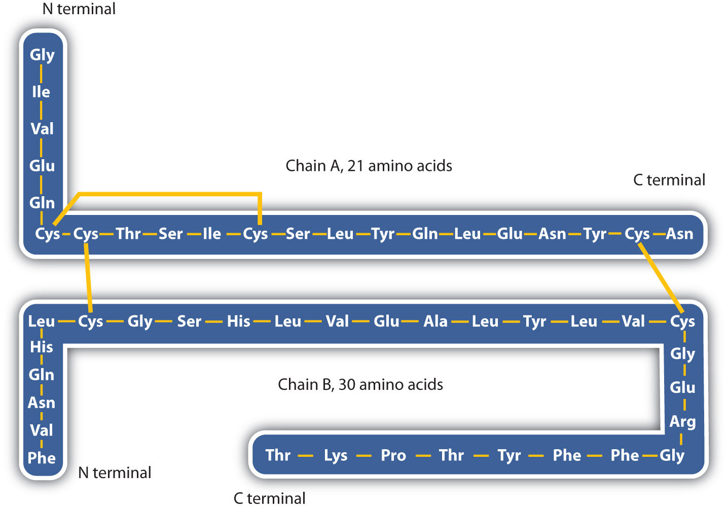
Human insulin

Slide 19
Insulin release
Release is stimulated by: Glucose, aa, pancreatic and gastric hormones & some medications (sulfonylureas, β-adrenergic agonists)
Release inhibited by: hypoglycemia, somatostatin (produced by pancreatic δ–cells) and various drugs (α-adrenergic agonists, β-adrenergic blockers, diazoxide,…)

Slide 20
Insulin degradation
On first pass through portal circulation, approx 50% of insulin is extracted by liver, where it’s degraded
Additional degradation occurs in kidneys,
Insulin is also filtered in glomerulus, reabsorbed and degraded in proximal tubules
Half life in circulation is 5-4 minutes

Slide 21
Proinsulin
Has approx 10% of insulin potency
Major storage form
Only ~5% of insulin is proinsulin
Its half life is ~30 minutes

Slide 22
C-peptide
Devoid of biological activity but necessary for insulin to ensure correct structure
Its plasma levels are 5-6-fold of insulin due to its longer half life of 35 minutes

Slide 23
Antibodies to insulin
Abs to insulin develop in almost all patients who are treated with exogenous insulin
Usually present in low titer and produce no adverse effects
Occasionally in type 2 diabetes, high titers produce insulin resistance

Slide 25
Glucagon
A 29-aa polypeptide
Primary hormone responsible for increasing glucose levels
Produced by α-cells of islets of Langerhans in pancreas
Induced release by stress, exercise and amino acids
Stimulates glucose synthesis in LIVER via glycogenolysis or gluconeogenesis
It’s a hyperglycemic agent

Slide 26
Glucagon
It enhances ketogenesis
Has a minor effect on adipocyte >> it increases lipolysis
Insulin inhibits Glucagon release
Increased Glucagon levels in diabetes, secondary to insulin deficiency, contributes to hyperglycemia state
Notes:
Proglucagon is also produced in gut by L-cells, which process it into glucagon, glucagon-like peptide I and glucagon like peptide II. Food ingestion stimulates release of glucagon like peptide I, which acts on B-cells of pancreas to stimulate insulin gene transcription and potentiate glucose-induced insulin secretion.

Slide 27
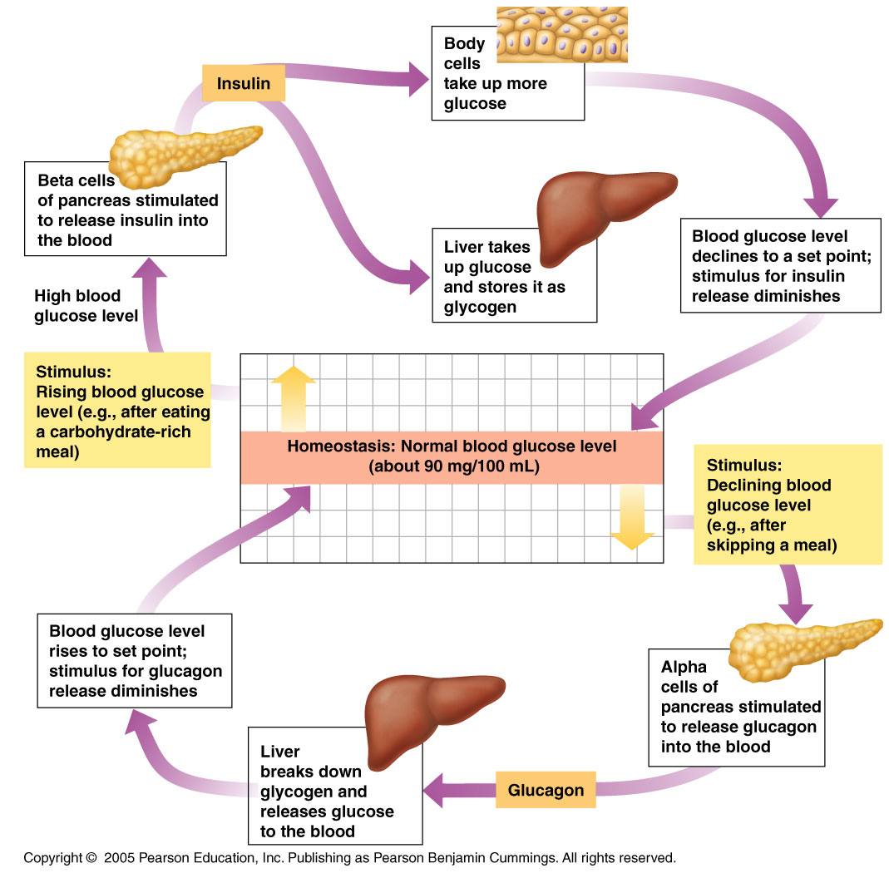
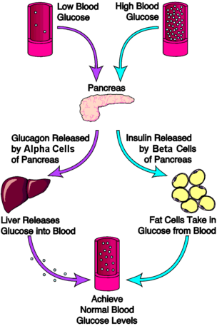

Slide 28
Epinephrine (Adrenaline)
Produced by adrenal medulla
Increases plasma glucose by inhibiting insulin secretion, increasing glycogenolysis & promoting lipolysis
Induced by stress

Slide 29
Glucocorticoids
Primarily cortisol
Produced by adrenal cortex upon stimulation by ACTH
Increases plasma glucose by decreasing intestinal entry into cells, increasing gluconeogenesis, liver glycogenolysis & lipolysis
Notes:
ACTH: adrenocorticotropic hormone.
Both GH and ACTH are produced by anterior pituitary gland.

Slide 30
Other regulators of carbohydrate metabolism
Two anterior pituitary hormones: ACTH & GH promote increased plasma glucose
ACTH: acts via stimulation of cortisol release
GH: decrease glucose entry into cells, increase glycolysis
Thyroxine: increases glycogenolysis, gluconeogenesis, intestinal absorption of glucose
Somatostatin: increases plasma glucose, via inhibition of insulin, glucagon, GH & other hormones

Slide 31
Hyperglycemia
Definition: an increase in plasma glucose levels caused by imbalance of hormones
Diabetes Mellitus
A group of metabolic diseases characterized by hyperglycemia resulting from defects in insulin secretion, insulin action, or both
Type 1
Results from cellular-mediated autoimmune destruction of β cells of pancreas, causing absolute deficiency of insulin
Constitutes 10–20% of all diabetes cases; occurs in childhood & adolescence and is genetic
Initiated by environmental factors, or infection in individuals with genetic predisposition
Characteristics: abrupt onset, insulin dependence, ketosis tendency

Slide 32
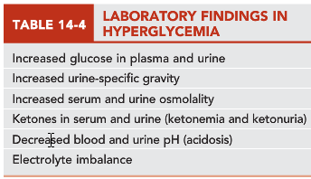
+ Increased HbA1c levels in plasma

Slide 33
Markers of autoimmune reactions in type 1 DM
One or more of the following markers are found in 85-90% of individuals with fasting hyperglycemia
Islet cell autoantibodies
Insulin autoantibodies
Glutamic acid decarboxylase autoantibodies
Tyrosine phosphatase IA-2 & IA-2B autoantibodies

Slide 34
Type 1 DM: symptoms
Polydipsia (excessive thirst),
Polyphagia (increased food intake),
Polyuria (excessive urine production),
Rapid weight loss,
Hyperventilation,
Mental confusion,
Possible loss of consciousness (due to decreased glucose to brain)

Slide 35
Hyperglycemia (cont’d)
Diabetes Mellitus
Type 2
Characterized by hyperglycemia caused by an individual’s resistance to insulin, resulting in a relative insulin deficiency
Constitutes majority of diabetes cases & is adult onset
Risk factors include age, obesity, lack of exercise, genetic predisposition.
Other specific types: associated with genetic defects of β-cell function or insulin action, pancreatic/endocrine diseases, etc.
Gestational: glucose intolerance with onset during pregnancy

Slide 36
Type 2 DM Characteristics
Adult onset of the disease
Milder symptoms than in type 1
Ketoacidosis seldom occurs
Patients are more likely to go into a hyperosmolar coma and are at an increased risk of developing macrovascular and microvascular complications

Slide 37
Gestational DM (GDM)
GDM has been defined as any degree of glucose intolerance with onset or first recognition during pregnancy
“High-risk” women are those found to have diabetes at their initial prenatal visit, using standard criteria
Causes include metabolic & hormonal changes
Associated with increased risk of perinatal complications and developing DM in later years
Infants are at increased risk for respiratory distress, hypoglycemia & hyperbilirubinemia

Slide 38
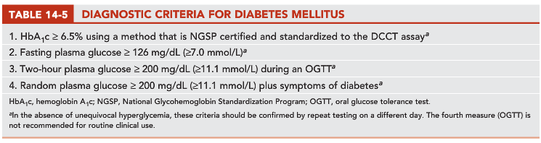

Slide 39
Pathophysiology of Diabetes Mellitus
Hyperglycemia, possibly severe
Glucosuria can occur after renal tubular transporter system for glucose becomes saturated (when plasma glucose >180 mg/dL).
Type 1
Absence of insulin with excess glucagon
Gluconeogenesis and lipolysis 🡪 Greater tendency to produce ketones
Lab findings in DM with ketoacidosis, reflects dehydration, electrolyte disturbances and acidosis
Type 2
Presence of insulin & hyperinsulinemia, attenuated glucagon
Fatty acid oxidation is inhibited; Fatty acids are incorporated into Triglycerides and released as LDL lipoprotein
Greater tendency to develop hyperosmolar nonketotic states

Slide 40
Diabetic hyperosmolar syndrome: glucose levels tops 600 mg/dL, blood becomes thick and syrupy 🡪 dehydration 🡪 diabetic coma
Bicarbonate & total CO₂ are usually decreased due to deep ventilation (Kussmaul respiration), a compensation to blow off CO₂ and remove hydrogen ions.
Serum osmolality is high as a result of hyperglycemia
Serum Na tends to be lower due to losses (polyuria)
The anion gap in this acidosis can exceed 16 mmol/L.
Grossly elevated Triglycerides will displace plasma volume
Hyperkalemia is almost always present as a result of displacement of K from cells

Slide 41
Hyperglycemia (cont’d)
Criteria for Testing for Pre-Diabetes and Diabetes
All adults >45 years old should have fasting blood glucose measured every 3 years, unless already diagnosed with diabetes.
Testing should be earlier or more frequent w/ these risk factors:
Overweight tendencies (BMI ≥25 kg/m²)
Habitual physical inactivity
Family history of diabetes in a first-degree relative
High-risk minority population (African American, Latino)
History of gestational diabetes or delivering baby > 4 kg
Hypertension (≥140/90)

Slide 42
Risk factors continued:
Low high-density lipoprotein (HDL) cholesterol concentrations (<35 mg/dL [0.90 mmol/L])
Elevated triglyceride concentrations > 250 mg/dL (2.82 mmol/L)
History of impaired fasting glucose/impaired glucose tolerance
Women with polycystic ovarian syndrome (PCOS)
Other clinical conditions associated with insulin resistance (e.g., severe obesity)
History of cardiovascular disease

Slide 43
Hyperglycemia (cont’d)
Criteria for Testing for Pre-Diabetes and Diabetes
Criteria for type 2 diabetes testing in children, beginning at age 10 or at onset of puberty & with follow-up testing every 2 years
Overweight
Family history (first- or second-degree) of type 2 diabetes
Race/ethnicity (African American, Latino, Native American)
Signs of insulin resistance (e.g., acanthosis nigricans, hypertension, dyslipidemia, and PCOS)
Maternal history of diabetes or gestational diabetes mellitus

Slide 44
Hyperglycemia (cont’d)
Criteria for the Diagnosis of Diabetes Mellitus
Four methods of diagnosis (each must be confirmed by one of the first 3 methods on a subsequent day)
HbA1c ≥6.5%
Diabetes symptoms + random glucose level of ≥200 mg/dL
A fasting plasma glucose of ≥126 mg/dL
An oral glucose tolerance test (OGTT) w/ 2-hour postload (75-g glucose load) ≥200 mg/dL
Patients with following criteria have “pre-diabetes”:
Fasting glucose of ≥100 mg/dL but <126 mg/dL
OGTT 2-hour level of ≥140 mg/dL but <200 mg/dL

Slide 45
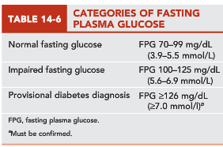
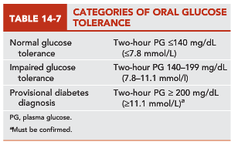

Slide 46
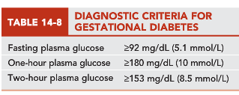
Hyperglycemia (cont’d)
Criteria for testing and diagnosis of GDM
All nondiabetic pregnant women should be screened for GDM at 24-28 weeks of gestation

Slide 47
Hypoglycemia
Decreased plasma glucose levels
Can be transient & relatively insignificant or life-threatening
Occurs in healthy-appearing and sick patients, as a result of reaction to medication or of illness
Symptoms appear at glucose level of about 50–55 mg/dL. (Plasma glucose level at which glucagon is released is 65-70 mg/dL)
Symptoms: increased hunger, sweating, nausea & vomiting, dizziness, nervousness & shaking, blurred speech & sight, mental confusion

Slide 48
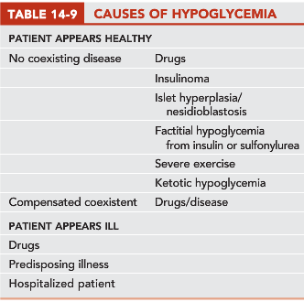
Decreased plasma glucose during hypoglycemia
Extremely elevated levels of insulin in patients with pancreatic β-cell tumors (insulinoma)

Slide 49
Genetic Diseases with Hypoglycemia
Von Gierke: glucose 6-phosphatase deficiency
Glycogen cannot be converted back to glucose by hepatic glycogenolysis 🡪 glycogen buildup in the liver 🡪 hepatomegaly
Other enzyme deficiencies: glycogen synthase, fructose 1,6-bisphosphatase, phosphoenolpyruvate carboxykinase, and pyruvate carboxylase (hypoglycemia). Glycogen debranching enzyme deficiency (no hypoglycemia, only hepatomegaly)
Galactosemia: galactose 1-phosphate uridyltransferase deficiency
Fructose 1-phosphate aldolase deficiency, causes nausea and hypoglycemia after fructose ingestion

Slide 50
Role of Laboratory in Differential Diagnosis and Management of Patients
Methods of Glucose Measurement
Glucose can be measured from serum, plasma, or whole blood.
Serum or plasma must be refrigerated & separated from cells within 1 hour to prevent loss of glucose.
Fasting blood glucose should be obtained in morning after 8- to 10-hour fast (not longer than 16 h).
Most common methods of glucose analysis use enzymes glucose oxidase or hexokinase.
Nonspecific methods are used in urinalysis section of lab to detect reducing substances other than glucose.

Slide 51
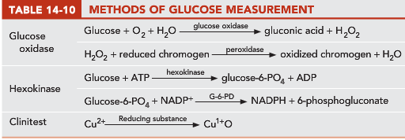

Slide 52
Role of Laboratory (cont’d)
Self-Monitoring of Blood Glucose
People with diabetes should closely monitor their blood glucose levels to keep them as close to normal as possible.
Those with type 1 diabetes should check levels 3 or 4 times/day.
Glucose Tolerance and 2-Hour Postprandial Tests
Oral glucose tolerance test (not recommended by ADA)
Patient drinks standardized (75 g) glucose load.
Glucose measurement is taken 2 hours later.
2-hour postprandial test
A variation of OGTT because OGTT is not recommended
More convenient. Patient’s glucose is measured after a meal.

Slide 54
Glycated Hemoglobin/Hemoglobin A₁c
Long-term blood glucose regulation can be followed by measurement of glycated hemoglobin.
Provides clinician with time-averaged picture of patient’s blood glucose concentration over past 3 months.
Glycated hemoglobin: formation of a hemoglobin compound produced when glucose reacts with amino group of hemoglobin
Glucose attaches non-enzymatically to Hb to form ketoamine
Affinity chromatography is preferred method of measurement.
Normal 4-6%
Estimated average Glucose (eAG, mg/dL)= 28.7 X HbA1c – 46.7
HbA₁c depends on the average glucose concentration and the red blood cell life span.
If the red blood cell life span is decreased because of another disease (hemoglobinopathies), Hb will have less time to become glycated and HbA1c will be lower.

Slide 55
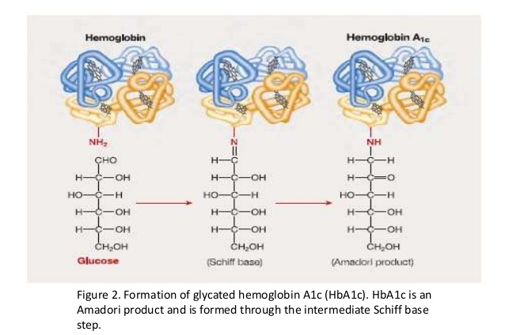
Formation of HbA1c

Slide 56
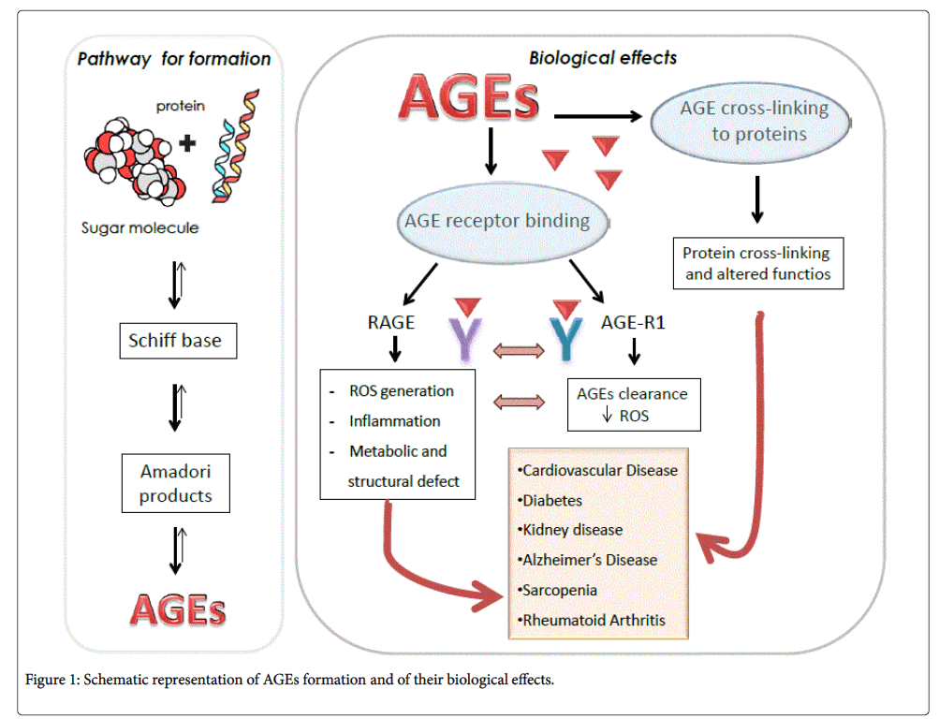
Formation of HbA1c

Slide 57
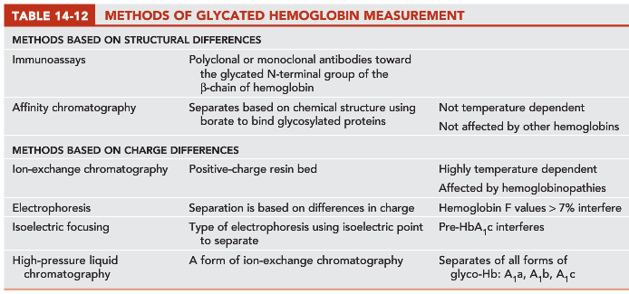

Slide 58

Ketones
Produced by liver through metabolism of fatty acids
Provide a ready energy source from stored lipids
Increase with carbohydrate deprivation or decreased carbohydrate use (diabetes, starvation/fasting, high-fat diets)
Three ketone bodies
Acetone (2%)
Acetoacetic acid (20%)
3-β-hydroxybutyric acid (78%)
Specimen requirement is fresh serum or urine.

Slide 59
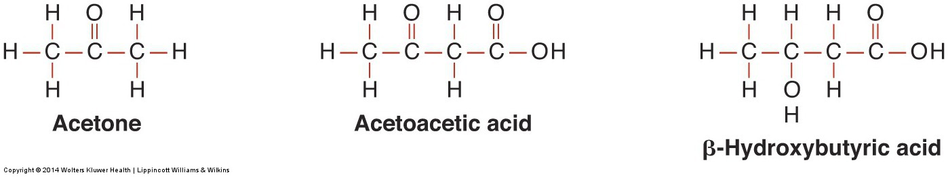
Role of Laboratory (cont’d)
Three ketone bodies

Slide 60
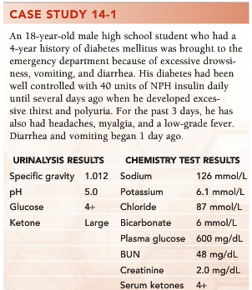
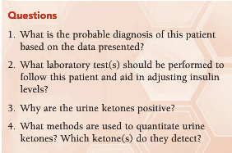
Diabetic patient in ketoacidosis
HbA1c
Ketosis occurs as a result of diabetes mellitus, which results from a lack of insulin. The lack of intracellular glucose needed for energy leads to an increased breakdown of fatty acids and triglycerides for energy. The breakdown products of fatty acids and triglycerides are ketoacids (β-hydroxybutyric acid and acetoacetic acid).
Acetest (sodium nitroprusside) detects acetoacetic acid. If glycine is present, acetone will also be detected.
Notes:
Ketonuria is a medical condition in which ketone bodies are present in the urine.
It is seen in conditions in which the body produces excess ketones as an indication that it is using an alternative source of energy. It is seen during starvation or more commonly in type I diabetes mellitus. Production of ketone bodies is a normal response to a shortage of glucose, meant to provide an alternate source of fuel from fatty acids.
It is worth noting that in severe diabetic ketoacidosis, the dipstix reaction based on sodium nitroprusside may underestimate the level of ketone bodies in the blood. It is sensitive to acetoacetate only, and the ratio of beta-hydroxybutyrate to acetoacetate is shifted from a normal value of around 1:1 up to around 10:1 under severely ketoacetotic conditions, due to a changing redox milieu in the liver. Measuring acetoacetate alone will thus underestimate the accompanying beta-hydroxybutyrate if the standard conversion factor is applied.^{[6]}

Slide 61
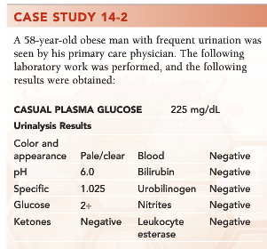
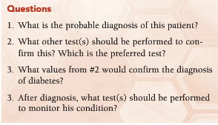
Type 2 diabetes mellitus
HbA1c, fasting plasma glucose, 2 hour glucose tolerance; HbA1c is preferred
Fasting plasma glucose greater than 126 mg/dL or a HbA1c greater than 6.5%
Self-monitoring blood glucose levels, HbA1c, microalbumin

Slide 62
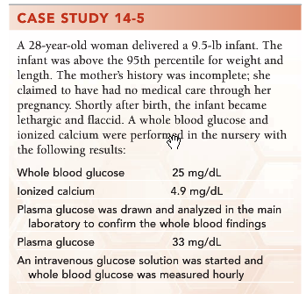
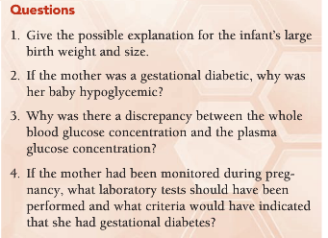
The mother has diabetes.
Fetal insulin secretion is stimulated in the neonate of a mother with diabetes. However, when an infant is born and the umbilical cord is severed, the infant’s oversupply of glucose is abruptly terminated, causing severe hypoglycemia.
The glucose concentration in whole blood is approximately 12% lower than the glucose concentration in serum or plasma.
The approach for screening and diagnosis is the performance of a 2 hour OGTT using a 75-g glucose load. A fasting plasma glucose value > 92 mg/dl, a 1 hour value >180 mg/dl, or a 2 hour glucose value >153 mg/dl is diagnostic of GDM if any one of the three criteria are met.

Slide 63
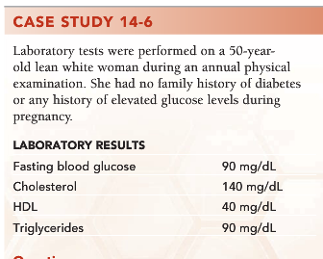
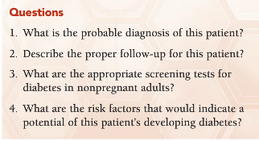
The patient is nondiabetic. A fasting blood glucose of 90 mg/dL is normal.
A lean Caucasian with no family history of type 2 diabetes has no additional risks for diabetes and should be screened for diabetes with either an HbA1c, FPG, or 2-hr PP in another 3 years according to the 2012 ADA guidelines.
HbA1c, FPG, or 2-hr PP depending on patient factors.
Obesity, family history of diabetes in a first-degree relative, etc.

Slide 64
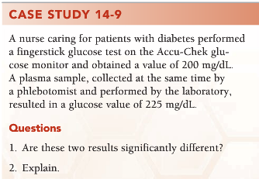
No
Whole blood is approximately 12% lower than plasma; therefore, there is no significant difference in the two results.

Slide 65
Role of Laboratory (cont’d)
Microalbuminuria
Increase in urinary albumin is early sign of renal nephropathy, a complication of diabetes mellitus.
Annual assessment of kidney function by determination of urinary albumin excretion is recommended for diabetic patients.
Defined as persistent albuminuria in range of 30–299 mg/24 hr or albumin-creatinine ratio of 30–300 µg/mg
Islet Autoantibody and Insulin Testing
Presence of autoantibodies to β-islet cells of pancreas is characteristic of type 1 diabetes.
Not currently recommended for diabetes diagnosis

