Slide 1


Files
Computer Science Department
Comp 132

Slide 2
Files
• Declare a file pointer variable
– FILE *ftp_in , /* pointer to input file */
– FILE *ftp_out; /* pointer to output file */
• The calls to function fopen
– ftp_in = fopen(“distance.dat”, “r” ) ;
– ftp_out = fopen(“distance.out”, “w”) ;
• Use of the functions
– fscanf(ftp_in, “%lf”, &miles);
– fprintf(ftp_out, “The distance in miles is %.2f. \n”, miles);
• End of use
– fclose(ftp_in);
– fclose(ftp_out);

Slide 3
Files (Examples)
1. Write a program to read two integers from a file (input.txt), find the sum of them and save the result into another file (output.txt).
2. Repeat the above example, but print the result on the screen instead of saving the result of the file.

Slide 4
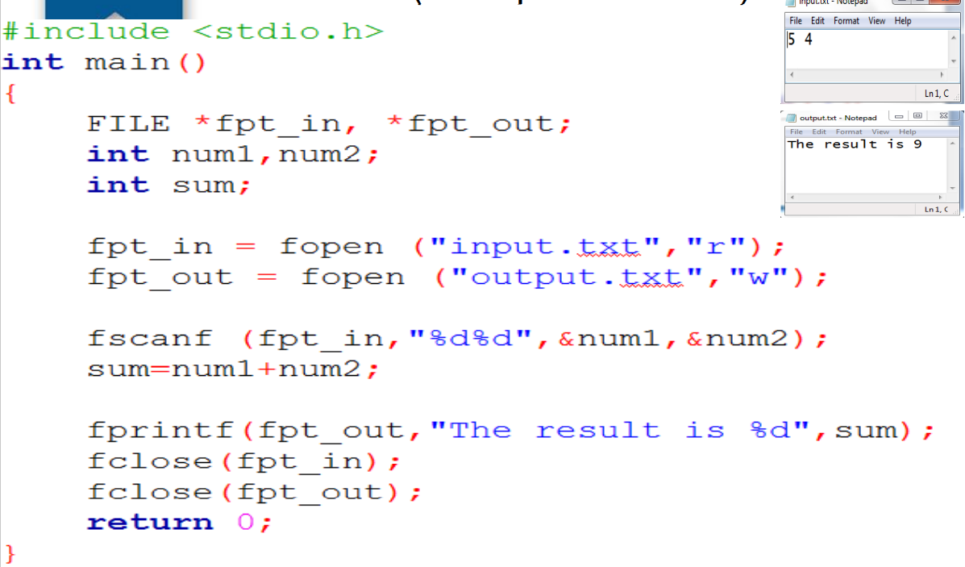
Files (Example 1 solution)

Slide 5
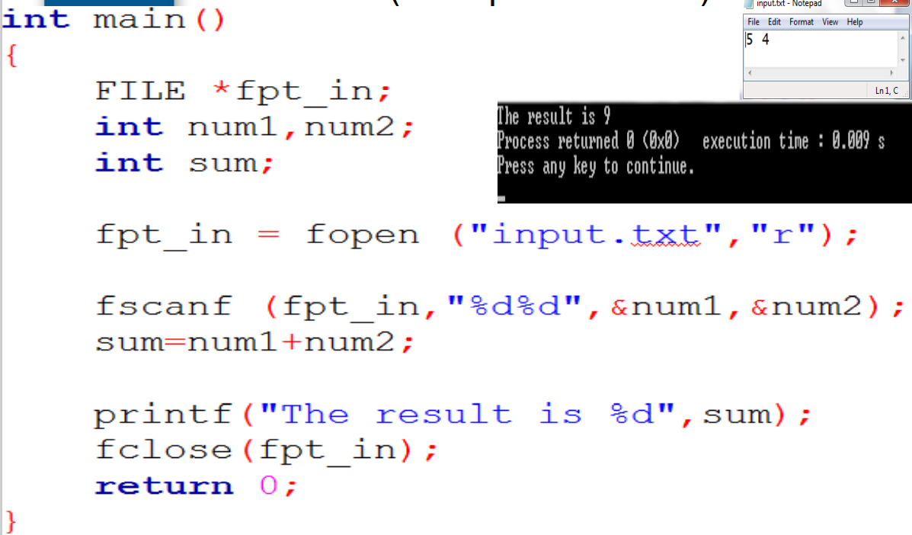
Files (Example 2 solution)

Slide 6
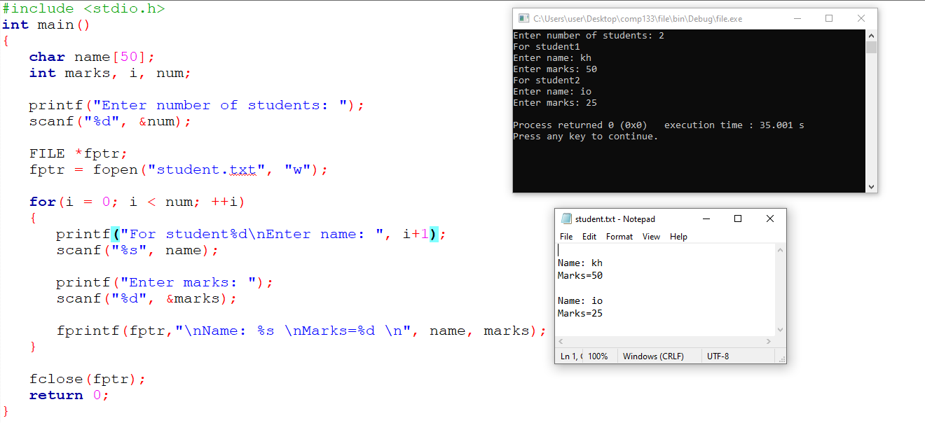
Files (Examples)
1. Write a C program to read name and marks of n number of students from user and store them in a file

