Slide 1
Serious Game Development Process

Slide 2
1- Concept Development
Define Objectives: Determine the primary goals of the game (education, training, health, etc.).
Target Audience: Identify who will be playing the game and their needs.
Brainstorming: Generate ideas for gameplay mechanics, storyline, and design.

Slide 3
Example
Game Title: Money Quest: Teen Financial Adventure
Objective: Teach basic financial literacy to teenagers. Target Audience: Teenagers (13-18 years old).
Gameplay Mechanics:
Players earn money by completing part-time jobs.
Manage budgets to meet daily needs (food, transportation) and wants (clothes, entertainment).
Set savings goals and earn interest on savings.
Simplified stock market simulation to introduce investing.

Slide 4
Storyline
Start as a high school student.
Navigate through life stages: high school, college, first job.
Balance work, school, and personal life while managing finances.
Design:
Art Style: Modern, bright, and appealing graphics.
User Interface: Easy-to-use with clear progress indicators.
Soundtrack: Background music to maintain engagement.
Here we have shown the steps from defining objectives to brainstorming ideas for a serious game aimed to teach young students financial concepts.
What do you think of this approach?

Slide 5
2- Pre-production
- Research : Gather information on the subject matter to ensure accuracy and relevance.
- Design Document : Create a detailed document outlining the game's concept, mechanics, story, and technical requirements.
- Prototyping : Develop initial prototypes to test basic gameplay mechanics and concepts.

Slide 6
Example
2.1.Research
- Objective : Teach teenagers basic financial literacy, including budgeting, saving, and investing.
- Data Collection :
- Consulted financial education resources like books, websites, and courses.
- Reviewed curriculum guidelines for financial literacy in schools.
- Interviewed financial experts and educators to ensure accuracy and relevance.

Slide 7
2.2 Design Document
Concept : A game where players earn money through part-time jobs, manage budgets, set savings goals, and invest in a simplified stock market.
- Mechanics :
- Players earn money by completing mini-games representing part-time jobs.
- Manage budgets to meet daily needs (food, transportation) and wants (clothes, entertainment).
- Set savings goals and earn interest on savings.
- Simplified stock market simulation to introduce basic investing concepts.
- Story : Players navigate various life scenarios that require financial decisions, encouraging responsible money management.
- Technical Requirements :
- Platform: Mobile and web-based game.
- Technologies: Scratch for game development and scripting.
- Assets: 2D graphics for characters, items, and environments; sound effects and background music.

Slide 8
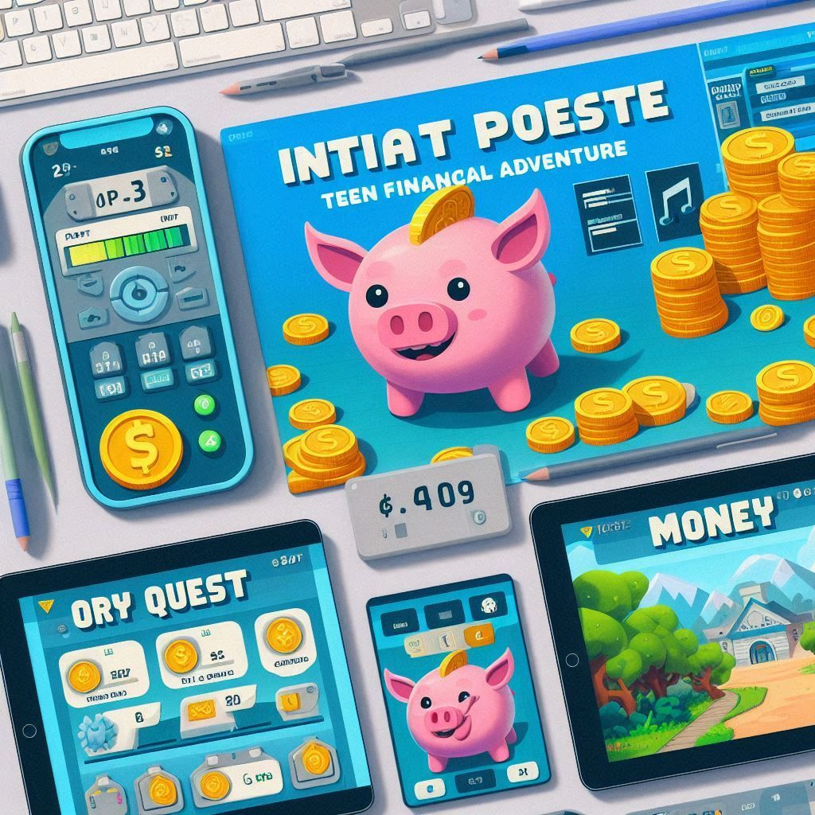
2.3 Prototyping
- Initial Prototypes :
- Developed simple versions of the mini-games to test core gameplay mechanics.
- Created basic interfaces for budget management and stock market simulation.
- Feedback Loop :
- Conducted playtesting sessions with a small group of teenagers.
- Gathered feedback on gameplay, mechanics, and educational content.
- Feedback Loop :
- Iteratively improved the game based on player feedback.
- Conducted playtesting sessions with a small group of teenagers.
- Gathered feedback on gameplay, mechanics, and educational content.
- Iteratively improved the game based on player feedback.
By following these steps, the team behind "Money Quest" was able to create an engaging and educational game that helps teenagers learn essential financial skills. This structured approach ensured that the final product met its objectives and resonated with its target audience.

Slide 9
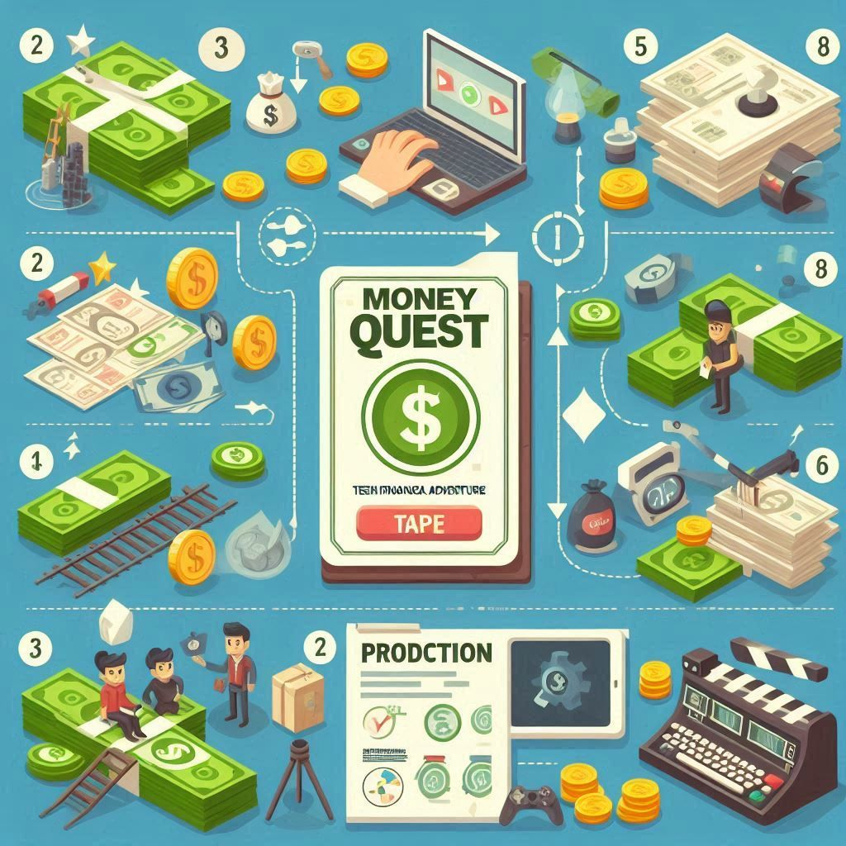
3- Production
Game Design: Design levels, characters, and environments.
Art and Animation: Create visual assets such as character models, backgrounds, and animations.
Sound Design: Develop sound effects, music, and voiceovers that enhance the gaming experience.
Programming: Code the game, integrating all design elements and ensuring functionality.
Testing: Perform iterative testing to identify and fix bugs, improve mechanics, and refine gameplay.

Slide 10
Case Study: "Money Quest: Teen Financial Adventure" - Production Steps
3.1. Game Desgin
- Design levels :
- Create different scenarios (e.g., part-time jobs, shopping, saving challenges).
- Each level introduces new financial concepts.
- Design characters :
Main character: Teenager navigating financial decisions.
non-player character: Bosses, shopkeepers, financial advisors, peers.
- Design environments: Settings: Job locations, shopping malls, banks, homes.
- Visual consistency: Ensure all environments fit the game's aesthetic.

Slide 11
3.2. Art and Animation
- Character Models :
- Create 2D/3D character models for the main character and NPCs.
- Design animations for various actions (e.g., walking, talking, working).
- Backgrounds :
- Develop detailed backgrounds for each level.
- Ensure backgrounds enhance the educational aspect of the game.
- Animations :
- Animate interactions with objects and environments.
- Create engaging and educational visual cues.

Slide 12
3.3. Sound Design
- Sound Effects :
- Develop sound effects for actions (e.g., cash register sound, job completion chime).
- Ensure sound effects are engaging and not intrusive.
- Music :
- Compose background music that fits the game's tone.
- Create different tracks for various levels and scenarios.
- Voiceovers :
- Record voiceovers for educational content and character dialogues.
- Ensure clear and understandable narration.

Slide 13
3.4. Programming
- Code Integration :
- Integrate all design elements into the game engine (e.g., Scratch).
- Implement core gameplay mechanics (e.g., earning money, budgeting, saving).
- Functionality :
- Ensure smooth and responsive controls.
- Implement user interface elements for budget management and stock market simulation.
- Technical Optimization :
- Optimize the game for performance across different devices.

Slide 14
3. 5. Testing
- Iterative Testing :
- Conduct regular playtesting to identify bugs and issues.
- Use feedback from testers to refine mechanics and improve gameplay.
- Bug Fixing :
- Fix identified bugs and ensure all game features work as intended.
- Refinement :
- Continuously improve game elements based on feedback.
- Ensure the game meets educational objectives and is enjoyable to play.

Slide 15
4- Post-production
Quality Assurance (QA): Conduct thorough QA testing to ensure the game runs smoothly across all intended platforms.
Feedback: Gather feedback from testers and make final adjustments to the game.
Localization: Translate and adapt the game for different languages and regions, if necessary.

Slide 16
5- Launch
Marketing and Promotion: Develop a marketing strategy to promote the game through various channels.
Distribution: Release the game on selected platforms (e.g., App Store, Google Play, Steam).
Launch Events: Host launch events or webinars to generate buzz and engage with the community.

Slide 17
5- Post-launch
User Support: Provide support to players and address any issues or concerns they may have.
Updates and Patches: Release updates and patches to fix bugs, add new features, and improve the game.
Community Engagement: Maintain an active presence in the game's community, engaging with players and gathering feedback.

Slide 18
6- Evaluation and Reflection
Measure Impact: Evaluate the game's success based on predefined metrics (e.g., player engagement, learning outcomes).
Collect Data: Gather data from player interactions to analyze the game's effectiveness.
Reflect: Reflect on the development process to identify what worked well and what could be improved for future projects.

