Slide 1
Engineering Economy
Chapter 4: The Time Value of Money

Slide 2
The objectives of Chapter 4 are:
★ to explain time value of money calculations, and
★ to illustrate economic equivalence.

Slide 3


Money has a time value.
Capital refers to wealth in the form of money or property that can be used to produce more wealth.
Engineering economy studies involve the commitment of capital for extended periods of time.
A dollar today is worth more than a dollar one or more years from now (for several reasons).

Slide 4
Return to capital in the form of interest and profit is an essential ingredient of engineering economy studies.
Interest and profit pay the providers of capital for forgoing its use during the time the capital is being used.
Interest and profit are payments for the risk the investor takes in letting another use his or her capital.
Any project or venture must provide a sufficient return to be financially attractive to the suppliers of money or property.

Slide 5

Simple Interest: infrequently used
When the total interest earned or charged is linearly proportional to:
(a) the initial amount of the loan (principal),
(B) the interest rate, and
(C) the number of interest periods,
the interest and interest rate are said to be simple.

Slide 6
Computation of simple interest
The total interest, I, earned or paid may be computed using the formula below.
P = principal amount lent or borrowed
N = number of interest periods (e.g., years)
i = interest rate per interest period
The total amount repaid at the end of N interest periods is P + I.

Slide 7
If $5,000 were loaned for five years at a simple interest rate of 7% per year, the interest earned would be
So, the total amount repaid at the end of five years would be the original amount ($5,000) plus the interest ($1,750), or $6,750.

Slide 8
Compound interest reflects both the remaining principal and any accumulated interest. For $1,000 at 10%…
Period | (1) Amount owed at beginning of period | (2)=(1)x10% Interest amount for period | (3)=(1)+(2) Amount owed at end of period
1 | $1,000 | $100 | $1,100
2 | $1,100 | $110 | $1,210
3 | $1,210 | $121 | $1,331
Compound interest is commonly used in personal and professional financial transactions.

Slide 9
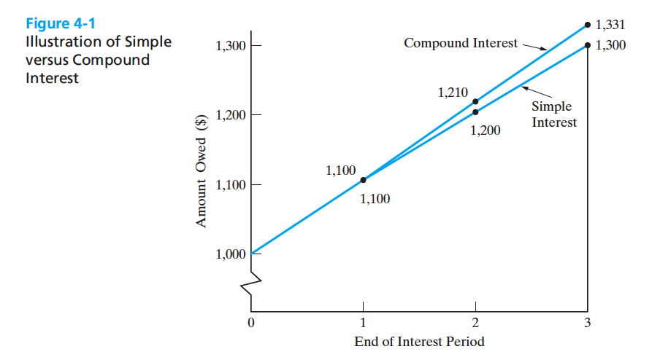

Slide 10
Economic equivalence allows us to compare alternatives on a common basis.
Each alternative can be reduced to an equivalent basis dependent on
interest rate,
amount of money involved, and
timing of monetary receipts or expenses.
Using these elements, we can “move” cash flows so that we can compare them at particular points in time.

Slide 11
We need some tools to find economic equivalence.
Notation used in formulas for compound interest calculations.
  i = effective interest rate per interest period
  N = number of compounding (interest) periods
  P = present sum of money; equivalent value of one or more cash flows at a reference point in time; the present
  F = future sum of money; equivalent value of one or more cash flows at a reference point in time; the future
  A = end-of-period cash flows in a uniform series continuing for a certain number of periods, starting at the end of the first period and continuing through the last

Slide 12
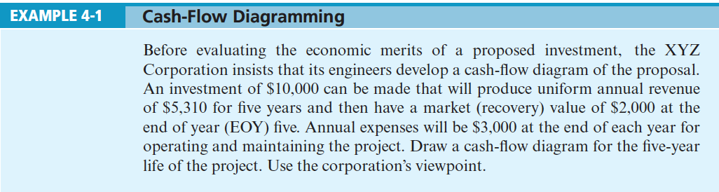
Pause and Solve!

Slide 13
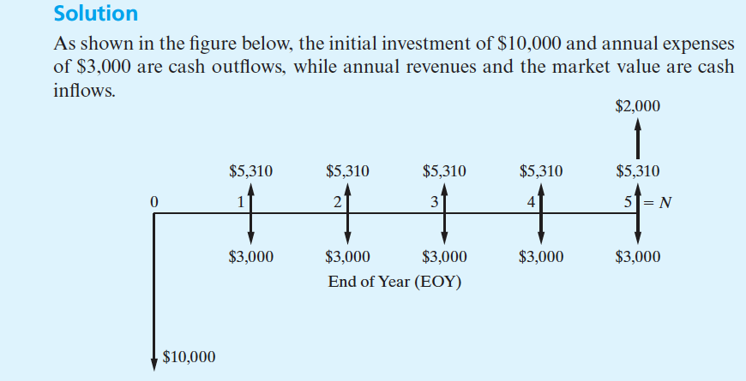

Slide 14
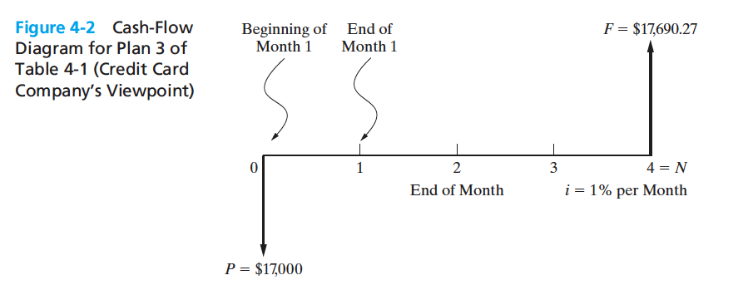
A cash flow diagram is an indispensable tool for clarifying and visualizing a series of cash flows. (Plan 3 of the example)

Slide 15
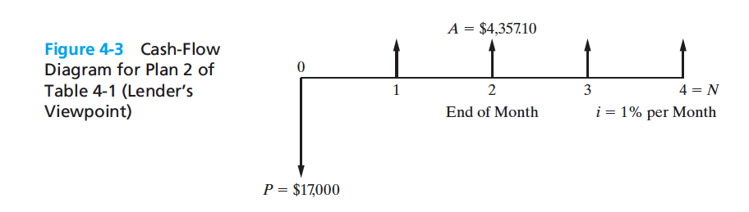
A cash flow diagram is an indispensable tool for clarifying and visualizing a series of cash flows. (Plan 2 of the example)

Slide 16
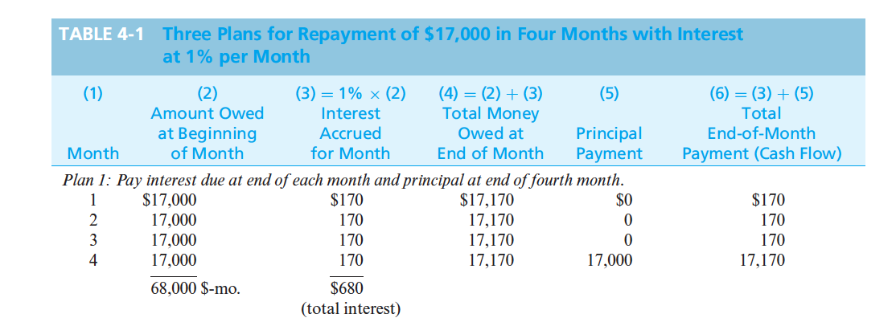
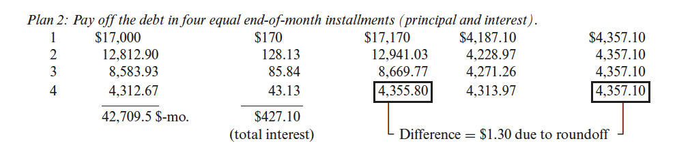
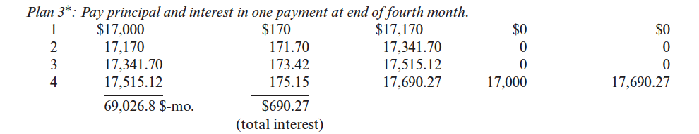








Slide 17

Economic Equivalance
This brings us back to the concept of economic equivalence. If the interest rate remains at 1% per month, you should be indifferent as to which plan you use to repay the $17,000 to your credit card company.
This assumes that you are charged 1% of the outstanding principal balance (which includes any unpaid interest) each month for the next four months.
If interest rates in the economy go up and increase your credit card rate to say, 1.25% per month, the plans are no longer equivalent.
What varies among the three plans is the rate at which principal is repaid and how interest is repaid.

Slide 18
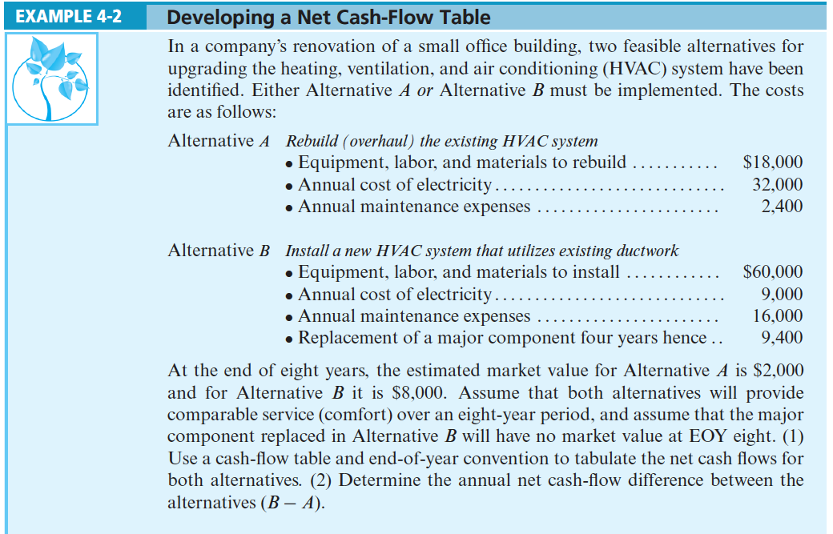

Slide 19
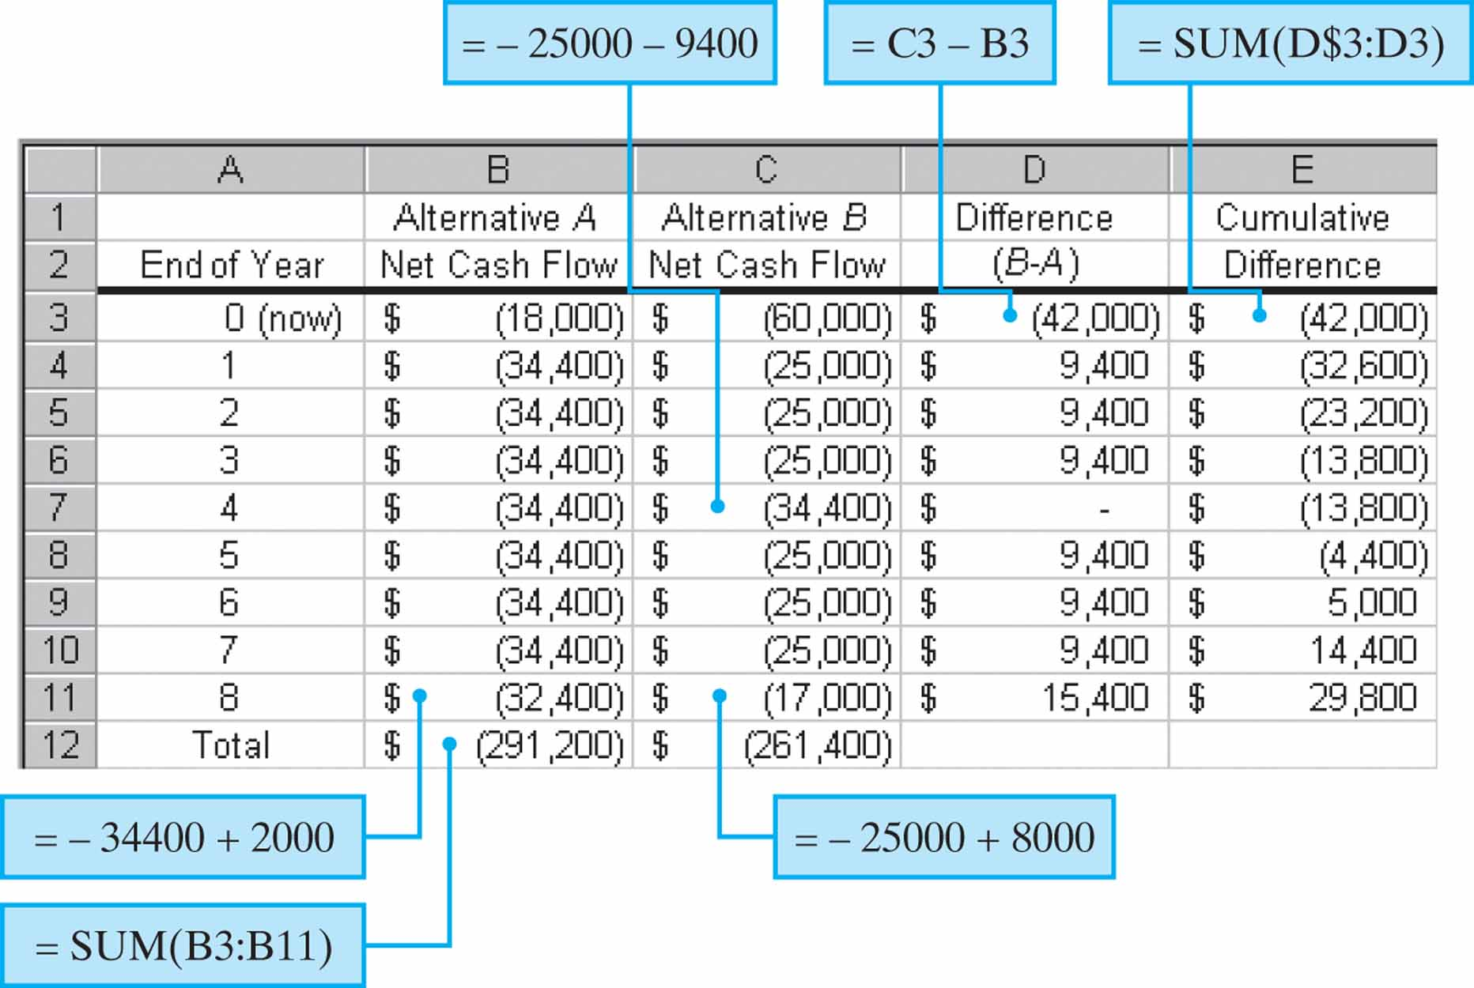
Cash flow tables are essential to modeling engineering economy problems in a spreadsheet

Slide 20
Analysis of the Data Results
On the basis of these results, several points can be made:
(1) doing nothing is not an option—either A or B must be selected;
(2) even though positive and negative cash flows are included in the table, on balance we are investigating two “cost-only” alternatives;
(3) a decision between the two alternatives can be made just as easily on the difference in cash flows (i.e., On the avoidable difference) as it can on the stand-alone net cash flows for alternatives A and B;
(4) alternative B has cash flows identical to those of alternative A, except for the differences shown in the table, so if the avoidable difference can “pay its own way,” alternative B is the recommended choice;
(5) cash-flow changes caused by inflation or other suspected influences could have easily been inserted into the table and included in the analysis; and
(6) it takes six years for the extra $42,000 investment in alternative B to generate sufficient cumulative savings in annual expenses to justify the higher investment. (This ignores the time value of money.) So, which alternative is better? We’ll be able to answer this question later when we consider the time value of money in order to recommend choices between alternatives.

Slide 21


We can apply compound interest formulas to “move” cash flows along the cash flow diagram.
Using the standard notation, we find that a present amount, P, can grow into a future amount, F, in N time periods at interest rate i according to the formula below.
In a similar way we can find P given F by

Slide 22
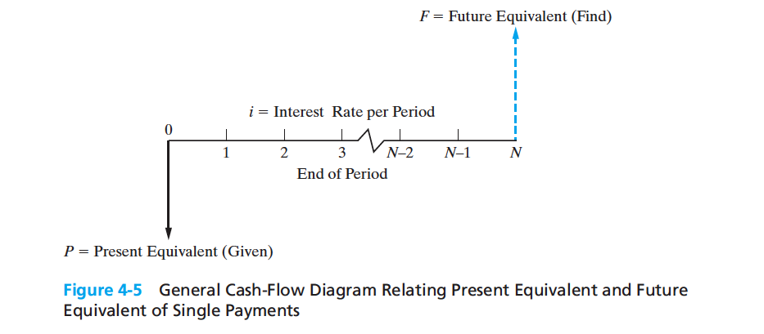

Slide 23


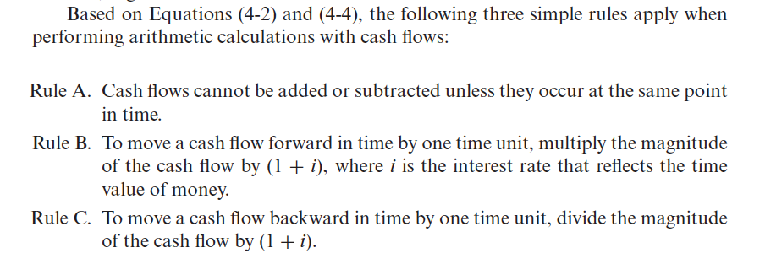

Slide 24

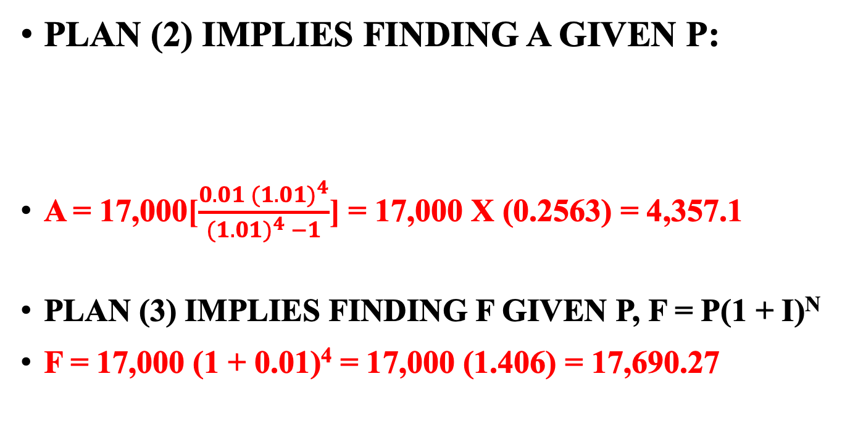
Finding F given P & Finding A Given P
Plan (2) implies finding A given P:
A = 17,000[$\frac{{0.01 (1.01)}^{4}}{{(1.01)}^{4} −1}$] = 17,000 x (0.2563) = 4,357.1
Plan (3) implies finding F given P, F = P(1 + i)^{N}
F = 17,000 (1 + 0.01)⁴ = 17,000 (1.406) = 17,690.27

Slide 25
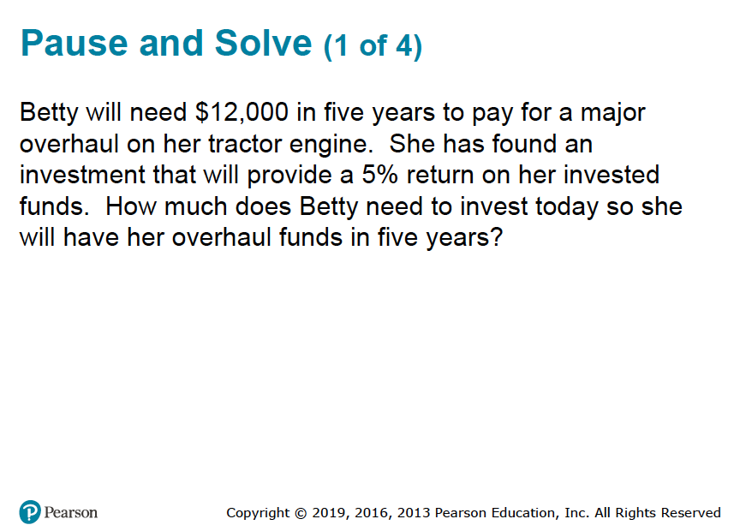

Slide 26
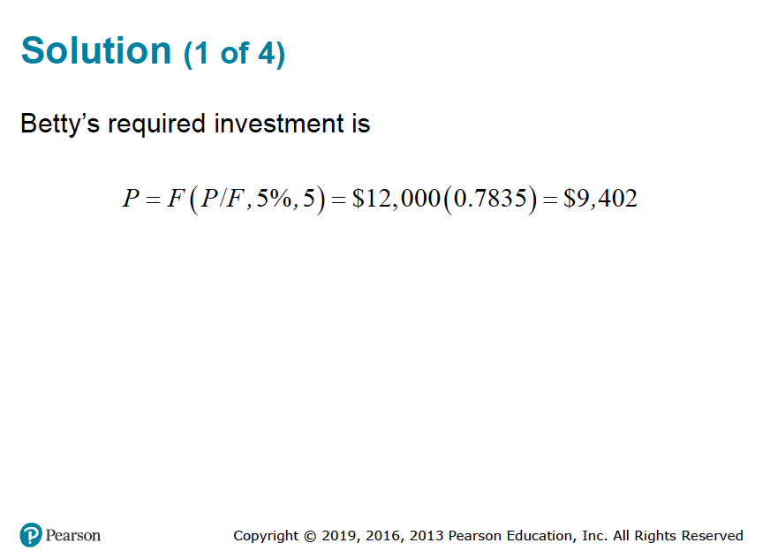

Slide 27

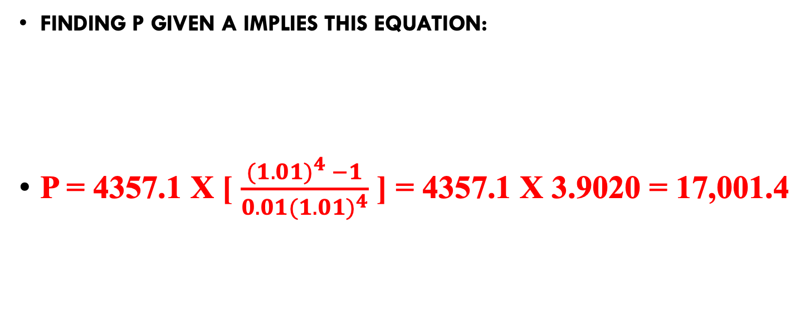
Finding P given A
Finding P given A implies this equation:
P = 4357.1 x [ $\frac{{(1.01)}^{4} −1}{{0.01(1.01)}^{4}}$ ] = 4357.1 X 3.9020 = 17,001.4

Slide 28
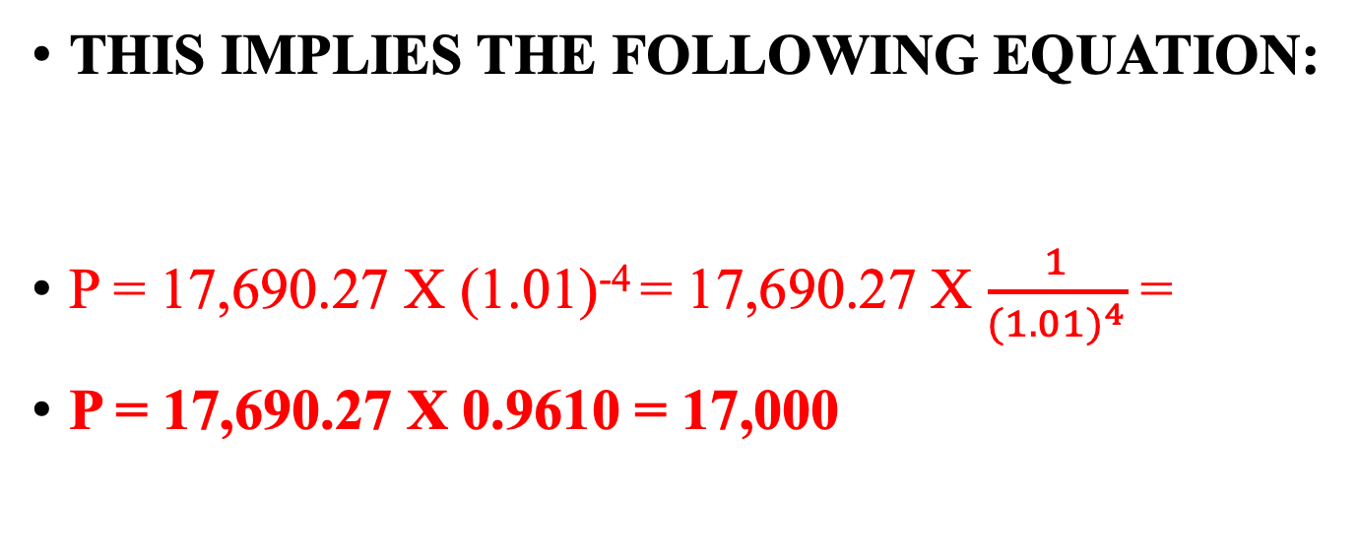
Finding P given F
This implies the following equation:
P = 17,690.27 X (1.01)⁻⁴ = 17,690.27 X $\frac{1}{{(1.01)}^{4}}$ =
P = 17,690.27 X 0.9610 = 17,000

Slide 29



Finding A Given F &
Finding F Given A
Finding A given F:
A = 17,690.27 [$\frac{0.01}{{(1.01)}^{4} −1}$] = 17,690.27 X 0.2463 = 4357.11
Finding F given A:
F = 4357.11 [$\frac{{(1.01)}^{4 }−1}{0.01}$] = 4357.11 x 4.0604 = 17,691.61

Slide 30
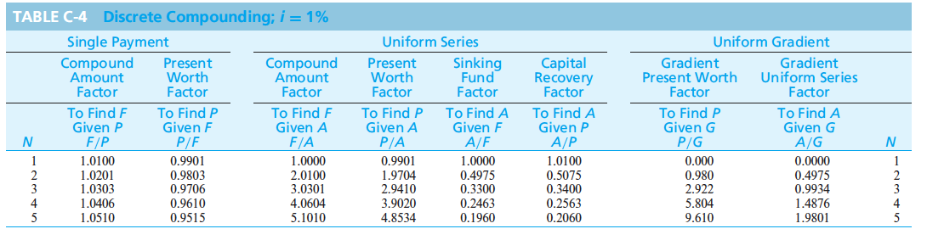


Slide 31


It is common to use standard notation for interest factors.
This is also known as the single payment compound amount factor. The term on the right is read “F given P at i% interest per period for N interest periods.”
is called the single payment present worth factor.

Slide 32
We can use these to find economically equivalent values at different points in time.
$2,500 at time zero is equivalent to how much after six years if the interest rate is 8% per year?
$3,000 at the end of year seven is equivalent to how much today (time zero) if the interest rate is 6% per year?

Slide 33
There are interest factors for a series of end-of-period cash flows, i.e. Finding F given A
How much will you have in 40 years if you save $3,000 each year and your account earns 8% interest each year?

Slide 34
Finding the present amount from a series of end-of-period cash flows, i.e. Finding P given A
How much would be needed today to provide an annual amount of $50,000 each year for 20 years, at 9% interest each year?

Slide 35
Finding A when given F
How much would you need to set aside each year for 25 years, at 10% interest, to have accumulated $1,000,000 at the end of the 25 years?

Slide 36
Finding A when given P
If you had $500,000 today in an account earning 10% each year, how much could you withdraw each year for 25 years?

Slide 37
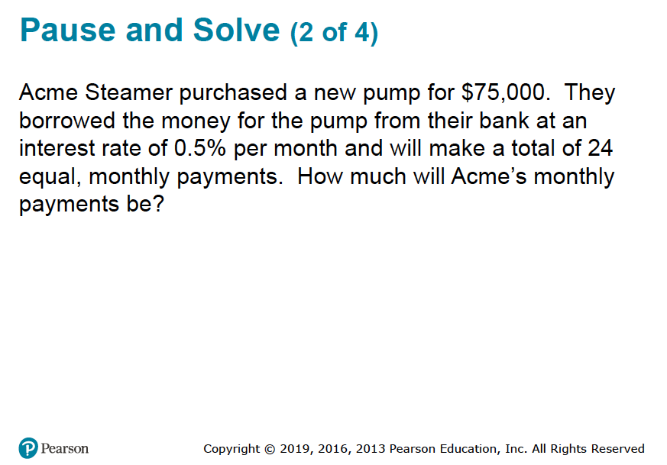

Slide 38
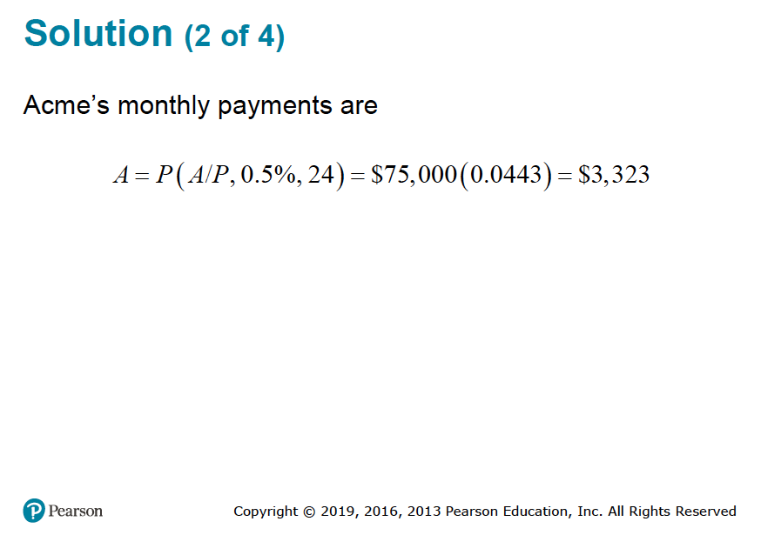

Slide 39
It can be challenging to solve for N or i.
We may know P, A, and i and want to find N.
We may know P, A, and N and want to find i.
These problems present special challenges that are best handled on a spreadsheet.

Slide 40








Finding N
Acme borrowed $100,000 from a local bank, which charges them an interest rate of 7% per year. If Acme pays the bank $8,000 per year, how many years will it take to pay off the loan?
So,
This can be solved by using the interest tables and interpolation, but we generally resort to a computer solution.

Slide 41





Finding i
Jill invested $1,000 each year for five years in a local company and sold her interest after five years for $8,000. What annual rate of return did Jill earn?
So,
Again, this can be solved using the interest tables and interpolation, but we generally resort to a computer solution.

Slide 42

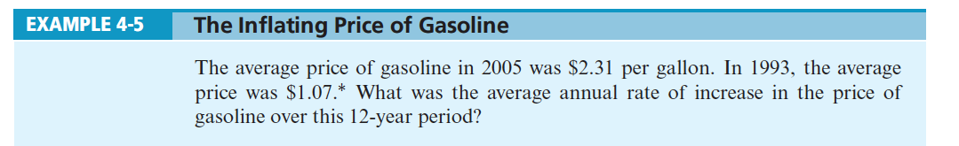
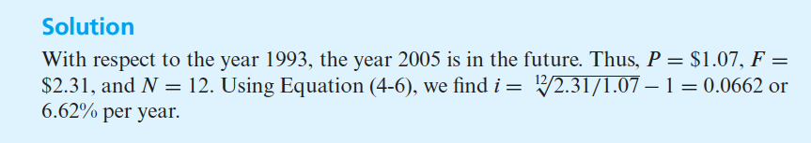



Slide 43
There are specific spreadsheet functions to find N and i.
The Excel function used to solve for N is
NPER(rate, pmt, pv), which will compute the number of payments of magnitude pmt required to pay off a present amount (pv) at a fixed interest rate (rate).
The Excel function used to solve for i is
RATE(nper, pmt, pv, fv), which returns a fixed interest rate for an annuity of pmt that lasts for nper periods to either its present value (pv) or future value (fv).

Slide 44



We can use the equivalence relationship given in Equation (4-2) to obtain an expression for N.
Using logarith we can solve this problem:
N log (1 + i) = log (F/P)
N = log (F/P) / log (1+i)
For example, how long would it take for $500 invested today at 15% interest per year to be worth $1,000?
N= log (1000/500) / log (1+ 0.15) = 0.301 / 0.0607 = 4.96
or approximately 5 years.

Slide 45
Pause & Solve
Example 4-6 Credit Card Minimum
Payment Credit cards are great in moderation. To help boost your FICO score, always pay your credit card balance (all of it) on time. Avoid late fees and penalties! Also keep your credit card charges to one-fourth of your credit limit. For example, a credit card balance of $1,000 will be one-fourth of your limit of $4,000 and will incur a monthly payment of $22.24 at 1% per month. This payment will be avoided if you can pay off all the $1,000 that you have charged to your credit card. About how many months has the credit card company built into its calculation of the $22.24 monthly payment?
Solution
Set up an equation for the equivalence of $22.24 per month to repay $1,000 when the interest rate is 1% per month:
$1, 000 = $22.24 (P/A, 1%,N)
44.964 = (P/A, 1%,N)
From Table C-4, we see that N is approximately 60 months.

Slide 46

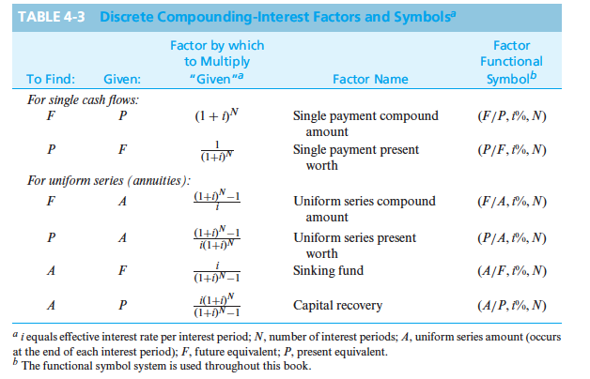

Slide 47

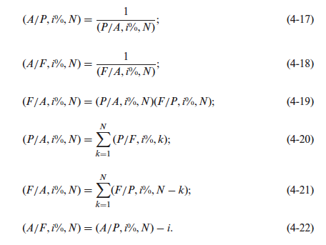

Slide 48
We need to be able to handle cash flows that do not occur until some time in the future.
Deferred annuities are uniform series that do not begin until some time in the future.
If the annuity is deferred J periods then the first payment (cash flow) begins at the end of period J+1.

Slide 49
Finding the value at time 0 of a deferred annuity is a two-step process.
Use (P/A, i%, N-J) find the value of the deferred annuity at the end of period J (where there are N-J cash flows in the annuity).
Use (P/F, i%, J) to find the value of the deferred annuity at time zero.

Slide 50
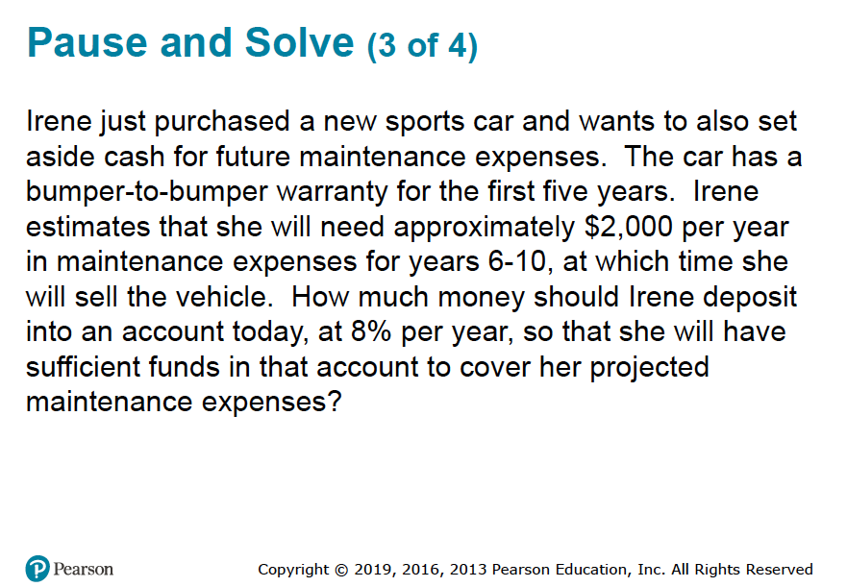

Slide 51
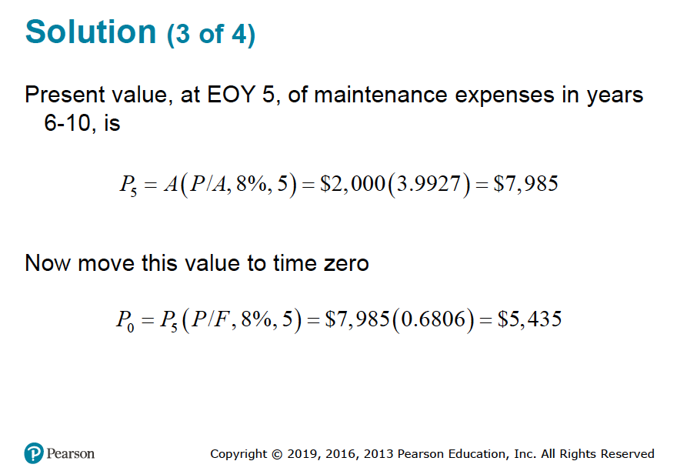

Slide 52
Sometimes cash flows change by a constant amount each period.
End of Period | Cash Flows
1 | 0
2 | G
3 | 2G
: | :
N | (N-1)G
We can model these situations as a uniform gradient of cash flows. The table shows such a gradient.

Slide 53

It is easy to find the present value of a uniform gradient series.
Similar to the other types of cash flows, there is a formula (albeit quite complicated) we can use to find the present value, and a set of factors developed for interest tables.

Slide 54


We can also find A or F equivalent to a uniform gradient series.

Slide 55
The annual equivalent of this series of cash flows can be found by considering an annuity portion of the cash flows and a gradient portion.
End of Year | Cash Flows ($)
1 | 2,000
2 | 3,000
3 | 4,000
4 | 5,000
End of Year | Annuity ($) | Gradient ($)
1 | 2,000 | 0
2 | 2,000 | 1,000
3 | 2,000 | 2,000
4 | 2,000 | 3,000

Slide 56
Sometimes cash flows change by a constant rate, ,each period--this is a geometric gradient series.
End of Year | Cash Flows ($)
1 | 1,000
2 | 1,200
3 | 1,440
4 | 1,728
This table presents a geometric gradient series. It begins at the end of year 1 and has a rate of growth, , of 20%.

Slide 57
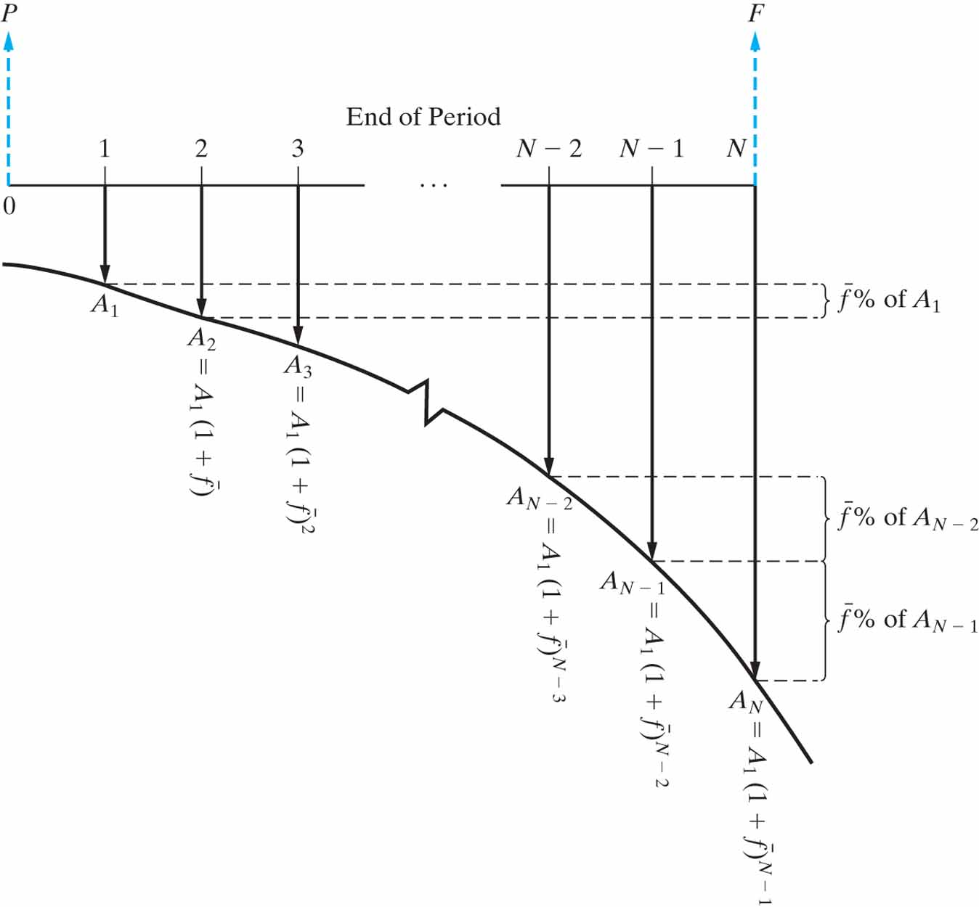

Slide 58

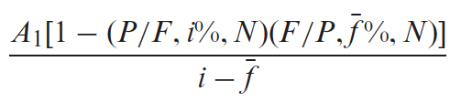

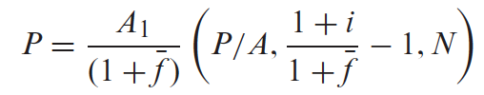

We can find the present value of a geometric series by using the appropriate formula below.
P =
P =
Where is the initial cash flow in the series.

Slide 59
Pause and Solve (4 of 4)
Acme Miracle projects good things for their new weight loss pill, LoseIt. Revenues this year are expected to be $1.1 million, and Acme believes they will increase 15% per year ( ( ) for the next 5 years. What are the:
Present value (P), and
Equivalent annual amount (A)
for the anticipated revenues? Acme uses an interest rate (i) of 20%.

Slide 60
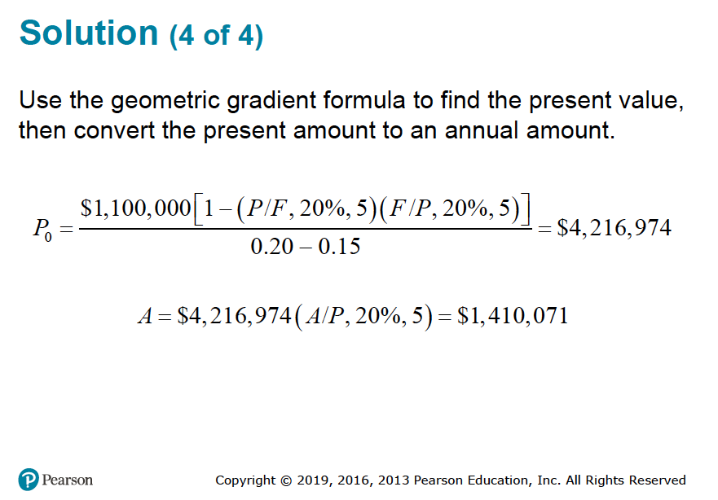

Slide 61
When interest rates vary with time different procedures are necessary.
Interest rates often change
with time (e.g., a variable rate mortgage).
We often must resort to moving cash flows one period at a time, reflecting the interest rate for that single period.

Slide 62


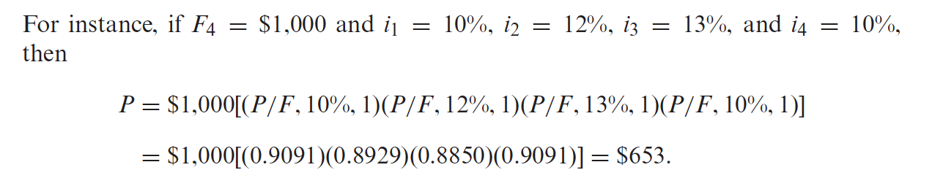
The present equivalent of a cash flow occurring at the end of period N can be computed with the equation below, where i_{k} is the interest rate for the k^{th} period.
The symbol
means “the product of”.

Slide 63
Nominal and effective interest rates.
More often than not, the time between successive compounding, or the interest period, is less than one year (e.g., daily, monthly, quarterly).
The annual rate is known as a nominal rate.
A nominal rate of 12%, compounded monthly, means an interest of 1% (12%/12) would accrue each month, and the annual rate would be effectively somewhat greater than 12%.
The more frequent the compounding the greater the effective interest.

Slide 64

The effect of more frequent compounding can be easily determined.
Let r be the nominal, annual interest rate and M the number of compounding periods per year. We can find, i, the effective interest by using the formula below.

Slide 65


Finding effective interest rates
For an 18% nominal rate, compounded quarterly, the effective interest is.
For a 7% nominal rate, compounded monthly, the effective interest is.

Slide 66
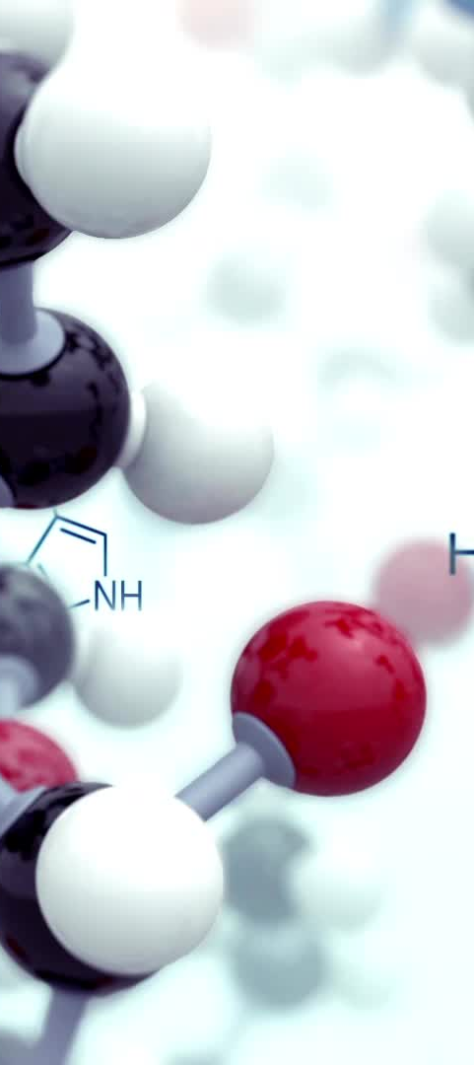
Interest can be compounded continuously.
Interest is typically compounded at the end of discrete periods.
In most companies, cash is always flowing, and should be immediately put to use.
We can allow compounding to occur continuously throughout the period.
The effect of this compared to discrete compounding is small in most cases.

Slide 67
We can use the effective interest formula to derive the interest factors.
As the number of compounding periods gets larger (M gets larger), we find that
العدد النيبيري e كما نسميه هو ثابت رقمي يساوي 2.71828، وهو الأساس للوغاريتم الطبيعي

Slide 68



Continuous compounding interest factors.
The other factors can be found from these.

Slide 69
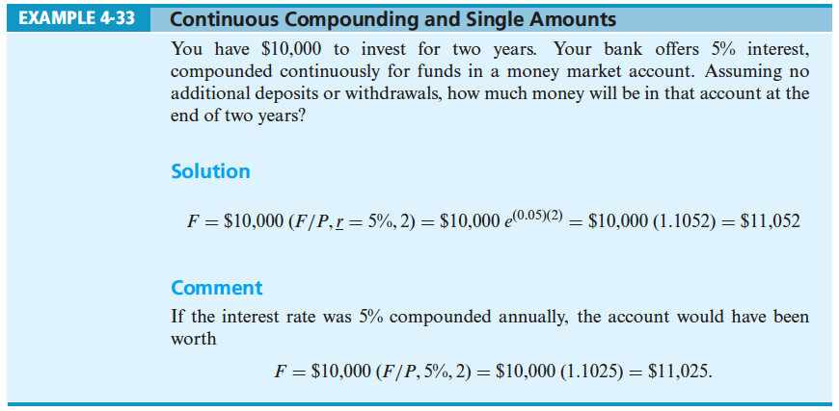

Slide 70
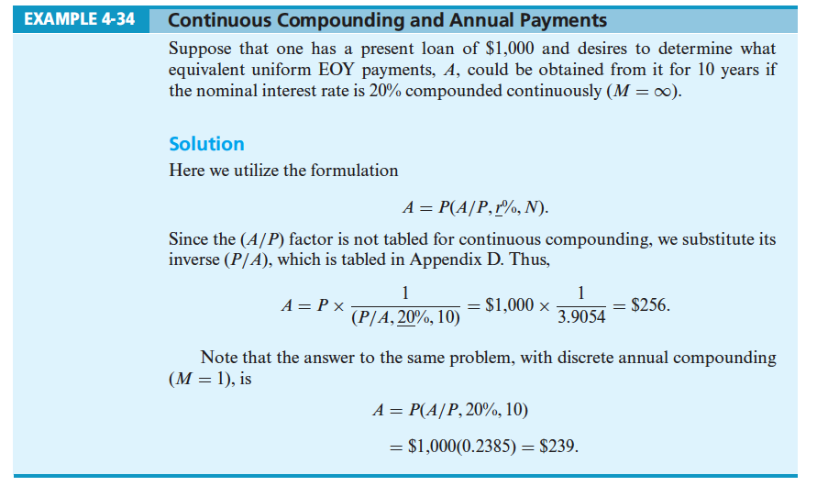

Slide 71
