Slide 1
Chapter 1
WEEK1
Basic Concepts and Computer Evolution
Notes:
In a class of computers called microcomputers, the relationship between architecture
and organization is very close. Changes in technology not only influence
organization but also result in the introduction of more powerful and more complex
architectures. Generally, there is less of a requirement for generation-
To-generation compatibility for these smaller machines. Thus, there is more interplay between
organizational and architectural design decisions. An intriguing example of this is
the reduced instruction set computer (RISC), which we examine in Chapter 15.
This book examines both computer organization and computer architecture.
The emphasis is perhaps more on the side of organization. However, because a
computer organization must be designed to implement a particular architectural
specification, a thorough treatment of organization requires a detailed examination
of architecture as well.

Slide 2
Computer Architecture
Computer Organization
Computer Architecture
Attributes of a system visible to the programmer
Have a direct impact on the logical execution of a program
Architectural attributes include:
Instruction set, number of bits used to represent various data types, I/O mechanisms, techniques for addressing memory
Computer Organization
The operational units and their interconnections that realize the architectural specifications
Organizational attributes include:
Hardware details transparent to the programmer, control signals, interfaces between the computer and peripherals, memory technology used
Notes:
In describing computers, a distinction is often made between computer architecture
and computer organization. Although it is difficult to give precise definitions
for these terms, a consensus exists about the general areas covered by each
(e.g., see [VRAN80], [SIEW82], and [BELL78a]); an interesting alternative view
is presented in [REDD76].
Computer architecture refers to those attributes of a system visible to a
programmer or, put another way, those attributes that have a direct impact on
the logical execution of a program. A term that is often used interchangeably with computer
architecture is instruction set architecture (ISA) . The ISA defines instruction
formats, instruction opcodes, registers, instruction and data memory; the effect of
executed instructions on the registers and memory; and an algorithm for controlling
instruction execution. Computer organization refers to the operational
units and their interconnections that realize the architectural specifications.
Examples of architectural attributes include the instruction set, the number of bits
used to represent various data types (e.g., numbers, characters), I/O mechanisms,
and techniques for addressing memory. Organizational attributes include those
hardware details transparent to the programmer, such as control signals; interfaces
between the computer and peripherals; and the memory technology used.
For example, it is an architectural design issue whether a computer will have
a multiply instruction. It is an organizational issue whether that instruction will
be implemented by a special multiply unit or by a mechanism that makes repeated
use of the add unit of the system. The organizational decision may be based on the
anticipated frequency of use of the multiply instruction, the relative speed of the two
approaches, and the cost and physical size of a special multiply unit.
Historically, and still today, the distinction between architecture and organization
has been an important one. Many computer manufacturers offer a family of
computer models, all with the same architecture but with differences in organization.
Consequently, the different models in the family have different price and performance
characteristics. Furthermore, a particular architecture may span many years and
encompass a number of different computer models, its organization changing with
changing technology.

Slide 3
Computer Revolution
Progress in computer technology
  Underpinned by Moore’s Law
Makes novel applications feasible
  Computers in automobiles
  Cell phones
  Human genome project
  World Wide Web
  Search Engines
Computers are pervasive

Slide 4
Classes of Computers
Personal computers
  General purpose, variety of software
  Subject to cost/performance tradeoff
Server computers
  Network based
  High capacity, performance, reliability
  Range from small servers to building sized

Slide 5
PostPC Era
Personal Mobile Device (PMD)
  Battery operated
  Connects to the internet
  Hundreds of dollars
  Smart phones, tablets, electronic glasses
Cloud computing
  Warehouse Scale Computers (WSC)
  Software as a Service (SaaS)
  Portion of software run on a PMD and a portion run in the Cloud
  Amazon and Google

Slide 6
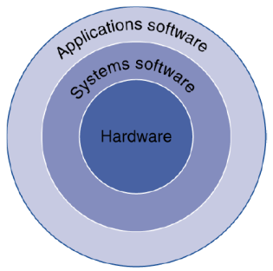
Below Your Program
Application software
  Written in high-level language
System software
  Compiler: translates HLL code to machine code
  Operating System: service code
    Handling input/output
    Managing memory and storage
    Scheduling tasks & sharing resources
Hardware
  Processor, memory, I/O controllers

Slide 7
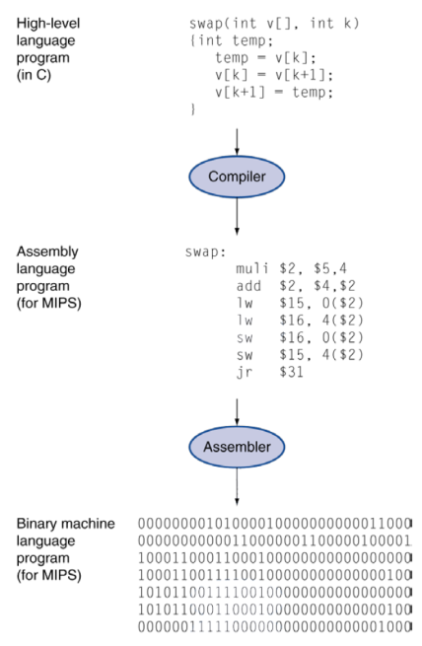
Levels of Program Code
High-level language
  Level of abstraction closer to problem domain
  Provides for productivity and portability
Assembly language
  Textual representation of instructions
Hardware representation
  Binary digits (bits)
  Encoded instructions and data

Slide 8
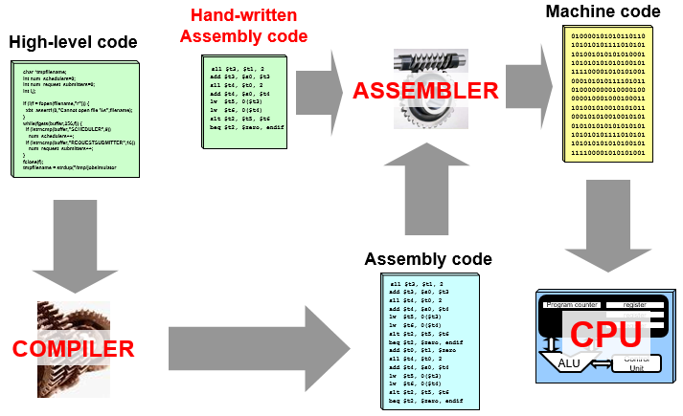
The Big (Simplified) Picture

Slide 9
Structure
Notes:
We now look in a general way at the internal structure of a computer. We begin with
a traditional computer with a single processor that employs a microprogrammed
control unit, then examine a typical multicore structure.
Figure 1.1 provides a hierarchical view
of the internal structure of a traditional single-processor computer.

Slide 10
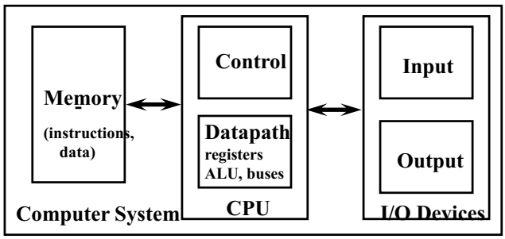
Von Neumann Computer Model
Partitioning of the computing engine into components:
  Central Processing Unit (CPU): Control Unit (instruction decode , sequencing of operations), Datapath (registers, arithmetic and logic unit, buses).
  Memory: Instruction and operand storage.
  Input/Output (I/O) sub-system: I/O bus, interfaces, devices.
  The stored program concept: Instructions from an instruction set are fetched from a common memory and executed one at a time
Control unit , controls the cpu ,linking registers with alu to decide what op
Major CPU Performance Limitation:
Von Neumann computing model implies sequential execution one instruction at a time

Slide 11
CPU – controls the operation of the computer and performs its data processing functions
Main Memory – stores data
I/O – moves data between the computer and its external environment
System Interconnection – some mechanism that provides for communication among CPU, main memory, and I/O
There are four main structural components
of the computer:
Notes:
There are four main structural components:
• Central processing unit (CPU): Controls the operation of the computer and
performs its data processing functions; often simply referred to as processor.
• Main memory: Stores data.
• I/O: Moves data between the computer and its external environment.
• System interconnection: Some mechanism that provides for communication
among CPU, main memory, and I/O. A common example of system interconnection
is by means of a system bus, consisting of a number of conducting
wires to which all the other components attach.

Slide 12
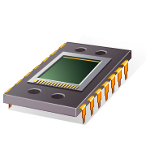
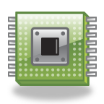
CPU
Control Unit
  Controls the operation of the CPU and hence the computer
  Arithmetic and Logic Unit (ALU)
  Performs the computer’s data processing function
  Registers
  Provide storage internal to the CPU
  CPU Interconnection
  Some mechanism that provides for communication among the control unit, ALU, and registers
Major structural components:
Notes:
There may be one or more of each of the aforementioned components.
Traditionally, there has been just a single processor. In recent years, there has been
increasing use of multiple processors in a single computer. Some design issues relating
to multiple processors crop up and are discussed as the text proceeds; Part Five
focuses on such computers.
Each of these components will be examined in some detail in Part Two.
However, for our purposes, the most interesting and in some ways the most complex
component is the CPU. Its major structural components are as follows:
• Control unit: Controls the operation of the CPU and hence the computer.
• Arithmetic and logic unit (ALU): Performs the computer’s data processing
functions.
• Registers: Provides storage internal to the CPU.
• CPU interconnection: Some mechanism that provides for communication
among the control unit, ALU, and registers.
Part Three covers these components, where we will see that complexity is added by
the use of parallel and pipelined organizational techniques. Finally, there are several
approaches to the implementation of the control unit; one common approach is
a microprogrammed implementation. In essence, a microprogrammed control unit
operates by executing microinstructions that define the functionality of the control
unit. With this approach, the structure of the control unit can be depicted, as in
Figure 1.1. This structure is examined in Part Four.

Slide 13



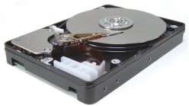
A Safe Place for Data
Volatile main memory
  Loses instructions and data when power off
  Cache, RAM,..
Non-volatile secondary memory
  Magnetic disk
  Flash memory
  Optical disk (CDROM, DVD)
  HD, flash, …

Slide 14
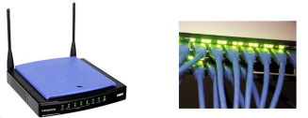
Networks
Communication, resource sharing, nonlocal access.
Local area network (LAN): Ethernet
Wide area network (WAN): Internet
Wireless network: WiFi, Bluetooth

Slide 15
General Purpose Processor/Computer System Generations
The First Generation, 1946-59: Vacuum Tubes, Relays, Mercury Delay Lines:
  ENIAC (Electronic Numerical Integrator and Computer): First electronic computer, 18000 vacuum tubes, 1500 relays, 5000 additions/sec (1944).
  First stored program computer: EDSAC (Electronic Delay Storage Automatic Calculator), 1949.
The Second Generation, 1959-64: Discrete Transistors.
  e.g. IBM Main frames

Slide 16
General Purpose Processor/Computer System Generations
The Third Generation, 1964-75: Small and Medium-Scale Integrated (MSI) Circuits.
  e.g Main frames (IBM 360) , mini computers (DEC PDP-8, PDP-11).
The Fourth Generation, 1975-Present: The Microcomputer. VLSI-based Microprocessors (single-chip processor)
  First microprocessor: Intel’s 4-bit 4004 (2300 transistors), 1970.
  Personal Computer (PCs), laptops, PDAs, servers, clusters …
  Reduced Instruction Set Computer (RISC) 1984

Slide 17
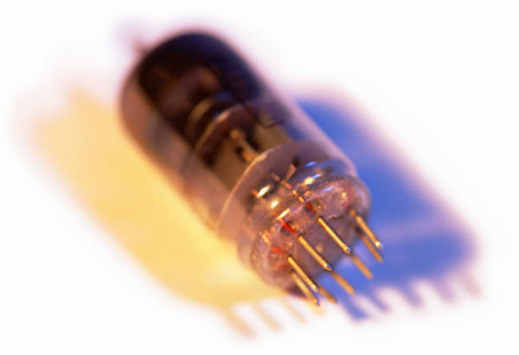
History of Computers
First Generation: Vacuum Tubes
Vacuum tubes were used for digital logic elements and memory
Instruction Set Architecture (ISA) computer
  Fundamental design approach was the stored program concept
    Attributed to the mathematician John von Neumann
    First publication of the idea was in 1945 for the EDVAC
  Design began at the Princeton Institute for Advanced Studies
  Completed in 1952
  Prototype of all subsequent general-purpose computers
Notes:
The first generation of computers used vacuum tubes for digital logic elements and
memory. A number of research and then commercial computers were built using
vacuum tubes. For our purposes, it will be instructive to examine perhaps the most
famous first-generation computer, known as the IAS computer.
A fundamental design approach first implemented in the IAS computer is
known as the stored-program concept . This idea is usually attributed to the mathematician
John von Neumann. Alan Turing developed the idea at about the same time.
The first publication of the idea was in a 1945 proposal by von Neumann for a new
computer, the EDVAC (Electronic Discrete Variable Computer).3
In 1946, von Neumann and his colleagues began the design of a new stored-
program computer, referred to as the IAS computer, at the Princeton Institute for
Advanced Studies. The IAS computer, although not completed until 1952, is the
prototype of all subsequent general-purpose computers.

Slide 18
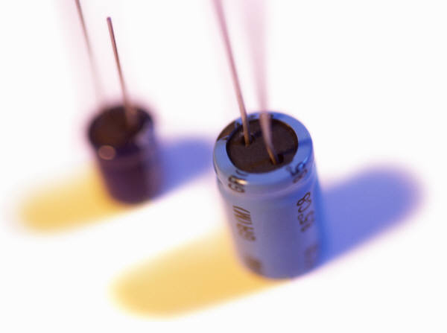
History of Computers
Second Generation: Transistors
  Smaller
  Cheaper
  Dissipates less heat than a vacuum tube
  Is a solid state device made from silicon
  Was invented at Bell Labs in 1947
  It was not until the late 1950’s that fully transistorized computers were commercially available
Notes:
The first major change in the electronic computer came with the replacement of
the vacuum tube by the transistor. The transistor is smaller, cheaper, and dissipates
less heat than a vacuum tube but can be used in the same way as a vacuum tube to
construct computers. Unlike the vacuum tube, which requires wires, metal plates, a
glass capsule, and a vacuum, the transistor is a solid-state device, made from silicon.
The transistor was invented at Bell Labs in 1947 and by the 1950s had launched
an electronic revolution. It was not until the late 1950s, however, that fully transistorized
computers were commercially available. The use of the transistor defines
the second generation of computers.

Slide 19
Second Generation Computers
Introduced:
  More complex arithmetic and logic units and control units
  The use of high-level programming languages
  Provision of system software which provided the ability to:
    Load programs
    Move data to peripherals
    Libraries perform common computations
Notes:
But there are other changes as well. The second generation saw the introduction
of more complex arithmetic and logic units and control units, the use of
high-level programming languages, and the provision of system software with the
computer. In broad terms, system software provided the ability to load programs,
move data to peripherals, and libraries to perform common computations, similar
to what modern operating systems like Windows and Linux do.

Slide 20
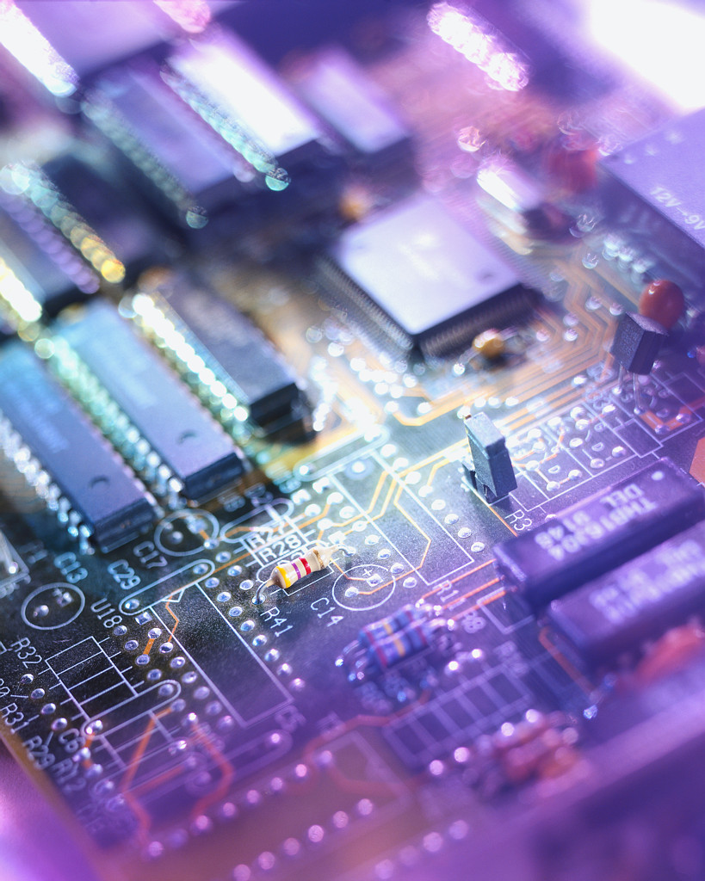
History of Computers
Third Generation: Integrated Circuits
1958 – the invention of the integrated circuit
Discrete component
  Single, self-contained transistor
  Manufactured separately, packaged in their own containers, and soldered or wired together onto masonite-like circuit boards
  Manufacturing process was expensive and cumbersome
  The two most important members of the third generation were the IBM System/360 and the DEC PDP-8
Notes:
A single, self-contained transistor is called a discrete component. Throughout the
1950s and early 1960s, electronic equipment was composed largely of discrete components—
transistors, resistors, capacitors, and so on. Discrete components were
manufactured separately, packaged in their own containers, and soldered or wired
together onto masonite-like circuit boards, which were then installed in computers,
oscilloscopes, and other electronic equipment. Whenever an electronic device called
for a transistor, a little tube of metal containing a pinhead-sized piece of silicon
had to be soldered to a circuit board. The entire manufacturing process, from transistor
to circuit board, was expensive and cumbersome.
These facts of life were beginning to create problems in the computer industry.
Early second-generation computers contained about 10,000 transistors. This
figure grew to the hundreds of thousands, making the manufacture of newer, more
powerful machines increasingly difficult.
In 1958 came the achievement that revolutionized electronics and started the
era of microelectronics: the invention of the integrated circuit. It is the integrated
circuit that defines the third generation of computers. In this section, we provide a
brief introduction to the technology of integrated circuits. Then we look at perhaps
the two most important members of the third generation, both of which were introduced
at the beginning of that era: the IBM System/360 and the DEC PDP-8.

Slide 21
Notes:
Initially, only a few gates or memory cells could be reliably manufactured
and packaged together. These early integrated circuits are referred to as small scale
Integration (SSI). As time went on, it became possible to pack more and more
Components on the same chip. This growth in density is illustrated in Figure 1.12; it is
one of the most remarkable technological trends ever recorded.
This figure reflects the
famous Moore’s law, which was propounded by Gordon Moore, cofounder of Intel,
in 1965 [MOOR65]. Moore observed that the number of transistors that could be
put on a single chip was doubling every year and correctly predicted that this pace
would continue into the near future. To the surprise of many, including Moore, the
pace continued year after year and decade after decade. The pace slowed to a doubling
every 18 months in the 1970s but has sustained that rate ever since.

Slide 22
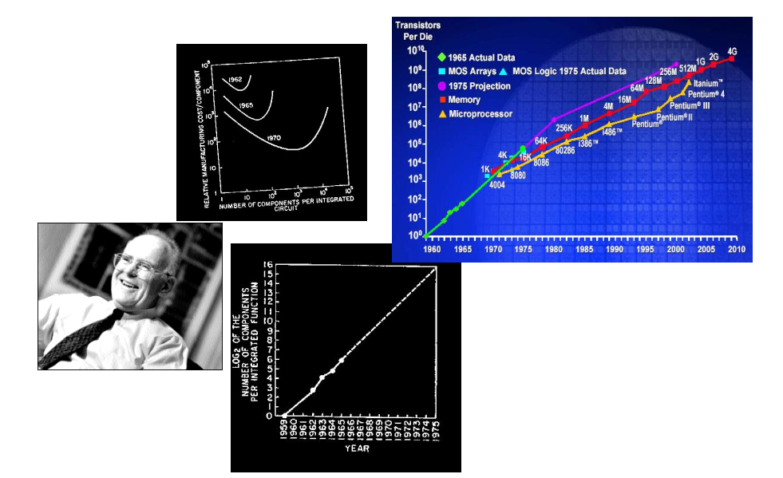
Moore’s Law: 2X transistors / “year”

Slide 23
Moore’s Law
Increased density of components on chip
Gordon Moore – co-founder of Intel
Number of transistors on a chip will double every year
Since 1970’s development has slowed a little
    Number of transistors doubles every 18 months
Cost of a chip has remained almost unchanged
Higher packing density means shorter electrical paths, giving higher performance
Smaller size gives increased flexibility
Reduced power and cooling requirements
Fewer interconnections increases reliability

Slide 24
Semiconductor Memory
Microprocessors
LSI
Large
Scale Integration
Later
Generations
VLSI
Very Large Scale Integration
ULSI
Ultra Large
Scale
Integration
Notes:
Beyond the third generation there is less general agreement on defining generations
of computers. Table 1.2 suggests that there have been a number of later generations,
based on advances in integrated circuit technology. With the introduction
of large-scale integration (LSI), more than 1000 components can be placed on a
single integrated circuit chip. Very-large-scale integration (VLSI) achieved more
than 10,000 components per chip, while current ultra-large-scale integration (ULSI)
chips can contain more than one billion components.
With the rapid pace of technology, the high rate of introduction of new products,
and the importance of software and communications as well as hardware, the
classification by generation becomes less clear and less meaningful. In this section,
we mention two of the most important of developments in later generations.

Slide 25
Microprocessors
The density of elements on processor chips continued to rise
  More and more elements were placed on each chip so that fewer and fewer chips were needed to construct a single computer processor
1971 Intel developed 4004
  First chip to contain all of the components of a CPU on a single chip
  Birth of microprocessor
1972 Intel developed 8008
  First 8-bit microprocessor
1974 Intel developed 8080
  First general purpose microprocessor
  Faster, has a richer instruction set, has a large addressing capability
Notes:
Just as the density of elements on memory chips has continued
to rise, so has the density of elements on processor chips. As time went on, more
and more elements were placed on each chip, so that fewer and fewer chips were
needed to construct a single computer processor.
A breakthrough was achieved in 1971, when Intel developed its 4004. The
4004 was the first chip to contain all of the components of a CPU on a single chip:
The microprocessor was born.
The 4004 can add two 4-bit numbers and can multiply only by repeated addition.
By today’s standards, the 4004 is hopelessly primitive, but it marked the beginning of
a continuing evolution of microprocessor capability and power.
This evolution can be seen most easily in the number of bits that the processor
deals with at a time. There is no clear-cut measure of this, but perhaps the best measure
is the data bus width: the number of bits of data that can be brought into or sent
out of the processor at a time. Another measure is the number of bits in the accumulator
or in the set of general-purpose registers. Often, these measures coincide, but
not always. For example, a number of microprocessors were developed that operate
on 16-bit numbers in registers but can only read and write 8 bits at a time.
The next major step in the evolution of the microprocessor was the introduction
in 1972 of the Intel 8008. This was the first 8-bit microprocessor and was almost twice
as complex as the 4004.
Neither of these steps was to have the impact of the next major event: the introduction
in 1974 of the Intel 8080. This was the first general-purpose microprocessor.
Whereas the 4004 and the 8008 had been designed for specific applications, the 8080
was designed to be the CPU of a general-purpose microcomputer. Like the 8008, the
8080 is an 8-bit microprocessor. The 8080, however, is faster, has a richer instruction
set, and has a large addressing capability.

Slide 26
Evolution of Intel Microprocessors
(a) 1970s Processors
Notes:
About the same time, 16-bit microprocessors began to be developed. However, it
was not until the end of the 1970s that powerful, general-purpose 16-bit microprocessors
appeared. One of these was the 8086. The next step in this trend occurred in 1981,
when both Bell Labs and Hewlett-Packard developed 32-bit, single-
chip microprocessors. Intel introduced its own 32-bit microprocessor, the 80386, in 1985 (Table 1.3).

Slide 27
Evolution of Intel Microprocessors
(b) 1980s Processors
Notes:
Table 1.3 (continued)

Slide 28
Evolution of Intel Microprocessors
(c) 1990s Processors
Notes:
Table 1.3 (continued)

Slide 29
Evolution of Intel Microprocessors
(d) Recent Processors
Notes:
Table 1.3 (continued)

Slide 30
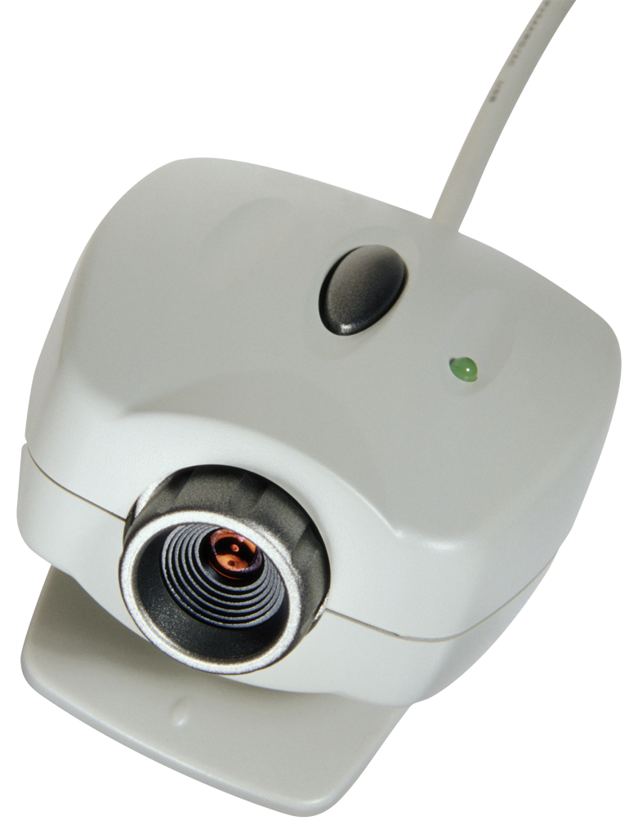
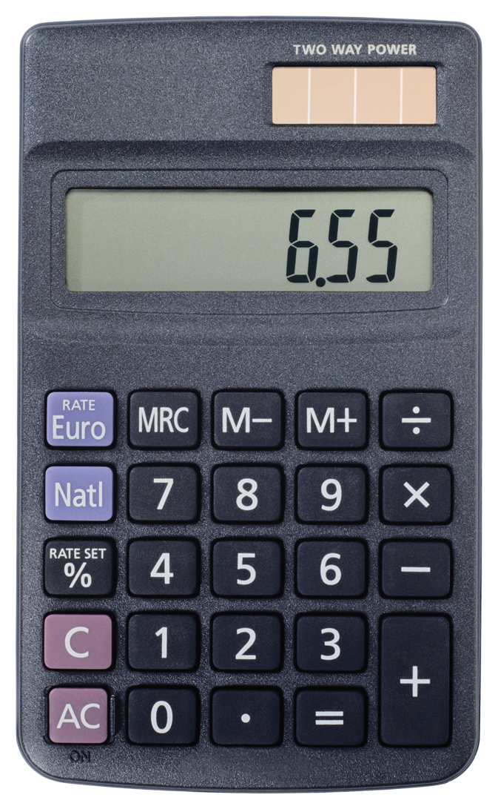
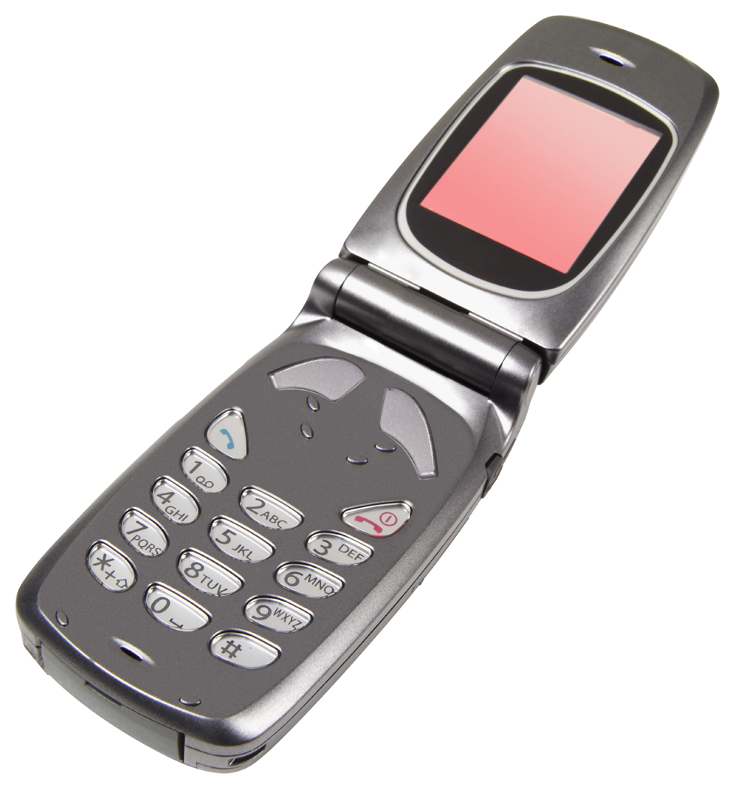
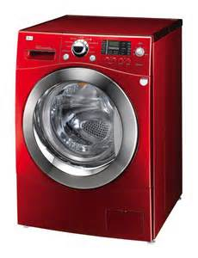
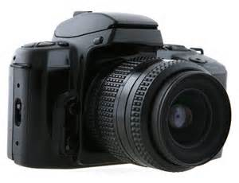
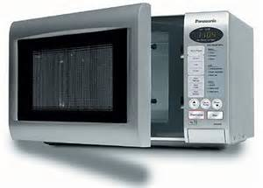
Embedded Systems
The use of electronics and software within a product
Billions of computer systems are produced each year that are embedded within larger devices
Today many devices that use electric power have an embedded computing system
Often embedded systems are tightly coupled to their environment
  This can give rise to real-time constraints imposed by the need to interact with the environment
    Constraints such as required speeds of motion, required precision of measurement, and required time durations, dictate the timing of software operations
  If multiple activities must be managed simultaneously this imposes more complex real-time constraints
Notes:
The term embedded system refers to the use of electronics and software within a
product, as opposed to a general-purpose computer, such as a laptop or desktop
system. Millions of computers are sold every year, including laptops, personal
computers, workstations, servers, mainframes, and supercomputers. In contrast, billions
of computer systems are produced each year that are embedded within larger
devices. Today, many, perhaps most, devices that use electric power have an embedded
computing system. It is likely that in the near future virtually all such devices
will have embedded computing systems.
Types of devices with embedded systems are almost too numerous to list.
Examples include cell phones, digital cameras, video cameras, calculators, microwave
ovens, home security systems, washing machines, lighting systems, thermostats,
printers, various automotive systems (e.g., transmission control, cruise
control, fuel injection, anti-lock brakes, and suspension systems), tennis rackets,
toothbrushes, and numerous types of sensors and actuators in automated systems.
Often, embedded systems are tightly coupled to their environment. This can
give rise to real-time constraints imposed by the need to interact with the environment.
Constraints, such as required speeds of motion, required precision of measurement,
and required time durations, dictate the timing of software operations. If
multiple activities must be managed simultaneously, this imposes more complex
real-time constraints.

Slide 31
Notes:
Figure 1.14 shows in general terms an embedded system organization. In addition
to the processor and memory, there are a number of elements that differ from
the typical desktop or laptop computer:
■ There may be a variety of interfaces that enable the system to measure, manipulate,
and otherwise interact with the external environment. Embedded systems
often interact (sense, manipulate, and communicate) with external world
through sensors and actuators and hence are typically reactive systems; a reactive
system is in continual interaction with the environment and executes at a
pace determined by that environment.
■ The human interface may be as simple as a flashing light or as complicated as
real-time robotic vision. In many cases, there is no human interface.
■ The diagnostic port may be used for diagnosing the system that is being
controlled—not just for diagnosing the computer.
■ Special-purpose field programmable (FPGA), application-specific
(ASIC), or even nondigital hardware may be used to increase performance or reliability.
■ Software often has a fixed function and is specific to the application.
■ Efficiency is of paramount importance for embedded systems. They are optimized
for energy, code size, execution time, weight and dimensions, and cost.
There are several noteworthy areas of similarity to general-
purpose computer systems as well:
■ Even with nominally fixed function software, the ability to field upgrade to fix
bugs, to improve security, and to add functionality, has become very important
for embedded system, and not just in consumer devices.
■ One comparatively recent development has been of embedded system platforms
that support a wide variety of apps. Good examples of this are smartphones
and audio/visual devices, such as smart TVs.

Slide 32
The Internet of Things (IoT)
Term that refers to the expanding interconnection of smart devices, ranging from appliances to tiny sensors
Is primarily driven by deeply embedded devices
Generations of deployment culminating in the IoT:
  Information technology (IT)
    PCs, servers, routers, firewalls, and so on, bought as IT devices by enterprise IT people and primarily using wired connectivity
  Operational technology (OT)
    Machines/appliances with embedded IT built by non-IT companies, such as medical machinery, SCADA, process control, and kiosks, bought as appliances by enterprise OT people and primarily using wired connectivity
  Personal technology
    Smartphones, tablets, and eBook readers bought as IT devices by consumers exclusively using wireless connectivity and often multiple forms of wireless connectivity
  Sensor/actuator technology
    Single-purpose devices bought by consumers, IT, and OT people exclusively using wireless connectivity, generally of a single form, as part of larger systems
  It is the fourth generation that is usually thought of as the IoT and it is marked by the use of billions of embedded devices
Notes:
It is worthwhile calling out separately one of the major drivers in the proliferation
of embedded systems. The Internet of things (IoT) is a term that refers to the
expanding interconnection of smart devices, ranging from appliances to tiny sensors.
A dominant theme is the embedding of short- range mobile transceivers into a wide
array of gadgets and everyday items, enabling new forms of communication between
people and things, and between things themselves. The Internet now supports the
interconnection of billions of industrial and personal objects, usually through cloud
systems. The objects deliver sensor information, act on their environment, and, in
some cases, modify themselves, to create overall management of a larger system, like
a factory or city.
The IoT is primarily driven by deeply embedded devices (defined below).
These devices are low-bandwidth, low-repetition data-capture, and low-bandwidth
data-usage appliances that communicate with each other and provide data via user
interfaces. Embedded appliances, such as high-resolution
video security cameras, video VoIP phones, and a handful of others, require high-bandwidth
streaming capabilities. Yet countless products simply require packets of data to be intermittently
delivered.
With reference to the end systems supported, the Internet has gone through
roughly four generations of deployment culminating in the IoT:
1. Information technology (IT) : PCs, servers, routers, firewalls, and so on, bought
as IT devices by enterprise IT people and primarily using wired connectivity
2. Operational technology (OT) : Machines/appliances with embedded IT built
by non-IT companies, such as medical machinery, SCADA (supervisory control
and data acquisition), process control, and kiosks, bought as appliances by
enterprise OT people and primarily using wired connectivity
3. Personal technology: Smartphones, tablets, and eBook readers bought as IT
devices by consumers (employees) exclusively using wireless connectivity and
often multiple forms of wireless connectivity
4. Sensor/actuator technology: Single-purpose devices bought by consumers, IT,
and OT people exclusively using wireless connectivity, generally of a single
form, as part of larger systems
It is the fourth generation that is usually thought of as the IoT, and it is marked
by the use of billions of embedded devices.

Slide 33
ARM
Refers to a processor architecture that has evolved from RISC design principles and is used in embedded systems
Family of RISC-based microprocessors and microcontrollers designed by ARM Holdings, Cambridge, England
Chips are high-speed processors that are known for their small die size and low power requirements
Probably the most widely used embedded processor architecture and indeed the most widely used processor architecture of any kind in the world
Acorn RISC Machine/Advanced RISC Machine
Notes:
The ARM architecture refers to a processor architecture that has evolved from
RISC design principles and is used in embedded systems. Chapter 15 examines
RISC design principles in detail. In this section, we give a brief overview of the
ARM architecture.
ARM is a family of RISC-based
microprocessors and microcontrollers designed
by ARM Holdings, Cambridge, England. The company doesn’t make processors
but instead designs microprocessor and multicore architectures and licenses them
to manufacturers. Specifically, ARM Holdings has two types of licensable products:
processors and processor architectures. For processors, the customer buys the
rights to use ARM-supplied design in their own chips. For a processor architecture,
the customer buys the rights to design their own processor compliant with ARM’s
architecture.
ARM chips are high-speed
processors that are known for their small die size
and low power requirements. They are widely used in smartphones and other handheld
devices, including game systems, as well as a large variety of consumer products.
ARM chips are the processors in Apple’s popular iPod and iPhone devices,
and are used in virtually all Android smartphones as well. ARM is probably the
most widely used embedded processor architecture and indeed the most widely
used processor architecture of any kind in the world [VANC14].
The origins of ARM technology can be traced back to the British-based
Acorn Computers company. In the early 1980s, Acorn was awarded a contract by the British
Broadcasting Corporation (BBC) to develop a new microcomputer architecture
for the BBC Computer Literacy Project. The success of this contract enabled Acorn
to go on to develop the first commercial RISC processor, the Acorn RISC Machine
(ARM). The first version, ARM1, became operational in 1985 and was used for
internal research and development as well as being used as a coprocessor in the
BBC machine.
In this early stage, Acorn used the company VLSI Technology to do the actual
fabrication of the processor chips. VLSI was licensed to market the chip on its own
and had some success in getting other companies to use the ARM in their products,
particularly as an embedded processor.
The ARM design matched a growing commercial need for a high-performance,
Low-power-consumption, small-size, and low-cost
processor for embedded applications.
But further development was beyond the scope of Acorn’s capabilities.
Accordingly, a new company was organized, with Acorn, VLSI, and Apple Computer
as founding partners, known as ARM Ltd. The Acorn RISC Machine became
Advanced RISC Machines.

Slide 34
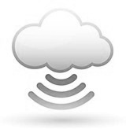
Cloud Computing
NIST defines cloud computing as:
“A model for enabling ubiquitous, convenient, on-demand network access to a shared pool of configurable computing resources that can be rapidly provisioned and released with minimal management effort or service provider interaction.”
You get economies of scale, professional network management, and professional security management
The individual or company only needs to pay for the storage capacity and services they need
Cloud provider takes care of security
Notes:
Although the general concepts for cloud computing go back to the 1950s, cloud computing
services first became available in the early 2000s, particular targeted at large
enterprises. Since then, cloud computing has spread to small and medium size businesses,
and most recently to consumers. Apple’s iCloud was launched in 2012 and
had 20 million users within a week of launch. Evernote, the cloud-based notetaking
and archiving service, launched in 2008, approached 100 million users in less than
6 years. In this section, we provide a brief overview. Cloud computing is examined in
more detail in Chapter 17.
There is an increasingly prominent trend in many organizations to move a substantial
portion or even all information technology (IT) operations to an Internet-
connected infrastructure known as enterprise cloud computing. At the same time, individual
users of PCs and mobile devices are relying more and more on cloud computing
services to backup data, synch devices, and share, using personal cloud computing.
NIST defines cloud computing, in NIST SP-800-145 (The NIST Definition of Cloud
Computing ), as follows:
Cloud computing: A model for enabling ubiquitous, convenient, on-demand
network access to a shared pool of configurable computing resources (e.g., networks, servers,
storage, applications, and services) that can be rapidly provisioned and released with
minimal management effort or service provider interaction.
Basically, with cloud computing, you get economies of scale, professional network
management, and professional security management. These features can be
attractive to companies large and small, government agencies, and individual PC
and mobile users. The individual or company only needs to pay for the storage capacity
and services they need. The user, be it company or individual, doesn’t have
the hassle of setting up a database system, acquiring the hardware they need, doing
maintenance, and backing up the data—all these are part of the cloud service.
In theory, another big advantage of using cloud computing to store your data
and share it with others is that the cloud provider takes care of security. Alas, the
customer is not always protected. There have been a number of security failures
among cloud providers. Evernote made headlines in early 2013 when it told all of its
users to reset their passwords after an intrusion was discovered.

Slide 35
Cloud Networking
Refers to the networks and network management functionality that must be in place to enable cloud computing
One example is the provisioning of high-performance and/or high-reliability networking between the provider and subscriber
The collection of network capabilities required to access a cloud, including making use of specialized services over the Internet, linking enterprise data center to a cloud, and using firewalls and other network security devices at critical points to enforce access security policies
Cloud Storage
Subset of cloud computing
Consists of database storage and database applications hosted remotely on cloud servers
Enables small businesses and individual users to take advantage of data storage that scales with their needs and to take advantage of a variety of database applications without having to buy, maintain, and manage the storage assets
Notes:
Cloud networking refers to the networks and network management functionality
that must be in place to enable cloud computing. Most cloud computing solutions
rely on the Internet, but that is only a piece of the networking infrastructure.
One example of cloud networking is the provisioning of high-performance
and/or high- reliability networking between the provider and subscriber. In this case, some
or all of the traffic between an enterprise and the cloud bypasses the Internet and
uses dedicated private network facilities owned or leased by the cloud service provider.
More generally, cloud networking refers to the collection of network capabilities
required to access a cloud, including making use of specialized services over
the Internet, linking enterprise data centers to a cloud, and using firewalls and other
network security devices at critical points to enforce access security policies.
We can think of cloud storage as a subset of cloud computing. In essence, cloud
storage consists of database storage and database applications hosted remotely on
cloud servers. Cloud storage enables small businesses and individual users to take
advantage of data storage that scales with their needs and to take advantage of a
variety of database applications without having to buy, maintain, and manage the
storage assets.

Slide 36
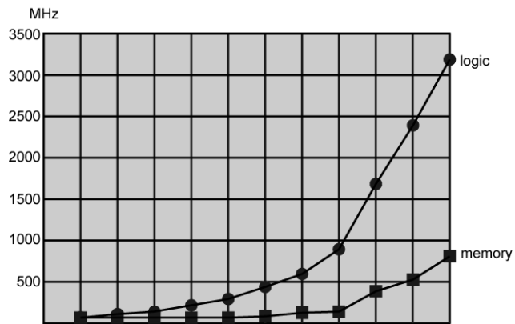
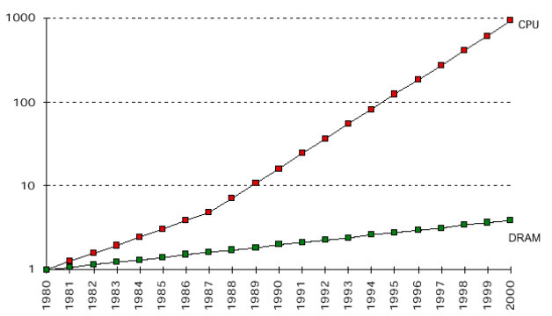
Logic and Memory Performance Gap
Notes:
In a way to recognize where is the problem, let us consider a hypothetical computer with a processor that operates at 800 MHz (a Pentium III, for instance), connected to a memory through a 100 MHz bus (SDRAM PC-100). Let us consider that this processor manipulates 800 million items (instructions and/or data) per second and that the memory achieves a debit (sending or receiving) of 100 million items per second. In this computer, for each single memory access, 8 processor clock cycles have elapsed. This way 7 in each 8 clock cycles are wasted, waiting for items. That represents a very high cost.

Slide 37
Solutions
Increase number of bits retrieved at one time
  Make DRAM “wider” rather than “deeper”
Change DRAM interface
  Cache
Reduce frequency of memory access
  More complex cache and cache on chip
Increase interconnection bandwidth
  High speed buses
  Hierarchy of buses
Notes:
There are a number of ways that a system architect can attack this problem, all of which are reflected in contemporary computer designs. Consider the following examples:
• Increase the number of bits that are retrieved at one time by making DRAMs “wider” rather than “deeper” and by using wide bus data paths.
• Change the DRAM interface to make it more efficient by including a cache or other buffering scheme on the DRAM chip.
• Reduce the frequency of memory access by incorporating increasingly complex
and efficient cache structures between the processor and main memory.
This includes the incorporation of one or more caches on the processor chip as
well as on an off-chip cache close to the processor chip.
• Increase the interconnect bandwidth between processors and memory by
using higher-speed buses and by using a hierarchy of buses to buffer and structure
data flow. Another area of design focus is the handling of I/O devices. As computers become faster and more capable, more sophisticated applications are developed that support the use of peripherals with intensive I/O demands. Figure 2.11 gives some examples of typical peripheral devices in use on personal computers and workstations. These devices create tremendous data throughput demands.
While the current generation of processors can handle the data pumped out by these devices, there remains the problem of getting that data moved between processor and peripheral. Strategies here include caching and buffering schemes plus the use of higher-speed interconnection buses and more elaborate structures of buses. In addition, the use of multiple-processor configurations can aid in satisfying I/O demands. The key in all this is balance. Designers constantly strive to balance the throughput and processing demands of the processor components, main memory, I/O devices, and the interconnection structures. This design must constantly be rethought to cope with two constantly evolving factors:
• The rate at which performance is changing in the various technology areas
(processor, buses, memory, peripherals) differs greatly from one type of element
to another.
• New applications and new peripheral devices constantly change the nature of
the demand on the system in terms of typical instruction profile and the data
access patterns.
Thus, computer design is a constantly evolving art form.This book attempts to
present the fundamentals on which this art form is based and to present a survey of the current state of that art.

Slide 38
Rule of Thumb for Latency Lagging BW
In the time that bandwidth doubles, latency improves by no more than a factor of 1.2 to 1.4
  (and capacity improves faster than bandwidth)
Stated alternatively:
  Bandwidth improves by more than the square of the improvement in Latency
Notes:
Latency Lags Bandwidth:
Bandwidth improved 120x to 2200x But latency improved only 4x to 20x Talk explains why and how to cope.
Memory bandwidth is the rate at which data can be read from or stored into a semiconductor memory by a processor. Memory bandwidth is usually expressed in units of bytes/second, though this can vary for systems with natural data sizes that are not a multiple of the commonly used 8-bit bytes.

Slide 39
Improvements in Chip Organization and
Architecture
Increase hardware speed of processor
  Fundamentally due to shrinking logic gate size
    More gates, packed more tightly, increasing clock rate
    Propagation time for signals reduced
Increase size and speed of caches
  Dedicating part of processor chip
    Cache access times drop significantly
Change processor organization and architecture
  Increase effective speed of execution
  Parallelism

