Slide 1
Hinrich Schütze and Christina Lioma
Lecture 3: Dictionaries and tolerant retrieval

Slide 2
Overview
Recap
Dictionaries
Wildcard queries
Edit distance
Spelling correction
Soundex
Statistical Poperties of Text: Power Laws

Slide 3
Outline
Recap
Dictionaries
Wildcard queries
Edit distance
Spelling correction
Soundex

Slide 4
Take-away
Tolerant retrieval: What to do if there is no exact match between query term and document term
Wildcard queries
Spelling correction
4

Slide 5
Outline
Recap
Dictionaries
Wildcard queries
Edit distance
Spelling correction
Soundex

Slide 6
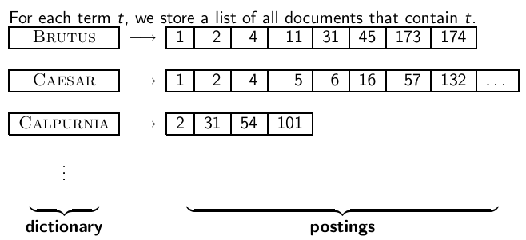
Recall: Inverted index
6

Slide 7
Dictionaries
The dictionary is the data structure for storing the term vocabulary.
Term vocabulary: the data
Dictionary: the data structure for storing the term vocabulary
7

Slide 8
Dictionary as array of fixed-width entries
For each term, we need to store a couple of items:
document frequency
pointer to postings list
. . .
Assume for the time being that we can store this information in a fixed-length entry.
Assume that we store these entries in an array.
8

Slide 9
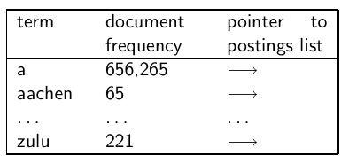
Dictionary as array of fixed-width entries
space needed: 20 bytes 4 bytes 4 bytes
How do we look up a query term q_{i} in this array at query time? That is: which data structure do we use to locate the entry (row) in the array where q_{i} is stored?
9

Slide 10
Data structures for looking up term
Two main classes of data structures: hashes and trees
Some IR systems use hashes, some use trees.
Criteria for when to use hashes vs. trees:
Is there a fixed number of terms or will it keep growing?
What are the relative frequencies with which various keys will be accessed?
How many terms are we likely to have?
10

Slide 11
Hashes
Each vocabulary term is hashed into an integer.
Try to avoid collisions
At query time, do the following: hash query term, resolve collisions, locate entry in fixed-width array
Pros: Lookup in a hash is faster than lookup in a tree.
Lookup time is constant.
Cons
no way to find minor variants (resume vs. résumé)
no prefix search (all terms starting with automat)
need to rehash everything periodically if vocabulary keeps growing
11

Slide 12
Trees
Trees solve the prefix problem (find all terms starting with automat).
Simplest tree: binary tree
Search is slightly slower than in hashes: O(logM), where M is the size of the vocabulary.
O(logM) only holds for balanced trees.
Rebalancing binary trees is expensive.
B-trees mitigate the rebalancing problem.
B-tree definition: every internal node has a number of children in the interval [a, b] where a, b are appropriate positive integers, e.g., [2, 4].
12

Slide 13
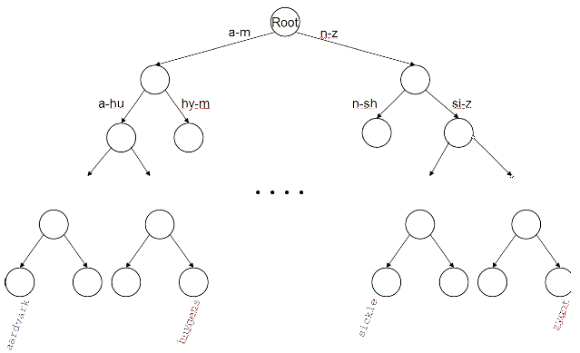
Binary tree
13

Slide 14
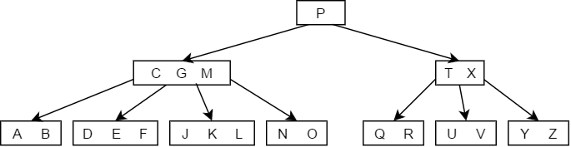
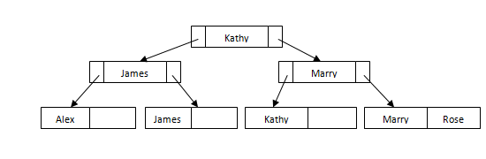
B-tree
Self-balancing search tree: adjusts itself so that all the leaves are at the same depth.
Contains multiple nodes which keep data in sorted order
14

Slide 15
Outline
Recap
Dictionaries
Wildcard queries
Edit distance
Spelling correction
Soundex

Slide 16
Wildcard queries
mon*: find all docs containing any term beginning with mon
Easy with B-tree dictionary: retrieve all terms t in the range: mon ≤ t < moo
*mon: find all docs containing any term ending with mon
Maintain an additional tree for terms backwards
Then retrieve all terms t in the range: nom ≤ t < non
Result: A set of terms that are matches for wildcard query
Then retrieve documents that contain any of these terms
16

Slide 17
How to handle * in the middle of a term
Example: m*nchen
We could look up m* and *nchen in the B-tree and intersect the two term sets.
Expensive [2 wildcard searches]
Alternative: permuterm index
Basic idea: Rotate every wildcard query, so that the * occurs at the end.
Store each of these rotations in the dictionary, say, in a B-tree
17

Slide 18
Permuterm index
For term HELLO: add
hello$,
ello$h,
llo$he,
lo$hel, and
o$hell
to the B-tree where $ is a special symbol
18

Slide 19
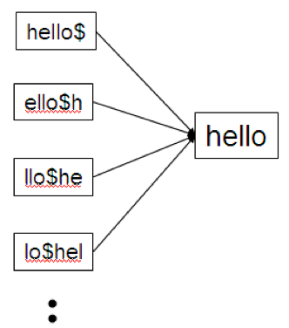
Permuterm → term mapping
19

Slide 20
Permuterm index
For HELLO, we’ve stored: hello$, ello$h, llo$he, lo$hel, and o$hell
Queries
For X, look up X$
For X*, look up X*$
For *X, look up X$*
For *X*, look up X* [the after * includes rotated all needed cases: example: *ll*➔ ll*= llo$he
For X*Y, look up Y$X*: Example: For hel*o, look up o$hel*= o$hell
Permuterm index would better be called a permuterm tree.
But permuterm index is the more common name.
20

Slide 21
Processing a lookup in the permuterm index
Rotate query wildcard to the right
Use B-tree lookup as before
Problem: Permuterm more than quadruples the size of the dictionary compared to a regular B-tree. (empirical number)
21

Slide 22
k-gram indexes
More space-efficient than permuterm index
Enumerate all character k-grams (sequence of k characters) occurring in a term
2-grams are called bigrams.
Example: from April is the cruelest month we get the bigrams: $a ap pr ri il l$ $i is s$ $t th he e$ $c cr ru ue el le es st t$ $m mo on nt h$
$ is a special word boundary symbol, as before.
Maintain an inverted index from bigrams to the terms that contain the bigram
22

Slide 23

Postings list in a 3-gram inverted index
23

Slide 24
k-gram (bigram, trigram, . . . ) indexes
Note that we now have two different types of inverted indexes
The term-document inverted index for finding documents based on a query consisting of terms [as usual!]
The k-gram index for finding terms based on a query consisting of k-grams
24

Slide 25
Processing wildcarded terms in a bigram index
Query mon* can now be run as: $m AND mo AND on
Gets us all terms with the prefix mon . . .
. . . but also many “false positives” like MOON.
We must postfilter these terms against query.
Surviving terms are then looked up in the term-document inverted index.
k-gram index vs. permuterm index
k-gram index is more space efficient. Why?
Permuterm index doesn’t require postfiltering.
Each word has multiple permuterms, 3-grams: limited
25

Slide 26
Exercise
Google has very limited support for wildcard queries.
For example, this query doesn’t work very well on Google: [gen* universit*]
Intention: you are looking for the University of Geneva, but don’t know which accents to use for the French words for university and Geneva.
According to Google search basics, 2010-04-29: “Note that the * operator works only on whole words, not parts of words.”
But this is not entirely true. Try [pythag*] and [m*nchen]
Exercise: Why doesn’t Google fully support wildcard queries?
26

Slide 27
Outline
Recap
Dictionaries
Wildcard queries
Edit distance
Spelling correction
Soundex

Slide 28
Spelling Tasks
Spelling Error Detection
Spelling Error Correction:
Autocorrect
hte→the
Suggest a correction
Suggestion lists

Slide 29
Types of spelling errors
Non-word Errors
graffe →giraffe
Real-word Errors
Typographical errors
three →there
Cognitive Errors (homophones)
piece→peace,
too → two

Slide 30
Rates of spelling errors
26%: Web queries Wang et al. 2003
13%: Retyping, no backspace: Whitelaw et al. English&German
7%: Words corrected retyping on phone-sized organizer
2%: Words uncorrected on organizer Soukoreff &MacKenzie 2003
1-2%: Retyping: Kane and Wobbrock 2007, Gruden et al. 1983

Slide 31
Non-word spelling errors
Non-word spelling error detection:
Any word not in a dictionary is an error
The larger the dictionary the better
Non-word spelling error correction:
Generate candidates: real words that are similar to error
Choose the one which is best: How: any suggestions?
Shortest weighted edit distance
Highest noisy channel probability

Slide 32
Real word spelling errors
For each word w, generate candidate set:
Find candidate words with similar pronunciations
Find candidate words with similar spelling
Include w in candidate set
Choose best candidate: how?

Slide 33
Spelling correction
Two principal uses
Correcting documents being indexed
Correcting user queries
Two different methods for spelling correction
Isolated word spelling correction
Check each word on its own for misspelling
Will not catch typos resulting in correctly spelled words, e.g., an asteroid that fell form the sky
قد قيل ما قيل .. أحداث قيل ظهر اليوم
Context-sensitive spelling correction
Look at surrounding words
Can correct form/from قبل/ قيلerror above
33

Slide 34
Correcting documents
In IR, we use document correction primarily for OCR’ed documents. (OCR = optical character recognition)
The general philosophy in IR is: don’t change the documents: even if provably erroneous: we search them AS ARE!
This may be at the expense of larger Vocabulary! OOVs
Document spelling correction is a form of normalization!
34

Slide 35
Example: Words within 1 of acress
Error | Candidate Correction | Correct Letter | Error Letter | Type
acress | actress | t | - | deletion
acress | cress | - | a | insertion
acress | caress | ca | ac | transposition
acress | access | c | r | substitution
acress | across | o | e | substitution
acress | acres | - | s | insertion

Slide 36
Correcting queries/Tolerant Retrieval
First: isolated word spelling correction
Premise 1: There is a list of “correct words” from which the correct spellings come (Dictionary).
Premise 2: We have a way of computing the distance between a misspelled word and a correct word.
Simple spelling correction algorithm:
return the “correct” word that has the smallest distance to the misspelled word. (or rank “ correct“ words if needed)
Example: informaton → information
For the list of correct words, we can use the vocabulary of all words that occur in our collection.
Why is this problematic?
36

Slide 37
Distance between misspelled word and “correct” word
We will study several alternatives.
Edit distance and Levenshtein distance
Weighted edit distance
k-gram overlap
37

Slide 38
Edit distance
The edit distance between string s₁ and string s₂ is the minimum number of basic operations that convert s₁ to s₂.
Levenshtein distance: The admissible basic operations are insert, delete, and replace
Levenshtein distance dog-do: 1
Levenshtein distance cat-cart: 1
Levenshtein distance cat-cut: 1
Levenshtein distance cat-act: 2
Damerau-Levenshtein distance cat-act: 1 [Exchange!]
Damerau-Levenshtein includes transposition as a fourth possible operation.
38

Slide 39
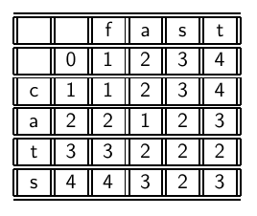
Levenshtein distance: Computation
39

Slide 40
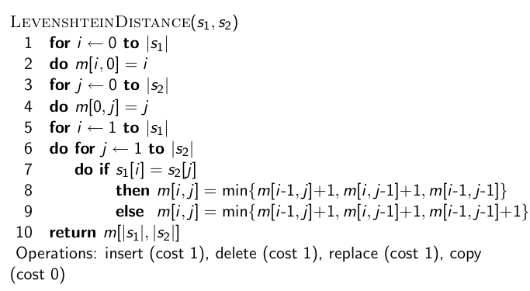
Levenshtein distance: Algorithm
40

Slide 41
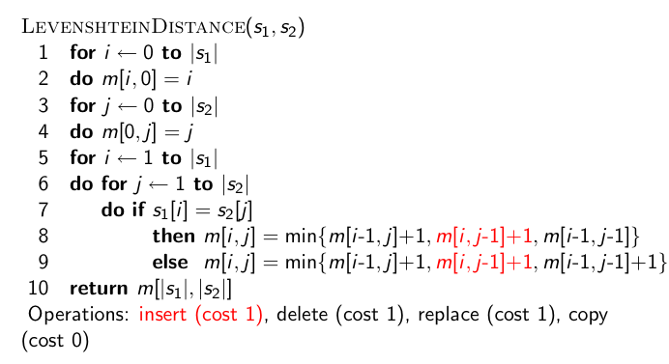
Levenshtein distance: Algorithm
41

Slide 42
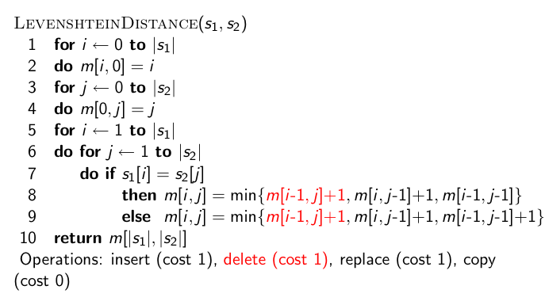
Levenshtein distance: Algorithm
42

Slide 43
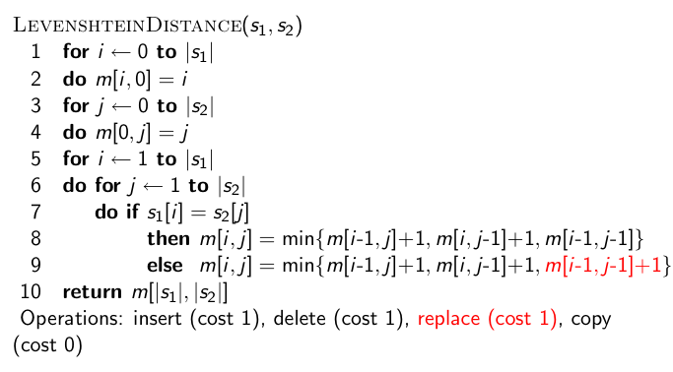
Levenshtein distance: Algorithm
43

Slide 44
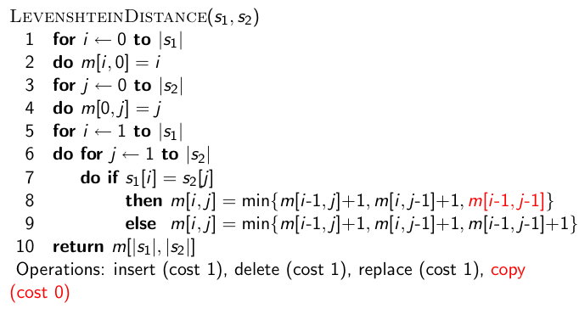
Levenshtein distance: Algorithm
44

Slide 45
Edit Distance
The Edit Distance (or Levenshtein distance) is a metric for measuring the amount of difference between two strings.
The Edit Distance is defined as the minimum number of edits needed to transform one string into the other.
It has many applications, such as spell checkers, natural language translation, and bioinformatics.

Slide 46
Edit Distance
The problem of finding an edit distance between two strings is as follows:
Given an initial string s, and a target string t, what is the minimum number of changes that have to be applied to s to turn it into t ?
The list of valid changes are:
Inserting a character
Deleting a character
Changing a character to another character.
??
Swap?

Slide 47
Edit Distance
You may think there are too many recursive cases. We could insert a character in quite a few locations!
(If the string is length n, then we can insert a character in n+1 locations.)
However, the key observation that leads to a recursive solution to the problem is that ultimately, the last characters will have to match.

Slide 48
Edit Distance
So, when matching one word to another one, consider the last characters of strings s and t.
If we are lucky enough that they ALREADY match,
then we can simply "cancel" and recursively find the edit distance between the two strings left when we delete this last character from both strings.
Otherwise, we MUST make one of three changes:
delete the last character of string s
delete the last character of string t
change the last character of string s to the last character of string t.
Also, in our recursive solution, we must note that the edit distance between the empty string and another string is the length of the second string. (This corresponds to having to insert each letter for the transformation.)

Slide 49
Edit Distance
So, an outline of our recursive solution is as follows:
If either string is empty, return the length of the other string.
If the last characters of both strings match, recursively find the edit distance between each of the strings without that last character.
If they don't match then return 1 + minimum value of the following three choices:
Recursive call with the string s w/o its last character and the string t
Recursive call with the string s and the string t w/o its last character
Recursive call with the string s w/o its last character and the string t w/o its last character.

Slide 50
Edit Distance
Consider the following example with s="hello" and t="keep".
To deal with empty strings, an extra row and column have been added to the chart below:
An entry in this table simply holds the edit distance between two prefixes of the two strings.
For example, the highlighted square indicates that the edit distance between the strings "he" and "keep" is 3.
 | - | h | e | l | l | o
- | 0 | 1 | 2 | 3 | 4 | 5
k | 1 | 1 | 2 | 3 | 4 | 5
e | 2 | 2 | 1 | 2 | 3 | 4
e | 3 | 3 | 2 | 2 | 3 | 4
p | 4 | 4 | 3 | 3 | 3 | 4

Slide 51
Edit Distance
In order to fill in all the values in this table we will do the following:
Initialize values corresponding to the base case in the recursive solution.
To convert –h to –k: - to – then: add h OR add h
- to –k then a replace k, - to –h replace.
 |  | h | e | l | l | o
 | 0 | 1 | 2 | 3 | 4 | 5
k | 1
e | 2
e | 3
p | 4

Slide 52
Edit Distance
In order to fill in all the values in this table we will do the following:
2) Loop through the table from the top left to the bottom right. In doing so, simply follow the recursive solution.
If the characters you are looking at match,
Else the characters don't match,
 |  | h | e | l | l | o
 | 0 | 1 | 2 | 3 | 4 | 5
k | 1 | 1 | 2 | 3 | 4 | 5
e | 2 | 2
e | 3
p | 4
Just bring down the up & left value 1
 |  | h | e | l | l | o
 | 0 | 1 | 2 | 3 | 4 | 5
k | 1 | 1 | 2 | 3 | 4 | 5
e | 2 | 2 | 1 | min
e | 3
p | 4
min ( 1+ above,
1+ left, 1+diag up) 2

Slide 53
Edit Distance
Dynamic Programming Example on the Board…

Slide 54
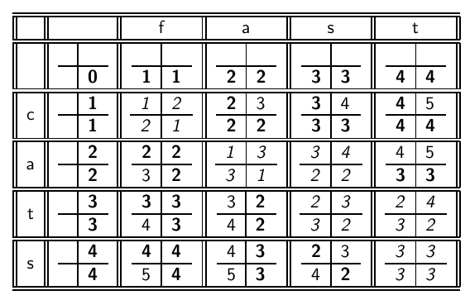
Levenshtein distance: Example
54

Slide 55
Each cell of Levenshtein matrix
cost of getting here from my upper left neighbor (copy or replace) | cost of getting here from my upper neighbor (delete)
cost of getting here from my left neighbor (insert) | the minimum of the three possible “movements”; the cheapest way of getting here
55

Slide 56
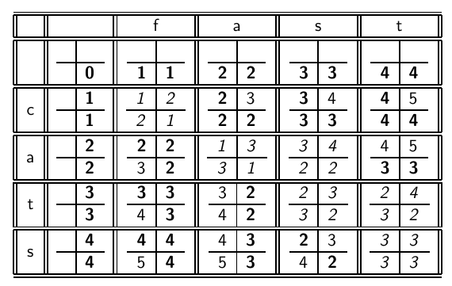
Levenshtein distance: Example
56

Slide 57
Dynamic programming (Cormen et al.)
Optimal substructure: The optimal solution to the problem contains within it subsolutions, i.e., optimal solutions to subproblems.
Overlapping subsolutions: The subsolutions overlap. These subsolutions are computed over and over again when computing the global optimal solution in a brute-force algorithm.
Subproblem in the case of edit distance: what is the edit distance of two prefixes
Overlapping subsolutions: We need most distances of prefixes 3 times – this corresponds to moving right, diagonally, down.
57

Slide 58
Weighted edit distance
As above, but weight of an operation depends on the characters involved.
Meant to capture keyboard errors, e.g., m more likely to be mistyped as n than as q. More errors with next keyboard letter
May add confusion letters: Hamza أ ا ئ ؤ إ and Ta: ة ه
Therefore, replacing m by n is a smaller edit distance than by q.
We now require a weight matrix as input.
Modify dynamic programming to handle weights
58

Slide 59
Using edit distance for spelling correction
Given query, first enumerate all character sequences within a preset (possibly weighted) edit distance
Intersect this set with our list of “correct” words
Then suggest terms in the intersection to the user.
→ exercise in a few slides
59

Slide 60
Candidate generation
80% of errors are within edit distance 1
Almost all errors within edit distance 2
Also allow insertion of space or hyphen
thisidea → this idea
inlaw → in-law

Slide 61
Exercise
Compute Levenshtein distance matrix for OSLO – SNOW
What are the Levenshtein editing operations that transform cat into catcat?
61

Slide 62
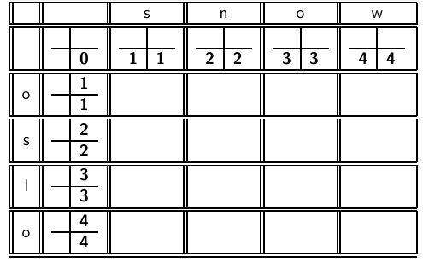
62

Slide 63
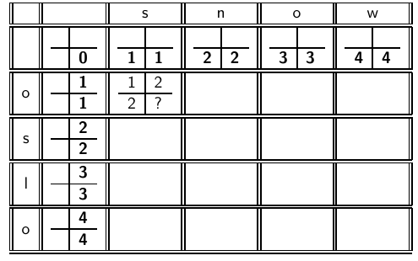
63

Slide 64
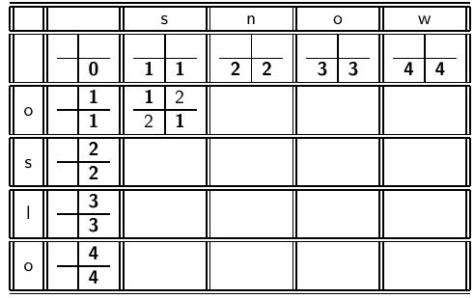
64

Slide 65
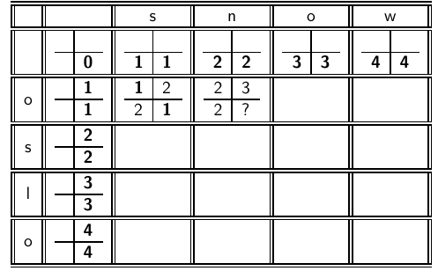
65

Slide 66
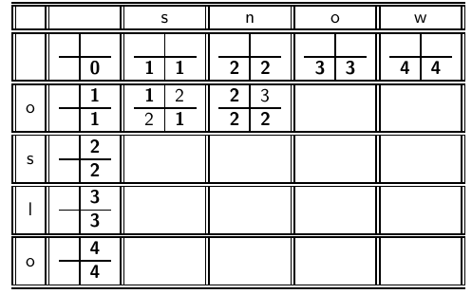
66

Slide 67
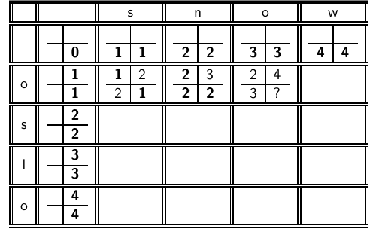
67

Slide 68
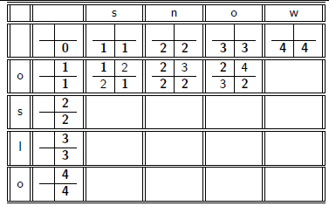
68

Slide 69
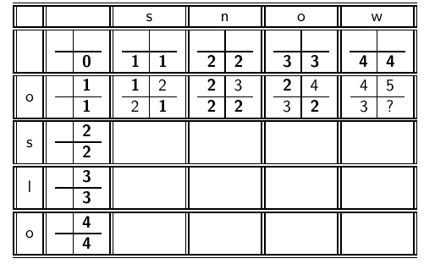
69

Slide 70
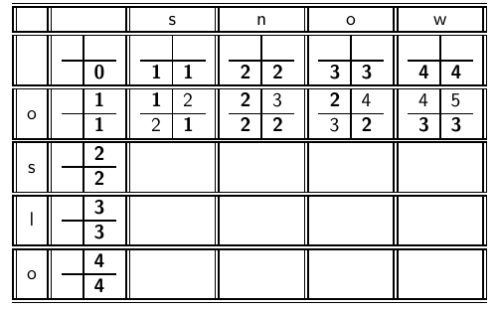
70

Slide 71
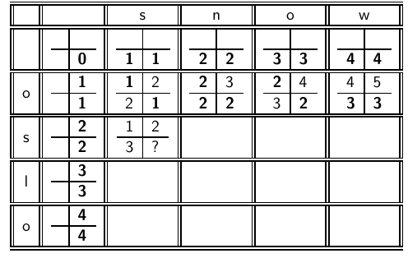
71

Slide 72
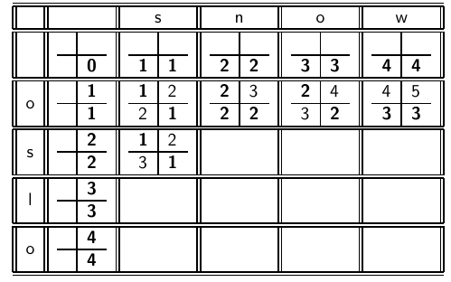
72

Slide 73
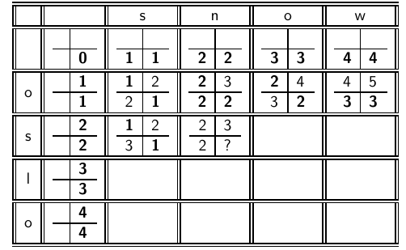
73

Slide 74
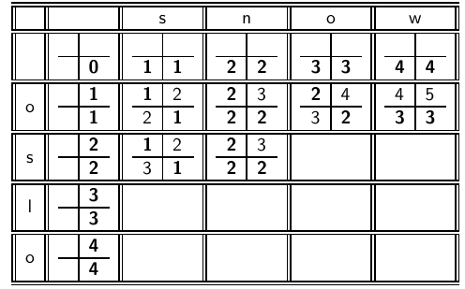
74

Slide 75
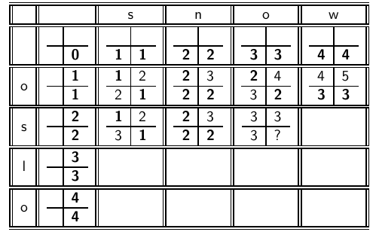
75

Slide 76
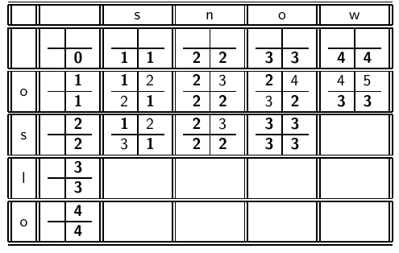
76

Slide 77
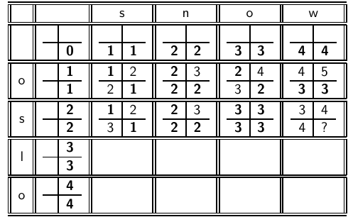
77

Slide 78
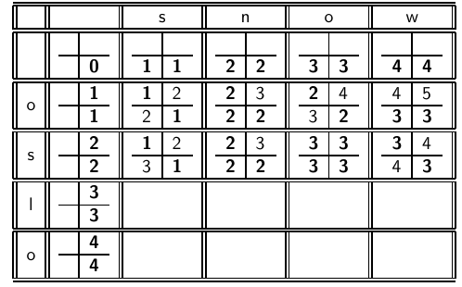
78

Slide 79
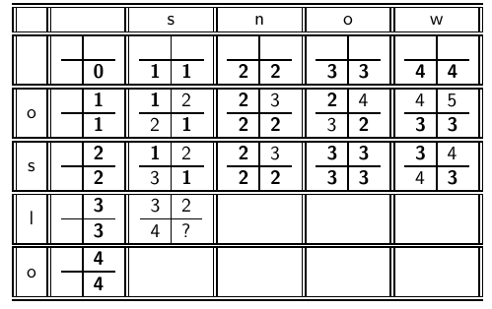
79

Slide 80
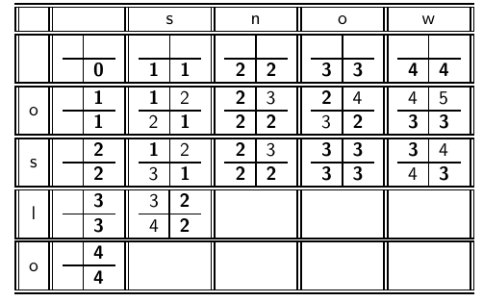
80

Slide 81
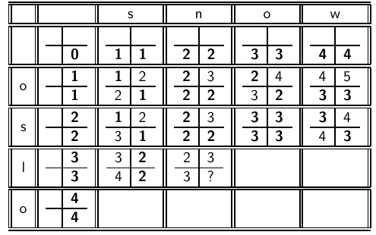
81

Slide 82
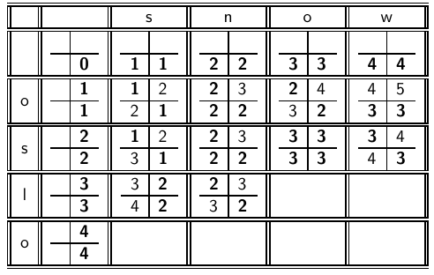
82

Slide 83
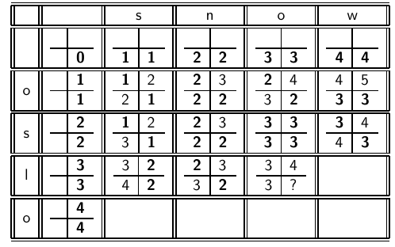
83

Slide 84
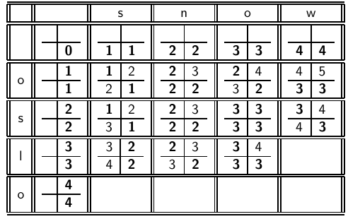
84

Slide 85
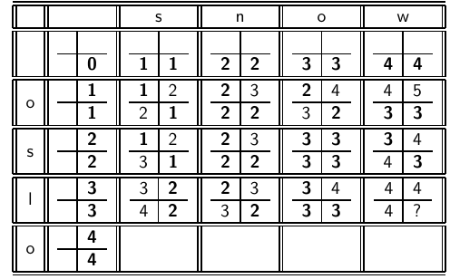
85

Slide 86
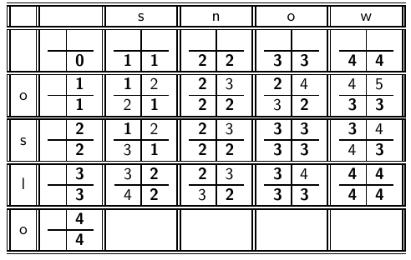
86

Slide 87
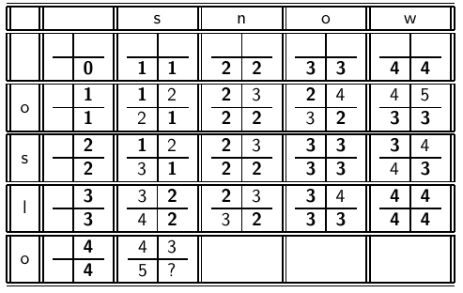
87

Slide 88
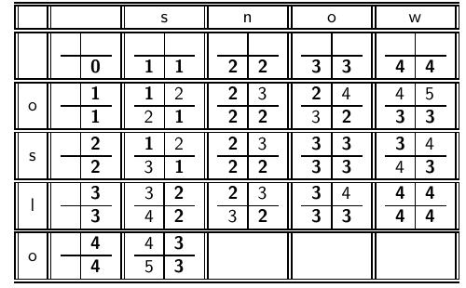
88

Slide 89
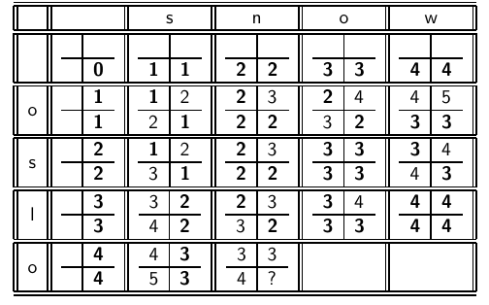
89

Slide 90
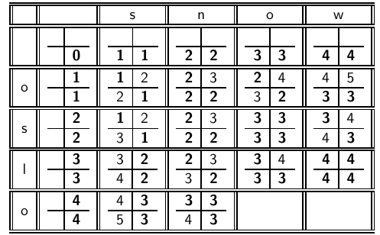
90

Slide 91
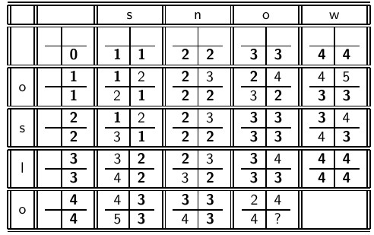
91

Slide 92
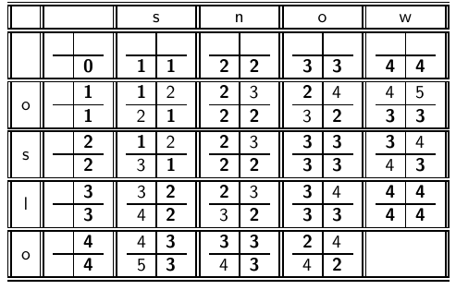
92

Slide 93
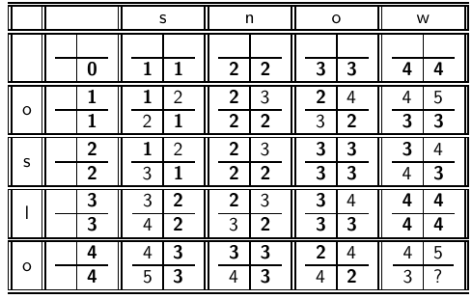
93

Slide 94
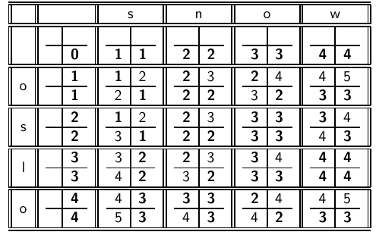
94

Slide 95
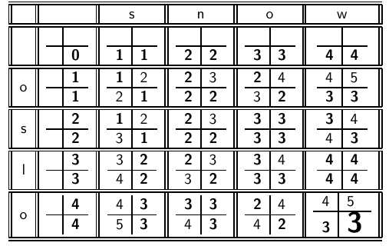
95

Slide 96
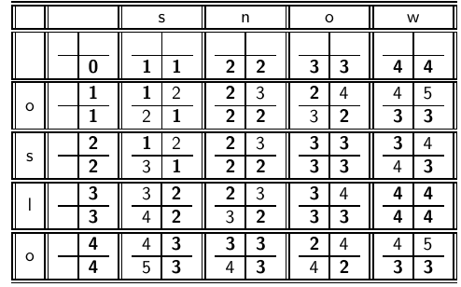
How do
I read out the editing operations that transform OSLO into SNOW?
96

Slide 97
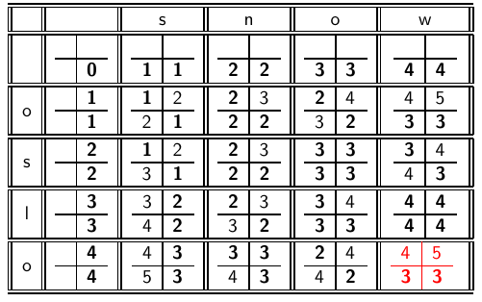

97

Slide 98


98

Slide 99


99

Slide 100


100

Slide 101


101

Slide 102

102

Slide 103


103

Slide 104


104

Slide 105


105

Slide 106


106

Slide 107
Unigram Prior probability [Metric] or [for equal distance corrections]
Counts from 404,253,213 words in Corpus of Contemporary English (COCA)
Order: across→access→acres→actress→caress→ cress
May be context sensitive: topic: may define the correction through frequencies:
حكم –جرم تصحيح ححم: نص رياضي أو ديني
word | Frequency of word | P(word)
actress | 9,321 | .0000230573
cress | 220 | .0000005442
caress | 686 | .0000016969
access | 37,038 | .0000916207
across | 120,844 | .0002989314
acres | 12,874 | .0000318463

Slide 108
k-gram indexes for spelling correction
Enumerate all k-grams in the query term
Example: bigram index, misspelled word bordroom
Bigrams: bo, or, rd, dr, ro, oo, om
Use the k-gram index to retrieve “correct” words that match query term k-grams [to a degree]
Threshold by number of matching k-grams
E.g., only vocabulary terms that differ by at most 3 k-grams
Similarity can be defined as the number of common n-grams over the number of all n-grams in both strings! DICE?
Actually you could rank spelling correction candidates by the number of matching n-grams instead of Edit Distance!
108

Slide 109

k-gram indexes for spelling correction: bordroom
109

Slide 110



Jackard Metric:
Jaccard index, also known as Intersection over Union and the Jaccard similarity coefficient:
Jackard Distance:
A,B are sets of word/charcter bi-grams,
tri-Grams, … of strings. research/resaerch: {re,es,se,ea,ar,rc,ch}/{re,es,sa,ae,er,rc,ch}
J(A,B)= 4/10; research/reserch?? Plate/Plat
110

Slide 111
Context-sensitive spelling correction
Our example was: an asteroid that fell form the sky
How can we correct form here?
One idea: hit-based spelling correction (choice with most hits)
Retrieve “correct” terms close to each query term
for „flew form munich“: flea for flew, from for form, munch for
munich
Now try all possible resulting phrases as queries with one word “fixed” at a time
Try query “flea form munich”
Try query “flew from munich”
Try query “flew form munch”
The correct query “flew from munich” has the most hits.
Hits from, say, Google Docs.
Suppose we have 7 alternatives for flew, 20 for form and 3 for munich, how many “corrected” phrases will we enumerate?
111

Slide 112
Context-sensitive spelling correction
The “hit-based” algorithm we just outlined is not very efficient.
More efficient alternative: look at “collection” of queries, not documents
112

Slide 113
General issues in spelling correction
User interface
automatic vs. suggested correction [Google/ios?]
Did you mean only works for one suggestion [how sure?].
What about multiple possible corrections? [Rank?]
Tradeoff: simple vs. powerful UI
Cost
Spelling correction is potentially expensive.
Avoid running on every query?
Maybe just on queries that match [too] few documents.
Guess: Spelling correction of major search engines is efficient enough to be run on every query.
113

Slide 114

Exercise: Understand Peter Norvig’s
spelling corrector
114

Slide 115
Outline
Recap
Dictionaries
Wildcard queries
Edit distance
Spelling correction
Soundex
Power Laws

Slide 116
Soundex
Soundex is the basis for finding phonetic (as opposed to orthographic) alternatives.
Example: chebyshev / tchebyscheff
Algorithm:
Turn every token to be indexed into a 4-character reduced form
Do the same with query terms
Build and search an index on the reduced forms
116

Slide 117
Soundex algorithm
Retain the first letter of the term.
Change all occurrences of the following letters to ’0’ (zero): A, E, I, O, U, H, W, Y
Change letters to digits as follows:
B, F, P, V to 1
C, G, J, K, Q, S, X, Z to 2
D,T to 3
L to 4
M, N to 5
R to 6
Repeatedly remove one out of each pair of consecutive identical digits
Remove all zeros from the resulting string; pad the resulting string
with trailing zeros and return the first four positions, which will
consist of a letter followed by three digits
117

Slide 118
Example: Soundex of HERMAN
Retain H
ERMAN → 0RM0N [zero for vowels]
0RM0N → 06505 [r→ 6, M,N →5]
06505 → 06505 [no repeating, no change]
06505 → 655 [remove zeros]
Return H655 [letter then code]
Note: HERMANN will generate the same code:
ERMANN → 0RM0NN→065055→ 06505→ 655→H655
Hermen, HERMEIN,…..[Clinton/Klinton/Clinten/Klintom]
What about: chebyshev / tchebyscheff !! Add/remove t!
118

Slide 119
Arabic Soundex: [suggested: how well?]
Initial:https://www.codeproject.com/Articles/26880/Arabic-Soundex
Hold the first letter.
Replace the characters ا, أ, إ, آ, ح, ع, غ, ش,و,ي with the value 0.
Replace the characters ف, ب with the value 1.
Replace the characters خ, ج, ز, س, ص, ظ, ق, ك with the value 2.
Replace the characters ت, ث,د,ذ,ض,ط with the value 3.
Replace the character ل with the value 4.
Replace the characters م, ن with the value 5.
Replace the character ر with the value 6.
changes were:
Remove the ا, أ, آ, إ characters from the beginning of the word if found, because I noticed they added more confusion.
Ignore the first character handling.
May want to check: Clinton with كلنتن، كلينتون، كلنتون،
119

Slide 120
How useful is Soundex?
Not very – for information retrieval
Ok for “high recall” tasks in other applications (e.g., Interpol)
Zobel and Dart (1996) suggest better alternatives for phonetic matching in IR.
As part of distance weighting: soundex similar letters are close to each other (small distance);
120

Slide 121
Exercise
Compute Soundex code of your last name: Arabic/English
121

Slide 122
Combined Distance Metric for SpellChecking
Actual distance between letters is the wighted sum of many distances:
D(letter1,letter2)= W₁ *D_Soundex(letter1,letter2) + W₂*D_Keyboard(letter1,letter2) + W₁D_Confusion (letter1,letter2) + ...
W_{i} Are Weights between 0-1 and sum to 1.
Weights may differ from desktop to mobile typing, speech recognition, OCR material, maybe profile specific....
Adaptive spellchecking: change weights as you learn from mistakes of individual users (learn from corrections).
122

