Slide 1
Foundation of management
Maram Jaghama

Slide 2
Historical development of management theory
Because organizations are complex and varied, theorists’ views of what successful management is and what it should be have changed repeatedly in the last 100 years

Slide 3
Scientific management (1900-1930)
Scientific management theory, also called classical management theory, developed by Frederick W. Taylor the “father of scientific management”.
-He was frustrated with what called ” systematic soldiering’’: where workers achieved minimum standards doing the least amount of work possible.
Its main objective is improving economic efficiency, especially labor productivity. Frederick Taylor's influential ideas, had focused on the individual and on ways in which an individual's performance could be improved

Slide 4
Four Principles of scientific management
Replace rule-of-thumb work methods with scientific methods: In other words, by using time and motion studies and the expertise of experienced workers, work could be scientifically designed to promote greatest efficiency of time and energy.
A scientific personnel system must be established so that workers can be hired, trained, and promoted based on their technical competence and abilities. Taylor thought that each employee’s abilities and limitations could be identified so that the worker could be best matched to the most appropriate job.

Slide 5
3. Workers should be able to view how they “fit” into the organization and how they contribute to overall organizational productivity. ( using financial incentives as a reward for work accomplished).
4. The relationship between managers and workers should be cooperative and interdependent, and the work should be shared equally.
As a result of the scientific management theory, the productivity and profits rose dramatically.

Slide 6
Bureaucratic organizations theory
About the same time that Taylor was examining worker tasks, Max Weber, began to study large-scale organizations to determine what made some workers more efficient than others.
Weber saw the need for legalized, formal authority and consistent rules and regulations for personnel in different positions.
Thus, he proposed bureaucracy as an organizational design.
A bureaucratic organization is a form of management that has a pyramidal command structure. The bureaucratic organization is very organized with a high degree of formality in the way it operates. Organizational charts generally exist for every department, and decisions are made through an organized process.

Slide 8
Management functions identified (1925)
Management functions first identified in 1925 by Henri Fayol: planning, organization, command, coordination, and control.
In 1937, Luther Gulick expanded on Fayol’s management functions in his introduction of the ‘’seven activities of management’’: (planning, organizing, staffing, directing, coordinating, reporting, and budgeting) as denoted by the mnemonic POSDCORB.

Slide 9
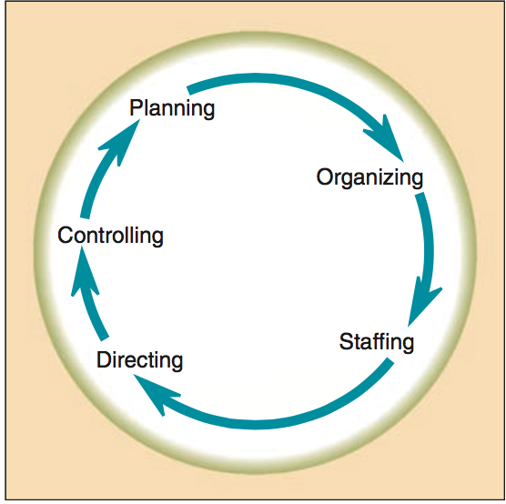
The management process.

Slide 10
Human Relations Management (1930- 1970)
The Industrial Revolution had resulted in great numbers of relatively unskilled laborers working in large factories on specialized tasks.
The human relations management theory is a researched belief that people desire to be part of a supportive team that facilitates development and growth. Therefore, if employees receive special attention and are encouraged to participate, they perceive their work has significance, and they are motivated to be more productive, resulting in high quality work.
This human relations era developed the concepts of participatory and humanistic management, emphasizing people rather than machine.

Slide 11
Mary Parker Follett (1926)
was one of the first theorists to suggest basic principles of what today would be called participative management.
Otherwise known as employee involvement or participative decision making, encourages the involvement of stakeholders at all levels of an organization in the analysis of problems, development of strategies, and implementation of solutions.
Follett espoused her belief that managers should have authority with, rather than over, employees. Thus, solutions could be found that satisfied both sides without having one side dominate the other.

Slide 12
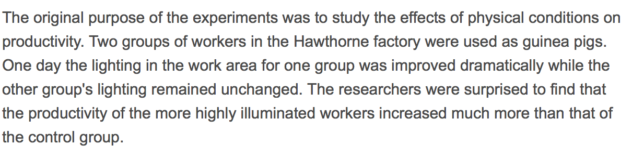
Elton Mayo (1927-1932)
Conducted a study at the Harvard associates began as an attempt to look at the relationship between light illumination in the factory and productivity.
The experiment: Hawthorne effect

Slide 13
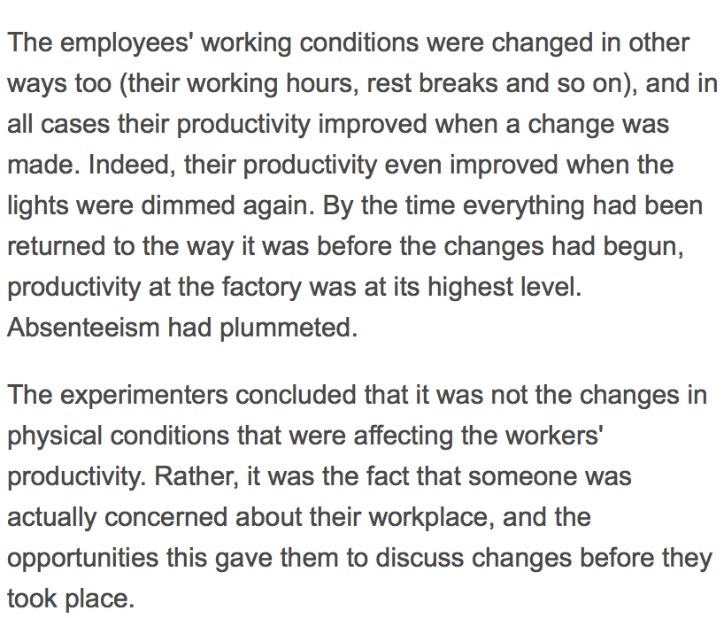

Slide 14
The results of this experiment
Mayo and his colleagues discovered that when management paid special attention to workers, productivity was likely to increase, regardless of the environmental working conditions.
This Hawthorne effect indicated that people respond to the fact that they are being studied, attempting to increase whatever behavior they feel will continue to warrant the attention.
Mayo also found that informal work groups and a socially informal work environment were factors in determining productivity.
Mayo recommended more employee participation in decision making.

Slide 15
Douglas McGregor (1960)
Douglas reinforced these ideas by theorizing that managerial attitudes about employees and, hence, how managers treat those employees, can be directly correlated with employee satisfaction.
He labeled this Theory X and Theory Y.
Theory X: managers believe that their employees are basically lazy, need constant supervision and direction, and are indifferent to organizational needs
Theory Y: managers believe that their workers enjoy their work, are self-motivated, and are willing to work hard to meet personal and organizational goals.

Slide 16
Chris Argyris (1964) ** employee participation **
He supported McGregor and Mayo by seeing that managerial domination causes workers to become discourage and passive.
He believed that if self-esteem and independence needs are not met, employees will become discouraged and troublesome or may leave the organization.
Argyris stressed the need for flexibility within the organization and employee participation in decision making.

Slide 17
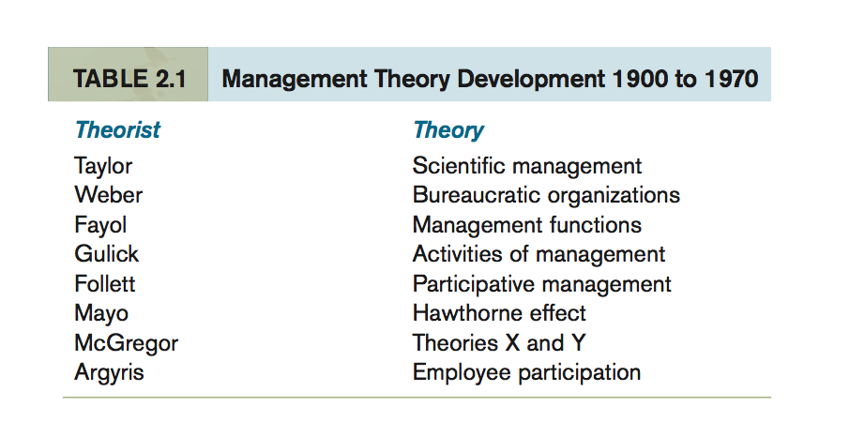
Management theory development
(1900-1970)

