Slide 1
Lecture 14
NUT343
Dr Emilia Rappocciolo

Slide 2
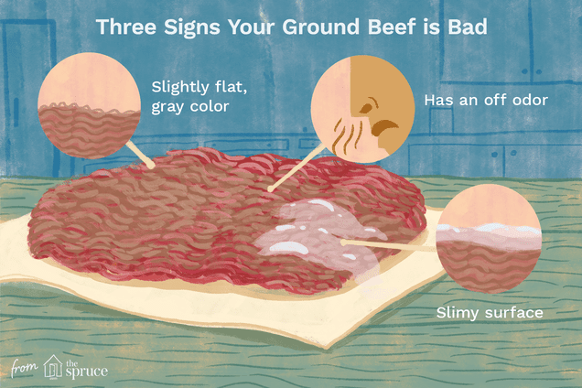
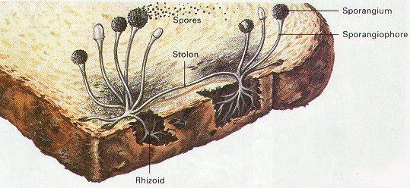
Food spoilage by microbes
Signs/changes of spoiled food
Bad odors
Off flavors
Liquefaction
Discoloration
Slime
This is good because
It warns people to avoid eating spoiled foods
When pathogens grow without visible signs - dangerous

Slide 3
Food Additives
Can be used : To prevent spoilage, maintain the nutritional quality of food and to improve appearance
Food additives cannot be used if
reduce the nutritive value of food or mask some manufacturing errors to deceive the customer
The smallest amount of pure additive that produces desirable effects must be used

Slide 4
Food Additives
Should be checked for toxicity
Should be used for specific type of food, example
Sorbate use in meat prevents its spoilage by microorganisms
K- sorbate prolongs the shelf life of foods by stopping the growth of mold, yeast, and fungi

Slide 5
Table sugar, Salt, vinegar
Natural preservatives: salt, sugar and vinegar
Sugar: To make jellies
Concentration in final product of 60% assures food preservation
Minimum Aw of 0.845 inhibit bacteria and yeast
Effect- increase osmotic pressure and inhibit growth

Slide 6
Table sugar, Salt, vinegar
Salt
Cause dehydration, more salt more protection
Become ionized to Na⁺, Cl⁻
Cl⁻ is harmful to organisms, it interferes with the action of proteolytic enzymes
Vinegar
Low pH interferes with bacteria metabolism, denatures proteins

Slide 7
Food additives
Preservatives - commonly used
Benzoic acid, calcium sorbate, potassium nitrate, sodium benzoate
Antioxidants - to protect cells from damage by free radicals due to oxidative stress
Butylated hydroxyanisole- BHA and Butylated hydroxytoluene - BHT
help the fats in products stay fresh longer.
Both are antioxidants, they can provide some protection from the damaging effects of oxygen exposure and free radicals.

Slide 8
Viable Cells of Lactic acid Bacteria as Preservative
High number of viable Lactobacillus and Pediococcus are used to control spoilage and reduce pathogenic bacteria during refrigerated storage (< 5°C) and (10 – 12°C)
When added to raw milk it controls the growth of psychrotrophs (Pseudomonas)
Adding lactic acid bacteria to fresh and processed meat control C. botulinum , Salmonella and S. aureus

Slide 9
Viable Cells of Lactic acid Bacteria as Preservative
The inhibitory property can be due to:
release of intracellular antimicrobial compounds:
organic acids
Bacteriocins
hydrogen peroxide

Slide 10
Antimicrobials
Antimicrobials can be:
Chemicals (sorbic acid, benzoic acid, sulfur dioxide, sulfates, nitrites)
Used for many years
Approved by many countries
Synthesized
Bad for consumers

Slide 11
Antimicrobials
Natural chemical antimicrobials
Vinegar from acetic acid
Benzoic acid from cranberries
Sorbic acid from rowanberries
These are extracted
Friendly – people like it

Slide 12
Organic Acids
Natural and chemically synthesized
Not used in foods with a pH >5.5
To be effective they must reach the cytoplasm
There are 2 types
Charged – useless cannot cross the CM
Un-charged – get into the bacteria and inhibit growth

Slide 13
Organic Acids
pH: measure the acidity of a solution
Organic acids are useful in acidic food when pH = pKa or slightly lower
At this pH organic acids cross the cell membrane into the cytoplasm
The cytoplasm is neutral, causes the organic acids to dissociate and lose their protons, which acidify the cytoplasm
The bacterial cell uses ATP dependent proton pump to work and expel protons
The ATP the cell needs to grow is used to maintain neutral pH
So organic acids inhibit bacterial growth

Slide 14
Organic Acids
Organic acid | Formula | pKa | Found in | Active Against | Application
Acetic | CH3-COOH | 4.5 | Vinegar | Bacteria yeast | Bakery, cheese
Benzoic | C6H5-COOH | 4.2 | Cranberries | Fungi | Beverages, jams, jellies
Lactic | CH3OH-COOH | 4.8 | Fermented food | Bacteria | pH control, flavor
Propionic | CH3CH3-COOH | 4.9 | Swiss cheese | Yeast, mold, bacteria | Baked goods, cheese
sorbic | CH3=CHCH=CH-COOH | 4.7 | rowanberry | Fungi, bacteria | Baked goods, cheese, wine
pK_{a} = −log₁₀ K_{a}
The larger the pK_{a}, the less dissociation

Slide 15
Organic Acids
Preservative | Uses | Antimicrobial
Lactic acid & salts (CH3OH-COOH, pKa = 4.8) | Enhance flavor in processed meats.Also for carcass wash | G+ve, G-ve: 1-2% - Static, at pH <5 - cidal. Not fungal
Acetic acid & salts (CH3-COOH, pKa=4.5) | Used for for carcass wash | Static (0.2%)- G+ve, G-ve, yeast, molds. Cidal at 0.3% and pH 4.5
Propionic acid and its salts (CH3CH3-COOH, pKa=4.9) | control molds in cheese, butter, bakery products | At 0.1-0.2%, pH 5, used as fungistatic in food
Benzoic acid, Na-benzoate most common | used in acid/acidified foods- juice, jam, jelly, pickles | Yeast is more inhibited than bacteria and molds
Sorbic Acid (Na, K salts) K salts very soluble | Used in Fruits and vegetables, juices, jams and jellies, antioxidants | At 25 mg/kg body wt. Inhibit yeasts/ mold

Slide 16
 | Uses |  | Antimicrobial
Nitrites Carcinogen (?) | Used in cured meats (150 ppm) Nitrosomyoglobin makes the meats have pink color. Contribute to flavor/texture, Act as antioxidant. Usually mixed with ascorbate (reducing agent- removes oxygen) |  | Antimicrobial activity. Works better under acidic pH When mixed with ascorbate it inhibits C. botulinum
Phosphates | Found in protein rich and dairy foods, eggs |  | Affect more G+ve, Chelate metal ions
NaCl: oldest | Preserve raw meat and fish S. aureus and Listeria are salt resistant |  | Reduce aw, cause plasmolysis via water loss.
Disinfectants
Sulfites- (SO₂) [k, Na –salts bisulfites |  | dry fruits and vegetables, fruit juice Antioxidant- inhibit browning. Inhibit CM, DNA replication, protein synthesis and enzymes | Control spoilage by yeast/bacteria (pH<4) Inhibit bacteria more than yeast (used in wine)
Sodium hypochlorite |  | a strong oxidizer, Corrosive, added to wash water and to sanitize surfaces where meat/chicken used | bacteria, yeast, molds, viruses
Chlorine dioxide CLO₂ |  | Better – odorless, breaks down compounds that have bad taste and smell such as: Phenols, sulfites, mercaptans

Slide 17
Preservative | Uses | Antimicrobial
Quaternary ammonium compounds | non-corrosive Very expensive | bacteria, yeast, fungi, viruses
Peroxides: H₂O₂ (3%) most common | Forms hydroxy radicals (OH.) Strong oxidizer reduce microbial load in meat/poultry sanitize surfaces | Reacts with membrane lipids, DNA, protein Kills bacteria, yeast, fungi, viruses
Ozone Not approved | Strong oxidant, Targets nucleic acids, Potential for use with raw fruits and vegetables,, | Reduce 0157:H7 viability 1000 fold

Slide 18
Naturally occurring antimicrobials
Preservative | Uses | Antimicrobial
Lysozyme | Natural enzyme in tears, saliva, eggs and milk. | Cleaves peptidoglycans of bacterial cell wall
Egg albumen - found in egg white and milk | Fe-binding protein | Active against gram positive bacteria
Lactoferrin found in cow and human milk Also in eye nose, intestine | Fe-binding protein in milk Colostrum- contains 7 times more lactoferrin than milk | Antibacterial, used as medicine, regulate Fe- absorption in intestine
Avidin- egg albumin protein | binds biotin Secreted by macrophages during inflammation - plays a role in defense against gram +ve/-ve bacteria | Inhibits bacteria that requires biotin for growth
Spices and oils | Cloves, cinnamon, oregano, thyme, sage, rosemary | Antimicrobial activity in the oils
Onion and garlic | Best characterized plant antimicrobial Phenolic compounds | Allicin in garlic Catechol in onion
Isothiocyanate | plants in the mustard family: Cabbage, cauliflower, broccoli, horseradish, mustard | Potent antimicrobials Inhibit bacteria, fungi, yeast by 0.016-0.062 uglml

Slide 19
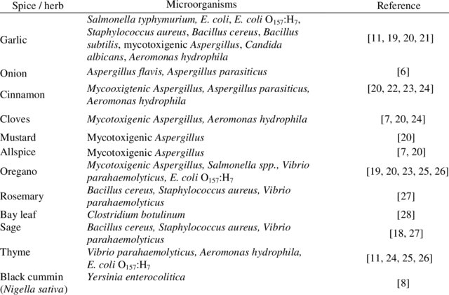
Naturally occurring antimicrobials
Nasser Al-Wabel and Shawkat Fathi. Antimicrobial activities of spices and herbs, International Conference on Antimicrobial Research - ICAR2012, 2012. Lisbon (Portugal)

Slide 20
Food Spoilage by Microbial Enzymes
Chapter 21

Slide 21
Food Spoilage by Microbial Enzymes
Nutrients in the food:
Carbohydrates, Proteins, Lipids
Nutrients- metabolized by spoilage organisms which grow and increase in number
Metabolites reduce the acceptance quality of food
Food spoilage can be detected by the changes that occur when the microbial population reach 10⁷⁻⁹ /g
The changes are caused by microbial catalytic enzymes
Intracellular enzymes (ICE) act on nutrients transported inside the cell (small molecules)
Extracellular enzymes (ECE) bound to the cell surface or are excreted in the food
Hydrolyze large molecules (polysacch., proteins, lipids) before transport into the cell

Slide 22
Food Spoilage by Microbial Enzymes
Food contains small molecular weight cpds:
Monosacharides, disaccharides and derivatives
Nitrogenous cpds – peptides, amino acids, nucleotides…..
Free fatty acids, organic acids (lactic, citric, and malic)
Spoilage bacteria use these molecules to grow to reach 10⁷⁻⁹/g and cause detectable food spoilage
Studies on P. aeruginosa and Bacillus spp showed that in the presence of small molecular weight cpds, extracellular enzymes are depressed
Microbial food spoilage from metabolism of low-molecular-weight nutrients by ICE occurs at the early stage of microbial growth
Spoilage from the breakdown of macromolecules by ECE appears late in the sequence of events

Slide 23
Food Spoilage by Microbial Enzymes
After microbial cells die by non thermal treatments, and the ICE and ECE are not destroyed - the enzymes can spoil food in the absence of viable cells
None thermal food treatments that cause microbial death:
freezing/thawing, drying/rehydration
Packaging, refrigeration
high hydrostatic pressure
Preservatives
Dead cells undergo autolysis to release intracellular enzymes
Prolonged storage of food favor catalytic activity, ICE and ECE contribute to spoilage

Slide 24
Food Spoilage by Microbial Enzymes
In thermally processed foods
heat-stable enzymes retain their activity after cell death, and during storage of food under favorable conditions they break down food nutrients to cause spoilage
Spoilage of food with heat stable enzymes applies to milk products- cheese, buttermilk, yogurt
Raw milk:
during storage at 7 C, psychro-trophs multiply to reach significant numbers
Pasteurization kills the bacteria
heat stable enzymes are not affected, spoil the milk
Pasteurized milk:
Psychrotrophs surviving pasteurization can multiply under refrigeration to reach significant numbers, secrete enzymes to cause spoilage of milk

