Slide 1
Chapter Three
AC Machine Fundamentals
aabdo@birzeit.edu Electrical Machine Fundamentals ENEE 4303

Slide 2
Introduction
Ac machines are generators that convert mechanical energy to ac electrical energy and motors that convert ac electrical energy to mechanical energy.
There are two major classes of ac machines:
Synchronous machines:
Synchronous machines are motors and generators whose magnetic field current is supplied by a separate dc power source,
2 . Induction machines:
Induction machines are motors and generators whose field current is supplied by magnetic induction (transformer action) into their field windings.
The field circuits of most synchronous and induction machines are located on their rotors.
aabdo@birzeit.edu AC Machine Fundamentals

Slide 3
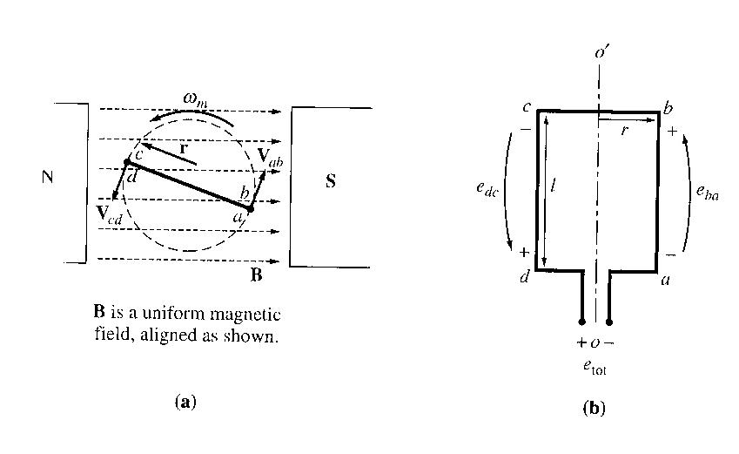
Simple Rotating Loop in a Uniform Magnetic Field
A loop of wire in a uniform magnetic field is the simplest possible machine that produces a sinusoidal ac voltage.
The figure below shows a simple rotating loop in a uniform magnetic field.
is the front view and (b) is the view of the coil.
The rotating part is called the rotor, and the stationary part is called the stator.
aabdo@birzeit.edu AC Machine Fundamentals

Slide 4
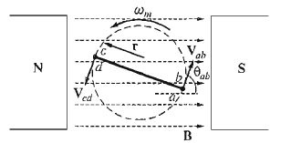
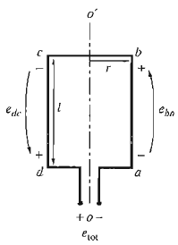
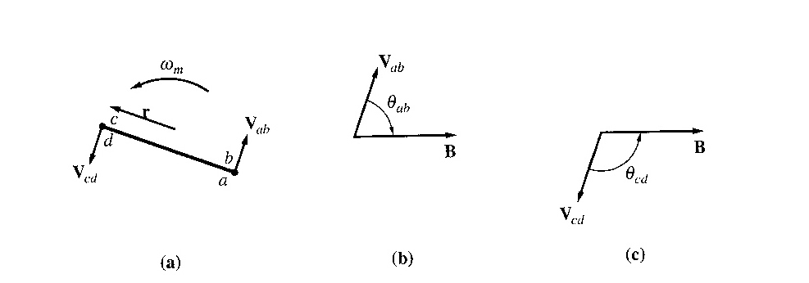
Voltage Induced in a Simple Rotating Loop
Rotor rotation will induce a voltage in the wire loop .
To determine total voltage induced in loop e_{tot ➔}
examine each segment separately using:
aabdo@birzeit.edu AC Machine Fundamentals

Slide 5
Voltage Induced in a Simple Rotating Loop
1. Segment ab
The velocity of the wire is tangential to the path of rotation, while the magnetic field B points to the right.
The quantity v x B points into the page, which is the same direction as segment ab. Thus, the induced voltage on this segment is:
e_{ba} = (v x B) . l = vBl sin θ_{ab} into the page
aabdo@birzeit.edu AC Machine Fundamentals

Slide 6
Voltage Induced in a Simple Rotating Loop
2. Segment cd
The velocity of the wire is tangential to the path of rotation, while B points to the right.
The quantity v x B points into the page, which is the same direction as segment cd. Thus,
e_{cd} = (v x B) . l = vBl sin θ_{cd} out of the page
aabdo@birzeit.edu AC Machine Fundamentals

Slide 7
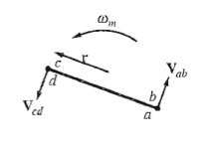
Voltage Induced in a Simple Rotating Loop
3. Segment bc
In the first half of this segment, the quantity v x B points into the page, and in the second half of this segment, the quantity v x B points out of the page. Since the length l is in the plane of the page, v x B is perpendicular to l for both portions of the segment. Thus,
e_{bc} = 0
4. Segment da
Same as segment bc, v x B is perpendicular to l. Thus,
e_{da} = 0
aabdo@birzeit.edu AC Machine Fundamentals

Slide 8
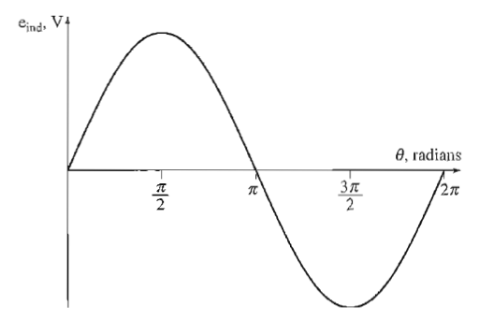
Voltage Induced in a Simple Rotating Loop
Total induced voltage on the loop
e_{ind}= e_{ba} + e_{cb} + e_{dc} + e_{ad}
= vBl sin θ_{ab} + vBl sin θ_{cd}
since θ_{ab} = 180º - θ_{cd} and sinθ = sin(180º - θ )
e_{ind}= 2 vBl sinθ
aabdo@birzeit.edu AC Machine Fundamentals

Slide 9
Voltage Induced in a Simple Rotating Loop
Alternative way to express e_{ind}:
If the loop is rotating at a constant angular velocity ω, then the angle θ of the loop will increase linearly with time.
θ = ωt
also, the tangential velocity v of the edges of the loop is:
v = r ω
where r is the radius from axis of rotation out to the edge of the loop and ω is the angular velocity of the loop.
Therefore,
e_{ind}= 2 vBl sinθ
e_{ind} = 2r ωBl sin ωt
= ABω sin ωt
since area, A = 2rl,
Finally, since maximum flux through the loop occurs when the loop is perpendicular to the magnetic flux density lines, so
aabdo@birzeit.edu AC Machine Fundamentals

Slide 10
Voltage Induced in a Simple Rotating Loop
Thus,
From here we may conclude that the induced voltage is dependent upon:
Flux level (the B component)
Speed of Rotation (the v component)
Machine Constants (the l component and machine materials)
aabdo@birzeit.edu AC Machine Fundamentals

Slide 11
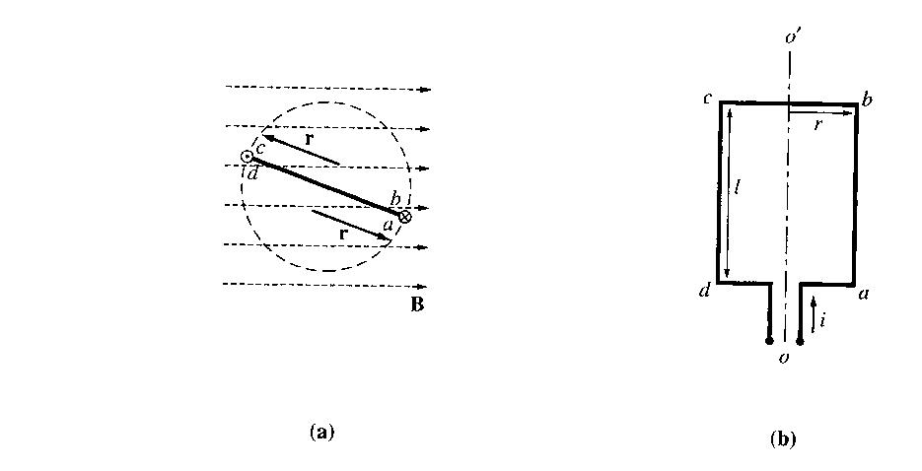
The Torque Induced in a Current-Carrying Loop
Assume that the rotor loop is at some arbitrary angle θ with respect to the magnetic field, and that current is flowing in the loop.
To determine the magnitude and direction of the torque, examine the phasors below:
The force on each segment of the loop is given by:
F = i (l x B )
Torque on that segment,
aabdo@birzeit.edu AC Machine Fundamentals

Slide 12
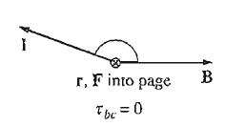
The Torque Induced in a Current-Carrying Loop
1. Segment ab
The direction of the current is into the page, while the magnetic field B points to the right. (l x B) points down. Thus,
F = i (l x B )= ilB down
Resulting torque, clockwise
2. Segment bc
The direction of the current is in the plane of the page, while the magnetic field B points to the right. (l x B) points into the page. Thus,
F = i (l x B ) = ilB into the page
Resulting torque is zero, since vector r and l are parallel and the angle θ_{bc} is 0.
aabdo@birzeit.edu AC Machine Fundamentals

Slide 13
The Torque Induced in a Current-Carrying Loop
3. Segment cd
The direction of the current is out of the page, while the magnetic field B points to the right. (l x B) points up. Thus,
F = i (l x B )= ilB up
Resulting torque,
clockwise
4. Segment da
The direction of the current is in the plane of the page, while the magnetic field B points to the right. (l x B) points out of the page. Thus,
F = i (l x B )= ilB out of the page
Resulting torque is zero, since vector r and l are parallel and the angle θ_{da} is 0.
aabdo@birzeit.edu AC Machine Fundamentals

Slide 14
The Torque Induced in a Current-Carrying Loop
The total induced torque on the loop:
Note : The torque is maximum when the plane of the loop is parallel to the magnetic field, and the torque is zero when the plane of the loop is perpendicular to the magnetic field.
aabdo@birzeit.edu AC Machine Fundamentals

Slide 15
The Torque Induced in a Current-Carrying Loop
Alternative way to express e_{ind}:
The current flowing in the wire loop will generate a magnetic flux density :
where G = factor depending on loop geometry.
Hence, since loop area A=2rl, by substituting :
Or
where k = AG/μ.
aabdo@birzeit.edu AC Machine Fundamentals

Slide 16
Factors Affecting Torque in Real Machines
Strength of the rotor magnetic field
Strength of external (stator) magnetic field
Angle between the two fields
Machine constants
aabdo@birzeit.edu AC Machine Fundamentals

Slide 17
The Rotating Magnetic Field
Torque is produced to align rotor (loop) magnetic field with stator magnetic field.
If stator magnetic field is rotated, torque will cause rotor to ‘chase’ the rotating stator magnetic field.
How to create a rotating stator magnetic field?
Use a set of three-phase windings displaced by 120° electrical around the machine circumference.
Fundamental principle – a 3-phase set of currents, each of equal magnitude and differing in phase by 120º, flows in a 3-phase winding, then it will produce a rotating magnetic field of constant magnitude
aabdo@birzeit.edu AC Machine Fundamentals

Slide 18
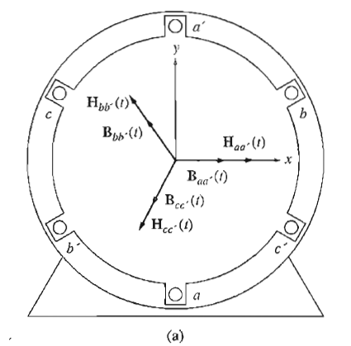
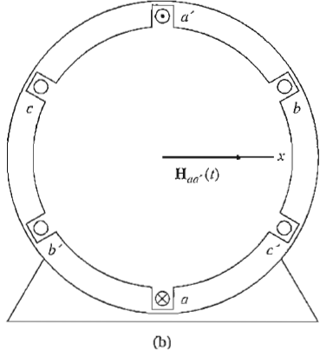
The Rotating Magnetic Field
(a) A simple three phase stator. Currents in this stator are assumed positive if they flow into the unprimed end and out the primed end of the coils. The magnetizing intensities produced by each coil are also shown.
(b) The magnetizing intensity vector Haa'(t) produced by a current flowing in coil aa' .
Let’s apply a set of currents to the stator above and see what happens at specific instants of time. Assume currents in the 3 coils are:
aabdo@birzeit.edu AC Machine Fundamentals

Slide 19
The Rotating Magnetic Field
The current in coil aa’ flows into the “a” end of the coil and out the ”a’” end of the coil. It produces the magnetic field intensity:
The flux densities equations are:
Where B_{M} = µ H_{M}
aabdo@birzeit.edu AC Machine Fundamentals

Slide 20
The Rotating Magnetic Field
At
The total magnetic field from all
three coils added together will be
The total magnetic field from all
three coils added together will be
=BM
20
aabdo@birzeit.edu AC Machine Fundamentals

Slide 21
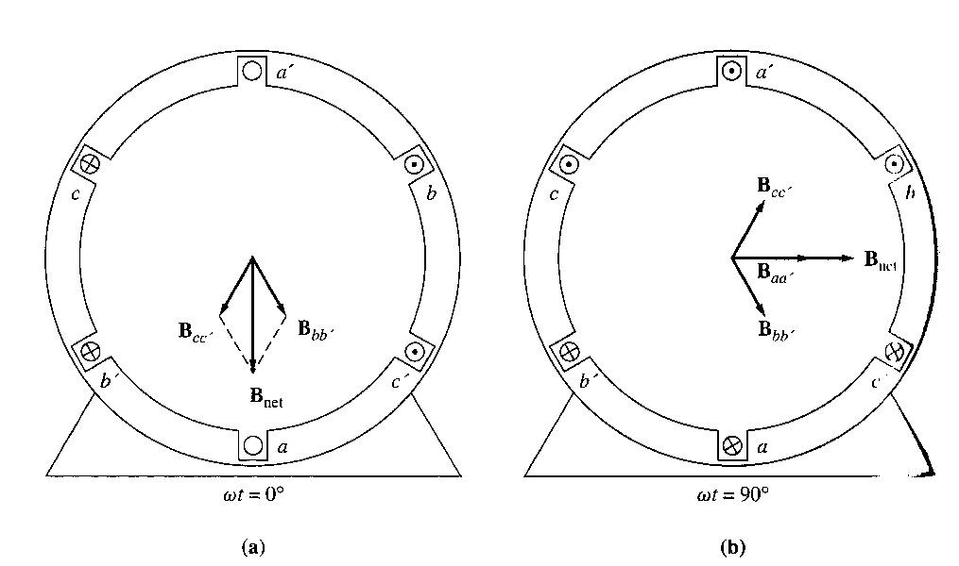
The Rotating Magnetic Field
The resulting magnetic flux
At any time t, the magnetic field will have the same magnitude 1.5 B_{M} and it will continue to rotate at angular velocity ω.
aabdo@birzeit.edu AC Machine Fundamentals

Slide 22
The Rotating Magnetic Field
The following figure shows that the rotating magnetic field in this stator can be represented as a north pole (the flux leaves the stator) and a south pole ( flux enters the stator).
These magnetic poles complete one mechanical rotation around the stator surface for each electrical cycle of the applied current.
The mechanical speed of rotation of the magnetic field in revolutions per second is equal to electric frequency in hertz:
f_{e} (hertz) = f_{m} (revolutions per second) two poles
ω_{e} (radians per second) = ω_{m} (radians per second) two poles
The windings on the 2-pole stator above occur in the order a – c’ – b – a’ – c – b’
aabdo@birzeit.edu AC Machine Fundamentals

Slide 23
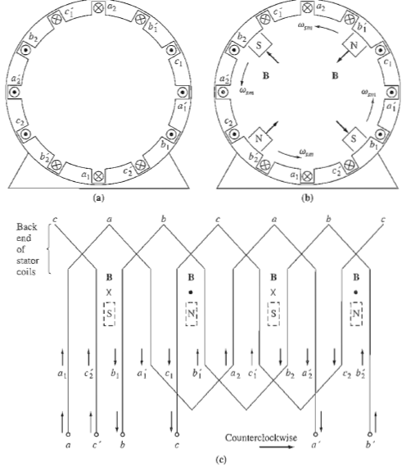
The Rotating Magnetic Field
If we were to double the amount of windings, hence the sequence of windings will be as follows:
a1 – c2’ – b1 – a1’ – c1 – b1’ – a2 – c1’ – b2 – a2’ – c2 – b2’
For a three-phase set of currents, this stator will have 2 north poles and 2 south poles produced in the stator winding, (refer figure (b)):
(a) A simple four-pole stator winding. (b) The resulting stator magnetic poles. Notice that there are moving poles of alternating polarity every 90° around the stator surface. (c) a winding diagram of the stator as seen from its inner surface, showing how the stator currents produce north and south magnetic poles.
aabdo@birzeit.edu AC Machine Fundamentals

Slide 24
The Rotating Magnetic Field
In this winding, a pole moves only halfway around the stator surface in one electrical cycle.
Since one electrical cycle is 360 electrical degrees, and mechanical motion is 180 mechanical degrees, the relationship between the electrical angle θ_{e} and the mechanical θ_{m} in this stator is
θs_{e} = 2θs_{m}
Thus, for a four pole winding, the electrical frequency of the current is twice the mechanical frequency of rotation:
f_{e} = 2f_{m}
ω_{e} = 2ω_{m}
aabdo@birzeit.edu AC Machine Fundamentals

Slide 25
The Rotating Magnetic Field
Therefore the general format will be as follows:
Also,
aabdo@birzeit.edu AC Machine Fundamentals

Slide 26
Reversing the direction of Magnetic Field Rotation
If the current in any two of the 3 coils is swapped, the direction of the magnetic field’s rotation will be reversed.
Magnetomotive Force and Flux Distribution on AC Machines
Assumptions in previous sections:
- Flux produced inside an ac machine is in free space
- Direction of flux density produced by a coil of wire is perpendicular to the plane
of the coil
- Direction of flux given by the right hand rule.
However, the flux in a real machine does not follow these assumptions, since there is a ferromagnetic rotor in the centre of the machine with a small air gap between the rotor and the stator.
aabdo@birzeit.edu AC Machine Fundamentals

Slide 27
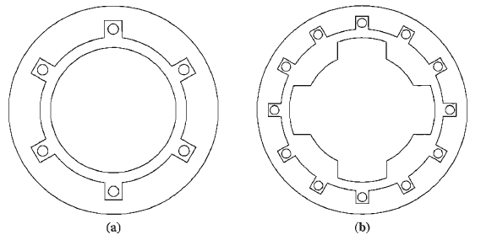
Magnetomotive Force and Flux Distribution on AC Machines
The rotor:
can be cylindrical (a) (nonsalient-pole), or
it can have pole faces projecting out from its surface (b) (salient pole).
aabdo@birzeit.edu AC Machine Fundamentals

Slide 28
Magnetomotive Force and Flux Distribution on AC Machines
The reluctance of the air gap in this machine is much higher than the reluctances of either the rotor or the stator, so the flux density vector B takes the shortest possible path across the air gap and jumps perpendicularly between the rotor and the stator.
To produce a sinusoidal voltage in a machine like this, the magnitude of the flux density vector B must vary in a sinusoidal manner along the surface of the air gap. The flux density will vary sinusoidally only if the magnetizing intensity H (and mmf) varies in a sinusoidal manner along the surface of the air gap.
aabdo@birzeit.edu AC Machine Fundamentals

Slide 29
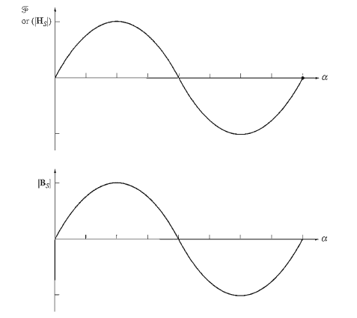
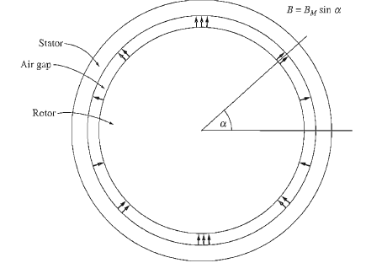
Magnetomotive Force and Flux Distribution on AC Machines
To achieve a sinusoidal variation of mmf along the surface of the air gap is
to distribute the turns of the winding that produces the mmf in closely spaced slots around the surface of the machine and
to vary the number of conductors in each slot in a sinusoidal manner.
A cylindrical rotor with sinusoidally varying air-gap flux density
The mmf or H or B as a function of angle in the air gap
aabdo@birzeit.edu AC Machine Fundamentals

Slide 30
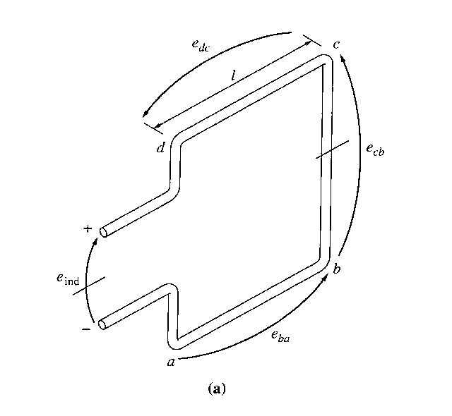
Induced Voltage in AC Machines
The induced voltage in a Coil on a Two-Pole Stator
Previously, discussions were made related to induced 3 phase currents producing a rotating magnetic field. Now, lets look into the fact that a rotating magnetic field may produce voltages in the stator. The Figures below show a rotating rotor with a sinusoidally distributed magnetic field in the centre of a stationary coil.
A rotating rotor magnetic field inside a stationary stator coil
aabdo@birzeit.edu AC Machine Fundamentals

Slide 31
Induced Voltage in AC Machines
The previous equation was derived for the case of a moving wire in a stationary magnetic field.
In this case, the wire is stationary and the magnetic field is moving, so the equation for induced voltage does not directly apply.
To use it, we must be in a frame of reference where the magnetic field appears to be stationary. If we "sit on the magnetic field" so that the held appears to be stationary, the sides of the coil will appear to go by at an apparent velocity vreI, and the equation can be applied.
The total voltage induced in the coil will be the sum of the voltages induced in each of its four sides.
aabdo@birzeit.edu AC Machine Fundamentals

Slide 32
Induced Voltage in AC Machines
Therefore, the total voltage on the coil will be
Since,
Therefore,
Since,
And the angular mechanical velocity should be equal to the angular electrical velocity,
or (taking into account number of turns of windings),
aabdo@birzeit.edu AC Machine Fundamentals

Slide 33
The Induced Voltage in a 3-Phase Set of Coils
If the stator now has 3 sets of different windings as such that the stator voltage induced due to the rotating magnetic field produced by the rotor will have a phase difference of 120º, the induced voltages at each phase will be as follows:
Therefore, a 3 phase set of currents flowing into the stator windings and hence generating a rotating magnetic field (earlier case), and at the same time, a rotating magnetic field produced by the rotor will be able to generate 3 phase voltages in a stator.
aabdo@birzeit.edu AC Machine Fundamentals

Slide 34
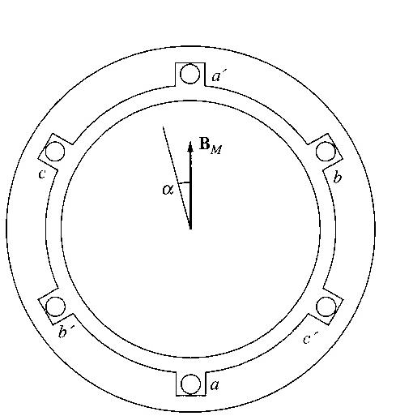
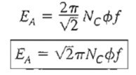
The Induced Voltage in a 3-Phase Set of Coils
Referring to the induced voltage derived earlier, the maximum induced voltage is when sin has a value of 1, hence,
Therefore, the rms voltage at the 3 phase stator:
Note: These are induced voltages at each phase, as for the line-line voltage values; it will depend upon how the stator windings are connected, whether as Y or D.
Solve Example 3-2
The production of three-phase voltages from three coils spaced 120º apart
aabdo@birzeit.edu AC Machine Fundamentals

Slide 35
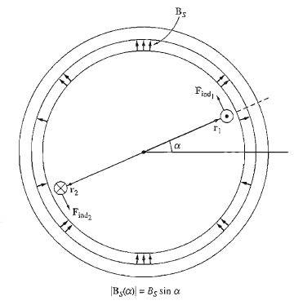
Induced Torque in an AC Machines
In ac machines under normal operating conditions, there are 2 magnetic fields present :
a magnetic field from the rotor circuit and,
another magnetic field from the stator circuit.
The interaction of these two magnetic fields produces the torque in the machine, just as 2 permanent magnets near each other will experience a torque, which causes them to line up.
A simplified ac machine with a sinusoidal stator flux distribution and a single coil of wire mounted in the rotor.
aabdo@birzeit.edu AC Machine Fundamentals

Slide 36
Induced Torque in an AC Machines
There will also be current flowing through the rotor windings (this will create another magnetic field originating from the wire), which will create force that can be found using the right hand rule
The stator flux density distribution in this machine is
B_{S}(α)=B_{S} sin α
Where B_{S} is the magnitude of the peak flux density; B_{S} (α) is positive when the flux density vector points radially outward from the rotor surface to the stator surface.
How much torque is produced in the rotor of this simplified ac machine?
This is done by analyzing the force and torque on each of the two conductors separately:
The induced force on conductor l is
aabdo@birzeit.edu AC Machine Fundamentals

Slide 37
Induced Torque in an AC Machines
Hence torque at conductor 1:
The same may be found for conductor 2, hence the total torque induced:
The current i flowing in the rotor coil produces a magnetic field of its own. The direction of the peak of this magnetic field is given by the right hand rule, and the magnitude of its magnetizing intensity H_{R} is directly proportional to the current flowing in the rotor, and H_{R} = Ci where C is a constant of proportionality.
aabdo@birzeit.edu AC Machine Fundamentals

Slide 38
Induced Torque in an AC Machines
Therefore the torque equation may be represented in the following form:
Note that K is a constant value.
Since B_{R}= μH_{R},
The constant k is a value which will be dependent upon the permeability of the machine’s material. Since the total magnetic field density will be the summation of the BS and BR, hence:
If there is an angle δ between B_{net} and B_{R},
These 3 equations will be used to help develop a qualitative understanding of the torque in ac machines.
aabdo@birzeit.edu AC Machine Fundamentals

Slide 39
Homework
From our text book the 5th edition try to solve the following problems:
3.1, 3.4 and 3.8
aabdo@birzeit.edu AC Machine Fundamentals

