Slide 1

Chapter 3: roadmap
Transport-layer services
Multiplexing and demultiplexing
Connectionless transport: UDP
Principles of reliable data transfer
Connection-oriented transport: TCP
Principles of congestion control
TCP congestion control
Evolution of transport-layer functionality

Slide 2

Principles of reliable data transfer
sending process
receiving process
application
data
data
transport
reliable channel
reliable service abstraction
Notes:
note arrows through reliable data transfer channel is just one way – reliably send from sender to receiver

Slide 3
Principles of reliable data transfer
sending process
receiving process
sending process
receiving process
application
data
data
application
data
data
transport
transport
reliable channel
sender-side of
reliable data transfer protocol
receiver-side
of reliable data transfer protocol
reliable service abstraction
transport
network
unreliable channel
reliable service implementation
Notes:
Spend some time talking about how its to the sender and receiver side protocol that IMPLEMENTS reliable data transfer
Communication over unreliable channel is TWO-way: sender and receiver will exchange messages back and forth to IMPLEMENT one-way reliable data transfer

Slide 4
Principles of reliable data transfer
sending process
receiving process
application
data
data
transport
sender-side of
reliable data transfer protocol
receiver-side
of reliable data transfer protocol
Complexity of reliable data transfer protocol will depend (strongly) on characteristics of unreliable channel (lose, corrupt, reorder data?)
transport
network
unreliable channel
reliable service implementation
Notes:
So we have a sender side and a receiver side. How much work they’ll have to do depends on the IMPAIRMENTS introduced by channel – if the channel is perfect – no problem!

Slide 5

Principles of reliable data transfer
sending process
receiving process
application
data
data
transport
sender-side of
reliable data transfer protocol
receiver-side
of reliable data transfer protocol
Sender, receiver do not know the “state” of each other, e.g., was a message received?
unless communicated via a message
transport
network
unreliable channel
reliable service implementation
Notes:
Here’s a point of view to keep in mind – it’s easy for US to look at sender and receiver together and see what is happening. OH – that message sent was lost.
But think about it say from senders POV How does the sender know if its transmitted message over the unreliable channel got though?? ONLY if receiver somehow signals to the sender that it was received.
The key point here is that one side does NOT know what is going on at the other side – it’s as if there’s a curtain between them. Everything they know about the other can ONLY be learned by sending/receiving messages.
Sender process wants to make sure a segment got through. But it can just somehow magically look through curtain to see if receiver got it. It will be up to the receiver to let the sender KNOW that it (the receiver) has correctly received the segment.
How will the sender and receiver do that – that’s the PROTOCOL.
Before starting to develop a protocol, let’s look more closely at the interface (the API if you will)

Slide 6
Reliable data transfer protocol (rdt): interfaces
rdt_send(): called from above, (e.g., by app.). Passed data to deliver to receiver upper layer
deliver_data(): called by rdt to deliver data to upper layer
sending process
receiving process
rdt_send()
data
data
deliver_data()
data
sender-side
implementation of rdt reliable data transfer protocol
receiver-side
implementation of rdt reliable data transfer protocol
packet
udt_send()
Header
data
Header
data
rdt_rcv()
unreliable channel
udt_send(): called by rdt
to transfer packet over
unreliable channel to receiver
rdt_rcv(): called when packet arrives on receiver side of channel
Bi-directional communication over unreliable channel

Slide 7
Reliable data transfer: getting started
The book:
incrementally develops sender, receiver sides of reliable data transfer protocol (rdt)
consider only unidirectional data transfer
  but control info will flow in both directions!
use finite state machines (FSM) to specify sender, receiver
event causing state transition
actions taken on state transition
state: when in this “state” next state uniquely determined by next event
state
1
state
2
event
actions
Notes:
SO let’s get started in developing our reliable data transfer protocol, which we’ll call rdt (need a good acronym for protocol – like HTTP, TCP, UDP, IP)
Bullet points 1 and 2
NOW if we are going to develop a protocol, so we’ll need some way to SPECIFY a protocol. How do we do that?
We could write text, but as all know, that’s prone to misinterpretation, and might be incomplete. You might write a specification, and then think “oh yeah – I forgot about that case”
What we need is more formal way to specify a protocol. In fact, with a formal specification there may be ways to PROVE PROPERTIES about a specification. But that’s an advanced topic we won’t get into here. We’ll start here by adopting a fairly simple protocol specification technique known as finite state machines (FSM)
And as the name might suggest, a central notion of finite state machines is the notion of STATE
<talk about state>

Slide 8
rdt3.0: channels with errors and loss
New channel assumption: underlying channel can also lose packets (data, ACKs)
  checksum, sequence #s, ACKs, retransmissions will be of help … but not quite enough
Q: How do humans handle lost sender-to-receiver words in conversation?

Slide 9
rdt3.0: channels with errors and loss
Channel assumption:
Corrupted data delivery
Out of order Delivery
Packet Loss (data, ACKs)
Packet Delay (data, ACKs)
Duplicate Packet/ACK Delivery

Slide 10

rdt3.0: channels with errors and loss
Approach: sender waits “reasonable” amount of time for ACK
retransmits if no ACK received in this time
if pkt (or ACK) just delayed (not lost):
    retransmission will be duplicate, but seq #s already handles this!
    receiver must specify seq # of packet being ACKed
use countdown timer to interrupt after “reasonable” amount of time
timeout

Slide 11
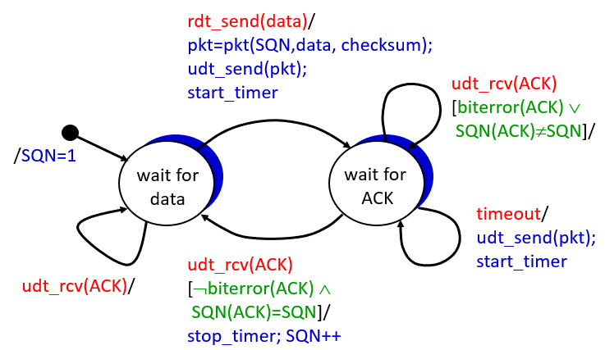
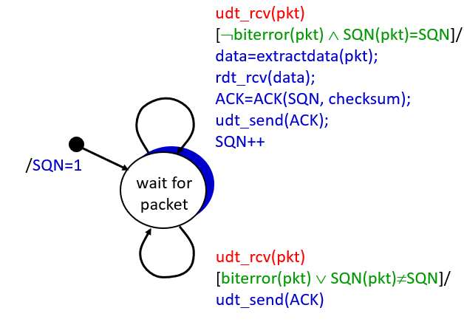
Stop-and-Wait (Summary)
Sender
Receiver

Slide 12
In Stop and wait protocol, how many bits do we need to store the sequence number?
1 bit at least
Therefore it is also called alternating bit protocol

Slide 13
rdt3.0 sender (stop-and-wait)
rdt_send(data)
sndpkt = make_pkt(0, data, checksum)
udt_send(sndpkt)
start_timer
Wait for
call 0 from above
Wait for ACK0
rdt_rcv(rcvpkt)
&& notcorrupt(rcvpkt)
&& isACK(rcvpkt,1)
rdt_rcv(rcvpkt)
&& notcorrupt(rcvpkt)
&& isACK(rcvpkt,0)
stop_timer
stop_timer
Wait for ACK1
Wait for
call 1 from above
rdt_send(data)
sndpkt = make_pkt(1, data, checksum)
udt_send(sndpkt)
start_timer
Notes:
We see the familiar four state sender from our rdt 2.1 and 2.2 protocols. Top two states when sending packet with zero seq # and bottom two

Slide 14
rdt3.0 sender (stop-and-wait)
rdt_send(data)
rdt_rcv(rcvpkt) &&
( corrupt(rcvpkt) ||
isACK(rcvpkt,1) )
sndpkt = make_pkt(0, data, checksum)
udt_send(sndpkt)
start_timer
rdt_rcv(rcvpkt)
Λ
Λ
Wait for
call 0 from above
Wait for ACK0
timeout
udt_send(sndpkt)
start_timer
rdt_rcv(rcvpkt)
&& notcorrupt(rcvpkt)
&& isACK(rcvpkt,1)
rdt_rcv(rcvpkt)
&& notcorrupt(rcvpkt)
&& isACK(rcvpkt,0)
stop_timer
stop_timer
Wait for ACK1
Wait for
call 1 from above
timeout
udt_send(sndpkt)
start_timer
rdt_rcv(rcvpkt)
rdt_send(data)
Λ
rdt_rcv(rcvpkt) &&
( corrupt(rcvpkt) ||
isACK(rcvpkt,0) )
sndpkt = make_pkt(1, data, checksum)
udt_send(sndpkt)
start_timer
Λ
Notes:
We see the familiar four state sender from our rdt 2.1 and 2.2 protocols. Top two states when sending packet with zero seq # and bottom two

Slide 15
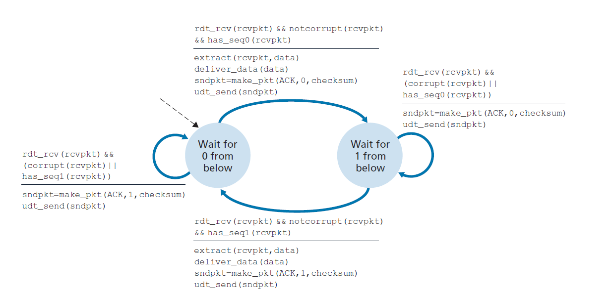
rdt 3.0 receiver stop-and-wait)

Slide 16

rdt3.0 in action
sender
receiver
sender
receiver
send pkt0
pkt0
send pkt0
pkt0
rcv pkt0
rcv pkt0
ack0
send ack0
ack0
send ack0
rcv ack0
rcv ack0
send pkt1
pkt1
send pkt1
pkt1
rcv pkt1
X
ack1
send ack1
loss
rcv ack1
send pkt0
pkt0
rcv pkt0
timeout
resend pkt1
ack0
send ack0
pkt1
rcv pkt1
ack1
send ack1
rcv ack1
send pkt0
pkt0
(a) no loss
rcv pkt0
ack0
send ack0
(b) packet loss

Slide 17
rdt3.0 in action (stop-and-wait))
sender
receiver
sender
receiver
send pkt0
pkt0
rcv pkt0
send pkt0
pkt0
send ack0
rcv pkt0
rcv ack0
ack0
ack0
send ack0
send pkt1
pkt1
rcv ack0
rcv pkt1
send pkt1
pkt1
send ack1
rcv pkt1
ack1
ack1
send ack1
X
timeout
resend pkt1
loss
pkt1
rcv pkt1
timeout
resend pkt1
rcv ack1
(detect duplicate)
pkt1
rcv pkt1
send ack1
send pkt0
pkt0
ack1
(detect duplicate)
rcv pkt0
rcv ack1
send ack1
rcv ack1
ack1
ack0
send ack0
send pkt0
pkt0
(ignore)
rcv pkt0
ack0
send ack0
pkt1
(c) ACK loss
(d) premature timeout/ delayed ACK

Slide 18
Performance of rdt3.0 (stop-and-wait)
  U _{sender}: utilization – fraction of time sender busy sending
example: 1 Gbps link, 15 ms prop. delay, 8000 bit packet
  time to transmit packet into channel:
L
8000 bits
D_{trans} =
=
=
8 microsecs
R
10⁹ bits/sec
Notes:
if RTT=30 msec, 1KB pkt every 30 msec: 33kB/sec thruput over 1 Gbps link
network protocol limits use of physical resources
Let’s develop a formula for utilization

Slide 19
rdt3.0: stop-and-wait operation
sender
receiver
first packet bit transmitted, t = 0
first packet bit arrives
RTT
last packet bit arrives, send ACK
ACK arrives, send next
packet, t = RTT + L / R

Slide 20
rdt3.0: stop-and-wait operation
sender
receiver
L / R
=
L/R
U_{sender}
RTT
+ L / R
.008
RTT
=
30.008
=
0.00027
rdt 3.0 protocol performance stinks!
Protocol limits performance of underlying infrastructure (channel)

Slide 21
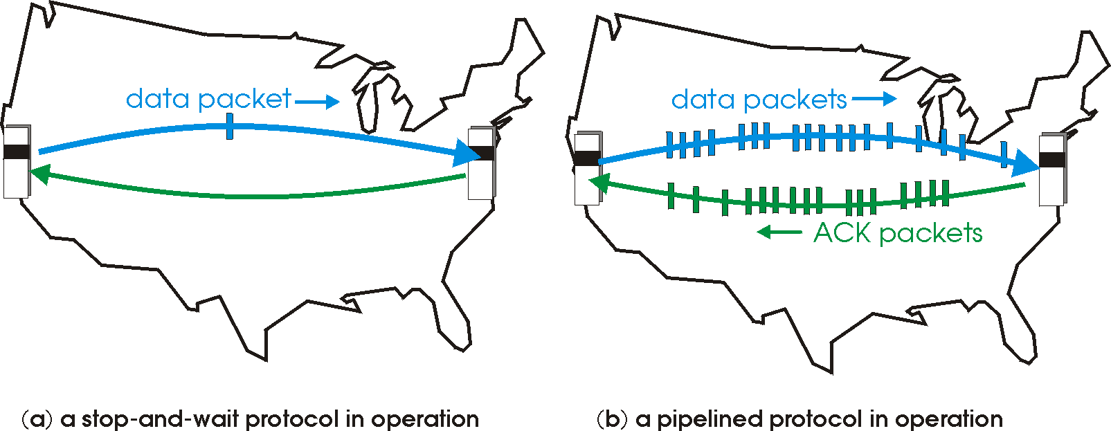
rdt3.0: pipelined protocols operation
pipelining: sender allows multiple, “in-flight”, yet-to-be-acknowledged packets
  range of sequence numbers must be increased
  buffering at sender and/or receiver

Slide 22
Pipelining: increased utilization
sender
receiver
first packet bit transmitted, t = 0
last bit transmitted, t = L / R
first packet bit arrives
RTT
last packet bit arrives, send ACK
last bit of 2nd packet arrives, send ACK
last bit of 3rd packet arrives, send ACK
ACK arrives, send next
packet, t = RTT + L / R
3-packet pipelining increases
utilization by a factor of 3!
Notes:
two generic forms of pipelined protocols: go-Back-N, selective repeat

Slide 23
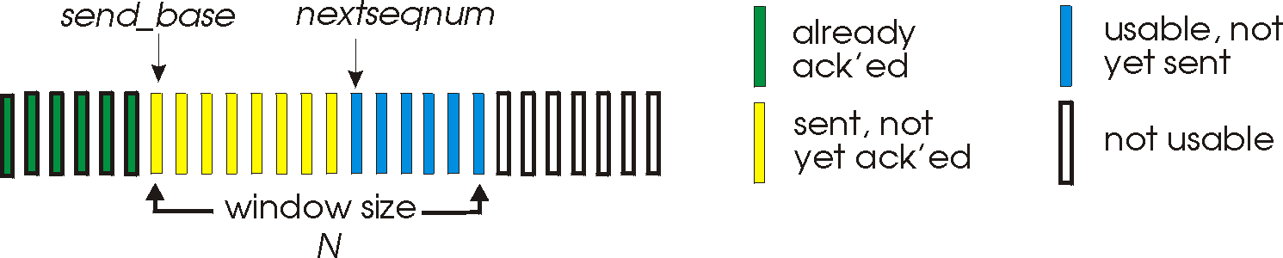
Go-Back-N: sender
sender: “window” of up to N, consecutive transmitted but unACKed pkts
  k-bit seq # in pkt header
cumulative ACK: ACK(n): ACKs all packets up to, including seq # n
  on receiving ACK(n): move window forward to begin at n+1
timer for oldest in-flight packet
timeout(n): retransmit packet n and all higher seq # packets in window
Notes:
window size of 14, 8 have been sent but are not yet ackowledgedm 6 sequence numbers are available for us. In woindow, but no calls from above to use them.
Note – we’ll skip the Go-Back-N FSM specification you can chack that out in powerpoitn slides or book)
TCP uses cumulative ACK

Slide 24
Go-Back-N: receiver
ACK-only: always send ACK for correctly-received packet so far, with highest in-order seq #
  may generate duplicate ACKs
  need only remember rcv_base
on receipt of out-of-order packet:
  can discard (don’t buffer) or buffer: an implementation decision
  re-ACK pkt with highest in-order seq #
Receiver view of sequence number space:
received and ACKed
…
…
Out-of-order: received but not ACKed
rcv_base
Not received
Notes:
Note – we’ll skip the Go-Back-N FSM specification (actually it’s

Slide 25
Go-Back-N in action
sender window (N=4)
sender
receiver
0 1 2 3 4 5 6 7 8
send pkt0
send pkt1
send pkt2
send pkt3
(wait)
0 1 2 3 4 5 6 7 8
0 1 2 3 4 5 6 7 8
receive pkt0, send ack0
receive pkt1, send ack1
receive pkt3, discard,
(re)send ack1
0 1 2 3 4 5 6 7 8
0 1 2 3 4 5 6 7 8
X
0 1 2 3 4 5 6 7 8
loss
0 1 2 3 4 5 6 7 8
0 1 2 3 4 5 6 7 8
rcv ack0, send pkt4
0 1 2 3 4 5 6 7 8
rcv ack1, send pkt5
receive pkt4, discard,
(re)send ack1
0 1 2 3 4 5 6 7 8
ignore duplicate ACK
receive pkt5, discard,
(re)send ack1
0 1 2 3 4 5 6 7 8
pkt 2 timeout
0 1 2 3 4 5 6 7 8
send pkt2
send pkt3
send pkt4
send pkt5
0 1 2 3 4 5 6 7 8
0 1 2 3 4 5 6 7 8
0 1 2 3 4 5 6 7 8
rcv pkt2, deliver, send ack2
rcv pkt3, deliver, send ack3
rcv pkt4, deliver, send ack4
rcv pkt5, deliver, send ack5
0 1 2 3 4 5 6 7 8
0 1 2 3 4 5 6 7 8
0 1 2 3 4 5 6 7 8
0 1 2 3 4 5 6 7 8
Notes:
Let’s skip FSM specification for GBN – check out the book or ppt – and let’s watch GBN sender and receivers in action.
Let assume a window size of 4. at t=0, sender sends packets 0, 1, 2 3, 4, and packet 2 will be lost
At the receiver:
Packet 0 received ACK0 generated
Packet 1 received ACK1 generated
Packet 2 is lost, and so when packet 3 is received, ACK 1 is sent – that’s the cumulative ACK, re-Acknowledging the receipt of packet 1. and in this implementation packet 3 is discarded

Slide 26
Selective repeat
receiver individually acknowledges all correctly received packets
  buffers packets, as needed, for eventual in-order delivery to upper layer
sender times-out/retransmits individually for unACKed packets
  sender maintains timer for each unACKed pkt
sender window
  N consecutive seq #s
  limits seq #s of sent, unACKed packets
Notes:
An important mechanism of GBN was the use of the cumulative acknowledgements, and as we mentioned, cumulative ACKs are used in TCP
An alternate ACK mechanism would be for the receiver to indiviually acknowledge specific packets as they are received. This mechanism is at the heart of the Selective repeat protocol.

Slide 27
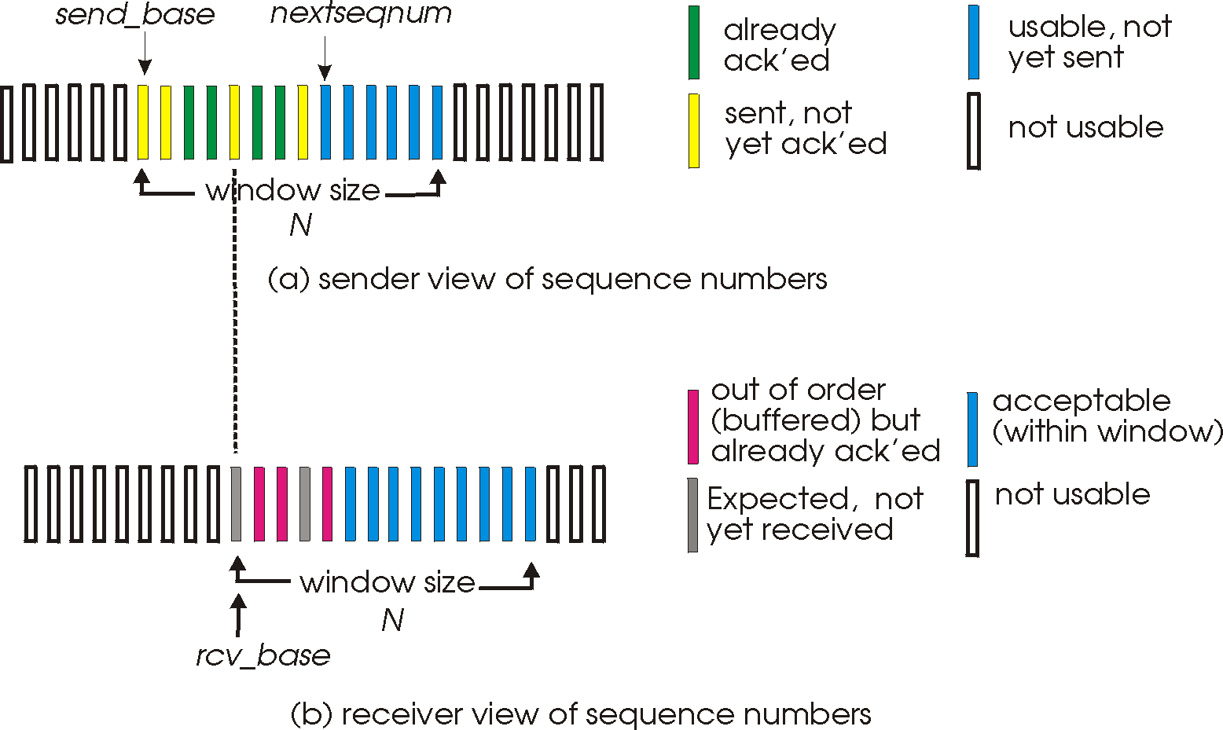
Selective repeat: sender, receiver windows

Slide 28
Selective repeat: sender and receiver
sender
receiver
data from above:
if next available seq # in window, send packet
timeout(n):
resend packet n, restart timer
ACK(n) in [sendbase,sendbase+N]:
mark packet n as received
if n smallest unACKed packet, advance window base to next unACKed seq #
packet n in [rcvbase, rcvbase+N-1]
send ACK(n)
out-of-order: buffer
in-order: deliver (also deliver buffered, in-order packets), advance window to next not-yet-received packet
packet n in [rcvbase-N,rcvbase-1]
ACK(n)
otherwise:
ignore
Notes:
If the packet is in order, its data will be delivered, as will any buffered data that can now be delived in order

Slide 29
Selective Repeat in action
sender window (N=4)
sender
receiver
0 1 2 3 4 5 6 7 8
send pkt0
send pkt1
send pkt2
send pkt3
(wait)
0 1 2 3 4 5 6 7 8
receive pkt0, send ack0
receive pkt1, send ack1
receive pkt3, buffer,
send ack3
0 1 2 3 4 5 6 7 8
X
0 1 2 3 4 5 6 7 8
loss
0 1 2 3 4 5 6 7 8
rcv ack0, send pkt4
0 1 2 3 4 5 6 7 8
rcv ack1, send pkt5
receive pkt4, buffer,
send ack4
record ack3 arrived
receive pkt5, buffer,
send ack5
pkt 2 timeout
0 1 2 3 4 5 6 7 8
send pkt2
(but not 3,4,5)
0 1 2 3 4 5 6 7 8
0 1 2 3 4 5 6 7 8
rcv pkt2; deliver pkt2,
pkt3, pkt4, pkt5; send ack2
0 1 2 3 4 5 6 7 8
Q: what happens when ack2 arrives?

Slide 30
Selective repeat: a dilemma!
sender window
(after receipt)
receiver window
(after receipt)
0 1 2 3 0 1 2
pkt0
0 1 2 3 0 1 2
pkt1
0 1 2 3 0 1 2
0 1 2 3 0 1 2
pkt2
0 1 2 3 0 1 2
example:
seq #s: 0, 1, 2, 3 (base 4 counting)
window size=3
0 1 2 3 0 1 2
0 1 2 3 0 1 2
pkt3
X
0 1 2 3 0 1 2
pkt0
will accept packet
with seq number 0
(a) no problem
0 1 2 3 0 1 2
pkt0
0 1 2 3 0 1 2
pkt1
0 1 2 3 0 1 2
0 1 2 3 0 1 2
pkt2
X
0 1 2 3 0 1 2
X
0 1 2 3 0 1 2
X
timeout
retransmit pkt0
0 1 2 3 0 1 2
pkt0
will accept packet
with seq number 0
(b) oops!

Slide 31

Selective repeat: a dilemma!
sender window
(after receipt)
receiver window
(after receipt)
0 1 2 3 0 1 2
pkt0
0 1 2 3 0 1 2
pkt1
0 1 2 3 0 1 2
0 1 2 3 0 1 2
pkt2
0 1 2 3 0 1 2
example:
seq #s: 0, 1, 2, 3 (base 4 counting)
window size=3
0 1 2 3 0 1 2
0 1 2 3 0 1 2
pkt3
X
0 1 2 3 0 1 2
receiver can’t see sender side
receiver behavior identical in both cases!
something’s (very) wrong!
pkt0
will accept packet
with seq number 0
(a) no problem
Q: what relationship is needed between sequence # size and window size to avoid problem in scenario (b)?
pkt0
0 1 2 3 0 1 2
0 1 2 3 0 1 2
pkt1
0 1 2 3 0 1 2
0 1 2 3 0 1 2
pkt2
X
0 1 2 3 0 1 2
X
0 1 2 3 0 1 2
X
timeout
retransmit pkt0
0 1 2 3 0 1 2
pkt0
will accept packet
with seq number 0
(b) oops!

Slide 32
Seq# >= 2*Window size if windows size is 8 we need SQN 16 ➔ we need 4 bit if the windows size is 16 bits then the SQN 17 bit
0 1 2 3 4 5 6 7
pkt0
0 1 2 3 4 5 6 7
pkt1
0 1 2 3 4 5 6 7
0 1 2 3 4 5 6 7
pkt2
X
0 1 2 3 4 5 6 7
X
0 1 2 3 4 5 6 7
X
timeout
retransmit pkt0
0 1 2 3 4 5 6 7
pkt0
will not accept packet
with seq number 0, it will know that this packet is an old packet

Slide 33
Chapter 3: roadmap
Transport-layer services
Multiplexing and demultiplexing
Connectionless transport: UDP
Principles of reliable data transfer
Connection-oriented transport: TCP
  segment structure
  reliable data transfer
  flow control
  connection management
Principles of congestion control
TCP congestion control

Slide 34
TCP: overview RFCs: 793,1122, 2018, 5681, 7323
point-to-point:
    one sender, one receiver
reliable, in-order byte steam:
    no “message boundaries"
full duplex data:
  bi-directional data flow in same connection
  MSS: maximum segment size
cumulative ACKs
pipelining:
    TCP congestion and flow control set window size
connection-oriented:
  handshaking (exchange of control messages) initializes sender, receiver state before data exchange
flow controlled:
  sender will not overwhelm receiver
Notes:
Typical MSS is 1460 bytes

Slide 35
TCP segment structure
32 bits
source port #
dest port #
segment seq #: counting bytes of data into bytestream (not segments!)
ACK: seq # of next expected byte; A bit: this is an ACK
sequence number
acknowledgement number
length (of TCP header)
head
len
not
used
A
P
S
receive window
flow control: # bytes receiver willing to accept
C
E
U
R
F
Internet checksum
checksum
Urg data pointer
options (variable length)
C, E: congestion notification
TCP options
application
data
(variable length)
data sent by application into TCP socket
RST, SYN, FIN: connection management

Slide 36
TCP sequence numbers, ACKs
outgoing segment from sender
Sequence numbers:
  byte stream “number” of first byte in segment’s data
source port #
dest port #
sequence number
acknowledgement number
rwnd
checksum
urg pointer
window size
N
Acknowledgements:
  seq # of next byte expected from other side
  cumulative ACK
  sender sequence number space
sent
ACKed
sent, not-yet ACKed
(“in-flight”)
usable
but not
yet sent
not
usable
Q: how receiver handles out-of-order segments
  A: TCP spec doesn’t say, - up to implementor
outgoing segment from receiver
source port #
dest port #
sequence number
acknowledgement number
A
rwnd
checksum
urg pointer

Slide 37
TCP sequence numbers, ACKs
Host A
Host B
User types‘C’
Seq=42, ACK=79, data = ‘C’
host ACKs receipt of‘C’, echoes back ‘C’
Seq=79, ACK=43, data = ‘C’
host ACKs receipt of echoed ‘C’
Seq=43, ACK=80
simple telnet scenario
Notes:
The key thing to note here is that the ACK number (43) on the B-to-A segment is one more than the sequence number (42) on the A-toB segment that triggered that ACK
Similarly, the ACK number (80) on the last A-to-B segment is one more than the sequence number (79) on the B-to-A segment that triggered that ACK

Slide 38
TCP Sender (simplified)
event: data received from application
create segment with seq #
seq # is byte-stream number of first data byte in segment
start timer if not already running
  think of timer as for oldest unACKed segment
  expiration interval: TimeOutInterval
event: timeout
retransmit segment that caused timeout
restart timer
event: ACK received
if ACK acknowledges previously unACKed segments
  update what is known to be ACKed
  start timer if there are still unACKed segments
Notes:
Given these details of TCP sequence numbers, acks, and timers, we can now describe the big picture view of how the TCP sender and receiver operate
You can check out FSMs in book; let’s just give an English text description here and let’s start with the sender.

Slide 39
TCP Receiver: ACK generation [RFC 5681]
Event at receiver
arrival of in-order segment with
expected seq #. All data up to
expected seq # already ACKed
arrival of in-order segment with
expected seq #. One other
segment has ACK pending
arrival of out-of-order segment
higher-than-expect seq. # .
Gap detected
arrival of segment that
partially or completely fills gap
TCP receiver action
delayed ACK. Wait up to 500ms
for next segment. If no next segment,
send ACK
immediately send single cumulative
ACK, ACKing both in-order segments
immediately send duplicate ACK,
indicating seq. # of next expected byte
immediate send ACK, provided that
segment starts at lower end of gap
Notes:
Rather than immediately ACKnowledig this segment, many TCP implementations will wait for half a second for another in-order segment to arrive, and then generate a single cumulative ACK for both segments – thus decreasing the amount of ACK traffic. The arrival of this second in-order segment and the cumulative ACK generation that covers both segments is the second row in this table.

Slide 40
TCP: retransmission scenarios
Host A
Host B
Host A
Host B
SendBase=92
Seq=92, 8 bytes of data
Seq=92, 8 bytes of data
timeout
timeout
Seq=100, 20 bytes of data
ACK=100
X
ACK=100
ACK=120
Seq=92, 8 bytes of data
Seq=92, 8
bytes of data
SendBase=100
send cumulative
ACK for 120
SendBase=120
ACK=100
ACK=120
SendBase=120
lost ACK scenario
premature timeout
Notes:
To cement our understanding of TCP reliability, let’s look a a few retransmission scenarios
In the first case a TCP segments is transmited and the ACK is lost, and the TCP timeout mechanism results in another copy of being transmitted and then re-ACKed a the sender
In the second example two segments are sent and acknowledged, but there is a premature timeout e for the first segment, which is retransmitted. Notet that when this retransmitted segment is received, the receiver has already received the first two segments, and so resends a cumulative ACK for both segments received so far, rather than an ACK for just this fist segment.

Slide 41
TCP: retransmission scenarios
Host A
Host B
Seq=92, 8 bytes of data
Seq=100, 20 bytes of data
ACK=100
X
ACK=120
Seq=120, 15 bytes of data
cumulative ACK covers for earlier lost ACK
Notes:
And in this last example, two segments are again transmitted, the first ACK is lost but the second ACK, a cumulative ACK arrives at the sender, which then can transmit a third segment, knowing that the first two have arrived, even though the ACK for the first segment was lost

Slide 42

TCP fast retransmit
Host A
Host B
TCP fast retransmit
if sender receives 3 additional ACKs for same data (“triple duplicate ACKs”), resend unACKed segment with smallest seq #
  likely that unACKed segment lost, so don’t wait for timeout
Seq=92, 8 bytes of data
Seq=100, 20 bytes of data
X
ACK=100
timeout
ACK=100
ACK=100
Receipt of three duplicate ACKs indicates 3 segments received after a missing segment – lost segment is likely. So retransmit!
ACK=100
Seq=100, 20 bytes of data
Notes:
Let’s wrap up our study of TCP reliability by discussing an optimization to the original TCP known as TCP fast retransmit,
Take a look at this example on the right where 5 segments are transmitted and the second segment is lost. In this case the TCP receiver sends an ACK 100 acknowledging the first received segment.
When the third segment arrives at the receiver, the TCP receiver sends another ACK 100 since the second segment has not arrived. And similarly for the 4th and 5th segments to arrive.
Now what does the sender see? The sender receives the first ACK 100 it has been hoping for, but then three additional duplicate ACK100s arrive. The sender knows that somethings’ wrong – it knows the first segment arrived at the receiver but three later arriving segments at the receiver – the ones that generated the three duplicate ACKs – we received correctly but were not in order. That is, that there was a missing segment at the receiver when each of the three duplicate ACK were generated.
With fast retransmit, the arrival of three duplicate ACK causes the sender to retransmit its oldest unACKed segment, without waiting for a timeout event. This allows TCP to recover more quickly from what is very likely a loss event
specifically that the second segment has been lost, since three higher -numbered segments were received

Slide 43
Chapter 3: roadmap
Transport-layer services
Multiplexing and demultiplexing
Connectionless transport: UDP
Principles of reliable data transfer
Connection-oriented transport: TCP
  segment structure
  reliable data transfer
  flow control
  connection management
Principles of congestion control
TCP congestion control

Slide 44
TCP flow control
application
process
Q: What happens if network layer delivers data faster than application layer removes data from socket buffers?
Application removing data from TCP socket buffers
TCP socket
receiver buffers
TCP
code
Network layer delivering IP datagram payload into TCP socket buffers
IP
code
from sender
receiver protocol stack
Notes:
(Presuming an intro)
Before diving into the details of TCP flow control, let’s first get the general context and motivate the need for flow control.
This diagram show a typical transport-layer implementation
A segment is brought up the protocol stack to the transport layer, and the segment’s payload is removed from the segment and written INTO socket buffers.
How does data get taken OUT of socket buffers? By applications performing socket reads, as we learned in Chapter 2.
And so the question is “What happens if network layer delivers data faster than an application-layer process removes data from socket buffers?”
Let’s watch a video of what happens when things arrive way too fast to fast to be processed.
<video>. (I love that video). Another human analogy showing the need for flow control is the saying – to use some English slang - “no one can drink from a firehose”
Flow control is a mechanism to the calamity of a receiver being over-run by a sender that is sending too fast – it allows the RECEIVER to explictly control the SENDER so sender won’t overflow receiver’s buffer by transmitting too much, too fast

Slide 45


TCP flow control
application
process
Q: What happens if network layer delivers data faster than application layer removes data from socket buffers?
Application removing data from TCP socket buffers
TCP socket
receiver buffers
TCP
code
Network layer delivering IP datagram payload into TCP socket buffers
IP
code
from sender
receiver protocol stack
Notes:
(Presuming an intro)
Before diving into the details of TCP flow control, let’s first get the general context and motivate the need for flow control.
This diagram show a typical transport-layer implementation
A segment is brought up the protocol stack to the transport layer, and the segment’s payload is removed from the segment and written INTO socket buffers.
How does data get taken OUT of socket buffers? By applications performing socket reads, as we learned in Chapter 2.
And so the question is “What happens if network layer delivers data faster than an application-layer process removes data from socket buffers?”
Let’s watch a video of what happens when things arrive way too fast to fast to be processed.
<video>. (I love that video). Another human analogy showing the need for flow control is the saying – to use some English slang - “no one can drink from a firehose”
Flow control is a mechanism to the calamity of a receiver being over-run by a sender that is sending too fast – it allows the RECEIVER to explictly control the SENDER so sender won’t overflow receiver’s buffer by transmitting too much, too fast

Slide 46
TCP flow control
application
process
Q: What happens if network layer delivers data faster than application layer removes data from socket buffers?
Application removing data from TCP socket buffers
TCP socket
receiver buffers
TCP
code
receive window
flow control: # bytes receiver willing to accept
IP
code
from sender
receiver protocol stack
Notes:
(Presuming an intro)
Before diving into the details of TCP flow control, let’s first get the general context and motivate the need for flow control.
This diagram show a typical transport-layer implementation
A segment is brought up the protocol stack to the transport layer, and the segment’s payload is removed from the segment and written INTO socket buffers.
How does data get taken OUT of socket buffers? By applications performing socket reads, as we learned in Chapter 2.
And so the question is “What happens if network layer delivers data faster than an application-layer process removes data from socket buffers?”
Let’s watch a video of what happens when things arrive way too fast to fast to be processed.
<video>. (I love that video). Another human analogy showing the need for flow control is the saying – to use some English slang - “no one can drink from a firehose”
Flow control is a mechanism to the calamity of a receiver being over-run by a sender that is sending too fast – it allows the RECEIVER to explictly control the SENDER so sender won’t overflow receiver’s buffer by transmitting too much, too fast

Slide 47
TCP flow control
application
process
Q: What happens if network layer delivers data faster than application layer removes data from socket buffers?
Application removing data from TCP socket buffers
TCP socket
receiver buffers
TCP
code
flow control
receiver controls sender, so sender won’t overflow receiver’s buffer by transmitting too much, too fast
IP
code
from sender
receiver protocol stack
Notes:
(Presuming an intro)
Before diving into the details of TCP flow control, let’s first get the general context and motivate the need for flow control.
This diagram show a typical transport-layer implementation
A segment is brought up the protocol stack to the transport layer, and the segment’s payload is removed from the segment and written INTO socket buffers.
How does data get taken OUT of socket buffers? By applications performing socket reads, as we learned in Chapter 2.
And so the question is “What happens if network layer delivers data faster than an application-layer process removes data from socket buffers?”
Let’s watch a video of what happens when things arrive way too fast to fast to be processed.
<video>. (I love that video). Another human analogy showing the need for flow control is the saying – to use some English slang - “no one can drink from a firehose”
Flow control is a mechanism to the calamity of a receiver being over-run by a sender that is sending too fast – it allows the RECEIVER to explictly control the SENDER so sender won’t overflow receiver’s buffer by transmitting too much, too fast

Slide 48
TCP flow control
TCP receiver “advertises” free buffer space in rwnd field in TCP header
  RcvBuffer size set via socket options (typical default is 4096 bytes)
  many operating systems autoadjust RcvBuffer
sender limits amount of unACKed (“in-flight”) data to received rwnd
guarantees receive buffer will not overflow
to application process
RcvBuffer
buffered data
rwnd
free buffer space
TCP segment payloads
TCP receiver-side buffering
Notes:
Here’s how TCP implement flow control. The basic idea is simple – the receiver informs the sender how much free buffer space there is, and the sender is limited to send no more than this amount of data. That the value o RWND in the diagram to the right.
This information is carried from the receiver to the sender in the “receiver advertised window” (do a PIP of header) in the TCP header, and the value will change as the amount of free buffer space fluctuates over time.

Slide 49
TCP flow control
flow control: # bytes receiver willing to accept
TCP receiver “advertises” free buffer space in rwnd field in TCP header
  RcvBuffer size set via socket options (typical default is 4096 bytes)
  many operating systems autoadjust RcvBuffer
sender limits amount of unACKed (“in-flight”) data to received rwnd
guarantees receive buffer will not overflow
receive window
TCP segment format
Notes:
Here’s how TCP implement flow control. The basic idea is simple – the receiver informs the sender how much free buffer space there is, and the sender is limited to send no more than this amount of data. That the value o RWND in the diagram to the right.
This information is carried from the receiver to the sender in the “receiver advertised window” (do a PIP of header) in the TCP header, and the value will change as the amount of free buffer space fluctuates over time.

Slide 50
At Receiver
LastByteRead (by the application)
LastByteRcvd (arrived from the network)
LastByteRcvd-LastByteRead<= (RcvBuffer)
rwnd= RcvBuffer- (LastByteRcvd-LastByteRead)

Slide 51
Sender
LastByteSent
LastByteAcked
LastByteSent-LastByteAcked<=rwnd

Slide 52
TCP connection management
before exchanging data, sender/receiver “handshake”:
agree to establish connection (each knowing the other willing to establish connection)
agree on connection parameters (e.g., starting seq #s)
application
application
connection state: ESTAB
connection variables:
  seq # client-to-server
  server-to-client
  rcvBuffer size
  at server,client
connection state: ESTAB
connection Variables:
  seq # client-to-server
  server-to-client
  rcvBuffer size
  at server,client
network
network
Socket clientSocket =
newSocket("hostname","port number");
Socket connectionSocket = welcomeSocket.accept();
Notes:
The other TCP topic we’ll want to consider here is that of “connection management”
The TCP sender and reciver have a number of pieces of shared state that they must establish before actually communication
FIRST theym ust both agree that they WANT to communicate with each other
Secondly there are connection parameters – the initial sequence number and the initial receiver-advertised bufferspace that they’ll want to agree on
This is done via a so-called handshake protocol – the client reaching our to the server, and the server answering back.
And before diving into the TCP handshake protocol, let’s first consider the problem of handshaking, of establishing shared state.

Slide 53
TCP 3-way handshake
Server state
Client state
serverSocket = socket(AF_INET,SOCK_STREAM)
serverSocket.bind((‘’,serverPort))
serverSocket.listen(1)
connectionSocket, addr = serverSocket.accept()
clientSocket = socket(AF_INET, SOCK_STREAM)
LISTEN
clientSocket.connect((serverName,serverPort))
LISTEN
choose init seq num, x
send TCP SYN msg
SYNSENT
SYNbit=1, Seq=x
choose init seq num, y
send TCP SYNACK
msg, acking SYN
SYN RCVD
SYNbit=1, Seq=y
ACKbit=1; ACKnum=x+1
received SYNACK(x)
indicates server is live;
send ACK for SYNACK;
this segment may contain
client-to-server data
ESTAB
ACKbit=1, ACKnum=y+1
received ACK(y)
indicates client is live
ESTAB
Notes:
TCP’s three way handshake, that operates as follows
Let’s say the client and server both create a TCP socket as we learned about in Chapter 2 and enter the LISTEN state
The client then connects to the server sending a SYN message with a sequence number x (SYN Message is an TCP Segment with SYN but set in the header – you might want to go back and review the TCP segment format!)
The server is waiting for a connection, and receives the SYN message enters the SYN received state (NOT the established state and sends a SYN ACK message back.
Finally the client sends an ACK message to the server, and when the server receiver this enters the ESTABLished state. This is when the application process would see the return from the wait on the socket accept() call

Slide 54
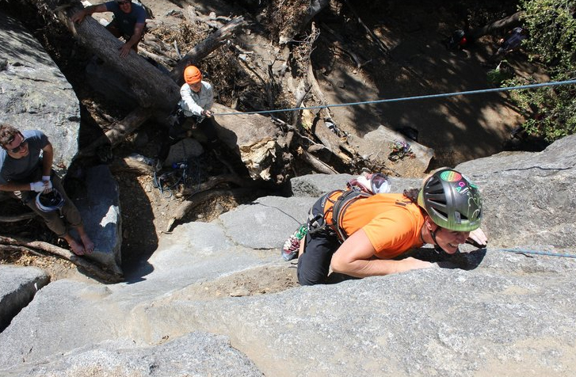
A human 3-way handshake protocol
1. On belay?
2. Belay on.
3. Climbing.
Notes:
As usual, there’s a human protocol analogy to the three way handshake, and I still remember thinking about this clinging for my life while climbing up a rockface
When you want start climbing you first say ON BELOW (meaning ARE YOU READY WITH MY SAFETY ROPE)
THE BELYER (server) responds BELAY ON (that lets you know the belayer is ready for you)
And then you say CLIMING
It’s amazing what can pass through your head when your clinging for your life o a

Slide 55
Closing a TCP connection
client, server each close their side of connection
  send TCP segment with FIN bit = 1
respond to received FIN with ACK
  on receiving FIN, ACK can be combined with own FIN
simultaneous FIN exchanges can be handled
Notes:
All good things must come to an end, and that’s true for a TCP connection as well.
And of course there’s a protocol for one side to gracefully close of a TCP connection using a FIN message, to which the other side sends a FINACK message and waits around a bit to respond to any retransmitted FIN messages before timing out.

Slide 56
Chapter 3: roadmap
Transport-layer services
Multiplexing and demultiplexing
Connectionless transport: UDP
Principles of reliable data transfer
Connection-oriented transport: TCP
Principles of congestion control
TCP congestion control
Evolution of transport-layer functionality

Slide 57
Chapter 3: roadmap
Transport-layer services
Multiplexing and demultiplexing
Connectionless transport: UDP
Principles of reliable data transfer
Connection-oriented transport: TCP
Principles of congestion control
TCP congestion control
Evolution of transport-layer functionality

Slide 58
TCP congestion control: AIMD
approach: senders can increase sending rate until packet loss (congestion) occurs, then decrease sending rate on loss event
Additive Increase
Multiplicative Decrease
  increase sending rate by 1 maximum segment size every RTT until loss detected
  cut sending rate in half at each loss event
AIMD sawtooth
behavior: probing
for bandwidth
TCP sender Sending rate
time

Slide 59
TCP AIMD: more
Multiplicative decrease detail: sending rate is
Cut in half on loss detected by triple duplicate ACK (TCP Reno)
Cut to 1 MSS (maximum segment size) when loss detected by timeout (TCP Tahoe)
Why AIMD?
AIMD – a distributed, asynchronous algorithm – has been shown to:
  optimize congested flow rates network wide!
  have desirable stability properties

Slide 60
TCP congestion control: details
sender sequence number space
TCP sending behavior:
roughly: send cwnd bytes, wait RTT for ACKS, then send more bytes
cwnd
last byte
ACKed
cwnd
sent, but not-yet ACKed
(“in-flight”)
available but not used
TCP rate
~
bytes/sec
~
RTT
last byte sent
TCP sender limits transmission:
cwnd is dynamically adjusted in response to observed network congestion (implementing TCP congestion control)
<
cwnd
LastByteSent- LastByteAcked

Slide 61
TCP slow start
Host A
Host B
when connection begins, increase rate exponentially until first loss event:
  initially cwnd = 1 MSS
  double cwnd every RTT
  done by incrementing cwnd for every ACK received
one segment
RTT
two segments
four segments
summary: initial rate is slow, but ramps up exponentially fast
time

Slide 62
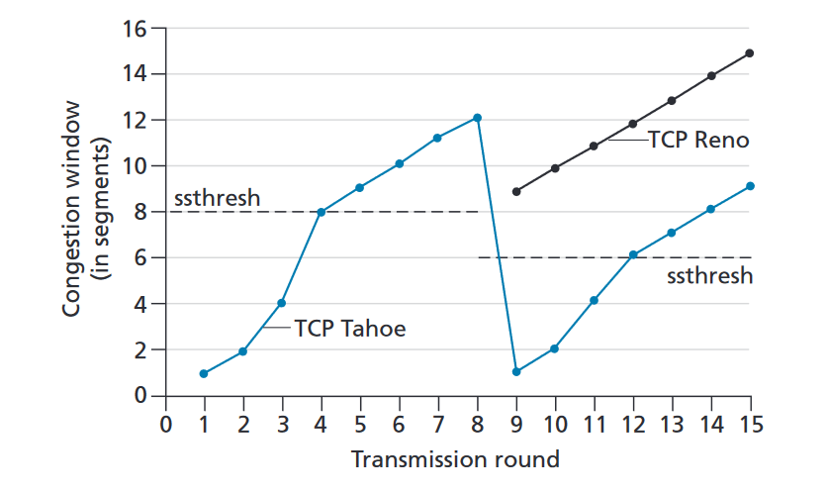
TCP: from slow start to congestion avoidance
Q: when should the exponential increase switch to linear?
A: when cwnd gets to 1/2 of its value before timeout.
Implementation:
variable ssthresh
on loss event, ssthresh is set to 1/2 of cwnd just before loss event
* Check out the online interactive exercises for more examples: http://gaia.cs.umass.edu/kurose_ross/interactive/

Slide 63
Sender
LastByteSent – LastByteAcked<= min{cwnd, rwnd}

Slide 64


Summary: TCP congestion control
New
ACK!
New
ACK!
.
duplicate ACK
new ACK
dupACKcount++
new ACK
cwnd = cwnd + MSS (MSS/cwnd)
dupACKcount = 0
transmit new segment(s), as allowed
cwnd = cwnd+MSS
dupACKcount = 0
transmit new segment(s), as allowed
Λ
cwnd = 1 MSS
ssthresh = 64 KB
dupACKcount = 0
cwnd > ssthresh
slow
start
Λ
congestion
avoidance
timeout
ssthresh = cwnd/2
cwnd = 1 MSS
dupACKcount = 0
retransmit missing segment
duplicate ACK
timeout
dupACKcount++
ssthresh = cwnd/2
cwnd = 1 MSS
dupACKcount = 0
retransmit missing segment
timeout
New
ACK!
ssthresh = cwnd/2
cwnd = 1
dupACKcount = 0
retransmit missing segment
New ACK
dupACKcount == 3
cwnd = ssthresh
dupACKcount = 0
dupACKcount == 3
ssthresh= cwnd/2
cwnd = ssthresh + 3
retransmit missing segment
ssthresh= cwnd/2
cwnd = ssthresh + 3
retransmit missing segment
fast
recovery
duplicate ACK
cwnd = cwnd + MSS
transmit new segment(s), as allowed

Slide 65
TCP CUBIC
Is there a better way than AIMD to “probe” for usable bandwidth?
Insight/intuition:
  W_{max}: sending rate at which congestion loss was detected
  congestion state of bottleneck link probably (?) hasn’t changed much
  after cutting rate/window in half on loss, initially ramp to to W_{max} faster, but then approach W_{max} more slowly
W_{max}
classic TCP
TCP CUBIC - higher throughput in this example
W_{max}/2

Slide 66
TCP CUBIC
K: point in time when TCP window size will reach W_{max}
  K itself is tuneable
increase W as a function of the cube of the distance between current time and K
  larger increases when further away from K
  smaller increases (cautious) when nearer K
TCP CUBIC default in Linux, most popular TCP for popular Web servers
W_{max}
TCP Reno
TCP CUBIC
TCP
sending
rate
time
t₀
t₁
t₂
t₃
t₄

Slide 67
TCP and the congested “bottleneck link”
TCP (classic, CUBIC) increase TCP’s sending rate until packet loss occurs at some router’s output: the bottleneck link
source
destination
application
TCP
network
link
physical
application
TCP
network
link
physical
packet queue almost never empty, sometimes overflows packet (loss)
bottleneck link (almost always busy)

Slide 68
TCP and the congested “bottleneck link”
TCP (classic, CUBIC) increase TCP’s sending rate until packet loss occurs at some router’s output: the bottleneck link
understanding congestion: useful to focus on congested bottleneck link
insight: increasing TCP sending rate will not increase end-end throughout with congested bottleneck
source
destination
application
TCP
network
link
physical
application
TCP
network
link
physical
insight: increasing TCP sending rate will increase measured RTT
Goal: “keep the end-end pipe just full, but not fuller”
RTT

Slide 69
Delay-based TCP congestion control
Keeping sender-to-receiver pipe “just full enough, but no fuller”: keep bottleneck link busy transmitting, but avoid high delays/buffering
# bytes sent in last RTT interval
RTT_{measured}
measured
throughput
=
RTT_{measured}
Delay-based approach:
RTT_{min} - minimum observed RTT (uncongested path)
uncongested throughput with congestion window cwnd is cwnd/RTT_{min}
if measured throughput “very close” to uncongested throughput
increase cwnd linearly /* since path not congested */
else if measured throughput “far below” uncongested throughout
decrease cwnd linearly /* since path is congested */

Slide 70
Delay-based TCP congestion control
congestion control without inducing/forcing loss
maximizing throughout (“keeping the just pipe full… ”) while keeping delay low (“…but not fuller”)
a number of deployed TCPs take a delay-based approach
  BBR deployed on Google’s (internal) backbone network

Slide 71
Explicit congestion notification (ECN)
TCP deployments often implement network-assisted congestion control:
two bits in IP header (ToS field) marked by network router to indicate congestion
  policy to determine marking chosen by network operator
congestion indication carried to destination
destination sets ECE bit on ACK segment to notify sender of congestion
involves both IP (IP header ECN bit marking) and TCP (TCP header C,E bit marking)
TCP
ECE (1 bit): ECN-Echo: depending on SYN flag. It indicates:
If the SYN flag is set (1), the TCP peer is ECN capable.
If the SYN flag is clear (0), that a packet with Congestion Experienced flag set (ECN=11) in the IP header was received. ➔indication of network congestion
source
TCP ACK segment
destination
application
TCP
network
link
physical
application
TCP
network
link
physical
ECE=1
Operation of ECN with IP
00 – Non ECN-Capable
10 – ECN Capable Transport, ECT(0)
01 – ECN Capable Transport, ECT(1)
11 – Congestion Encountered, CE.
ECN=10
ECN=11
IP datagram

Slide 72
TCP fairness
Fairness goal: if K TCP sessions share same bottleneck link of bandwidth R, each should have average rate of R/K
TCP connection 1
bottleneck
router
capacity R
TCP connection 2

Slide 73
Q: is TCP Fair?
Example: two competing TCP sessions:
additive increase gives slope of 1, as throughout increases
multiplicative decrease decreases throughput proportionally
R
equal bandwidth share
Is TCP fair?
A: Yes, under idealized assumptions:
same RTT
fixed number of sessions only in congestion avoidance
loss: decrease window by factor of 2
congestion avoidance: additive increase
Connection 2 throughput
loss: decrease window by factor of 2
congestion avoidance: additive increase
Connection 1 throughput
R

Slide 74
Fairness: must all network apps be “fair”?
Fairness and UDP
multimedia apps often do not use TCP
  do not want rate throttled by congestion control
instead use UDP:
  send audio/video at constant rate, tolerate packet loss
there is no “Internet police” policing use of congestion control
Fairness, parallel TCP connections
application can open multiple parallel connections between two hosts
web browsers do this , e.g., link of rate R with 9 existing connections:
  new app asks for 1 TCP, gets rate R/10
  new app asks for 11 TCPs, gets R/2

Slide 75
Transport layer: roadmap
Transport-layer services
Multiplexing and demultiplexing
Connectionless transport: UDP
Principles of reliable data transfer
Connection-oriented transport: TCP
Principles of congestion control
TCP congestion control
Evolution of transport-layer functionality

Slide 76
Evolving transport-layer functionality
TCP, UDP: principal transport protocols for 40 years
different “flavors” of TCP developed, for specific scenarios:
Scenario | Challenges
Long, fat pipes (large data transfers) | Many packets “in flight”; loss shuts down pipeline
Wireless networks | Loss due to noisy wireless links, mobility; TCP treat this as congestion loss
Long-delay links | Extremely long RTTs
Data center networks | Latency sensitive
Background traffic flows | Low priority, “background” TCP flows
moving transport–layer functions to application layer, on top of UDP
  HTTP/3: QUIC

Slide 77
QUIC: Quick UDP Internet Connections
application-layer protocol, on top of UDP
  increase performance of HTTP
  deployed on many Google servers, apps (Chrome, mobile YouTube app)
HTTP/2
HTTP/2 (slimmed)
Application
HTTP/3
TLS
QUIC
Transport
TCP
UDP
Network
IP
IP
HTTP/2 over TCP
HTTP/2 over QUIC over UDP

Slide 78
QUIC: Quick UDP Internet Connections
adopts approaches we’ve studied in this chapter for connection establishment, error control, congestion control
  error and congestion control: “Readers familiar with TCP’s loss detection and congestion control will find algorithms here that parallel well-known TCP ones.” [from QUIC specification]
  connection establishment: reliability, congestion control, authentication, encryption, state established in one RTT
multiple application-level “streams” multiplexed over single QUIC connection
  separate reliable data transfer, security
  common congestion control

Slide 79
QUIC: Connection establishment
TCP handshake
(transport layer)
QUIC handshake
data
TLS handshake
(security)
data
TCP (reliability, congestion control state) + TLS (authentication, crypto state)
2 serial handshakes
QUIC: reliability, congestion control, authentication, crypto state
1 handshake

Slide 80
QUIC: streams: parallelism, no HOL blocking
HTTP
GET
HTTP
GET
HTTP
GET
HTTP
GET
HTTP
GET
application
HTTP
GET
QUIC
encrypt
QUIC
encrypt
QUIC
encrypt
QUIC
encrypt
QUIC
encrypt
QUIC
encrypt
TLS encryption
TLS encryption
QUIC
RDT
QUIC
RDT
QUIC
RDT
QUIC
RDT
QUIC
RDT
QUIC
RDT
error!
QUIC Cong. Cont.
QUIC Cong. Cont.
TCP RDT
TCP RDT
error!
transport
TCP Cong. Contr.
TCP Cong. Contr.
UDP
UDP
(a) HTTP 1.1
(b) HTTP/2 with QUIC: no HOL blocking

Slide 81
Chapter 3: roadmap
Transport-layer services
Multiplexing and demultiplexing
Connectionless transport: UDP
Principles of reliable data transfer
Connection-oriented transport: TCP
Principles of congestion control
TCP congestion control
Evolution of transport-layer functionality

Slide 82




HTTP server
client
application
application
HTTP msg
transport
transport
network
transport
network
link
network
link
physical
link
physical
physical

Slide 83
HTTP server
client
application
application
HTTP msg
transport
H_{t}
HTTP msg
transport
network
transport
network
link
network
link
physical
link
physical
physical

Slide 84
HTTP server
client
application
application
HTTP msg
transport
H_{t}
HTTP msg
H_{n}
H_{t}
network
transport
HTTP msg
transport
network
link
network
link
physical
link
physical
physical

Slide 85
HTTP server
client
application
application
transport
transport
network
transport
network
link
network
link
physical
link
physical
physical
H_{n}
H_{t}
HTTP msg

Slide 86

HTTP server
client₁
client₂
application
P-client₁
P-client₂
application
transport
transport
network
transport
network
link
network
link
physical
link
physical
physical

Slide 87
Multiplexing/demultiplexing
multiplexing at sender:
demultiplexing at receiver:
handle data from multiple
sockets, add transport header (later used for demultiplexing)
use header info to deliver
received segments to correct
socket
application
application
P1
P2
application
socket
P3
transport
P4
process
transport
network
transport
network
link
network
link
physical
link
physical
physical

Slide 88
How demultiplexing works
host receives IP datagrams
  each datagram has source IP address, destination IP address
  each datagram carries one transport-layer segment
  each segment has source, destination port number
host uses IP addresses & port numbers to direct segment to appropriate socket
32 bits
source port #
dest port #
other header fields
application
data
(payload)
TCP/UDP segment format

Slide 89
Connectionless demultiplexing
Recall:
when creating socket, must specify host-local port #:
DatagramSocket mySocket1 = new DatagramSocket(12534);
when receiving host receives UDP segment:
  checks destination port # in segment
  directs UDP segment to socket with that port #
when creating datagram to send into UDP socket, must specify
  destination IP address
  destination port #
IP/UDP datagrams with same dest. port #, but different source IP addresses and/or source port numbers will be directed to same socket at receiving host

Slide 90
Connectionless demultiplexing: an example
DatagramSocket serverSocket = new DatagramSocket
(6428);
DatagramSocket mySocket2 = new DatagramSocket
(9157);
DatagramSocket mySocket1 = new DatagramSocket (5775);
application
application
P1
application
P3
P4
transport
transport
network
transport
network
link
network
link
physical
link
physical
physical
source port: 6428
dest port: 9157
source port: ?
dest port: ?
source port: 9157
dest port: 6428
source port: ?
dest port: ?

Slide 91
Connection-oriented demultiplexing
TCP socket identified by 4-tuple:
  source IP address
  source port number
  dest IP address
  dest port number
server may support many simultaneous TCP sockets:
  each socket identified by its own 4-tuple
  each socket associated with a different connecting client
demux: receiver uses all four values (4-tuple) to direct segment to appropriate socket

Slide 92
Connection-oriented demultiplexing: example
application
application
P4
P5
P6
application
P1
P2
P3
transport
transport
network
transport
network
link
network
link
physical
link
physical
server: IP address B
physical
host: IP address A
source IP,port: B,80
dest IP,port: A,9157
host: IP address C
source IP,port: C,5775
dest IP,port: B,80
source IP,port: A,9157
dest IP, port: B,80
source IP,port: C,9157
dest IP,port: B,80
Three segments, all destined to IP address: B,
dest port: 80 are demultiplexed to different sockets

Slide 93
Chapter 3: summary
principles behind transport layer services:
  multiplexing, demultiplexing
  reliable data transfer
  flow control
  congestion control
instantiation, implementation in the Internet
  UDP
  TCP
Up next:
leaving the network “edge” (application, transport layers)
into the network “core”
two network-layer chapters:
  data plane
  control plane

Slide 94
Summary
Multiplexing, demultiplexing: based on segment, datagram header field values
UDP: demultiplexing using destination port number (only)
TCP: demultiplexing using 4-tuple: source and destination IP addresses, and port numbers
Multiplexing/demultiplexing happen at all layers

Slide 95
Additional Chapter 3 slides

Slide 96
Go-Back-N: sender extended FSM
rdt_send(data)
if (nextseqnum < base+N) {
sndpkt[nextseqnum] = make_pkt(nextseqnum,data,chksum)
udt_send(sndpkt[nextseqnum])
if (base == nextseqnum)
start_timer
nextseqnum++
}
else
refuse_data(data)
Λ
base=1
nextseqnum=1
timeout
Wait
start_timer
udt_send(sndpkt[base])
udt_send(sndpkt[base+1])
…
udt_send(sndpkt[nextseqnum-1])
rdt_rcv(rcvpkt)
&& corrupt(rcvpkt)
rdt_rcv(rcvpkt) &&
notcorrupt(rcvpkt)
base = getacknum(rcvpkt)+1
If (base == nextseqnum)
stop_timer
else
start_timer

Slide 97
Go-Back-N: receiver extended FSM
any other event
udt_send(sndpkt)
rdt_rcv(rcvpkt)
&& notcorrupt(rcvpkt)
&& hasseqnum(rcvpkt,expectedseqnum)
Λ
Wait
extract(rcvpkt,data)
deliver_data(data)
sndpkt = make_pkt(expectedseqnum,ACK,chksum)
udt_send(sndpkt)
expectedseqnum++
expectedseqnum=1
sndpkt =
make_pkt(expectedseqnum,ACK,chksum)
ACK-only: always send ACK for correctly-received packet with highest in-order seq #
  may generate duplicate ACKs
  need only remember expectedseqnum
out-of-order packet:
  discard (don’t buffer): no receiver buffering!
  re-ACK pkt with highest in-order seq #

Slide 98
TCP sender (simplified)
data received from application above
create segment, seq. #: NextSeqNum
pass segment to IP (i.e., “send”)
NextSeqNum = NextSeqNum + length(data)
if (timer currently not running)
start timer
Λ
NextSeqNum = InitialSeqNum
SendBase = InitialSeqNum
wait
for
event
timeout
retransmit not-yet-acked segment with smallest seq. #
start timer
ACK received, with ACK field value y
if (y > SendBase) {
SendBase = y
/* SendBase–1: last cumulatively ACKed byte */
if (there are currently not-yet-acked segments)
start timer
else stop timer
}

Slide 99
TCP 3-way handshake FSM
closed
Socket connectionSocket = welcomeSocket.accept();
Λ
Socket clientSocket =
newSocket("hostname","port number");
SYN(x)
SYNACK(seq=y,ACKnum=x+1)
create new socket for communication back to client
SYN(seq=x)
listen
SYN
sent
SYN
rcvd
SYNACK(seq=y,ACKnum=x+1)
ACK(ACKnum=y+1)
ESTAB
ACK(ACKnum=y+1)
Λ

Slide 100
Closing a TCP connection
client state
server state
ESTAB
ESTAB
clientSocket.close()
FIN_WAIT_1
can no longer
send but can
receive data
FINbit=1, seq=x
CLOSE_WAIT
ACKbit=1; ACKnum=x+1
can still
send data
FIN_WAIT_2
wait for server
close
LAST_ACK
FINbit=1, seq=y
TIMED_WAIT
can no longer
send data
ACKbit=1; ACKnum=y+1
timed wait
for 2*max
segment lifetime
CLOSED
CLOSED

Slide 101
TCP throughput
avg. TCP thruput as function of window size, RTT?
  ignore slow start, assume there is always data to send
W: window size (measured in bytes) where loss occurs
  avg. window size (# in-flight bytes) is ¾ W
  avg. thruput is 3/4W per RTT
avg TCP thruput =
3
W
4
RTT
bytes/sec
W
W/2

Slide 102
TCP over “long, fat pipes”
example: 1500 byte segments, 100ms RTT, want 10 Gbps throughput
requires W = 83,333 in-flight segments
throughput in terms of segment loss probability, L [Mathis 1997]:
  ➜ to achieve 10 Gbps throughput, need a loss rate of L = 2·10⁻¹⁰ – a very small loss rate!
versions of TCP for long, high-speed scenarios
1.22
.
MSS
TCP throughput =
RTT
L

