Slide 1
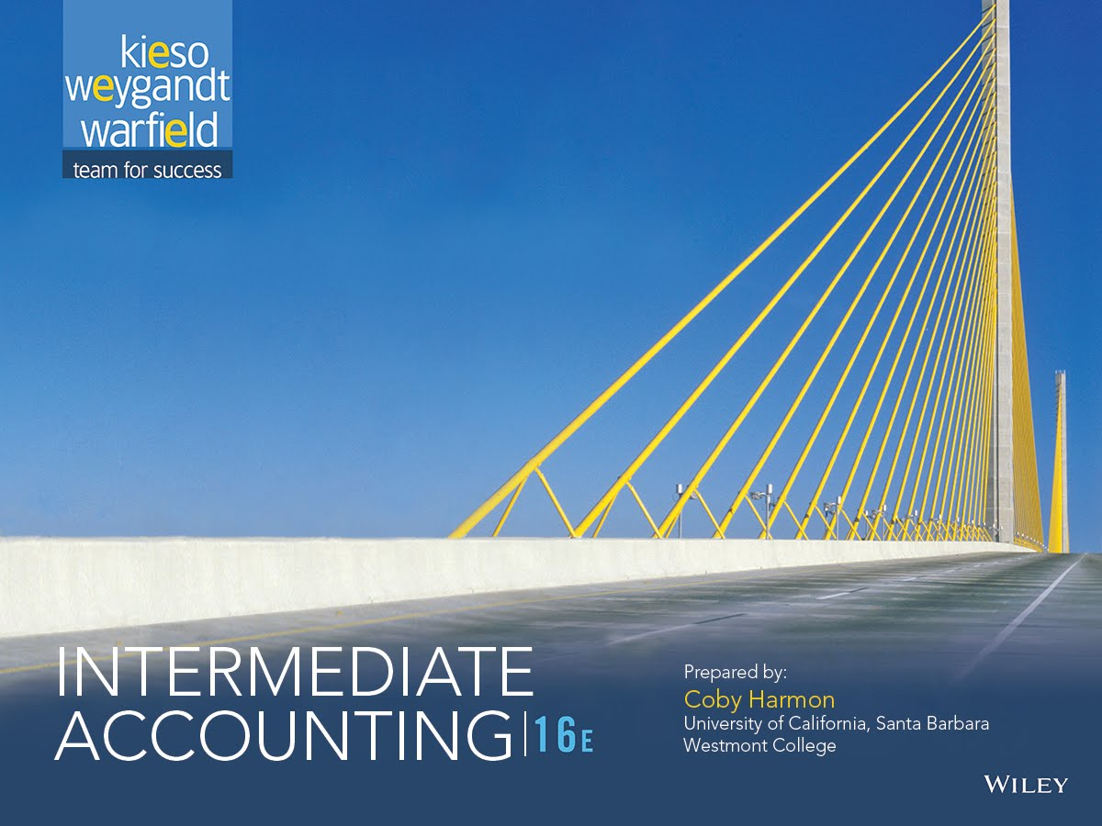

Slide 2
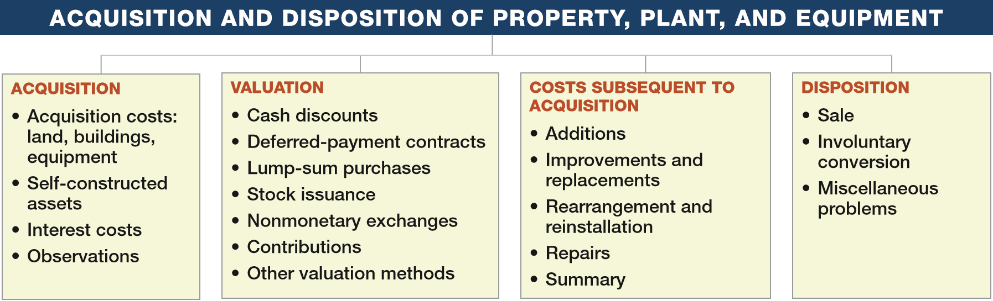
PREVIEW OF CHAPTER 10
Intermediate Accounting
16th Edition
Kieso ● Weygandt ● Warfield

Slide 3
LEARNING OBJECTIVES
Acquisition and Disposition of Property, Plant, and Equipment
10
After studying this chapter, you should be able to:
Understand property, plant, and equipment and its related costs.
Describe the accounting problems associated with self-constructed assets.
Describe the accounting problems associated with interest capitalization.
Understand accounting issues related to acquiring and valuing plant assets.
Describe the accounting treatment for costs subsequent to acquisition.
Describe the accounting treatment for the disposal of property, plant, and equipment.
LO 1

Slide 4
PROPERTY, PLANT, AND EQUIPMENT
Property, plant, and equipment are assets of a durable nature. Other terms commonly used are plant assets and fixed assets.
“Used in operations” and not for resale.
Long-term in nature and usually depreciated.
Possess physical substance.
Includes:
Land,
Building structures (offices, factories, warehouses), and
Equipment (machinery, furniture, tools).
LO 1

Slide 5
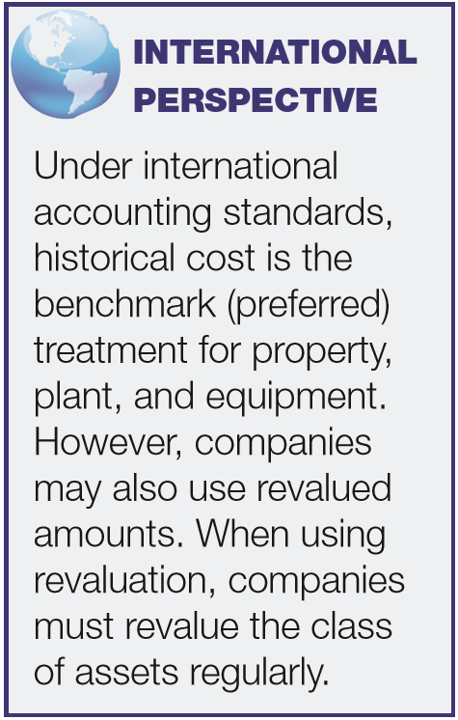
PROPERTY, PLANT, AND EQUIPMENT
Acquisition of Property, Plant, and Equipment
Historical cost measures the cash or cash equivalent price of obtaining the asset and bringing it to the location and condition necessary for its intended use.
Main reasons for historical cost valuation:
  Historical cost is reliable.
  Companies should not anticipate gains and losses but should recognize gains and losses only when the asset is sold.
LO 1

Slide 6
Acquisition of Property, Plant, and Equipment
Cost of Land
Includes all expenditures to acquire land and ready it for use. Costs typically include:
  purchase price;
  closing costs, such as title to the land, attorney’s fees, and recording fees;
  costs of grading, filling, draining, and clearing;
  assumption of any liens, mortgages, or encumbrances on the property; and
  additional land improvements that have an indefinite life.
LO 1

Slide 7
Acquisition of Property, Plant, and Equipment
Cost of Land
Improvements with limited lives, such as private driveways, walks, fences, and parking lots, are recorded as Land Improvements and depreciated.
  Land acquired and held for speculation is classified as an investment.
  Land held by a real estate concern for resale should be classified as inventory.
LO 1

Slide 8
Acquisition of Property, Plant, and Equipment
Cost of Buildings
Includes all expenditures related directly to acquisition or construction. Costs include:
  materials, labor, and overhead costs incurred during construction and
  professional fees and building permits.
LO 1

Slide 9
Acquisition of Property, Plant, and Equipment
Cost of Equipment
Include all expenditures incurred in acquiring the equipment and preparing it for use. Costs include:
  purchase price,
  freight and handling charges,
  insurance on the equipment while in transit,
  cost of special foundations if required,
  assembling and installation costs, and
  costs of conducting trial runs.
LO 1

Slide 10
Acquisition of Property, Plant, and Equipment
Illustration: The expenditures and receipts below are related to land, land improvements, and buildings acquired for use in a business enterprise. Determine how the following should be classified:
Money borrowed to pay building contractor
Payment for construction from note proceeds
Cost of land fill and clearing
Delinquent real estate taxes on property assumed
Premium on 6-month insurance policy during construction
Refund of 1-month insurance premium because construction completed early
Notes Payable
Building
Land
Land
Building
(Building)
LO 1

Slide 11
Acquisition of Property, Plant, and Equipment
Illustration: The expenditures and receipts below are related to land, land improvements, and buildings acquired for use in a business enterprise. Determine how the following should be classified:
(g) Architect’s fee on building
(h) Cost of real estate purchased as a plant site (land $200,000 and building $50,000)
(i) Commission fee paid to real estate agency
(j) Installation of fences around property
(k) Cost of razing and removing building
Proceeds from salvage of demolished building
Cost of parking lots and driveways
Cost of trees and shrubbery (permanent)
Building
Land
Land
Land Improvements
Land
(Land)
Land Improvements
Land
LO 1

Slide 12
LEARNING OBJECTIVES
10
Acquisition and Disposition of Property, Plant, and Equipment
After studying this chapter, you should be able to:
Understand property, plant, and equipment and its related costs.
Describe the accounting problems associated with self-constructed assets.
Describe the accounting problems associated with interest capitalization.
Understand accounting issues related to acquiring and valuing plant assets.
Describe the accounting treatment for costs subsequent to acquisition.
Describe the accounting treatment for the disposal of property, plant, and equipment.
LO 2

Slide 13
Acquisition of Property, Plant, and Equipment
Self-Constructed Assets
Costs include:
  Materials and direct labor
  Overhead can be handled in two ways:
    Assign no fixed overhead.
    Assign a portion of all overhead to the construction process.
  Companies use the second method extensively.
LO 2

Slide 14
LEARNING OBJECTIVES
10
Acquisition and Disposition of Property, Plant, and Equipment
After studying this chapter, you should be able to:
Understand property, plant, and equipment and its related costs.
Describe the accounting problems associated with self-constructed assets.
Describe the accounting problems associated with interest capitalization.
Understand accounting issues related to acquiring and valuing plant assets.
Describe the accounting treatment for costs subsequent to acquisition.
Describe the accounting treatment for the disposal of property, plant, and equipment.
LO 3

Slide 15
Acquisition of Property, Plant, and Equipment
Interest Costs During Construction
Three approaches have been suggested to account for the interest incurred in financing the construction.
Increase to Cost of Asset
$ 0
$ ?
Capitalize no interest during construction
Capitalize all costs of funds
Capitalize actual costs incurred during construction
ILLUSTRATION 10-1 Capitalization of Interest Costs
GAAP
LO 3

Slide 16
Acquisition of Property, Plant, and Equipment
Interest Costs During Construction
  GAAP requires — capitalizing actual interest (with modification).
  Consistent with historical cost.
  Capitalization considers three items:
    Qualifying assets.
    Capitalization period.
    Amount to capitalize.
LO 3

Slide 17
Interest Costs During Construction
Qualifying Assets
Require a period of time to get them ready for their intended use.
Two types of assets:
  Assets under construction for a company’s own use.
  Assets intended for sale or lease that are constructed or produced as discrete projects.
LO 3

Slide 18
Interest Costs During Construction
Capitalization Period
Begins when:
  Expenditures for the asset have been made.
  Activities for readying the asset are in progress .
  Interest costs are being incurred.
Ends when:
The asset is substantially complete and ready for use.
LO 3

Slide 19
Interest Costs During Construction
Amount to Capitalize
Capitalize the lesser of:
  Actual interest costs.
  2. Avoidable interest - the amount of interest cost during the period that a company could theoretically avoid if it had not made expenditures for the asset.
LO 3

Slide 20
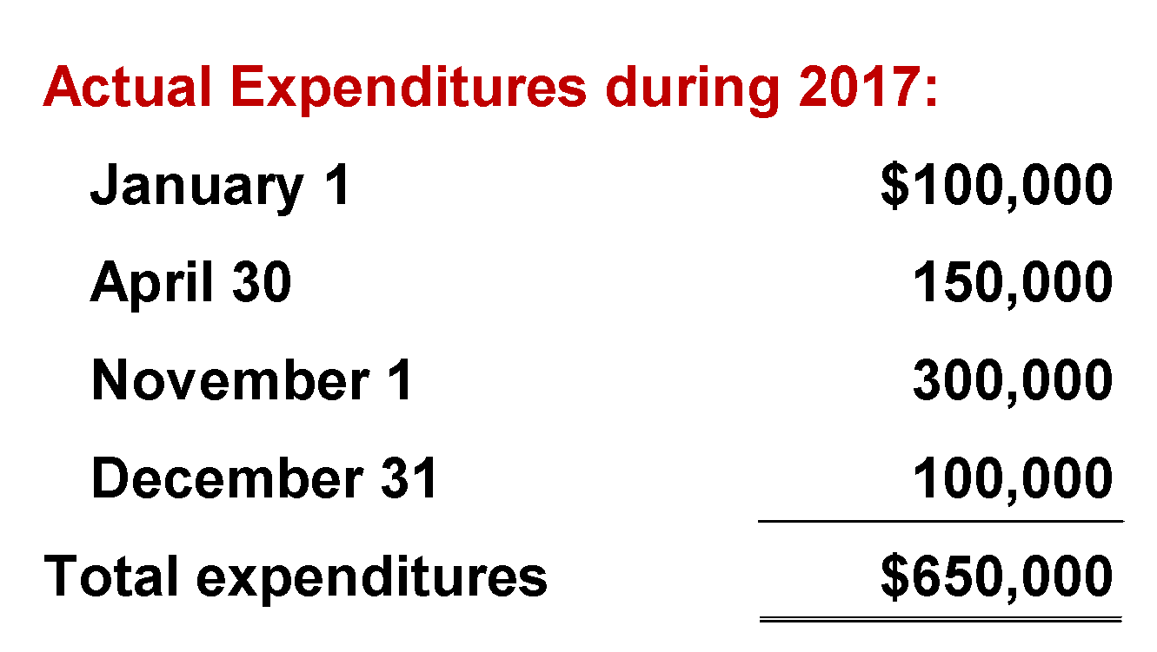
Interest Costs During Construction
Interest Capitalization Illustration: Assume a company borrowed $200,000 at 12% interest from State Bank on Jan. 1, 2017, for specific purposes of constructing special-purpose equipment to be used in its operations. Construction on the equipment began on Jan. 1, 2017, and the following expenditures were made prior to the project’s completion on Dec. 31, 2017:
Other general debt existing on Jan. 1, 2017:
$500,000, 14%, 10-year bonds payable
$300,000, 10%, 5-year note payable
LO 3

Slide 21
Interest Costs During Construction
Step 1 - Determine which assets qualify for capitalization of interest.
  Special purpose equipment qualifies because it requires a period of time to get ready and it will be used in the company’s operations.
Step 2 - Determine the capitalization period.
  The capitalization period is from Jan. 1, 2017 through Dec. 31, 2017, because expenditures are being made and interest costs are being incurred during this period while construction is taking place.
LO 3

Slide 22
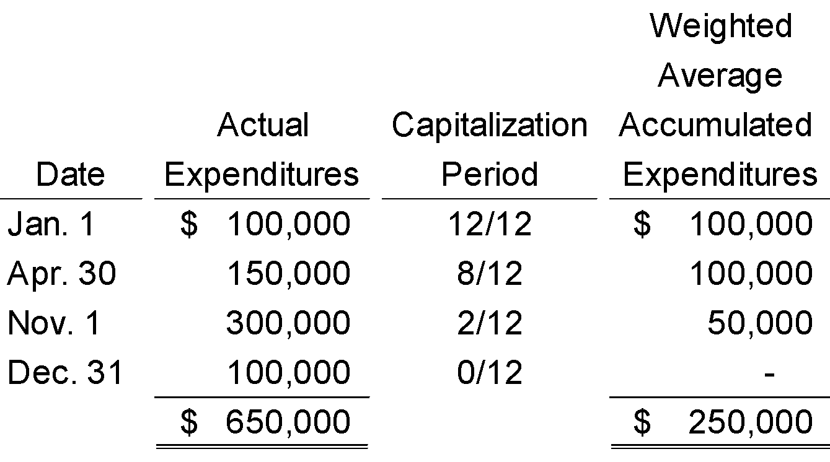
Interest Costs During Construction
Step 3 - Compute weighted-average accumulated expenditures.
A company weights the construction expenditures by the amount of time (fraction of a year or accounting period) that it can incur interest cost on the expenditure.
LO 3

Slide 23
Interest Costs During Construction
Step 4 - Compute the Actual and Avoidable Interest.
Selecting Appropriate Interest Rate:
For the portion of weighted-average accumulated expenditures that is less than or equal to any amounts borrowed specifically to finance construction of the assets, use the interest rate incurred on the specific borrowings.
For the portion of weighted-average accumulated expenditures that is greater than any debt incurred specifically to finance construction of the assets, use a weighted average of interest rates incurred on all other outstanding debt during the period.
LO 3

Slide 24
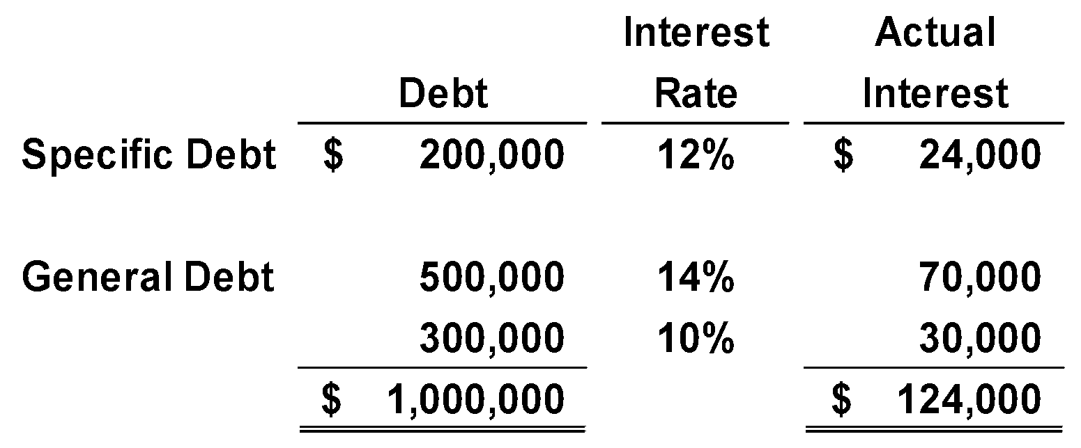
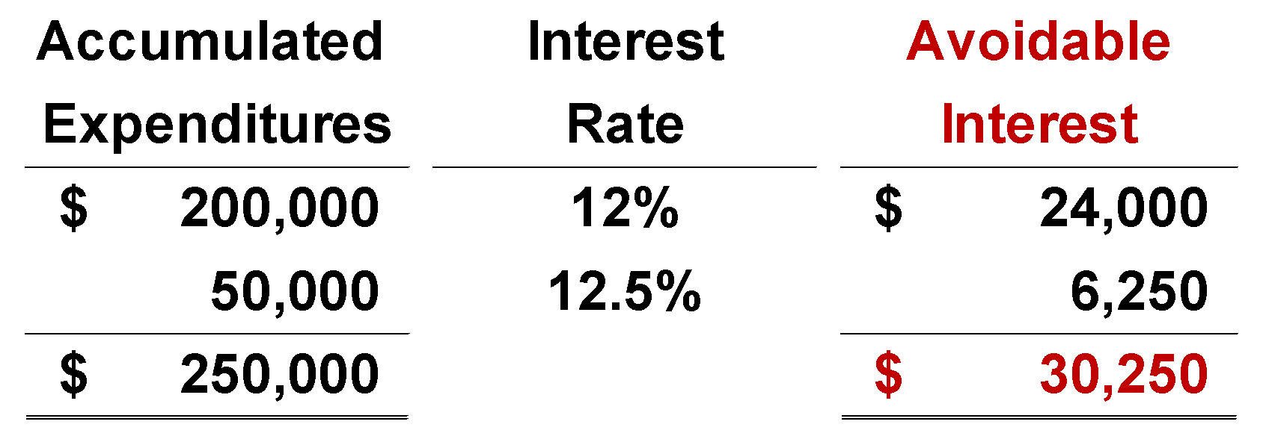
Interest Costs During Construction
Step 4 - Compute the Actual and Avoidable Interest.
Actual Interest
Weighted-average interest rate on general debt
$100,000 $800,000
= 12.5%
Avoidable Interest
Amount by which the weighted-average accumulated expenditures exceeds the construction loan.
LO 3

Slide 25
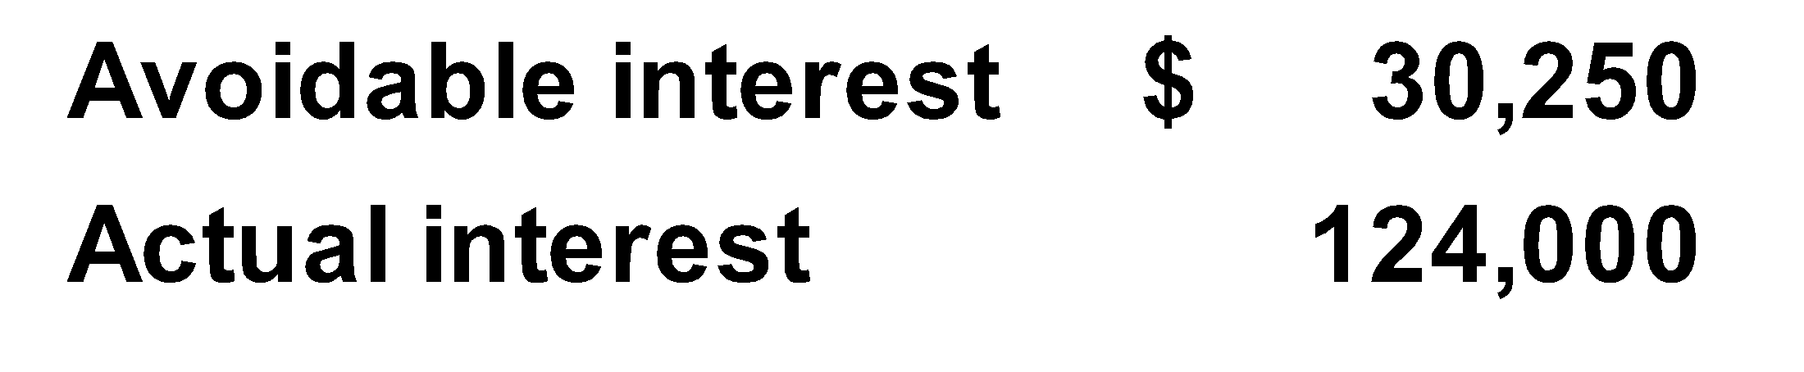
Interest Costs During Construction
Step 5 – Capitalize the lesser of Avoidable interest or Actual interest.
Journal entry to Capitalize Interest:
Equipment 30,250
Interest Expense 30,250
LO 3

Slide 26
Interest Costs During Construction
Comprehensive Illustration: On November 1, 2016, Shalla Company contracted Pfeifer Construction Co. to construct a building for $1,400,000 on land costing $100,000 (purchased from the contractor and included in the first payment). Shalla made the following payments to the construction company during 2017.
LO 3

Slide 27
Interest Costs During Construction
Pfeifer Construction completed the building, ready for occupancy, on December 31, 2017. Shalla had the following debt outstanding at December 31, 2017.
Specific Construction Debt
1. 15%, 3-year note to finance purchase of land and construction of the building, dated December 31, 2016, with interest payable annually on December 31
Other Debt
2. 10%, 5-year note payable, dated December 31, 2013, with interest payable annually on December 31
3. 12%, 10-year bonds issued December 31, 2012, with interest payable annually on December 31
$750,000
$550,000
$600,000
Compute weighted-average accumulated expenditures for 2017.
LO 3

Slide 28
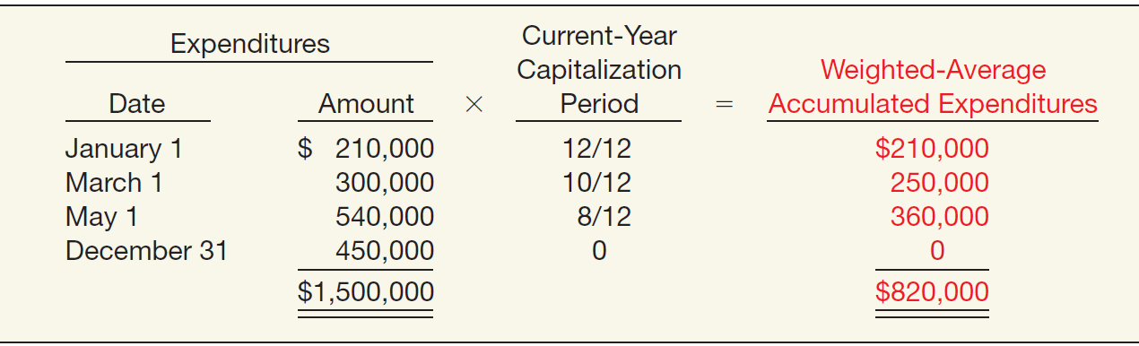

Interest Costs During Construction
Compute weighted-average accumulated expenditures for 2017.
ILLUSTRATION 10-4 Computation of Weighted-Average Accumulated Expenditures
LO 3

Slide 29
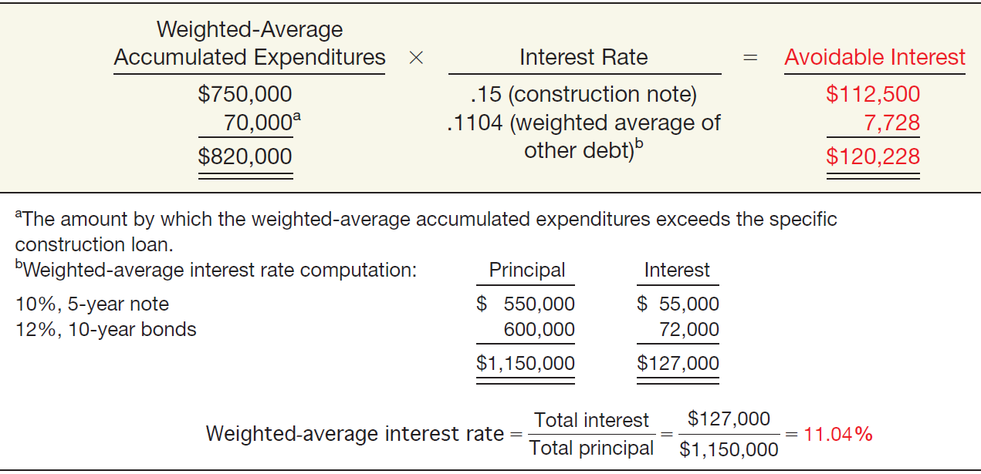
Interest Costs During Construction
Compute the avoidable interest.
ILLUSTRATION 10-5
Computation of Avoidable Interest
LO 3

Slide 30
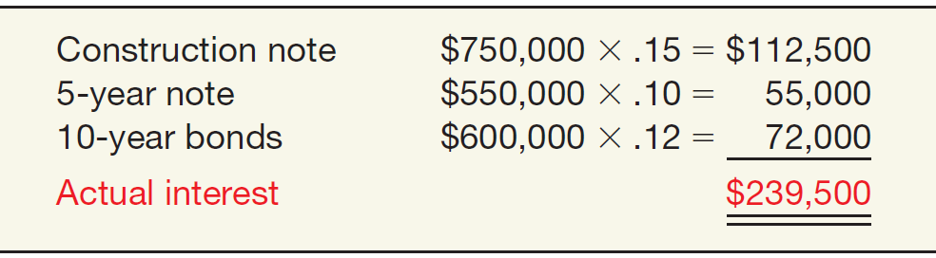
Interest Costs During Construction
Compute the actual interest cost, which represents the maximum amount of interest that it may capitalize during 2017.
ILLUSTRATION 10-6
Computation of Actual Interest Cost
The interest cost that Shalla capitalizes is the lesser of $120,228 (avoidable interest) and $239,500 (actual interest), or $120,228.
LO 3

Slide 31
Interest Costs During Construction
Shalla records the following journal entries during 2017:
January 1 Land 100,000
Buildings (or CIP) 110,000
Cash 210,000
March 1 Buildings 300,000
Cash 300,000
May 1 Buildings 540,000
Cash 540,000
December 31 Buildings 450,000
Cash 450,000
Buildings (Capitalized Interest) 120,228
Interest Expense 119,272
Cash 239,500
LO 3

Slide 32
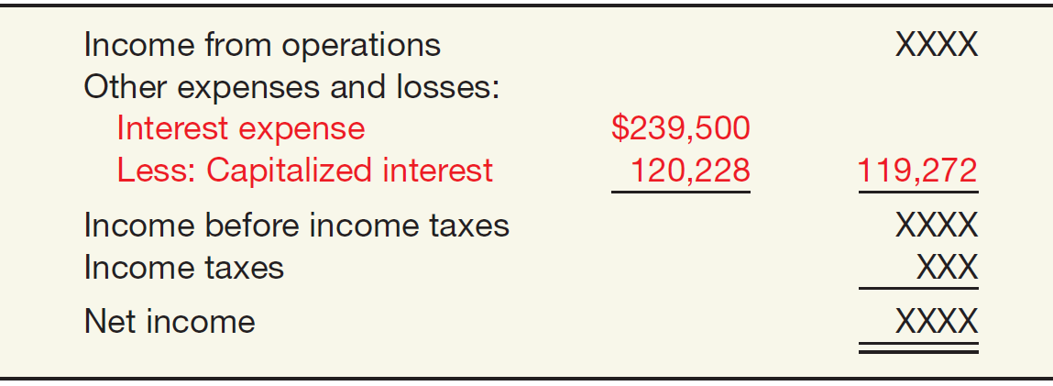
Interest Costs During Construction
At December 31, 2017, Shalla discloses the amount of interest capitalized either as part of the income statement or in the notes accompanying the financial statements.
ILLUSTRATION 10-7
Capitalized Interest Reported in the Income Statement
Note 1: Accounting Policies. Capitalized Interest. During 2017, total interest cost was $239,500, of which $120,228 was capitalized and $119,272 was charged to expense.
ILLUSTRATION 10-8
Capitalized Interest Disclosed in a Note
LO 3

Slide 33
WHAT DO THE NUMBERS MEAN? WHAT’S IN YOUR INTEREST?
WHAT’S YOUR PRINCIPLE
WHAT ‘S I YOUR INTEREST?
The requirement to capitalize interest can significantly impact financial statements. For example, when earnings of building manufacturer Jim Walter’s Corporation dropped from $1.51 to $1.17 per share, the company offset 11 cents per share of the decline by capitalizing the interest on coal mining projects and several plants under construction.
How do statement users determine the impact of interest capitalization on a company’s bottom line? They examine the notes to the financial statements. Companies with material interest capitalization must disclose the amounts of capitalized interest relative to total interest costs. For example,
Anadarko Petroleum Corporation capitalized nearly 30 percent of its total interest costs in a recent year and provided the following footnote related to capitalized interest.
Financial Footnotes
Total interest costs incurred during the year were $82,415,000. Of this amount, the Company capitalized $24,716,000. Capitalized interest is included as part of the cost of oil and gas properties. The capitalization rates are based on the Company’s weighted-average cost of borrowings used to finance the expenditures.
LO 3

Slide 34
Interest Costs During Construction
Special Issues Related to Interest Capitalization
Expenditures for Land
  If the company purchases land as a site for a structure, interest costs capitalized during the period of construction are part of the cost of the plant, not the land.
  Conversely, if the company develops land for lot sales, it includes any capitalized interest cost as part of the acquisition cost of the developed land.
Interest Revenue
  In general, companies should not net or offset interest revenue against interest cost.
LO 3

Slide 35
LEARNING OBJECTIVES
10
Acquisition and Disposition of Property, Plant, and Equipment
After studying this chapter, you should be able to:
Understand property, plant, and equipment and its related costs.
Describe the accounting problems associated with self-constructed assets.
Describe the accounting problems associated with interest capitalization.
Understand accounting issues related to acquiring and valuing plant assets.
Describe the accounting treatment for costs subsequent to acquisition.
Describe the accounting treatment for the disposal of property, plant, and equipment.
LO 4

Slide 36
VALUATION OF PROPERTY, PLANT, AND EQUIPMENT
Companies should record property, plant, and equipment:
  at the fair value of what they give up or
  at the fair value of the asset received,
whichever is more clearly evident.
LO 4

Slide 37
VALUATION OF PP&E
Cash Discounts — Discount for prompt payment.
Deferred-Payment Contracts — Assets purchased on long-term credit contracts at the present value of the consideration exchanged.
Lump-Sum Purchases — Allocate the total cost among the various assets on the basis of their relative fair market values.
Issuance of Stock — The market price of the stock issued is a fair indication of the cost of the property acquired.
LO 4

Slide 38
VALUATION OF PP&E
Exchanges of Nonmonetary Assets
Ordinarily accounted for on the basis of:
  the fair value of the asset given up or
  the fair value of the asset received,
whichever is clearly more evident.
Companies should recognize immediately any gains or losses on the exchange when the transaction has commercial substance.
LO 4

Slide 39
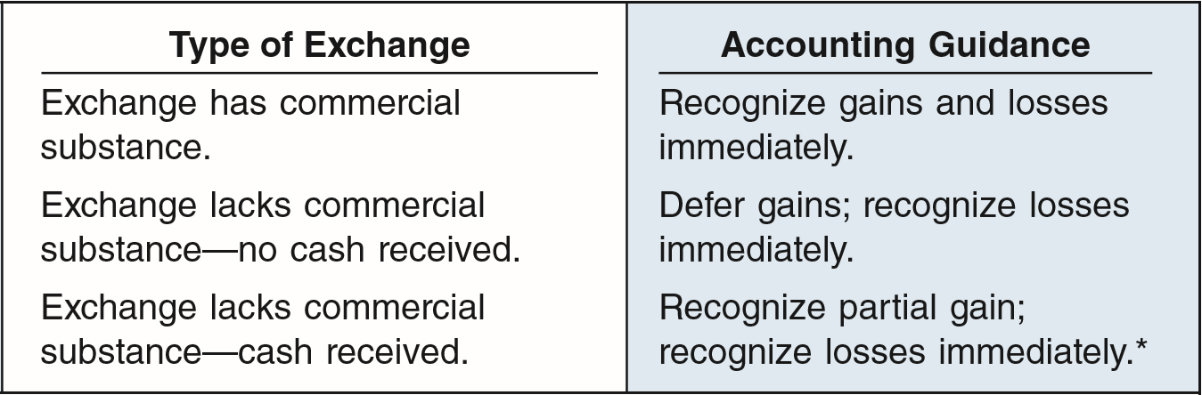
VALUATION OF PP&E
Meaning of Commercial Substance
Exchange has commercial substance if the future cash flows change as a result of the transaction. That is, if the two parties’ economic positions change, the transaction has commercial substance.
* If cash is 25% or more of the fair value of the exchange, recognize entire gain because earnings process is complete.
ILLUSTRATION 10-10
Accounting for Exchanges
LO 4

Slide 40
VALUATION OF PP&E
Exchanges—Loss Situation
Companies recognize a loss immediately whether the exchange has commercial substance or not.
Rationale: Companies should not value assets at more than their cash equivalent price; if the loss were deferred, assets would be overstated.
LO 4

Slide 41
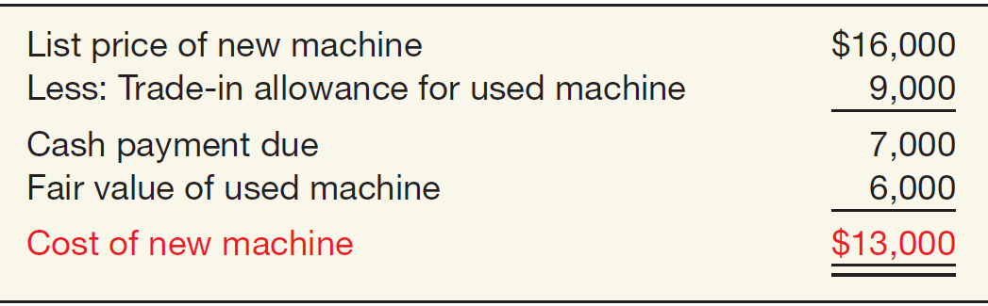
VALUATION OF PP&E
Illustration: Information Processing, Inc. trades its used machine for a new model at Jerrod Business Solutions Inc. The exchange has commercial substance. The used machine has a book value of $8,000 (original cost $12,000 less $4,000 accumulated depreciation) and a fair value of $6,000. The new model lists for $16,000. Jerrod gives Information Processing a trade-in allowance of $9,000 for the used machine. Information Processing computes the cost of the new asset as follows.
ILLUSTRATION 10-11
Computation of Cost of New Machine
LO 4

Slide 42
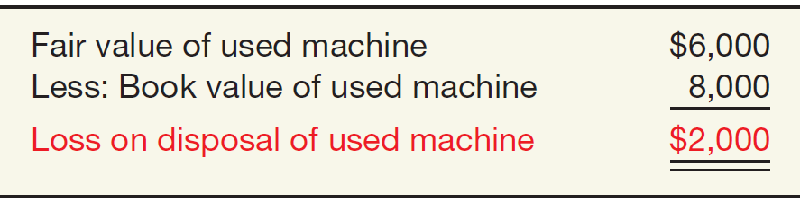
VALUATION OF PP&E
Illustration: Information Processing records this transaction as follows:
Equipment 13,000
Accumulated Depreciation—Equipment 4,000
Loss on Disposal of Equipment 2,000
Equipment 12,000
Cash 7,000
Loss on Disposal
ILLUSTRATION 10-12
Computation of Loss on Disposal of Used Machine
LO 4

Slide 43
VALUATION OF PP&E
Exchanges—Gain Situation
Has Commercial Substance. Company usually records the cost of a nonmonetary asset acquired in exchange for another nonmonetary asset at the fair value of the asset given up, and immediately recognizes a gain.
LO 4

Slide 44
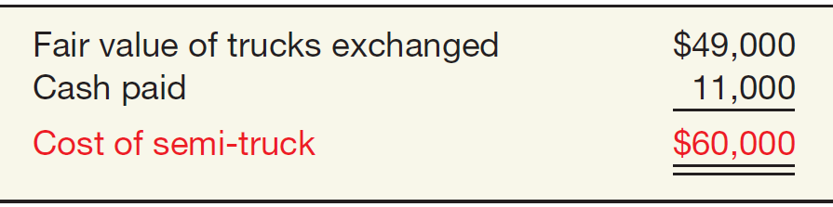
VALUATION OF PP&E
Illustration: Interstate Transportation Company exchanged a number of used trucks plus cash for a semi-truck. The used trucks have a combined book value of $42,000 (cost $64,000 less $22,000 accumulated depreciation). Interstate’s purchasing agent, experienced in the secondhand market, indicates that the used trucks have a fair market value of $49,000. In addition to the trucks, Interstate must pay $11,000 cash for the semi-truck. Interstate computes the cost of the semi-truck as follows.
ILLUSTRATION 10-13
Computation of Semi-Truck Cost
LO 4

Slide 45
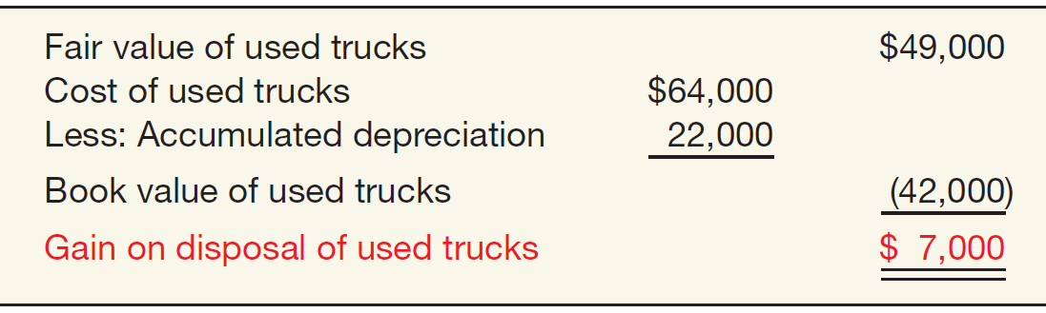
VALUATION OF PP&E
Illustration: Interstate records the exchange transaction as follows:
Truck (semi) 60,000
Accumulated Depreciation—Trucks 22,000
Trucks (used) 64,000
Gain on Disposal of Trucks 7,000
Cash 11,000
Gain on Disposal
ILLUSTRATION 10-14
Computation of Gain on Disposal of Used Trucks
LO 4

Slide 46
VALUATION OF PP&E
Exchanges—Gain Situation
Lacks Commercial Substance—No Cash Received. Now assume that Interstate Transportation Company exchange lacks commercial substance.
Interstate defers the gain of $7,000 and reduces the basis of the semi-truck.
LO 4

Slide 47
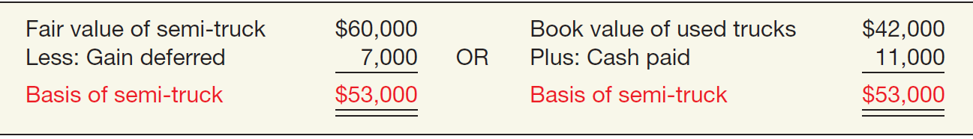
VALUATION OF PP&E
Illustration: Interstate records the exchange transaction as follows:
Trucks (semi) 53,000
Accumulated Depreciation—Trucks 22,000
Trucks (used) 64,000
Cash 11,000
ILLUSTRATION 10-15
Basis of Semi-Truck—Fair Value vs. Book Value
LO 4

Slide 48
VALUATION OF PP&E
Exchanges—Gain Situation
Lacks Commercial Substance—Some Cash Received. When a company receives cash (sometimes referred to as “boot”) in an exchange that lacks commercial substance, it may immediately recognize a portion of the gain. The general formula for gain recognition when an exchange includes some cash is as follows:
ILLUSTRATION 10-16
Formula for Gain Recognition, Some Cash Received
LO 4

Slide 49
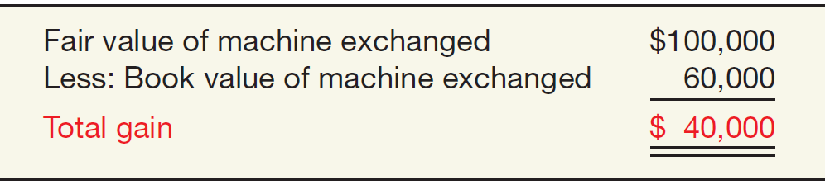
VALUATION OF PP&E
Illustration: Queenan Corporation traded in used machinery with a book value of $60,000 (cost $110,000 less accumulated depreciation $50,000) and a fair value of $100,000. It receives in exchange a machine with a fair value of $90,000 plus cash of $10,000.
ILLUSTRATION 10-17
Computation of Total Gain
LO 4

Slide 50
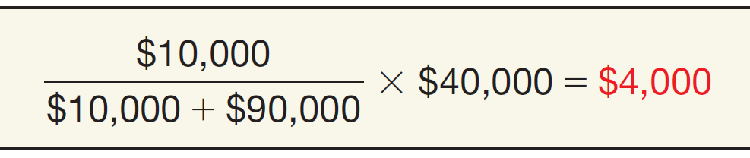

VALUATION OF PP&E
The portion of the gain a company recognizes is the ratio of monetary assets (cash in this case) to the total consideration received.
ILLUSTRATION 10-18
Computation of Gain Based on Ratio of Cash Received to Total Consideration Received
LO 4

Slide 51
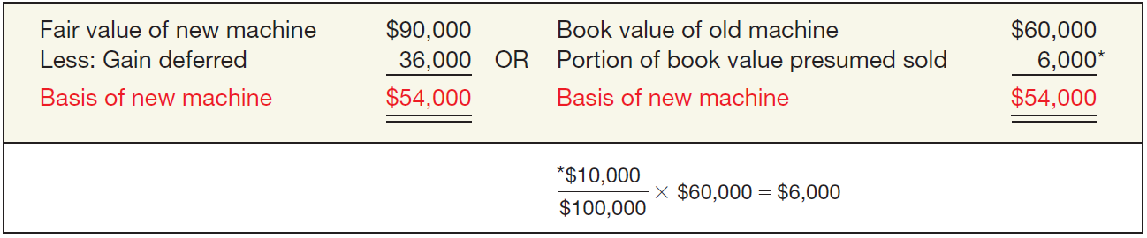
VALUATION OF PP&E
Queenan would record the following entry.
ILLUSTRATION 10-19
Computation of Basis
Cash 10,000
Machine (new) 54,000
Accumulated Depreciation—Machinery 50,000
Machine 110,000
Gain on Disposal of Machinery 4,000
LO 4

Slide 52
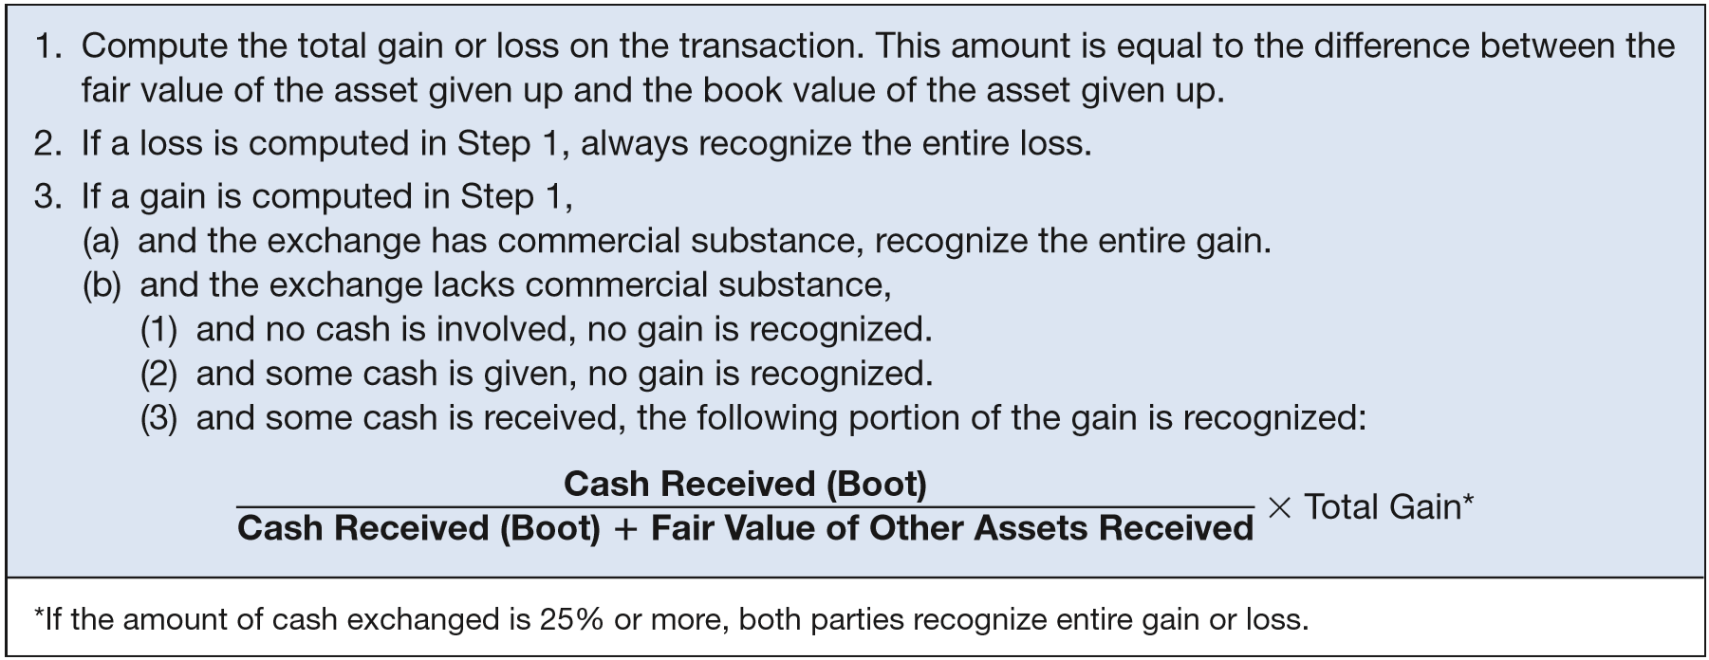
VALUATION OF PP&E
Summary of Gain and Loss Recognition on Exchanges of Non-Monetary Assets
ILLUSTRATION 10-20
LO 4

Slide 53
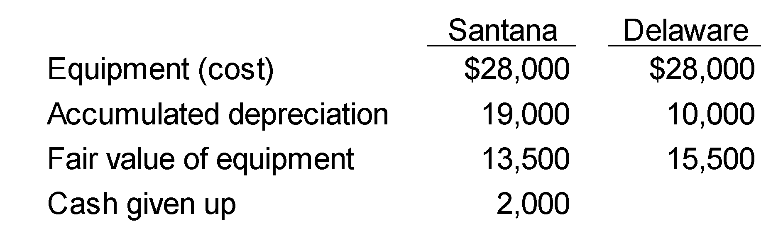
VALUATION OF PP&E
Illustration: Santana Company exchanged equipment used in its manufacturing operations plus $2,000 in cash for similar equipment used in the operations of Delaware Company. The following information pertains to the exchange.
Instructions: Prepare the journal entries to record the exchange on the books of both companies.
LO 4

Slide 54
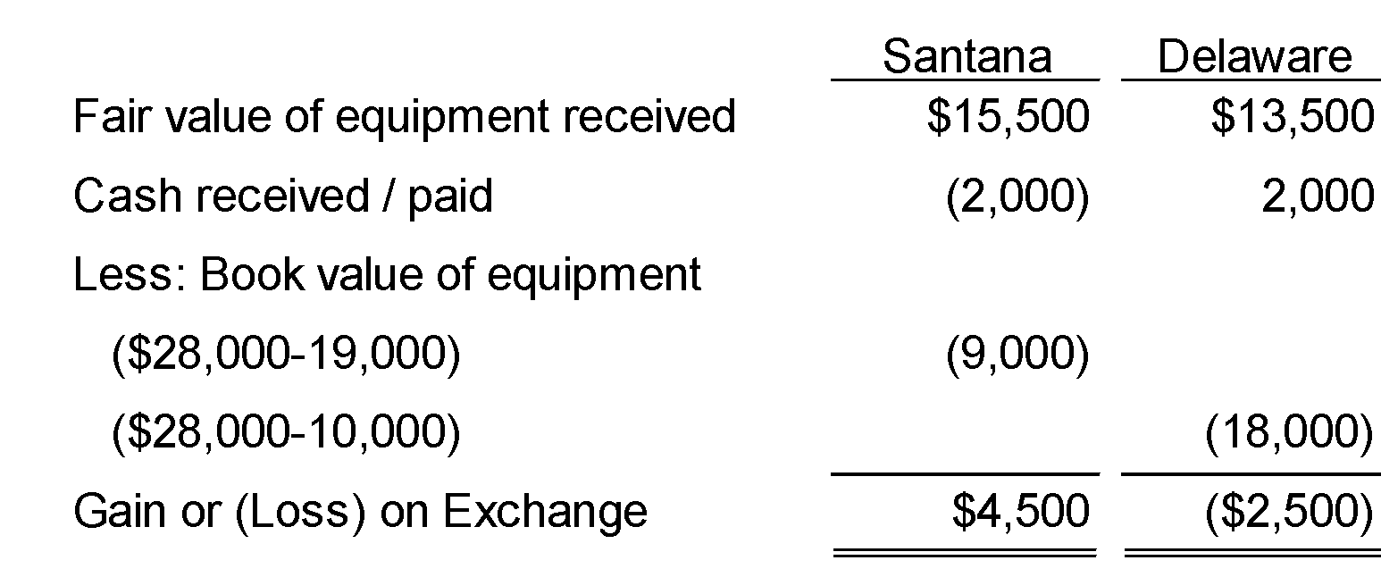
VALUATION OF PP&E
Calculation of Gain or Loss
LO 4

Slide 55
VALUATION OF PP&E
Has Commercial Substance
Santana:
Equipment 15,500
Accumulated Depreciation 19,000
Cash 2,000
Equipment 28,000
Gain on Exchange 4,500
Delaware:
Cash 2,000
Equipment 13,500
Accumulated Depreciation 10,000
Loss on Exchange 2,500
Equipment 28,000
LO 4

Slide 56
VALUATION OF PP&E
Santana (Has Commercial Substance):
Equipment 15,500
Accumulated Depreciation 19,000
Cash 2,000
Equipment 28,000
Gain on Disposal of Equipment 4,500
Santana (LACKS Commercial Substance):
Equipment (15,500 – 4,500) 11,000
Accumulated Depreciation 19,000
Cash 2,000
Equipment 28,000
LO 4

Slide 57
VALUATION OF PP&E
Delaware (Has Commercial Substance):
Cash 2,000
Equipment 13,500
Accumulated Depreciation 10,000
Loss on Disposal of Equipment 2,500
Equipment 28,000
Delaware (LACKS Commercial Substance):
Cash 2,000
Equipment 13,500
Accumulated Depreciation 10,000
Loss on Disposal of Equipment 2,500
Equipment 28,000
LO 4

Slide 58
WHAT DO THE NUMBERS MEAN? ABOUT THOSE SWAPS
WHAT’S YOUR PRINCIPLE
WHAT’S YOUR PRINCIPLE
WHAT ‘S I YOUR INTEREST?
In a press release, Roy Olofson, former vice president of finance for Global Crossing, accused company executives of improperly describing the company’s revenue to the public. He said the company had improperly recorded long-term sales immediately rather than over the term of the contract, had improperly booked as cash transactions swaps of capacity with other carriers, and had fi red him when he blew the whistle.
The accounting for the swaps involves exchanges of similar network capacity. Companies have said they engage in such deals because swapping is quicker and less costly than building segments of their own networks, or because such pacts provide redundancies to make their own networks more reliable. In one expert’s view, an exchange of similar network capacity is the equivalent of trading a blue truck for a red truck-it shouldn’t boost a company’s revenue.
But Global Crossing and Qwest, among others, counted as revenue the money received from the other company in the swap. (In general, in transactions involving leased capacity, the companies booked the revenue over the life of the contract.) Some of these companies then treated their own purchases as capital expenditures, which were not run through the income statement. Instead, the spending led to the addition of assets on the balance sheet (and an inflated bottom line).
The SEC questioned some of these capacity exchanges, because it appeared they were a device to pad revenue. This reaction was not surprising, since revenue growth was a key factor in the valuation of companies such as Global Crossing and Qwest during the craze for tech stocks in the late 1990s and 2000.
Source: Adapted from Henny Sender, “Telecoms Draw Focus for Moves in Accounting,” Wall Street Journal (March 26, 2002), p. C7.
LO 4

Slide 59
VALUATION OF PP&E
Accounting for Contributions
Companies should use:
  the fair value of the asset to establish its value on the books and
  should recognize contributions received as revenues in the period received.
LO 4

Slide 60
VALUATION OF PP&E
Contributions
Illustration: Max Wayer Meat Packing, Inc. has recently accepted a donation of land with a fair value of $150,000 from the Memphis Industrial Development Corp. In return Max Wayer Meat Packing promises to build a packing plant in Memphis. Max Wayer’s entry is:
Land 150,000
Contribution Revenue 150,000
LO 4

Slide 61
VALUATION OF PP&E
Contributions
When a company contributes a non-monetary asset, it should record the amount of the donation as an expense at the fair value of the donated asset.
Illustration: Kline Industries donates land to the city of Los Angeles for a city park. The land cost $80,000 and has a fair value of $110,000. Kline Industries records this donation as follows.
Contribution Expense 110,000
Land 80,000
Gain on Disposal of Land 30,000
LO 4

Slide 62
LEARNING OBJECTIVES
10
Acquisition and Disposition of Property, Plant, and Equipment
After studying this chapter, you should be able to:
Understand property, plant, and equipment and its related costs.
Describe the accounting problems associated with self-constructed assets.
Describe the accounting problems associated with interest capitalization.
Understand accounting issues related to acquiring and valuing plant assets.
Describe the accounting treatment for costs subsequent to acquisition.
Describe the accounting treatment for the disposal of property, plant, and equipment.
LO 5

Slide 63
COSTS SUBSEQUENT TO ACQUISITION
In general, costs incurred to achieve greater future benefits should be capitalized, whereas expenditures that simply maintain a given level of services should be expensed.
In order to capitalize costs, one of three conditions must be present:
  useful life must be increased,
  quantity of units produced must be increased, and
  quality of units produced must be enhanced.
LO 5

Slide 64
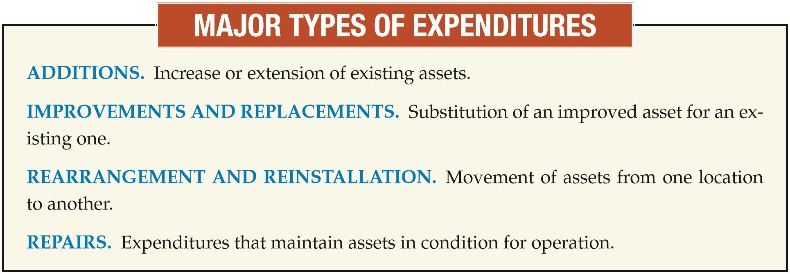
COSTS SUBSEQUENT TO ACQUISITION
LO 5

Slide 65
WHAT DO THE NUMBERS MEAN? DISCOUNNECTED
WHAT’S YOUR PRINCIPLE
WHAT’S YOUR PRINCIPLE
WHAT ‘S I YOUR INTEREST?
It all started with a check of the books by an internal auditor for WorldCom Inc. The telecom giant’s newly installed chief executive had asked for a ﬁnancial review, and the auditor was spot-checking records of capital expenditures. She found the company was using an unorthodox technique to account for one of its biggest expenses: charges paid to local telephone networks to complete long-distance calls.
Instead of recording these charges as operating expenses, WorldCom recorded a signiﬁcant portion as capital expenditures. The maneuver was worth hundreds of millions of dollars to WorldCom’s bottom line. It effectively turned a loss for all of 2001 and the ﬁrst quarter of 2002 into a proﬁt. The graph below compares WorldCom’s accounting to that under GAAP. Soon after this discovery, WorldCom ﬁled for bankruptcy.
LO 5

Slide 66
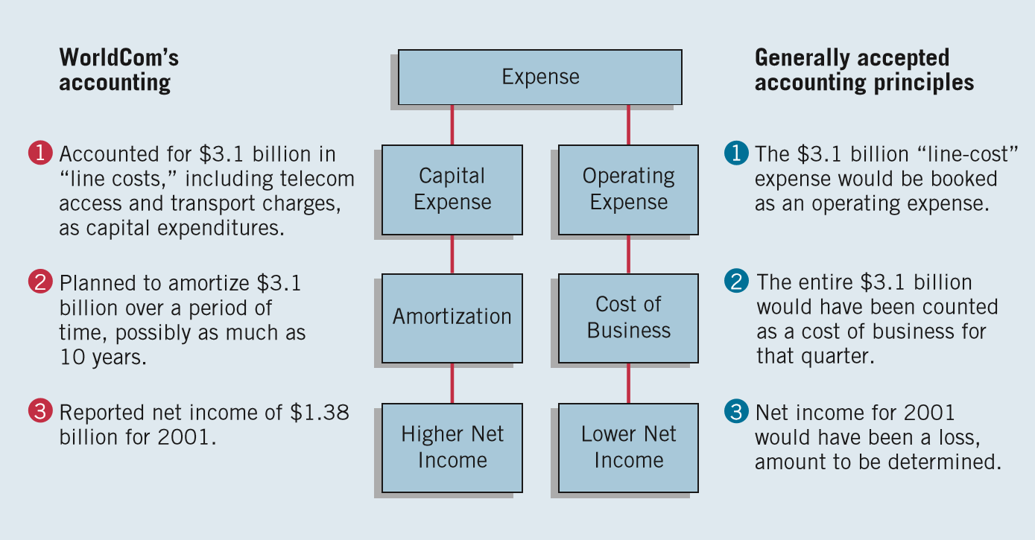
WHAT DO THE NUMBERS MEAN? DISCOUNNECTED
WHAT’S YOUR PRINCIPLE
WHAT’S YOUR PRINCIPLE
WHAT ‘S I YOUR INTEREST?
Source: Adapted from Jared Sandberg, Deborah Solomon, and Rebecca Blumenstein, “Inside WorldCom’s Unearthing of a Vast Accounting Scandal,” Wall Street Journal (June 27, 2002), p. A1.
LO 5

Slide 67
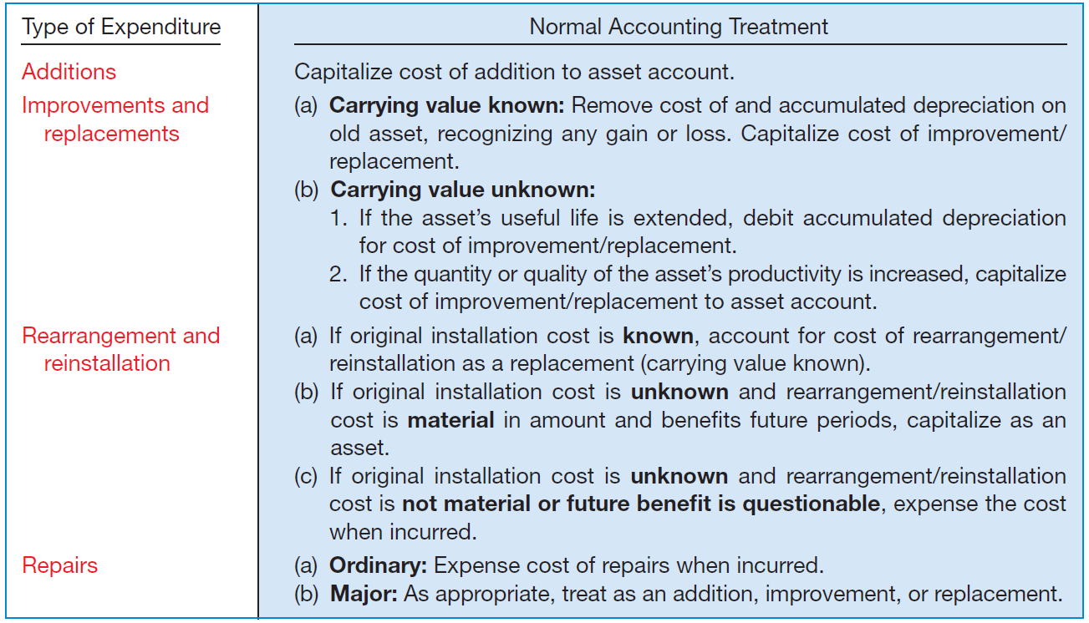
COSTS SUBSEQUENT TO ACQUISITION
Summary
ILLUSTRATION 10-21
Summary of Costs Subsequent to Acquisition of Property, Plant, and Equipment
LO 5

Slide 68
LEARNING OBJECTIVES
10
Acquisition and Disposition of Property, Plant, and Equipment
After studying this chapter, you should be able to:
Understand property, plant, and equipment and its related costs.
Describe the accounting problems associated with self-constructed assets.
Describe the accounting problems associated with interest capitalization.
Understand accounting issues related to acquiring and valuing plant assets.
Describe the accounting treatment for costs subsequent to acquisition.
Describe the accounting treatment for the disposal of property, plant, and equipment.
LO 6

Slide 69
DISPOSITION OF PP&E
A company may retire plant assets voluntarily or dispose of them by
  Sale,
  Exchange,
  Involuntary conversion, or
  Abandonment.
  Depreciation must be taken up to the date of disposition.
LO 6

Slide 70
DISPOSITION OF PP&E
Sale of Plant Assets
Illustration: Barret Company recorded depreciation on a machine costing $18,000 for 9 years at the rate of $1,200 per year. If it sells the machine in the middle of the tenth year for $7,000, Barret records depreciation to the date of sale as:
Depreciation Expense ($1,200 x 1/2) 600
Accumulated Depreciation 600
LO 6

Slide 71
DISPOSITION OF PP&E
Illustration: Barret Company recorded depreciation on a machine costing $18,000 for 9 years at the rate of $1,200 per year. If it sells the machine in the middle of the tenth year for $7,000, Barret records depreciation to the date of sale. Record the entry to record the sale of the asset:
Cash 7,000
Accumulated Depreciation 11,400
Machinery 18,000
Gain on Disposal of Machinery 400
LO 6

Slide 72
DISPOSITION OF PP&E
Involuntary Conversion
Sometimes an asset’s service is terminated through some type of involuntary conversion such as fire, flood, theft, or condemnation.
Companies report the difference between the amount recovered (e.g., from a condemnation award or insurance recovery), if any, and the asset’s book value as a gain or loss.
They treat these gains or losses like any other type of disposition.
LO 6

Slide 73
DISPOSITION OF PP&E
Illustration: Camel Transport Corp. had to sell a plant located on company property that stood directly in the path of an interstate highway. For a number of years, the state had sought to purchase the land on which the plant stood, but the company resisted. The state ultimately exercised its right of eminent domain, which the courts upheld. In settlement, Camel received $500,000, which substantially exceeded the $200,000 book value of the plant and land (cost of $400,000 less accumulated depreciation of $200,000). Camel made the following entry.
Cash 500,000
Accumulated Depreciation—Plant Assets 200,000
Plant Assets 400,000
Gain on Disposal of Plant Assets 300,000
LO 6

Slide 74
COPYRIGHT
“Copyright © 2016 John Wiley & Sons, Inc. All rights reserved. Reproduction or translation of this work beyond that permitted in Section 117 of the 1976 United States Copyright Act without the express written permission of the copyright owner is unlawful. Request for further information should be addressed to the Permissions Department, John Wiley & Sons, Inc. The purchaser may make back-up copies for his/her own use only and not for distribution or resale. The Publisher assumes no responsibility for errors, omissions, or damages, caused by the use of these programs or from the use of the information contained herein.”

