Slide 1
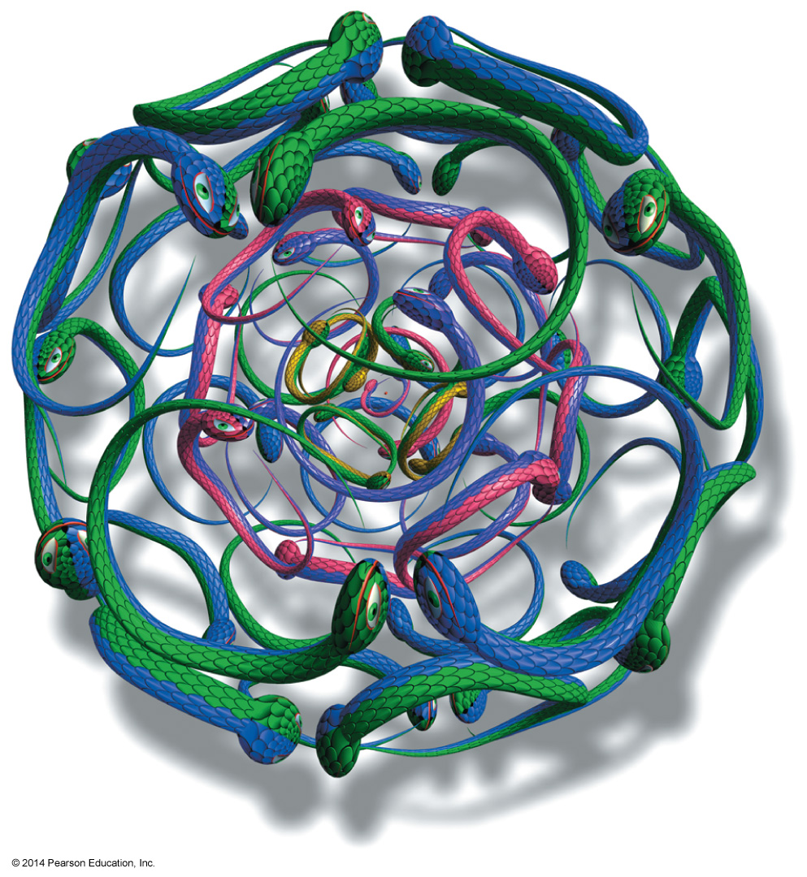
Chapter 7
Delocalized Electrons and Their Effect on Stability, pKa, and the Products of a Reaction • Aromaticity and the Reactions of Benzene
Paula Yurkanis Bruice
University of California,
Santa Barbara

Slide 2
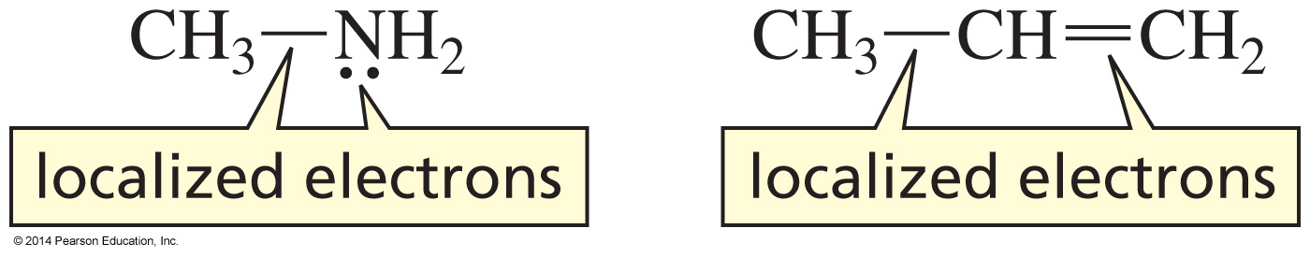
Localized Electrons

Slide 3
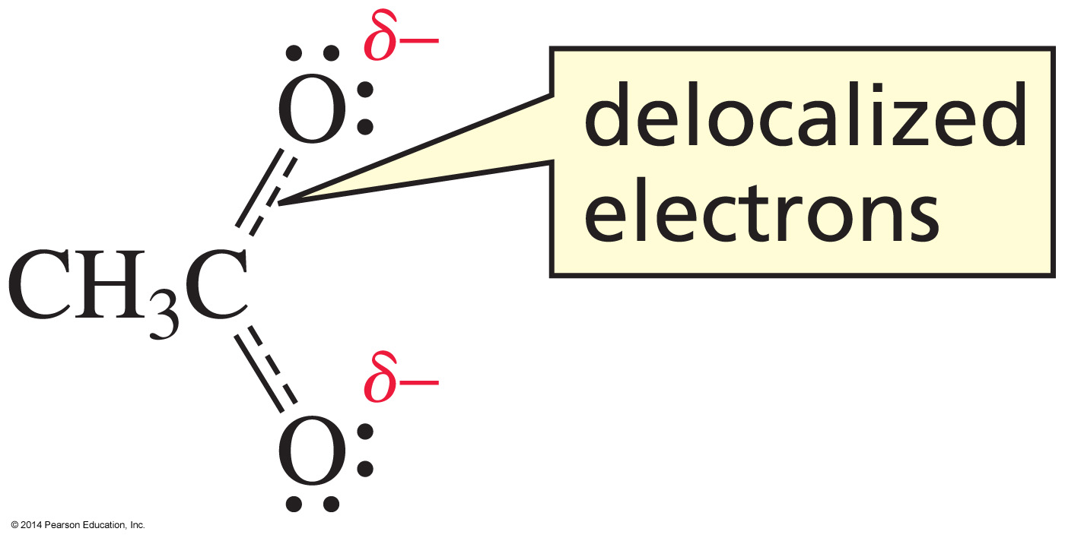
Delocalized Electrons

Slide 4
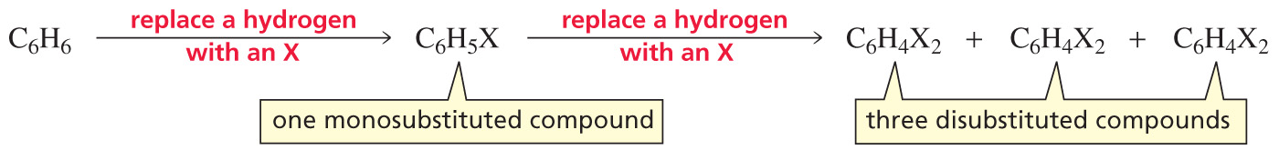
What is the structure of Benzene?

Slide 5
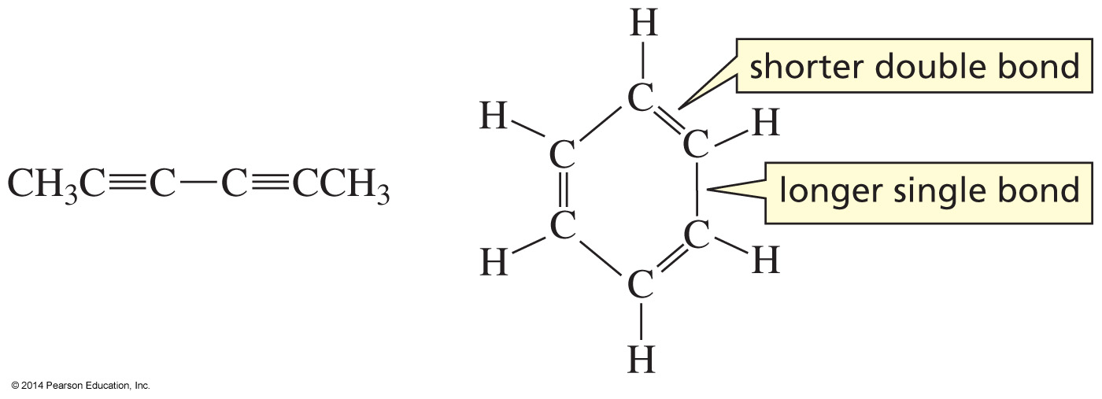
Degree of Unsaturation = 4
DoU = (2C+2+N−X−H)/ 2

Slide 6
Two Disubstituted Products

Slide 7
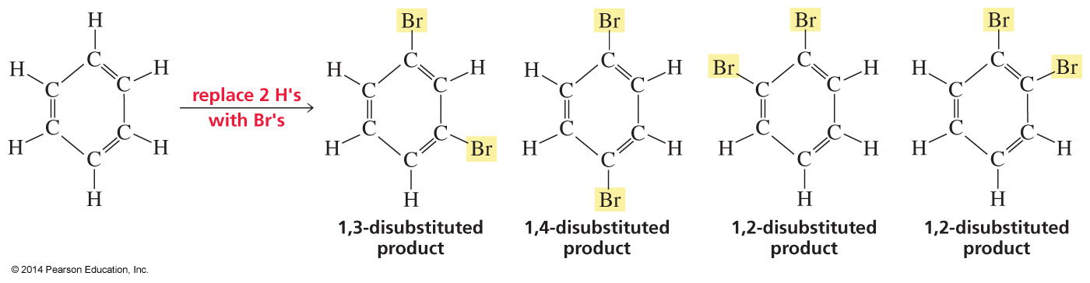
Four Disubstituted Products

Slide 8
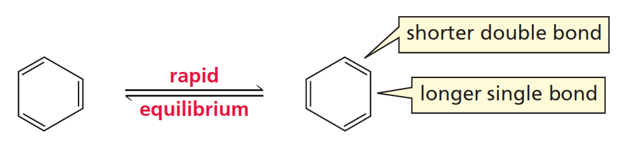
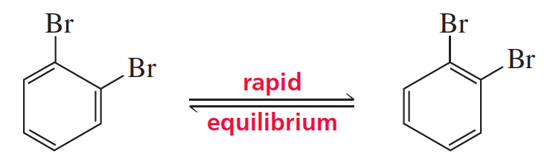
Two are in Rapid Equilibrium

Slide 9
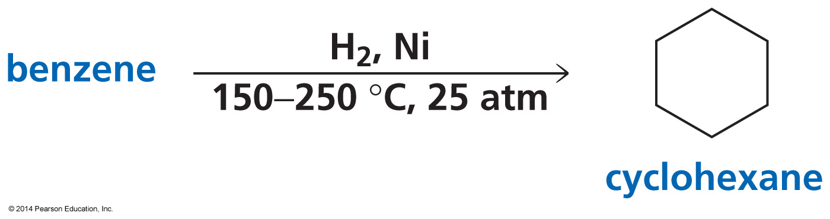
It was confirmed that Benzene is cyclic in 1901

Slide 10
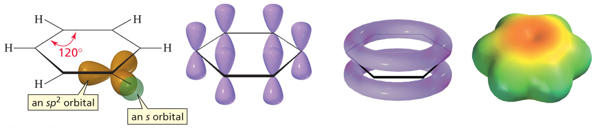
The Structure of Benzene

Slide 11
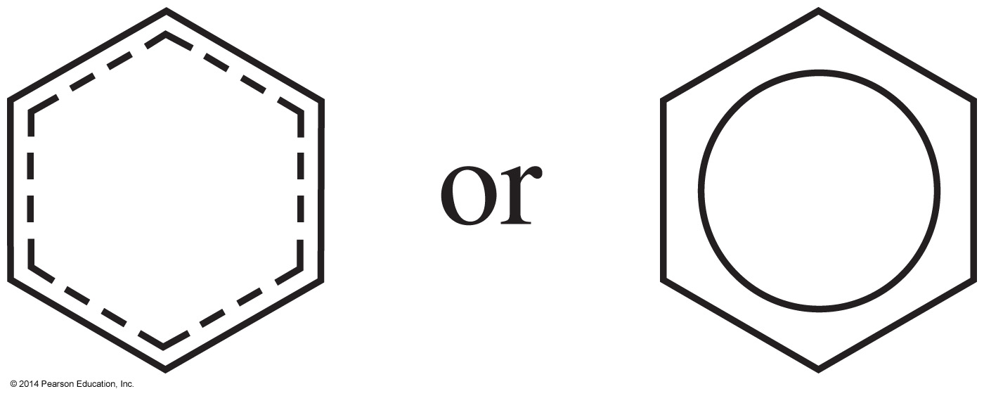
Showing Delocalized Electrons

Slide 12
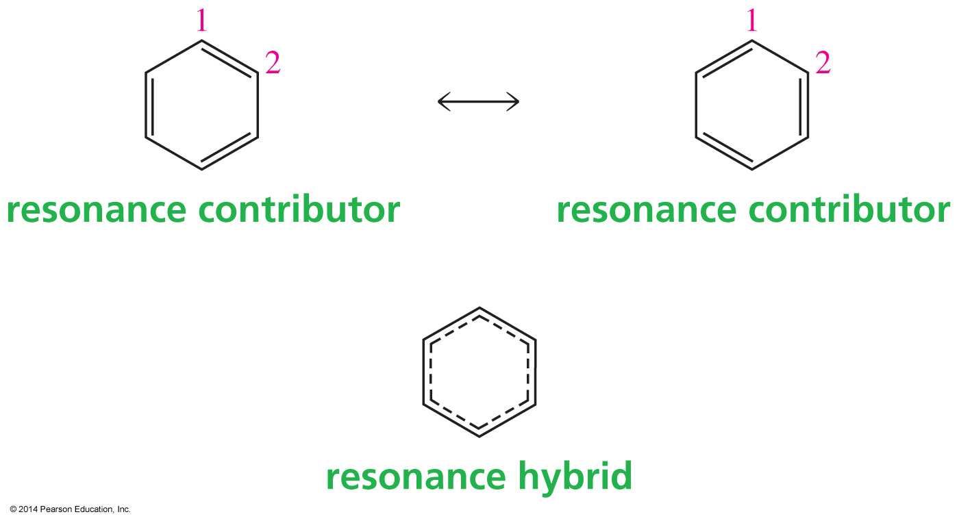
Resonance Contributors Resonance Hybrid

Slide 13
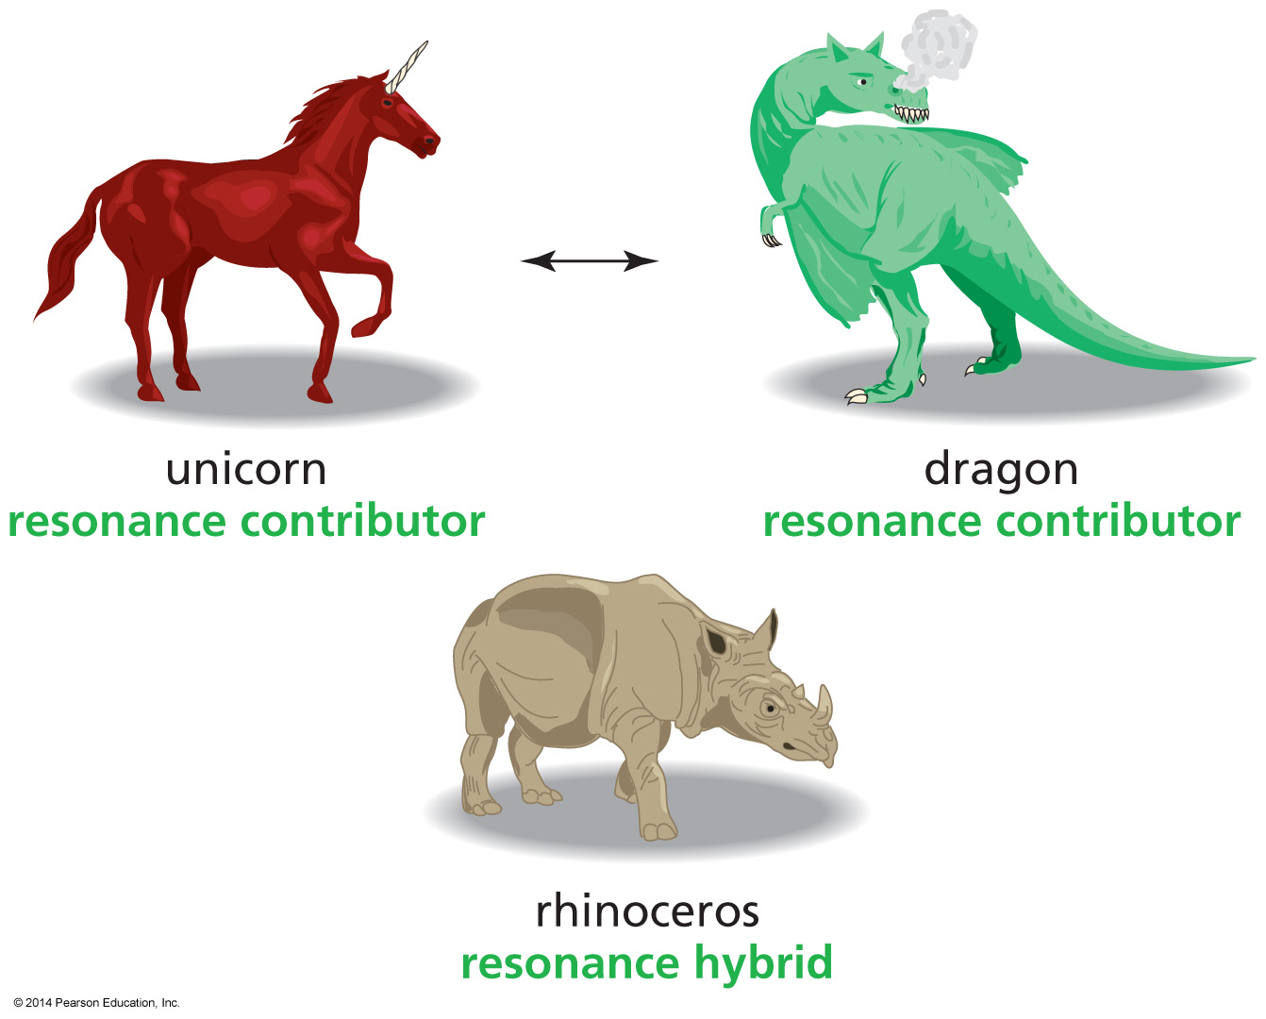
Resonance Contributors Resonance Hybrid
Imaginary

Slide 14
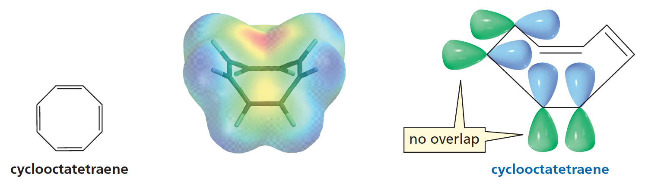
Cyclooctatriene does not have
Delocalized Electrons
Planar: bond angle 135º
Tub shape (not planar): 120º
Cyclooctatetraene is not planar.

Slide 15
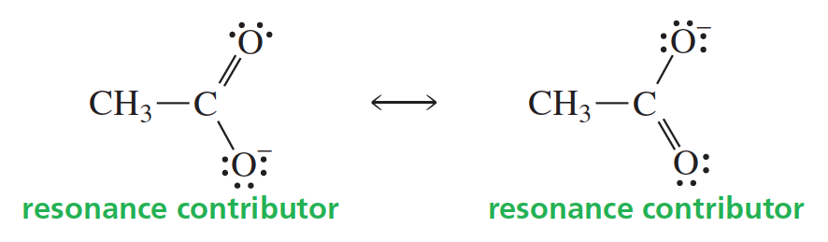
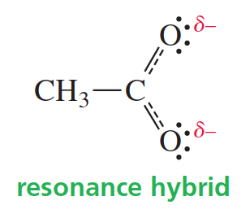
Delocalized Electrons
Delocalized electrons result from the p orbital of one atom
overlapping the p orbitals of two adjacent atoms.
Notes:
Needs high res artwork

Slide 16
Rules for Drawing
Resonance Contributors
Only electrons move.
Only π electrons and lone-pair electrons move.
3. The total number of electrons in the molecule
does not change.

Slide 17
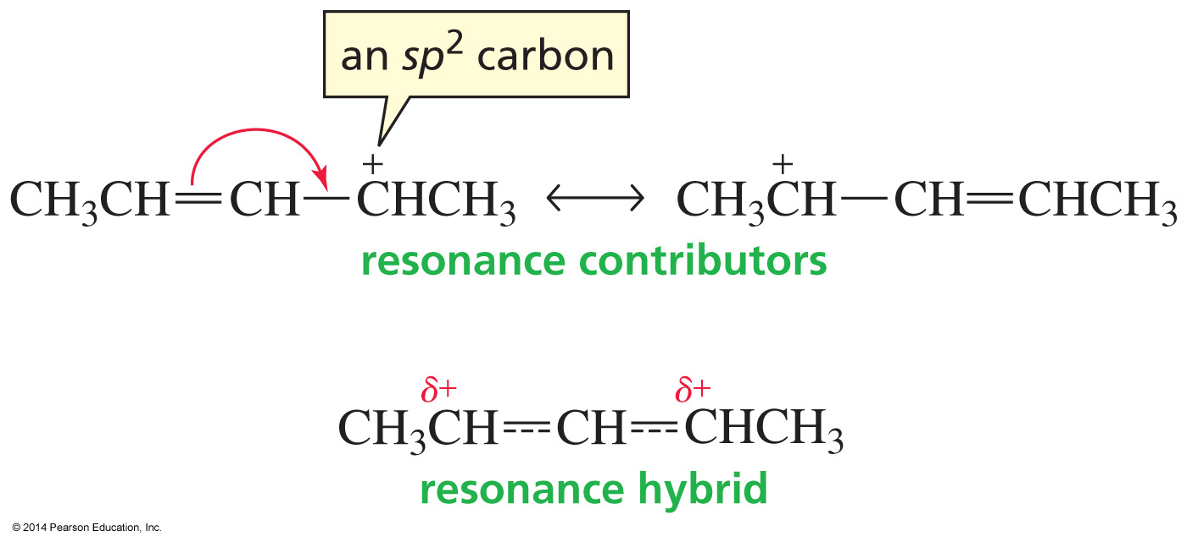
Move π Electrons to an
sp² Carbon

Slide 18
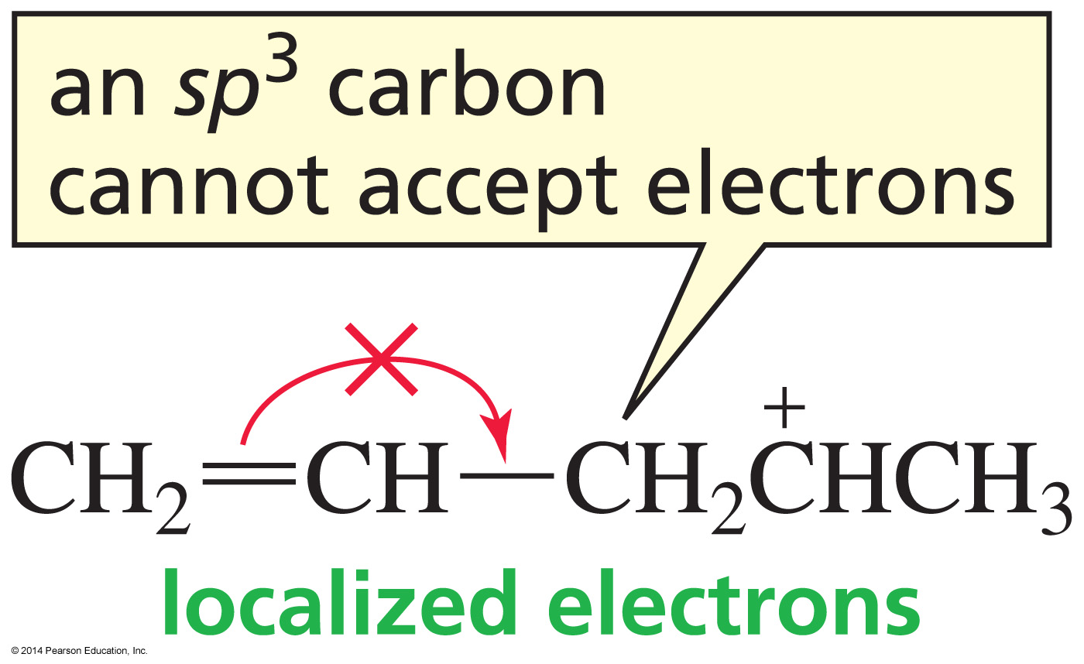
Cannot Move Electrons to an sp³ Carbon

Slide 19
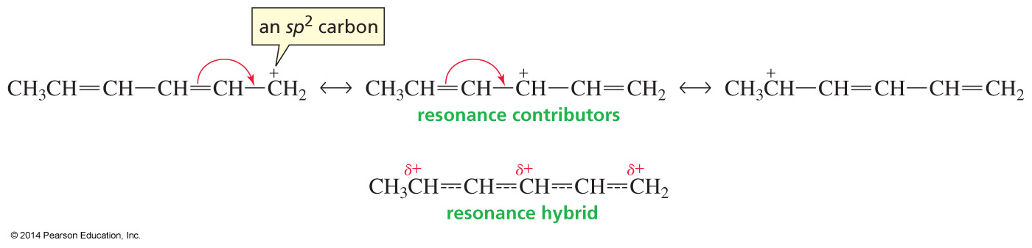
Move π Electrons to an sp² Carbon

Slide 20
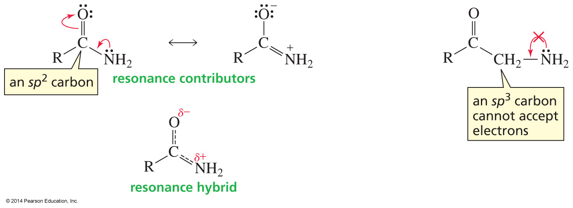
Move Lone-Pair Electrons to an sp² Carbon

Slide 21
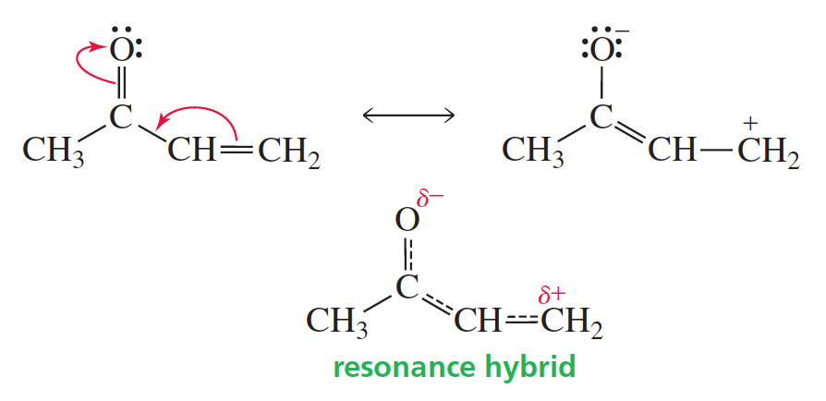
Move Lone-Pair Electrons to an sp² Carbon

Slide 22
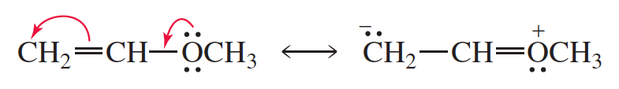
Moving Electrons away from the most Electronegative Atom

Slide 23
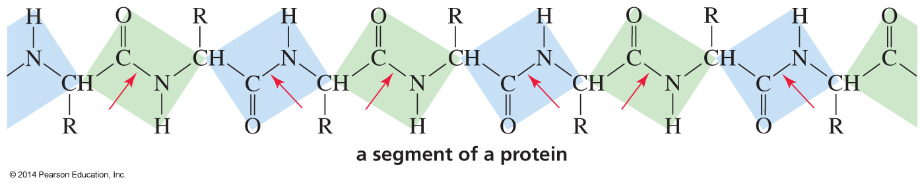
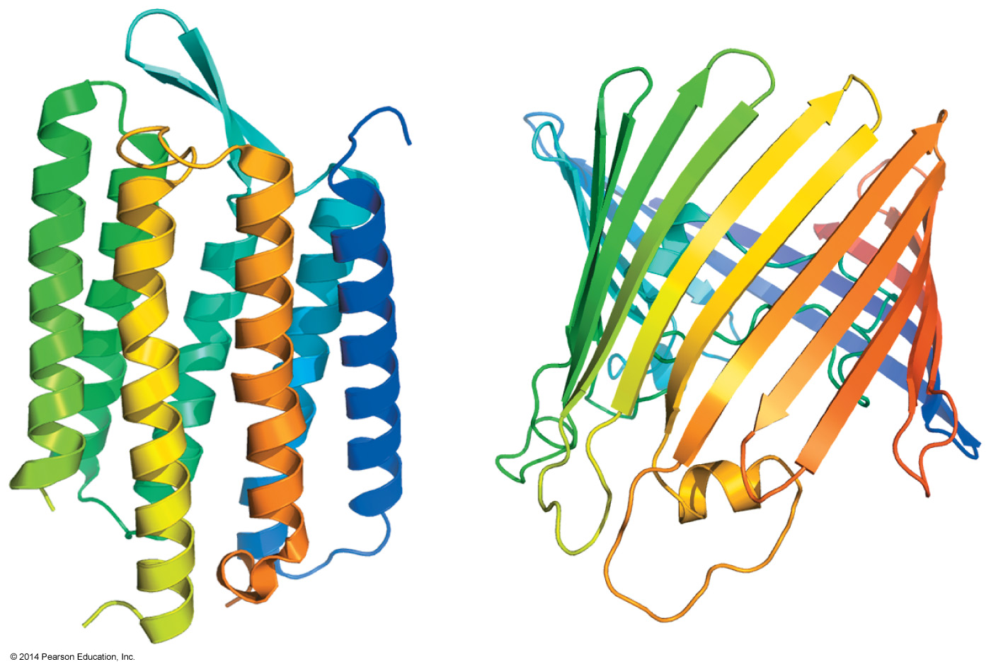
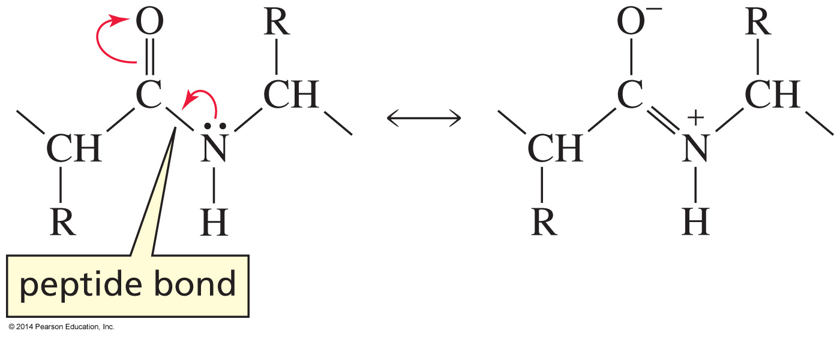
How delocalized Electrons affect
Protein Structure
red arrows point at peptide bonds

Slide 24
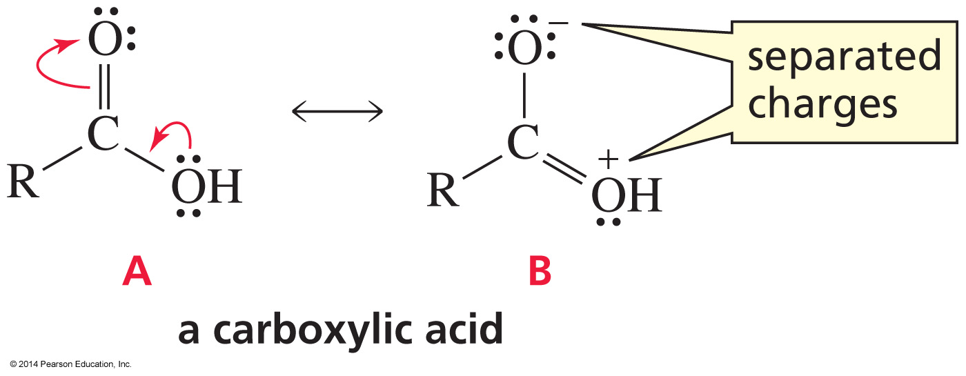
A is more Stable than B

Slide 25
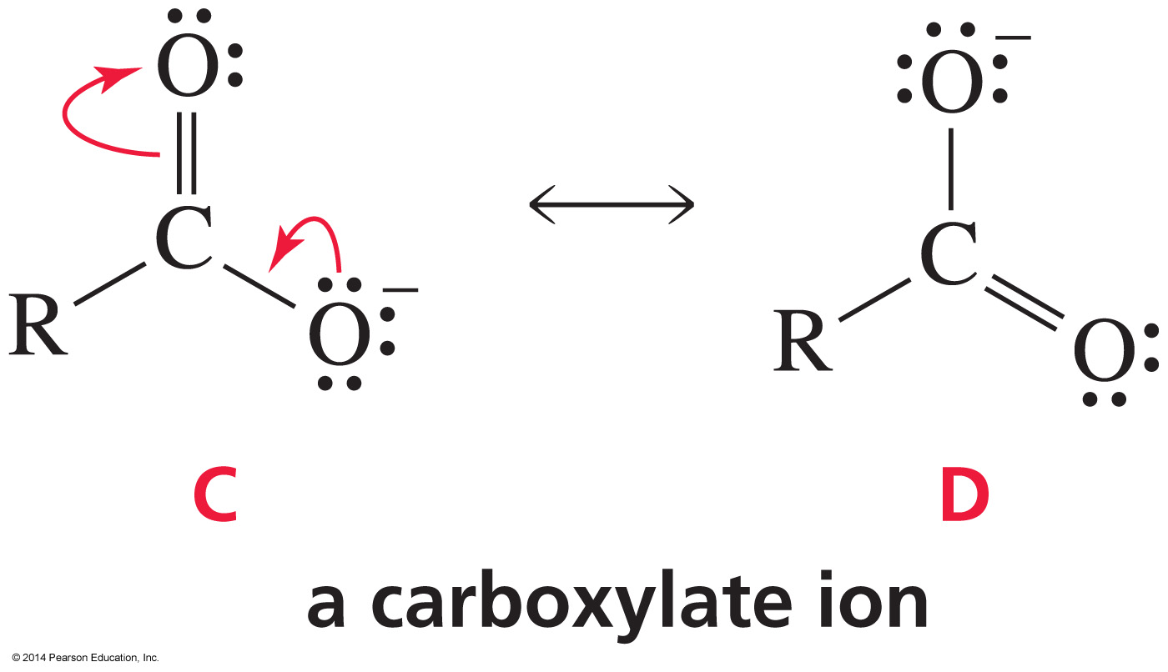
C and D are equally Stable

Slide 26
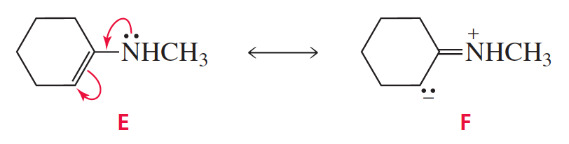
E is more Stable than F
F has separated charges, with N holding a positive charge.
Notes:
Needs high res artwork

Slide 27
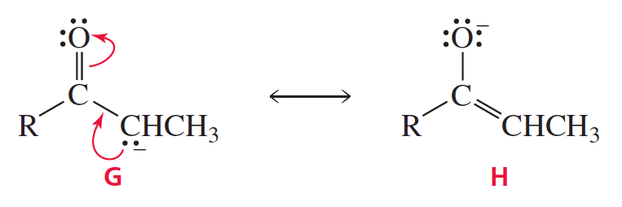
H is more Stable than G
Oxygen better accommodates the negative charge
Notes:
Needs high res artwork

Slide 28
Delocalization Energy
The delocalization energy is the extra stability a compound has as a result of having delocalized electrons.
Electron delocalization is also called resonance.
Delocalization energy is also called resonance energy.
The resonance hybrid is more stable than any of its resonance contributors is predicted to be.

Slide 29
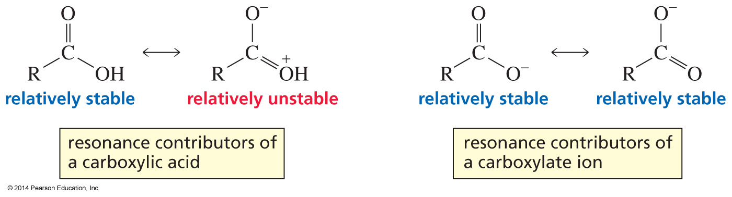
The greater the number of Relatively Stable Resonance Contributors, the greater the Delocalization Energy
The delocalization energy is greater for the carboxylate ion
than for the carboxylic acid.

Slide 30
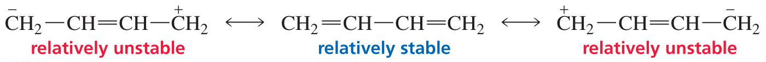
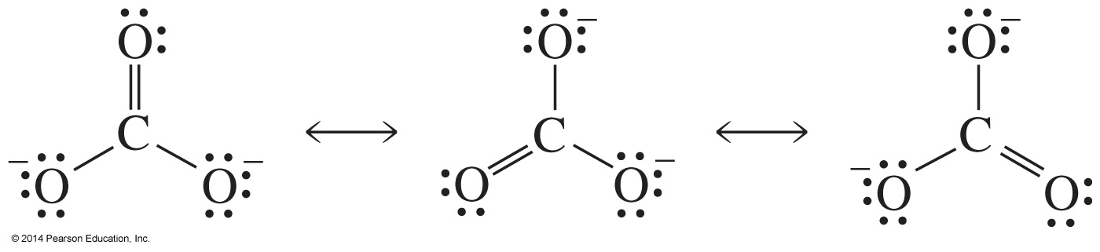
The number of Relatively Stable Resonance Contributors is what is important
Little delocalization energy
Significant delocalization energy

Slide 31
Summary
The greater the predicted stability of a resonance contributor, the more it contributes to the resonance hybrid.
The greater the number of relatively stable resonance contributors, the greater the delocalization energy.
The more nearly equivalent the resonance contributors, the greater the delocalization energy.

Slide 32
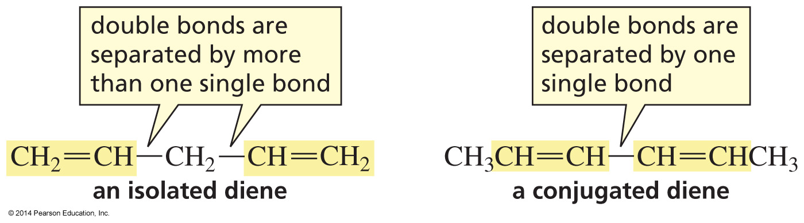
Conjugated and Isolated Dienes

Slide 33
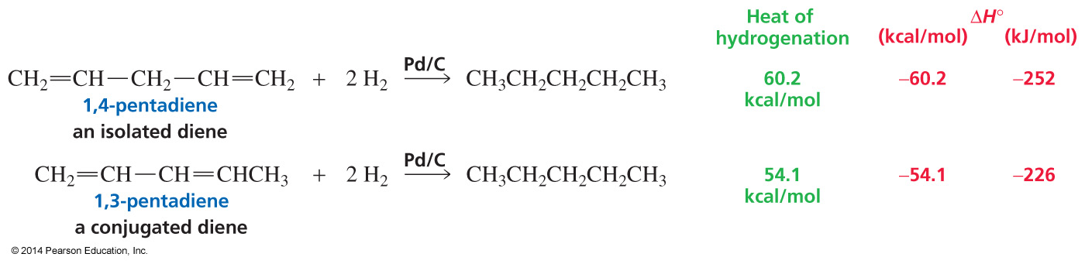
The smaller the Heat of Hydrogenation, the more stable the Compound

Slide 34
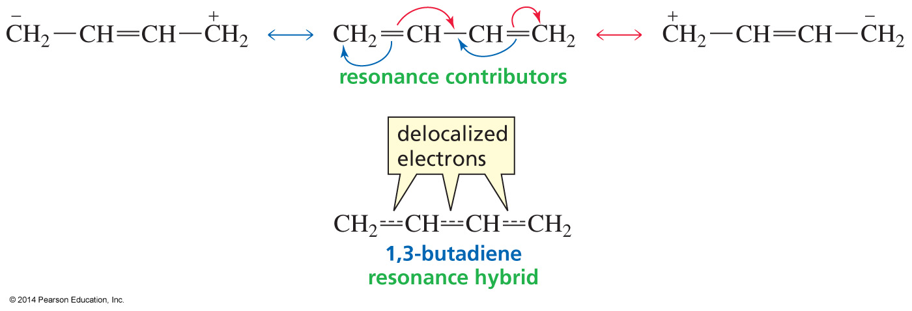
Conjugated Dienes have Delocalized Electrons

Slide 35
Allylic and Benzylic Cations

Slide 36
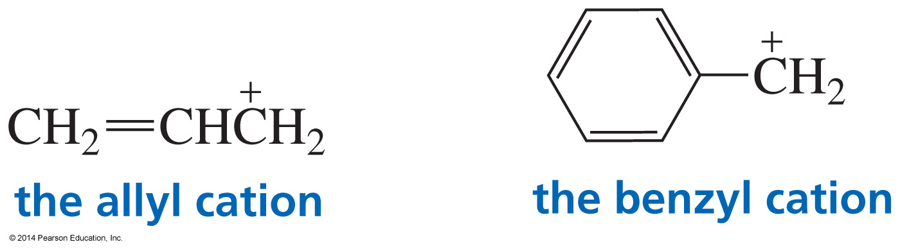
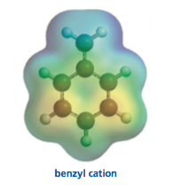
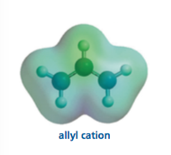
Allylic and Benzylic Cations
Electrostatic potential map

Slide 37
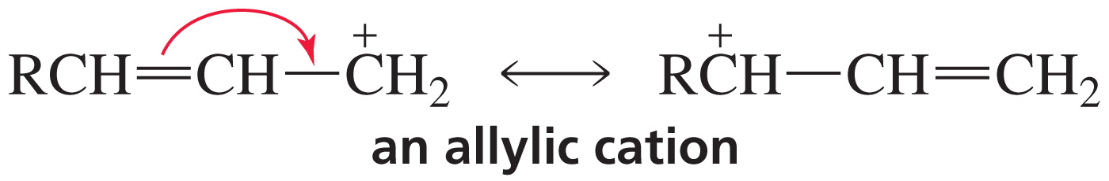
Resonance Contributors for an Allylic Cation

Slide 38
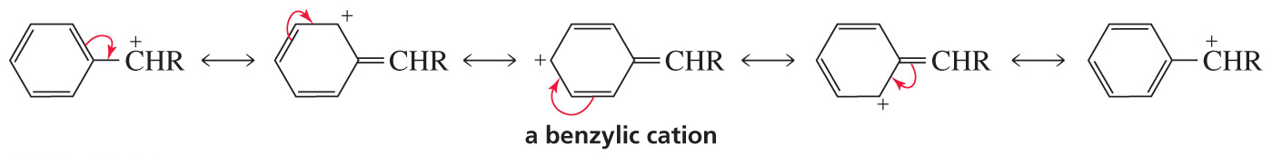
Resonance Contributors for a Benzylic Cation

Slide 39
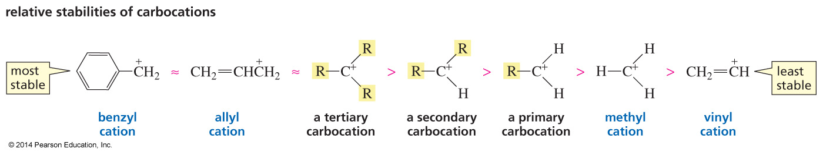
Relative Stabilities of Carbocations

Slide 40
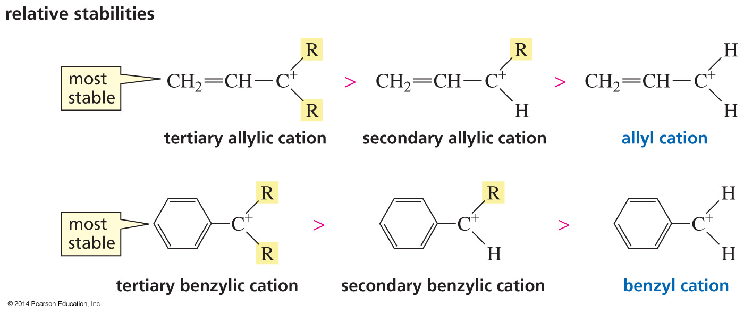
Relative Stabilities of Carbocations
Notes:
40
Define carbonyl group

Slide 41
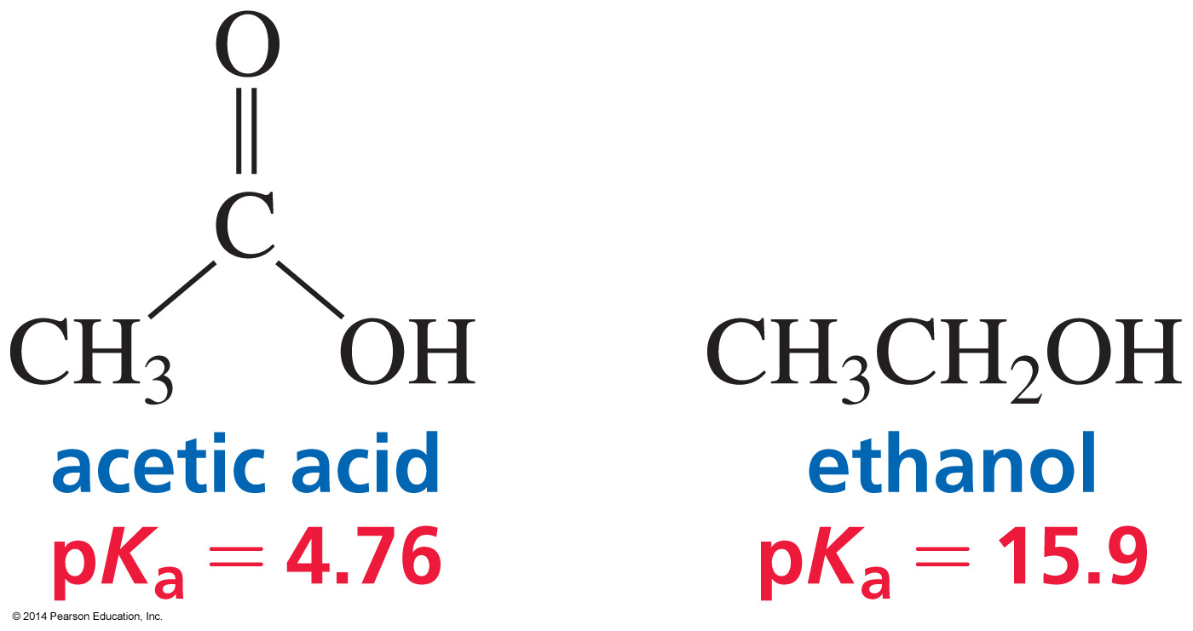
Delocalized Electrons affect pK_{a} Values

Slide 42
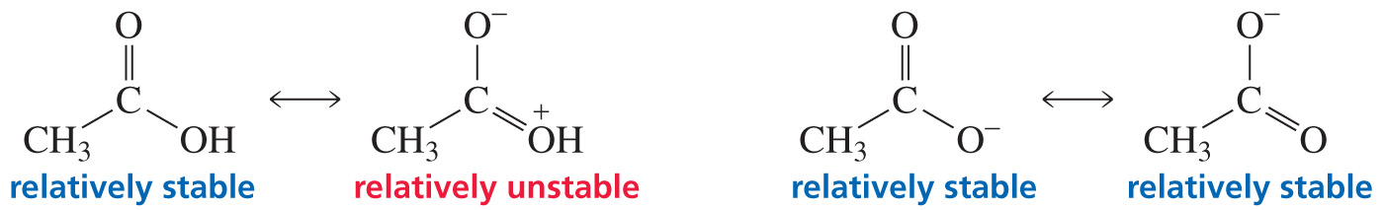
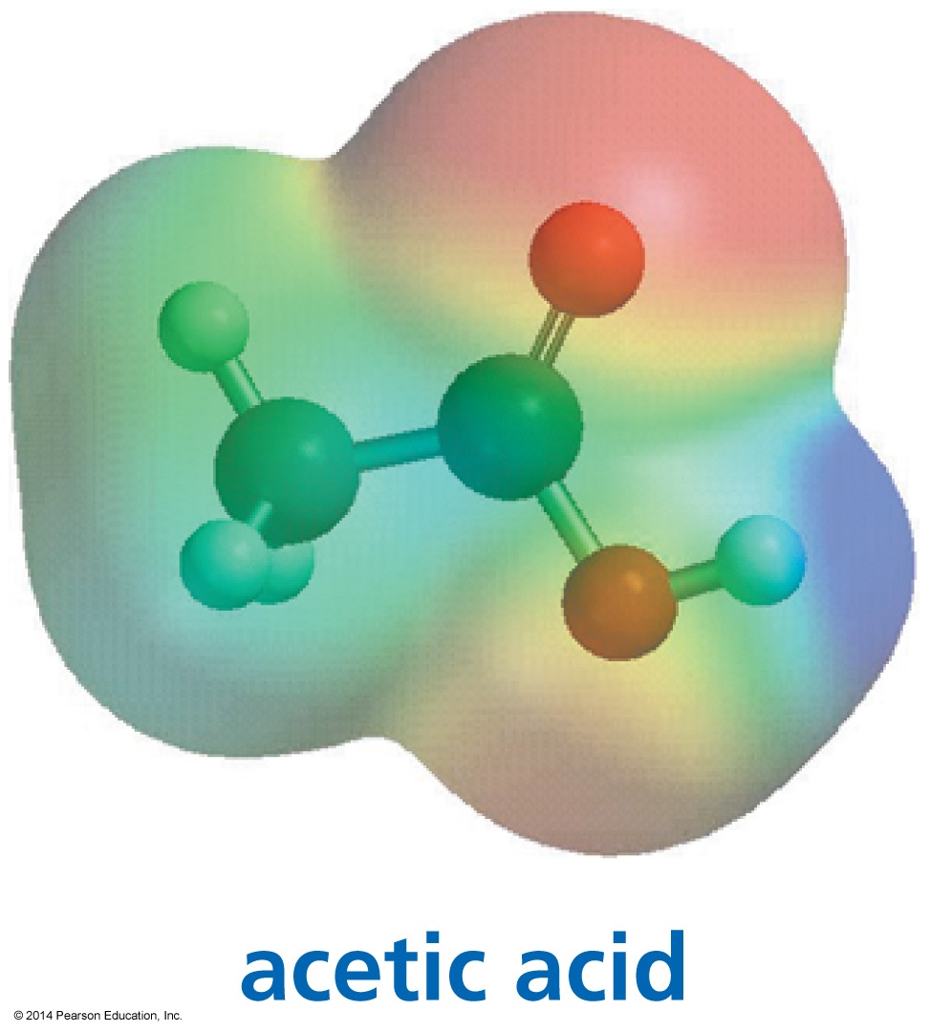
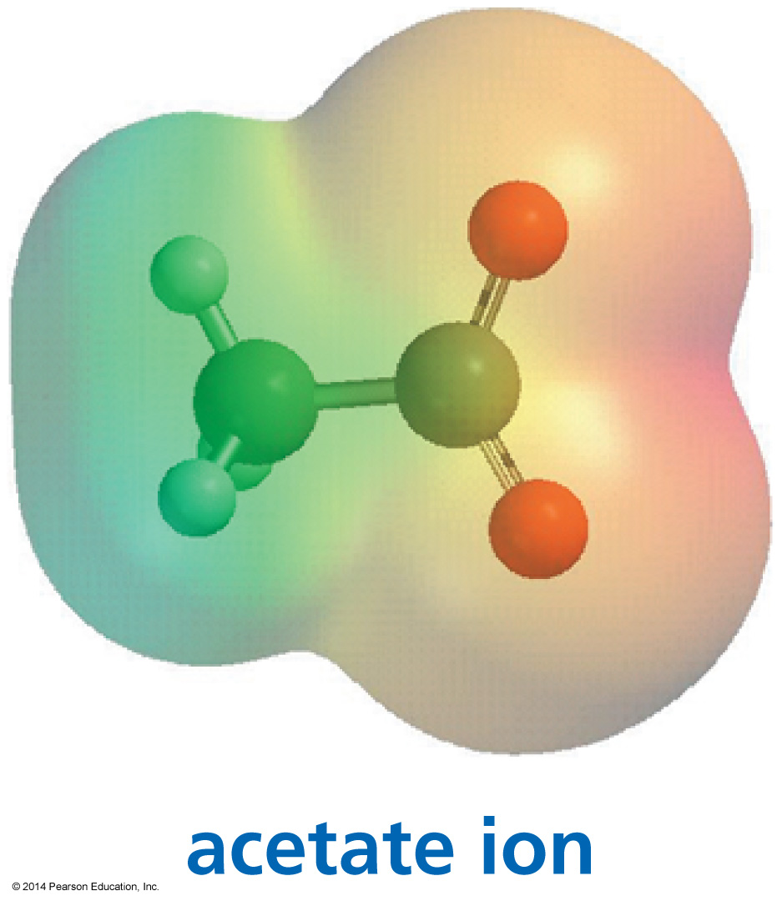
Proton loss is accompanied by greater Delocalization Energy
The negative charge is localized on one oxygen.
The negative charge is shared by
two oxygens.

Slide 43
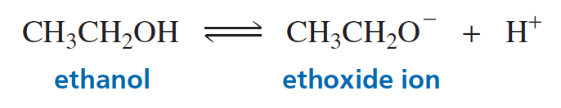
No Electron Delocalization

Slide 44
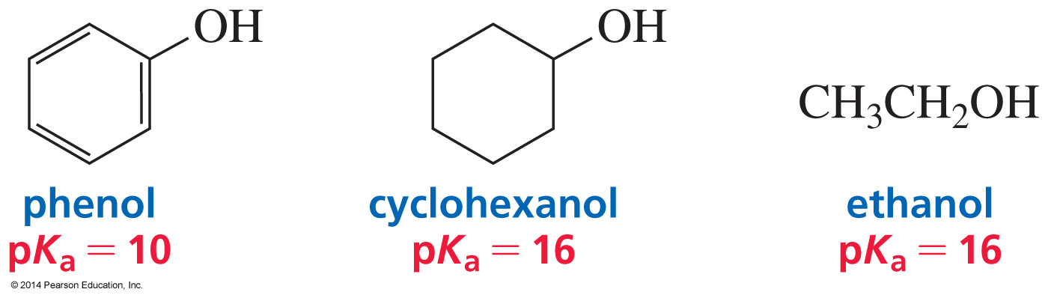
Phenols versus Alcohols

Slide 45
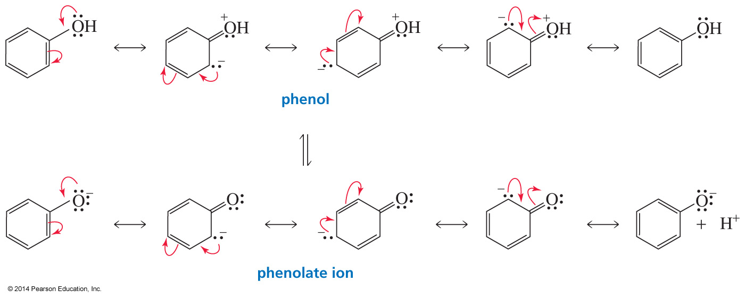
Why Phenols are more Acidic
The base has greater delocalization energy than the conjugate acid.

Slide 46
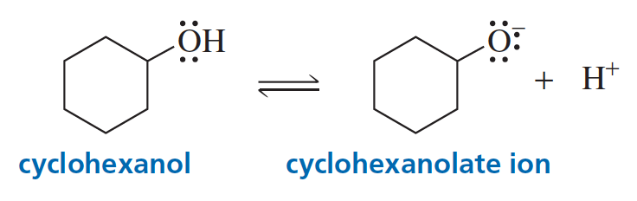
No Electron Delocalization

Slide 47

Protonated Anilines versus Protonated Amines

Slide 48

Why Protonated Anilines are more Acidic
The base has greater delocalization energy than the conjugate acid.

Slide 49

No Delocalized Electrons
Notes:
49
Ic acid = yl chloride

Slide 50

Important!

Slide 51

Electronic Effects: Substituents on the Benzene Ring affect pKa Values

Slide 52


Inductive Electron Withdrawal
and Donation
A substituent more electronegative than a hydrogen withdraws σ electrons inductively from the benzene ring more than a hydrogen will.
An alkyl group donates electrons into the ring by hyperconjugation.

Slide 53

Resonance Electron Donation
A lone pair on an atom directly attached to the ring donates electrons by resonance.

Slide 54

Resonance Electron Withdrawal
An atom directly attached to the ring that is doubly or triply bonded to an electronegative atom withdraws electrons by resonance.

Slide 55

Substituents on the Benzene Ring Affect the pKa of Benzoic Acid
electron donating groups decrease the acidity (destabilize the conjugate base)
electron withdrawing groups increase the acidity (stabilize the conjugate base)

Slide 56

Substituents on the Benzene Ring Affect the pKa of Phenol
electron donating groups decrease the acidity (destabilize the conjugate base)
electron withdrawing groups increase the acidity (stabilize the conjugate base)

Slide 57

Substituents on the Benzene Ring
Affect the pKa of Protonated Aniline
electron donating groups decrease the acidity (destabilize the conjugate base)
electron withdrawing groups increase the acidity (stabilize the conjugate base)

Slide 58


Delocalized Electrons can affect
the product of a Reaction

Slide 59

Isolated and Conjugated Dienes

Slide 60

Reactions of Isolated Dienes

Slide 61

The Mechanism

Slide 62

Double Bonds can have Different Reactivities

Slide 63

Reactions of Conjugated Dienes
?

Slide 64


1,2-Addition and 1,4-Addition

Slide 65


Mechanism for the
Reaction of a Conjugated Diene

Slide 66

The Diels–Alder Reaction forms a Six-Membered Ring

Slide 67

The Mechanism

Slide 68

Faster if there is an Electron Withdrawing Group on the Dienophile
?

Slide 69


The Electron Withdrawing Group makes the Electrophile a better Electrophile

Slide 70

Another Diels–Alder Reaction

Slide 71

Alkynes can also be Dienophiles
The cyclic product has two double bonds.

Slide 72

The Stereochemistry of the
Diels–Alder Reaction
The product will be a racemic mixture.

Slide 73

How to Determine the Reactants of a Diels–Alder Reaction

Slide 74

Benzene is an Aromatic Compound
The delocalization energy of benzene is 36 kcal/mol.

Slide 75

Criteria for a Compound to be Aromatic
It must have an uninterrupted cloud of π electrons.(cyclic, planar, every ring atom must have a p orbital).
The π cloud must have an odd number of pairs of π electrons.
“Hückel's rule when the number of its π-electrons equals 4n + 2”

Slide 76

Examples of Compounds that are not Aromatic
Cyclobutadiene has an even number of pairs of π electrons.
Cyclooctatetraene has an even number of pairs of π electrons and it is not planar.

Slide 77

Nonaromatic and Aromatic Compounds

Slide 78

Resonance Contributors and
the Resonance Hybrid

Slide 79

Aromatic Compounds

Slide 80


How Benzene Reacts
Aromatic compounds such as benzene undergo electrophilic aromatic substitution reactions.

Slide 81


Benzene Reacts with Electrophiles
The π electrons above and below the ring make benzene a nucleophile.
Benzene attacking an electrophile is like an alkene attacking an electrophile.

Slide 82

Benzene undergoes Substitution, not Addition
Aromaticity is restored in the product from electrophilic substitution.

Slide 83

Benzene undergoes Substitution, not Addition
The reaction of benzene with an electrophile forms the aromatic substitution product, not the nonaromatic addition product.

Slide 84

An Electrophilic Aromatic
Substitution Reaction
An electrophile (Y⁺) substitutes for H⁺.

Slide 85

The Mechanism for Electrophilic Aromatic Substitution

Slide 86

Generating the Electrophile:
Halogenation
Donating a lone pair to a Lewis acid weakens the Br—Br or Cl—Cl bond.

Slide 87



Generating the Electrophile:
Nitration

Slide 88

Generating the Electrophile:
Sulfonation

Slide 89


Generating the Electrophile:
Friedel–Crafts Acylation and Alkylation

Slide 90
Electrophilic Aromatic Substitution
Halogenation:
1st step is generating an electrophile:
FeBr₃ is a Lewis acid that coordinates with Br₂ and
polarizes it, generating an electrophilic Br⁺

Slide 91
Electrophilic Aromatic Substitution
Nitration:
1st step is generating an electrophile, the nitronium ion:

Slide 92
Electrophilic Aromatic Substitution
The highly electrophilic nitronium ion
attacks the aromatic ring.

Slide 93
Electrophilic Aromatic Substitution
Sulfonation: generating the electrophile

Slide 94
Electrophilic Aromatic Substitution
Sulfonation: reaction of electrophile
with aromatic ring

Slide 95
Electrophilic Aromatic Substitution
Sulfonation: reaction of electrophile
with aromatic ring

Slide 96
Electrophilic Aromatic Substitution
Friedel–Crafts Acylation
Formation of acylium ion

Slide 97
Electrophilic Aromatic Substitution
Friedel–Crafts Alkylation

Slide 98

Organizing what we know about the Reactions of Organic Compounds

