Slide 1
JavaFX UI Controls

Slide 2
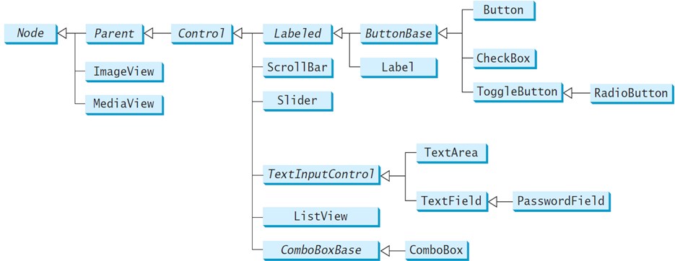
Frequently Used UI Controls
Throughout this book, the prefixes lbl, bt, chk, rb, tf, pf, ta, cbo, lv, scb, sld, and mp are used to name reference variables for Label, Button, CheckBox, RadioButton, TextField, PasswordField, TextArea, ComboBox, ListView, ScrollBar, Slider, and MediaPlayer.

Slide 3
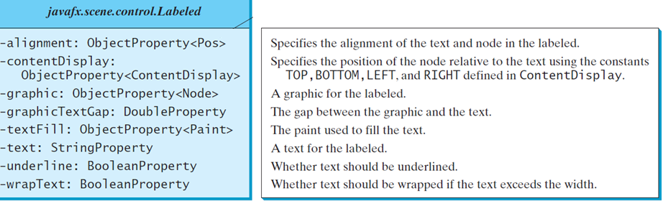
Labeled
A label is a display area for a short text, a node, or both.
It is often used to label other controls (usually text fields).
Labels and buttons share many common properties. These common properties are defined in the Labeled class.

Slide 4
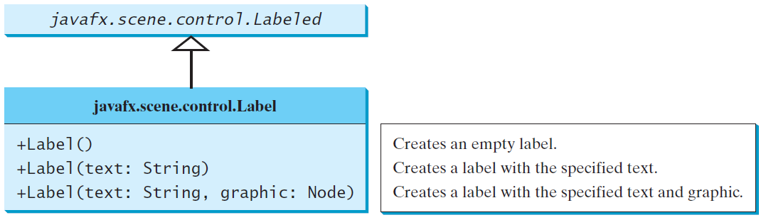
Label
The Label class defines labels.

Slide 5
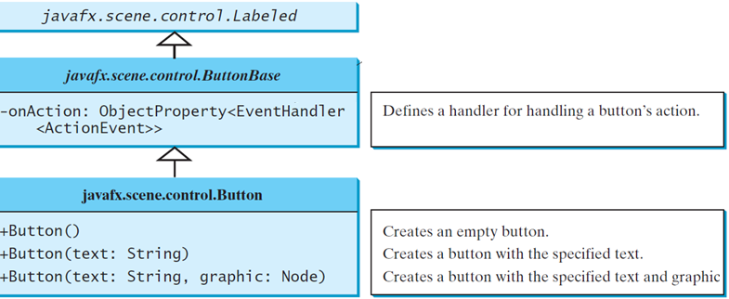
ButtonBase and Button
A button is a control that triggers an action event when clicked.
JavaFX provides regular buttons, toggle buttons, check box buttons, and radio buttons.
The common features of these buttons are defined in ButtonBase and Labeled classes.

Slide 6
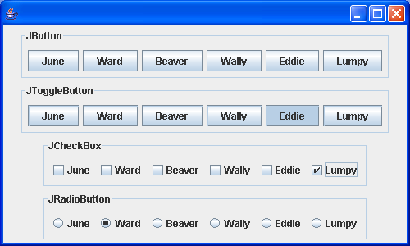

Slide 7
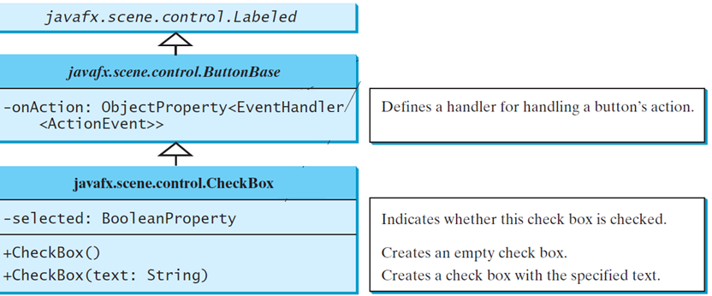
CheckBox
A CheckBox is used for the user to make a selection.
Like Button, CheckBox inherits all the properties such as onAction, text, graphic, alignment, graphicTextGap, textFill, contentDisplay from ButtonBase and Labeled.

Slide 8
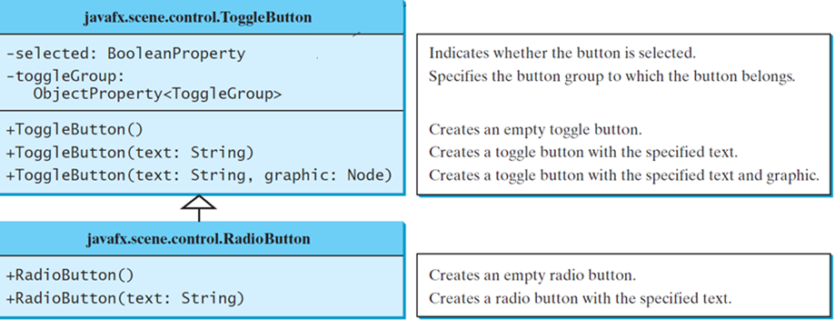
RadioButton
Radio buttons, also known as option buttons, enable you to choose a single item from a group of choices.
In appearance radio buttons resemble check boxes, but check boxes display a square that is either checked or blank, whereas radio buttons display a circle that is either filled (if selected) or blank (if not selected).

Slide 9
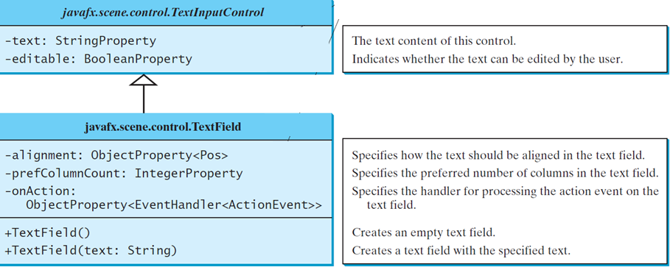
TextField
A text field can be used to enter or display a string. TextField is a subclass of TextInputControl.

Slide 10
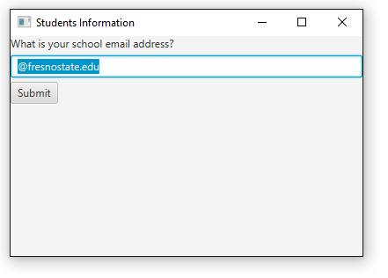

Slide 11
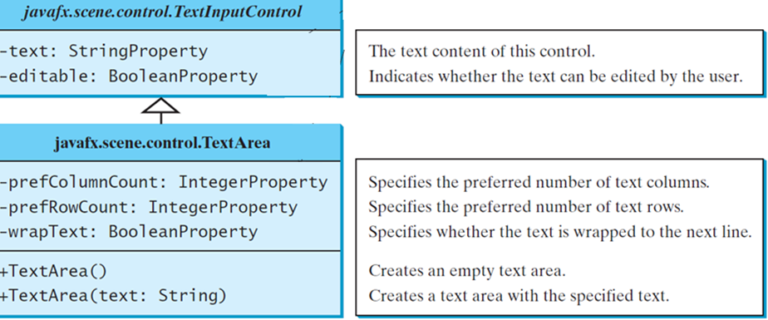
TextArea
A TextArea enables the user to enter multiple lines of text.

Slide 12
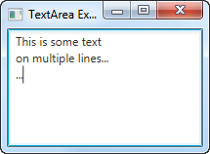

Slide 13
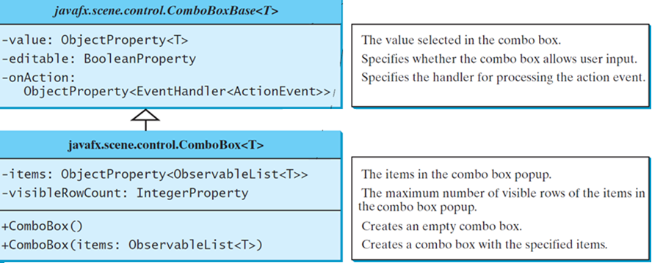
ComboBox
A combo box, also known as a choice list or drop-down list, contains a list of items from which the user can choose.

Slide 14
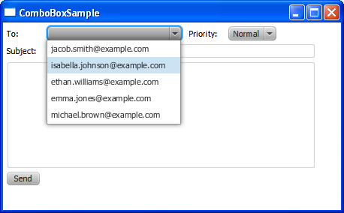

Slide 15
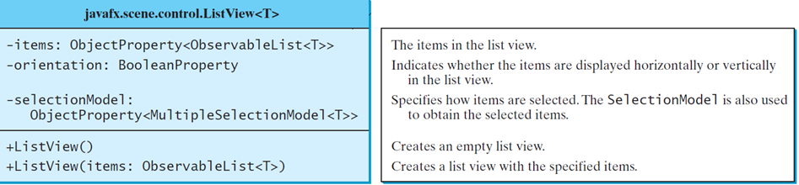
ListView
A list view is a component that performs basically the same function as a combo box, but it enables the user to choose a single value or multiple values.

Slide 16
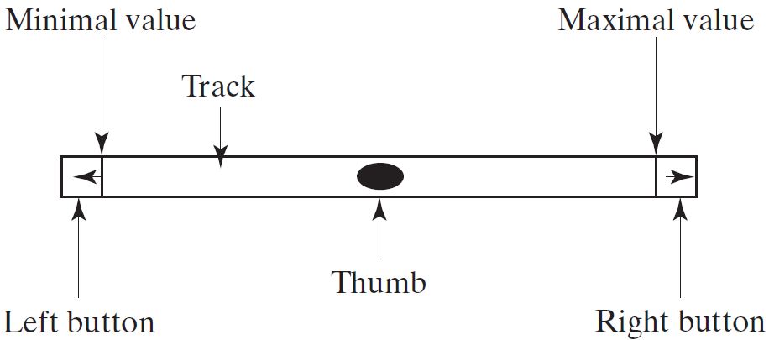
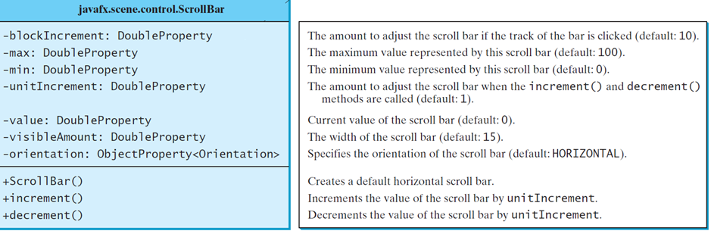
ScrollBar
A scroll bar is a control that enables the user to select from a range of values. The scrollbar appears in two styles: horizontal and vertical.

Slide 17
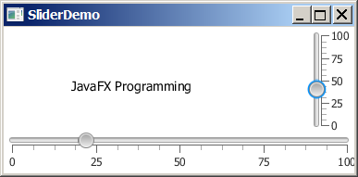
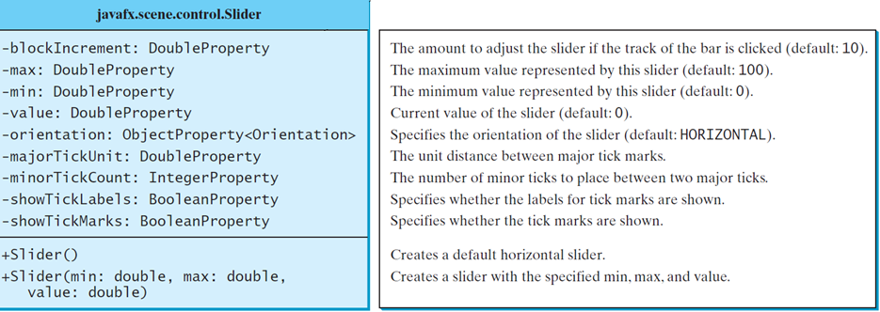
Slider
Slider is similar to ScrollBar, but Slider has more properties and can appear in many forms.

Slide 18
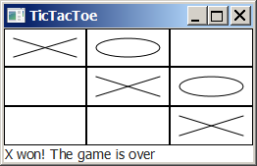
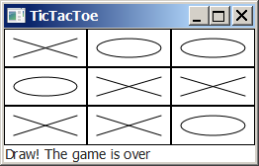
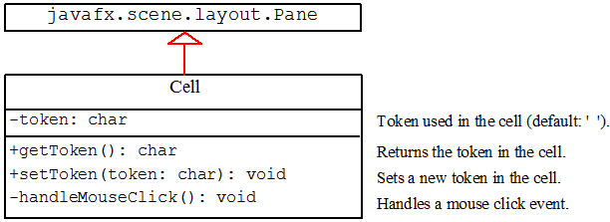
Case Study: TicTacToe

Slide 19
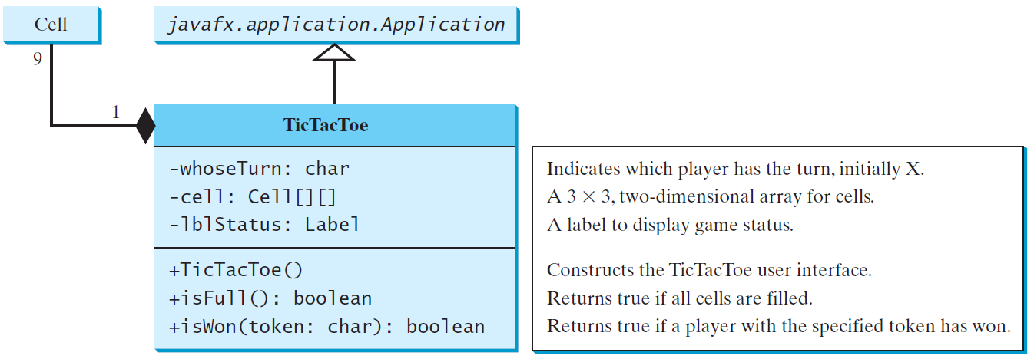
Case Study: TicTacToe cont.
TicTacToe

Slide 20
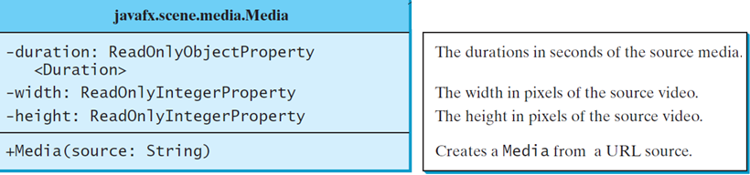
Media
You can use the Media class to obtain the source of the media, the MediaPlayer class to play and control the media, and the MediaView class to display the video.
JavaFX supports MP3, AIFF, WAV, and MPEG-4 audio formats and FLV and MPEG-4 video formats

Slide 21
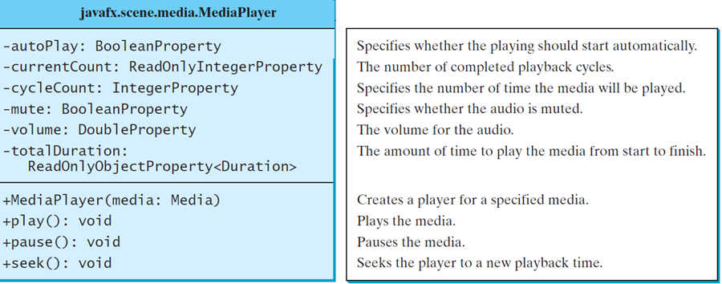
MediaPlayer
The MediaPlayer class playes and controls the media with properties such as autoPlay, currentCount, cycleCount, mute, volume, and totalDuration.

Slide 22
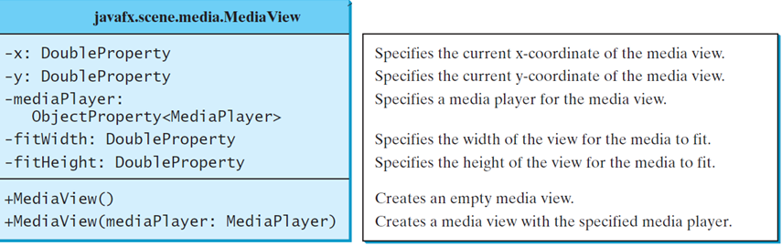
MediaView
The MediaView class is a subclass of Node that provides a view of the Media being played by a MediaPlayer. The MediaView class provides the properties for viewing the media.

