Slide 1
Skin Integrity and Wound Care

Slide 2
Introduction
The skin is the largest organ in the body and serves a variety of important functions in maintaining health and protecting the individual from injury.
Impaired skin integrity is not a frequent problem for most healthy people but is a threat to older adults; to clients with restricted mobility; chronic illnesses, or trauma; and to those undergoing invasive health care procedures. To protect the skin and manage wounds effectively, the nurse must understand the factors affecting skin integrity, the physiology of wound healing, and specific measures that promote skin conditions.

Slide 3
Skin Integrity
Is the presence of normal skin and skin layers uninterrupted by wounds.
The appearance of the skin and skin integrity are influenced by internal factors such as genetics, age, and the underlying health of the individual as well as external factors such as activity.

Slide 4
Genetics and hereditary determine many aspects of a person’s skin, including skin color, sensitivity to sun light, and allergies. Age influences skin integrity in that the skin of both the very young and the very old is more fragile and susceptible to injury than that of most adults. Wounds tend to heal more rapidly in infants and children.

Slide 5
Many chronic illnesses and their treatments affect skin integrity. People with peripheral arterial circulation may have skin on the legs that damages easily. Some medications, corticosteroids for example, cause thinning of the skin and allow it to be much more readily harmed.

Slide 6
Many medications increase sensitivity to sunlight and can predispose one to severe sunburns. Some of the most common medications that cause this damage are certain antibiotics (e.g., tetracycline), chemotherapy (e.g., methotrexate), and some psychotherapeutic drugs (e.g., tricyclic antidepressants). Poor nutrition alone can interfere with appearance and function of normal skin.

Slide 7
Types of Wounds
Body wounds are either intentional or unintentional.
Intentional trauma occurs during therapy. Examples are operations or venipunctures. Although removing a tumor, for example is therapeutic, the surgeon must cut into body tissues, thus traumatizing them.
Unintentional wounds are accidental, for example, a person may fracture an arm in an automobile collision. If tissues are traumatized without a break in the skin, the wound is closed. The wound is open when the skin or mucous membrane surface is broken.

Slide 8
Types of Wound by contamination
Clean wounds: are uninfected wounds in which there is minimal inflammation and the respiratory, gastrointestinal, genital and urinary tracts are not entered. Clean wounds are primarily closed wounds.

Slide 9
Clean-contaminated wounds are surgical wounds in which the respiratory, gastrointestinal, genital or urinary tract has been entered. Such wounds show no evidence of infection.

Slide 10
Contaminated wounds include open, fresh, accidental wounds and surgical wounds involving a major break in sterile technique or a large amount of spillage from the gastrointestinal tract. Contaminated wounds show evidence of inflammation.

Slide 11
Dirty or infected wounds includes wounds containing dead tissue and wounds with evidence of a clinical infection, such as purulent drainage.

Slide 12
Types of Wounds
Incision | Sharp instrument (e.g., knife or scalpel). | Open wound, deep or shallow, once the edges have been sealed together as a part of treatment or healing, the incision becomes a closed wound.
Contusion | Blow from a blunt instrument. | Closed wound, skin appears ecchymotic (bruised) because of damaged blood vessels.
Abrasion | Surface scrape, either intentional or unintentional. | Open wound involving the skin.
Puncture | Penetration of the skin and often the underlying tissues by a sharp instrument. | Open wound.
Laceration | Tissues torn apart, often from accidents. | Open wound, edges are often jagged.
Penetrating | Penetration of the skin and the underlying tissues, usually unintentional (e.g., from a bullet). | Open wound.

Slide 13
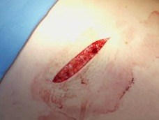
Incision wound

Slide 14
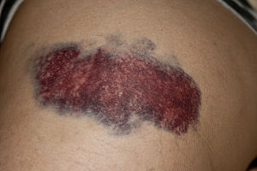
Contusion Wound

Slide 15
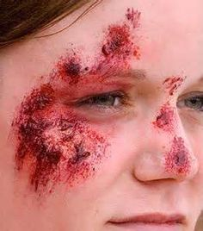
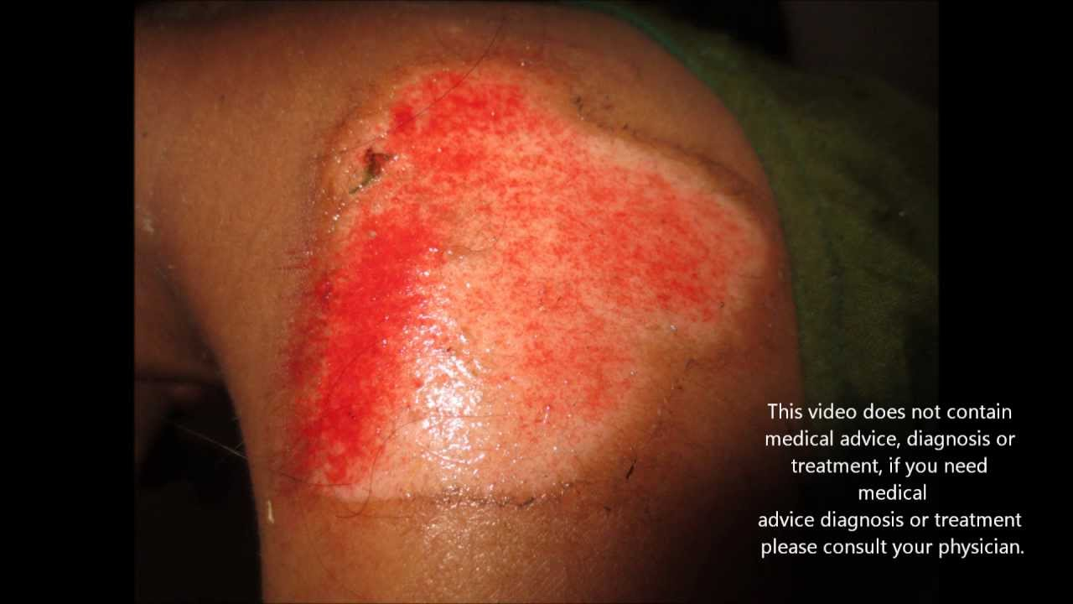
Abrasion Wound

Slide 16
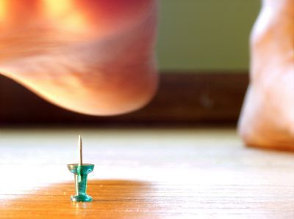
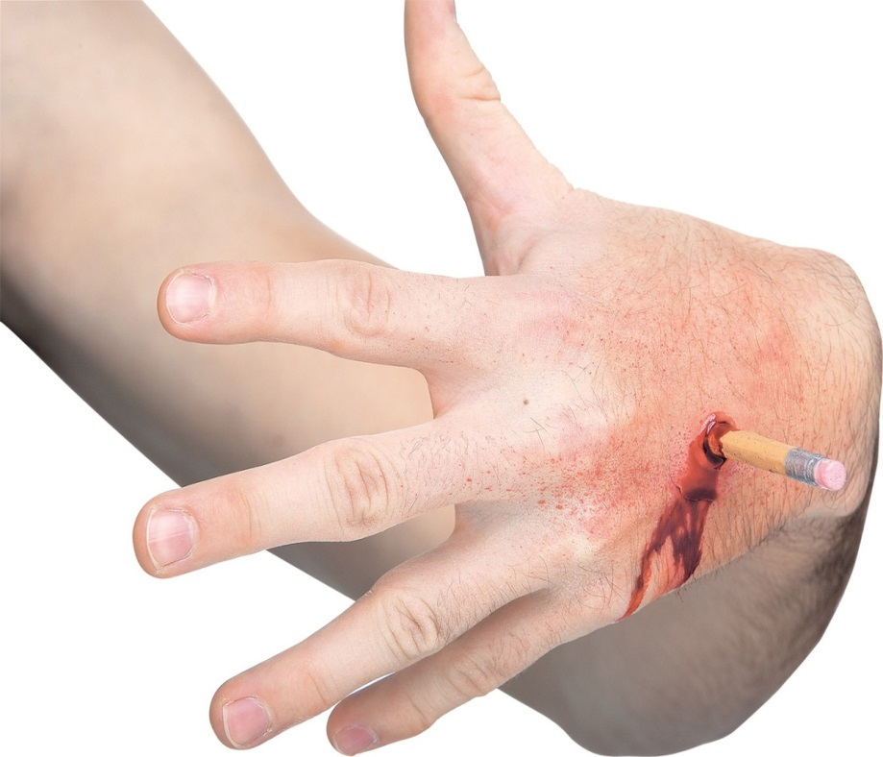
Puncture Wound

Slide 17
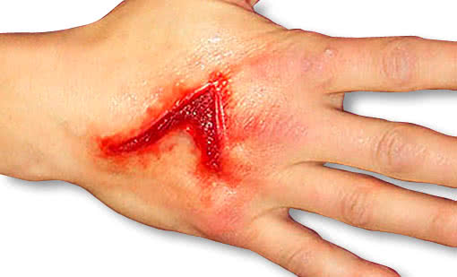
Laceration Wound

Slide 18
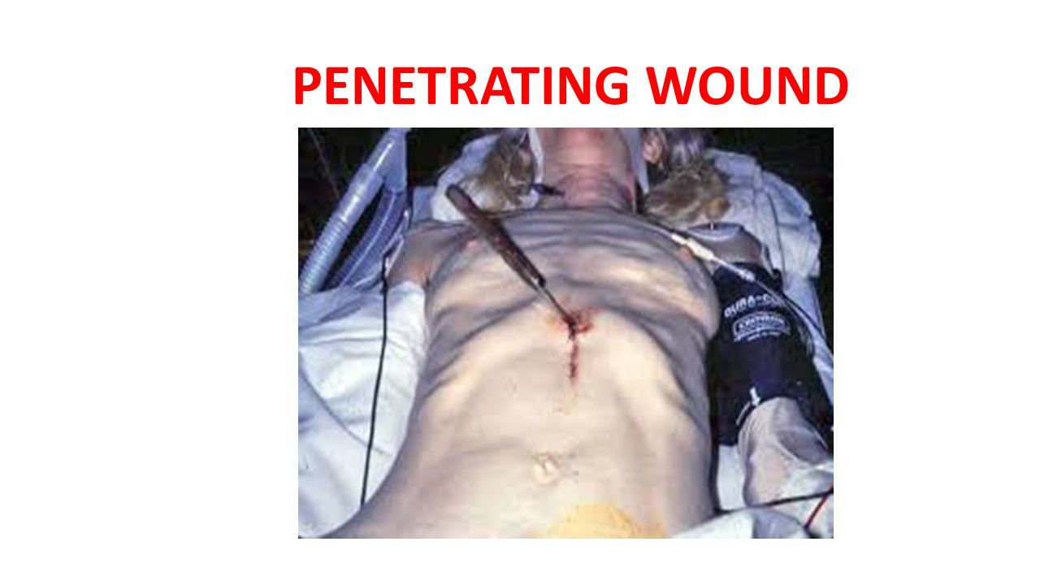

Slide 19
Types of Wounds by Depth
Partial thickness: confined to the skin, that is, the dermis and epidermis; heal by regeneration.
Full thickness: involve the dermis, epidermis, subcutaneous tissue and possibly muscle and bone, require connective tissue repair.

Slide 20
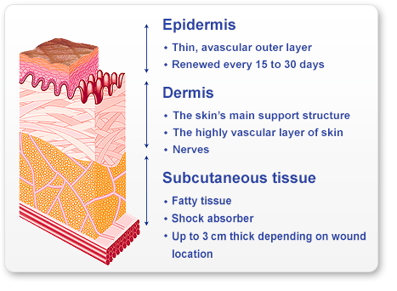
Types of wounds by depth

Slide 21
Pressure Ulcers
Consist of injury to the skin and/or underlying tissue usually over a bony prominence, as a result of force alone or in combination with movement.
PU were previously called decubitus ulcer, pressure sores, or bed sores. PU are a problem in both acute care settings and long-term care settings including homes.

Slide 22
Safety
Assess and periodically reassess each resident’s risk for developing a pressure ulcer and take action to address any identified risks.

Slide 23
Etiology of PU
PU are due to localized ischemia, a deficiency in the blood supply to the tissue. The tissue is compressed between two surfaces, usually the surface of furniture such as the bed or chair and the bony skeleton. When blood can not reach the tissue, the cells are deprived of oxygen and nutrients, the waste products of metabolism accumulate in the cells, and the tissue consequently dies. Prolonged, unrelieved pressure also damages the small blood vessels.

Slide 24
After the skin has been compressed, it appears pale, as if the blood had been squeezed out of it. When pressure is relieved, the skin takes on a bright red flush, called reactive hyperemia. The flush is due to vasodilation, a process in which extra blood floods to the area to compensate for the preceding period of impeded blood flow.

Slide 25
Reactive hyperemia usually lasts one half to three quarters as long as the duration of impeded blood flow to the area. If the redness disappears in that time, no tissue damage is anticipated. If however, the redness does not disappear, then tissue damage has occurred.

Slide 26
Risk Factors
Friction & shearing.
Immobility.
Inadequate nutrition.
Fecal & urinary incontinence.
Decreased mental status.
Diminished sensation.
Excessive body heat.
Advanced age.
Chronic medical conditions.
Other factors: as lifting technique and transfer of patient.

Slide 27
Stages of PU
Stage I: non-blanchable erythema signaling potential ulceration.
Stage II: partial-thickness skin loss (abrasion, blister, or shallow crater) involving the epidermis and possibly the dermis.
Stage III: full-thickness skin loss involving damage or necrosis undermining of adjacent tissue.
Stage IV: full-thickness skin loss with tissue necrosis or damage to muscle, bone or supporting structures such as a tendon, or joint capsule.

Slide 28
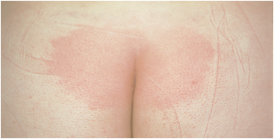
Stage I PU

Slide 29
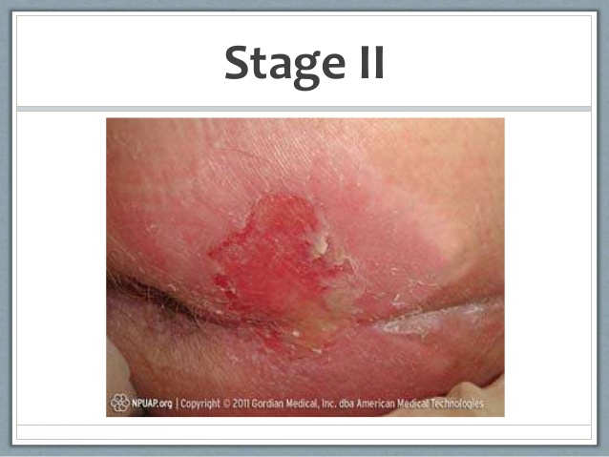
Stage II PU

Slide 30
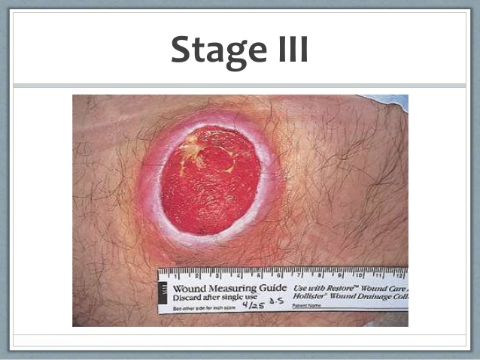
Stage III PU

Slide 31
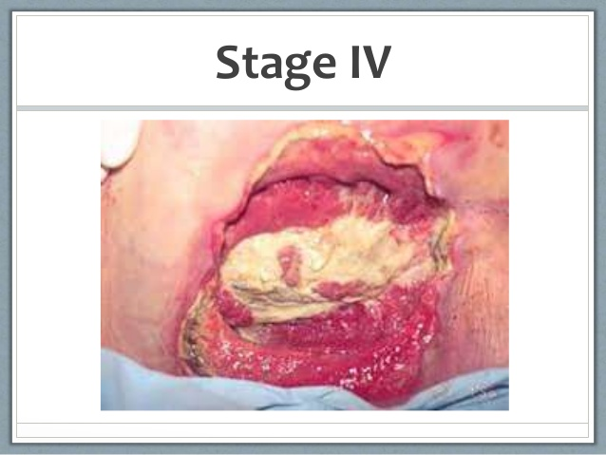
Stage IV PU

Slide 32
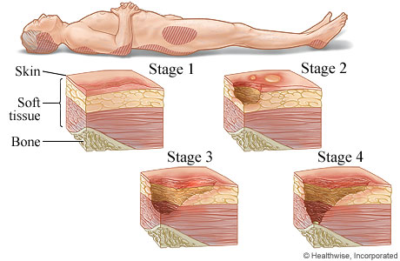
Stages of Pressure ulcer

Slide 33
Types of Wound Exudate
Exudate: is material, such as fluid and cells, that has escaped from blood vessels during the inflammatory process and is deposited in tissue or on tissue surfaces. The nature and amount of exudate vary according to the tissue involved, the intensity and duration of the inflammation, and the presence of microorganisms.
The three major types of exudate are serous, purulent, and sanguineous.

Slide 34
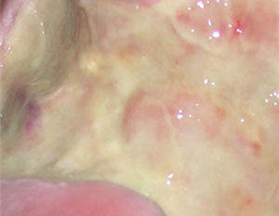
Serous Exudate
Consists chiefly of serum (the clear portion of the blood) derived from blood and the serous membranes of the body, such as peritoneum. It looks watery and has few cells. An example is the fluid in a blister from a burn.

Slide 35
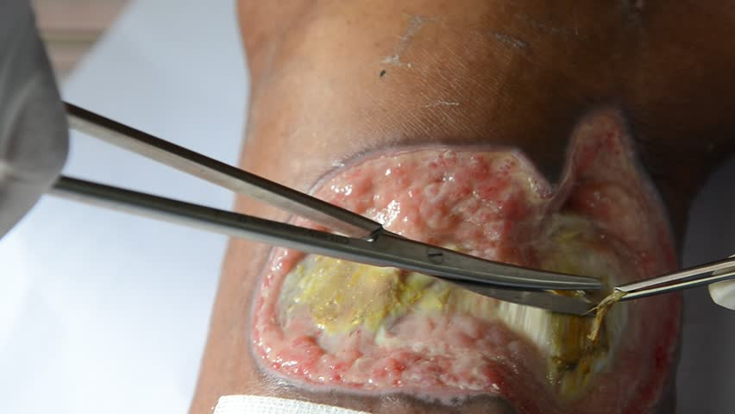
Purulent Exudate
Is thicker than serous exudate because of the presence of pus, which consists of leukocytes, liquefied dead tissue debris, and dead and living bacteria. Purulent exudate varies in color, some acquiring tinges of blue, green or yellow. The color may depend on causative organism.

Slide 36
Sanguineous Exudate
Consists of large amounts of red blood cells, indicating damage to capillaries that is severe enough to allow the escape of red blood cells from plasma. This type of exudate is frequently seen in open wounds.
Mixed types of exudate are often observed. A serosanguinous exudate consisting of both clear and blood-tinged drainage, is commonly seen in surgical incisions.
A purosanguinous discharge, consist of pus and blood, is often seen in anew wound that is infected.

Slide 37
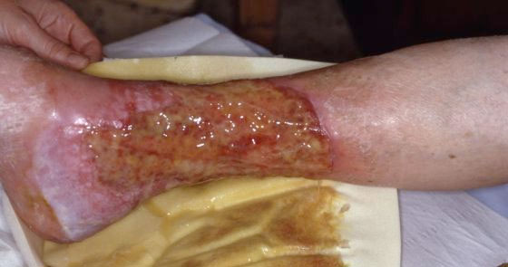
Sanguineous Exudate

Slide 38
Clinical Alert
A bright sanguineous exudate indicates fresh bleeding, whereas dark sanguineous exudate denotes older bleeding.

Slide 39
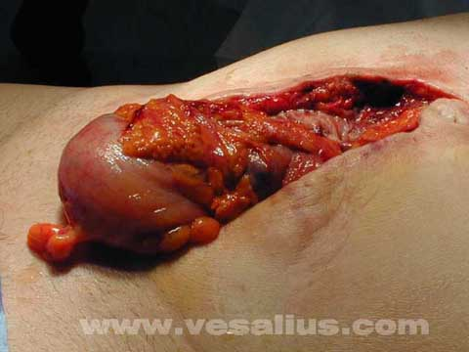
Complications of Wound Healing
Hemorrhage.
Infection.
Dehiscence with possible evisceration.

Slide 40
Factors affecting Wound Healing
Developmental considerations.
Nutrition.
Lifestyle.
Medications.

