Slide 1

Chapter 7, System Design: Addressing Design Goals

Slide 2
Overview
System Design I (Chapter 6)
0. Overview of System Design
1. Design Goals
2. Subsystem Decomposition
Architectural Styles
System Design II (Chapter 7)
3. Concurrency
4. Hardware/Software Mapping
5. Persistent Data Management
6. Global Resource Handling and Access Control
7. Software Control
8. Boundary Conditions

Slide 3
System Design
8. Boundary
Conditions
1. Design Goals
Definition
Trade-offs
Initialization
Termination
Failure
2. Subsystem Decomposition
7. Software
Control
Layers vs Partitions
Coherence/Coupling
Monolithic
Event-Driven
Conc. Processes
3. Concurrency
Identification of
Threads
4. Hardware/
Software Mapping
5. Data
Management
6. Global Resource
Handlung
Special Purpose
Buy vs Build
Allocation of Resources
Connectivity
Persistent Objects
File system vs Database
Access Control List
vs Capabilities
Security

Slide 4
Concurrency
Nonfunctional Requirements to be addressed: Performance, Response time, latency, availability.
Two objects are inherently concurrent if they can receive events at the same time without interacting
Source for identification: Objects in a sequence diagram that can simultaneously receive events
Unrelated events, instances of the same event
Inherently concurrent objects can be assigned to different threads of control
Objects with mutual exclusive activity could be folded into a single thread of control
Notes:
Objects with mutual exclusive activity could be folded into a single thread of control (Why?)
Should client and server of a client/server architecture be folded on the same thread?
If there are multiple clients?
If there is only a single client and the server?.

Slide 5
Thread of Control
A thread of control is a path through a set of state diagrams on which a single object is active at a time
A thread remains within a state diagram until an object sends an event to different object and waits for another event
Thread splitting: Object does a non-blocking send of an event to another object.
Concurrent threads can lead to race conditions.
A race condition (also race hazard) is a design flaw where the output of a process is depends on the specific sequence of other events.
The name originated in digital circuit design: Two signals racing each other to influence the output.
Notes:
Example: An instance of a client/server architectural style consists of at least two threads
A race condition or race hazard is a flaw in a system or process whereby the output and/or result of the process is unexpectedly and critically dependent on the sequence or timing of other events. The term originates with the idea of two signals racing each other to influence the output first.

Slide 6
Example: Problem with threads
Assume: Initial balance = 200
:WithdrawCtrl
:BankAccount
:WithdrawCtrl
c1:Customer
c2:Customer
withdraw(50)
getBalance()
Thread 1
200
withdraw(50)
getBalance()
computeNewBalance(200,50)
Thread 2
200
computeNewBalance(200,50)
setBalance(150)
setBalance(150)
Should BankAccount
be another Thread ?
Final
balance = 150 ??!
Notes:
When you introduce the second customer, say that he interacts with his own control object of type WithdrawCtrl
Ask this question at the end of the animation: Can thread 1 or 2 be folded with thread 3?

Slide 7
Solution: Synchronization of Threads
Single WithdrawCtrl Instance
Initial balance = 200
:WithdrawCtrl
:BankAccount
c1:Customer
c2:Customer
withdraw(50)
getBalance()
withdraw(50)
200
Synchronized method
computeNewBalance(200,50)
Synchronized method
setBalance(150)
End balance = 100

Slide 8
Concurrency Questions
To identify threads for concurrency we ask the following questions:
Does the system provide access to multiple users?
Which entity objects of the object model can be executed independently from each other?
What kinds of control objects are identifiable?
Can a single request to the system be decomposed into multiple requests? Can these requests and handled in parallel? (Example: a distributed query)
Notes:
Examples for requests:
Examples:
Sorting request
Searching request in a distributed data base
Image recognition by decomposing the image into stripes
Matrix multiplication with a systolic array algorithm

Slide 9
Implementing Concurrency
Concurrent systems can be implemented on any system that provides
Physical concurrency: Threads are provided by hardware
or
Logical concurrency: Threads are provided by software
Physical concurrency is provided by multiprocessors and computer networks
Logical concurrency is provided by threads packages.
Notes:
Logical concurrency is provided by threads packages : Java, for example, has a thread abstraction

Slide 10
Implementing Concurrency (2)
In both cases, - physical concurrency as well as logical concurrency - we have to solve the scheduling of these threads:
Which thread runs when?
Today’s operating systems provide a variety of scheduling mechanisms:
Round robin, time slicing, collaborating processes, interrupt handling
General question addresses starvation, deadlocks, fairness -> Topic for researchers in operating systems
Sometimes we have to solve the scheduling problem ourselves
Topic addressed by software control (system design topic 7).
Notes:
Round robin, time slicing, collaborating processes, interrupt handling
Topics in operating systems!!!

Slide 11
System Design
8. Boundary
Conditions
1. Design Goals
Definition
Trade-offs
Initialization
Termination
Failure
2. Subsystem Decomposition
7. Software
Control
Layers vs Partitions
Coherence/Coupling
Monolithic
Event-Driven
Conc. Processes
3. Concurrency
Identification of
Threads
4. Hardware/
Software Mapping
5. Data
Management
6. Global Resource
Handlung
Special Purpose
Buy vs Build
Allocation of Resources
Connectivity
Persistent Objects
Filesystem vs Database
Access Control List
vs Capabilities
Security

Slide 12
4. Hardware Software Mapping
This system design activity addresses two questions:
How shall we realize the subsystems: With hardware or with software?
How do we map the object model onto the chosen hardware and/or software?
Mapping the Objects:
Processor, Memory, Input/Output
Mapping the Associations:
Network connections
Notes:
A first heuristic would be Control objects need a processor, Entity objects need memory
Boundary objects should be mapped to input/output devices.
These abstractions are available in hardware as well as in software.

Slide 13
Mapping Objects onto Hardware
Control Objects -> Processor
Is the computation rate too demanding for a single processor?
Can we get a speedup by distributing objects across several processors?
How many processors are required to maintain a steady state load?
Entity Objects -> Memory
Is there enough memory to buffer bursts of requests?
Boundary Objects -> Input/Output Devices
Do we need an extra piece of hardware to handle the data generation rates?
Can the desired response time be realized with the available communication bandwidth between subsystems?
Notes:
Does the response time exceed the available bandwith for a task and a piece of hardware?

Slide 14
Mapping the Associations: Connectivity
Describe the physical connectivity
(“Physical layer in the OSI reference model”)
Describes which associations in the object model are mapped to physical connections
Describe the logical connectivity (subsystem associations)
Associations that do not directly map into physical connections
In which layer should these associations be implemented?
Informal connectivity drawings often contain both types of connectivity
Practiced by many developers, sometimes confusing.
Notes:
Describe the physical connectivity of the hardware
This is usually the physical layer in the OSI Reference Model
Which associations in the object model are mapped to physical connections?
Which of the client-supplier relationships in the analysis/design model correspond to physical connections?
Describe the logical connectivity (subsystem associations)
Identify associations that do not directly map into physical connections:
How should these associations be implemented?

Slide 15
Example: Informal Connectivity Drawing
TCP/IP
Logical
Connectivity
Ethernet Cat 5
Physical
Connectivity

Slide 16
Logical vs Physical Connectivity and the relationship to Subsystem Layering
Application Layer
Application Layer
Presentation Layer
Presentation Layer
Logical
Connectivity
Session Layer
Session Layer
Bidirectional associa- tions for each layer
Transport Layer
Transport Layer
Network Layer
Network Layer
Data Link Layer
Data Link Layer
Physical
Connectivity
Physical Layer
Physical Layer
Processor 1
Processor 2

Slide 17
Hardware-Software Mapping Difficulties
Much of the difficulty of designing a system comes from addressing externally-imposed hardware and software constraints
Certain tasks have to be at specific locations
Example: Withdrawing money from an ATM machine
Some hardware components have to be used from a specific manufacturer
Example: To send DVB-T signals, the system has to use components from a company that provides DVB-T transmitters.

Slide 18

Hardware/Software Mappings in UML
A UML component is a building block of the system. It is represented as a rectangle with a tabbed rectangle symbol inside
Components have different lifetimes:
Some exist only at design time
Classes, associations
Others exist until compile time
Source code, pointers
Some exist at link or only at runtime
Linkable libraries, executables, addresses
The Hardware/Software Mapping addresses dependencies and distribution issues of UML components during system design.

Slide 19
Two New UML Diagram Types
Deployment Diagram:
Illustrates the distribution of components at run-time.
Deployment diagrams use nodes and connections to depict the physical resources in the system.
Component Diagram:
Illustrates dependencies between components at design time, compilation time and runtime

Slide 20
Deployment Diagram
Deployment diagrams are useful for showing a system design after these system design decisions have been made:
Subsystem decomposition
Concurrency
Hardware/Software Mapping
A deployment diagram is a graph of nodes and connections (“communication associations”)
Nodes are shown as 3-D boxes
Connections between nodes are shown as solid lines
Nodes may contain components
Components can be connected by “lollipops” and “grabbers”
Components may contain objects (indicating that the object is part of the component).
:PC
:Server

Slide 21
UML Component Diagram
Used to model the top-level view of the system design in terms of components and dependencies among the components. Components can be
source code, linkable libraries, executables
The dependencies (edges in the graph) are shown as dashed lines with arrows from the client component to the supplier component:
The lines are often also called connectors
The types of dependencies are implementation language specific
Informally also called “software wiring diagram“ because it show how the software components are wired together in the overall application.

Slide 22
UML Interfaces: Lollipops and Sockets
A UML interface describes a group of operations used or created by UML components.
There are two types of interfaces: provided and required interfaces.
A provided interface is modeled using the lollipop notation
A required interface is modeled using the socket notation.
A port specifies a distinct interaction point between the component and its environment.
Ports are depicted as small squares on the sides of classifiers.

Slide 23
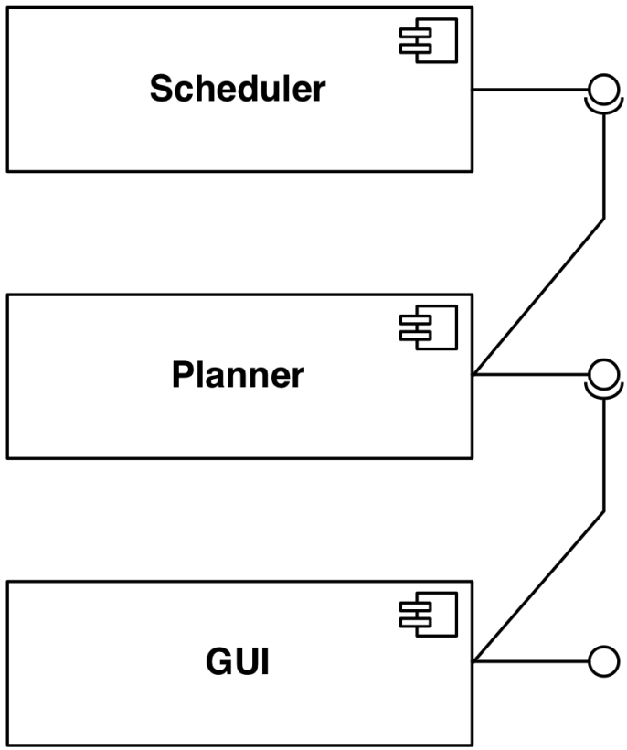
Component Diagram Example
Dependency.
reservations
UML
Component
update
UML Interface

Slide 24
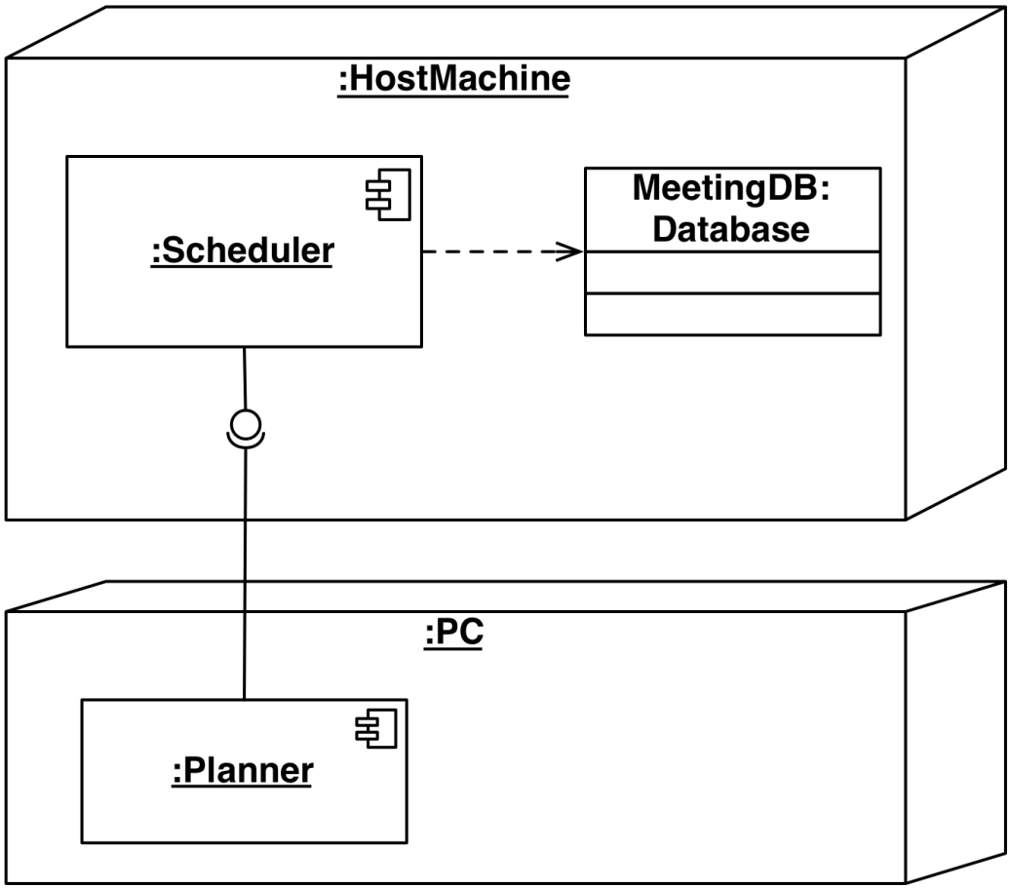
Deployment Diagram Example
UML Node
Dependency
(in a node)
UML
Interface
Dependency
(between nodes)

Slide 25
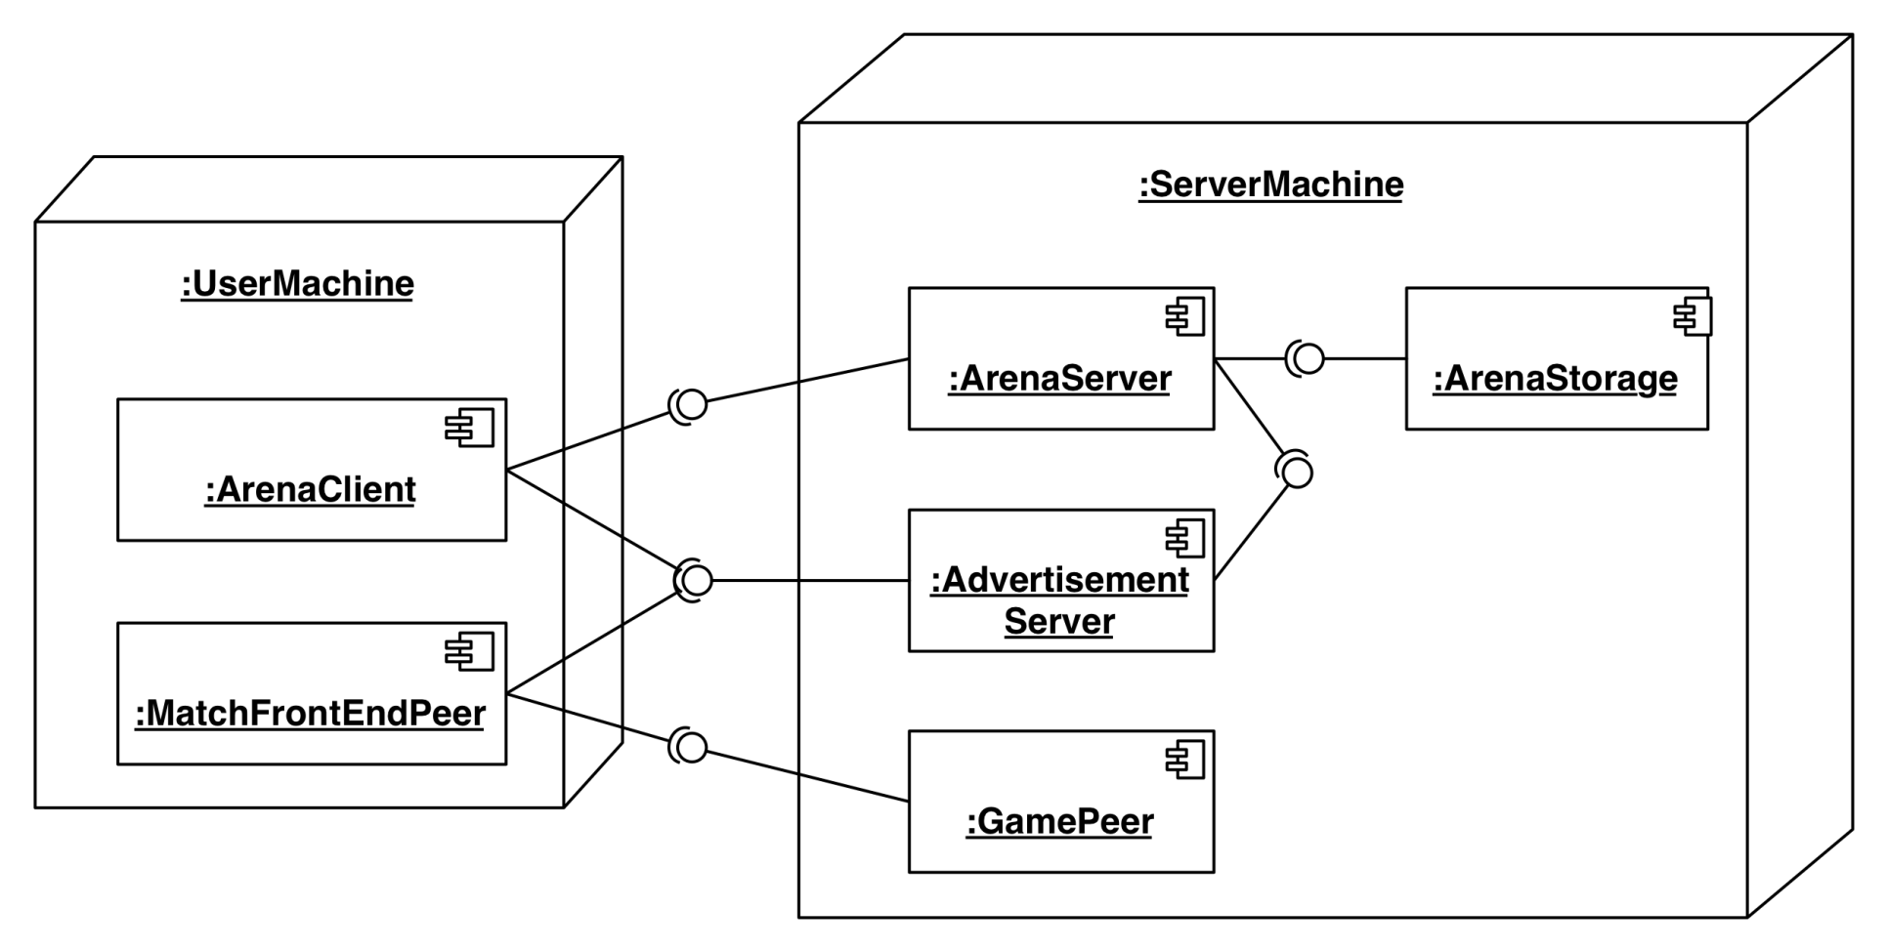
ARENA Deployment Diagram

Slide 26
Another ARENA Deployment Diagram

Slide 27
5. Data Management
Some objects in the system model need to be persistent:
Values for their attributes have a lifetime longer than a single execution
A persistent object can be realized with one of the following mechanisms:
Filesystem:
If the data are used by multiple readers but a single writer
Database:
If the data are used by concurrent writers and readers.
Notes:
Some objects in the system model need to be persistent
Provide clean separation points between subsystems with well-defined interfaces.
Data structure
If the data can be volatile
Files
If the data has a lifetime longer than a single execution
Cheap, simple, permanent storage
Low level (Read, Write)
Applications must add code to provide suitable level of abstraction
Database
Powerful, easy to port
Supports multiple writers and readers

Slide 28
Data Management Questions
How often is the database accessed?
What is the expected request (query) rate? The worst case?
What is the size of typical and worst case requests?
Do the data need to be archived?
Should the data be distributed?
Does the system design try to hide the location of the databases (location transparency)?
Is there a need for a single interface to access the data?
What is the query format?
Should the data format be extensible?
Notes:
Should the database be relational or object-oriented?

Slide 29
Mapping Object Models
UML object models can be mapped to relational databases
The mapping:
Each class is mapped to its own table
Each class attribute is mapped to a column in the table
An instance of a class represents a row in the table
One-to-many associations are implemented with a buried foreign key
Many-to-many associations are mapped to their own tables
Methods are not mapped
More details in Lecture: Mapping Models to Relational Schema
Notes:
UML object models can be mapped to relational databases
Some degradation occurs because all UML constructs must be mapped to a single relational database construct - the table
UML mappings (Chapter 10, p 414ff)

Slide 30
6. Global Resource Handling
Discusses access control
Describes access rights for different classes of actors
Describes how object guard against unauthorized access.

Slide 31
Defining Access Control
In multi-user systems different actors usually have different access rights to different functionality and data
How do we model these accesses?
During analysis we model them by associating different use cases with different actors
During system design we model them determining which objects are shared among actors.
Notes:
During system design we model them by examining the object model by determining which objects are shared among actors.
Depending on the security requirements of the system, we also define how actors are authenticated
to the system and how selected data in the system should be encrypted.

Slide 32
Access Matrix
We model access on classes with an access matrix:
The rows of the matrix represents the actors of the system
The column represent classes whose access we want to control
Access Right: An entry in the access matrix. It lists the operations that can be executed on instances of the class by the actor.

Slide 33
Access Matrix Example
Classes
Access Rights
Actors
Arena
League
Tournament
Match
Operator
<<create>> createUser() view ()
<<create>> archive()
LeagueOwner
view ()
edit ()
<<create>> archive() schedule() view()
<<create>> end()
Player
view() applyForOwner()
view() subscribe()
applyFor() view()
play() forfeit()
Spectator
view() applyForPlayer()
view() subscribe()
view()
view() replay()

Slide 34
Access Matrix Implementations
Global access table: Represents explicitly every cell in the matrix as a triple (actor,class, operation)
LeagueOwner, Arena, view()
LeagueOwner, League, edit()
LeagueOwner, Tournament, <<create>>
LeagueOwner, Tournament, view()
LeagueOwner, Tournament, schedule()
LeagueOwner, Tournament, archive()
LeagueOwner, Match, <<create>>
LeagueOwner, Match, end()
.
Notes:
Global access table: Represents explicitly every cell in the matrix as a triple (actor,class, operation)
Determining if an actor has access to a specific object requires looking up the corresponding tuple. If no such tuple is found, access is denied.

Slide 35
Better Access Matrix Implementations
Access control list
Associates a list of (actor,operation) pairs with each class to be accessed.
Every time an instance of this class is accessed, the access list is checked for the corresponding actor and operation.
Capability
Associates a (class,operation) pair with an actor.
A capability provides an actor to gain control access to an object of the class described in the capability.
Notes:
Access control list associates a list of (actor,operation) pairs with each class to be accessed.
Every time an object is accessed, its access list is checked for the corresponding actor and operation.
Example: guest list for a party.
A capability associates a (class,operation) pair with an actor.
A capability provides an actor to gain control access to an object of the class described in the capability.
Example: An invitation card for a party.
Which is the right implementation?

Slide 36
Access Matrix Example
Arena
League
Tournament
Match
Match
Operator
<<create>> createUser() view ()
<<create>> archive()
LeagueOwner
view ()
edit ()
<<create>> archive() schedule() view()
<<create>> end()
Player
Player
view() applyForOwner()
view() subscribe()
applyFor() view()
play() forfeit()
play() forfeit()
Spectator
view() applyForPlayer()
view() subscribe()
view()
view() replay()

Slide 37
Match
Player
play() forfeit()

Slide 38
Access Control List Realization
Access Control List for m1
I am joe, I want to play in match m1
m1:Match
joe may play alice may play
joe:Player
Gatekeeper checks identification against list and allows access.

Slide 39
Capability Realization
Here’s my ticket, I’d like to play in match m1
m1:Match
joe:Player
Gatekeeper checks if ticket is valid and allows access.
Ticket for match “m1”
Capability

Slide 40
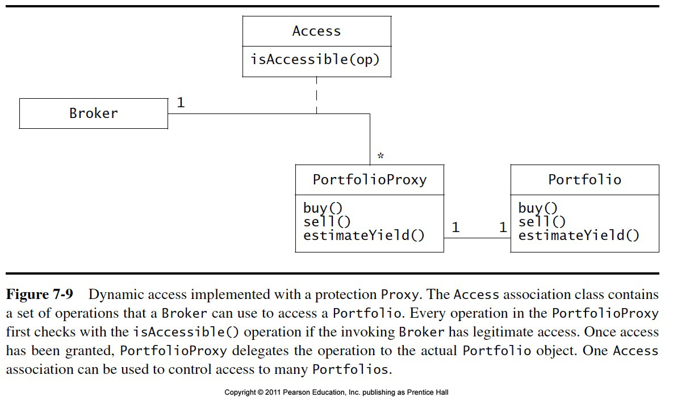

Slide 41
Global Resource Questions
Does the system need authentication?
If yes, what is the authentication scheme?
User name and password? Access control list
Tickets? Capability-based
What is the user interface for authentication?
Does the system need a network-wide name server?
How is a service known to the rest of the system?
At runtime? At compile time?
By Port?
By Name?

Slide 42
7. Decide on Software Control
Two major design choices:
1. Choose implicit control
2. Choose explicit control
Centralized or decentralized
Centralized control:
Procedure-driven: Control resides within program code.
Event-driven: Control resides within a dispatcher calling functions via callbacks.
Decentralized control
Control resides in several independent objects.
Examples: Message based system, RMI
Possible speedup by mapping the objects on different processors, increased communication overhead.
Notes:
Two major design choices:
1. Choose implicit control (non-procedural, declarative languages)
Rule-based systems
Logic programming
2. Choose explicit control (procedural languages): Centralized or decentralized
In the case of centralized control we have another choice: Procedure-driven or event-driven?
Procedure-driven control
Control resides within program code. Example: Main program calling procedures of subsystems.
Simple, easy to build, hard to maintain (high recompilation costs)
Event-driven control
Control resides within a dispatcher calling functions via callbacks.
Very flexible, good for the design of graphical user interfaces, easy to extend

Slide 43
Software Control
Explicit Control
Implicit Control
Rule-based Control
Logic Programming
Decentralized Control
Centralized Control
Event-based Control
Procedural Control.

Slide 44
Centralized vs. Decentralized Designs
Centralized Design
One control object or subsystem ("spider") controls everything
Pro: Change in the control structure is very easy
Con: The single control object is a possible performance bottleneck
Decentralized Design
Not a single object is in control, control is distributed; That means, there is more than one control object
Con: The responsibility is spread out
Pro: Fits nicely into object-oriented development

Slide 45
Centralized vs. Decentralized Designs (2)
Should you use a centralized or decentralized design?
Take the sequence diagrams and control objects from the analysis model
Check the participation of the control objects in the sequence diagrams
If the sequence diagram looks like a fork => Centralized design
If the sequence diagram looks like a stair => Decentralized design.

Slide 46
8. Boundary Conditions
Initialization
The system is brought from a non-initialized state to steady-state
Termination
Resources are cleaned up and other systems are notified upon termination
Failure
Possible failures: Bugs, errors, external problems
Good system design foresees fatal failures and provides mechanisms to deal with them.
Notes:
Most of the system design effort is concerned with the steady-state behavior described
in the analysis phase.
However, the system design phase must also address
the initiation and finalization of the system.
This is done with a set of new uses cases called administration use cases
Initialization
Describes how the system is brought from an non initialized state to steady-state ("startup use cases”)
Termination
Describes what resources are cleaned up and which systems are notified upon termination ("termination use cases")
Failure
Describes possible failures: Bugs, errors, external problems (power supply).
Good system design foresees fatal failures (“failure use cases”)

Slide 47
Boundary Condition Questions
Initialization
What data need to be accessed at startup time?
What services have to registered?
What does the user interface do at start up time?
Termination
Are single subsystems allowed to terminate?
Are subsystems notified if a single subsystem terminates?
How are updates communicated to the database?
Failure
How does the system behave when a node or communication link fails?
How does the system recover from failure?.
Notes:
8.1 Initialization
How does the system start up?
What data need to be accessed at startup time?
What services have to registered?
What does the user interface do at start up time?
How does it present itself to the user?
8.2 Termination
Are single subsystems allowed to terminate?
Are other subsystems notified if a single subsystem terminates?
How are local updates communicated to the database?
8.3 Failure
How does the system behave when a node or communication link fails? Are there backup communication links?
How does the system recover from failure? Is this different from initialization?

Slide 48
Modeling Boundary Conditions
Boundary conditions are best modeled as use cases with actors and objects
We call them boundary use cases or administrative use cases
Actor: often the system administrator
Interesting use cases:
Start up of a subsystem
Start up of the full system
Termination of a subsystem
Error in a subsystem or component, failure of a subsystem or component.

Slide 49
Example: Boundary Use Case for ARENA
Let us assume, we identified the subsystem AdvertisementServer during system design
This server takes a big load during the holiday season
During hardware software mapping we decide to dedicate a special node for this server
For this node we define a new boundary use case ManageServer
ManageServer includes all the functions necessary to start up and shutdown the AdvertisementServer.
Notes:
Administration use cases for MyTrip (UML use case diagram).

Slide 50
ManageServer Boundary Use Case
<<include>>
StartServer
Server
Administrator
<<include>>
ManageServer
ShutdownServer
<<include>>
ConfigureServer

Slide 51
Summary
System design activities:
Concurrency identification
Hardware/Software mapping
Persistent data management
Global resource handling
Software control selection
Boundary conditions
Each of these activities may affect the subsystem decomposition
Two new UML Notations
UML Component Diagram: Showing compile time and runtime dependencies between subsystems
UML Deployment Diagram: Drawing the runtime configuration of the system.
Notes:
In this lecture, we reviewed the activities of system design:
….
Each of these activities may affects the subsystem decomposition to address a specific issue
Once these activities are completed, the interface of the subsystems can be defined.
This leads us to Object Design

Slide 52
Additional Slides

Slide 53
Component Diagram (UML 1.0 Notation)
Scheduler
reservations
UML
Component
Dependency.
Planner
update
UML Interface
GUI

Slide 54
Deployment Diagram (UML 1.0 Notation)
UML Node
Dependency
:HostMachine
<<database>>
meetingsDB
UML
Interface
:Scheduler
Dependency
(between nodes)
:PC
:Planner

Slide 55
ARENA Deployment Diagram (UML 1.0)

