Slide 1
ENCS5321
Advanced Computer Networks
SDN

Slide 2

Happy holidays

Slide 3
Traditional Networks

Slide 4
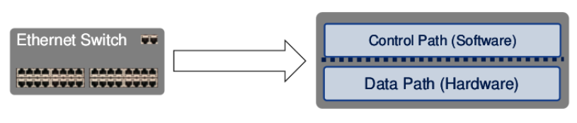
Definition
Network consists of :
  Data Plane,
  Control Plane,
  Management Plane.

Slide 5
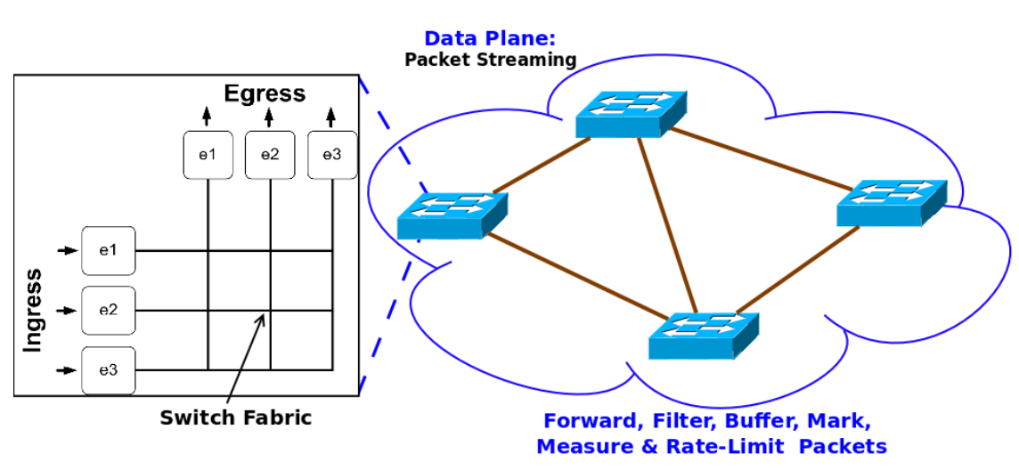
Traditional Networks: Data Plane

Slide 6
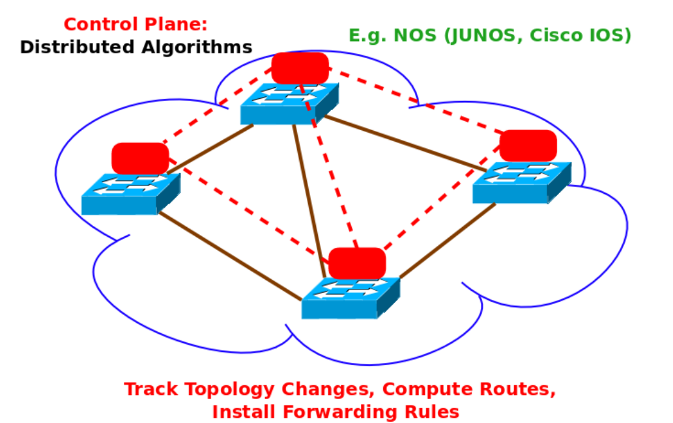
Traditional Networks: Control Plane
Notes:
Network operating system (NOS)

Slide 7
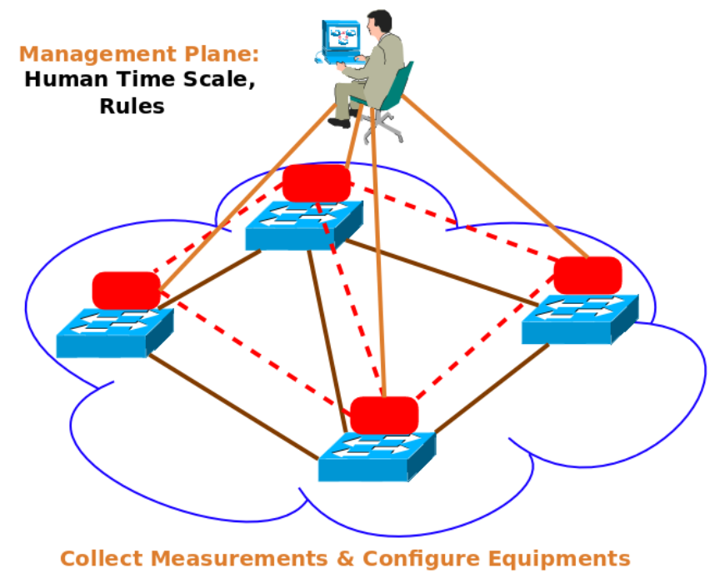
Traditional Networks: Management Plane

Slide 8
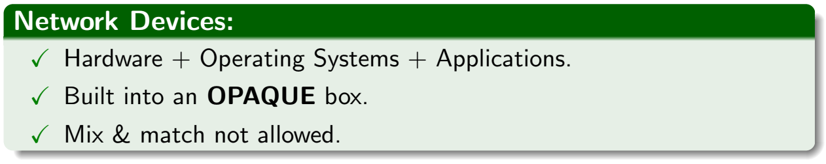
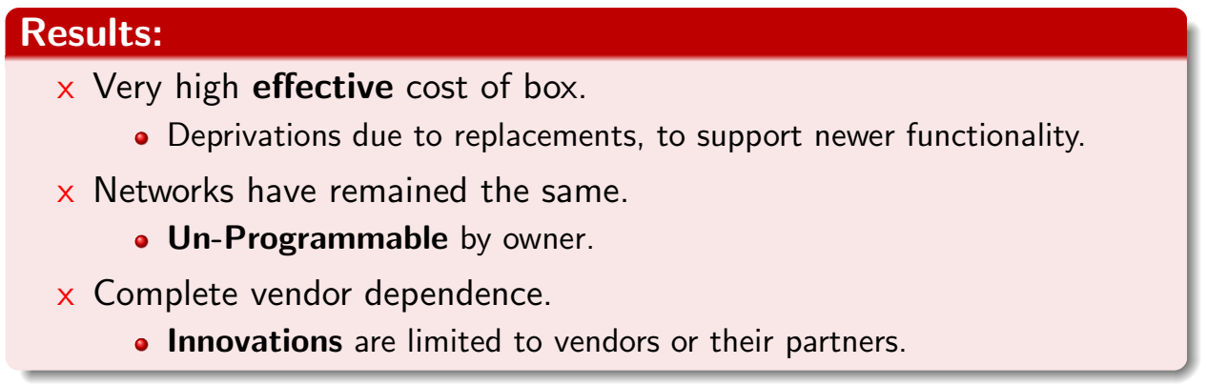
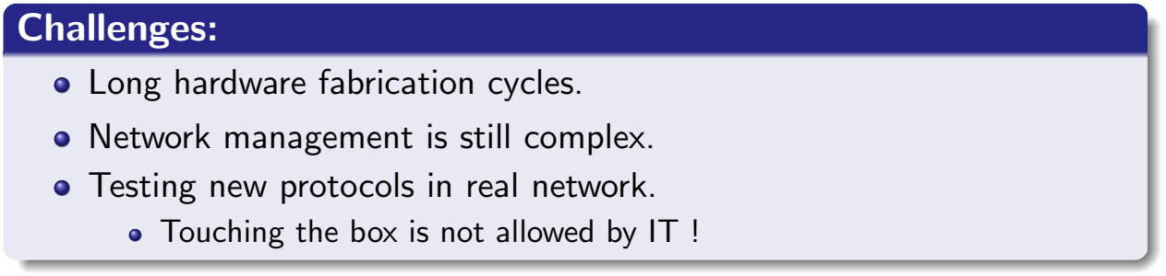
Traditional Networks

Slide 9
Software Defined Networks

Slide 10
What is Software Defined Networking?
A new approach to do networking
  new fundamental principles
How does it contrast with traditional networking?
Before knowing what it is, let us understand why we need it in the first place
  what is wrong with the current Internet?

Slide 11
The Internet: A Remarkable Story
Tremendous success
  From research experiment to global infrastructure
Brilliance of under-specifying
  Network: best-effort packet delivery
  Hosts: arbitrary applications
Enables innovation in applications
  Web, P2P, VoIP, social networks, virtual worlds
But, change is easy only at the edge…

Slide 12
Inside the Net: A Different Story
Closed equipment
  Software bundled with hardware
  Vendor-specific interfaces
Over specified
  Slow protocol standardization
Few people can innovate
  Equipment vendors write the code
  Long delays to introduce new features
Impacts performance, security, reliability, cost…

Slide 13
Networks are Hard to Manage
Operating a network is expensive
  More than half the cost of a network
  Yet, operator error causes most outages
Buggy software in the equipment
  Routers with 20+ million lines of code
  Cascading failures, vulnerabilities, etc.
The network is “in the way”
  Especially a problem in data centers
  … and home networks

Slide 14
Networks Vs. Other Systems
Networks are hard to manage
  Computation and storage have been virtualized
    Creating more flexible and manageable infrastructure
  Networks are still notoriously hard to manage
    Still heavily rely on network administrators
Networks are hard to evolve
  Ongoing innovation in systems software
    New programming languages, operating systems, etc.
  Networks are stuck in the past
    Routing algorithms change very slowly
    Network management extremely primitive

Slide 15
Networking as a Discipline
Other fields in “systems”: OS, DB, DS, etc.
  Teach basic principles
  Are easily managed
  Continue to evolve
Networking:
  Teach big bag of protocols
  Notoriously difficult to manage
  Evolves very slowly
A failure from an academic point of view

Slide 16
Why Does Networking Lag Behind?
Networks used to be simple: Ethernet, IP, TCP….
New control requirements led to great complexity
  Isolation → VLANs, ACLs
  Traffic engineering → MPLS
  Packet processing → Firewalls, NATs
  Payload analysis → Deep packet inspection
Ability to master complexity → a curse
  Extract simplicity is needed to build a discipline
Notes:
Multiprotocol label switching (MPLS) is a technique for speeding up network connections

Slide 17
A Good Example: Programming
Machine languages: no abstractions
  Mastering complexity was crucial
Higher-level languages: OS and other abstractions
  File system, virtual memory, abstract data types, ...
Modern languages: even more abstractions
  Object orientation, garbage collection,…
Abstractions key to extracting simplicity
Notes:
التجريد هو المفتاح لاستخراج البساطة

Slide 18
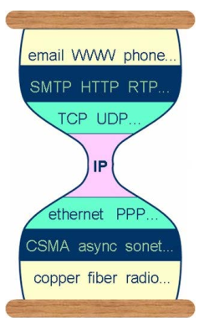
Key to the Internet’s Success
Hourglass IP model
Layered service abstractions (why is this important?)
  decompose delivery into fundamental components
  independent, compatible innovation at each layer
Only for network edges

Slide 19
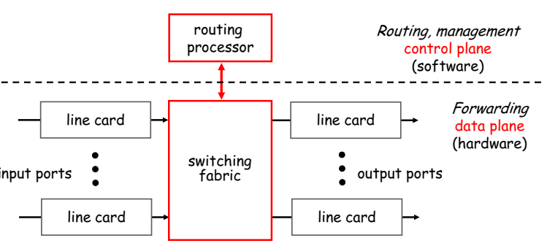
Complicated Router at the Core
Two key router functions:
  run routing algorithms/protocol (RIP, OSPF, BGP)
  forwarding datagrams from incoming to outgoing link
Notes:
Data Plane: processing and delivery of packets
❍ Based on state in routers and endpoints
❍ E.g., IP, TCP, Ethernet, etc.
❍ Fast timescales (per-packet)
Control Plane: establishing the state in routers
❍ Determines how and where packets are
forwarded
❍ Routing, traffic engineering, firewall state, …
❍ Slow time-scales (per control event)

Slide 20
What have we learned so far?
Layers are great abstractions
  Layers only deal with the data plane
  No powerful control plane abstractions!
“Modularity based on abstraction is the way things get done” – Barbara Liskov
Abstractions → Interfaces → Modularity
How do we find control plane abstractions?
  first define problem
  and then decompose it

Slide 21
The network control problem
Compute the configuration of each physical devices, e.g., forwarding tables
Operate without communication guarantees
Operate within given network-level protocol, e.g., RIP, OSPF.
Only people who love complexity would find this a reasonable request!

Slide 22
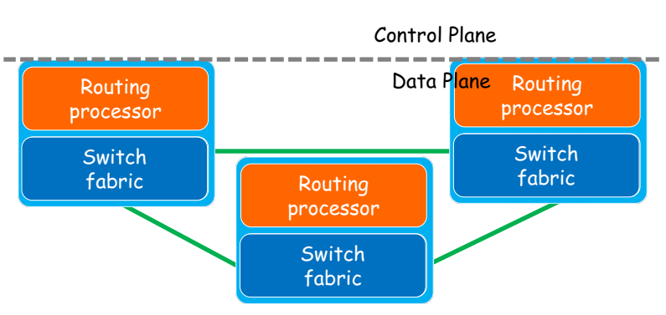
Separation of Control/Data Plane

Slide 23
Benefits of Separation
Independent evolution and development
  The software control of the network can evolve independently of the hardware.
Control from high-level software program
  Control behavior using higher-order programs
  Debug/check behavior more easily

Slide 24
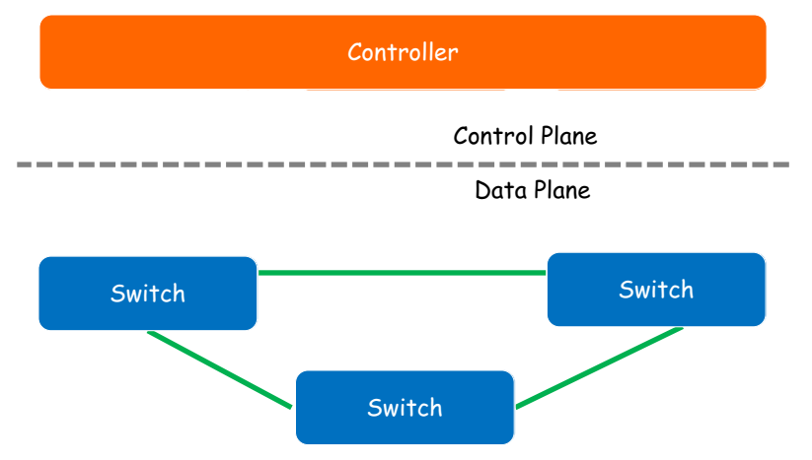
Logically Centralized Control

Slide 25
Benefits of Centralization
Centralized decisions are easier to make
  e.g., OSPF
  Distributed system part
  Routing algorithm
Logically vs. physically centralized
  Issues of a physically centralized controller?
  How to implement a logically centralized one?
Notes:
A centralized controller is a single entity that have the ability to manage all forwarding devices of the network. SDN offers centralized controllers to significantly increment the programmability of the network. The SDN Controller represents the centralized controller of OpenFlow network. It conserves topology information, sets up all OpenFlow devices, and observes the global status of whole network. The Open- Flow device, such as a router, switch or access point, is any device that have the ability to support OpenFlow functionality. Each device preserves a flow table that indicates the processing applied to any packet of a certain flow. Centralized controller considers a single point of failure, also may have limitations concerning the scalability issue. A single controller may not be enough to handle a network with a large number of data plane entities.
Opposite to a centralized layout, a distributed network operating system (NOS) can be scaled up to meet the conditions of potentially any environment, from small to large-scale networks. Distributed controllers have been suggested for Software Defined Networking to overcome the problems of reliability and scalability that emerged with a centralized controller.
In the distributed architecture, each single controller is in charge of controlling only a part of the switches. In order to preserve the consistency of the network’s status and work collaboratively, any single controller can communicate with other controllers in the network through east/westbound APIs.

Slide 26
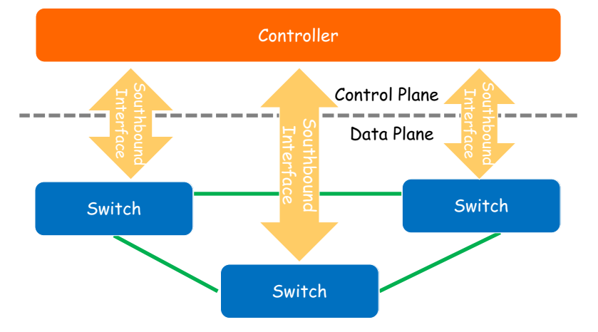
Open Interfaces
Notes:
A northbound interface is an interface that permits a specific entity of a network to communicate with a higher-level entity. On the contrary, a southbound interface permits a specific network entity to communicate with a lower-level entity.
In Software Defined Networking (SDN), the southbound interface is either OpenFlow or other protocol. Its main job is to allow communication between the SDN controller and the network entities (which include both virtual and physical switches and routers) so that the router have the ability to discover topology of the network, define network flows and perform requests relayed to it through northbound APIs. The northbound interface depicts the field of protocol-supported communication between applications or high level programs and the controller.

Slide 27
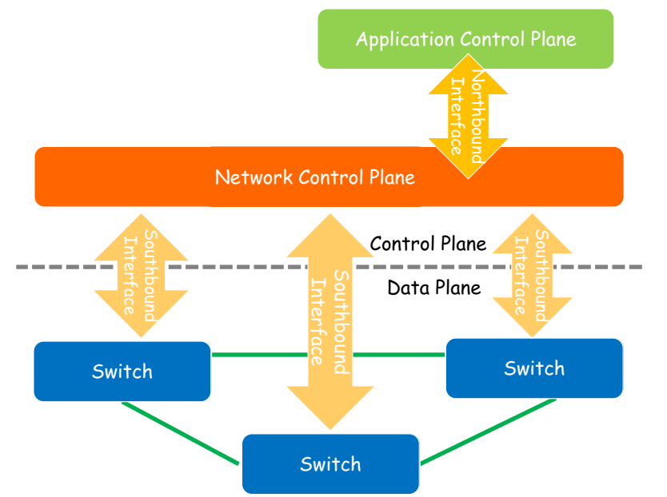
Programmability
Notes:
A northbound interface is an interface that allows a particular component of a network to communicate with a higher-level component. Conversely, a southbound interface allows a particular network component to communicate with a lower-level component.

Slide 28
Benefits of Open Interfaces and Programmability
Enable competitive technologies
  Independent developments
  Rapid innovation and fast evolution
  Cheap and better networks
Make network management much easier
  Management goals are expressed as policies
  New control/services for network providers
  Detailed configuration are done by controller

Slide 29
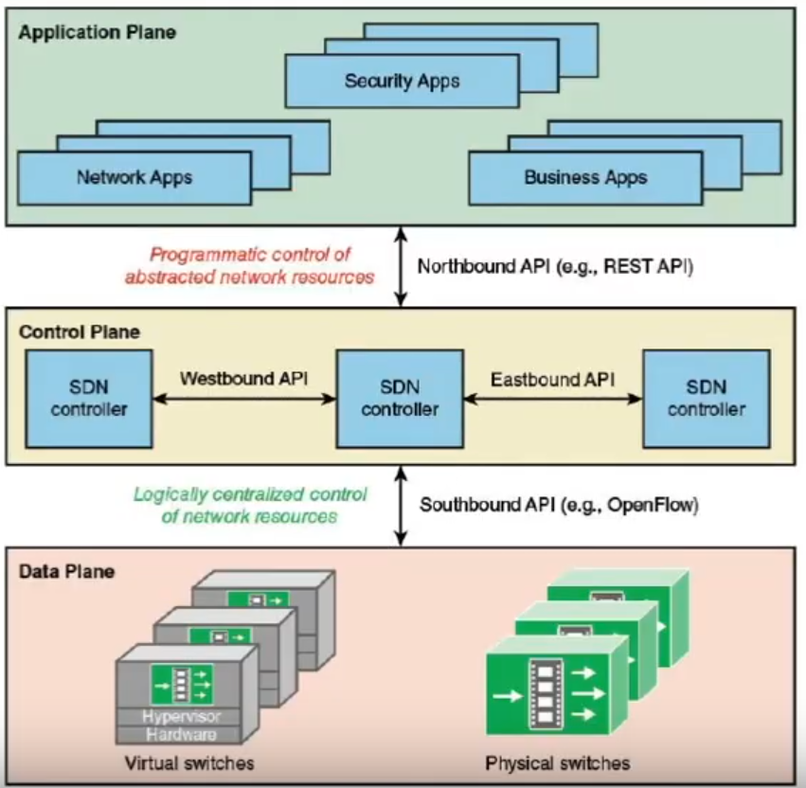

Slide 30
A Quick Summary
Principles of Software Defined Networking
  Separation of Control Plane and Data Plane
  Logically Centralized Control
  Open Interfaces
  Programmability
All these principles use abstractions to modularize the network control problem

Slide 31
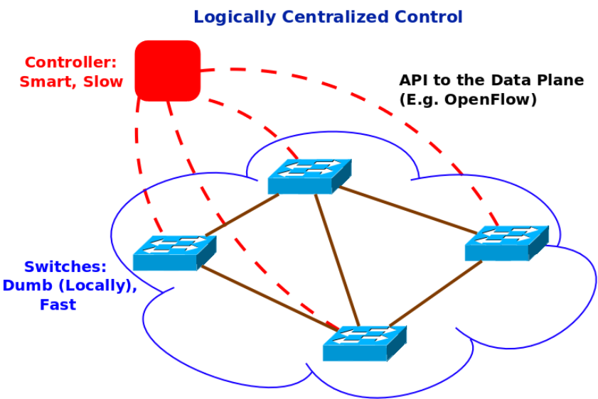
SDN = Dumb Switches + Smart Controller

Slide 32
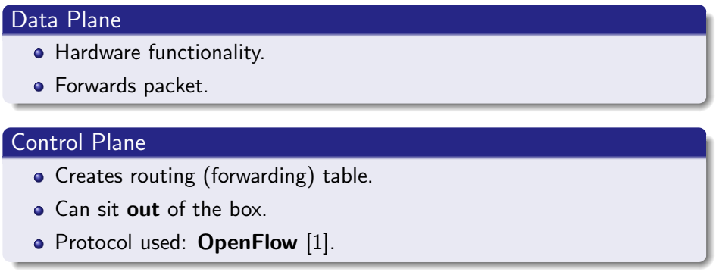
SDN decouples CONTROL and DATA Plane
[1] POX: http://www.noxrepo.org/pox/about-pox/
Notes:
[1] POX: http://www.noxrepo.org/pox/

Slide 33
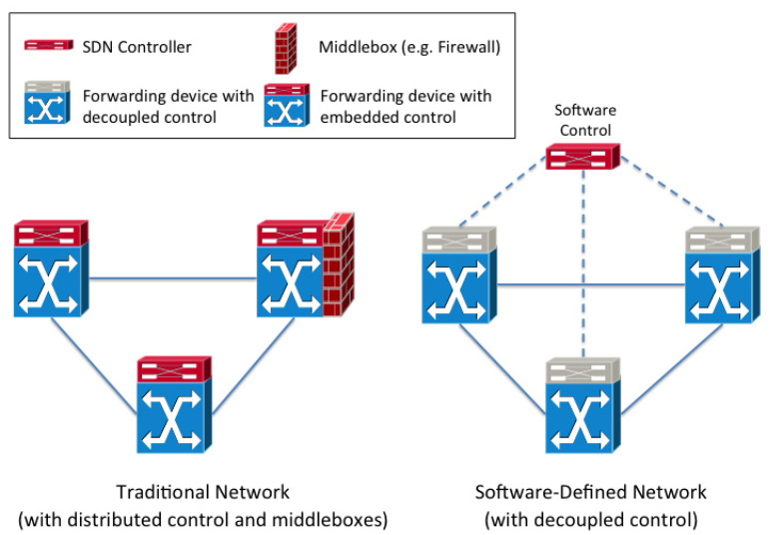
Decoupling of CONTROL and DATA Plane

Slide 34
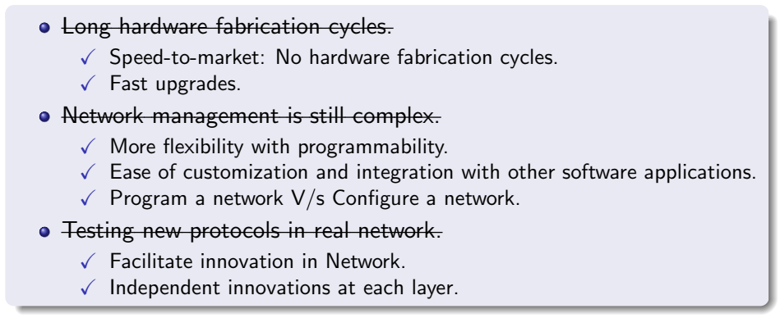
SDN Benefits

Slide 35
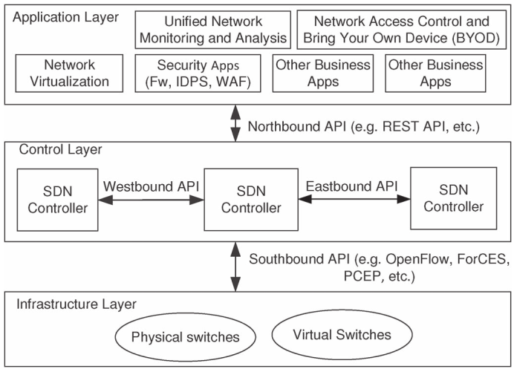
SDN Architecture
Notes:
PCEP (Path Computation Element Protocol) is a protocol that is used to compute network paths.
intrusion detection and prevention system (IDPS)
A web application firewall (WAF) is a firewall that monitors, filters and blocks Hypertext
East/westbound interfaces are considered as special instances that are used only in distributed controllers. These interfaces can make more than one function include import/export data between controllers, observation /notification potentials (e.g., know whether a controller is up or notify a takeover on a set of forwarding devices) and algorithms for data consistency models.

Slide 36
SDN Architecture: Infrastructure Layer
Also known as the Data Plane.
It consists mainly of Forwarding Elements (FEs) including physical and virtual Switches.
FEs are accessible via an open interface.
Allows packet switching and forwarding.
Every FE must support Southbound APIs (The reason why traditional FE can’t be used as per SDN standards).

Slide 37
SDN Architecture: Control Layer
Also known as the Control Plane.
It consists of a set of software-based SDN Controllers.
Provides a consolidated control functionality.
Supervises the network forwarding behaviour through an open interface.
Three communication interfaces allow the Controllers to interact: Southbound, Northbound, East/Westbound.

Slide 38
SDN Architecture: Communication Interfaces
Southbound Interface
  Allows the Controller to interact with the forwarding elements in the infrastructure layer.
  e.g. OpenFlow, a protocol maintained by ONF.
Northbound Interface
  Enables the programmability of the Controllers.
  e.g. REpresentational State Transfer (REST)-based APIs.
East/Westbound Interface
  It is an envisioned communication interface.
  Which is not currently supported by an accepted standard.
  It is mainly meant for enabling communication between federations of Controllers to synchronize state for high availability.
Notes:
The Open Networking Foundation (ONF) is a user-driven non-profit organization focused on promoting the adoption of software-defined networking (SDN) through open standards development. It was founded by Deutsche Telekom, Facebook, Google, Microsoft, Verizon, and Yahoo! in 2011.
REST (representational state transfer) is a software architectural style that was created to guide the design and development of the architecture for the World Wide Web. REST defines a set of constraints for how the architecture of a distributed, Internet-scale hypermedia system, such as the Web, should behave.

Slide 39
SDN Architecture: Application Layer
It mainly consists of the end-user business applications.
It consume the SDN communications and network services.
e.g. network visualization and security business applications.
Notes:
Network visualization, also known as network topology mapping, is the practice of creating visual depictions of the device arrangement, dependencies, and data flows in a network. It offers granular visibility into your IT infrastructure and helps you track the real-time health and performance of various network components, such as routers and servers.
With the increasing size and complexity of enterprise networks, identifying faulty devices, incorrect configurations, and malicious network traffic has become a considerable challenge. Network visualization helps you precisely understand your network architecture, including device connections and data flows. For instance, visualizing your network via graphs, charts, and maps allows you to rapidly identify faulty or misconfigured devices. Network visualization is also critical from a network monitoring and analysis perspective. Any slight change in network layout or device uptime status is instantly visible on the network maps generated by visualization tools, helping streamline your network management efforts.

Slide 40
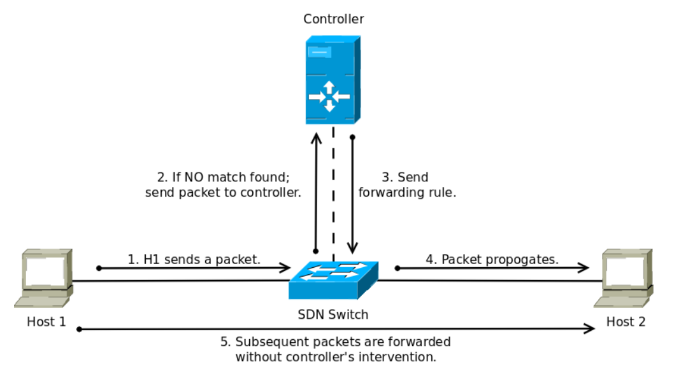
SDN: Working
Notes:
Software Defined networks do not have a device explicitly named as router. The Network is generally made of switches and controllers. However, can sdn networks achieve functionality of routing ? Definitely!
Sdn uses controllers. In a very broad sense controllers work on the principle of match criteria and corresponding action . The controller uses the match criteria to instruct the switch what it should do with the packet. Hence switches in sdn are sometimes referred as dumb switches.
The match criteria can be destination mac - so it behaves as a switch - L2.
It can be destination IP . so it acts as a router. It can be source MAC or source IP . which is a part of policy based routing .
Or it can be any header field from l2-l5.
It can even determine the action by using the application layer data
Hence a controller in sdn can be a router but it's capable of much more than that .
But you wont find the word router used much in the context of sdn
Hope it helps
To answer the second question . Sdn gives you the control of packets forwarding. So using controller APIs you can implement practically any algorithm which may be the exact routing algorithm we use now like ospf , a modification of them or a new concept altogether that suits your Network.

Slide 41
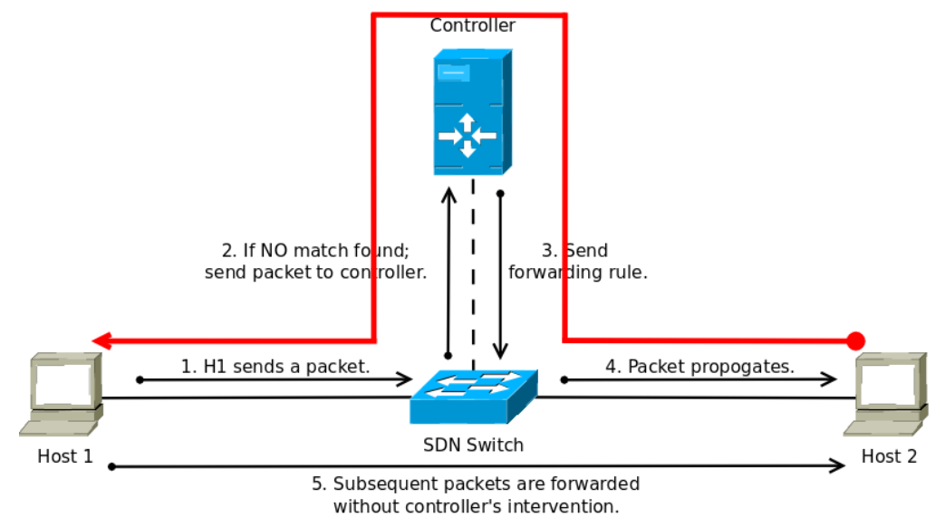
SDN: Working

Slide 42
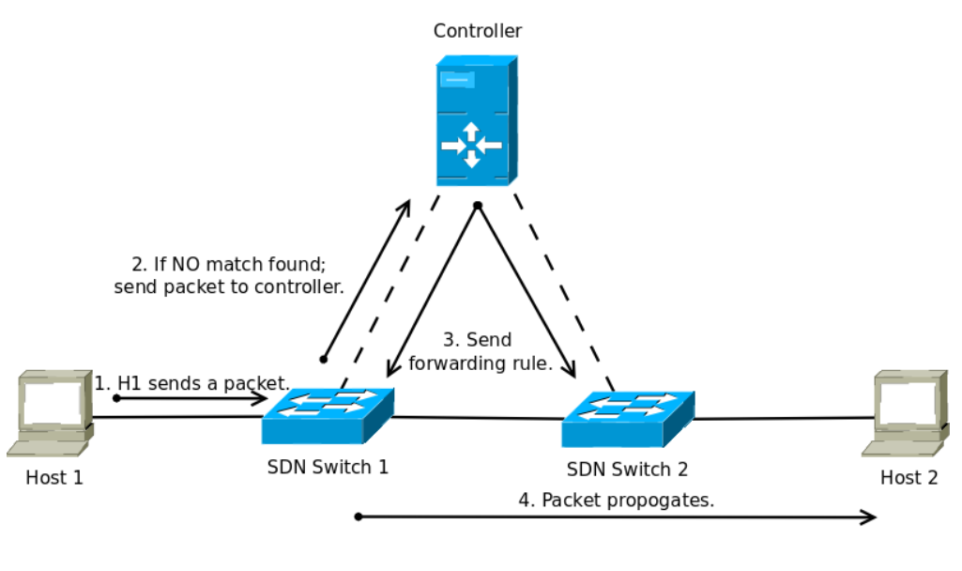
SDN: Working - Use Global View

Slide 43
OpenFlow Protocol

Slide 44
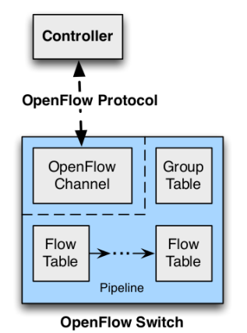
OpenFlow Protocol
OpenFlow is a Layer 2 communication protocol.
OpenFlow is the first standard communications interface defined between the Control and Forwarding layers of SDN architecture.
OpenFlow allows direct access & manipulation of the Forwarding Plane of network devices such as Switches and Routers.

Slide 45
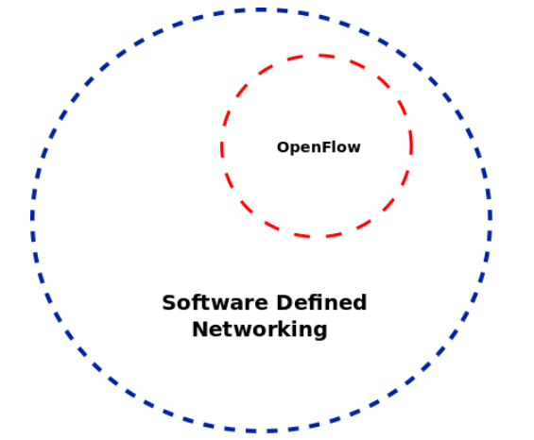
OpenFlow does not equal SDN
General Myth: OpenFlow is SDN
Reality: OpenFlow is one flavour, or a subset, of SDN
Others: NetConf & Application Layer Traffic Optimization (ALTO)

Slide 46
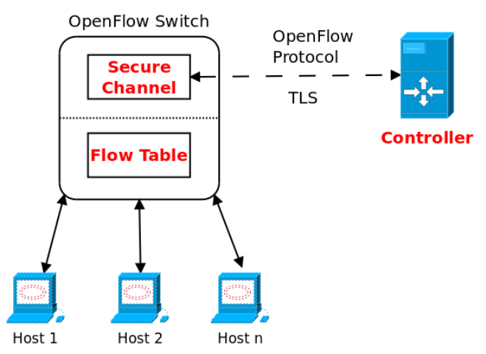
Components of OpenFlow Network
Notes:
Transport Layer Security (TLS)

Slide 47
Components of OpenFlow Network
Controller
  Defines the forwarding policies (actions to take for each flow) based on information acquired from various network devices.
    SDN relies on Controller. Any SDN must have at-least one Controller.
Secure Channel
  Connects a Switch to the Controller, allowing commands and packets to be sent between a Controller & the Switch through OpenFlow protocol.
Flow Table
  Consists of a Flow Entry & an Action associated with each flow entry to tell the Switch how to process the flow.
* Network Operating System (NOS) is the set of Controllers that forms an execution environment.

Slide 48
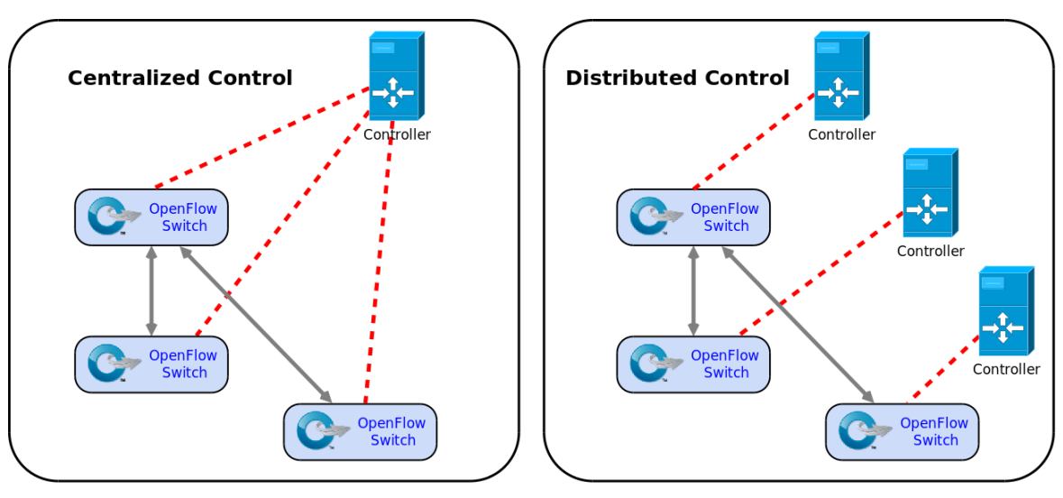
Controller: Centralized V/s Distributed

Slide 49
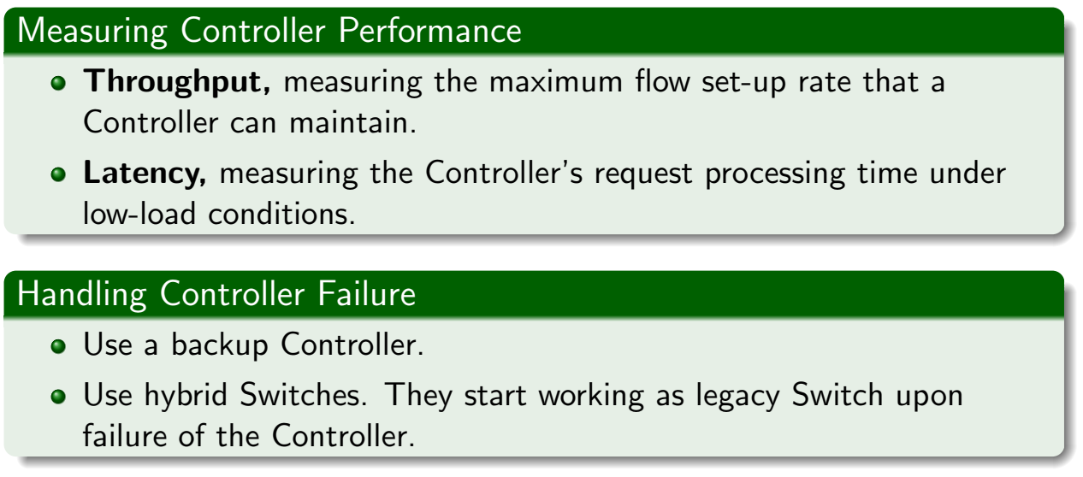
Controller: Measuring Performance & Handling Failure

Slide 50
Secure Channel
A Controller configures and manages the Switch, receives events from the Switch & send packets out the Switch via this interface.
SC establishes and terminates the connection between OpenFlow Switch & the Controller using Connection Setup & Connection Interruption procedures.
The SC connection is a TLS (or TCP) connection. Switch and Controller mutually authenticate by exchanging certificates signed by a site-specific private key.

Slide 51
Flow Table: Open Flow Protocol Messages
Controller-to-Switch - Initiated by the Controller & used to manage or inspect the state of the Switch.
  Features, Config, Modify State, Read-State, Packet-Out, Barrier.
Asynchronous messages are sent without the Controller soliciting them, from a Switch.
  Packet-in, Flow Removed / Expiration, Port-status, Error.
Symmetric - Symmetric messages are sent without solicitation, in either direction.
  Hello, Echo, Error, Experimenter
Notes:
OpenFlow Messages
OpenFlow Protocol supports 3 message types, each with their own setup of sub-types:
Controller-to-switch
Asynchronous
Symmetric
Controller-to-switch Messages
Controller-to-switch Messages and initiated by the controller and used to directly manage or inspect the switch. These messages include:
Features – switch needs to request identity
Configuration – set and query configuration parameters
Modify-State – also called ‘flow mod’, used to add, delete and modify flow/group entries
Read-States – get statistics
Packet Outs – controller send message to the switch, either full packet or buffer ID.
Barrier – Request or reply messages are used by controller to ensure message dependencies have been met, and receive notification.
Role-Request – set the role of its OpenFlow channel
Asynchronous-Configuration – set an additional filter on asynchronous message that it wants to receive on OpenFlow Channel
Asynchronous Messages
Asynchronous messages are initiated by the switch and used to update the controller of network events and changes to the switch state. These messages include:
Packet-in – transfer the control of a packet to the controller
Flow-Removed – inform controller that flow has been removed
Port Status – inform controller that switch has gone down
Error – notify controller of problems
Symmetric Messages
Symmetric messages are initiated either by the switch or controller and sent without solicitation. These messages include:
Hello – introduction or keep-alive messages exchanged between switch and controller
Echo – sent from either switch or controller, these verify liveness of connection and used to measure latency or bandwidth
Experimenter – a standard way for OpenFlow switches to offer additional functionality within the OpenFlow message type space.

Slide 52
Flow Table: Instructions & Action Set
Each flow entry contains a set of instructions that are executed when a packet matches the entry.
Instructions contain either a set of actions to be added to the action set or modify pipeline processing.
Action Set contains a list of actions to be applied immediately to the packet.
An Action set is always associated with every entry. By default it is empty.
A flow entry modifies action set using Write-Action or Clear-Action instruction.

Slide 53
Flow Table: Instructions
List of Instructions to modify action set:
Apply Actions
  Apply the specified actions immediately.
Clear Actions
  Clear all the actions in the set immediately.
Write Actions
  Merge the specified actions to the current set.
Write Metadata
  Write the metadata field with the specified value.
Goto -Table
  Indicated the next table in the processing pipeline.

Slide 54
Flow Table: Actions
Actions are of two type:
Required Actions
  Output - Forward a packet to the specified port.
  Drop
Optional Actions
  Set-Queue
  Push/Pop Tag
  Set-Field

Slide 55
Flow Table: Packet Matching
OpenFlow pipeline contains multiple flow tables starting with Table 0.
Each flow table contains one or more flow entries. Matching starts with the first flow entry.
If a Match is found :
  Instructions associated with flow entry are executed.
  Instruction may direct the packet to the next flow table in pipeline.
  When processing stops, the associated action set is applied.
Instructions describe packet forwarding, packet modification and pipeline processing.

Slide 56
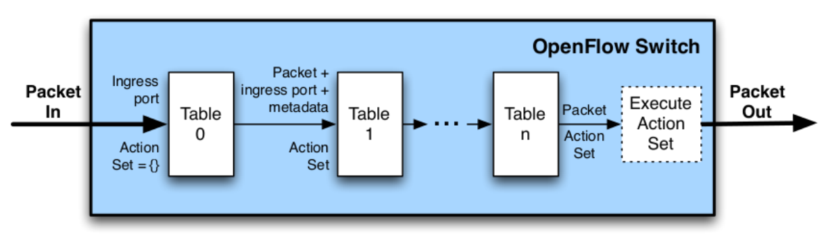
Flow Table: Pipeline Processing
Packets are matched against multiple tables in the pipeline:
Notes:
https://overlaid.net/2017/02/15/openflow-basic-concepts-and-theory/
Typically, you’ll have more than a single flow table, so it’s important to note that matching starts at the first flow table and may continue to additional flow tables of the pipeline. The packet will first start in table 0 and check those entries based on priority. Highest priority will match first (e.g. 200, then 100, then 1). If the flow needs to continue to another table, goto statement tells the packet to go to the table specified in the instructions.
If a matching entry is found, the instructions associated with the specific flow entry are executed. If no match is found in a flow table, the outcome depends on the configuration of the Table-miss flow entry.

Slide 57
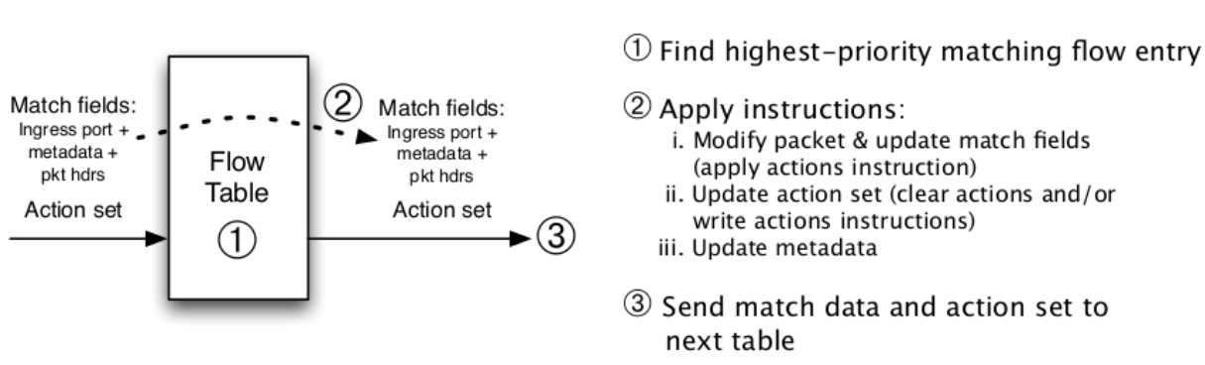
Flow Table: Pipeline Processing
Per-table packet processing:

Slide 58
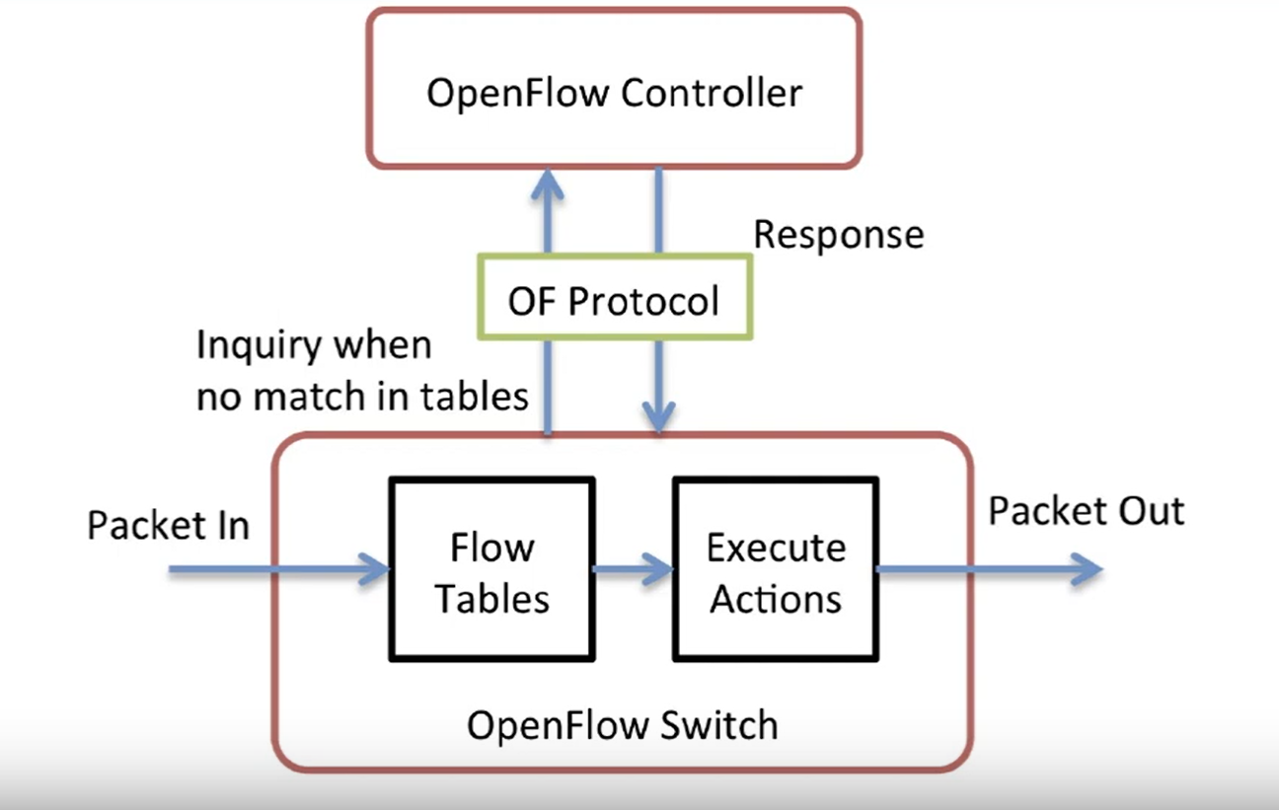

Slide 59
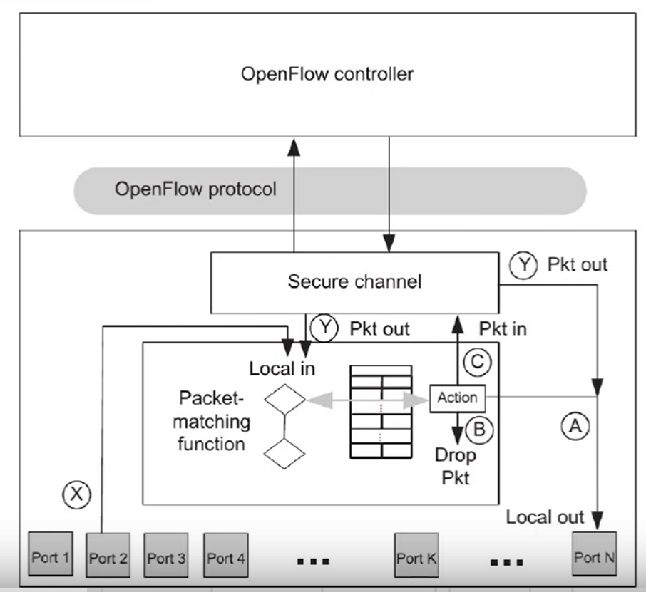

Slide 60
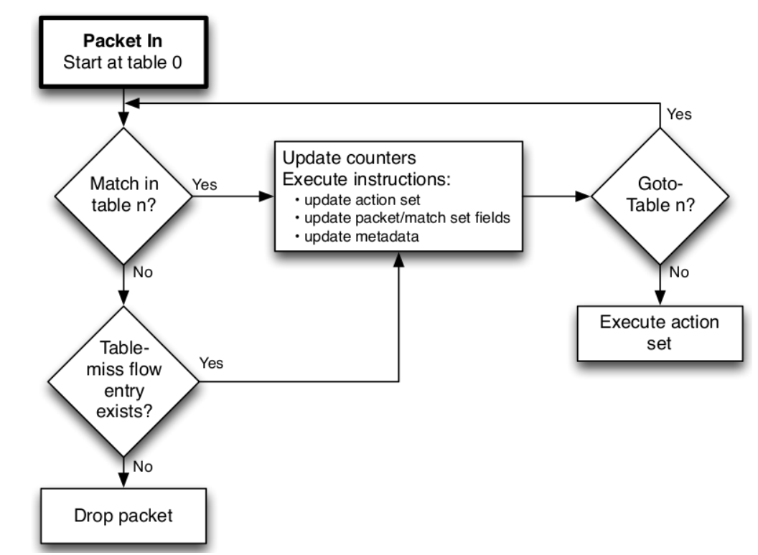
Flowchart detailing packet flow through an OpenFlow Switch

Slide 61
Flow Table: Table Miss
Every flow table must support a table-miss flow entry to process table misses.
The table-miss flow entry specifies how to process packets unmatched by other flow entries in the flow table.
  e.g. send packets to the Controller, direct packets to a subsequent table or drop packets.
If a table is missed & a table-miss entry exists then it causes penalty in form of delay.

Slide 62
Flow Table: Flow Removal
Flow entries are removed either
At the request of the Controller,
Or via the Switch flow expiry mechanism.
  Idle_timeout causes the flow entry to be removed when it has matched no packets in the given number of seconds.
  hard_timeout causes the flow entry to be removed after the given number of seconds, regardless of how many packets it has matched.

Slide 63
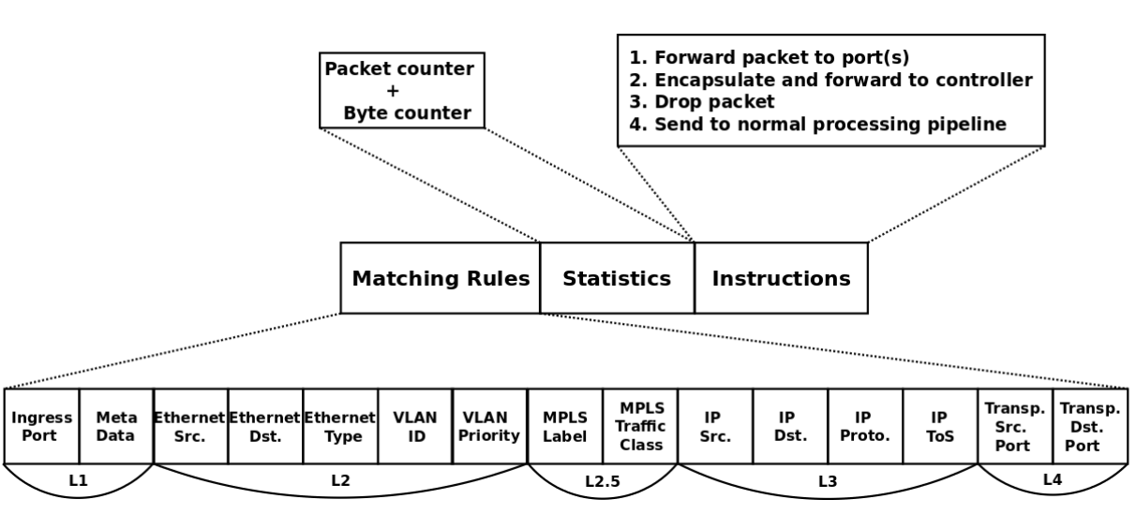
A Flow Table Entry

Slide 64
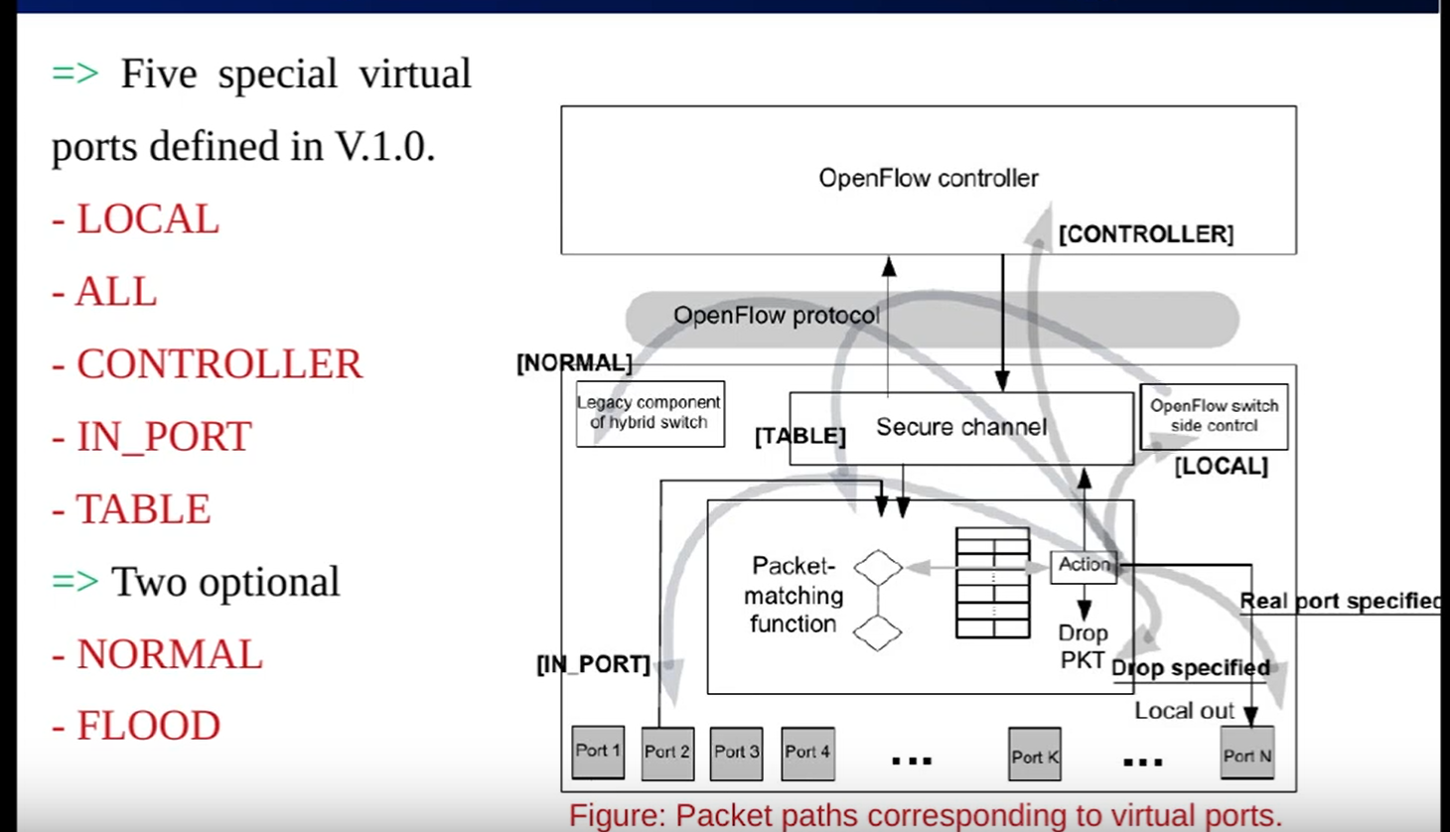

Slide 65
SDN Resources, Issues &
Use Cases

Slide 66
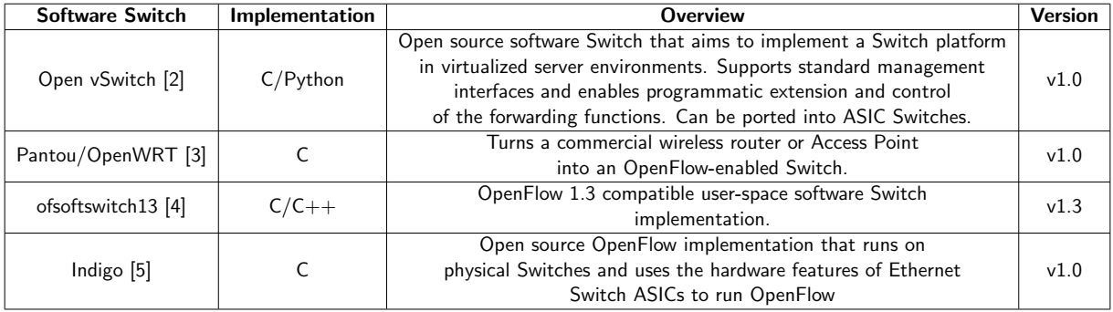
Software Switch Implementation Compliant With OpenFlow

Slide 67
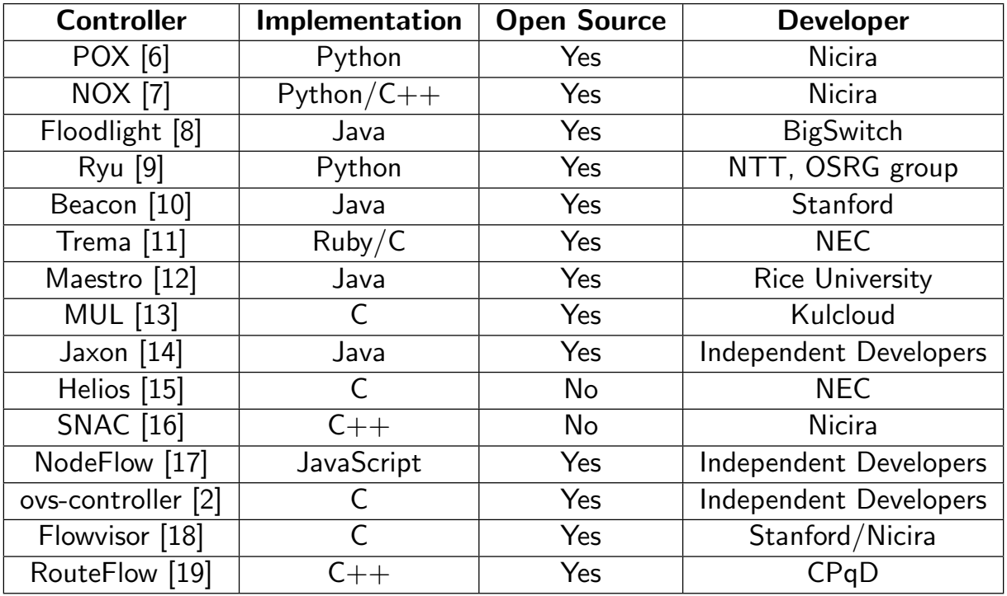
Controller Implementation Compliant With OpenFlow

Slide 68
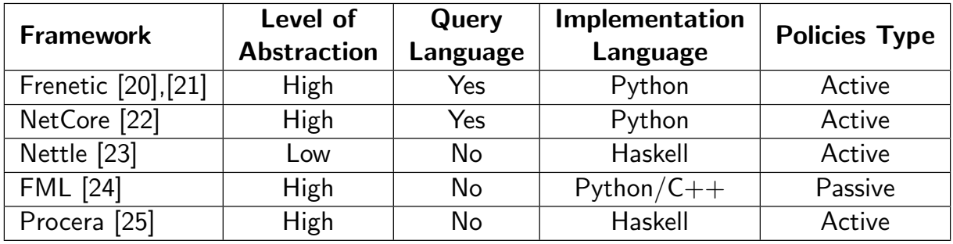
SDN Programming Languages

Slide 69
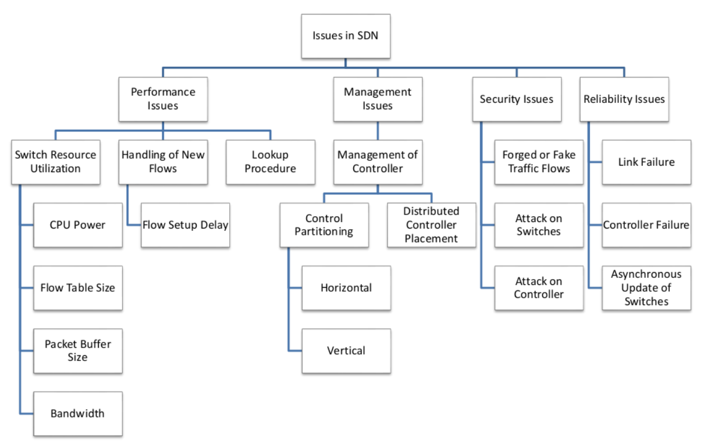
Issues in SDN

Slide 70
Performance Issues: Switch Resource Utilization
CPU Power
  Every flow is handled by the system CPU.
  CPU is needed to encapsulate the packet to be transmitted to the Controller for flow setup through the Secure Channel.
  Limited power of a Switch CPU can restrict the bandwidth between the Switch and the Controller.
Flow Tables Size
  OpenFlow Switches maintain complete visibility in a large OpenFlow network which results in increase in flow table size.

Slide 71
Performance Issues: Switch Resource Utilization
Packet Buffer Size
  Limited packet buffer size may lead to drop in packets and decrease in throughput.
Bandwidth Between Switch and Controller
  Limited bandwidth between Switch and Controller may lead to decrease in performance.

Slide 72
Performance Issues: Handling of New Flows
Performance of Control Plane is determined by the number of new flows per second that the Controller can handle and the delay of a flow setup.
Goals of OpenFlow was to keep the Data Plane simple and to delegate the control task to a logically centralized Controller.
As a result, Switches consult the Controller frequently for instructions on how to handle incoming packets of new flows.
This tends to congest Switch-Controller connections, which in turn adds latency to the processing of the first packets of a flow in the Switch buffer.

Slide 73
Performance Issues: Lookup Procedure
Two types of flow tables exist:
Hash table
  Stored in Static RAM (SRAM) on the Switch.
  This type of memory is off-chip, leading to increased lookup latencies.
Linear table
  Stored on TCAM (Ternary Content Addressable Memory).
  Located on Switch-chip, leading to decreased lookup latencies.
In ordinary Switches, lookup mechanism is the main operation that is performed.
In OpenFlow-enabled Switches, other operations especially the “insert" operation is considered that can lead to a higher power dissipation & a longer access latency.

Slide 74
Management Issues
Distributed Controllers Placement
  Determining the number of the needed Controllers and their placement within the controlled domain is an issue.
Control Partitioning
  Refers to partitioning of the network into multiple controlled domains. It can be done in two ways:
    Horizontal: Multiple Controllers are organized in a flat Control Plane where each one governs a subset of the network Switches.
    Vertical: Controllers functionalities are organized vertically. Control tasks are distributed to different Controllers depending on criteria such as network view and locality requirements.

Slide 75
Security Issues
Forged or faked traffic flows
  To attack Switch/Controllers.
  Can be triggered by faulty device or malicious user.
  Aims to launch DoS/D-DoS attack against network devices.
Attack on Switches
  To slow down.
  Or to drop packets.
Attack on Controller
  Inject traffic or forged requests to overload the Controller.
  Once the Controller is attacked, all lower level Switches are misled and can’t correctly deliver packets.

Slide 76
Reliability Issues
Link Failure
  Failure of link between Controller and Switch.
  Failure of Switch-to-Switch path link.
Controller Failure
Asynchronous Update of Switches
  Controller may not be able to synchronously update all the Switches.

Slide 77

EXAM View

