Slide 1
History of Gardens
Agriculture
Urban environment, relation to nature, structure of society.
Role of plants and garden in the city.
Geometry and nature
Gardens are product of dictatorship, power, wealth.

Slide 2
concept Form Geographic setting Forms are response to climate and context connection between form and concept is idealized in paradise garden, protected shaded retreat, expression of nature, expression of geometry and mathematical proportion botanical collection
Garden design

Slide 3
Prototype of historic gardens and parks 1.architecture 2.nature
Prototypes

Slide 4
sources of prototypes literature: travelers’ and visitors’ writings illustrations visible remains

Slide 5
Garden
Garden is an enclosure of land for pleasure and delight.
Pleasure: originated in mythology
Layout: originated from ancient cultivation and irrigation practices

Slide 6
Sacred grove memory, hero, trees rocks, shrine or alter
Myth, ( the god garden)garden and agriculture is connected with god. Demeter goddess of corn …..
Farm garden , derived from sacred groove, egypt pond fish agricultural plants, lutus
Garden of Eden
Symbolism of plants olive fig thorn
Promise garden of prophet Mohammad

Slide 7
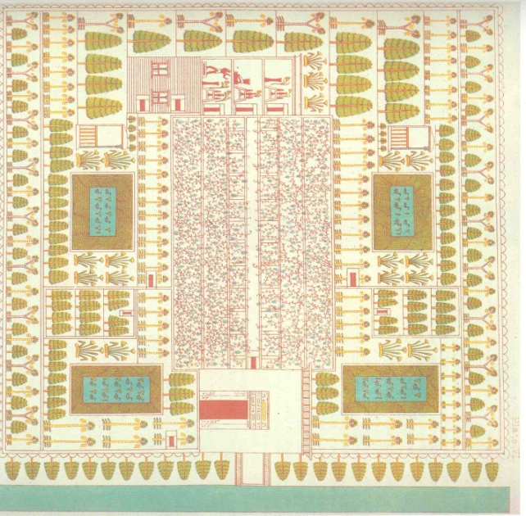
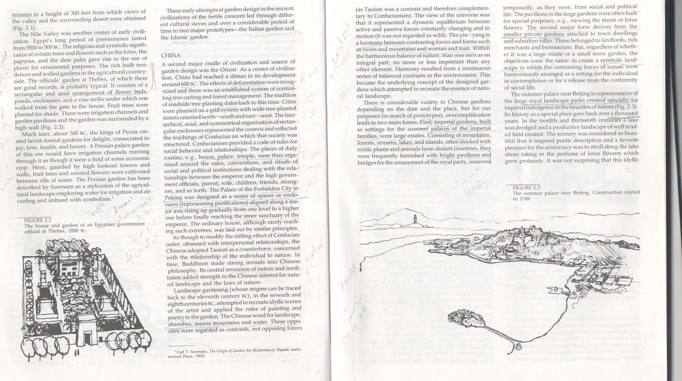
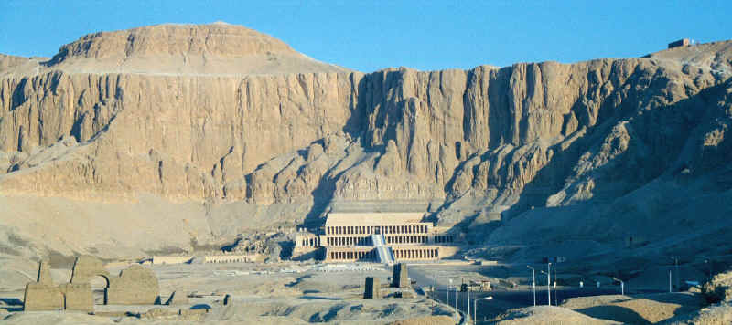
Egypt farm garden
Rectangular and axial arrangement of flower beds, ponds and enclosure
Surrounded by high wall
Irrigation channels
Lutus and papyrus and date palm, pomegranate, sycamore.
Fruit trees for shade
Vine trellis

Slide 8
Babylon paradise garden
3500 BC
Gardens were for pleasure and representation of Paradise
Irrigation channels and ponds (functional and enjoyment of water in hot climate)
Shades was provided by trees planted in groves
Palace of ruler made sun-baked bricks and garden

Slide 9
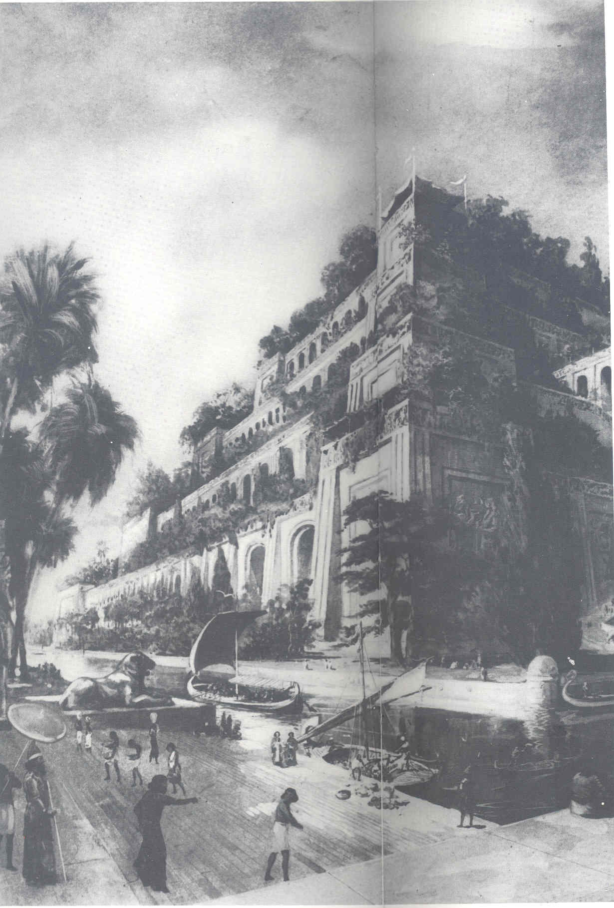
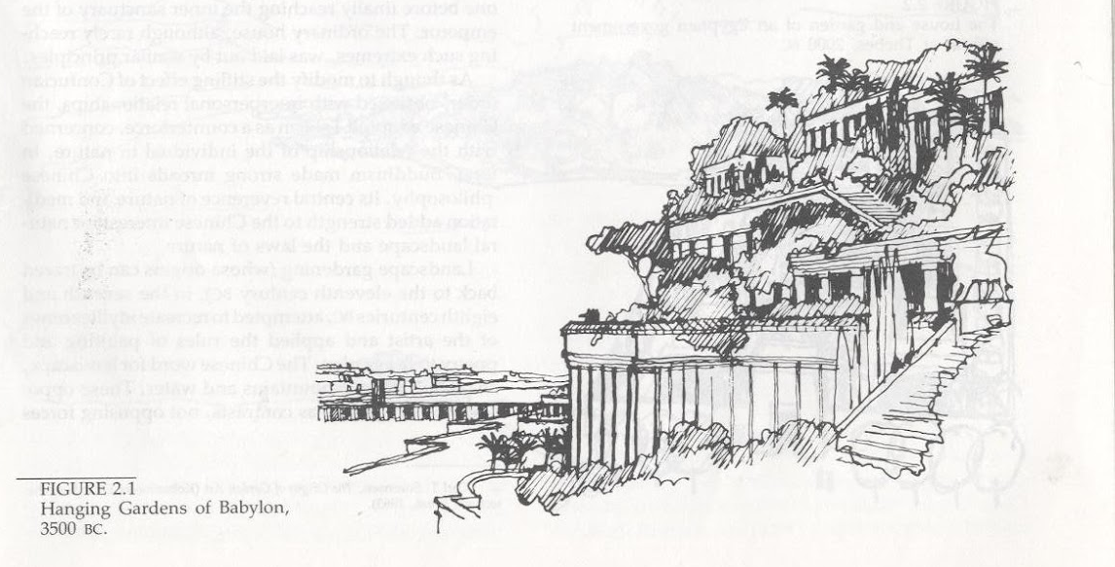
Babylon paradise garden
4 acres
300feet
Planted and irrigated roof terraces height 300 feet
Nabukhath Nassar

Slide 10
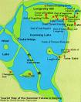

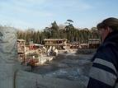
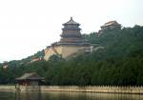
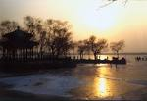
China Summer Palace

Slide 11
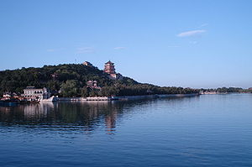
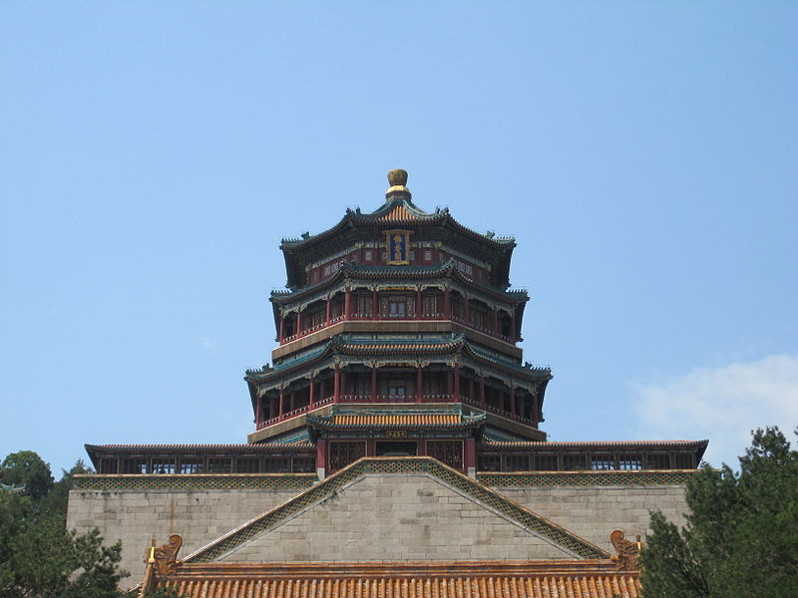
Tower of Buddhist

Slide 12
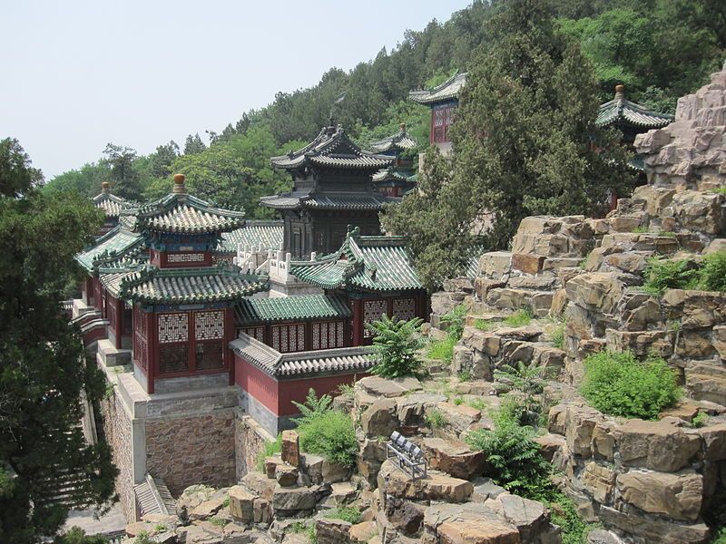
Pavilion of Precious Clouds

Slide 13
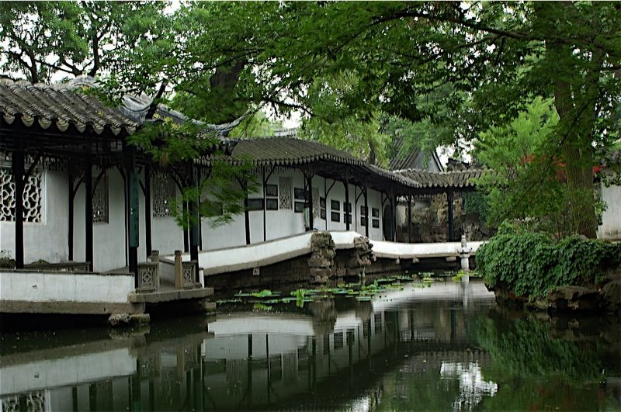
tkvz7d3z
Humble Administrator's Garden (Zhuo Zheng Yuan) in Suzhou

Slide 14
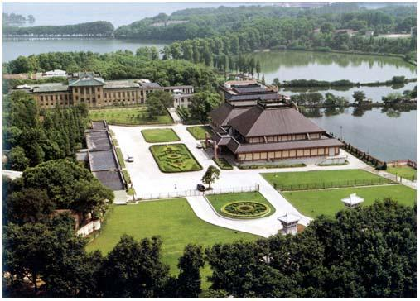
tkvz7d3z

Slide 15
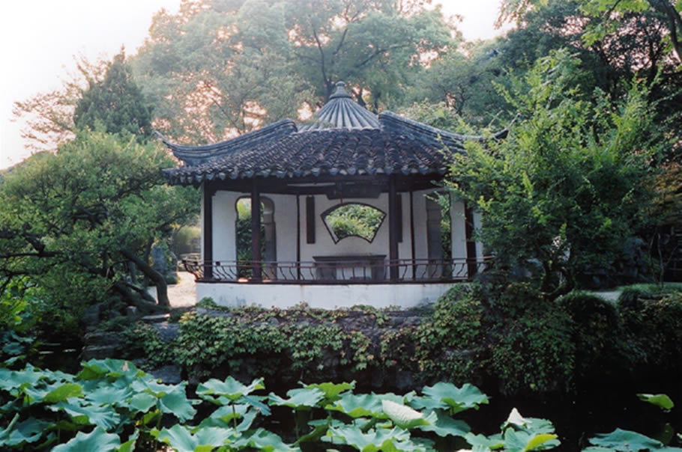
tkvz7d3z

Slide 16
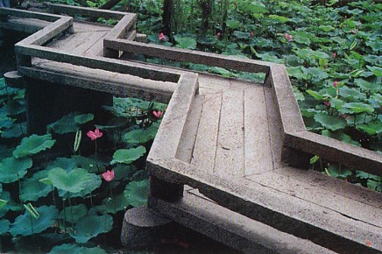

Slide 17
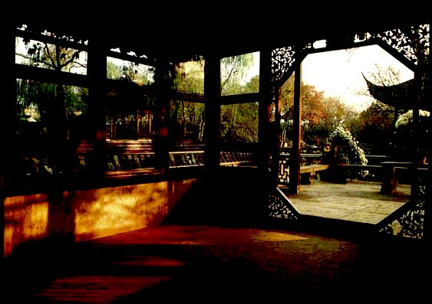
tkvz7d3z

Slide 18
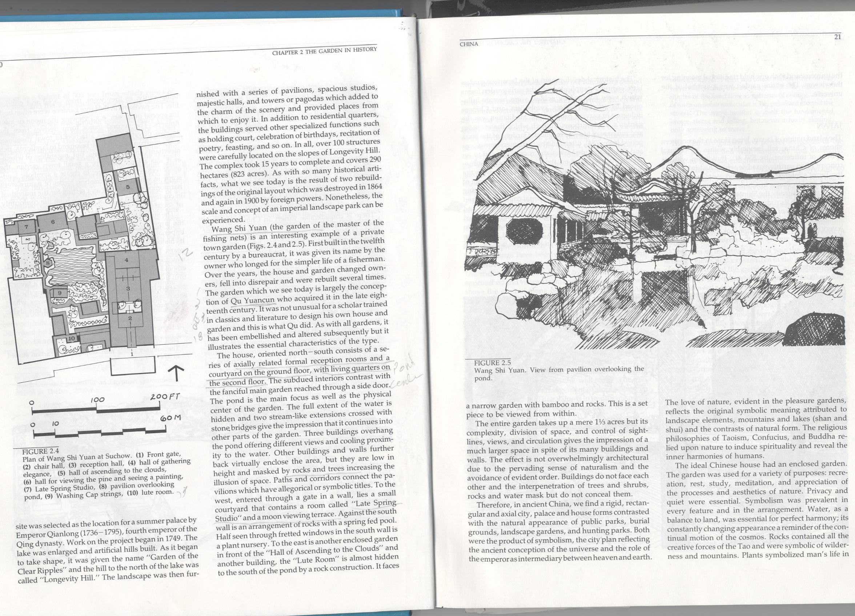





Wang shi

Slide 19
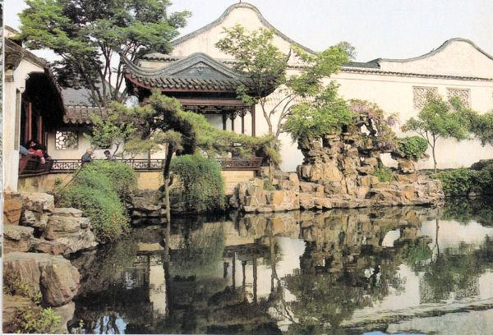
tkvz7d3z
Wang Shi Yuan (Garden of the Master of the Fishing Nets) in Suzhou.

Slide 20
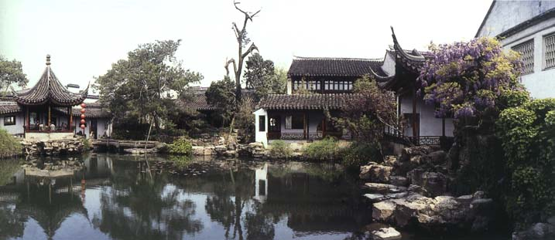
tkvz7d3z

Slide 21
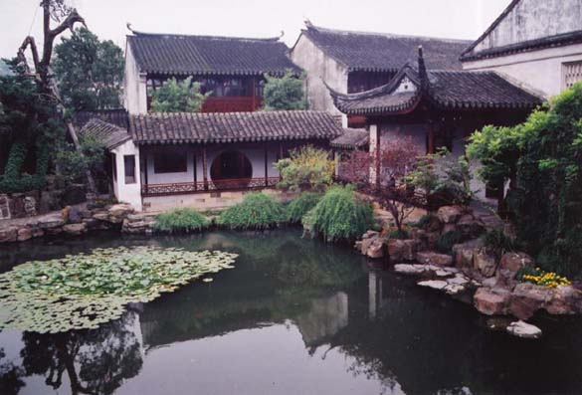
tkvz7d3z

Slide 22
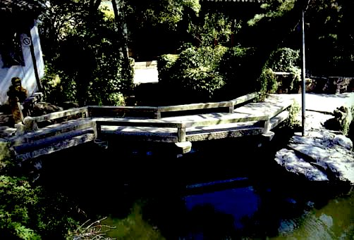
tkvz7d3z

Slide 23
Azalea sp. Azalea
Bambousa sp. Bamboo,
Camellia sp. Camelia,
Chrysanthemum Chrysanthemum
Ginco Biloba Ginkgo
Morus alba Mulberry
Nelumbo nucifera Lotus
Nymphae sp. Water lilly
Orchids
Paeonia suffruticosa Peony

Slide 24
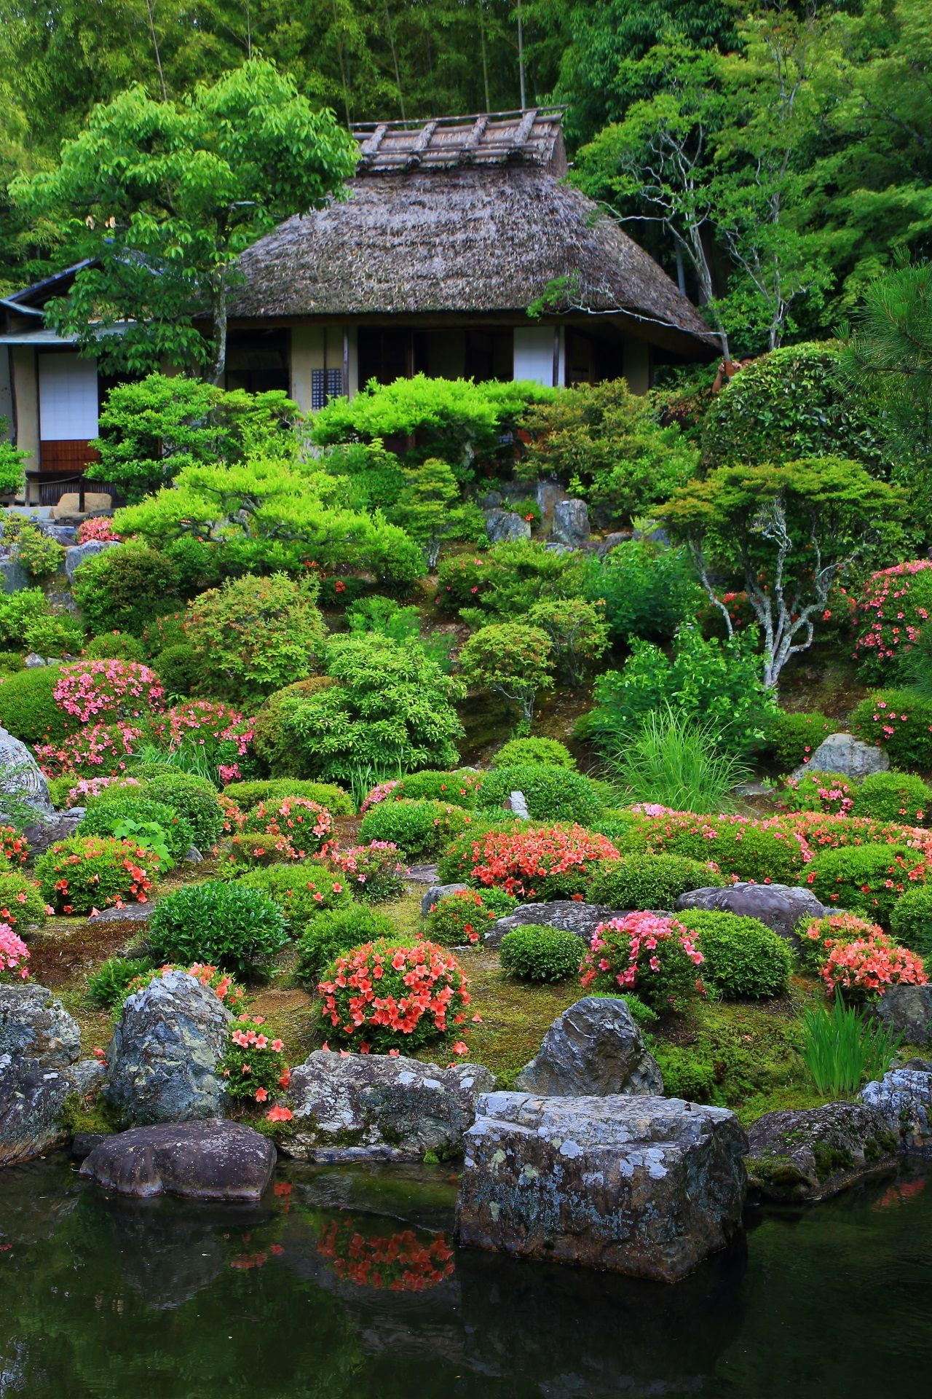
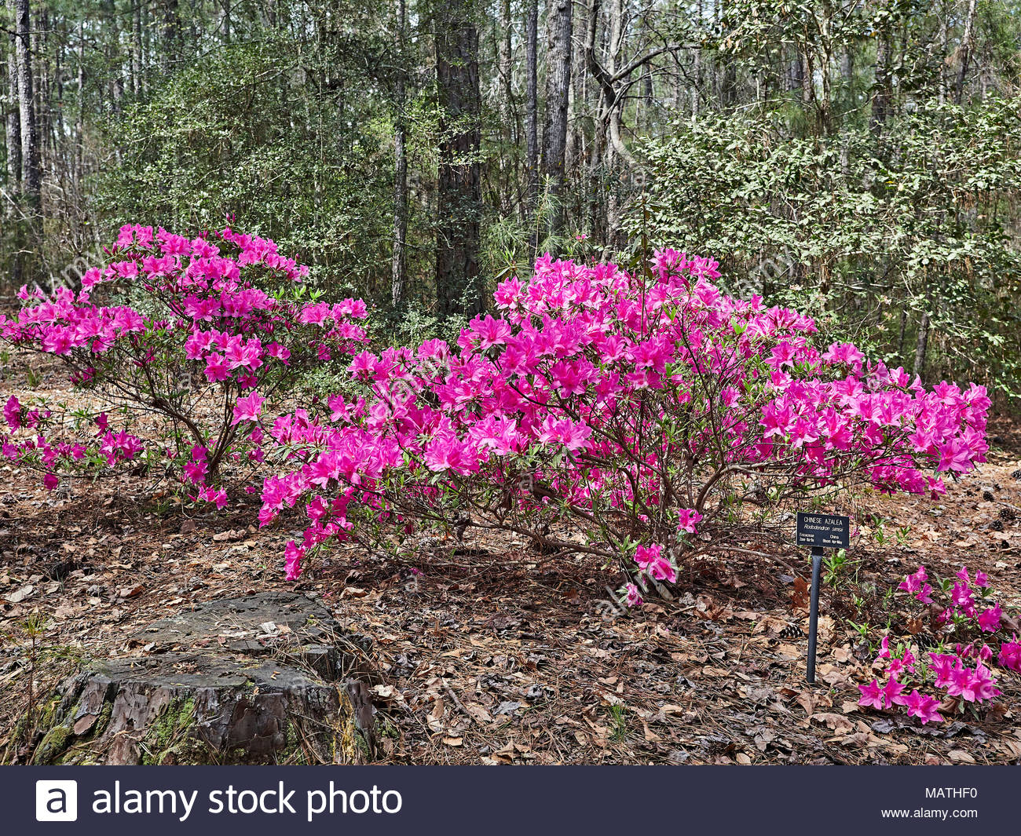
azaleas

Slide 25
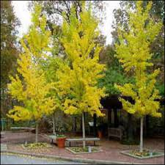
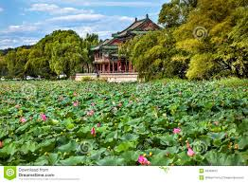

Slide 26
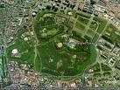

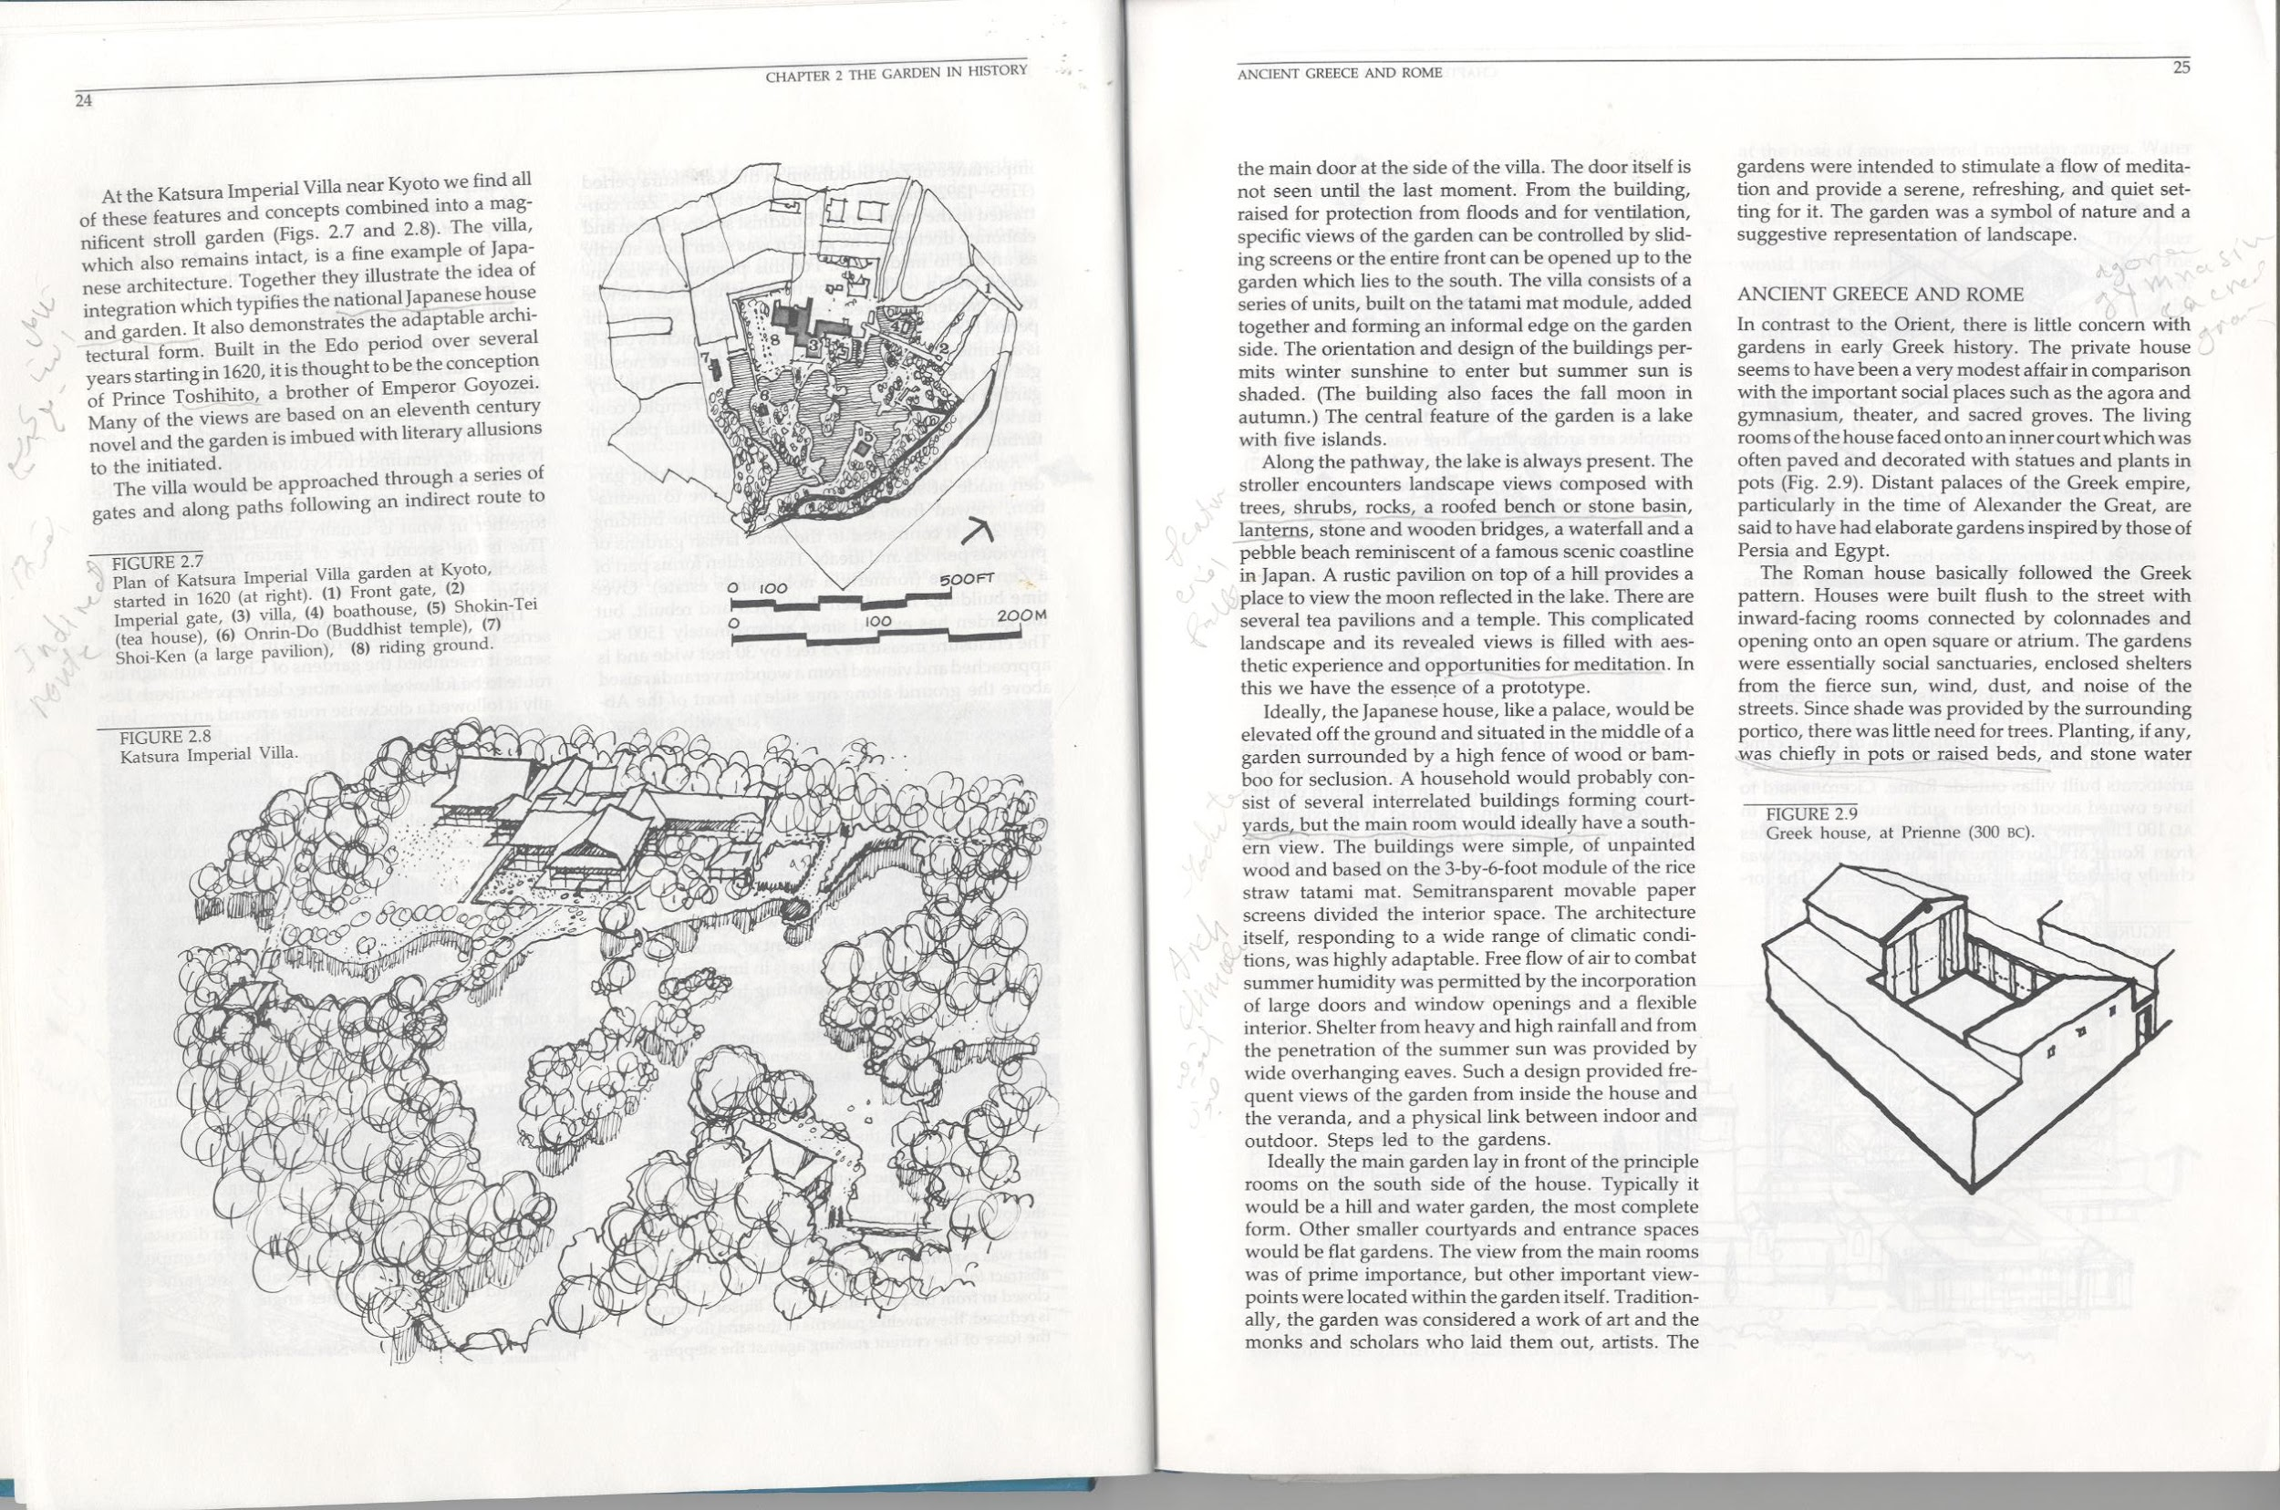
Japan imperial palace

Slide 27



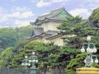
Japan imperial palace

Slide 29

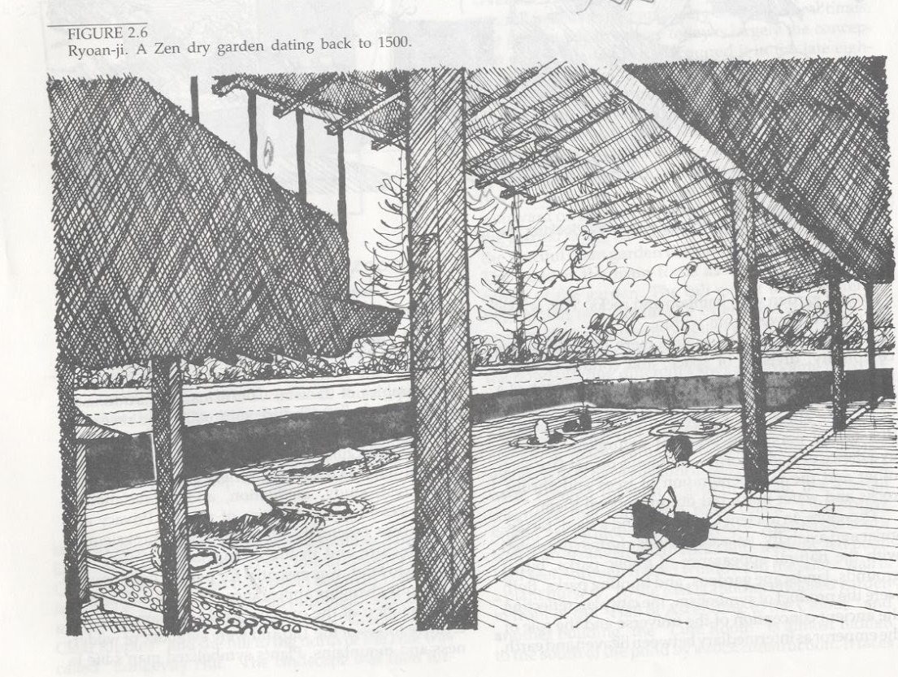
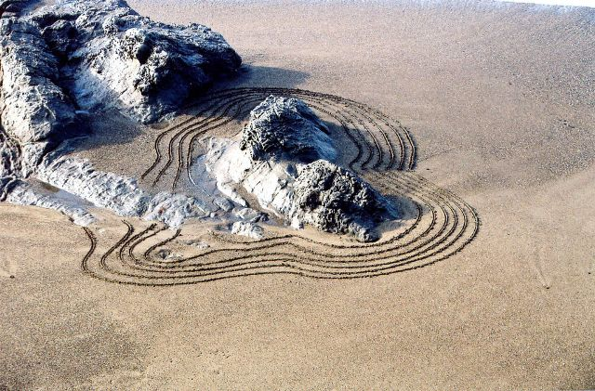
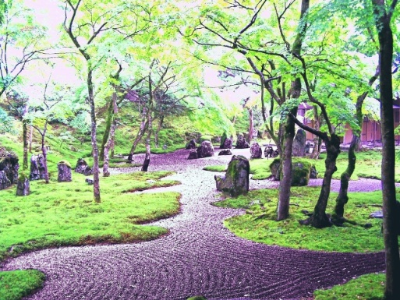
Zen Garden

Slide 30
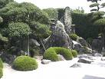
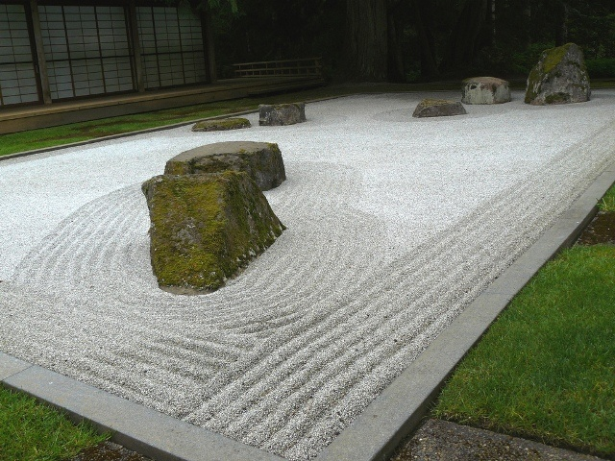
Zen Garden

Slide 31
Acer palmatum Japanese Maple
Azalea sp. Azalea
Bambousa sp. Bamboo,
Camellia japonica. Camelia,
Crecidiphyllum japonica Kastura Tree
Iris ensata Japanese Iris
Pinus densiflora Japanese red flora
Pinus thunbergiana Japanese black pine
Prunus sp. Flowering cherry

Slide 32
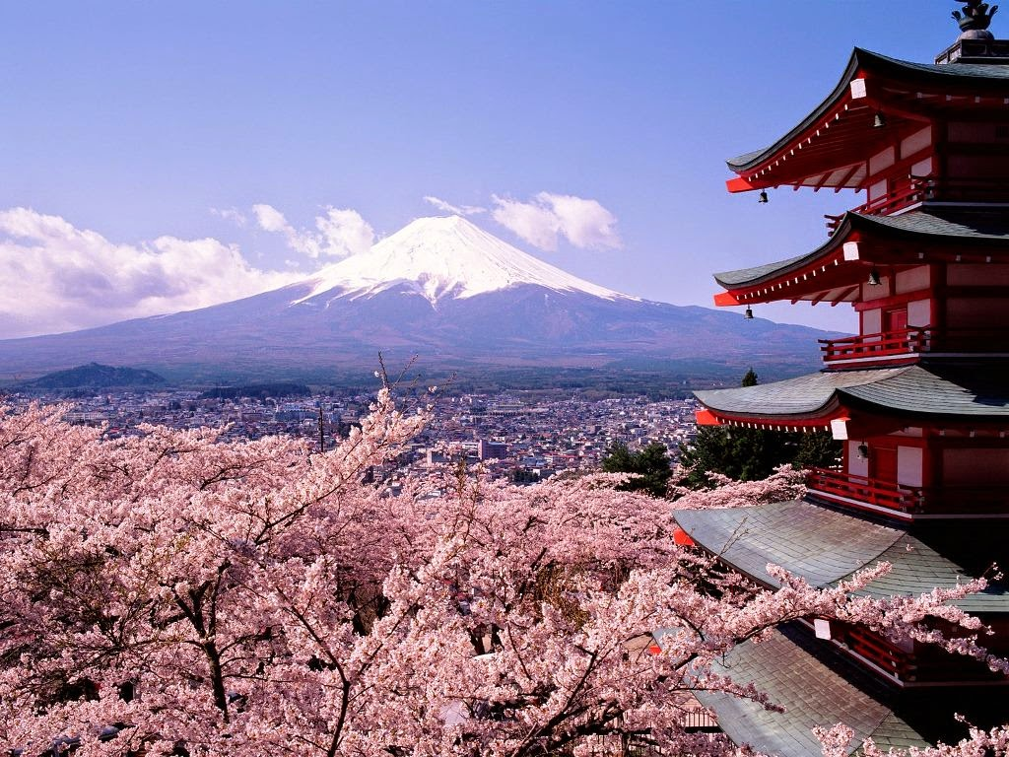
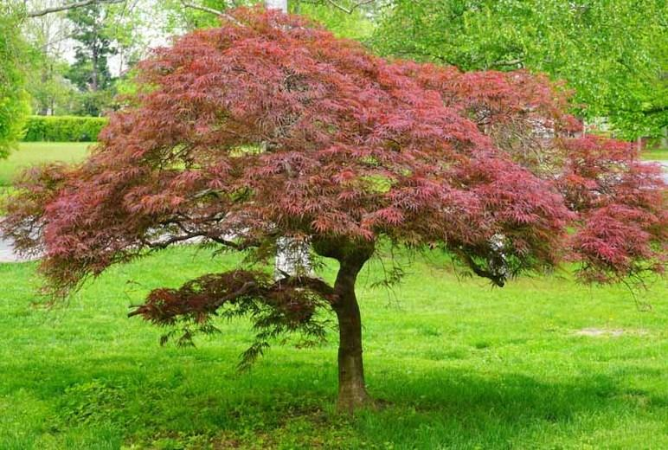
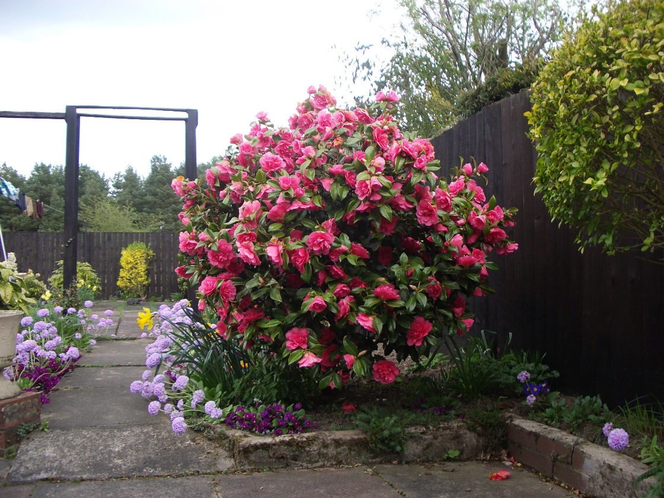
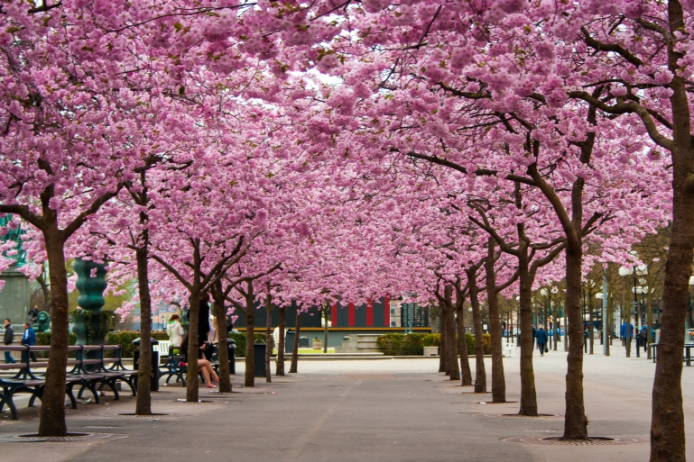

Slide 33
