Slide 1
NUTD 331: CLINICAL NUTRITION 1
INSTRUCTOR: Hind Eliyan

Slide 2
What is Malnutrition
Unbalanced nutrition
Undernutrition
Overnutrition

Slide 3
Undernutrition
Caused by a lack of calories, protein or other nutrients
Usually seen in areas of the world with inadequate supply of food and drinking water
Protein-energy malnutrition - resulting from deficiencies in any or all nutrients ( macro and micro)
  Wasting ( low weight for height)
  Stunting ( Low height for Age)
  Underweight ( low weight for age)
Micronutrient deficiencies or insufficiencies (a lack of important vitamins and minerals)
According to the WHO
“Globally in 2020, 149 million children under 5 were estimated to be stunted (too short for age), 45 million were estimated to be wasted (too thin for height)”
“Around 45% of deaths among children under 5 years of age are linked to undernutrition”
World Health Organization, Malnutrition.

Slide 4
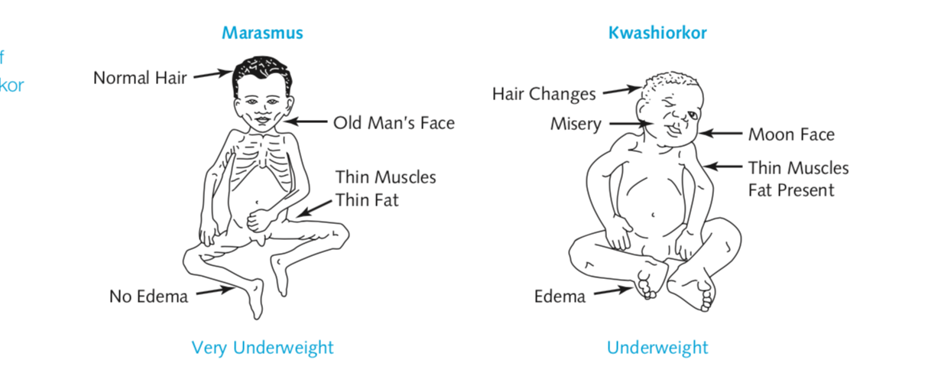
Protein Energy Malnutrition
The most widespread form of malnutrition in the world today.
PEM includes
kwashiorkor (a protein-deficiency disease)
Marasmus- A deficiency disease caused by inadequate food intake
Community Nutrition in Action - Marie A. Boyle

Slide 5
Malnutrition- Undernutrition
Chronic Malnutrition usually results in Stunting - Inadequate nutrition over long period of time leading to failure of linear growth
“Stunting is often associated with cognitive impairments such as delayed motor development, impaired brain function and poor school performance”
Acute Malnutrition usually results in wasting ( Too thin for height)
” Rapid deterioration in nutritional status over a short period of time”
  Acute malnutrition
  Moderate acute malnutrition (MAM)
  Severe acute malnutrition (SAM).
2020 Global Nutrition Report
https://globalnutritionreport.org/454aeb#0718a918-stunting-in-children-under-five

Slide 6
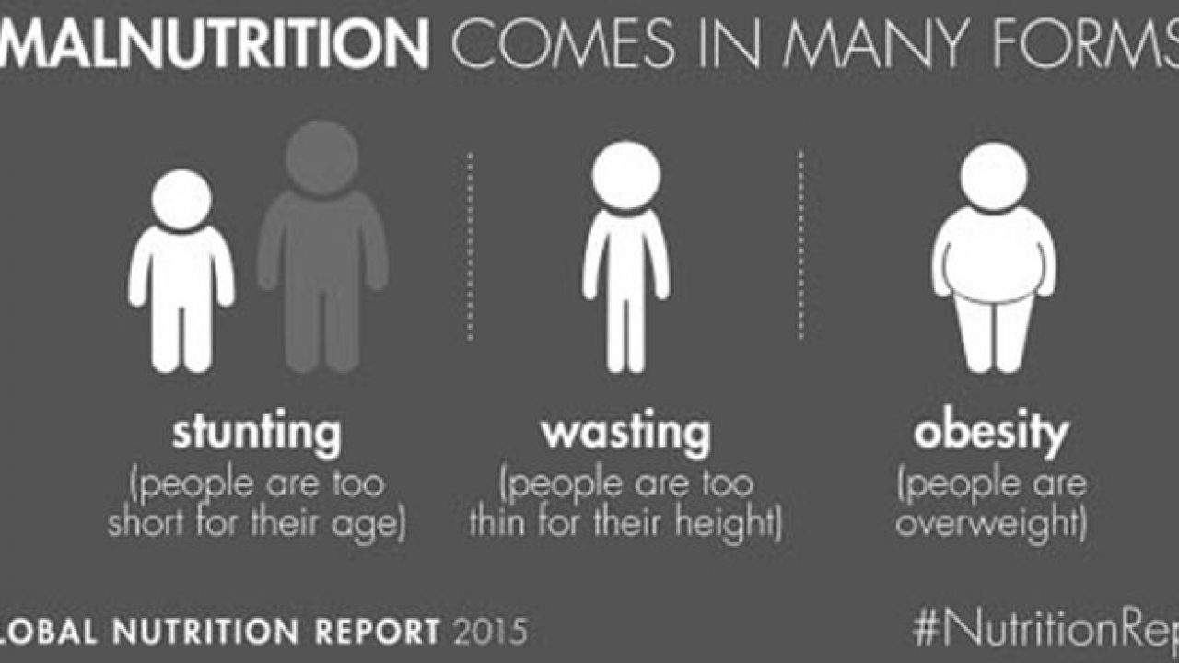
Children who are underweight can experience stunting, wasting or both

Slide 7
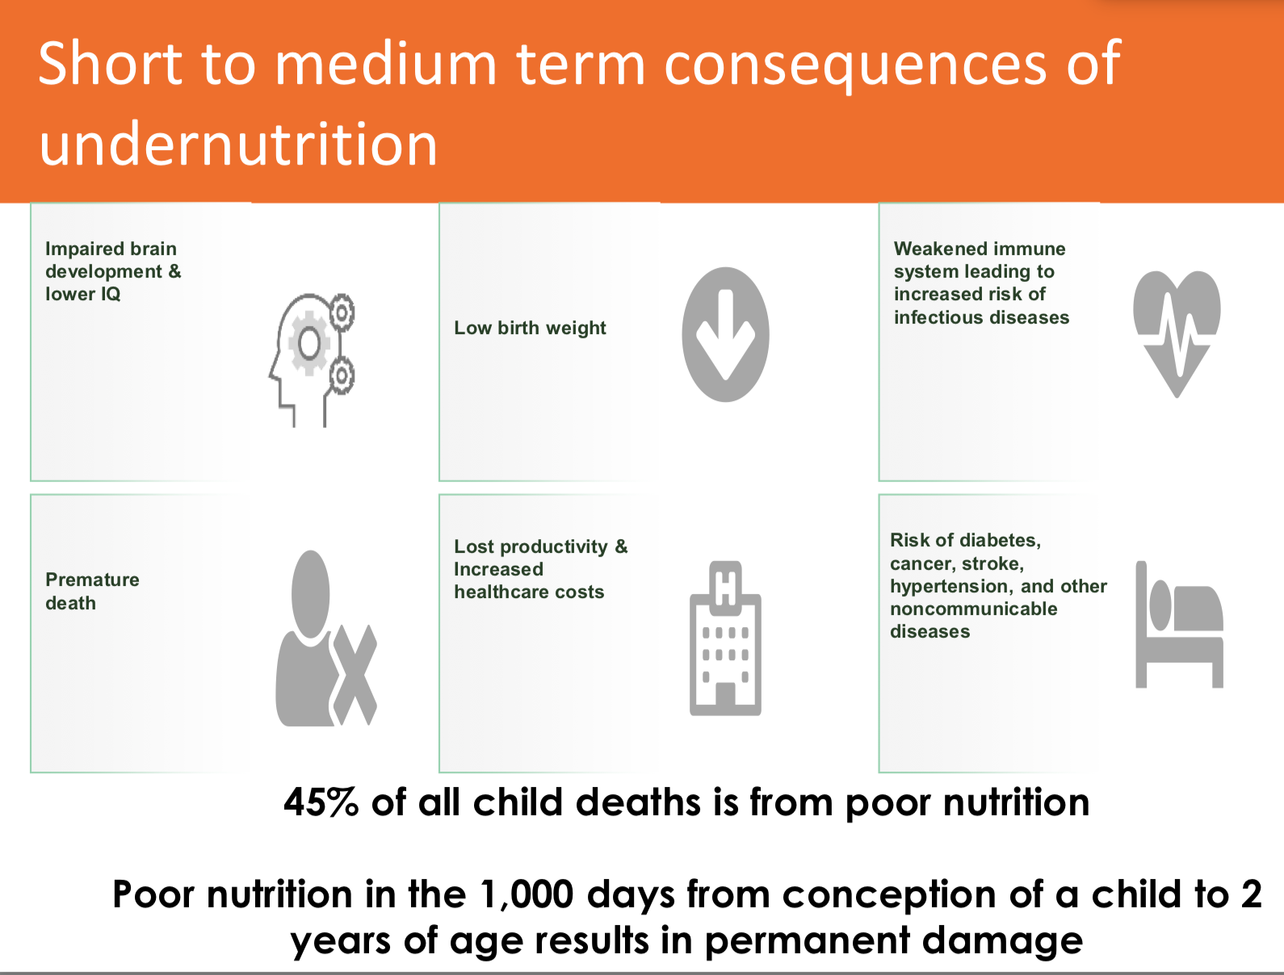
Mawuli Sablah, Causes and Impacts of Undernutrition over the Life Course,UNICEF, New York, Sept 2019

Slide 8
Micronutrient deficiencies
Lack of intake, absorption or use of one or more vitamins or minerals
Micronutrients that remain issues globally
Iron
  Iron-deficiency anemia is estimated to affect some 1.6 billion people. Iron deficiency in infancy and early childhood is associated with decreased cognitive abilities and resistance to disease
  Iron deficiency in infancy and babies causes impaired developmental growth and severe iron deficiency kills about 50,000 young women a year in pregnancy and childbirth
Zinc
  Zinc deficiency contributes to growth failure and weakened immunity in young children
  Results in some 800,000 child deaths per year
  Zinc deficiency is typically the result of inadequate dietary intake, as children in the developing world have mainly plant-based diets, which are often low in zinc.
Holben, B., 2012. Community nutrition in action: Entrepreneurial appr, Cengage.

Slide 9
Vitamin A
About 140 Million children experience vitamin A deficiency
Thousands suffer from partial blindness as a result
Compromise immune system and leads to early deaths among children
Folate
Folate deficiency increases the risk of neural tube defects
Anemia
Vitamin B12
Anemia
cognitive damage ( in severe B12 def)
Iodine
The major preventable cause of mental retardation
Causes mental and physical retardation
Goiter
Holben, B., 2012. Community nutrition in action: Entrepreneurial appr, Cengage.
Notes:
Goiter- enlarged thyroid gland/ swelling of the neck

Slide 10
Malnutrition in Adults
Moderate and severe thinness or underweight in adults
BMI< 18.5 underweight
BMI < 17.0 Moderate and severe thinness
BMI< 16.0 risk for ill health and even death
Besides inadequate access to food and water, malnutrition can be the result of an eating disorder, organ failure, severe infections , physical trauma or chronic diseases

Slide 11
Malnutrition/ Older Adults
Among the adult population, malnutrition can occur especially in those with dementia or Alzheimer’s disease.
Adults with Disorders of the gastrointestinal system ( malabsorption of nutrients) – drugs can interact with absorption of nutrients
Tooth loss and other dental issues, loss of appetite can also lead to malnutrition among the elderly
Chronic illness: diabetes
Depression
Socioeconomic status
Evans, C., 2005. Malnutrition in the elderly: A multifactorial failure to thrive. The Permanente Journal, 9(3).

Slide 12
Clinical Malnutrition
When a hospital patient becomes malnourished
If patient is recovering/healing: Body requires more nutrition than usual
Patient may not be absorbing the nutrients they eat. In this case nutrition through a tube inserted into their stomach ( through GI tract)
Intravenous nutrition, where the digestive tract is bypassed altogether (Parenteral nutrition)
Malnutrition is frequently reported in patients hospitalized with an acute illness.
Malnutrition weakens the immune system
Surgical patients with malnutrition are much more likely to suffer from major and minor complication/ influence response to treatment

Slide 13
Indicators used to Measure Nutritional Status
Body composition
Anthropometric measures: Weight and height
Body circumferences (mid upper arm, head, chest, abdomen etc.)
Skin folds (biceps, triceps, sub-scapular
Clinical signs of deficiency
Physical function
e.g. checking for body fat and muscle loss, fluid accumulation and hand grip strength
Biochemical data such as
Serum proteins
Transferrin
Serum enzymes
Retinol binding proteins
Electrolytes
Dietary intake

Slide 14
Malnutrition- Obesity
Excessive fat accumulation can impair health
obesity develops when a person’s fat cells increase in number or size, or commonly, both
Prevention of obesity is most critical, then, during the growing years of childhood and adolescence, when fat cells increase in number

Slide 15
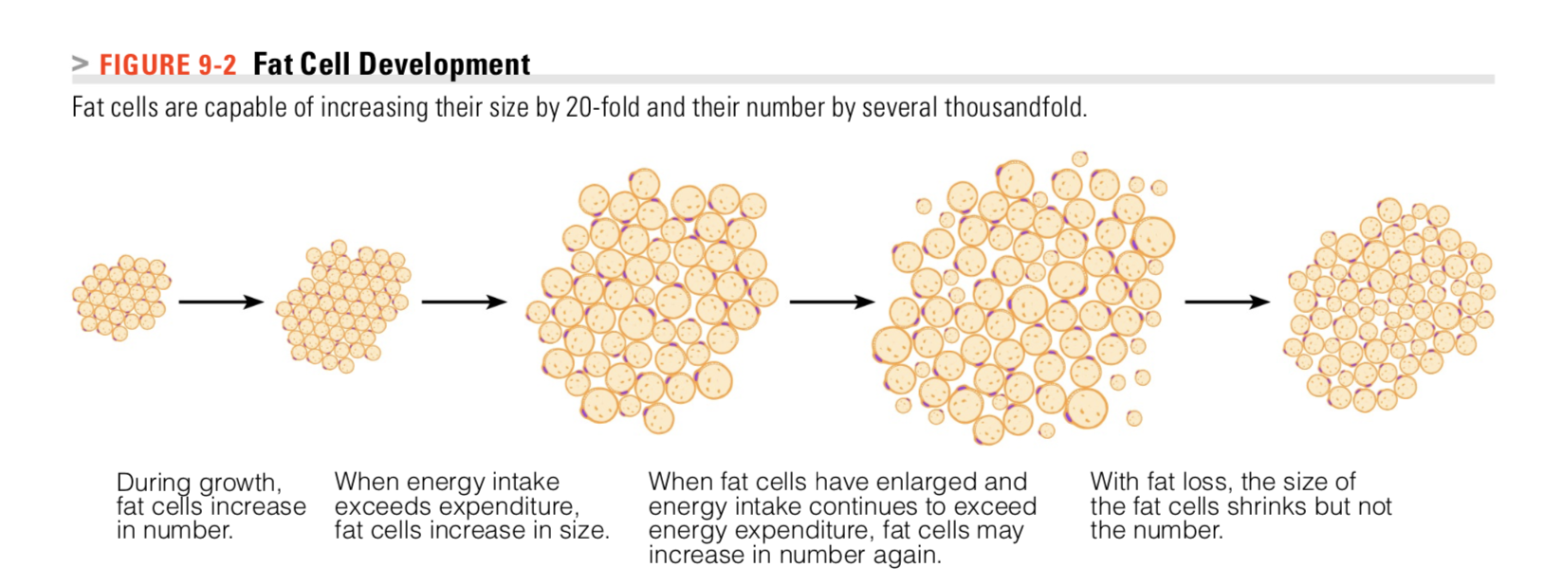
People with increased number of fat cells – more difficult to maintain weight loss because as they gain weight , their fat cells readily fill in
People with increased fat cell size may be more successful at maintaining weight loss

Slide 16
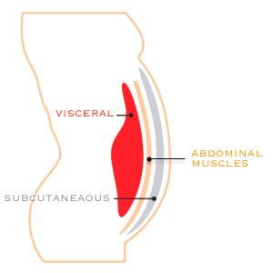
Obesity
BMI
Location of the type of obesity (visceral vs subcutaneous) may be more important than BMI itself
Subcutaneous fat around the hips and thighs, sometimes referred to as lower-body fat, is most common in women

Slide 17
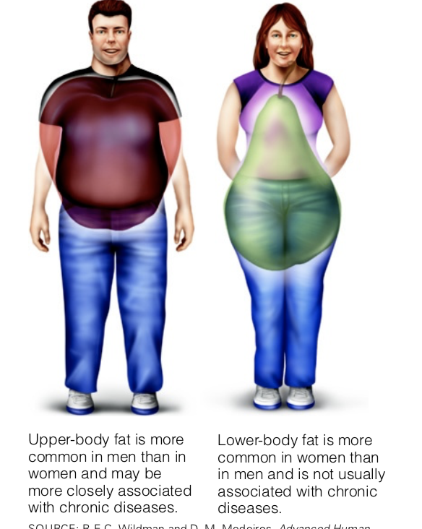
Visceral fat : stored around the organs of the abdomen is referred to as central obesity or upper-body fat
Visceral fat is thought to induce a number of metabolic changes that promote insulin resistance, which then leads to hyperglycemia and other abnormalities.

Slide 18
Obesity and Diet-related noncommunicable diseases
Excess fat first fills the body’s natural storage site—adipose tissue
If fat is still abundant, the excess is deposited in organs such as the heart and liver and plays a key role in the development of diseases such as heart failure and fatty liver, and other CVDs

Slide 19
Adipose tissue ( Not only a storage site but has endocrine function as well )
Produces adipokines ( a family of hormones that help regulate energy balance
Adipokines have both
  Inflammatory
  Anti inflammatory activities
The type and quantity of adipokine secretions change depending on the quantity of adipose tissue
Dysregulated production or secretion of adipokines has been linked with obesity-linked complications
Example: Resistin, an adipokine that promotes inflammation and insulin resistance—factors that predict heart disease and diabetes

Slide 20
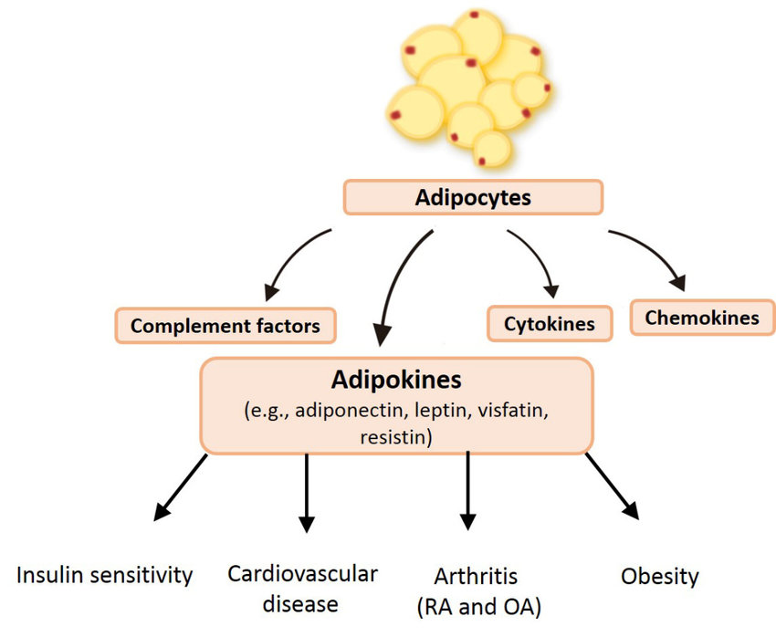
Fat cells
Cytokines
Small soluble proteins involved and cell signaling and communication among immune and non-immune cells.
chronic ‘inflammation’ characterized by abnormal cytokine production and other mediators,
Examples : (Tumor necrosis factor)TNF-α is a proinflammatory cytokine that activates various signal transduction cascades, including many of the pathways involved in the inhibitors of insulin action.
MᵃᶜDonald et al. International journal of molecular sciences. 2019;20(6), 1505.
Notes:
Chemokines are tiny protein molecules that form a subfamily of the cell signaling molecules or cytokines ( help direct movement)
Complement factors: mediators of inflammation that help causing recruitment and activation of neutrophils, macrophages, and other cell types.

Slide 21
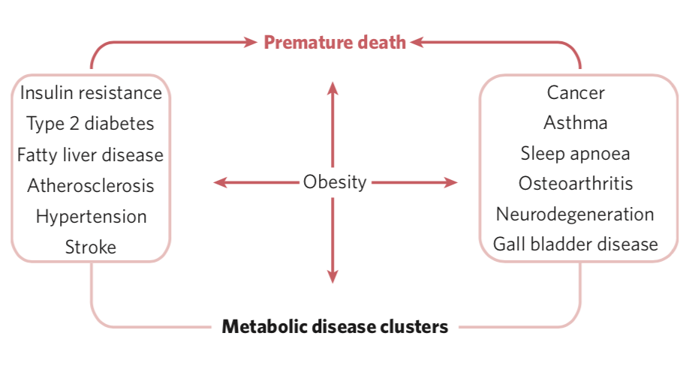
“Obesity is considered to be a central feature that increases the risk for a vast array of diseases”
Hotamisligil GS. Inflammation and metabolic disorders. Nature. 2006 Dec 14;444(7121):860-7.

Slide 22
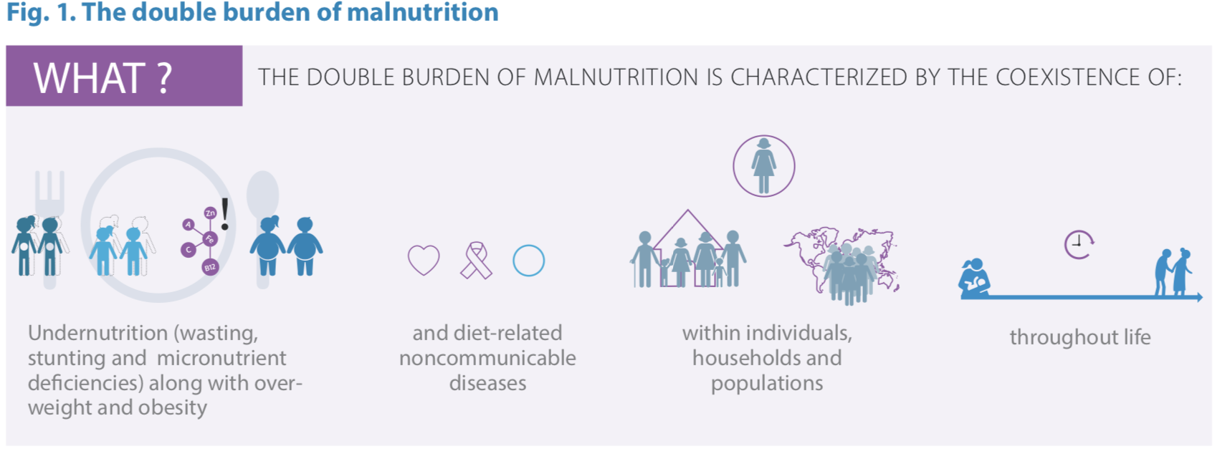
DOUBLE BURDEN OF MALNUTRITION
World Health Organization. (‎2016)‎. The double burden of malnutrition: policy brief. World Health Organization.

Slide 23
The double burden of malnutrition can manifest at three levels, the individual, household and population level
At the individual level simultaneous
The development of two of more types of malnutrition
e.g. obesity with anemia or any vitamin or mineral deficiencies or insufficiencies.
Can be temporally separated- e.g. suffering from chronic under nutrition in childhood leading to stunting and becoming overweight in adulthood due to an economic shift in one’s environment
World Health Organization. (‎2016)‎. The double burden of malnutrition: policy brief. World Health Organization.

Slide 24
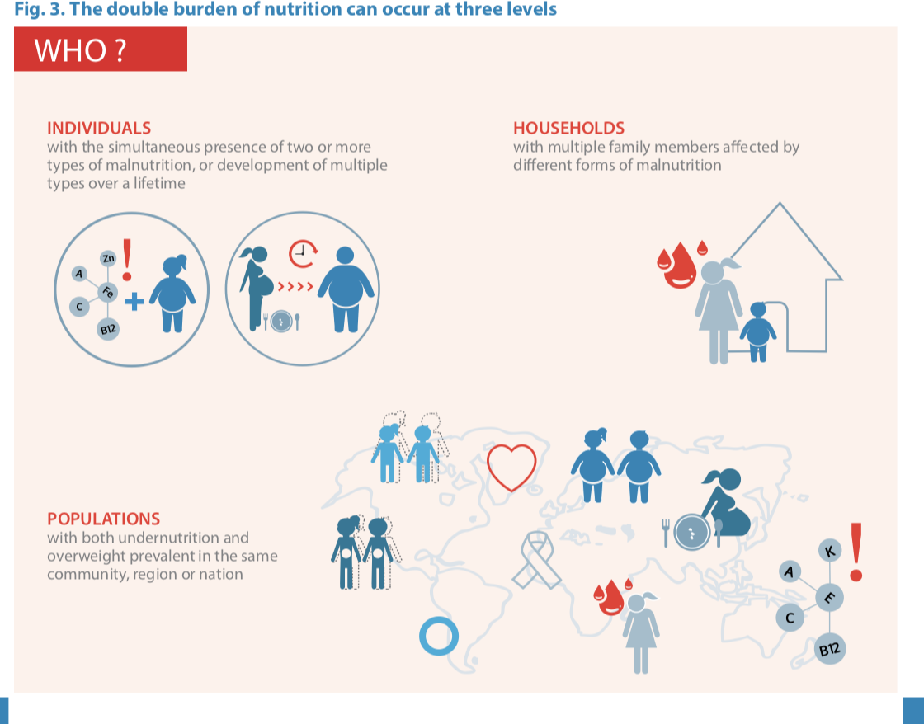
World Health Organization. (‎2016)‎. The double burden of malnutrition: policy brief. World Health Organization.

Slide 25
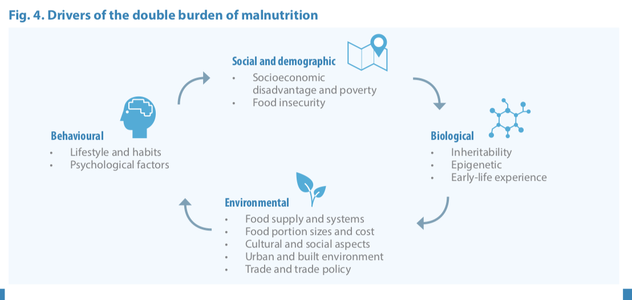
World Health Organization. (‎2016)‎. The double burden of malnutrition: policy brief. World Health Organization.

Slide 26
Some studies show that obesity prevalence is increasing rapidly in some regions of the world where micronutrient deficiencies are more prevalent. Could the micronutrient deficiencies of individuals in these communities contributing to the increase in obesity rates?
Or could the obesity contribute to the manifestation of the micronutrient deficiencies
Some micronutrient concerns and obesity
Vitamin D is highly prevalent among obese individuals
One study suggests that vitamin D-deficient obese children improved their vitamin D status following weight loss- some fat soluble vitamins may deattach from adipose tissue and become less bioavailable
Vitamin A and obesity
Calcium and obesity
“Growing evidence that vitamin and mineral deficiencies are prevalent among overweight and obese individuals across a variety of populations in both developing and industrializing countries”
García et al. Impact of micronutrient deficiencies on obesity, Nutrition Reviews, 2009. 67 (10)

Slide 27
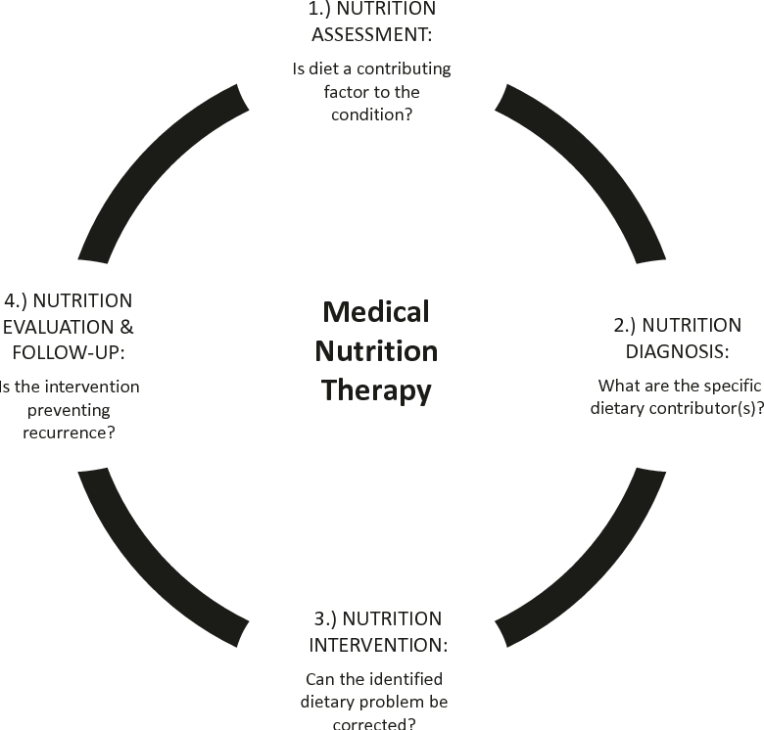
Medical Nutrition Therapy
The scope of Clinical Nutrition Foods, metabolic responses, and behaviors which promote optimal health to prevent or manage disease conditions.

Slide 28

MNT
Medical Nutrition Therapy
The nutritional treatment necessary to manage or treat a condition, illness or injury
An evidence-based medical approach to treating certain chronic conditions through the use of an individually-tailored nutrition plan.

Slide 29

Nutrition services are one of the first treatments that individuals should receive to improve conditions such as diabetes, heart disease and hypertension.
Registered dietitians work among the health professional team to
to treat patients

