Slide 1
Global Market-Entry Strategies
Chapter 9

Slide 2
Licensing
Licensing is a contractual arrangement in which one company (the licensor) makes a legally protected asset available to another company (the licensee) in exchange for compensation. Licensing enables a company to “borrow” another company’s resources.
Licensed assets include: brand name, company name, patent, trade secret, product formula.
Licensing is a revenue stream for a wide range of organizations example: NBA, Disney, Coca-Cola, fashion industry.

Slide 3
Licensing
Licensing is a global market-entry strategy with attractive return on investment, and minimal operational cost.
Advantages:
  Low cost and high returns
  Enables companies to avoid export barriers.
  Products and goods are adapted to local taste/ licensee autonomy.
  Speed the diffusion of new products.
Disadvantages:
  Limited market control/ no involvement in marketing program thus loss of potential returns.
  Agreement time ends- potential competitor
  cross-technology exchange to avoid unilateral benefits.

Slide 4
Special Licensing Agreements
Contract manufacturing involves providing technical specifications to a local manufacturer, where the subcontractor oversee production.
Advantages:
  Licensing firm specialize in product design & marketing
  Limited commitment of financial & managerial resources
  Quick entry into target markets
Disadvantages:
  Public criticism – poorly paid workers- image advertising

Slide 5
Special Licensing Agreements
Franchising is a contract between a franchiser and a franchisee where it allows the franchisee to operate a business developed by the franchiser in return for fees and adherence to policies and practices.
Advantages:
  Market entry
  Adaptation of products and business layout to local taste
Disadvantages:
  Franchisees could give the brand a bad reputation
  Limited control over running the business
Favorable in the retailing industry and fast-food.

Slide 6
Investment
Investment is the action of having partial or full ownership of operations outside the home country. A more extensive form of participation.
Foreign direct investment (FDI) reflect investment flows out of the home country as companies invest or acquire plants, or other assets.
FDI allows companies to produce, sell, and compete locally in key markets.
FDI may take the form of
  Minority or majority shares in joint ventures
  Minority or majority equity stake
  acquisition

Slide 7
Joint Ventures
JVs usually involves equity ownership by more than one organization.
JVs usually formed to achieve particular and specific objectives, but can continue to operate indefinitely as objectives are redefined.
JVs may involve more than two companies. When more than two organizations participate, the venture is called a consortium.
The more companies in the JV, the more complex its management becomes.
There are various possible combinations for a joint venture.

Slide 8
Joint Ventures
Joint venture is an entry strategy for a single target country in which partners share ownership of newly created business entity.
Advantages:
  Financial and political risk sharing
  Learning experience about new markets
  Achieve synergy between partners- combine value chain activities.
  Easy access to regulatory-rigid market

Slide 9
Joint Ventures
Disadvantages:
  Rewards are shared.
  Significant control and coordination cost- partnership management.
  Potential for conflict between partners mainly due to cultural differences.
  The ability to evolve into a competitor.

Slide 10
Equity Stake or Full Ownership
An equity stake is simply an investment; if the investor owns fewer than 50% of the shares, it is a minority stake ownership of more than 50% makes it a majority.
Full ownership means the investor has 100% control. This is achieved by a startup of new operations (greenfield investment), or by merger or acquisition.
Governments sometimes restrict 100% ownership to foreign companies.
Companies adopt this strategy to achieve faster expansion, greater control and higher profits.

Slide 11
Equity Stake or Full Ownership
Advantages:
  Access to new markets
  Access to new manufacturing techniques and technology transfer- acquisition
  Avoidance of tariff and export barriers
  Avoiding communication and coordination with partners.
Disadvantages:
  Require a lot of reporting and communication to HQ
  Risk of disruptive factors.

Slide 12
Global Strategic Partnership
Recent changes in political, economical, sociocultural, and technological environments provide unprecedented marketing opportunities.
Global strategic partnership (GSP) refer to linkages among companies from different countries to jointly pursue a common goal.
Characteristics of GSP include:
  Participants remain independent
  Participants share the benefits of the alliance as well as control over performance.
  Participants make ongoing contribution in technology, and products.

Slide 13
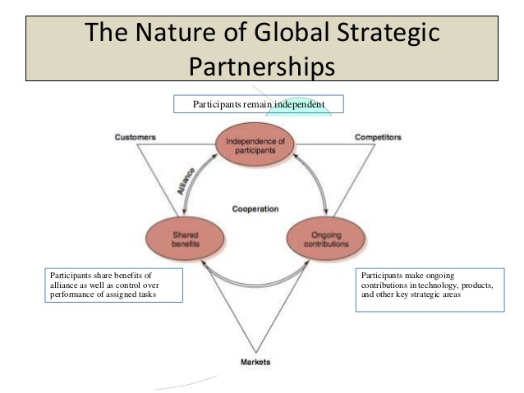

Slide 14
Global Strategic Partnership
Advantages:
  Share high product-development cost
  One company alone cannot perform due to technological requirements, skills, capital, know-how.
  Secures access to regional markets
  Provides a learning experience
Disadvantages:
  Shared control over tasks creates management challenges.
  Strengthening an existing competitor

Slide 15
Attributes of GSP
Aim is to achieve world leadership by pursuing cost leadership or differentiation strategy.
The relationship is reciprocal.
The partners’ vision is global, extending beyond home countries.
Continual transfer of resources between partners is required.
When competing in markets excluded from partnership, the participants retain their national identities.

Slide 16
Success factors for GSP
Mission: win-win situation and mutual benefits.
Strategy: a company may establish a number of GSP, this must be thought of to avoid conflicts.
Governance: partners are equal, consensus is important.
Culture: personal chemistry and organizational culture.
Organization: innovative structure to avoid complexity of multi-country management.
Management: clear lines of authority must be in place.

Slide 17
Principals of successful GSP
Partners must remember they are competitors
Some conflict to be expected,
All employees and managers must understand where cooperation ends and competition starts.
Learning from partners is critically important.

