Slide 1
Endometriosis

Slide 2
Definition
Endometriosis is a disease in which endometrium implants and grows in areas outside the uterus→ sustained inflammatory reaction
Most commonly implants are found in the pelvis
Lesions may occur at distant sites: pleural cavity, liver, kidney, gluteal muscles, bladder, etc

Slide 3
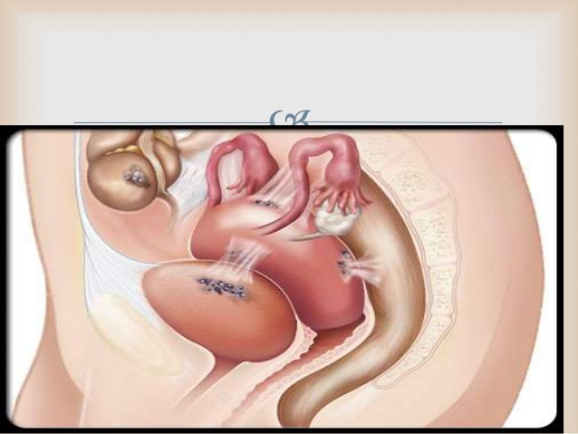

Slide 4
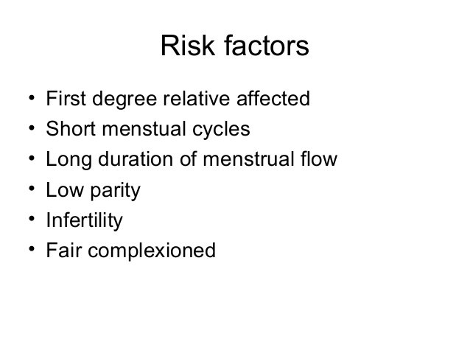

Slide 5
Clinical Presentation
Dysmenorrhea
Heavy or irregular bleeding
Cylical/noncylical pelvic pain
Lower abdominal or back pain
Bloating, nausea, and vomiting
Inguinal pain
Dysuria
Dyspareunia
Nodules may be felt upon pelvic exam
Imaging may indicate pelvic mass
Infertility

Slide 6
Physical Findings
Tender nodules along the uterosacral ligaments , especially just before menses
Pain without nodules
Uterine or adnexal fixation, or an adnexal mass

Slide 7
Diagnosis of Endometriosis
Direct visualization of implants
Laparoscopy
Imaging of endometriomas
MR
Ultrasound

Slide 8
Treatment of Endometriosis
Management of pain
Surgery
Ablation of endometrial implants
Lysis of adhesions
Resection of endometriomas
Laparoscopy
Hysterectomy/oophorectomy/Salpingo-oophorectomy
Medical therapy
Pain relieve (NSAIDs)
Hormone therapy

Slide 9
Treatment of infertility
Surgery
Ovulation induction
Assisted reproductive technology

Slide 10
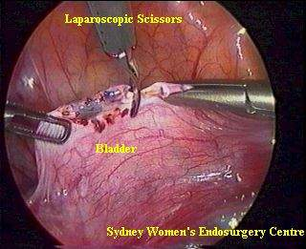
Removal of Endometriosis

