Slide 1

Course: Fundamental of nursing ”LAB”
Topic: Hypertension
Name: Mariam Shuaib
Number: 1200437
Teacher: Maram Jaghama

Slide 2
Concepts:
Definition of disease
Sings and symptoms
Causes
Diagnosis
Treatment
Care plan as a nurse
References

Slide 3
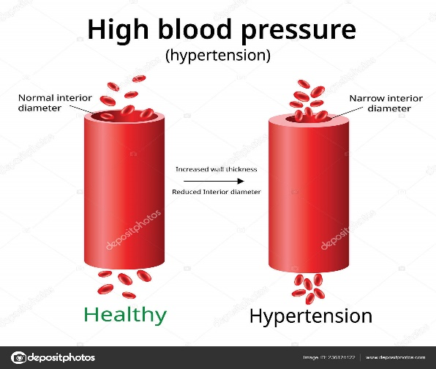
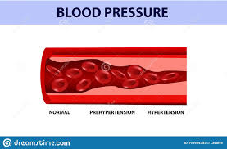
Definition of disease:
Hypertension or High blood pressure is a common condition in which the long-term force of the blood against your artery walls is high enough that it may eventually cause health problems such as heart disease.
In addition, Blood pressure is determind both by the amount of blood your heart pumps and the amount of resistance to blood flow in your arteries.The more your heart pumps and the narrower your arteries, the higher your blood pressure.

Slide 4




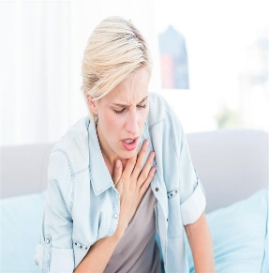
Sings and symptoms:
One of the most dangerous things about High blood pressure is that may not know you have it. That’s because high blood pressure dosent have any unless its very severe, the best to know if your blood pressure is high is through regular chekups.
But, if your blood pressure is extremely high, thay may be certin symptoms to look out for, including:
Severe headaches
Nosebleed
Confusion
Irregular heartbeat
Vision problems
Chest pain
Difficulty breathing
Blood in the urine
Pounding in your chest, neck and ears

Slide 5
Causes:
There is two typs of hypertension:
Primary hypertension:
For more adults, there is no specific cause of high blood pressure. This type of hypertension tends to develops gradually over many years.
Secondary hypertension:
It is the blood pressure caused by underlying conditions, this type of hypertension tends to appear suddenly and cause higher blood pressure than the other type dose. In addition various condition and medications can lead this type of hypertention, including:
Obstructive sleep apnea
Kidney problems
Adrenal gland tumors
Thyroid problem
Certain medications, such as birth control pills
Illegal drugs, such as cocaine and amphetamines

Slide 6
Diagnosis:
To measure your blood pressure, your doctor will usually place an inflatable arm cuff around your arm and measure your blood pressure using a pressure-measuring gauge.
A blood pressure reading, given in millimeters of mercury (mm Hg), has two numbers. The first, or upper, number measures the pressure in your arteries when your heart beats (systolic pressure). The second, or lower, number measures the pressure in your arteries between beats (diastolic pressure).
Blood pressure measurements fall into four general categories:
Normal blood pressure.Your blood pressure is normal if it's below 120/80 mm Hg.
Elevated blood pressure. Elevated blood pressure is a systolic pressure ranging from 120 to 129 mm Hg and a diastolic pressure below 80 mm Hg. Elevated blood pressure tends to get worse over time unless steps are taken to control blood pressure.
Stage 1 hypertension. Stage 1 hypertension is a systolic pressure ranging from 130 to 139 mm Hg or a diastolic pressure ranging from 80 to 89 mm Hg.
Stage 2 hypertension. More severe hypertension, stage 2 hypertension is a systolic pressure of 140 mm Hg or higher or a diastolic pressure of 90 mm Hg or higher.

Slide 7
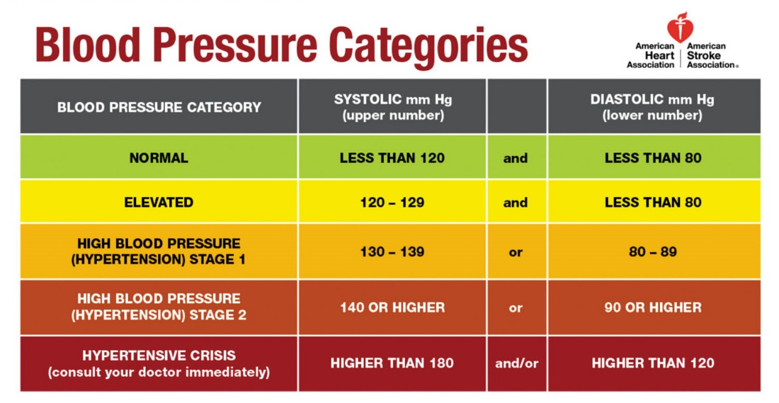

Slide 8




Treatment:
If you have elevated blood pressure accompanied by diabetes, kidney disease or cardiovascular disease, your doctor might recommend blood pressure medication in addition to lifestyle changes.
If you've been diagnosed with elevated blood pressure, the benefits of medication are less clear. If you have stage 1 or stage 2 hypertension, your doctor will likely prescribe medications. Lifestyle changes to help control your elevated blood pressure include:
Getting to and maintaining a healthy weight
Eating a healthy, low-salt diet
Exercising regularly
Limiting the amount of alcohol you drink
Quitting smoking

Slide 9
Care plan as a nurse1:
Risk for acute pain r/t increased high cerebral vascular pressure
Rationales | Interventions
Facilitates diagnosis of problem and initiation of appropriate therapy. Helpful in evaluating effectiveness of therapy | Determine specifics of pain (location, characteristics, intensity (0-10scale),(onest and duration)
To assess etiology or precipitating contributory factors. | Note client’s attitude toward pain and use of pain medications, including any history of substance abuse.

Slide 10
Care plan as a nurse2:
Risk for not being physically active r/t tend to have higher heart rates
Rationales | Interventions
Helps in increasing the tolerance for the activity. | Have the patient perform the activity more slowly, in a longer time with more rest or pauses, or with assistance if necessary.
Activities should be planned ahead to coincide with the patient’s peak energy level. | Instruct patient to plan activities for times when they have the most energy.
These techniques reduce oxygen consumption, allowing a more prolonged activity. | Teach energy conservation techniques, such as: Pushing rather than pulling Resting for at least 1 hour after meals before starting a new activity

Slide 11
Care plan as a nurse 3:
Risk for obesity increases the pressure on your artery walls r/t need more blood to supply oxygen and nutrients to your tissues
Rationales | Interventions
Provides the opportunity for the individual to focus on a realistic picture of the amount of food ingested and corresponding eating habits and feelings. Identifies patterns requiring change or a base on which to tailor the dietary program. | Carry out and review daily food diary (caloric intake, types and amounts of food, eating habits).
Helps identify when patient is eating to satisfy an emotional need, rather than physiological hunger. | Explore and discuss emotions and events associated with eating.
Water retention may be a problem because of increased fluid intake and fat metabolism. | Discuss restriction of salt intake

Slide 12
References:
Mayo clinic:
https://www.mayoclinic.org/diseases-conditions/high-blood-pressure/symptoms-causes/syc-20373410
Webmd:
https://www.webmd.com/hypertension-high-blood-pressure/default.htm
Nursestudy:
https://nursestudy.net/hypertension-care-plan/

