Slide 1
FAT SOLUBLE VITAMINS

Slide 2
Vitamin D (calciferol)
Two major forms
Vitamin D₂
Plant foods
Vitamin D₃
Animal foods
Synthesis in the skin
The body can synthesize Vitamin D, with the help of sunlight, from a precursor that the body makes from cholesterol.
With adequate exposure to sunlight, is vitamin D an essential nutrient ?
These two forms of vitamin D are similar and both must be activated before they can fully function.

Slide 3
Making Vitamin D
ultraviolet rays from the sun hit a precursor in the skin and convert it to previtamin D3, which is converted to vitamin D3 with the help of the body’s heat.
To produce the active form of vitamin D (whether made in the body or consumed from the diet), two hydroxylation reactions must occur
The liver adds an OH group
The kidneys add another OH group
If a person has a disease affecting the liver or the kidneys, can they experience symptoms of vitamin D deficiency ?

Slide 4
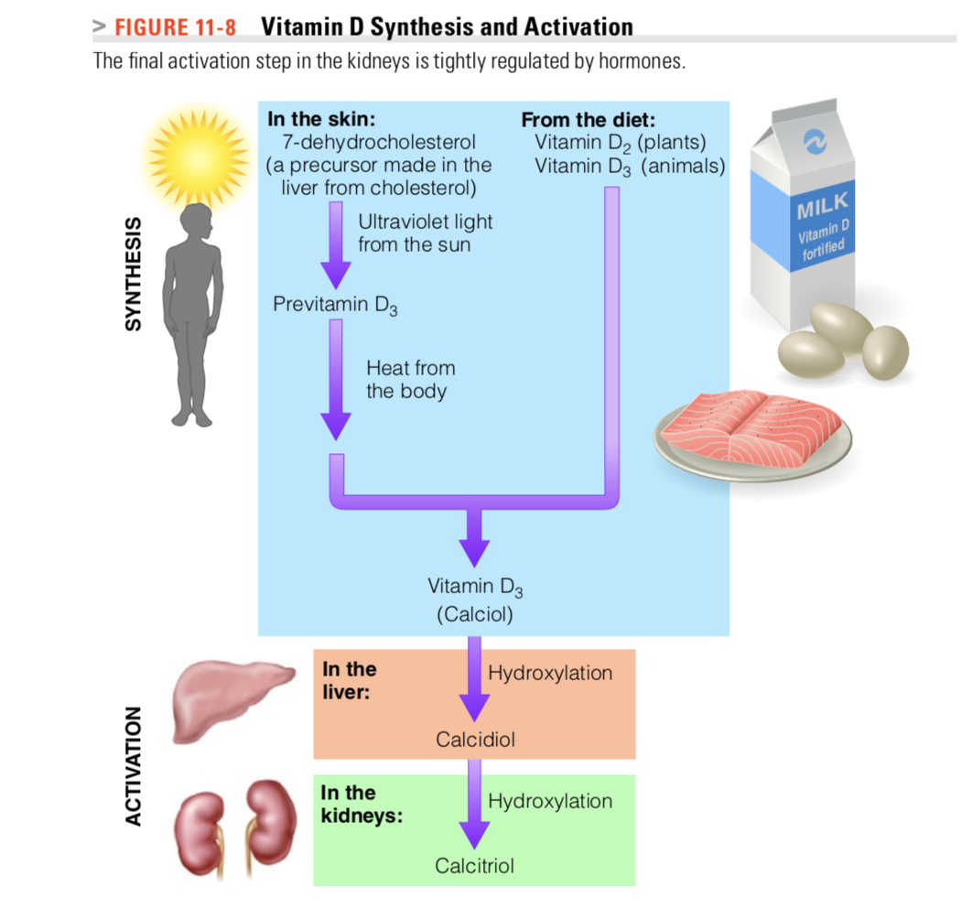

Slide 5
Roles in the body
The active form of vitamin D is actually a hormone
vitamin D has a binding protein that carries it to the target organ
  The intestines
  The kidneys
  The bones

Slide 6
in THE BONES
Vitamin D raises blood concentrations of bone minerals in the following ways
  When the diet is sufficient (calcium and phosphorus are sufficient)
  Vitamin D enhances mineral absorption from the GI tract. When the diet is insufficient, vitamin D provides the needed minerals from other sources
  Reabsorption by the kidneys
  Mobilization from the bones into the blood
Vitamin D helps in the absorption of calcium and phosphorus, therefore plays a role in maintaining blood concentrations of these minerals
The bones grow denser and stronger as they absorb and deposit these minerals ( Calcium and Phosphorus)

Slide 7
Vitamin D Deficiency
Factors that contribute to vitamin D deficiency
Dark skin
Breastfeeding without supplementation
lack of sunlight
Using non-fortified milk

Slide 8
Vitamin D Deficiency
Calbindin, a protein that binds calcium in the intestinal cells.
In vitamin D deficiency, production of calbindin decreases
Calcium without calbindin passes through the GI tract unabsorbed
vitamin D deficiency creates a calcium deficiency and increases the risks of several chronic diseases and osteoporosis.

Slide 9
Vitamin D Deficiency
Rickets
Worldwide, the prevalence of the vitamin D–deficiency disease rickets is extremely high, affecting more than half of the children in countries such as China and Mongolia, and regions such as sub-Saharan Africa, the Middle East, and Latin America
In the United States, rickets is not common
To prevent rickets, the American Academy of Pediatrics recommends a supplement for all infants, children, and adolescents who do not receive enough vitamin D

Slide 10
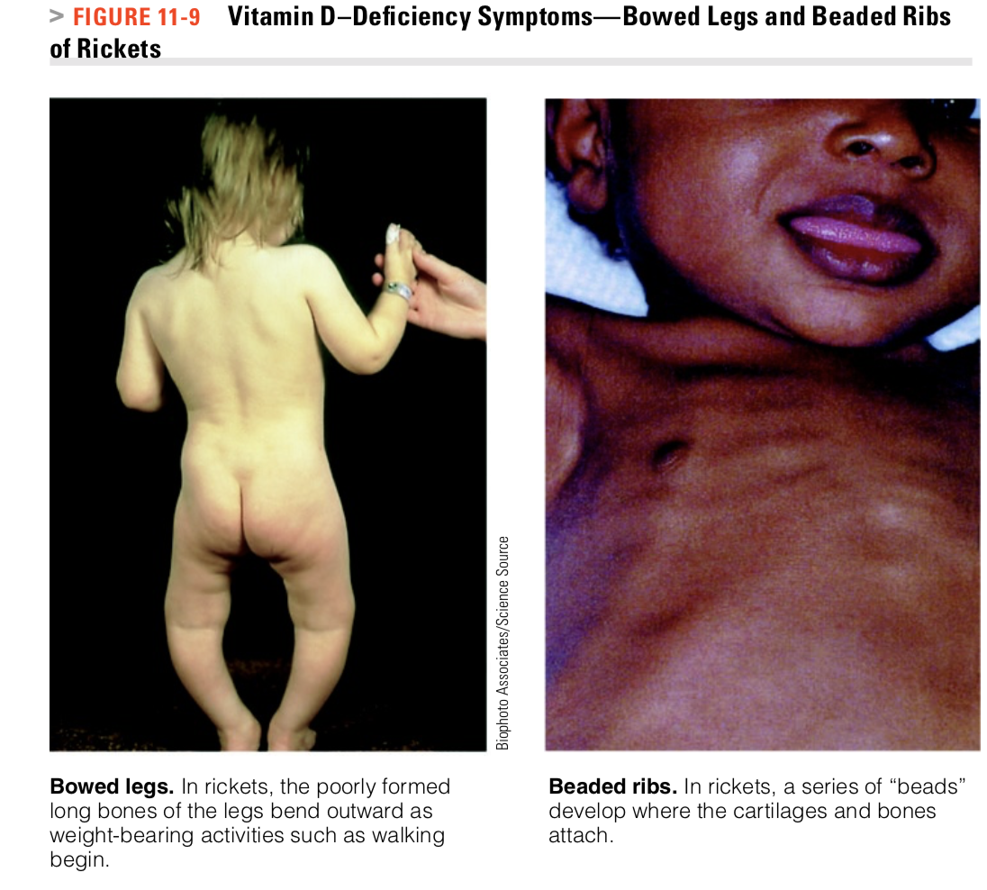
Vitamin D Deficiency
Rickets
In rickets, the bones fail to calcify normally, causing growth retardation and skeletal abnormalities
The bones become so weak that they bend when they have to support the body’s weight

Slide 11
Vitamin D Deficiency
Osteomalacia In adults, the poor mineralization of bone results in the painful bone disease osteomalacia. The bones become increasingly soft, flexible, brittle, and deformed.
Osteoporosis Any failure to synthesize adequate vitamin D or obtain enough from foods sets the stage for a loss of calcium from the bones, which can result in fractures ( Over time → reduced bone density)
The Elderly Vitamin D deficiency is especially likely in older adults- why ?
The skin, liver, and kidneys lose their capacity to make and activate vitamin D with advancing age
Older adults typically drink little or no milk—the main dietary source of vitamin D
older adults typically spend much of the day indoors,
Wearing protective clothing or apply sunscreen to all sun- exposed areas of their skin. Dark-skinned adults living in northern regions are particularly vulnerable.

Slide 12
Vitamin D Toxicity
Vitamin D is among the most likely of the vitamins to have toxic effects when consumed in excessive amounts
Supplements containing the vitamin in concentrated form should be kept out of the reach of children and used cautiously by adults.
Excess vitamin D raises the concentration of blood calcium. AND EXCESS BLOOD CALCIUM causes several issues such as
Forming stones, especially in the kidneys where calcium is concentrated in an effort to excrete it.
Calcification can harden the blood vessels and is especially dangerous in the major arteries of the brain, heart, and lungs, where it can cause death
Excess blood calcium can precipitate in soft tissues

Slide 13
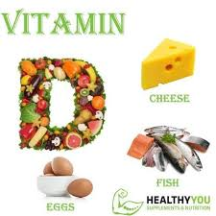
Vitamin D Recommendations and Sources
Foods that contain Vitamin D
The fortification of milk and other foods with vitamin D is the best guarantee that people will meet their needs
Alternatives such as soy milk or almond milk need to read labels carefully to ensure they are getting vitamin D–fortified products
Egg yolks and oily fish such as salmon, mackerel, and sardines are the best natural sources of vitamin D
Meeting vitamin D needs is difficult without adequate sunshine, fortification

Slide 14
RDA
RDA: Adults:
15 μg/day (19–70 yr)
20 μg/day (>70 yr)
UL : Adults: 100 μg/day

Slide 15
Vitamin d AND THE sun
The sun imposes no risk of vitamin D toxicity; prolonged exposure to sunlight degrades the vitamin D precursor in the skin, preventing its conversion to the active vitamin.
Prolonged exposure to sunlight can, however, prematurely wrinkle the skin and cause skin cancer
Sunscreens a sun protection factor (SPF) of 8 and higher can also reduce vitamin D synthesis
For most people, exposing hands, face, and arms on a clear summer day for 5 to 10 minutes two or three times a week should be sufficient to maintain vitamin D nutrition
The pigments of dark skin reduce vitamin D synthesis. Dark-skinned people require more sunlight exposure than light-skinned people—perhaps as much as 4 to 6 times longer

Slide 16
Vitamin E
The vitamin E family consists of two subgroups
Tocopherols ( saturated side chain)
Tocotrienols ( unsaturated side chain)
Each of the subgroups contains four members
Of all the members of the vitamin E family, only alpha-tocopherol is maintained in the body and can meet the body’s needs for the vitamin.
The RDA is based only on alpha-tocopherol

Slide 17
roles
Vitamin E as an Antioxidant
Vitamin E is a fat-soluble antioxidant and one of the body’s primary defenders
vitamin E protects the cell and cell membrane from destruction.
Specifically, vitamin E prevents the oxidation of the polyunsaturated fatty acids, and protects other lipids and related compounds

Slide 18
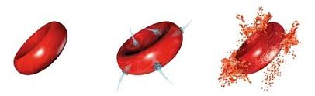
Vitamin E Deficiency
Deficiency of vitamin E (from poor dietary intake) is rare;
Deficiency is usually associated with diseases of fat malabsorption
Without vitamin E, the red blood cells break and spill their contents, probably because of oxidation of the polyunsaturated fatty acids in their membranes. This classic sign of vitamin E deficiency, known as erythrocyte hemolysis
Vitamin E treatment corrects hemolytic anemia.

Slide 19
Vitamin E Toxicity
Toxicity is rare, and vitamin E supplement intake appears safe across a range of intakes
The liver carefully regulates vitamin E concentrations ( metabolizes and excretes excess)
The UL for vitamin E (1000 milligrams) which is 65 times greater than the recommended intake for adults (15 milligrams)

Slide 20
Vitamin E Recommendations
The RDA for vitamin E is based on the alpha-tocopherol form only.
RDA: Adults: 15 mg/day
Vitamin E sources in Foods
Much of the vitamin E in the diet comes from vegetable oils and products made from them, such as margarine and salad dressings
Best from fresh foods, because Vitamin E is susceptible to oxidation

Slide 21
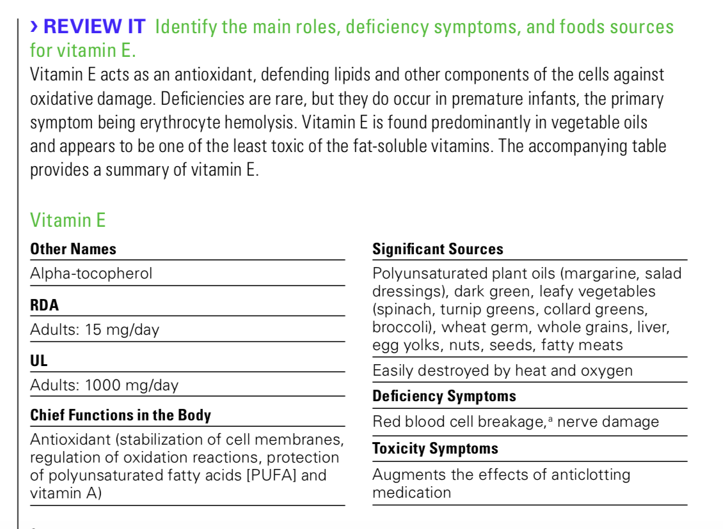

Slide 22
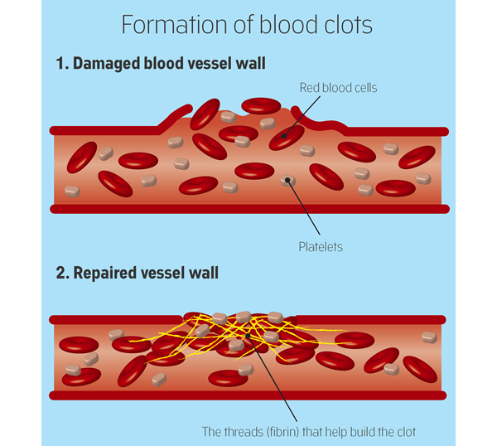
Vitamin K
Very important function
Primary action is blood clotting
Vitamin K is essential for the activation of proteins and minerals involved in making a blood clot
In the case, blood-clotting factors are lacking, hemorrhagic disease results.
(for instance if an artery or vein is cut or broken, bleeding goes unchecked)

Slide 23
VITAMIN k ROLES
Vitamin K also participates in the metabolism of bone proteins, osteocalcin. Vitamin K helps osteocalcin ( a protein) bind to the minerals that normally form bones--> helps maintain bone density!

Slide 24
Vitamin K Deficiency
Primary deficiency → inadequate dietary intake
Secondary deficiency MAY occur because of
Problems with absorption of fat: for example: bile insufficiency so vitamin K absorption decreases
Some drugs disrupt vitamin K’s synthesis and action in the body: antibiotics kill the vitamin K–producing bacteria in the intestine,
Anticoagulant drugs interfere with vitamin K metabolism and activity
Consequence: Excessive bleeding due to a vitamin K deficiency can be fatal.

Slide 25
Vitamin K Recommendations and Sources
Vitamin K can be obtained from
Foods
(phylloquinone)
K1
Bacteria in the GI tract synthesize vitamin K
(Menaquinone )
K2
Note: The amount from bacteria is insufficient to meet the body’s needs
Food sources: leafy green vegetables such as spinach and kale, fruits such as avocado and kiwi, and some vegetable oils such as soy- bean oil

Slide 26
To prevent hemorrhagic disease in the new- born, a single dose of vitamin K is given at birth by intramuscular injection, WHY?
Babies are born with a sterile intestinal tract
  And the vitamin K– producing bacteria take weeks to establish themselves
  Little vitamin k is transported through the Placenta and little Vitamin K is available in breast milk

Slide 27
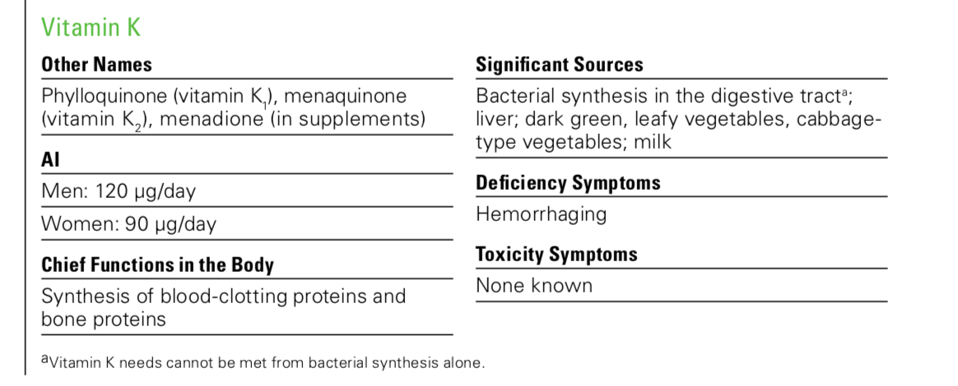
Vitamin K Toxicity
Toxicity is not common, and no adverse effects have been reported with high intakes of vitamin K. Therefore, a UL has not been established.
High doses of vitamin K can reduce the effectiveness of anticoagulant drugs

