Slide 1

COMP231 Advanced Programming
Chapter 1 Introduction to Computers, Programs, and Java

Slide 2
Course Description
  Demonstrate understanding of classes, constructors, objects, and instantiation.
  Access variables and modifier keywords.
  Develop methods using parameters and return values.
  Build control structures in an object-oriented environment.
  Convert data types using API methods and objects.
  Design object-oriented programs using scope, inheritance, and other design techniques.
  Create an object-oriented application using Java packages, APIs. and interfaces, in conjunction with classes and objects.

Slide 3
Logistics
Instructor: Bassem Sayrafi (Masri 316)
Facebook Group: www.facebook.com/groups/bzucomp231
Textbook:
  Introduction To JAVA Programming, 11th edition.
  Author: Y. Daniel Liang.
  Publisher: Prentice Hall.
Lab Manual:
  Title: LABORATORY WORK BOOK (COMP231 Updated)
Eclipse

Slide 4
Special Regulations
Assignments:
  All assignments are individual efforts any duplicated copies will be treated as a cheating attempt which lead to ZERO mark.
  Using code from the internet will be treated as cheating as well.
  The assignments should be submitted through Ritaj within the specified deadline.
  No late submissions are accepted.

Slide 5
Honor Code (ميثاق شرف)
All work/code must be your own work. You are not allowed to submit code or parts of code that are not your own. Furthermore, you are not allowed to share your code with other students– even after you finish this class. Also you are not to ask others to show their work to you or write parts of the code for you.
كل العمل يجب أن يكون عملك الخاص. لا يُسمح لك بتقديم برمجيات (كود) أو أجزاء من برمجيات لم تقم انت بإنتاجها. علاوة على ذلك ، لا يُسمح لك بمشاركة الكود الخاص بك مع طلاب آخرين حتى بعد الانتهاء من هذا الفصل. كما أنك لن تطلب من الآخرين إظهار أعمالهم لك أو كتابة أجزاء من الكود لك.

Slide 6
Course Outline
Topics | Chapter | # of lectures
Introduction to Java | 1-8 | 6
Objects and Classes | 9 | 3
Strings | 4.4, 10.10, 10.11 | 2
Thinking in Objects | 10 | 2
Inheritance and Polymorphism | 11 | 3
Abstract Classes and Interfaces | 13 | 3
Exception Handling and Text I/O | 12 | 3
JavaFX Basics | 14 | 3
JavaFX UI Controls | 16 | 3
Event-Driven Programming | 15 | 3

Slide 7
Lab Outline
Lab # | Title | Quizzes
1 | Program structure in Java
2 | Structure Programming - Revision
3 | Methods
4 | Arrays and Object Use | Q1
5 | Object-Oriented Programming
6 | String I
7 | String II | Q2
8 | Inheritance and Polymorphism
9 | Abstract classes and Interfaces
10 | Text I/O | Q3
11 | GUI
12 | Event-Driven Programming | Q4
Practical Final Exam (10%)

Slide 8
Popular High-Level Languages
Notes:
Assembly: very close to machine language
High level language: closer to human language. Made of statements. Program here is source code.

Slide 9
Interpreting/Compiling Source Code
A program written in a high-level language is called a source program or source code. Because a computer cannot understand a source program, a source program must be translated into machine code for execution. The translation can be done using another programming tool called an interpreter or a compiler.

Slide 10
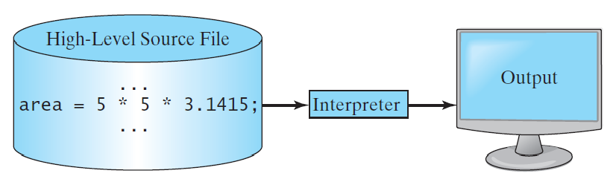
Interpreting Source Code
An interpreter reads one statement from the source code, translates it to the machine code or virtual machine code, and then executes it right away, as shown in the following figure. Note that a statement from the source code may be translated into several machine instructions.

Slide 11
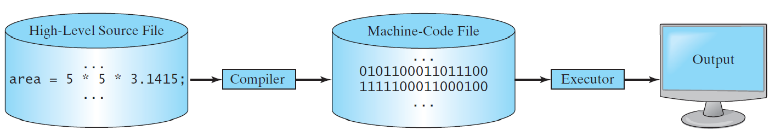
Compiling Source Code
A compiler translates the entire source code into a machine-code file, and the machine-code file is then executed, as shown in the following figure.

Slide 12
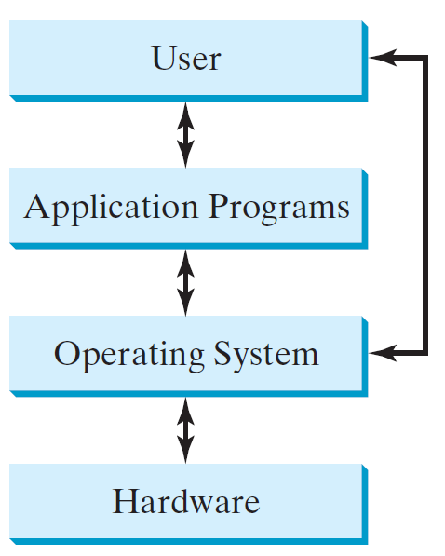
Operating Systems
The operating system (OS) is a program that manages and controls a computer’s activities. The popular operating systems for general-purpose computers are Microsoft Windows, Mac OS, and Linux. Application programs, such as a Web browser or a word processor, cannot run unless an operating system is installed and running on the computer.
Notes:
OS TASKS
Control and monitor system and processes: keyboard, monitor, drives, different programs at the same time, security
Allocate and assign system resources: cpu time, memory space, I/O time
Scheduling operations: multi-processes, multi threading, word, email, web, messenger, etc… single cpu .. Distribute its time. Otherwise most of cpu time is idle.

Slide 13

Java’s History
James Gosling and Sun Microsystems
Oak
Java, May 20, 1995, Sun World
HotJava
  The first Java-enabled Web browser
Early History Website:
http://www.java.com/en/javahistory/index.jsp

Slide 14
Why Java?
Java enables users to develop and deploy applications on the Internet for servers, desktop computers, and small hand-held devices. The future of computing is being profoundly influenced by the Internet, and Java promises to remain a big part of that future.
Java is a general purpose programming language.
Java is the Internet programming language.

Slide 15
Java, Web, and Beyond
Java can be used to develop standalone applications.
Java can be used to develop applications running from a browser.
Java can also be used to develop applications for hand-held devices.
Java can be used to develop applications for Web servers.

Slide 16
Characteristics of Java
Companion Website
Java Is Simple
Java Is Object-Oriented
Java Is Distributed
Java Is Interpreted
Java Is Robust
Java Is Secure
Java Is Architecture-Neutral
Java Is Portable
Java's Performance
Java Is Multithreaded
Java Is Dynamic
www.cs.armstrong.edu/liang/JavaCharacteristics.pdf

Slide 17
Characteristics of Java
Companion Website
Java Is Simple
Java Is Object-Oriented
Java Is Distributed
Java Is Interpreted
Java Is Robust
Java Is Secure
Java Is Architecture-Neutral
Java Is Portable
Java's Performance
Java Is Multithreaded
Java Is Dynamic
Java is partially modeled on C++, but greatly simplified and improved. Some people refer to Java as "C++--" because it is like C++ but with more functionality and fewer negative aspects.

Slide 18
Characteristics of Java
Companion Website
Java Is Simple
Java Is Object-Oriented
Java Is Distributed
Java Is Interpreted
Java Is Robust
Java Is Secure
Java Is Architecture-Neutral
Java Is Portable
Java's Performance
Java Is Multithreaded
Java Is Dynamic
Java is inherently object-oriented. Although many object-oriented languages began strictly as procedural languages, Java was designed from the start to be object-oriented. Object-oriented programming (OOP) is a popular programming approach that is replacing traditional procedural programming techniques.
One of the central issues in software development is how to reuse code. Object-oriented programming provides great flexibility, modularity, clarity, and reusability through encapsulation, inheritance, and polymorphism.

Slide 19
Characteristics of Java
Companion Website
Java Is Simple
Java Is Object-Oriented
Java Is Distributed
Java Is Interpreted
Java Is Robust
Java Is Secure
Java Is Architecture-Neutral
Java Is Portable
Java's Performance
Java Is Multithreaded
Java Is Dynamic
Distributed computing involves several computers working together on a network. Java is designed to make distributed computing easy. Since networking capability is inherently integrated into Java, writing network programs is like sending and receiving data to and from a file.

Slide 20
Characteristics of Java
Companion Website
Java Is Simple
Java Is Object-Oriented
Java Is Distributed
Java Is Interpreted
Java Is Robust
Java Is Secure
Java Is Architecture-Neutral
Java Is Portable
Java's Performance
Java Is Multithreaded
Java Is Dynamic
You need an interpreter to run Java programs. The programs are compiled into the Java Virtual Machine code called bytecode. The bytecode is machine-independent and can run on any machine that has a Java interpreter, which is part of the Java Virtual Machine (JVM).

Slide 21
Characteristics of Java
Companion Website
Java Is Simple
Java Is Object-Oriented
Java Is Distributed
Java Is Interpreted
Java Is Robust
Java Is Secure
Java Is Architecture-Neutral
Java Is Portable
Java's Performance
Java Is Multithreaded
Java Is Dynamic
Java compilers can detect many problems that would first show up at execution time in other languages.
Java has eliminated certain types of error-prone programming constructs found in other languages.
Java has a runtime exception-handling feature to provide programming support for robustness.

Slide 22
Characteristics of Java
Companion Website
Java Is Simple
Java Is Object-Oriented
Java Is Distributed
Java Is Interpreted
Java Is Robust
Java Is Secure
Java Is Architecture-Neutral
Java Is Portable
Java's Performance
Java Is Multithreaded
Java Is Dynamic
Java implements several security mechanisms to protect your system against harm caused by stray programs.

Slide 23
Characteristics of Java
Companion Website
Java Is Simple
Java Is Object-Oriented
Java Is Distributed
Java Is Interpreted
Java Is Robust
Java Is Secure
Java Is Architecture-Neutral
Java Is Portable
Java's Performance
Java Is Multithreaded
Java Is Dynamic
Write once, run anywhere
With a Java Virtual Machine (JVM), you can write one program that will run on any platform.

Slide 24
Characteristics of Java
Companion Website
Java Is Simple
Java Is Object-Oriented
Java Is Distributed
Java Is Interpreted
Java Is Robust
Java Is Secure
Java Is Architecture-Neutral
Java Is Portable
Java's Performance
Java Is Multithreaded
Java Is Dynamic
Because Java is architecture neutral, Java programs are portable. They can be run on any platform without being recompiled.

Slide 25
Characteristics of Java
Companion Website
Java Is Simple
Java Is Object-Oriented
Java Is Distributed
Java Is Interpreted
Java Is Robust
Java Is Secure
Java Is Architecture-Neutral
Java Is Portable
Java's Performance
Java Is Multithreaded
Java Is Dynamic
Java’s performance Because Java is architecture neutral, Java programs are portable. They can be run on any platform without being recompiled.

Slide 26
Characteristics of Java
Companion Website
Java Is Simple
Java Is Object-Oriented
Java Is Distributed
Java Is Interpreted
Java Is Robust
Java Is Secure
Java Is Architecture-Neutral
Java Is Portable
Java's Performance
Java Is Multithreaded
Java Is Dynamic
Multithread programming is smoothly integrated in Java, whereas in other languages you have to call procedures specific to the operating system to enable multithreading.

Slide 27
Characteristics of Java
Companion Website
Java Is Simple
Java Is Object-Oriented
Java Is Distributed
Java Is Interpreted
Java Is Robust
Java Is Secure
Java Is Architecture-Neutral
Java Is Portable
Java's Performance
Java Is Multithreaded
Java Is Dynamic
Java was designed to adapt to an evolving environment. New code can be loaded on the fly without recompilation. There is no need for developers to create, and for users to install, major new software versions. New features can be incorporated transparently as needed.

Slide 28
JDK Versions
JDK 1.02 (1995)
JDK 1.1 (1996)
JDK 1.2 (1998)
JDK 1.3 (2000)
JDK 1.4 (2002)
JDK 1.5 (2004) a. k. a. JDK 5 or Java 5
JDK 1.6 (2006) a. k. a. JDK 6 or Java 6
JDK 1.7 (2011) a. k. a. JDK 7 or Java 7
JDK 1.8 (2014) a. k. a. JDK 8 or Java 8

Slide 29
JDK Editions
Java Standard Edition (J2SE)
  J2SE can be used to develop client-side standalone applications or applets.
Java Enterprise Edition (J2EE)
  J2EE can be used to develop server-side applications such as Java servlets, Java ServerPages, and Java ServerFaces.
Java Micro Edition (J2ME).
  J2ME can be used to develop applications for mobile devices such as cell phones.
This book uses J2SE to introduce Java programming.
Notes:
JRE : runtime environment… jvm
JDK: compiling and running and testing java programs

Slide 30


Popular Java IDEs
NetBeans
Eclipse

Slide 31
A Simple Java Program
Listing 1.1
// This program prints Welcome to Java!
public class Welcome {
public static void main(String[] args) {
System.out.println("Welcome to Java!");
}
}
Welcome
Run

Slide 32

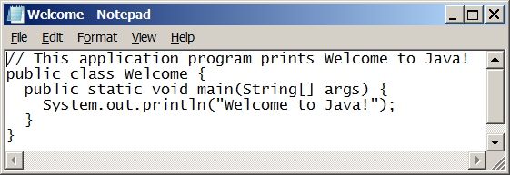
Creating and Editing Using NotePad
To use NotePad, type
  notepad Welcome.java
from the DOS prompt.

Slide 33

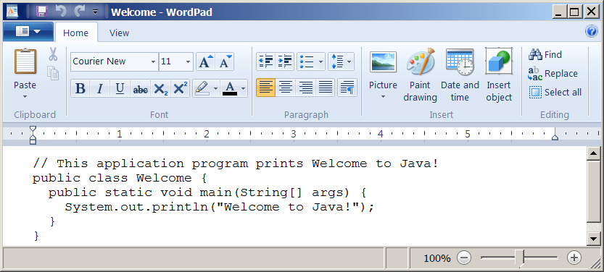
Creating and Editing Using WordPad
To use WordPad, type
  write Welcome.java
from the DOS prompt.

Slide 34
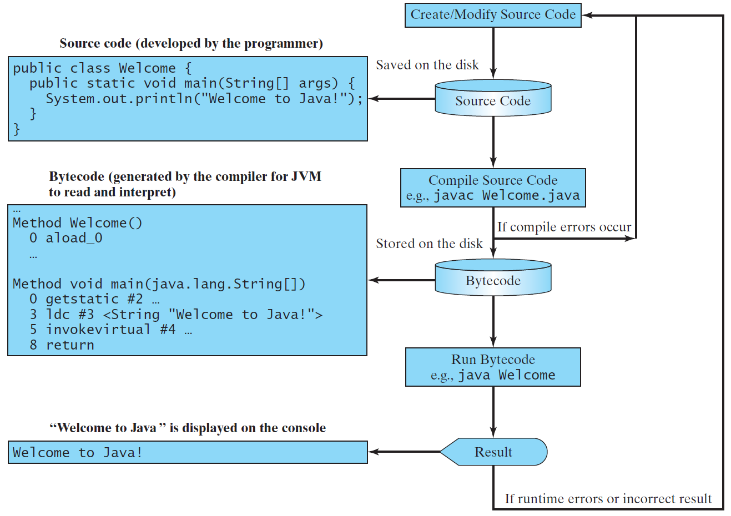
Creating, Compiling, and Running Programs

Slide 35
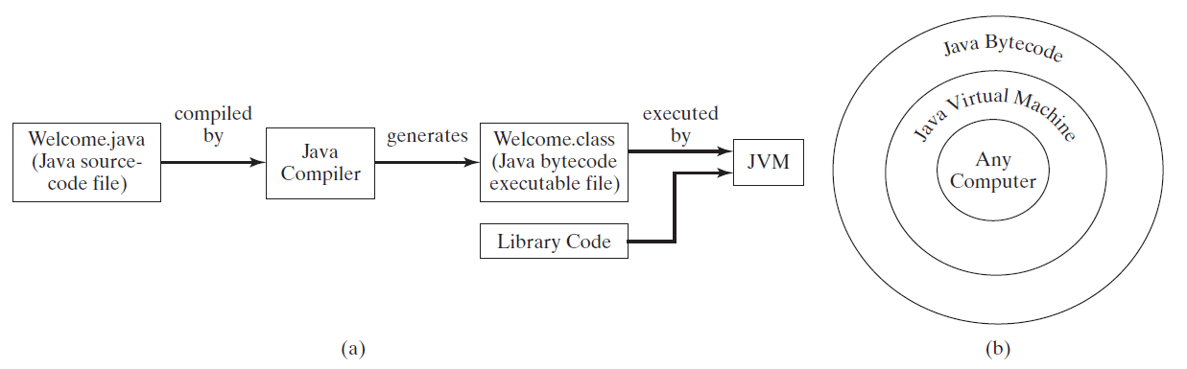
Compiling Java Source Code
You can port a source program to any machine with appropriate compilers. The source program must be recompiled, however, because the object program can only run on a specific machine. Nowadays computers are networked to work together. Java was designed to run object programs on any platform. With Java, you write the program once, and compile the source program into a special type of object code, known as bytecode. The bytecode can then run on any computer with a Java Virtual Machine, as shown below. Java Virtual Machine is a software that interprets Java bytecode.

Slide 36
Trace a Program Execution
animation
Enter main method
// This program prints Welcome to Java!
public class Welcome {
public static void main(String[] args) {
System.out.println("Welcome to Java!");
}
}

Slide 37
Trace a Program Execution
animation
Execute statement
// This program prints Welcome to Java!
public class Welcome {
public static void main(String[] args) {
System.out.println("Welcome to Java!");
}
}

Slide 38
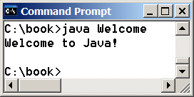
Trace a Program Execution
animation
// This program prints Welcome to Java!
public class Welcome {
public static void main(String[] args) {
System.out.println("Welcome to Java!");
}
}
print a message to the console

Slide 39
Two More Simple Examples
WelcomeWithThreeMessages
Run
ComputeExpression
Run

Slide 40
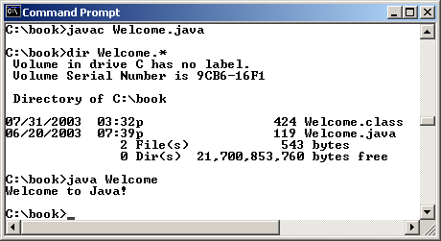
Compiling and Running Java from the Command Window
Companion Website
Set path to JDK bin directory
  set path=c:\Program Files\java\jdk1.8.0\bin
Set classpath to include the current directory
  set classpath=.
Compile
  javac Welcome.java
Run
  java Welcome

Slide 41
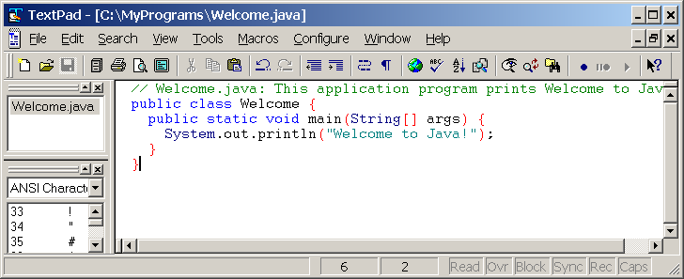
Compiling and Running Java from TextPad
Companion Website
See Supplement II.A on the Website for details

Slide 42
Anatomy of a Java Program
Class name
Main method
Statements
Statement terminator
Reserved words
Comments
Blocks

Slide 43
Class Name
Every Java program must have at least one class. Each class has a name. By convention, class names start with an uppercase letter. In this example, the class name is Welcome.
// This program prints Welcome to Java!
public class Welcome {
public static void main(String[] args) {
System.out.println("Welcome to Java!");
}
}

Slide 44
Main Method
Line 2 defines the main method. In order to run a class, the class must contain a method named main. The program is executed from the main method.
// This program prints Welcome to Java!
public class Welcome {
public static void main(String[] args) {
System.out.println("Welcome to Java!");
}
}

Slide 45
Statement
A statement represents an action or a sequence of actions. The statement System.out.println("Welcome to Java!") in the program in Listing 1.1 is a statement to display the greeting "Welcome to Java!“.
// This program prints Welcome to Java!
public class Welcome {
public static void main(String[] args) {
System.out.println("Welcome to Java!");
}
}

Slide 46
Statement Terminator
Every statement in Java ends with a semicolon (;).
// This program prints Welcome to Java!
public class Welcome {
public static void main(String[] args) {
System.out.println("Welcome to Java!");
}
}

Slide 47
Reserved words
Reserved words or keywords are words that have a specific meaning to the compiler and cannot be used for other purposes in the program. For example, when the compiler sees the word class, it understands that the word after class is the name for the class.
// This program prints Welcome to Java!
public class Welcome {
public static void main(String[] args) {
System.out.println("Welcome to Java!");
}
}

Slide 48
Blocks
A pair of braces in a program forms a block that groups components of a program.

Slide 49
Special Symbols

Slide 50
{ … }
// This program prints Welcome to Java!
public class Welcome {
public static void main(String[] args) {
System.out.println("Welcome to Java!");
}
}

Slide 51
( … )
// This program prints Welcome to Java!
public class Welcome {
public static void main(String[] args) {
System.out.println("Welcome to Java!");
}
}

Slide 52
;
// This program prints Welcome to Java!
public class Welcome {
public static void main(String[] args) {
System.out.println("Welcome to Java!");
}
}

Slide 53
// …
// This program prints Welcome to Java!
public class Welcome {
public static void main(String[] args) {
System.out.println("Welcome to Java!");
}
}

Slide 54
" … "
// This program prints Welcome to Java!
public class Welcome {
public static void main(String[] args) {
System.out.println("Welcome to Java!");
}
}

Slide 55
Programming Style and Documentation
Appropriate Comments
Naming Conventions
Proper Indentation and Spacing Lines
Block Styles

Slide 56
Appropriate Comments
Include a summary at the beginning of the program to explain what the program does, its key features, its supporting data structures, and any unique techniques it uses.
Include your name, class section, instructor, date, and a brief description at the beginning of the program.

Slide 57
Naming Conventions
Choose meaningful and descriptive names.
Class names:
  Capitalize the first letter of each word in the name. For example, the class name ComputeExpression.

Slide 58
Proper Indentation and Spacing
Indentation
  Indent two spaces.
Spacing
  Use blank line to separate segments of the code.

Slide 59
Block Styles
Use end-of-line style for braces.

Slide 60
Programming Errors
Syntax Errors
  Detected by the compiler
Runtime Errors
  Causes the program to abort
Logic Errors
  Produces incorrect result

Slide 61
Syntax Errors
public class ShowSyntaxErrors {
public static main(String[] args) {
System.out.println("Welcome to Java);
}
}
ShowSyntaxErrors
Run

Slide 62
Runtime Errors
public class ShowRuntimeErrors {
public static void main(String[] args) {
System.out.println(1 / 0);
}
}
ShowRuntimeErrors
Run

Slide 63
Logic Errors
public class ShowLogicErrors {
public static void main(String[] args) {
System.out.println("Celsius 35 is Fahrenheit degree ");
System.out.println((9 / 5) * 35 + 32);
}
}
ShowLogicErrors
Run

