Slide 1
Thermal Fluid Engineering
ENMC4411
Chapter 2 Fluid Statics
Afif Akel Hasan
Mechanical & Mechatronics Engineering Department
Birzeit University

Slide 2
Outline
Fluids
Units & dimensions
Properties of fluids
Pressure variations
Pressure forces
Buoyancy

Slide 3
Fluid
Matter consist of two states ; fluid and solid . A solid can resist sheer stress by a static deformation . The fluid move and deforms continuously as long as sheer stress is applied.
A fluid continues to flow for as long as the force is applied and will not recover its original form when the force is removed.
Shear force : force component tangent to the surface .
Shear stress is the sheer force per unit area τ = F/area .

Slide 4
Fluid Mechanics
Fluid Mechanics : is the study of the fluids either in motion or at rest and the effects of the fluid upon the boundaries. Gases and liquid are classified as fluids .
Fluid at rest : fluid statics
Fluid in motion : fluid dynamics

Slide 5
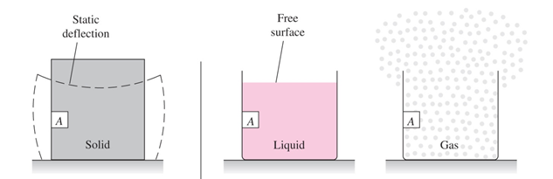
Fluids
fluid of two classes: liquids and gases .
A liquid composed of relatively closed – packed molecules with strong cohesive forces ,while gases are widely spaced molecules with negligible cohesive forces .
A gas has no definite volume

Slide 6
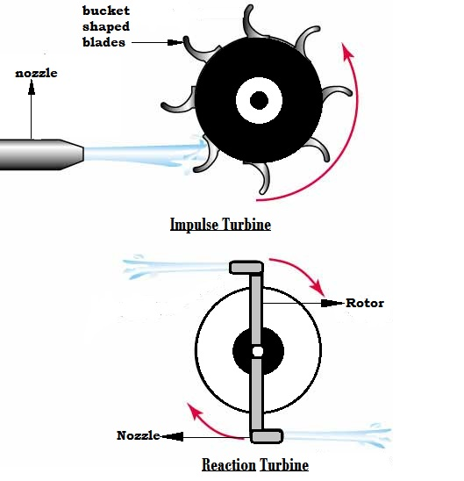
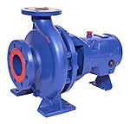
Engineering Application
Examples include breathing , blood flow, heart, swimming,
Machinery: Pumps, fans, turbines
Ships, cars , air planes , plane engines , jets …

Slide 7
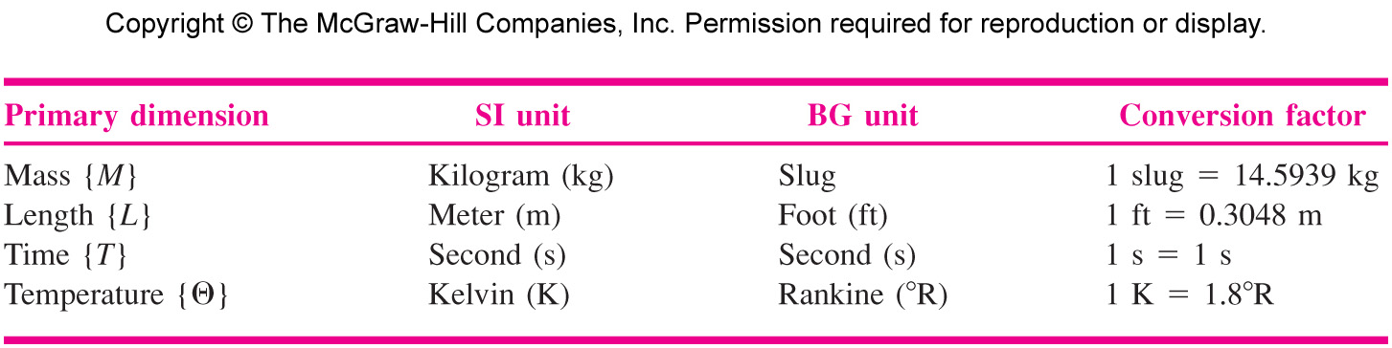
Dimensions and Units
Primary dimensions: from which all other dimensions can be derived : mass, length, time and temperature , for ones used in fluid mechanics see Table (1.1) P. 8 .

Slide 8

Secondary dimensions
Derived or constructed from combinations of these four primary dimensions eg .
Acceleration L/T2 = LT⁻² dv/dt
Force F = m a (Newton's 2nd law)
F = M L T⁻²
i.e 1N = 1kg .m/s²
See table 1.2 p .9 for some secondary dimensions.

Slide 9
Primary unit systems
  There are three primary unit systems in use:
    the International System of Units (SI units - kg, N, m, s, K)
    the English Engineering System of Units (commonly called English units - lbm, lbf, ft, s, R)
    the British Gravitational System of Units (BG - slug, lbf, ft, s, ºR)
  Units must always have numbers associated with them.
  For example, length is a dimension, but it is measured in units of feet (ft) or meters (m).

Slide 10
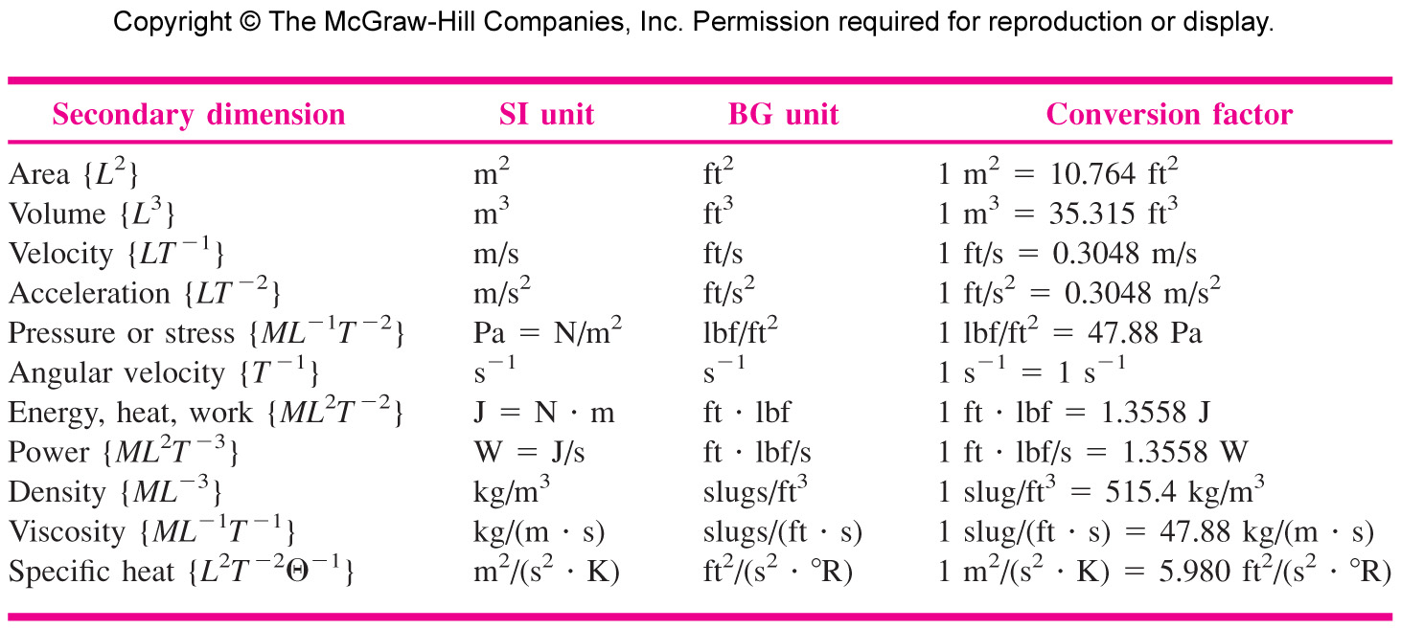
Secondary dimensions

Slide 11
Outline
Fluids
Units & dimensions
Properties of fluids
Pressure variations
Pressure forces
Buoyancy

Slide 12
Thermodynamic Properties of a fluid
Most common properties
Pressure P
Density ρ
Temperature T
Others for work and energy calculations:
Internal energy u
Enthalpy h = u +P/r
Specific heat C_{p} , C_{v}
Entropy s
Viscosity μ
Thermal conductivity k
Two properties such as ( P,T) are sufficient to fix the value of all other properties for pure substances.

Slide 13
Pressure & temperature
Pressure: pressure is the stress at a point in a static fluid, or force per unit normal area P = F_{normal} / A_{area} .
1 atmosphere = 101300 Pa = 101.30 kPa= 14.7 PSI
Temperature : a measure of the internal energy level of a fluid,
Centigrade ( Celsius) and absolute K = C +273.16 .

Slide 14
Fluid density
Density : mass per unit volume , symbol ( ρ )
ρ = m/v [ kg/m³ ]
Density is nearly constant for liquids, while increasing proportional to pressure of gases .
Liquids are treated as incompressible fluid (density doesn’t change with changing pressure ) .
e.g water density 1000kg/m³, air density 1.2 kg/m³ at 300 K 1 atm.
Mercury 13600 kg/m³.

Slide 15
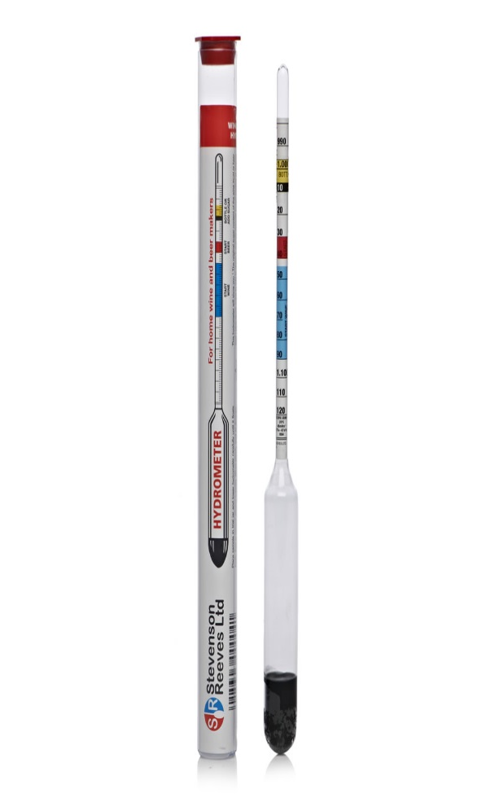
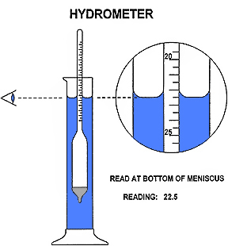
Specific gravity
Specific gravity SG : a ratio of a fluid density to standard reference fluid.
Reference fluids: water ( for liquids ) and air for gases .
SG _{gas} = ρ _{gas} / ρ _{air} = ρ _{gas} / 1.205 kg/m³
SG _{liquid} = ρ _{liquid} / ρ _{water} = ρ _{liquid} / 998 kg/m³
e.g SG _{Hg} = 13580 / 998 = 13.6

Slide 16
Specific weight
Specific weight: denoted by “ ɣ “ is the weight per unit volume ɣ = ρ g
since ɣ = mg /V = ρ g .
Hence units of [ɣ ] are N / m³ or lbf/ ft³ .
e.g ɣ _{air} = 1.205*9.8 = 11.8 N/m³ = 0.0752 lbf/ft³
  at 20 C ɣ _{water} = 9.807 *998 = 9790 N/m³ = 62.4 lbf/ft³
To remember: ɣ _{air} = 10 N/ m³ , ɣ _{water} = 10kN/m³

Slide 17
Potential and Kinetic Energy
Energy stored in a system by molecular, activity and molecular bonding forces is denoted as internal energy .
Potential energy equals the work required to move up the system mass ‘m’ from one elevation to another one against the gravity field . PE = mg ∆z
Kinetic energy equals the work required to change the speed of the ‘m’ from zero to velocity V , its value is ½mV² .
The total storage energy per unit mass in fluid mechanics is given as e = u + ½V² + gz

Slide 18
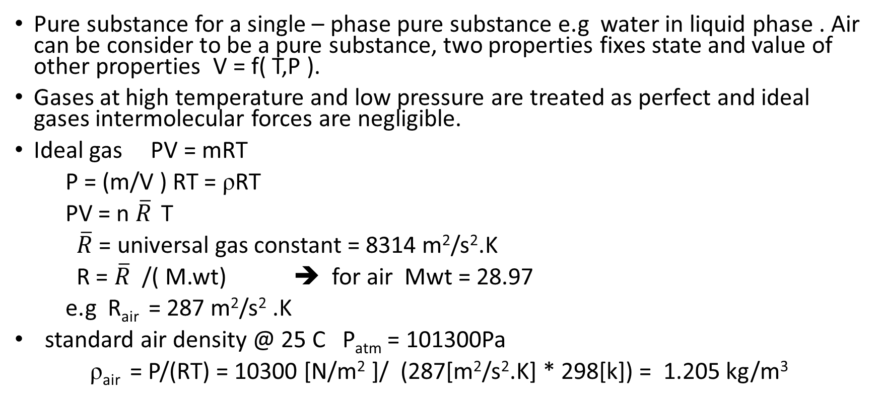
State relation of gases
Pure substance for a single – phase pure substance e.g water in liquid phase . Air can be consider to be a pure substance, two properties fixes state and value of other properties V = f( T,P ).
Gases at high temperature and low pressure are treated as perfect and ideal gases intermolecular forces are negligible.
Ideal gas PV = mRT
P = (m/V ) RT = ρRT
PV = n $\overline{R}$ T
$\overline{R}$ = universal gas constant = 8314 m²/s².K
R = $\overline{R}$ /( M.wt) ➔ for air Mwt = 28.97
e.g R_{air} = 287 m²/s² .K
standard air density @ 25 C P_{atm} = 101300Pa
ρ_{air} = P/(RT) = 10300 [N/m² ]/ (287[m²/s².K] * 298[k]) = 1.205 kg/m³

Slide 19
Specific heat
for gases
Specific heat at constant volume C_{v} = ( du/dt )_{v}
Specific heat at constant pressure C_{p} = ( dh/dt )_{p}
Specific heat ratio K = (C_{p} /C_{v} ) > 1
For air k=1.4
For ideal gases internal energy and enthalpy are only function of temperature.
u = f(t) , h = f(t)
dh = C_{po} dT → ∆h = ∫ C_{po} dT
du = C_{vo} dT → ∆u = ∫ C_{vo} dT

Slide 20
Vapor pressure
It is the pressure developed above the liquid when liquid in a closed container or pressure at which liquid boils .
Vapor pressure is a function of temperature e.g for water
at 100 º C P_{vapor} =1 atm = 101.30kPa .
at 50 º C P_{vapor} = 12.350 kPa
Vapor pressure of water.

Slide 21
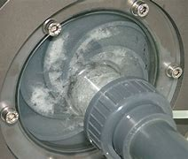
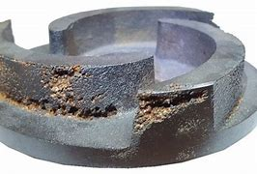
Cavitation
Cavitation occurs when pressure is lower than vapor pressure at given temperature of liquid ( liquid will flash into vapor ).
For cavitation , dimensionless parameter called cavitation number is used
C_{a} = (P_{sys} - P­_{v} )/ ½ρV²
Where : P_{sys} = system pressure
P_{v} = vapor pressure
V = flow velocity
Critical cavitation number : value of C_{a} below which cavitation ( bubbles formation ) Take place in a flow.

Slide 22

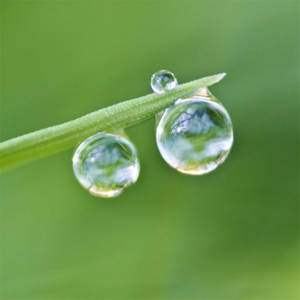
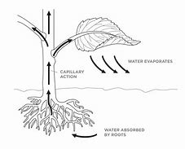
Surface Tension
A liquid will form an interface with a second liquid or a gas .
Surface tension results from cohesive forces, between similar molecules , and “adhesive” force between unlike molecules .
At interface cohesive force from below ( liquid ) exceeds adhesive force ( gas/liquid ) hence resulting in surface tension .
Surface tension results in formation of liquid droplets, bubbles, and capillary action .
It is measured by stretching force required to form the film , surface energy per unit length .
Unit of [σ] : F/L SI N/m or lbf/ft
e.g water /air σ = 0.073N/m
air / mercury σ = 0.48 N/m

Slide 23
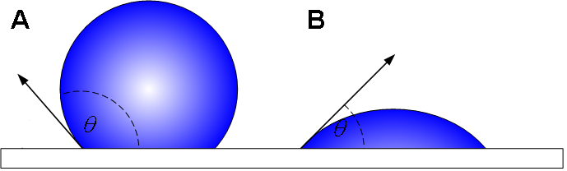
Contact angle
Surface tension occurs during a gas-liquid interface, but if that interface comes in contact with a solid surface - such as the walls of a container - the interface usually curves up or down near that surface. Such a concave or convex surface shape is known as a meniscus.

Slide 24
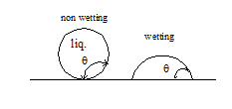
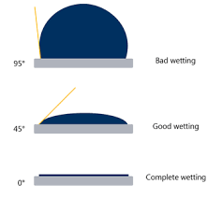
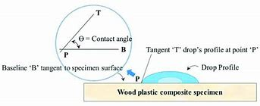
Capillary Action
contact angle ϴ appears when liquid intersect
with the a solid surface .
If ϴ < 90 wetting ( wets the solid )
If ϴ > 90 Non wetting liquid .
capillary action when liquid rises or falls in capillary tubes .
it is caused by surface tension and by the relative values of adhesive ( liquid to solid ) and cohesive force ( between the liquid molecules ).

Slide 25
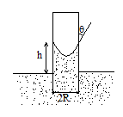
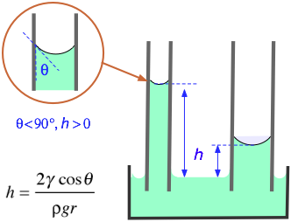
Example 1.9 p 31
Surface tension force at inter-face must balance the weight of the column of liquid of height (h )
(2σ π R) cosϴ = ɣ π R² h
then h = (2 σ cosϴ /ɤR)
h > 0 positive if ϴ < 90
h < 0 negative if ϴ > 90
a ) e.g for water – air –glass ϴ = 0 σ = 0.073 N/m
ρ = 1000kg/m³ R = 1 mm
h = 2(0.073cos ϴ / (1000*9.81*0.001) = 0.015 m = 1.5 cm .
b ) for mercury – air – glass
ϴ = 130, σ = 0.48 N/m ρ = 13600 kg /m³
R = 1 mm
h = 2*0.48 *cos130 / 13600*9.81*0.001 = -0.46

Slide 26
Basic Flow-Analysis Techniques
There are three basic ways to attack a fluid-flow problem;
  Control-volume, or integral analysis (Chap. 3)
  Infinitesimal system, or differential analysis (Chap. 4)
  Experimental study, or dimensional analysis (Chap. 5)
The flow must satisfy the three basic laws of mechanics plus a thermodynamic state relation and associated boundary conditions.
  Conservation of mass (continuity)
  Linear momentum (Newton’s second law)
  First law of thermodynamics (conservation of energy)
  A state relation like f(p, T)
  Appropriate boundary conditions at solid surfaces, interfaces, inlets, and exits

Slide 27
Outline
Fluids
Units & dimensions
Properties of fluids
Pressure variations
Pressure forces
Buoyancy

Slide 28
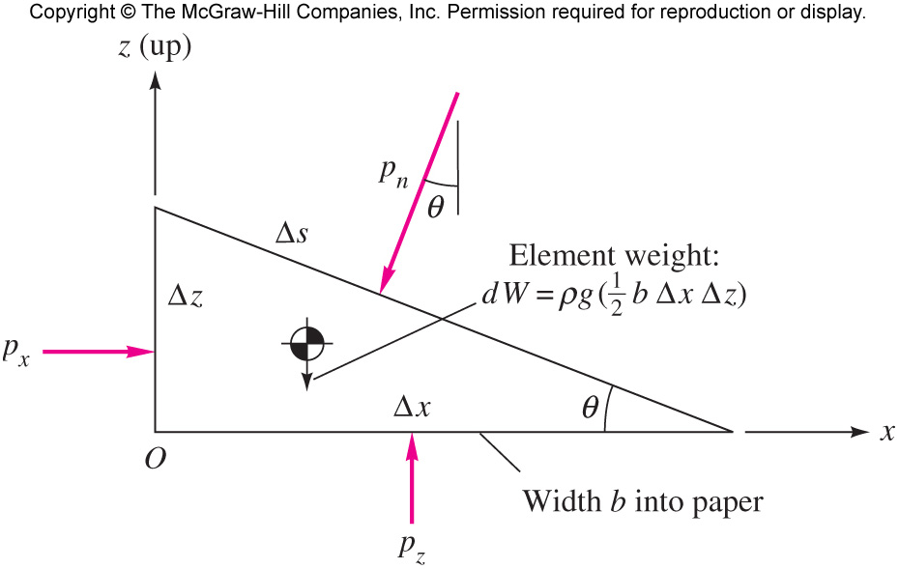
Pressure at a point
It can be shown that at any point in a fluid the pressure is the same in all directions .
P_{x} = P_{y} = P_{z}

Slide 29
Pressure variation
Pressure in a continuously distributed uniform static fluid varies only with vertical distance and is independent of the shape of the container.
The pressure is the same at all points on a given horizontal plane in the fluid.
The pressure increases with depth in the fluid.

Slide 30
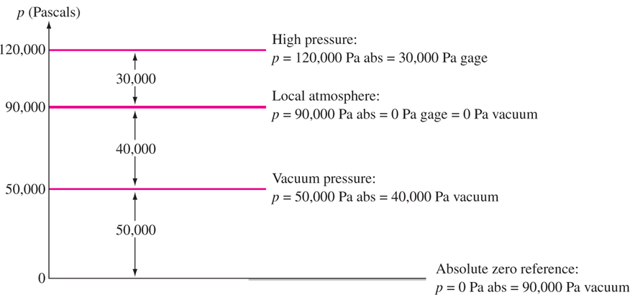
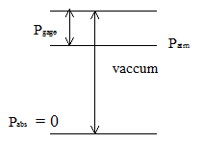
Pressure scale
Absolute pressure at complete vacuum
P_{gauge} = P _{absolute} - P_{atmosphere}
Or
P_{abs} = P_{atm} + P_{gauge}
P_{atm} = 760 mm Hg
= 101.325kPa
= 14.7 psi
Bourdon gauge : measures gauge pressure
Barometer : measure atmospheric pressure

Slide 31
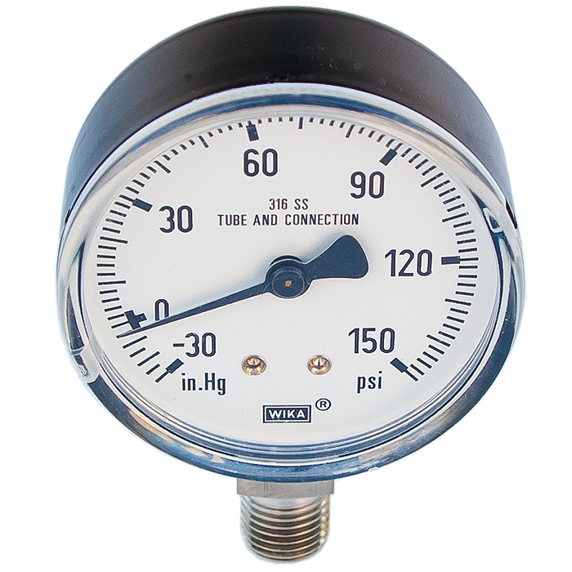
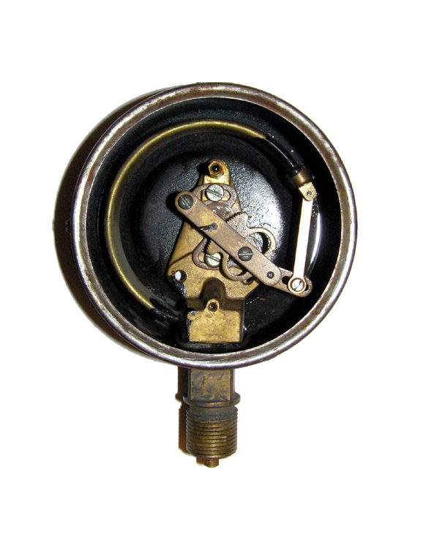
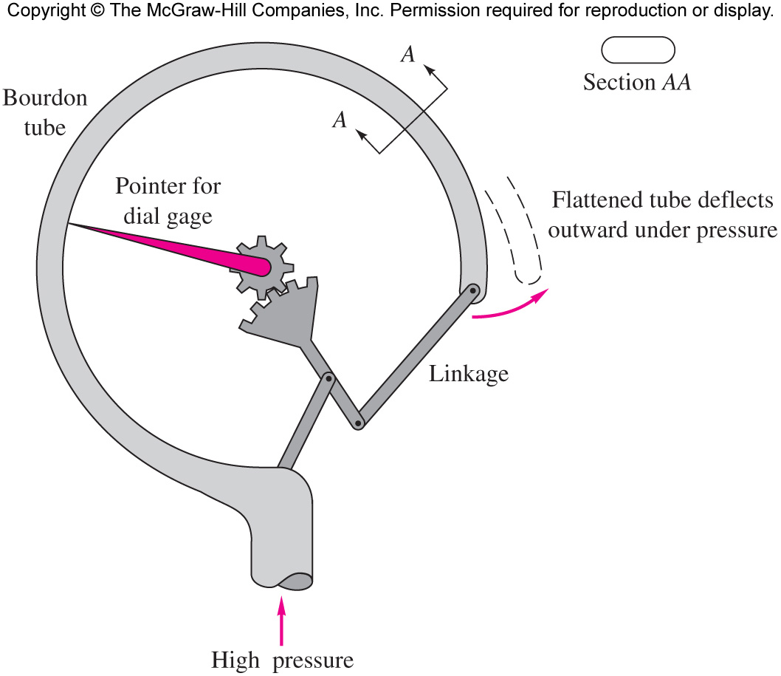
Bourdon gauge

Slide 32
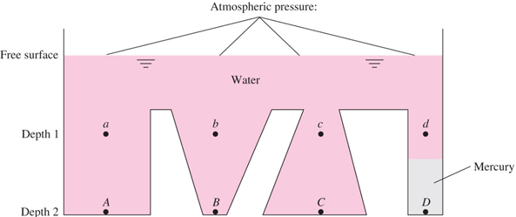
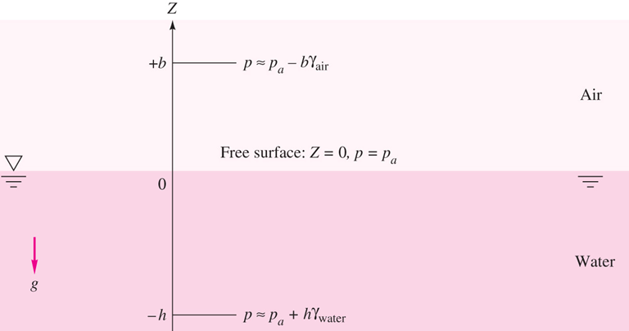
Incompressible fluid
Hydrostatic pressure distribution
( dp/dz ) = -ɣ = -ρg
P₂ –P₁ = - ɣ (z₂-z₁ )
P₂ = P₁ + ɣ (z₁-z₂)
P₂ = P₁ + ɣh
If P₁ = P_{atm}
Then P₂ = P_{atm} + ɣh
P _{down} = P_{up} +ɤ h

Slide 33
EXAMPLE 2.1
Newfound Lake, a freshwater lake near Bristol, New Hampshire, has a maximum depth of 60 m, and the mean atmospheric pressure is 91 kPa. Estimate the absolute pressure in kPa at this maximum depth.

Slide 34

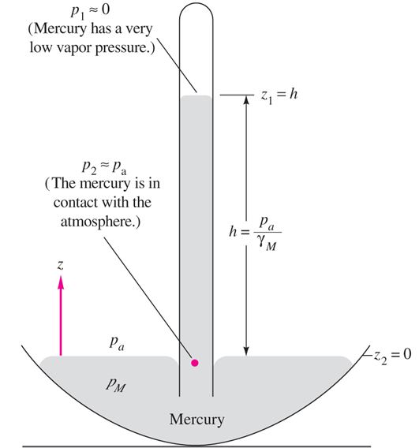
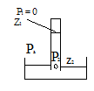
Barometer
Barometer is simplest application of the hydrostatic formula.
P₂ - P₁ = -ρg( z₂- z₁ )
Mercury barometer is a tube filled with mercury and inverted in mercury reservoir.
P₂ = P₁+ ρg( z2- z1 ) = P1 + ρg h
At z₁ top of mercury P₁ = 0 since Hg has low vapor pressure P₂ = P_{a} at the same level
P₂ = P_{a} = ρ_{Hg} g h ➔ h = P_{a}/ ρ_{Hg} g
e.g P_{a} = 101350 Pa ɤ_{Hg} = 133100N/m³
then h = 0.761 m = 761 mm
mercury is used because it is the heaviest liquid
h _{H2O} = 101350/ɣ_{H2O} = (101350/9790) m H₂O

Slide 35
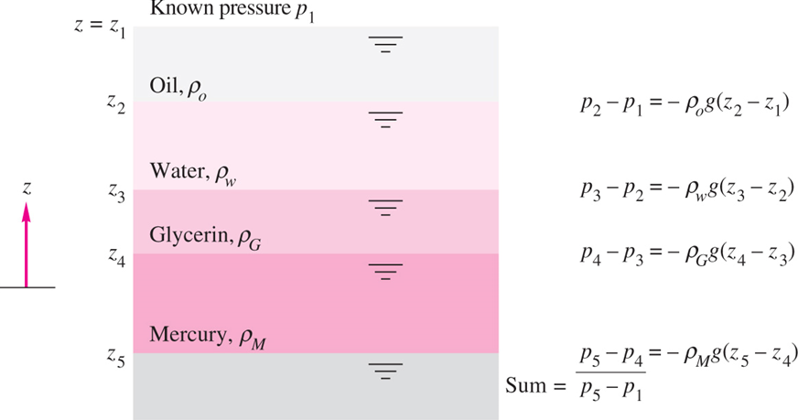
Multi layer liquids

Slide 36
EXAMPLE 2.8 modified
A tank is filled with layered liquids; 8 ft of oil, 6 ft of water, and 4 ft of mercury. Compute pressure at middle of each layer.

Slide 37
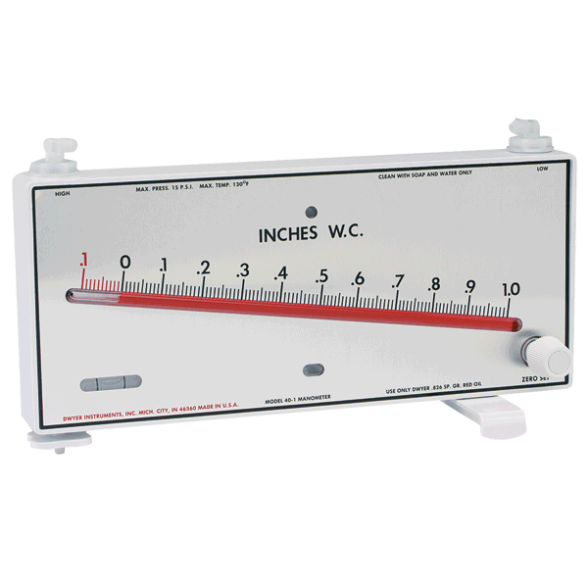
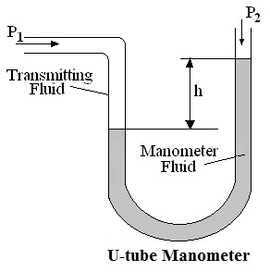
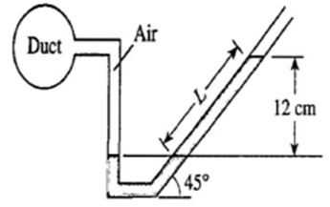
Manometer
Based on Pascal law two points at the same level of continuous fluid have same pressure .

Slide 38
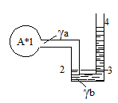
Manometer
Based on Pascal law two points at the same level of continuous fluid have same pressure
P₂ = P₃ at the same level .
P₂ = P_{A} + ϒ_{a 1}h₂
And P₃ = P₄ +ϒ_{b 3}h₄
P_{A} + ϒ _{a 1}h₂ = P₄ + ϒ _{b 3}h₄
P_{A} = - ϒ _{a 1}h₂ + P₄ + ϒ _{b 3}h₄
P_{A} = P_{atm} + ϒ _{b 3}h₄ - ϒ _{a 1}h₂

Slide 39
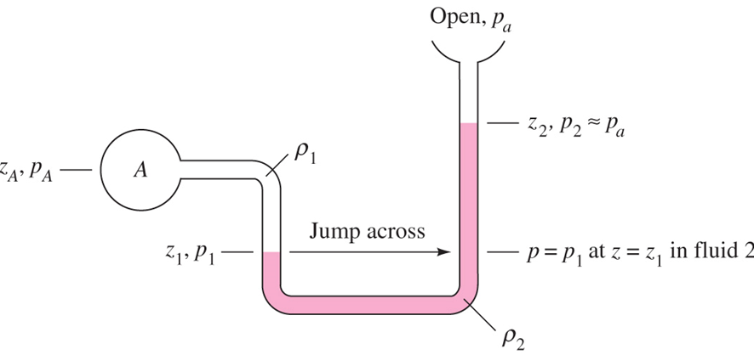
Manometer Problems
Systematic approach .
  Start at one end and write pressure there .
  Add to this , the change in the same units from one meniscus to the next one plus if next meniscus is lower and minus if it is higher
  Continue until the end of the gauge and equate the expression to the pressure at that point .

Slide 40
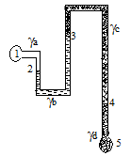
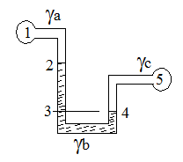
Example
Example 3 Find P₁- P₅ = ?
P₁ + ϒ_{a 1}h₂ - ϒ _{b 2}h₃ + ϒ _{c 3}h₄ + ϒ _{d 4}h₅= P5
P₁ – P₅ = - ϒ _{a 1}h₂ + ϒ _{b 2}h₃ - ϒ _{c 3}h₄ - ϒ _{d 4}h₅
Example 4 Re work e.g 2
P₁ + ϒ _{a 1}h₂ +ϒ_{b 2}h₃ + - ϒ _{c 4}h₅ = P₅
P₁ - P₅ = - ϒ _{b 2}h₃ - ϒ _{a 1}h₂ + ϒ _{c 4}h₅

Slide 41
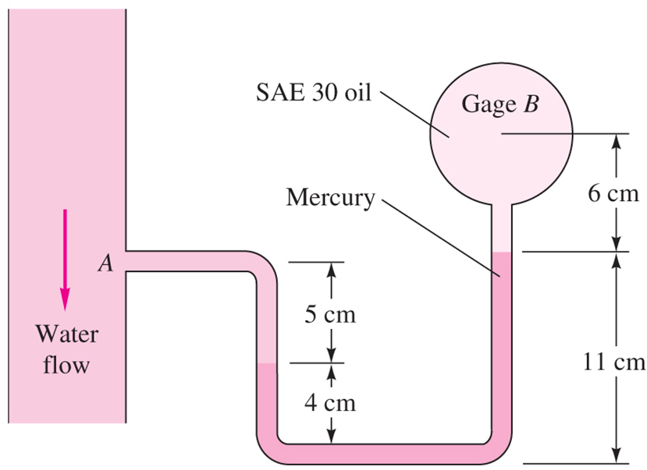
Example 2.4 p.76
Pressure at B is 87 kPag estimate pressure at A?

Slide 42
Outline
Fluids
Units & dimensions
Properties of fluids
Pressure variations
Pressure forces
Buoyancy

Slide 43
Force on plane areas
The distributed pressure forces may be replaced by a resultant force ,F_{R} its line of action is called pressure center .
Task to calculate resultant force magnitude and direction.
Derive formula for horizontal surfaces
Derive formula for inclined surfaces.

Slide 44
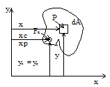
Horizontal surfaces
df =PdA but P is constant
F = ∫df= ∫ PdA= PA
Direction normal to the surface and toward the surface .
Pressure center :
To find center of pressure (Xp, Yp) moment of distributed pressure forces equals moment of F_{R}
For Xp take moment about the y – axis

Slide 46
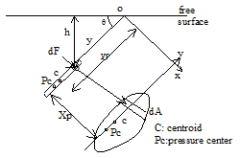
Inclined surface
Consider area element dA
dF= PdA
but P = ϒh then dF =ϒhdA
but h = y sinθ then dF=ϒ y sinθdA

Slide 47
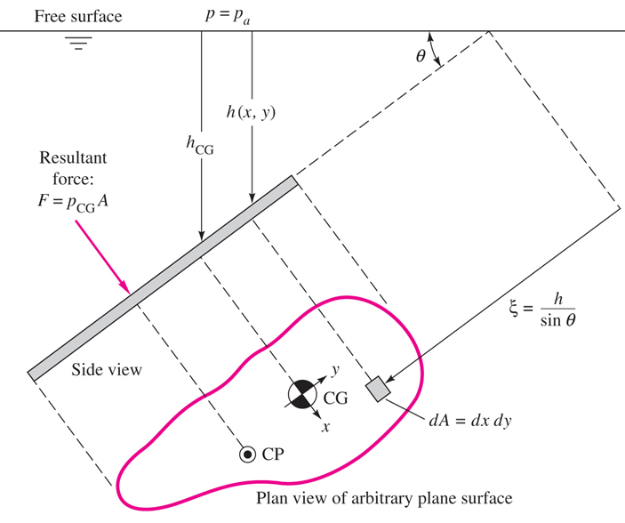
Inclined surface
F_{R} = ϒhc A = P_{c} A
Resultant hydrostatic pressure force is pressure at the centroid multiplied by area of surface.

Slide 48
Center of pressure
Distributed pressure moment about O equals F_{R} moment about O:

Slide 51


Slide 52
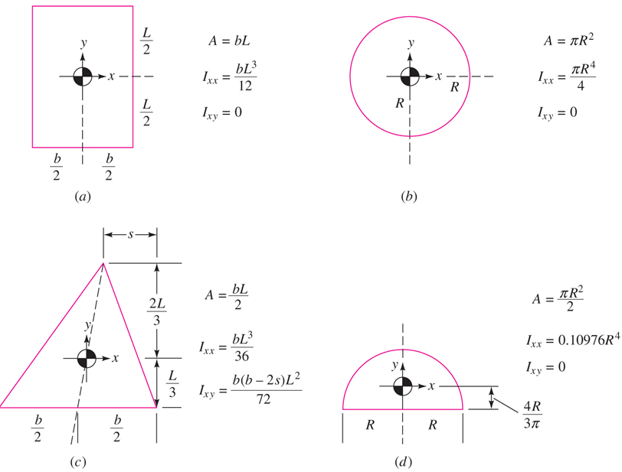

Slide 53


Book notation
Resultant force; $F=$P_{CG} A where P_{CG} is the pressure at centroid
Center of pressure
Ixx is the area moment of inertia of the plate area about its centroidal x axis
Y _{CP} is below the centroid or
Ycp = Yc -Yp
where Ixy is the product of inertia of the plate
X _{CP} is below the centroid or
Xcp = Xc -Xp

Slide 54
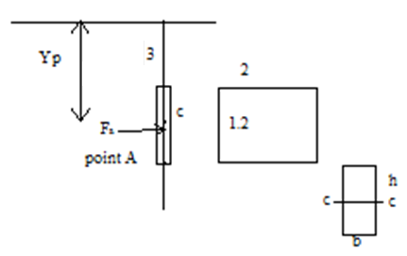
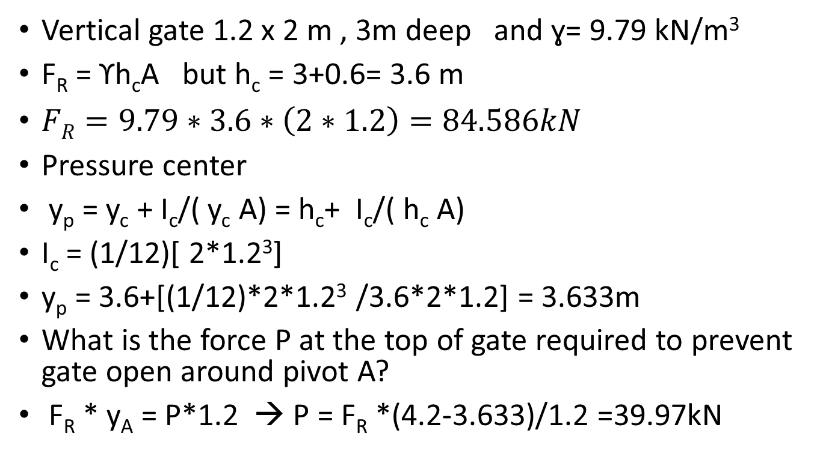
Example vertical rectangular gate
Vertical gate 1.2 x 2 m , 3m deep and ɣ= 9.79 kN/m³
F_{R} = ϒh_{c}A but h_{c} = 3+0.6= 3.6 m
$FR=9.79∗3.6∗\left(2∗1.2\right)=84.586kN$
Pressure center
y_{p} = y_{c} + I_{c}/( y_{c} A) = h_{c}+ I_{c}/( h_{c} A)
I_{c} = (1/12)[ 2*1.2³]
y_{p} = 3.6+[(1/12)*2*1.2³ /3.6*2*1.2] = 3.633m
What is the force P at the top of gate required to prevent gate open around pivot A?
F_{R} * y_{A} = P*1.2 → P = F_{R} *(4.2-3.633)/1.2 =39.97kN

Slide 55
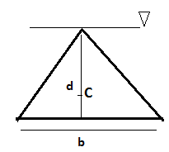
Example vertical triangular gate
Vertical equal sides triangle , head at free surface .
F_{R} =P_{c}A= γh_{c}A
Centroid (2/3) from top h_{c} = (2/3)d
F_{R} = γ(2/3)d*A
A= (bd/2)
So F_{R} = γ(2/3) d (bd/2) = (γ/3)bd²
y_{p} = h_{p} = y_{c} +[(I_{c})_{xx}/y_{c}A] = h_{c} +I_{c}/h_{c}A
y_{p} = (2/3)d + [bd³ /36]/(2/3)d(bd/2)= 3d/4

Slide 56
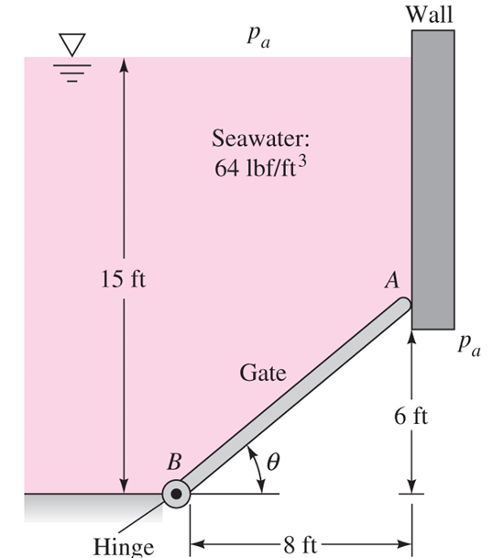
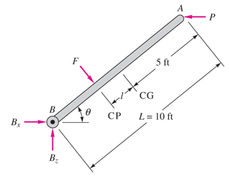
Example 2.5 p. 80
A 5 ft wide gate hinged at B and rest against smooth surface at A. Compute (a) the force on the gate due to seawater pressure. (b) the horizontal force P exerted by the wall at A, and (c ) the reactions at the hinge B?

Slide 57

Example 2.5 p. 80

Slide 59
Outline
Fluids
Units & dimensions
Properties of fluids
Pressure variations
Pressure forces
Buoyancy

Slide 60
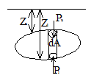
Buoyant Forces
Completely submerged body .
dF_{b} = dF_{l} –dF_{u}
= P_{l} dA – P_{u} dA
= ϒ z_{l} dA – ϒz_{u} dA
dF _{B} = = ϒ(z_{l} – z_{u} )dA = ϒ dV_{body}
* buoyant force equals weight of displaced fluid “ Archimedes Principle “
Center of buoyancy : It can be shown that
X_{B} = (1/F_{B} ) ∫ ϒ x (z_{l} – z_{u} )dA = (ϒ /F_{B} )∫ x dV = (1/V) ∫ x dV
Which is the centroid of volume ( submerged )

Slide 61
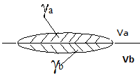
Buoyant Forces
Body at interface of two immiscible fluids it can be shown
F_{B} = ϒ_{a}V_{a} +ϒ_{b}V_{b}
Weight of fluids being displaced by the body
See e.g 2.11 p.91

Slide 62
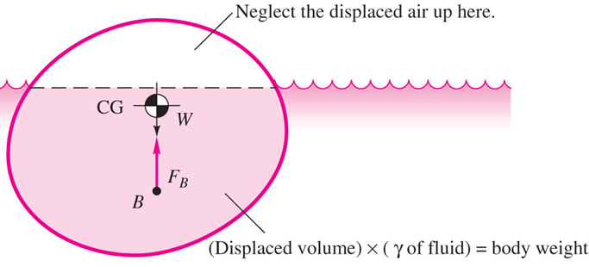

Floating bodies
Weight = buoyancy
Neglect buoyance due to air

Slide 63

Buoyant Forces
weight in fluid 1 F_{B1} + F₁ = w
ϒ₁v+F₁ = w
weight in fluid 2 F_{B2} + F₂ = w
  = ϒ ₂ V +F₂ = w
then V = (F₁-F₂ )/ (ϒ₂- ϒ ₁ ) ; and
w = (F₁ ϒ ₂ - F₂ ϒ ₁)/ (ϒ ₂ - ϒ ₁ )
also
ρ = (w/g )/v = (F₁ ϒ ₂ - F₂ ϒ ₁)/ g(F₁-F₂ )
S.G = (w/v ) / ϒ _{H2o}

