Slide 1
Assessing control risk and reporting on internal controls
Chapter 12

Slide 2
Chapter 12 Learning Objectives
12-1 Obtain and document an understanding of internal control.
12-2 Assess control risk by linking key controls and control
deficiencies to transaction-related audit objectives.
12-3 Describe the process of designing and performing tests of controls.
12-4 Understand how control risk impacts detection risk and the
design of substantive tests.
12-5 Understand requirements for auditor reporting on internal control.
12-6 Describe the differences in evaluating, reporting, and testing
internal control for nonpublic and smaller companies.
12-7 Describe how the complexity of the IT environment impacts control
risk assessment and testing.

Slide 3
OBJECTIVE 12-1
Obtain and document an understanding of internal control.

Slide 4
Obtain and document understanding of internal control
Auditors need to understand controls that are relevant to financial statement audits in order to identify and assess the risks of material misstatements
There are four steps in the process of understanding controls, as shown in Figure 12-1:
  Obtain and document understanding of internal control.
  Assess control risk.
  Design, perform, and evaluate tests of controls.
  Decide planned detection risk and substantive tests.
Notes:
Auditing standards require that auditors obtain an understanding of the client’s internal control and to document that understanding in the audit files.

Slide 6
Obtain and document understanding of internal control (cont.)
Obtain and Document Understanding of Internal Control—Auditors use the following techniques:
  Narrative—Written description of client’s internal controls including:
    The origin of every document and record in the system
    All processing that takes place
    The disposition of every document and record in the system
    An indication of the controls relevant to the assessment of control risk
  Flowchart—A diagram of the client’s documents flow in the organization.
  Internal Control Questionnaire—Illustrated in Figure 12-2.
Notes:
Auditors obtain an understanding through many different activities starting with asking for documentation of the system from the client.

Slide 7
Notes:
This is part of a questionnaire that is used by auditors to obtain information from the client’s employees.

Slide 8
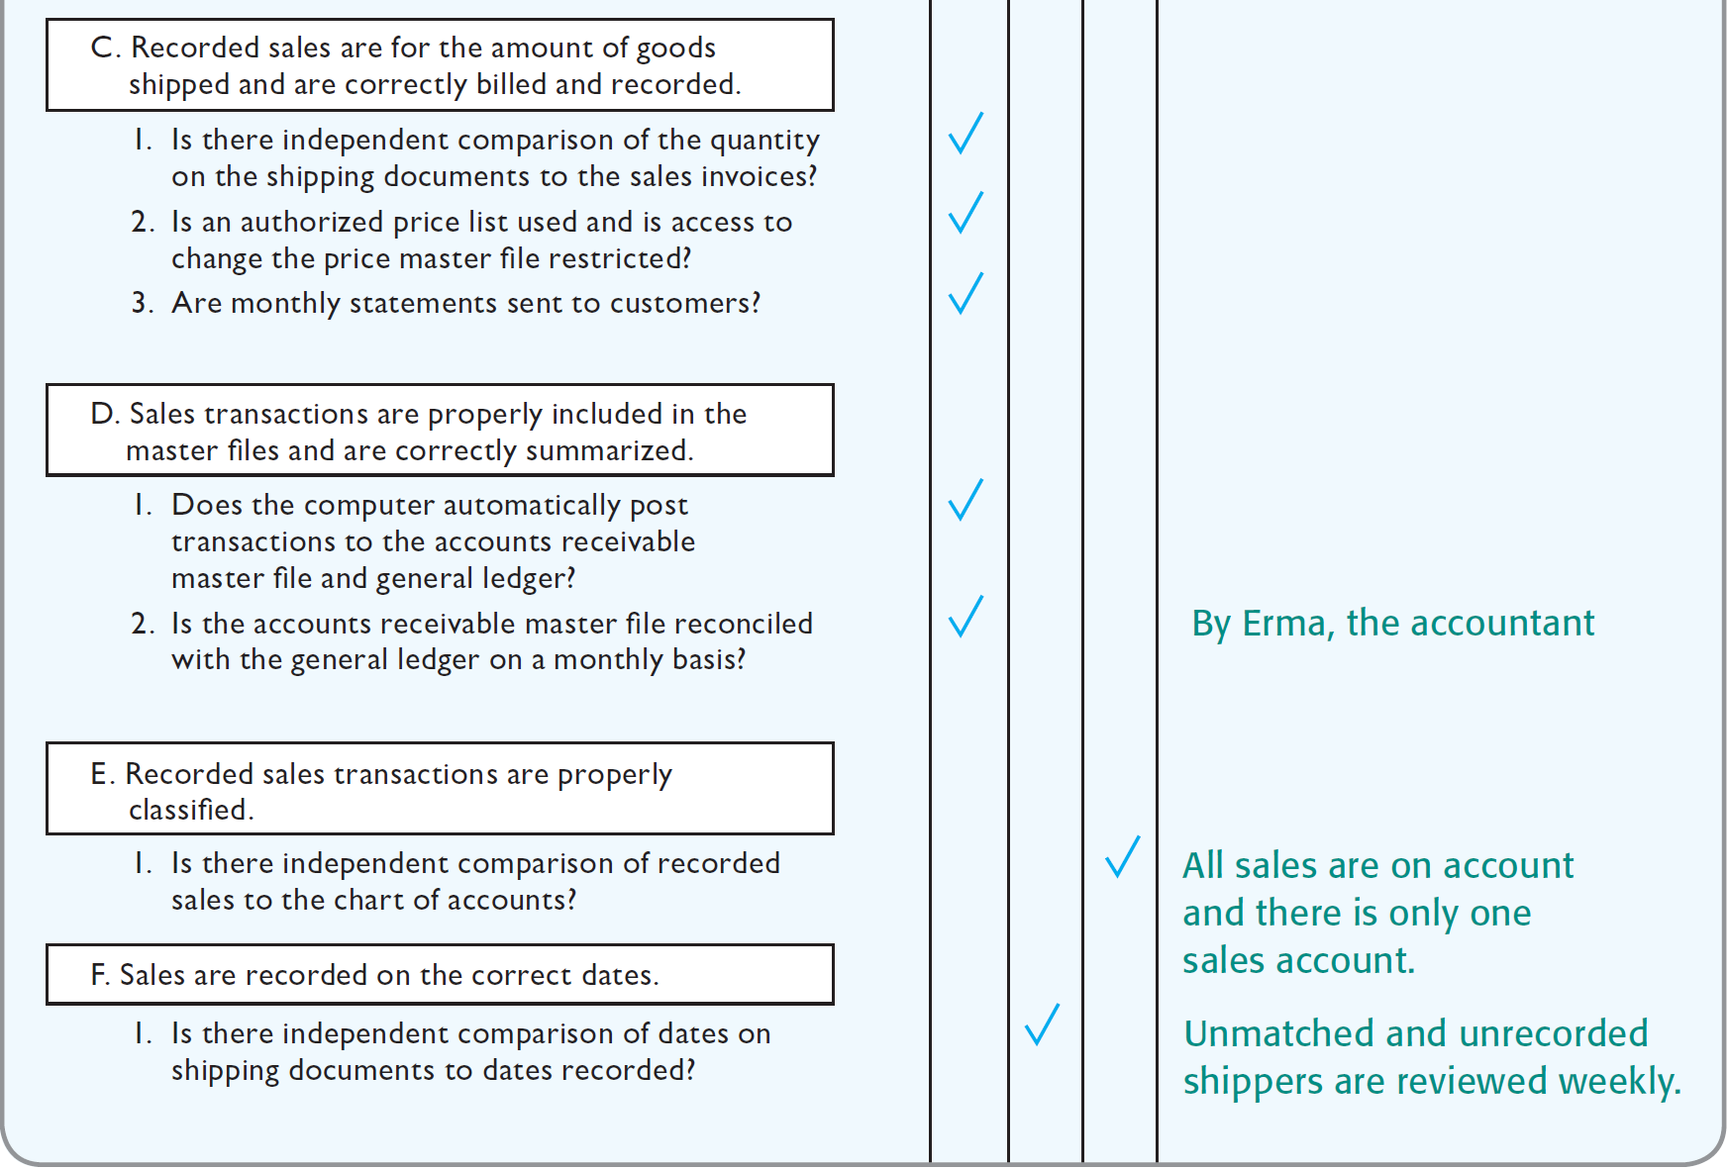
Notes:
This is part of a questionnaire that is used by auditors to obtain information from the client’s employees.

Slide 9
Obtain and document understanding of internal control (cont.)
Evaluating Internal Control Implementation—In addition to understanding the design of the internal controls, the auditor must also evaluate whether the designed controls are implemented.
Auditors use the following methods to evaluate implementation:
  Update and evaluate auditor’s previous experience with the entity.
  Make inquiries of client personnel.
  Examine documents and records.
  Observe entity activities and operations.
  Perform walkthroughs of the accounting system.
Notes:
Once the auditor has an understanding of the internal control, they must evaluate the implementation of that system.

Slide 10
OBJECTIVE 12-2
Assess control risk by linking key controls and control deficiencies to transaction-related audit objectives.

Slide 11
Assess control risk
Determine Assessed Control Risk Supported by the Understanding Obtained—The auditor makes a preliminary assessment of control risk based on entity-level control risks as well as IT general controls.
Use of a Control Risk Matrix to Assess Control Risk—A sample matrix is included in Figure 12-3 on page 373.
Components of the Matrix include:
  Identify audit objectives.
  Identify existing controls.
  Associate controls with related audit objectives.
Notes:
Auditors use the understanding of internal control to assess control risk using the control risk matrix.

Slide 12
Assess control risk (cont.)
Identify and Evaluate Control Deficiencies, Significant Deficiencies, and Material Weaknesses—Auditors must evaluate whether key controls are absent in the design of internal control over financial reporting.
Auditing standards define three levels of the absence of internal controls:
  Control Deficiency—The design or implementation of internal controls does not permit company personnel to prevent or detect misstatement.
  Significant Deficiency—A deficiency that is less severe than a material weakness, but important enough to merit attention.
  Material Weakness—Exists if a significant deficiency, or combination of significant deficiencies, result in a reasonable possibility that internal control will not prevent or detect material financial statement misstatement.

Slide 13
Assess control risk (cont.)
Identify Deficiencies, Significant Deficiencies, and Material Weaknesses—involves the following process:
  Identify existing controls.
  Identify the absence of key controls.
  Consider the possibility of compensating controls.
  Decide whether there is a significant deficiency or material weakness.
  Determine potential misstatements that could result.
Evaluating significant control deficiencies is illustrated in Figure 12-4.
Notes:
The auditor must determine if there are deficiencies, significant deficiencies, or material weaknesses in the system of internal control.

Slide 15
Assess control risk (cont.)
Identify Deficiencies, Significant Deficiencies, and Material Weaknesses (cont.)
Associate Control Deficiencies with Related Audit Objectives—The control matrix is useful for this task.
Assess Control Risk for Each Related Audit Objective—Again, the control matrix is useful for this assessment.
Two different deficiencies in internal control are described in Figure 12-5.

Slide 16
Notes:
Deficiencies in internal control must be evaluated for potential material misstatement in the financial statements and audit procedures may need to be modified.

Slide 17
OBJECTIVE 12-3
Describe the process of designing and performing tests of controls.

Slide 18
Tests of controls
Purpose of Tests of Controls—to test the effectiveness of controls in support of a reduced control risk for the audit
Procedures for Tests of Controls—The auditor uses four types of procedures to test controls:
  Make inquiries of appropriate client personnel.
  Examine documents, records, and reports.
  Observe control-related activities.
  Reperform client procedures.
Notes:
Tests of controls are performed for the purpose of reducing control risk. If the internal controls are effective, the auditor may rely on them and lower control risk.

Slide 19
Tests of controls (cont.)
Extent of Procedures—depends on preliminary assessed control risk
If the auditor wants a lower control risk, more extensive tests of controls are applied, both in number and extent of tests.
The extent of tests of controls is also dependent on the following:
  Reliance on evidence from the prior year’s audit
  Testing of controls related to significant risks
  Testing less than the entire audit period

Slide 20
Tests of controls (cont.)
Relationship Between Tests of Controls and Procedures to Obtain an Understanding—There is significant overlap between tests of controls and procedures to obtain an understanding. However, there are two primary differences:
  In obtaining an understanding of internal control, the procedures are applied to all controls identified during that phase. Tests of controls are applied only when the assessed control risk has not been satisfied.
  Procedures to obtain an understanding are performed on only one or a few transactions. Tests of controls are performed on larger samples and often at more than one point in time.
This concept is illustrated in more detail in Table 12-1.

Slide 21
Notes:
Assessed control risk affects the extent of procedures performed.

Slide 22
Tests of controls (cont.)
Relationship Between Tests of Controls and Procedures to Obtain an Understanding (cont.)
Understanding Internal Controls on Outsourced Systems—
  When clients use service centers for processing transactions, the auditor may need to obtain an understanding of the controls of the service center.
Reliance on Service Center Auditors—
  It has become increasingly common for service centers to engage their own CPA firm to obtain the understanding necessary for an audit and issue a report to be used by the auditors of their customers.

Slide 23
OBJECTIVE 12-4
Understand how control risk impacts detection risk and the design of substantive tests.

Slide 24
Decide planned detection risk and design substantive tests
The completion of these activities is sufficient for the audit of internal control over financial reporting.
The auditor uses the control risk assessment and results of tests of controls to determine planned detection risk and related substantive tests for the audit.
  The auditor links the control risk assessment to the balance-related audit objectives for the accounts affected by the major transaction types and to the four presentation and disclosure audit objectives.

Slide 25
OBJECTIVE 12-5
Understand requirements for auditor reporting on internal control.

Slide 26
Auditor reporting on internal control
Communications to Those Charged with Governance
and Management Letters
The auditor must communicate significant deficiencies and material weaknesses in writing to those charges with governance as soon as the auditor becomes aware of their existence. An example of a report used in the audit of a nonpublic company is shown in Figure 12-6.
Management letters are not required by auditing standards, but auditors usually provide them when less significant internal control-related issues exist.
Notes:
Auditors must communicate significant deficiencies and often communicate less significant internal-control related issues to management.

Slide 28
Auditor reporting on internal control (cont.)
Section 404 Reporting Requirements—The auditor is required to issue an audit report on internal control over financial reporting for public companies.
Types of Opinions on Internal Control
Unqualified Opinion—The auditor will issue an unqualified opinion on internal control over financial reporting when two conditions are met:
  There are no identified material weaknesses as of the end of the fiscal year.
  There have been no restrictions on the scope of the auditor’s work.
Notes:
Section 404 of Sarbanes-Oxley requires that the auditor report on internal control.

Slide 29
Auditor reporting on internal control (cont.)
Types of Opinions on Internal Control (cont.)
Adverse Opinion
  The auditor will express an adverse opinion on the effectiveness of internal control over financial reporting when one or more material weaknesses exist.
Qualified or Disclaimer of Opinion
  A scope limitation requires the auditor to express a qualified or disclaimer of opinion.
The definition of a material weakness and opinion paragraph are shown in Figure 12-7.

Slide 31
OBJECTIVE 12-6
Describe the differences in evaluating, reporting, and testing internal control for nonpublic and smaller companies.

Slide 32
Evaluating, reporting, and testing internal Control for nonpublic and smaller public companies
Most of the concepts in this chapter apply equally to audits of companies of all sizes, both public and nonpublic. The differences for smaller companies that are not subject to Section 404(b):
  Reporting—no requirement for a report on internal control
  Extent of Internal Controls—may be less extensive, e.g. adequate separation of duties is difficult in smaller companies
  Extent of Understanding Needed—sufficient to assess risk for the audit
  Assessing Control Risk—the auditor will assess control risk at maximum when controls are ineffective or nonexistent for any audit objectives
  Extent of Tests of Controls Needed—the auditor will not perform tests of controls when control risk is assessed at maximum
  These differences are illustrated in Figure 12-8.
Notes:
Reporting for companies not subject to Section 404 differ in that a report on internal control is not required. It is also possible for the auditor to assess control risk at the maximum and forego any tests of controls.

Slide 34
OBJECTIVE 12-7
Describe how the complexity of the IT environment impacts control risk assessment and testing.

Slide 35
Impact of IT environment on control risk assessment and testing
Auditing in More Complex IT Environments— When traditional source documents and accounting records exist only electronically, the auditors must change their approach by auditing through the computer. This can be done using several approaches:
  Test Data Approach—Illustrated in Figure 12-9.
  Parallel Simulation—Illustrated in Figure 12-10.
  Auditors commonly do parallel simulation testing using generalized audit software (GAS). Common uses of GAS are shown in Table 12-2.
  Embedded Audit Module Approach—Auditors insert an audit module into the client’s application system to identify specific types of transactions.
Notes:
Auditing internal controls in a complex IT environment is challenging. Auditors often need software of their own to assist in this process.

Slide 39
