Slide 1
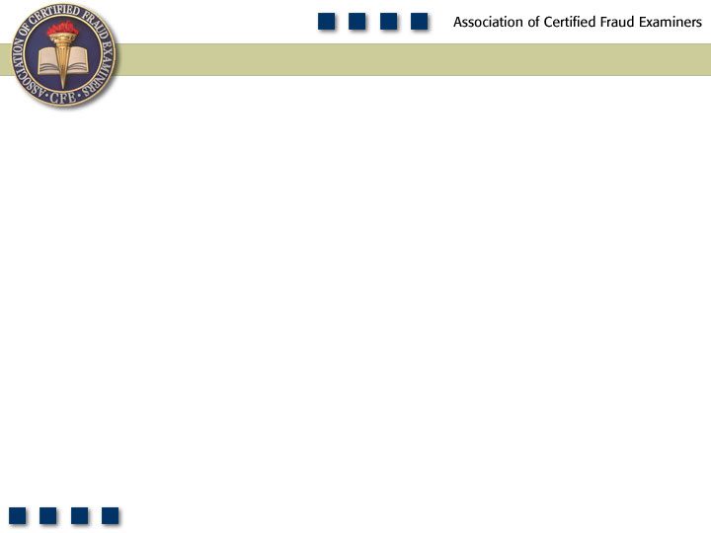
Chapter 11
Accounting Principles and Fraud

Slide 2
Learning Objectives
Define fraud as it relates to financial statements.
Identify the main groups of people who commit financial statement fraud.
List the primary reasons people commit financial statement fraud.
Describe the general methods used to commit financial statement fraud.

Slide 3
Learning Objectives
Define overstatements.
Define understatements.
Describe the conceptual framework for financial reporting.
List examples of various types of financial statements.

Slide 4
Who Commits Financial Statement Fraud?
Senior management
Mid- and lower-level employees
Organized criminals

Slide 5
Why Do People Commit Financial Statement Fraud?
To conceal true business performance
To preserve personal status/control
To maintain personal income/wealth

Slide 6
Why Senior Management Will Overstate Business Performance
To meet or exceed the earnings or revenue growth expectations of stock market analysts
To comply with loan covenants
To increase the amount of financing available from asset-based loans
To meet a lender’s criteria for granting/extending loan facilities
To meet corporate performance criteria set by the parent company

Slide 7
Why Senior Management Will Overstate Business Performance
To meet personal performance criteria
To trigger performance-related compensation or earn-out payments
To support the stock price in anticipation of a merger, acquisition, or sale of personal stockholding
To show a pattern of growth to support a planned securities offering or sale of the business

Slide 8
Why Senior Management Will Understate Business Performance
To defer surplus earnings to the next accounting period
To take all possible write-offs in one “big bath” now so future earnings will be consistently higher
To reduce expectations now so future growth will be better perceived and rewarded
To preserve a trend of consistent growth, avoiding volatile results
To reduce the value of an owner-managed business for purposes of a divorce settlement
To reduce the value of a corporate unit whose management is planning a buyout

Slide 9
How Do People Commit Financial Statement Fraud?
Playing the accounting system
Beating the accounting system
Going outside the accounting system

Slide 10
Conceptual Framework for Financial Reporting
Recognition and measurement concepts
Assumptions
Economic entity
Going concern
Monetary unit
Periodicity

Slide 11
Recognition and Measurement Concepts
Principles
Historical cost
Revenue recognition
Matching
Full disclosure

Slide 12
Recognition and Measurement Concepts
Constraints
Cost-benefit
Materiality
Industry practice
Conservatism

Slide 13
Qualitative Characteristics
Relevance and reliability
Comparability and consistency

Slide 14
Responsibility for Financial Statements
Company management is responsible for financial statements
Company’s board of directors and senior management set the code of conduct
Company’s “ethic” – the standard by which all other employees will tend to conduct themselves

Slide 15
Users of Financial Statements
Transaction
Activity
Accounting
System
Financial
Statements
Bankers
Investors
Vendors
Government
Management
Information
Users
Balance Sheet
Income Statement
Statement of
Owner Equity
Statement of
Cash Flows
Loan Approval
Financial Investment
Credit Approval
Operational &
Financial Decisions
Decisions

Slide 16
Types of Financial Statements
Balance sheet
Statement of income or statement of operations
Statement of retained earnings
Statement of cash flows
Statement of changes in owner’s equity
Statement of assets and liabilities that does not include owner’s equity accounts
Statement of revenue and expenses
Summary of operations
Statement of operations by product lines
Statement of cash receipts and disbursements

Slide 17
Other Financial Data Presentations
Prospective financial information
Pro forma financial statements
Proxy statements
Interim financial information
Current value financial representations
Personal financial statements
Bankruptcy financial statements
Registration statement disclosures

Slide 18
Other Financial Data Presentations
Other comprehensive bases of accounting, according to SAS 62 (AU 623), Special Reports
Government or regulatory agency accounting
Tax-basis accounting
Cash receipts and disbursements, or modified cash receipts and disbursements
Any other basis with a definite set of criteria applied to all material items, such as the price-level basis of accounting

Slide 19
The Sarbanes-Oxley Act
Establishing higher standards for corporate governance and accountability
Creating an independent regulatory framework for the accounting profession
Enhancing the quality and transparency of financial reports
Developing severe civil and criminal penalties for corporate wrongdoers
Establishing new protections for corporate whistleblowers

Slide 20
SEC Rules Pertaining to the Sarbanes-Oxley Act
Management’s report on internal control over financial reporting and certification of disclosure in periodic reports
Improper influence on conduct of audits
New standards of professional conduct for attorneys
Standards and procedures related to listed company audit committees
Strengthening the commission’s requirements regarding auditor independence
Disclosure in management’s discussion and analysis about off-balance sheet arrangements and aggregate contractual obligations

Slide 21
SEC Rules Pertaining to the Sarbanes-Oxley Act
Disclosures regarding a code of ethics for senior financial officers and audit committee financial expert
Retention of records relevant to audits and reviews
Insider trades during pension fund blackout periods
Conditions for use of non-GAAP financial measures
Certification of disclosure in companies’ quarterly and annual reports

Slide 22
Public Company Accounting Oversight Board
To oversee the audit of public companies that are subject to the securities laws, and related matters, in order to protect the interests of investors and further the public interest in the preparation of informative, accurate, and independent audit reports for companies, the securities of which are sold to, and held by and for, public investors

Slide 23
PCAOB’s Duties
Registering public accounting firms that audit publicly traded companies
Establishing or adopting auditing, quality control, ethics, independence, and other standards relating to audits of publicly traded companies
Inspecting registered public accounting firms

Slide 24
PCAOB’s Duties
Investigating registered public accounting firms and their employees, conducting disciplinary hearings, and imposing sanctions where justified
Performing such other duties as are necessary to promote high professional standards among registered accounting firms, to improve the quality of audit services offered by those firms, and to protect investors
Enforcing compliance with the Sarbanes-Oxley Act, the rules of the Board, professional standards, and securities laws relating to public company audits

Slide 25
Certification Obligations for CEOs and CFOs
Criminal certifications
Corporate officers who knowingly violate the certification requirements are subject to fines of up to $1 million and up to 10 years imprisonment, or both
Corporate officers who willfully violate the certification requirements are subject to fines of up to $5 million and up to 20 years imprisonment, or both

Slide 26
Certification Obligations for CEOs and CFOs – Civil Certifications
They have personally reviewed the report
Based on their knowledge, the report does not contain any material misstatement that would render the financials misleading
Based on their knowledge, the financial information in the report fairly presents in all material respects the financial conditions, results of operations, and cash flows of the company

Slide 27
Certification Obligations for CEOs and CFOs – Civil Certifications
Accepted responsibility for designing, maintaining, and evaluating the company’s internal controls; have evaluated the controls within 90 days prior to the report; and have presented their conclusions about the effectiveness of those controls in the report
Disclosed to the auditors and the audit committee any material weaknesses in the controls and any fraud, whether material or not, that involves management or other employees who have a significant role in the company’s internal controls
Indicated in their report whether there have been significant changes in the company’s internal controls since the filing of the last report

Slide 28
Management Assessment of Internal Controls
All annual reports are required to contain an internal control report that
States management’s responsibility for establishing and maintaining an adequate internal control structure and procedures for financial reporting
Contains an assessment of the effectiveness of the internal control structure and procedures of the company for financial reporting

Slide 29
Standards for Audit Committee Independence
Audit committee responsibilities
Composition of the audit committee
Financial expert
Establishing a whistleblowing structure

Slide 30
Standards for Auditor Independence
Restrictions on non-audit activity
Bookkeeping services
Financial information systems design and implementation
Appraisal or valuation services, fairness opinions, or contribution-in-kind reports
Actuarial services
Internal audit outsource services
Management functions or human resources
Broker or dealer, investment advisor, or investment banking services
Legal services and expert services unrelated to the audit
Any other service that the PCAOB proscribes

Slide 31
Standards for Auditor Independence
Mandatory audit partner rotation
Conflict of interest provisions
Auditor reports to audit committees
All critical accounting policies and procedures used
Alternative GAAP methods that were discussed with management, the ramifications of the use of those alternative policies, and the treatment preferred by the auditors
Any other material written communications between the auditors and management
Auditors’ attestation to internal controls
Improper influence on audits

Slide 32
Enhanced Financial Disclosure Requirements
Off-balance sheet transactions
Pro forma financial information
Prohibitions on personal loans to executives
Restrictions on insider trading
Code of ethics for senior financial officers
Enhanced review of periodic filings
Real-time disclosures

Slide 33
Protections for Corporate Whistleblowers under Sarbanes-Oxley
Civil liability whistleblower protection
Creates civil liability for companies that retaliate against whistleblowers
Protects only employees of publicly traded companies
The employee must report the suspected misconduct to a federal regulatory or law enforcement agency, a member of Congress or committee of Congress, or a supervisor
Employees are protected against retaliation for filing, testifying in, participating in, or otherwise assisting in a proceeding filed or about to be filed
Protected even if the company is ultimately found not to have committed securities fraud

Slide 34
Protections for Corporate Whistleblowers under Sarbanes-Oxley
Criminal liability whistleblower protection
Makes it a crime to knowingly, with the intent to retaliate, take any harmful action against a person for providing truthful information relating to the commission or possible commission of any federal offense
Information must be provided to a law enforcement officer in order for protection to be triggered
Broader than the civil liability protections
Protections covers all individuals regardless of where they work

Slide 35
Enhanced Penalties for White-Collar Crime
Attempt and conspiracy
Mail fraud and wire fraud
Securities fraud
Document destruction
Freezing of assets
Bankruptcy loopholes
Disgorgement of bonuses

Slide 36
Frequency of Types of Occupational Fraud and Abuse

Slide 37
Median Loss of Types of Occupational Fraud and Abuse

Slide 38
Financial Statement Schemes by Category

