Slide 1
Spherical coordinates and the Hydrogen atom
Ch 8 Part III

Slide 2
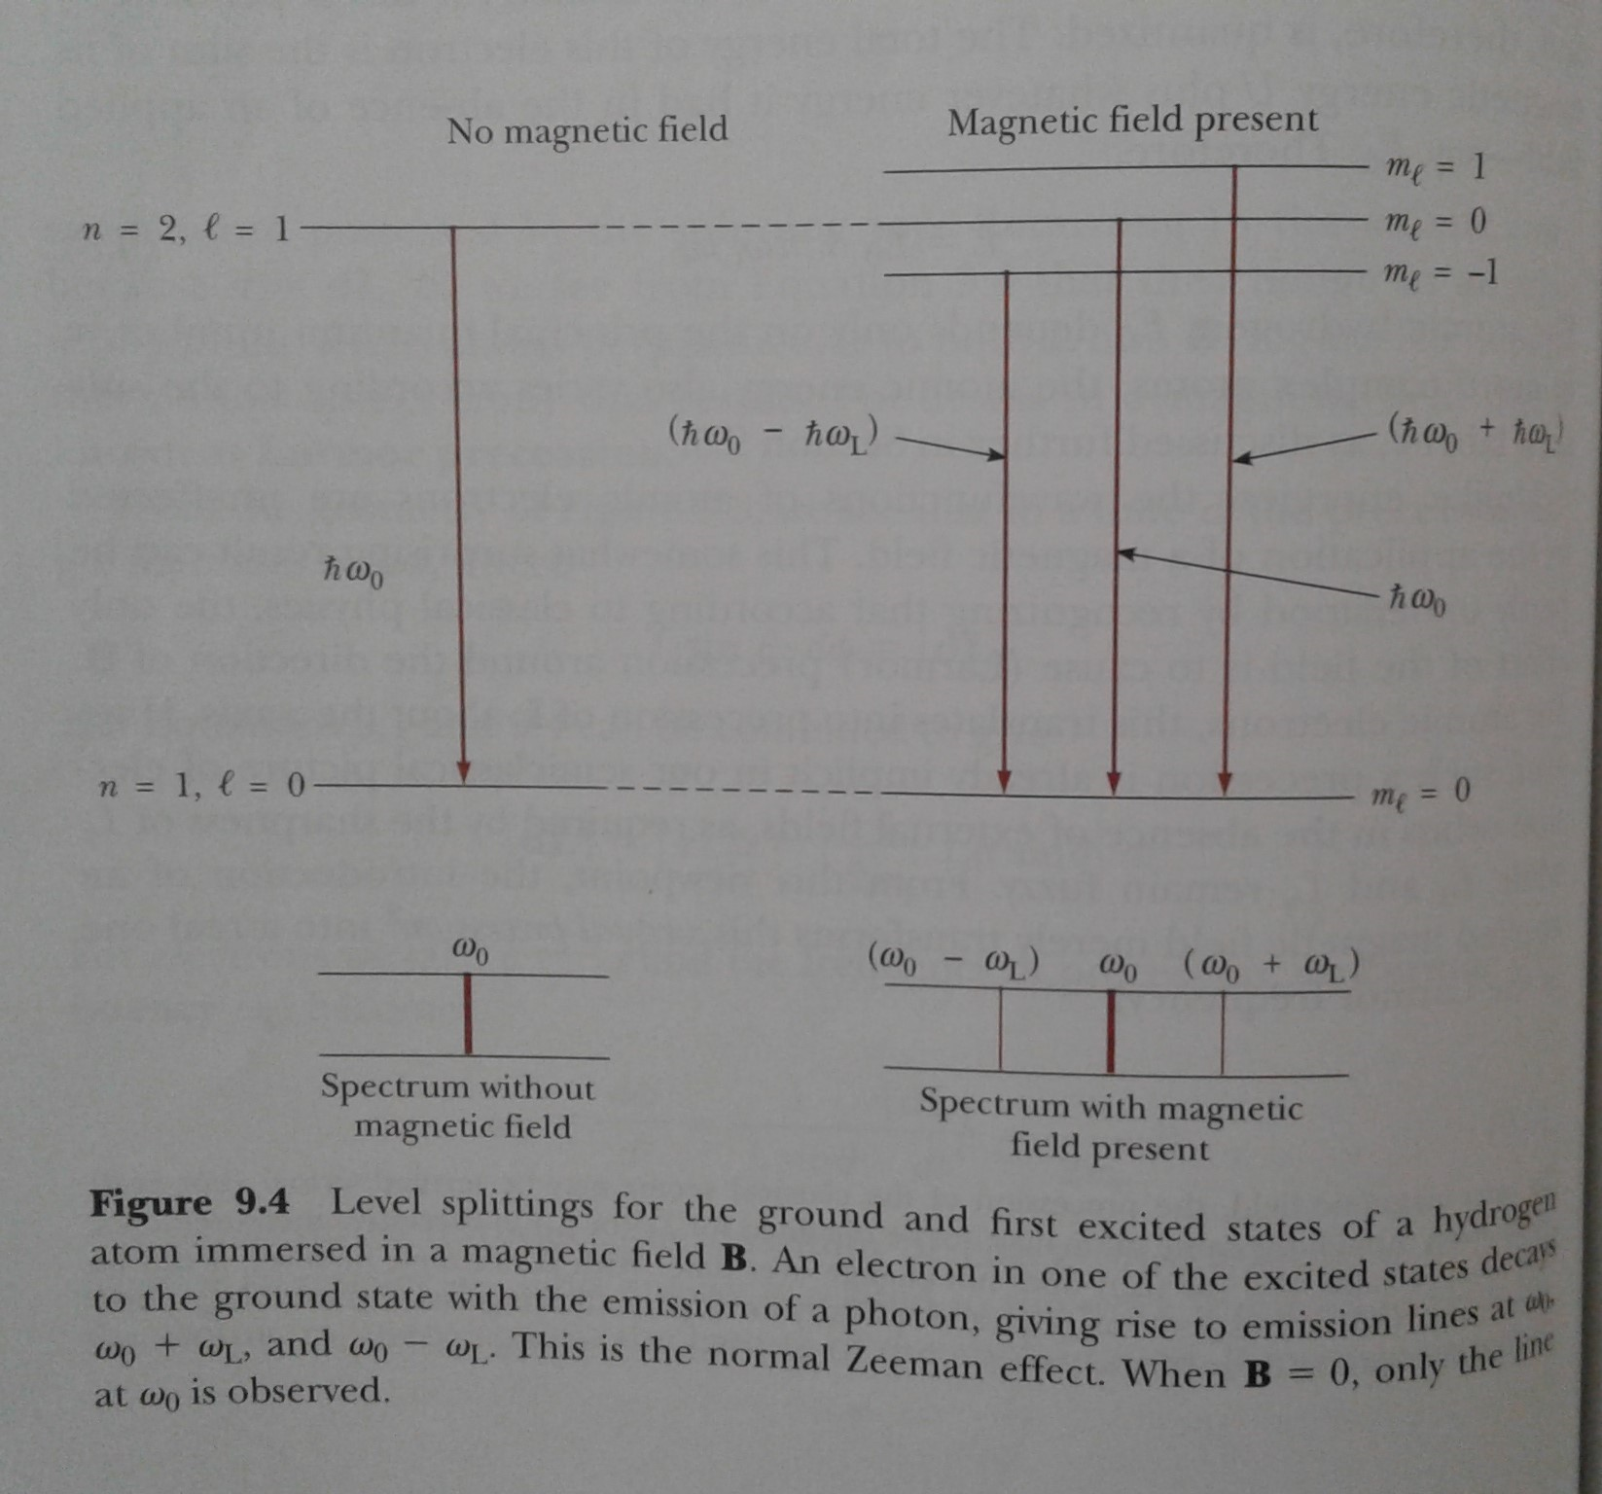
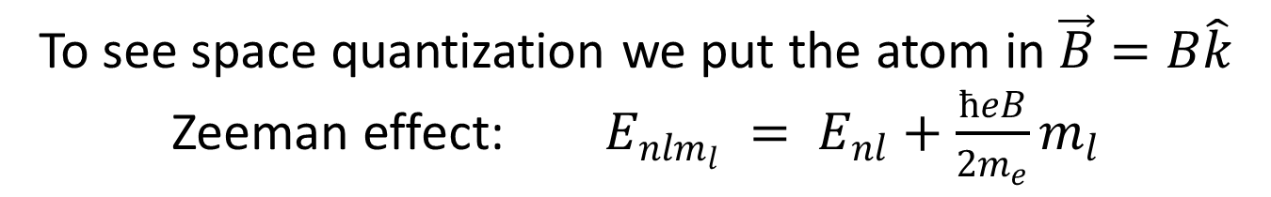
To see space quantization we put the atom in $\vec{B}=B\hat{k}$
Zeeman effect: $E_{{nlm}_{l}} = E_{nl}+\frac{ħeB}{2m_{e}}m_{l}$

Slide 3
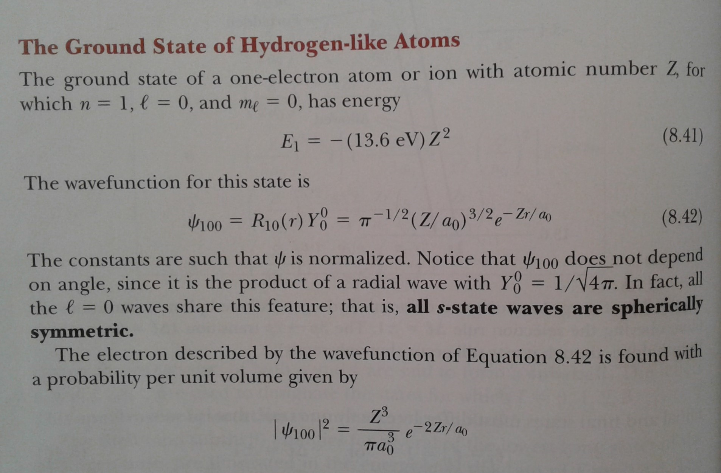
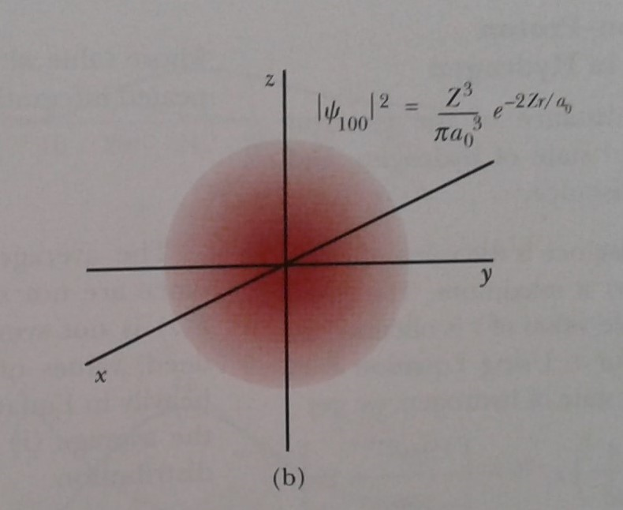
$Ψ_{nlm}\left(r,θ,φ\right)=R_{nl}(r)Y_{l}^{m}\left(θ,φ\right)$ , $E_{n}= −13.6 eV\frac{Z^{2}}{n^{2}}$

Slide 4
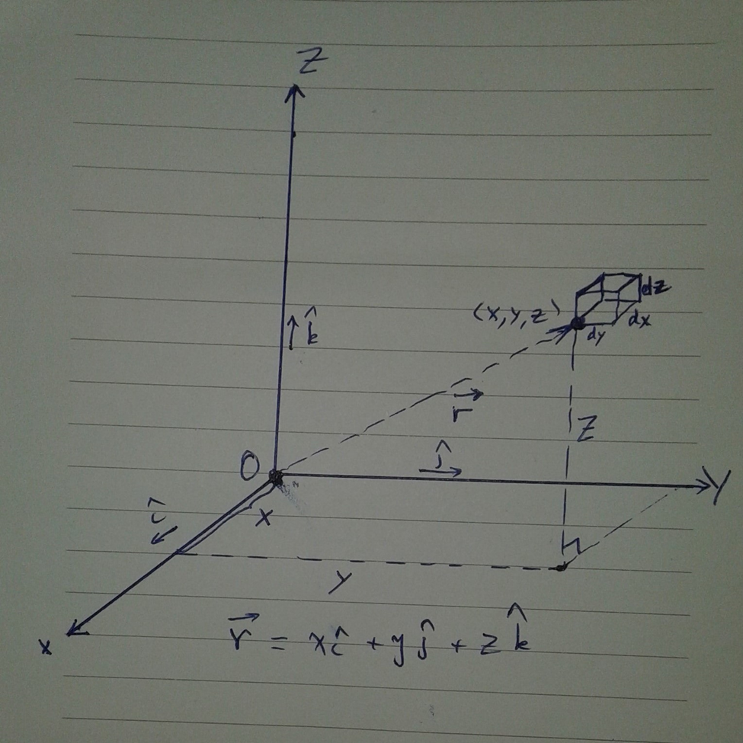
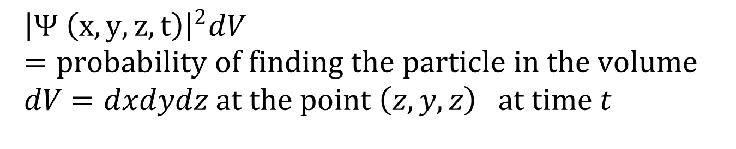
$${\left|Ψ \left(x, y, z, t\right)\right|}^{2}dV=probability of finding the particle in the volume \\ dV=dxdydz at the point \left(z, y, z\right) at time t$$

Slide 5
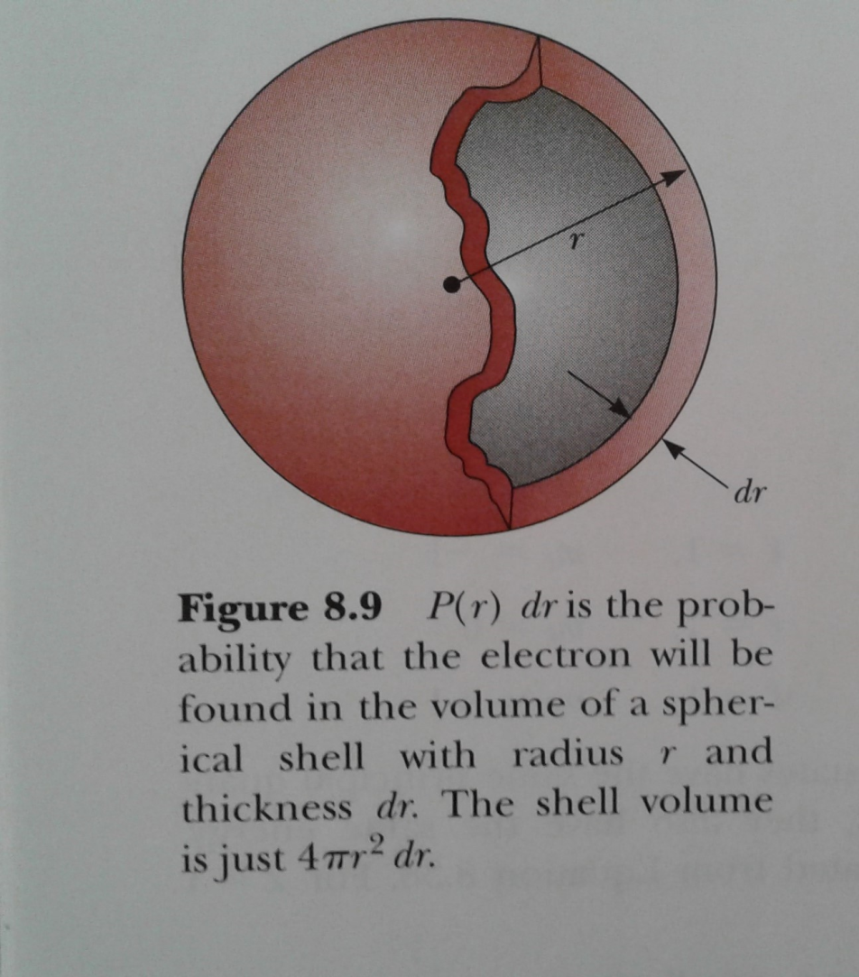
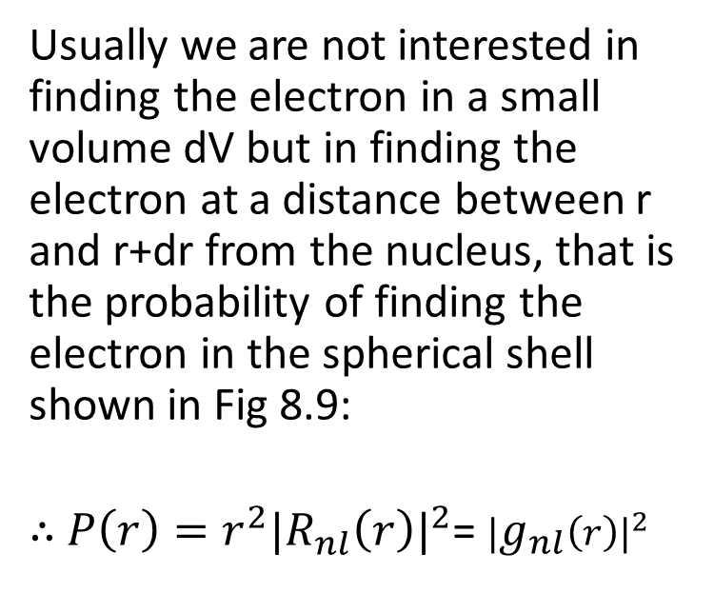
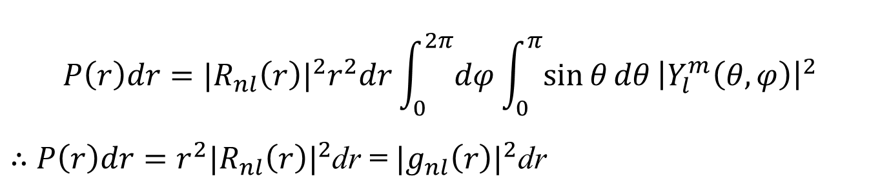
$$P\left(r\right)dr=|{R_{nl}\left(r\right)|}^{2}r^{2}dr\int_{0}^{2π}{dφ}\int_{0}^{π}{\sin{θ}dθ}{\left|Y_{l}^{m}\left(θ,φ\right)\right|}^{2}$$
$∴$ $P\left(r\right)dr=r^{2}|{R_{nl}\left(r\right)|}^{2}$dr = $|{g_{nl}\left(r\right)|}^{2}$dr
Usually we are not interested in finding the electron in a small volume dV but in finding the electron at a distance between r and r+dr from the nucleus, that is the probability of finding the electron in the spherical shell shown in Fig 8.9:
$∴$ $P\left(r\right)=r^{2}|{R_{nl}\left(r\right)|}^{2}$= $|{g_{nl}\left(r\right)|}^{2}$

Slide 6
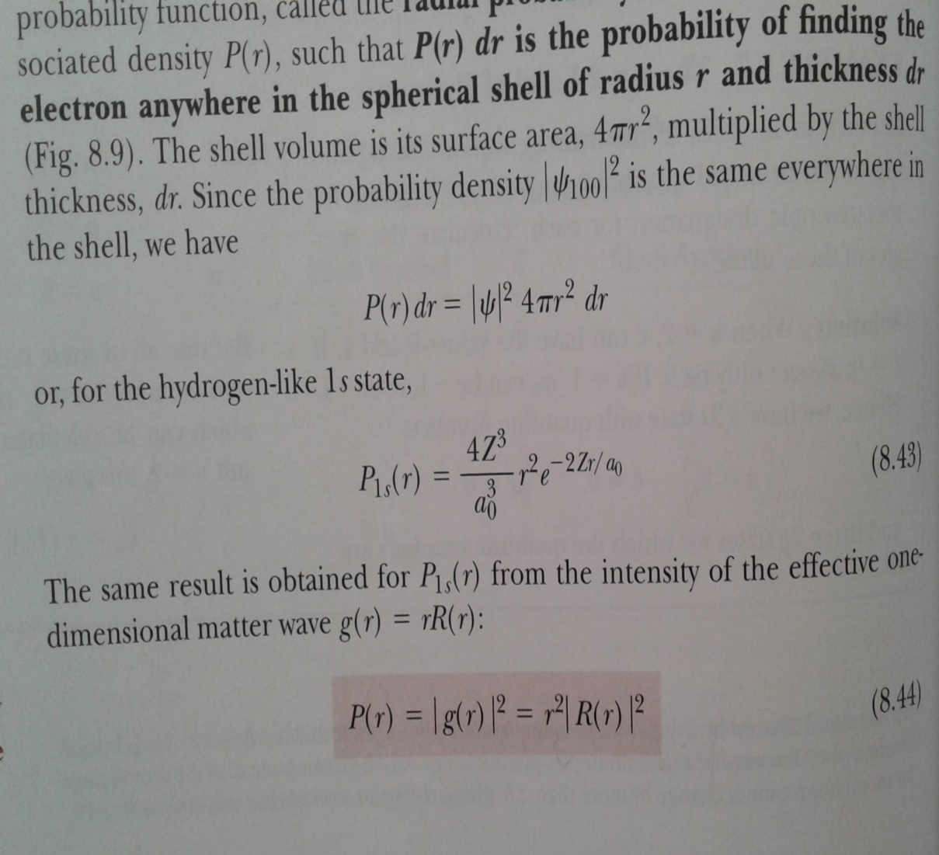
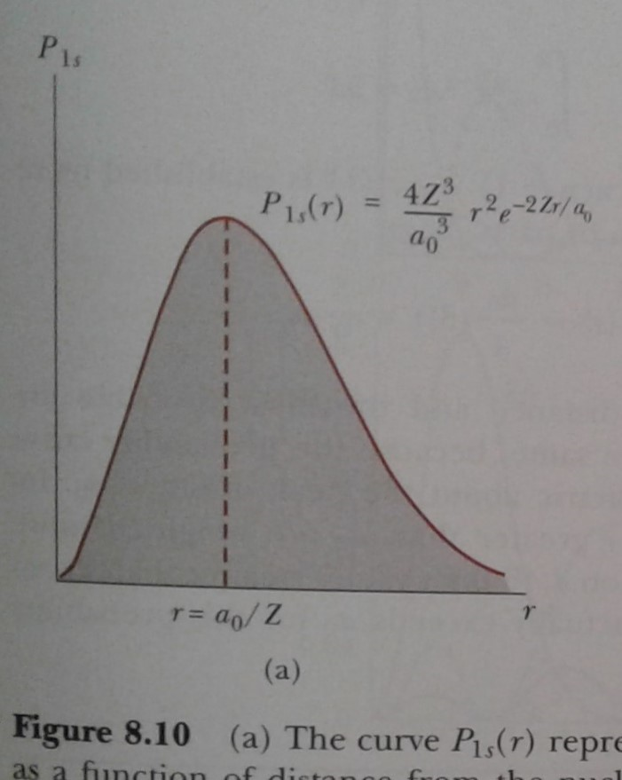
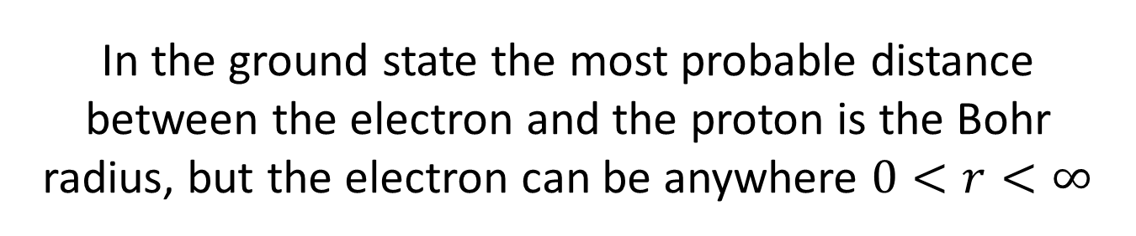
In the ground state the most probable distance between the electron and the proton is the Bohr radius, but the electron can be anywhere $0<r<∞$

Slide 7
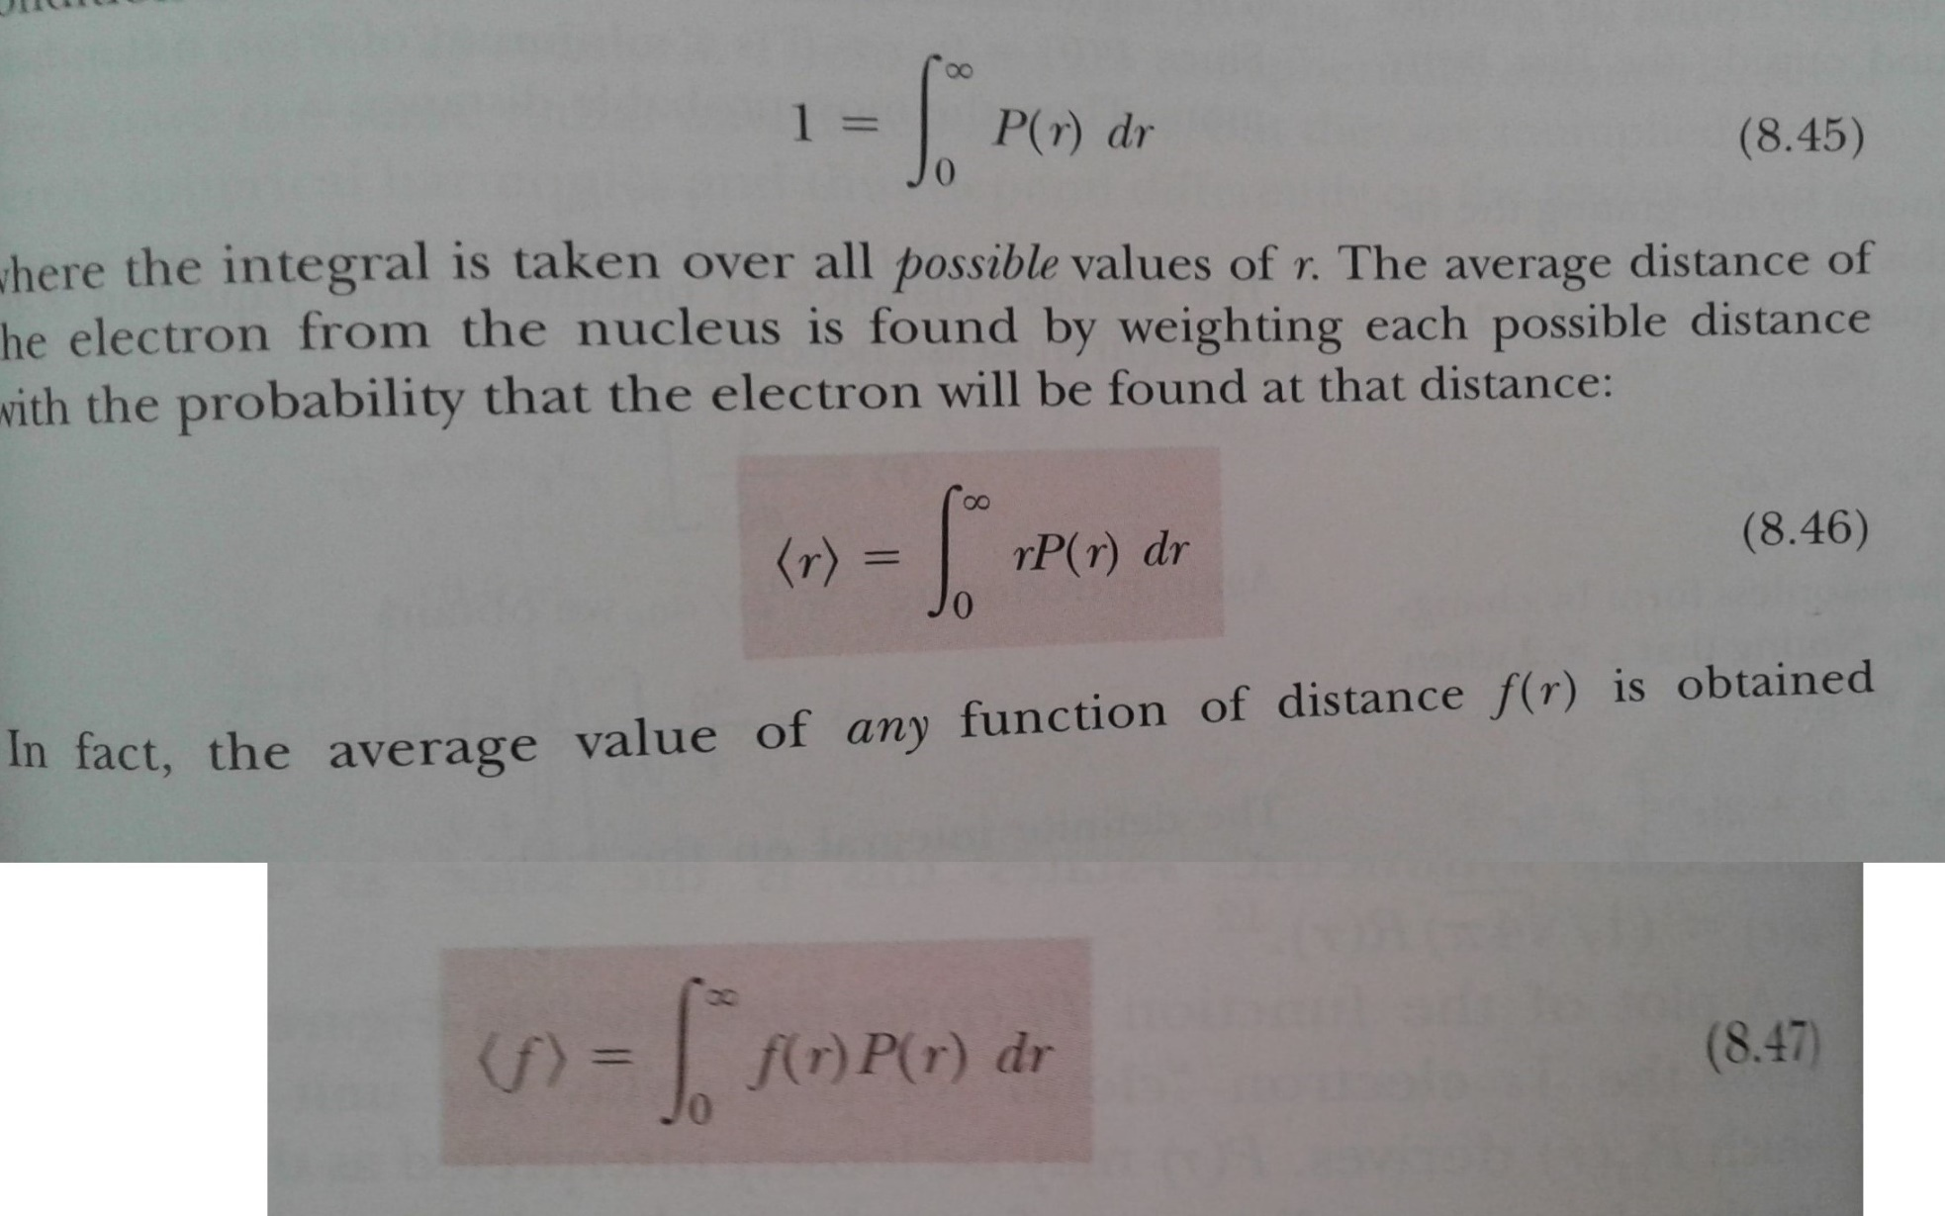
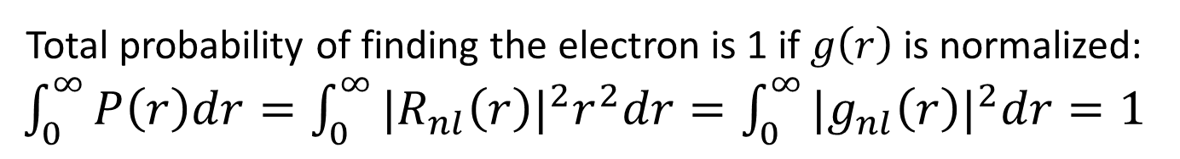
Total probability of finding the electron is 1 if $g\left(r\right)$ is normalized: $\int_{0}^{∞}{P\left(r\right)dr=\int_{0}^{∞}{|{R_{nl}\left(r\right)|}^{2}r^{2}dr=\int_{0}^{∞}{|{g_{nl}\left(r\right)|}^{2}dr=1}}}$

Slide 8
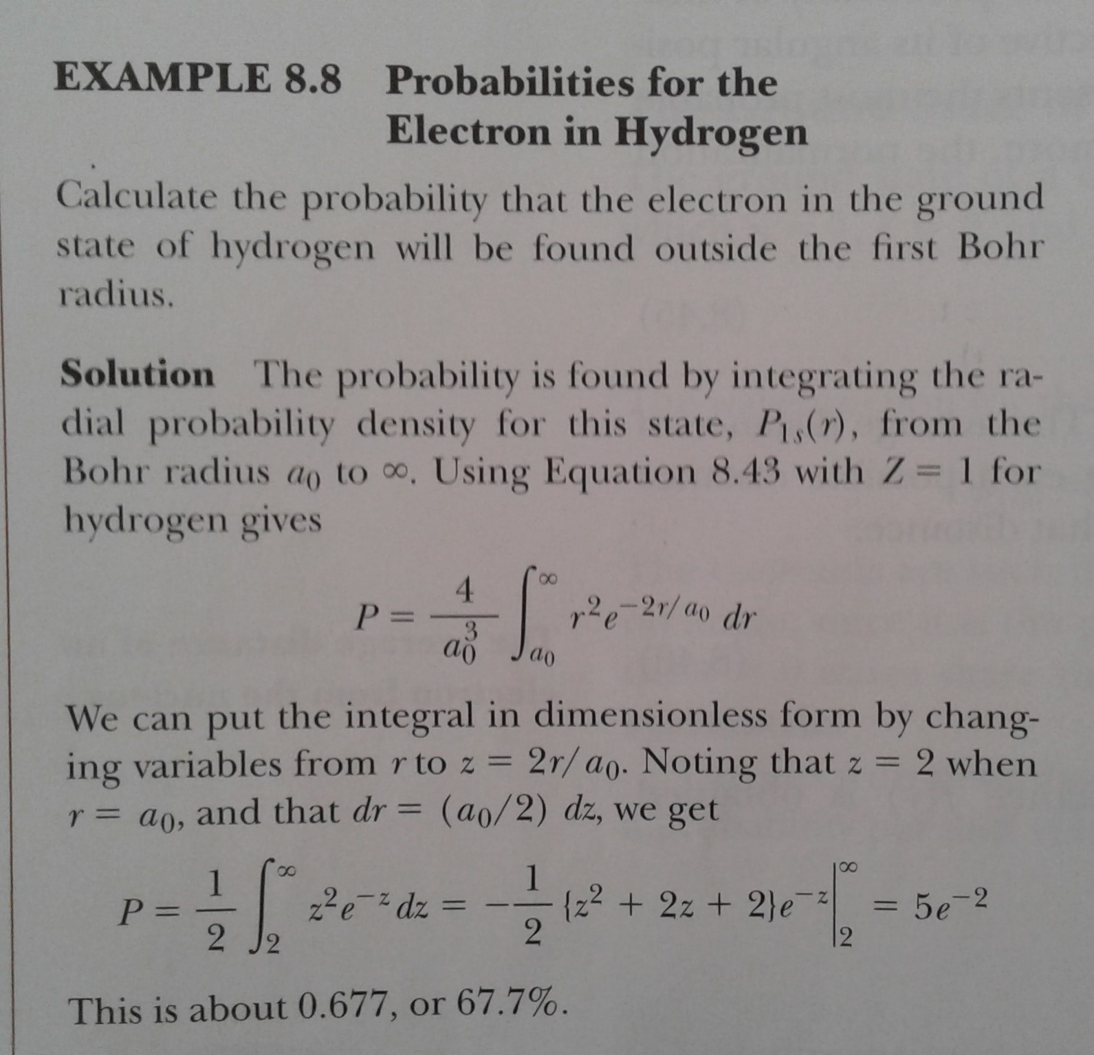
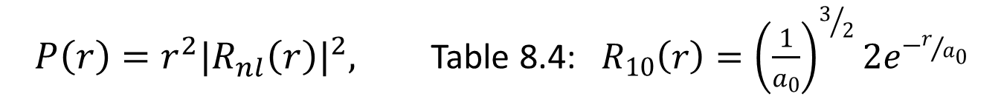
$P\left(r\right)=r^{2}|{R_{nl}\left(r\right)|}^{2},$ Table 8.4: $R_{10}\left(r\right)={\left(\frac{1}{a_{0}}\right)}^{3/2}2e^{−r/{a_{0}}}$

Slide 9
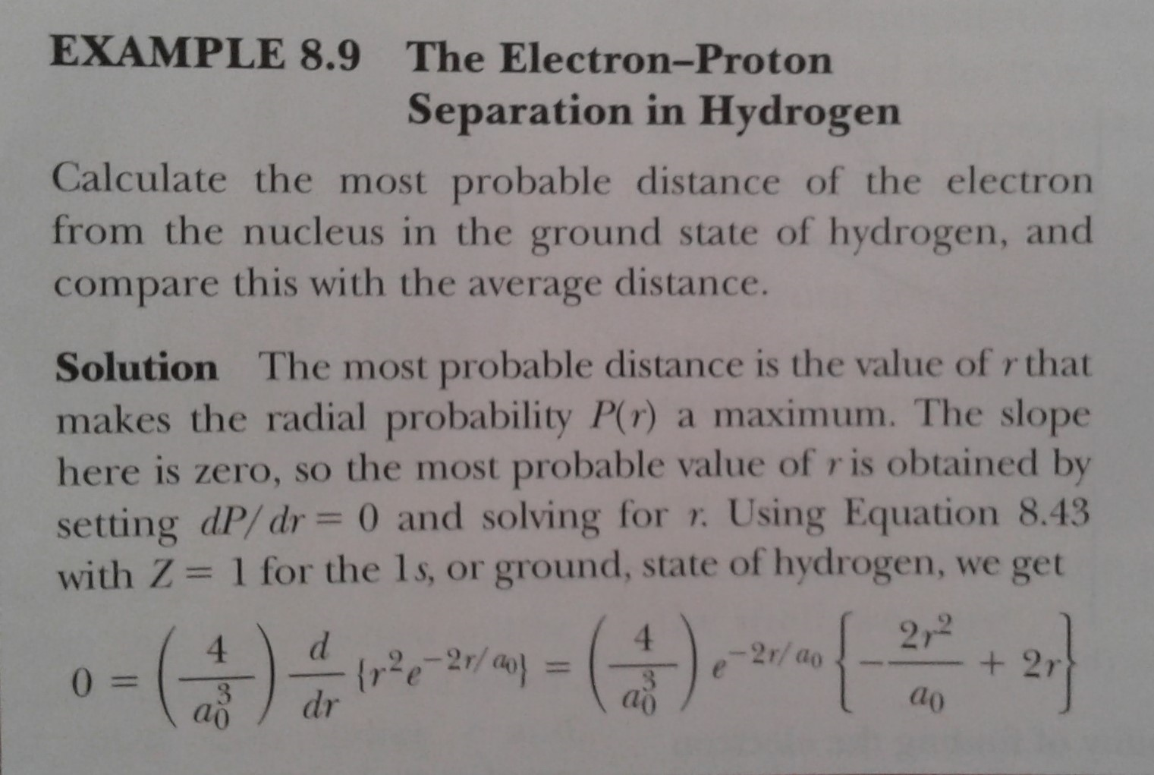
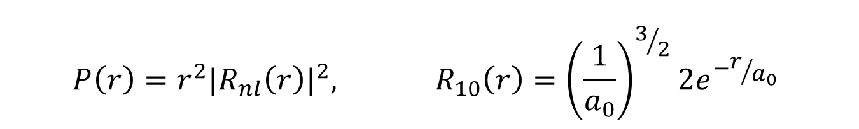
$$P\left(r\right)=r^{2}|{R_{nl}\left(r\right)|}^{2}, R_{10}\left(r\right)={\left(\frac{1}{a_{0}}\right)}^{3/2}2e^{−r/{a_{0}}}$$

Slide 10
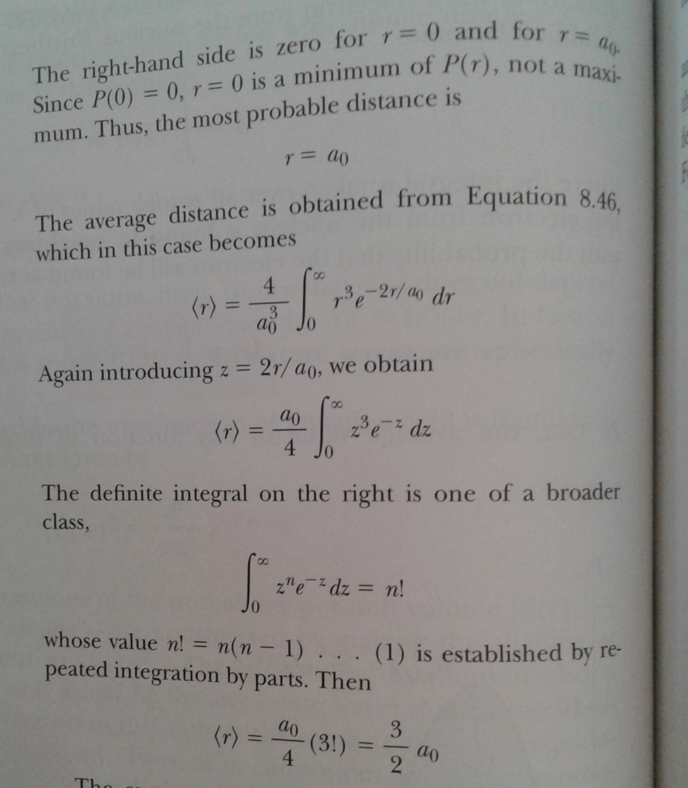

Slide 11
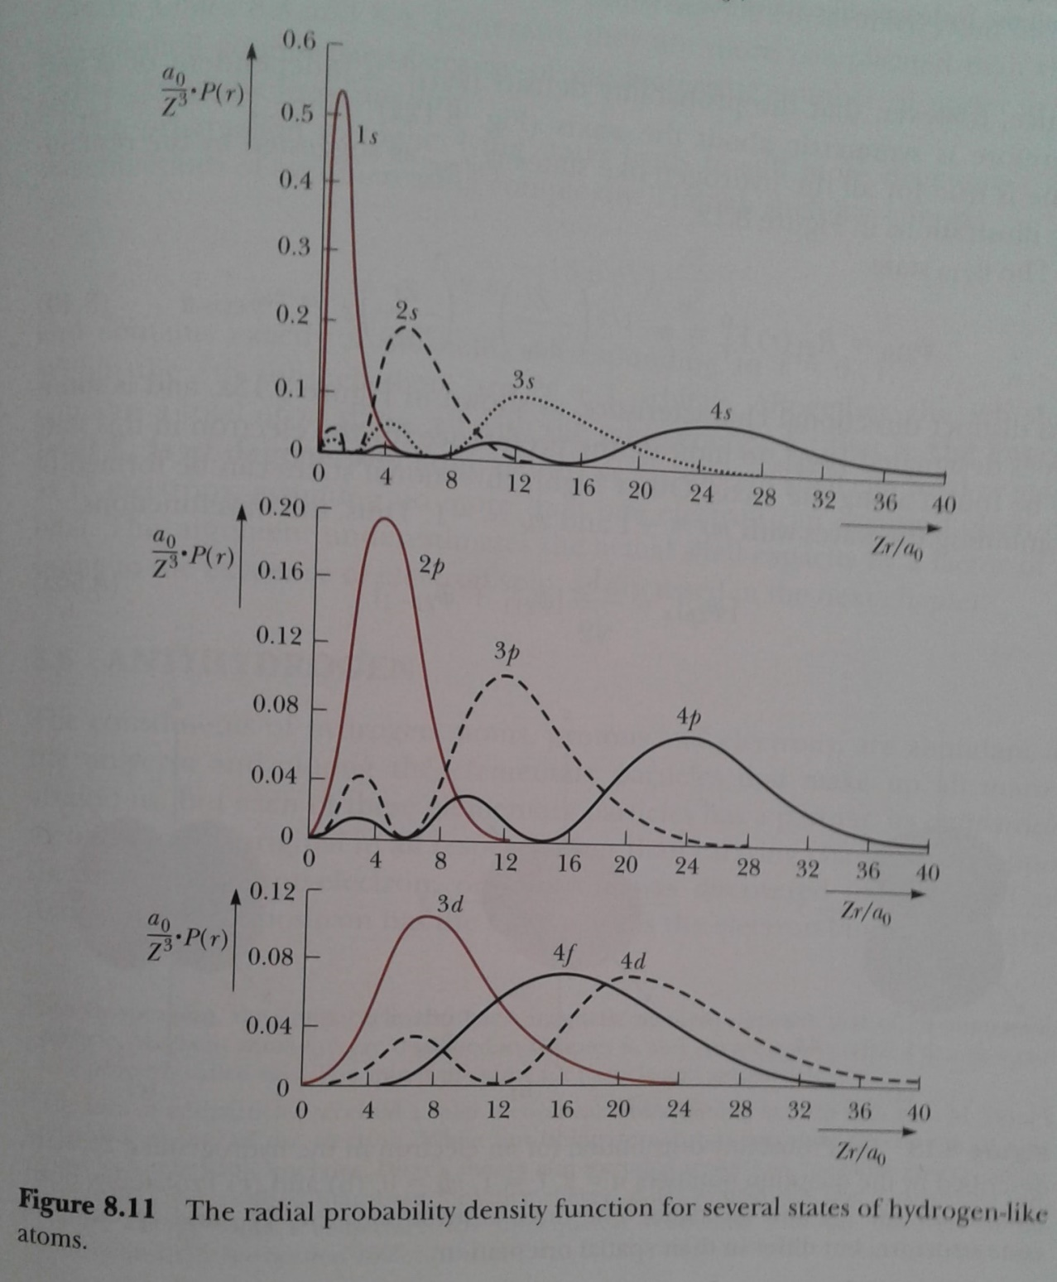
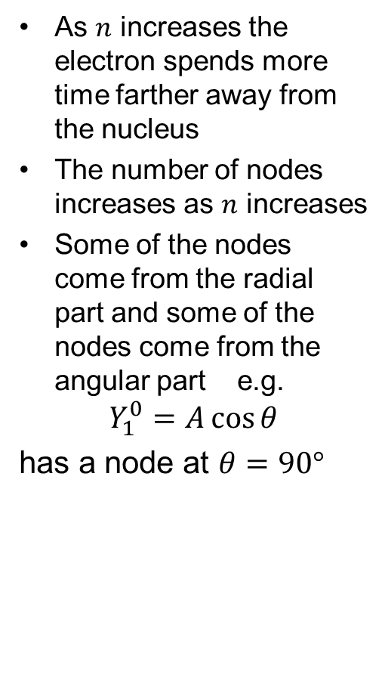
Excited states of the Hydrogen atom
As $n$ increases the electron spends more time farther away from the nucleus
The number of nodes increases as $n$ increases
Some of the nodes come from the radial part and some of the nodes come from the angular part e.g.
$$Y_{1}^{0}=A\cos{θ}$$
has a node at $θ=90°$

Slide 12
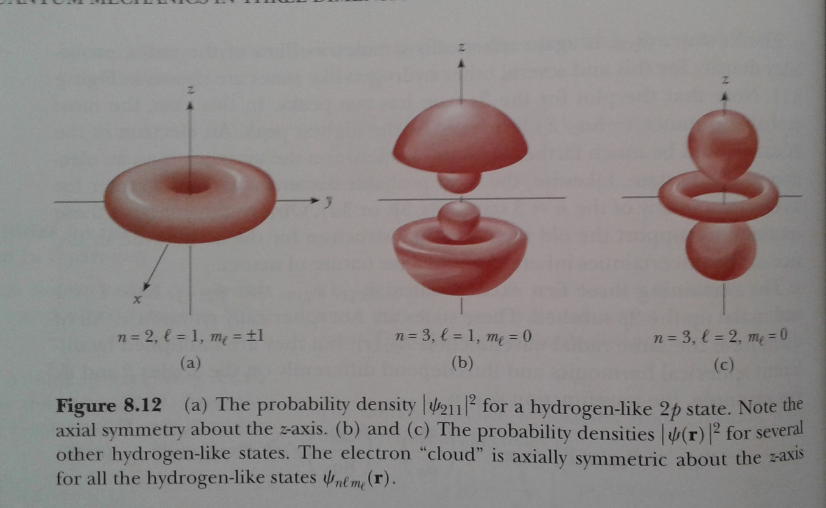
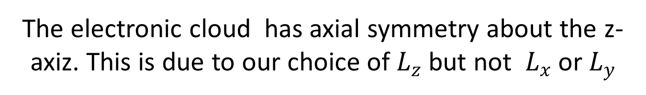
The electronic cloud has axial symmetry about the z-axiz. This is due to our choice of $L_{z}$ but not $L_{x}$ or $L_{y}$

Slide 13
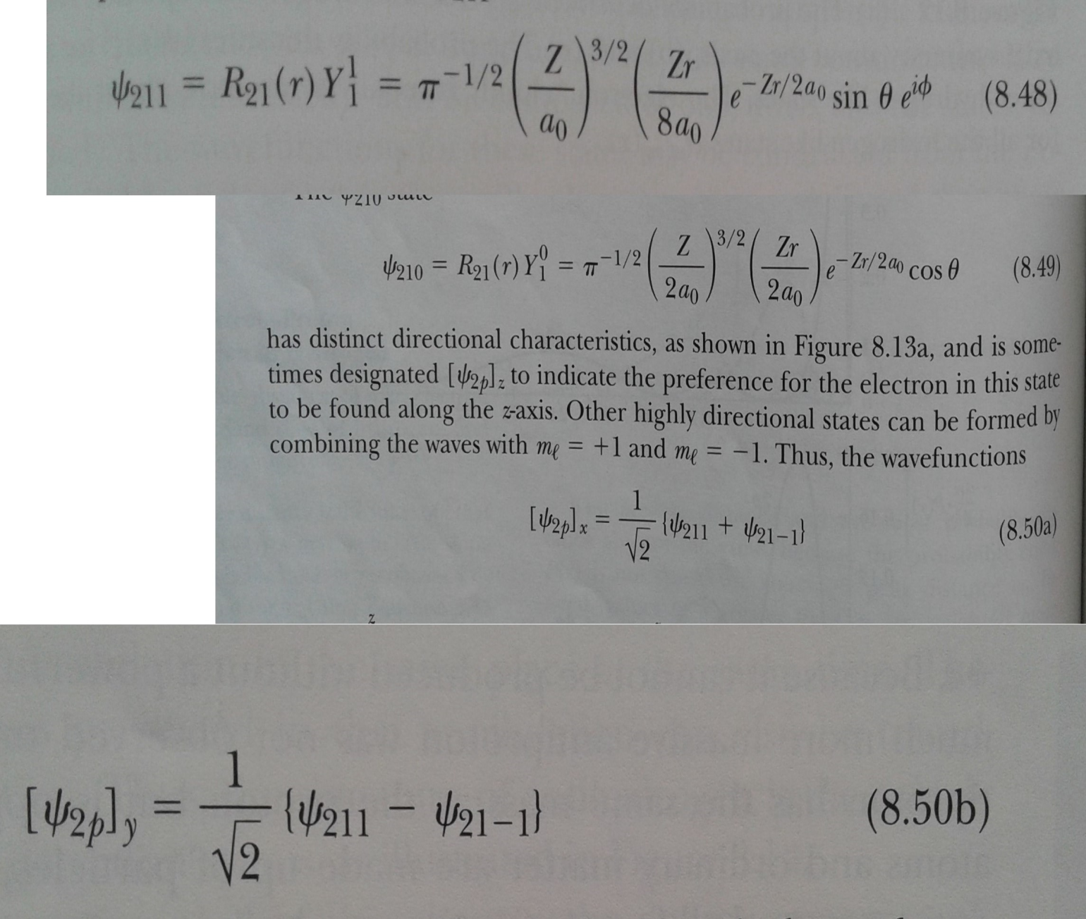
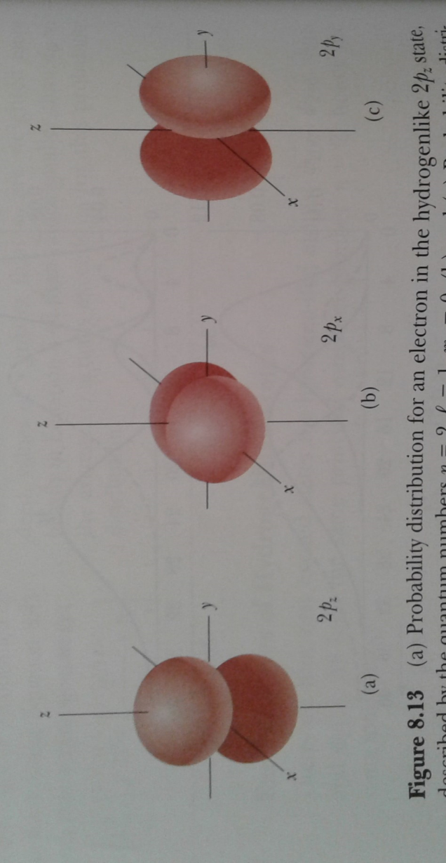
Excited States of H atom

Slide 14
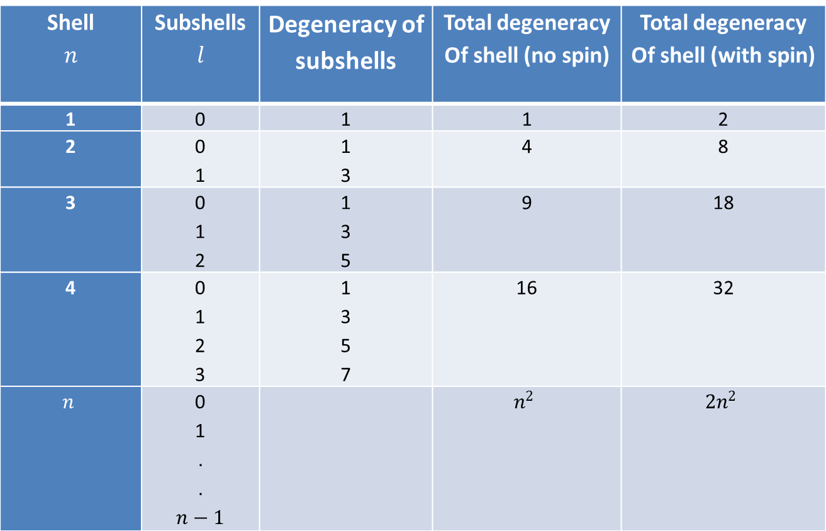
Degeneracy of energy levels in H atom
Shell $$n$$ | Subshells $$l$$ | Degeneracy of subshells | Total degeneracy Of shell (no spin) | Total degeneracy Of shell (with spin)
1 | 0 | 1 | 1 | 2
2 | 0 1 | 1 3 | 4 | 8
3 | 0 1 2 | 1 3 5 | 9 | 18
4 | 0 1 2 3 | 1 3 5 7 | 16 | 32
$$n$$ | 0 1 . . $$n−1$$ |  | $$n^{2}$$ | $$2n^{2}$$

Slide 15
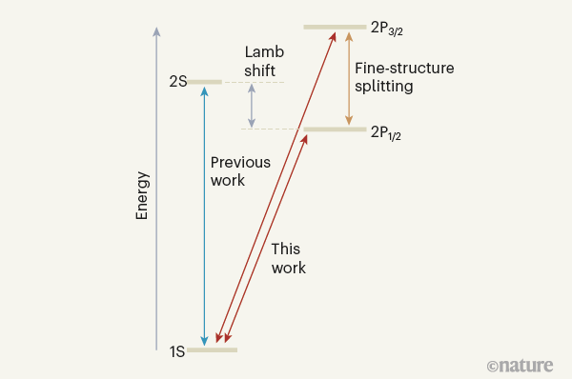
Antihydrogen: a positron revolving around an anti-proton
Experiments started in 1990s
19 FEBRUARY 2020
Fundamental symmetry tested using antihydrogen - Nature
Figure 1 | Lowest-energy states of antihydrogen. The ALPHA Collaboration¹ carried out high-precision spectroscopic measurements of antihydrogen — the antimatter counterpart of hydrogen. The authors found that all of these results are in agreement with the corresponding ones for ordinary hydrogen. (Drawing not to scale.)

