Slide 1
Hydration
NUTD 334

Slide 2
Water and our body
Major solvent in our body cell
  Except in bones and fat cells
Main component of blood
Important in chemical reaction
  Protein or peptide bond breaking into amino acids
  Glycogen to glucose
Homeostasis
  Water have high heat capacit as you need lots of energy to increase water temperature by 1 degree
  This allows water to be a good buffer in our body for termeprature changes
  Allowing us to stay within body temperature 4
Maintains electrolyte balance

Slide 3
Water intake
Water intake
  Water consumption through drinking water, beverages, consuming foods
  Fruits and vegetables, are at least 80% water.
  The same is true for various other beverages such as milk, soda and fruit juices.
  Potato chips, crackers and chocolate contain less than 10% water.
  The water content of most other foods lies somewhere in between.
Total water intake is 2 to 3 litres/day for most people
  Depend on the diet, lifestyle, and the environment
    Active, high fruits and vegetable intake, hot or cold climate
Many people don’t reach the minimum water intake!!!!

Slide 4
Water loss
Our bodies lose water mainly via
  urine, sweat, exhaled air and stools.
  Stools can account for 150 ml water loss per day
    Diarrhea increases these losses
    Can be life threatening
  Through skin we lose from few millimeters to 5 litres per day (in hot climates)
  We lose as we exhale 300 to 400 ml of water
  Water control in our by is controlled by ADH

Slide 5
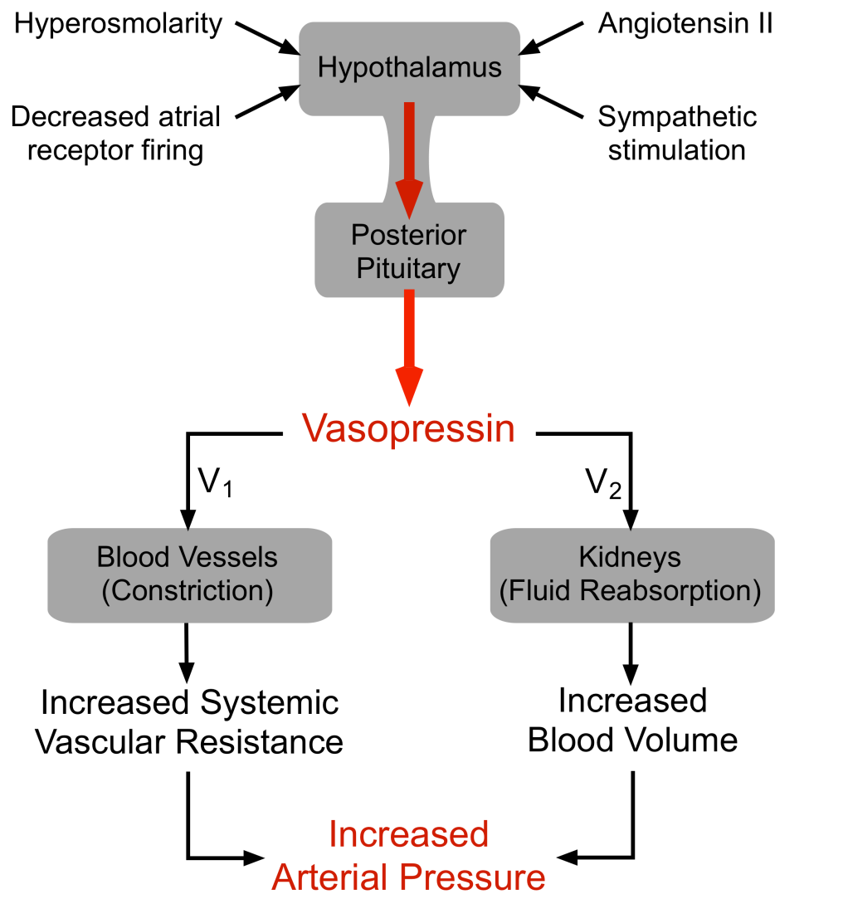
Anitdiruetic hormone
When ADH is high
more aquaporins (water channels) are expressed
in the kidney to reabsorb water

Slide 6
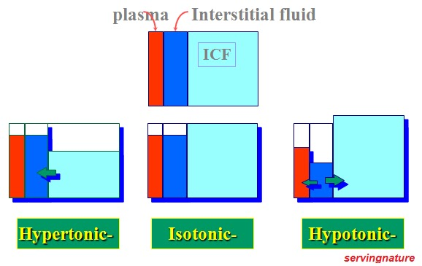
Dehydration
Most vulnerable people for dehydration
  Children
  Elderly
Types of dehydration
  Hypertonic
  Isotonic
  hypotonic

Slide 7
Water intoxication
Very rare
  Mainly in medical settings
  Among endurance athletes
Excess water consumption exceeding water ability to excrete water
Results in osmolar dilution and ICF volume increase and Swelling of cells
Symptoms include
  Nausea, vomiting, blindness, muscle twitching, death are some of the consequences

Slide 8
Water and Health
No concrete evidence yet but claims
  Water reduces hyperglycemia
  Improves muscle recovery
  Improves sexsual perfromance
  Reduce kidney dysfunction overtime
  Reduces inflammation
  Improves weight loss
  Reduces stroke
  Improves sleep

