Slide 1
Hydration
NUTD 334

Slide 2
Water and our body
Major solvent in our body cell
Except in bones and fat cells
Main component of blood
Important in chemical reaction
Protein or peptide bond breaking into amino acids
Glycogen to glucose
Homeostasis
Water have high heat capacit as you need lots of energy to increase water temperature by 1 degree
This allows water to be a good buffer in our body for termeprature changes
Allowing us to stay within body temperature 4
Maintains electrolyte balance

Slide 3
Water intake
Water intake
Water consumption through drinking water, beverages, consuming foods
Fruits and vegetables, are at least 80% water.
The same is true for various other beverages such as milk, soda and fruit juices.
Potato chips, crackers and chocolate contain less than 10% water.
The water content of most other foods lies somewhere in between.
Total water intake is 2 to 3 litres/day for most people
Depend on the diet, lifestyle, and the environment
Active, high fruits and vegetable intake, hot or cold climate
Many people don’t reach the minimum water intake!!!!

Slide 4
Water loss
Our bodies lose water mainly via
urine, sweat, exhaled air and stools.
Stools can account for 150 ml water loss per day
Diarrhea increases these losses
Can be life threatening
Through skin we lose from few millimeters to 5 litres per day (in hot climates)
We lose as we exhale 300 to 400 ml of water
Water control in our by is controlled by ADH

Slide 5
Anitdiruetic hormone
When ADH is high
more aquaporins (water channels) are expressed
in the kidney to reabsorb water

Slide 6
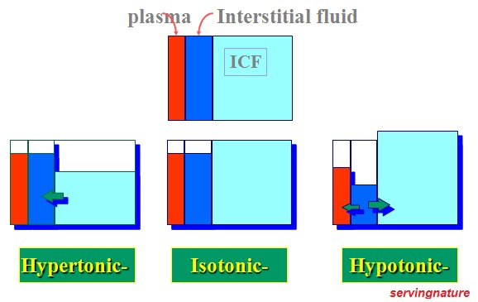
Dehydration
Most vulnerable people for dehydration
Children
Elderly
Types of dehydration
Hypertonic
Isotonic
hypotonic

Slide 7
Water intoxication
Very rare
Mainly in medical settings
Among endurance athletes
Excess water consumption exceeding water ability to excrete water
Results in osmolar dilution and ICF volume increase and Swelling of cells
Symptoms include
Nausea, vomiting, blindness, muscle twitching, death are some of the consequences

Slide 8
Water and Health
No concrete evidence yet but claims
Water reduces hyperglycemia
Improves muscle recovery
Improves sexsual perfromance
Reduce kidney dysfunction overtime
Reduces inflammation
Improves weight loss
Reduces stroke
Improves sleep

