Slide 1
Density, Specific Gravity and Specific Volume
Chap 5

Slide 2





Slide 3
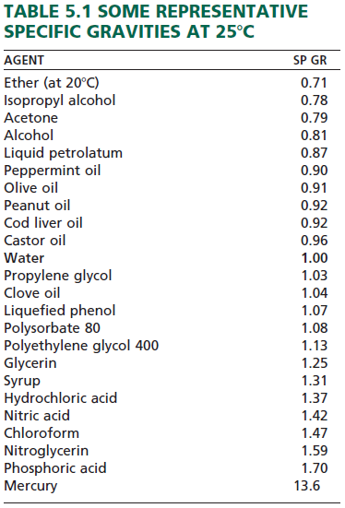
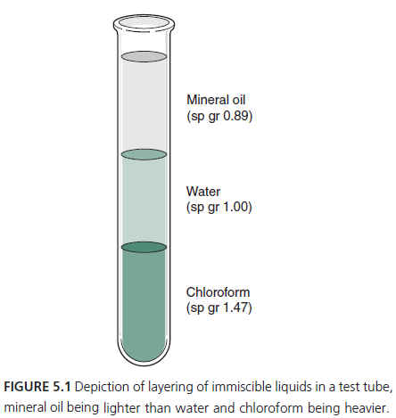

Slide 4




Slide 5

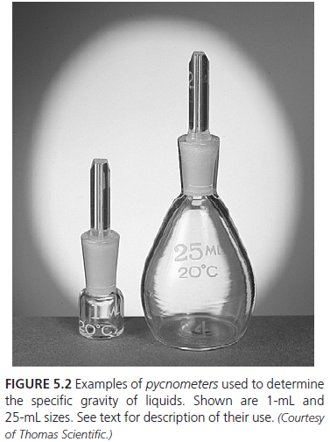




Slide 6

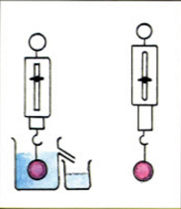
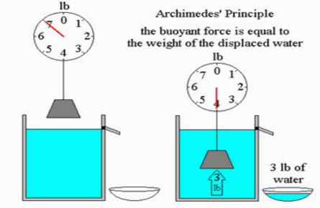

Videos

Slide 7



Slide 8



Slide 9
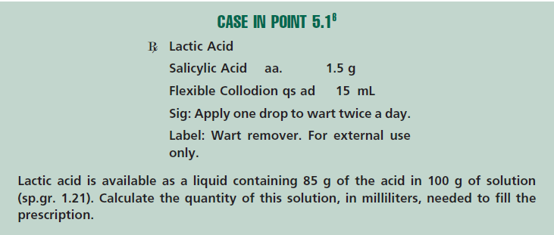

Slide 10


Specific volume tells us how much greater (or smaller) in volume a mass is than the same weight of water.
It may be calculated by dividing the volume of a given mass by the volume of an equal weight of water.

Slide 11


Slide 12


