Slide 1
ENGL337

Slide 2
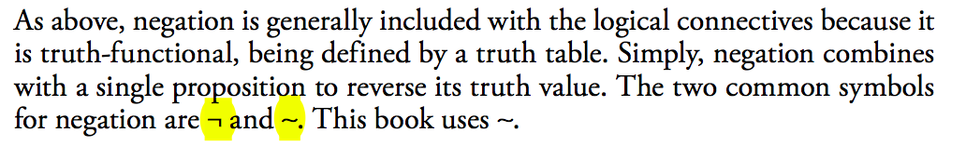
Negation
Negation is expressed in several ways in English, most commonly by not or n’t after the first auxiliary verb.

Slide 3
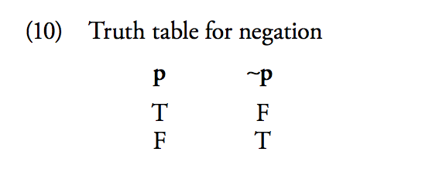
The Truth Table for Negation

Slide 4
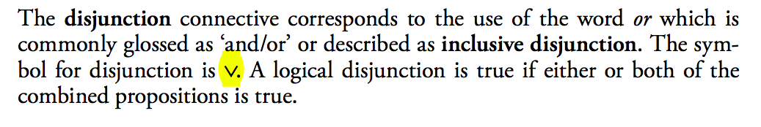
Disjunction

Slide 5
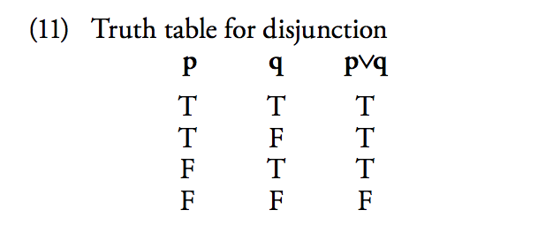
Disjunction Truth Table

Slide 6
Disjunction Reduction
This is where two propositions joined by disjunction have some content in com- mon, the sentence expressing the proposition (with the word or) is usually abbreviated in the form.
EX: That job will take two or three tins of paint, depending on the weather
Interpretation: ‘That job will take two tins of paint or that job will take three tins of paint, depending on the weather’.

Slide 7
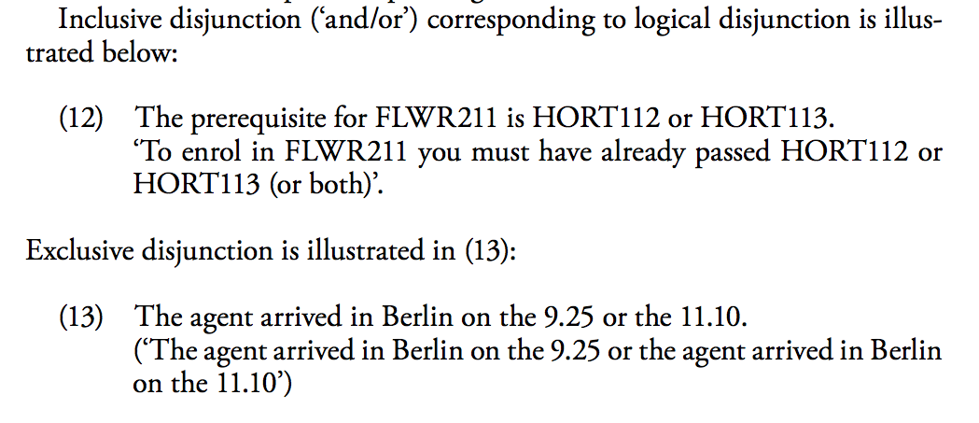
Inclusive Vs Exclusive Disjunction

Slide 8
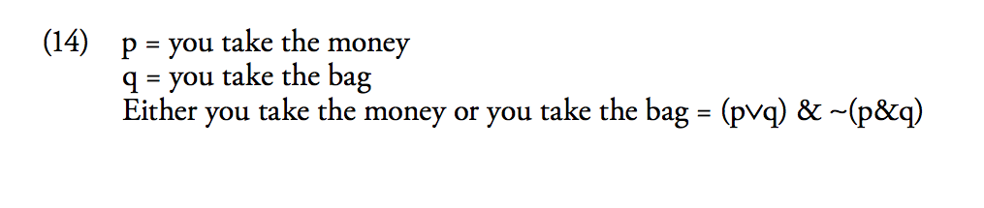
“Either but not both”

Slide 9
The Material Implication Connective
Conditionality is mainly expressed by certain uses of if or if...then. Sentences with if are called conditional sentences or conditionals for short. There are two truth-functional connectives corresponding to conditionals:
1- The material implication connective
2- The biconditional connective

Slide 10
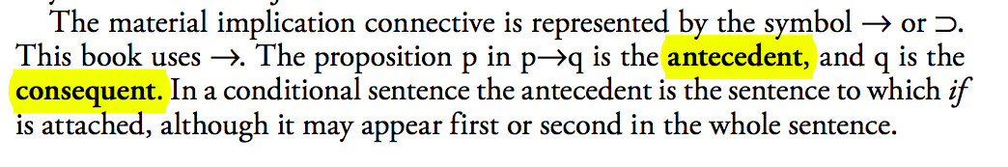
The Material Implication Connective

Slide 11
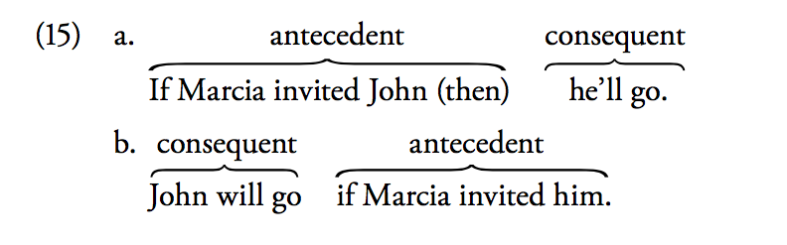
Antecedent and Consequent

Slide 12
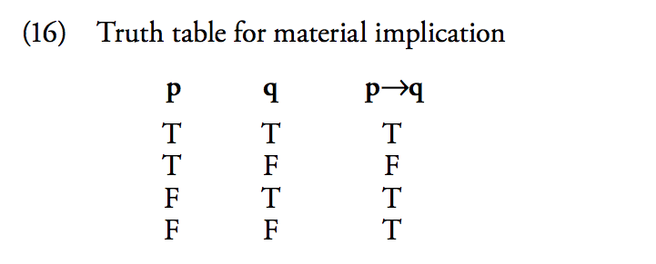
The Truth Table

Slide 13
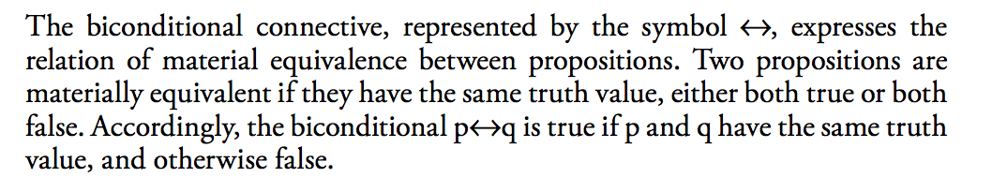
The Biconditional Connective

Slide 14
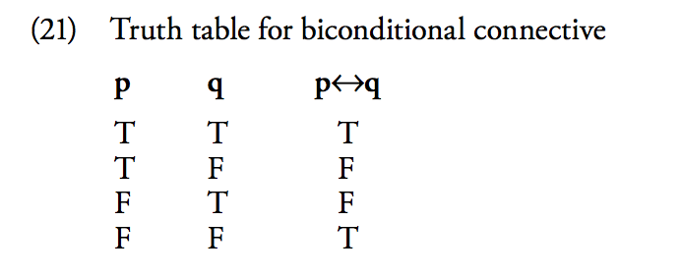
The Truth Table

