Slide 1
Overview
Size and space issues
Compression
Term statistics/Power Laws
Dictionary compression
Postings compression

Slide 2
Outline
Size and space issues
Compression
Term statistics/Power Laws
Dictionary compression
Postings compression

Slide 3
Vocabulary and Posting
  One entry per term for each document: less terms less entries!
  Too many terms: can reduce by stemming, normalization, removing diactritics حركات and more: more about that earlier/later
  Still what remains is large: 300K (and grows)
  Need to keep in memory as frequently used for lookup of query terms
  Usually sorted alphabetically to facilitate searching (and compression!?)
3

Slide 4
Vocabulary and Posting
  Number of postings too large: Docs*Terms (300,000 * 10,000,000,000)
  Too many postings: mostly zeros!. Sparse matrix
  Store as links: one non-zero posting points to the next nonzero posting: Term links to docs it occurs in
  Will need an extra field per posting for value: tf (integer), relative frequency (?), tf.idf (real).
  We use integer tf, integer df and calculate reals later
  May order posting in increasing order of Doc IDs for faster intersecting
4

Slide 5
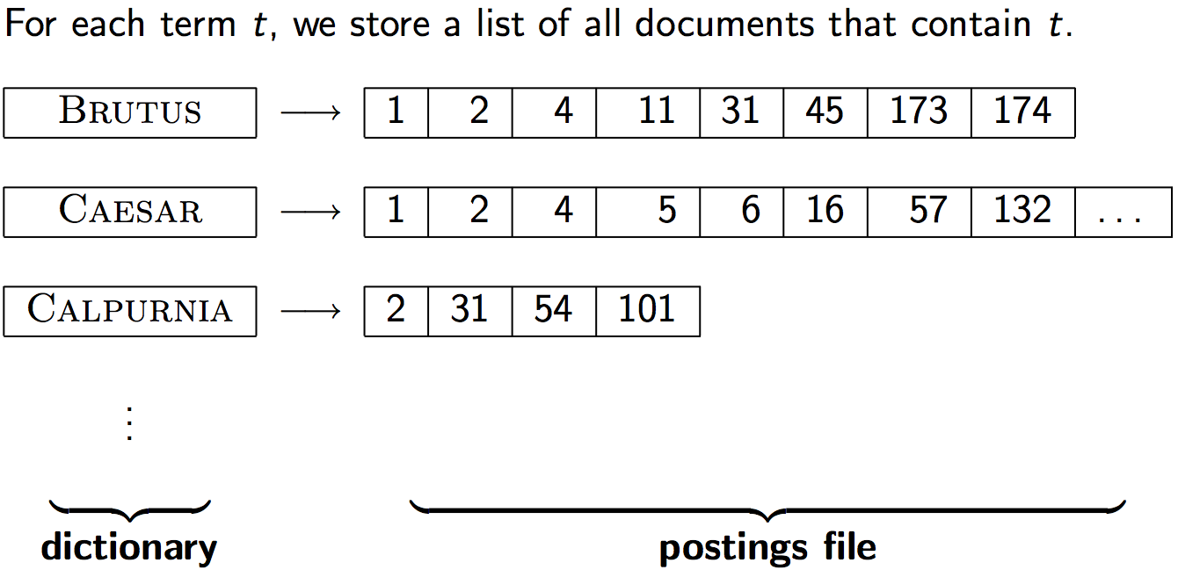
5

Slide 6
Vocabulary and Posting
  Save on number but need extra links (real savings).
  Use integers for df_{i} and tf_{ij} (not reals).
  Note: df for term i is the count of postings (links in the list for that term: do you see that?)
  Doc id needs log2 (# of Docs) bits: here 34 bits??
  Same is needed for document frequency(df): may be as large as N: the number of docs (which terms?).
6

Slide 7
Vocabulary and Posting
  Remove stop words (with too many links).
  Still what remains is large:
  need to fit the postings of 2 terms in memory to intersect, and to keep all on disk
  Compression is our solution
7

Slide 8
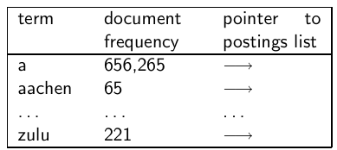
Take-away today
8

Slide 9
Take-away today
  Motivation for compression in information retrieval systems
  How can we compress the dictionary component of the inverted index?
  How can we compress the postings component of the inverted index?
  Term statistics: how are terms distributed in document collections?
9

Slide 10
Outline
Recap
Compression
Term statistics
Dictionary compression
Postings compression

Slide 11
Why compression? (in general)
  Use less disk space (saves money)
  Keep more stuff in memory (increases speed)
  Increase speed of transferring data from disk to memory (again, increases speed)
    [read compressed data and decompress in memory] is faster than [read uncompressed data]
  Premise: Decompression algorithms are fast.
  This is true of the decompression algorithms we will use.
11

Slide 12
Why compression in information retrieval?
  First, we will consider space for dictionary
    Main motivation for dictionary compression: make it small enough to keep in main memory
  Then for the postings file
    Motivation: reduce disk space needed, decrease time needed to read from disk
    Note: Large search engines keep significant part of postings in memory
  We will devise various compression schemes for dictionary and postings.
12

Slide 13
Lossy vs. lossless compression
  Lossy compression: Discard some information, irrevocably
  Several of the preprocessing steps we frequently use can be viewed as lossy compression:
    downcasing, stop words, porter stemming, number elimination
  Lossless compression: All information is preserved.
    What we mostly do in index compression
13

Slide 14
Outline
Recap
Compression
Term statistics/Power Laws
Dictionary compression
Postings compression

Slide 15
Model collection: The Reuters collection
symbol | statistics | value
N L M T | documents avg. # tokens per document word types avg. # bytes per token (incl. spaces/punct.) avg. # bytes per token (without spaces/punct.) avg. # bytes per term (= word type) non-positional postings Recall: Token=Word (may be repeating) Term=vocabulary element, distinct words only Always more tokens than terms! Needed space for dictionary: 7.5x400,000=3,000,000B | 800,000 200 400,000 6 4.5 7.5 100,000,000
15

Slide 16
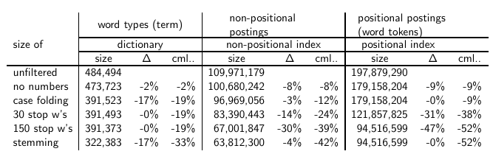
Effect of preprocessing for Reuters
16

Slide 17
Statistical Properties of Text
IR inverted index size depends on the number of types (Vocabulary size) and word frequencies (Positional case)!
Knowing how large these can be is important!
  How is the frequency of different words distributed?
  How fast does vocabulary size grow with corpus size?
  Such factors affect the performance of information retrieval and can be used to select appropriate term weights and other aspects of an IR system.

Slide 18
Word Frequency
A few words are very common.
  2 most frequent words (e.g. “the”, “of”) can account for about 10% of word occurrences.
  What about Arabic?
Most words are very rare.
  Half the terms in a corpus appear only once, called hapax legomena (Greek for “read only once”)
Called a “heavy tailed” or “long tailed” distribution, since most of the probability mass is in the “tail” compared to an exponential distribution.

Slide 19
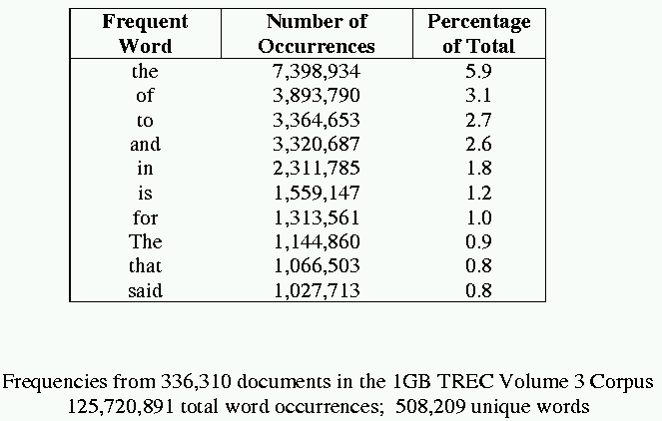
Sample Word Frequency Data
(from B. Croft, UMass)

Slide 20
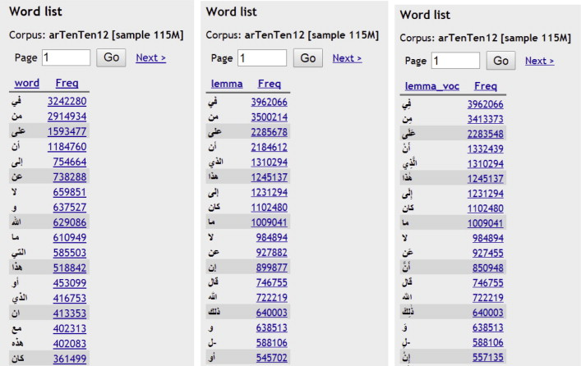
Sample Arabic Word Frequency Data https://ars.els-cdn.com/content/image/1-s2.0-S1319157814000330-gr6.jpg

Slide 21
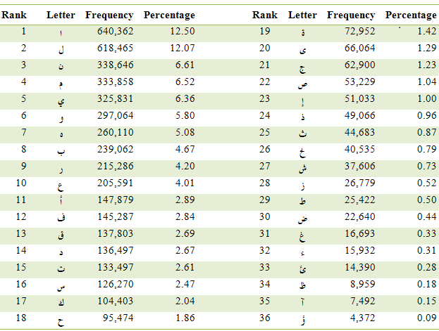
Sample Letter Frequency Data http://www.intellaren.com/articles/en/a-study-of-arabic-letter-frequency-analysis

Slide 22
Zipf’s Law for Text Collection
Rank (r ): The numerical position of a word in a list sorted by decreasing frequency (f ).1 most frequent
Zipf (1949) “discovered” that:
Can be viewed as f=k.r ⁻¹ -power law, power -1
If probability of word of rank r is p_{r} and N is the total number of word occurrences in collection/corpus:
r= A*N/f, K=N/10 or A=0.1

Slide 23
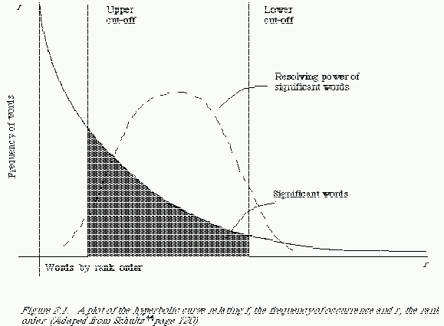
Zipf and Term Weighting
Luhn (1958) suggested that both extremely common and extremely uncommon words were not very useful for indexing.

Slide 24
Prevalence of Zipfian Laws
Many items exhibit a Zipfian distribution.
  Population of cities
  Wealth of individuals
    Discovered by sociologist/economist Pareto in 1909
  Popularity of books, movies, music, web-pages, etc.
  Popularity of consumer products
    Chris Anderson’s “long tail”
  Access to Web pages
  Paper Citations,…..

Slide 25
Predicting Occurrence Frequencies
Recall: f.r=N.A
By Zipf, a word appearing n times has rank r_{n}=AN/n
Several words may occur n times, assume rank r_{n} applies to the last of these.
Therefore, r_{n} words occur n or more times and r_{n+1} words occur n+1 or more times.
So, the number of words appearing exactly n times is:
Recall: N is the total number of word occurrences (tokens)

Slide 26
Predicting Word Frequencies (cont)
Assume highest ranking term occurs once and therefore has rank D = AN/1. (D total types)
Given this and From
The Fraction of words with frequency n is:
This n=1 so the fraction of words appearing only once is therefore ½.

Slide 27
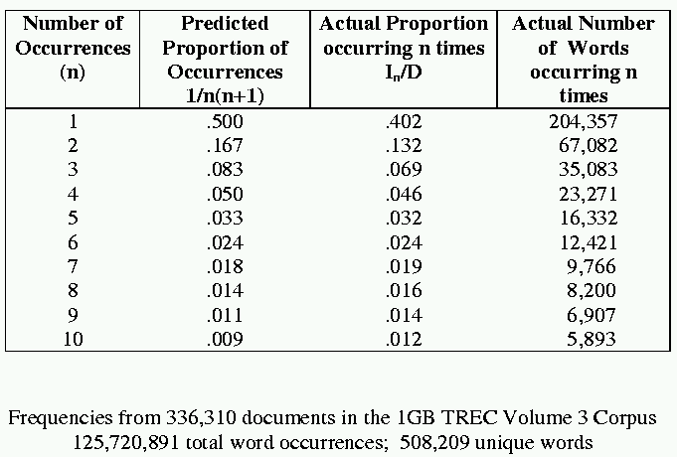
Occurrence Frequency Data
(from B. Croft, UMass)

Slide 28
Does Real Data Fit Zipf’s Law?
A law of the form y = kx^{c} is called a power law.
Zipf’s law is a power law with c = –1
On a log-log plot, power laws give a straight line with slope c. (Y frequency, X rank)
Zipf is quite accurate except for very high and low rank.

Slide 29
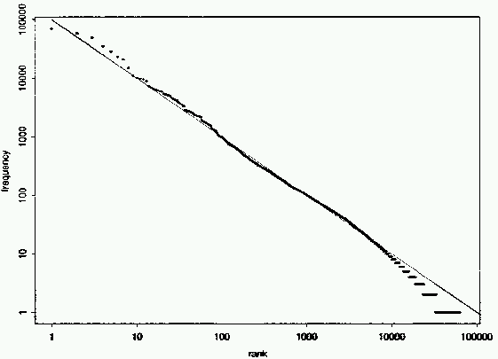
Fit to Zipf for Brown Corpus
k = 100,000

Slide 30
Explanations for Zipf’s Law
Zipf’s explanation was his “principle of least effort.” Balance between speaker’s desire for a small vocabulary and hearer’s desire for a large one.
Debate (1955-61) between Mandelbrot and H. Simon over explanation.
Simon explanation is “rich get richer.”
Li (1992) shows that just random typing of letters including a space will generate “words” with a Zipfian distribution.
  http://linkage.rockefeller.edu/wli/zipf/

Slide 31
Zipf’s Law Impact on IR
Good News:
  Stopwords will account for a large fraction of text so eliminating them greatly reduces inverted-index storage costs.
  Postings list for most remaining words in the inverted index will be short since they are rare, making retrieval fast.
Bad News:
  For most words, gathering sufficient data for meaningful statistical analysis (e.g. for correlation analysis for query expansion) is difficult since they are extremely rare.

Slide 32
Vocabulary Growth
How does the size of the overall vocabulary (number of unique words) grow with the size of the corpus?
This determines how the size of the inverted index will scale with the size of the corpus.
Vocabulary not really upper-bounded due to proper names, typos, etc.

Slide 33
Heaps’ Law
If V is the size of the vocabulary and the n is the length of the corpus in words:
Typical constants:
  K ≈ 10−100
  β ≈ 0.4−0.6 (approx. square-root)

Slide 34
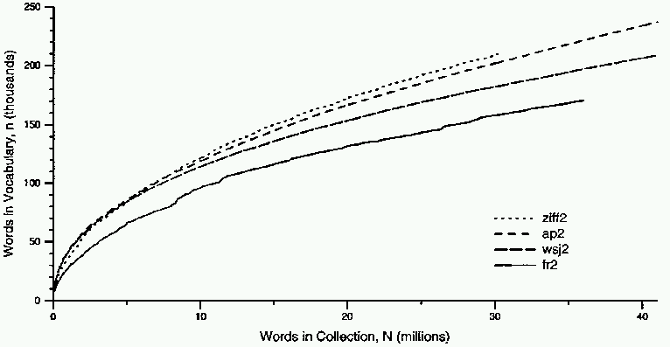
Heaps’ Law Data

Slide 35
Explanation for Heaps’ Law
Can be derived from Zipf’s law by assuming documents are generated by randomly sampling words from a Zipfian distribution.

Slide 36
Word Statistical Behavior Patterns (2015)
Type-to-Token Ratio (TTR)
TTR is the number of tokens processed over the number of distinct types found
One can expect a consistently larger TTR for Arabic compared to English.
The Wikipedia text corpus (AlQuds) text corpus
Tokens 51,754,172 125,225,339
Types 1,062,486 1,749,247
TTR 49 72
TTR (f>1) 97 173
TTR (f>10) 288 525

Slide 37
How big is the term vocabulary?
Recall: Power Laws: Heap and Zipf!
  How many distinct words are there?
  Is there is an upper bound?Not really!
  At least 70²⁰ ≈ 10³⁷ different words of length 20.
  The vocabulary will keep growing with collection size.
  Heaps’ law (one Power law): M = kT ^{b}
  M is the size of the vocabulary/types, T is the number of tokens in the collection. K and b are constants for a language
  Typical values for k and b are: 30 ≤ k ≤ 100 and b ≈ 0.5.
  Heaps’ law: linear in log-log space log(M) = log(k) + b*log(T).
    It is the simplest possible relationship between collection size and vocabulary size in log-log space.
    Empirical law. Test it!!!
37

Slide 38
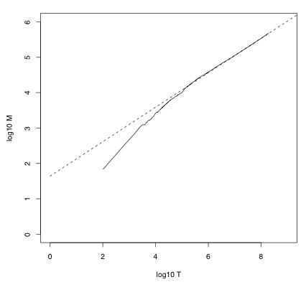
Heaps’ law for Reuters
Vocabulary size M as a
function of collection size T (number of tokens) for
Reuters-RCV1. The dashed line log₁₀M = 0.49 ∗ log₁₀ T + 1.64 is the best least square fit.
Thus, M = 10^{1.64}T ^{0.49} and
k = 10^{1.64} ≈ 44 and b = 0.49.
38

Slide 39
Empirical fit for Reuters
  Good, as we just saw in the graph.
  Example: for the first 1,000,020 tokens Heaps’ law predicts 38,323 terms:44 × 1,000,020^{0.49} ≈ 38,323
  The actual number is 38,365 terms, very close to the prediction.
  Empirical observation: fit is good in general.
39

Slide 40
Exercise
  What is the effect of including spelling errors vs. automatically correcting spelling errors on Heaps’ law?
  Compute vocabulary size M
    Looking at a collection of web pages, you find that there are 3000 different terms in the first 10,000 tokens and 30,000 different terms in the first 1,000,000 tokens.
    A search engine indexes a total of 20,000,000,000 (2 × 10¹⁰) pages, with 200 tokens per page, on average
    What is the size of the vocabulary of the indexed collection as predicted by Heaps’ law?
40

Slide 41
Zipf’s law
  Now we have characterized the growth of the vocabulary in collections.
  We also want to know how many frequent vs. infrequent terms we should expect in a collection.
  In natural language, there are a few very frequent terms and very many very rare terms.
41

Slide 42



Zipf’s law
  Zipf’s law: The i ^{th} most frequent term has frequency proportional to 1/i .
  cf is collection frequency: the number of occurrences of the term in the collection.
  So if the most frequent term (the) occurs cf₁ times, then the second most frequent term (of) has half as many occurrences
  . . . and the third most frequent term (and) has a third as many occurrences
  Equivalent: cf_{i} = ci^{k} and log cf_{i} = log c +k log i (for k = −1)
  Example of a power law (as was Heap’s law)!
42

Slide 43
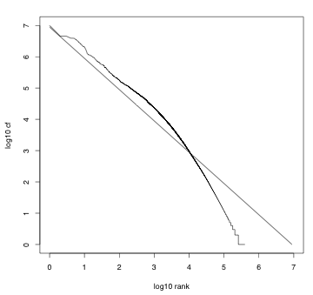
Zipf’s law for Reuters
Fit is not great. What
is important is the
key insight: Few frequent
terms, many
rare terms.
43

Slide 44
Outline
Recap
Compression
Term statistics
Dictionary compression
Postings compression

Slide 45
Dictionary Compression
  The dictionary is small compared to the postings file.
  How small: 300K words, 40B each: 12000KB=12MB
  How small: 400K words, 20B each: 8000KB=8MB
  Imagine Bi-Tri-Quad-grams!
  But we want to keep it in memory.
  Also: competition with other applications, cell phones, onboard computers, fast startup time
  So compressing the dictionary is important; at least it can help.
  To specify word length: need at most 1 byte (no larger than 256 letter: probably 6bits will do, but!)
45

Slide 46
Recall: Dictionary as array of fixed-width entries
  Space needed: 20 bytes 4 bytes 4 bytes
  Why? 4bytes can point to 4G Docs, df can be 4G: [need only 19 bits for REUTERS, but allow for growth, more DOCs, more space!]
  4bytes can point to 4G memory locations. 4GB, 4GWords of 4 or even 16 or more each!
  for Reuters: (20+4+4)*400,000 = 11.2 MB for dictionary
46

Slide 47
Fixed-width entries are bad.
  Most of the bytes in the term column are wasted.
    We allot 20 [or even 40] bytes for terms of length 1.
  We can’t handle HYDROCHLOROFLUOROCARBONS and SUPERCALIFRAGILISTICEXPIALIDOCIOUS
  Average length of a term in English: 8 characters [Arabic=?]
  How can we use on average 8 characters per term?
  How many characters do we have? 400,000*8=3.2MB
  To address any character of the 3.2MB we need 22 bits or 3 BYTES!
  Want to check for Arabic: http://corpus.kacst.edu.sa/stat.jsp
47

Slide 48
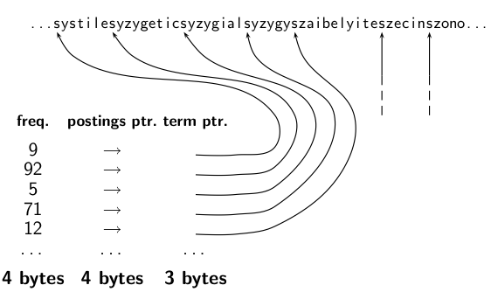
Compression: Dictionary as a String
48

Slide 49
Space for dictionary as a string
  4 bytes per term for frequency
  4 bytes per term for pointer to postings list
  8 bytes (on average) for term in string
  3 bytes per pointer into string (need log2 8 · 400000 < 24 bits to resolve 8 · 400,000 positions)
  Space: 400,000 × (4 +4 +3 + 8) = 7.6MB
  (Compared to 11.2 MB for fixed-width array)
49

Slide 50
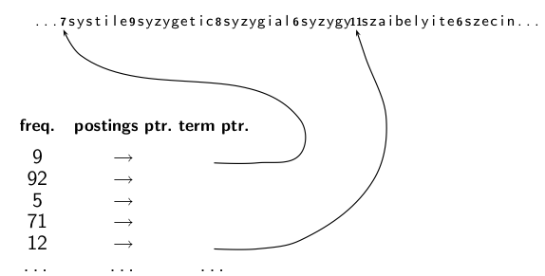
Dictionary as a string with blocking:
One Pointer per block, not word
50

Slide 51
Space for dictionary as a string with blocking
  Example block size k = 4
  Where we used 4 × 3 bytes for term pointers without blocking . . .
  . . .we now use 3 bytes for one pointer plus 4 bytes for indicating the length of each term [one byte is enough for length.
  We save 12 − (3 + 4) = 5 bytes per block.
  Total savings: 400,000/4 ∗ 5 = 0.5 MB
  This reduces the size of the dictionary from 7.6 MB to 7.1
  MB.
51

Slide 52
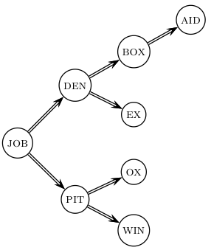
Lookup of a term without blocking
52

Slide 53
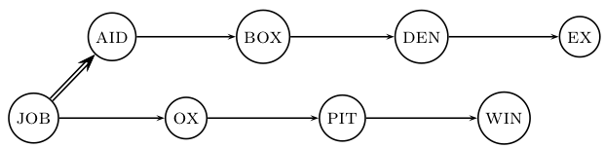
Lookup of a term with blocking: (slightly) slower
53

Slide 54
Front coding
One block in blocked compression (k = 4) . . .
8 a u t o m a t a 8 a u t o m a t e 9 a u t o m a t i c 10 a u t o m a t i o n
⇓
. . . further compressed with front coding.
8 a u t o m a t ∗ 1a ⋄ 1 e ⋄ 2i c ⋄ 3 i o n ⋄
8 a u t o m a t ∗ 1a ⋄ 1 e ⋄ 9automati* 1c ⋄ 2 o n ⋄
*End of front code ⋄ End of increment
54

Slide 55
Dictionary compression for Reuters: Summary
data structure | size in MB
dictionary, fixed-width dictionary, term pointers into string ∼, with blocking, k = 4 ∼, with blocking & front coding | 11.2 7.6 7.1 5.9
55

Slide 56
Exercise
  Which prefixes should be used for front coding? What are the tradeoffs?
  8 a u t o m a t ∗ 1a ⋄ 1e ⋄ 2i c ⋄ 3i o n
  8 a u t o m a t ∗ 1a ⋄ 1e ⋄9automati* c1 ⋄ 2 o n ⋄
  Input: list of terms (= the term vocabulary)
  Output: list of prefixes that will be used in front coding
56

Slide 57
Outline
Recap
Compression
Term statistics
Dictionary compression
Postings compression

Slide 58
Postings compression
  The postings file is much larger than the dictionary, factor of at least 10.
  Important: store each posting compactly
  A posting for our purposes is a docID.
  For Reuters (800,000 documents), we would use 32 bits per docID when using 4-byte integers.
  Alternatively, we can use log₂ 800,000 ≈ 19.6 < 20 bits per docID.
  Our goal: use a lot less than 20 bits per docID.
58

Slide 59
Gaps: Key idea: Store gaps instead of docIDs
  Each postings list is ordered in increasing order of docID.
  Example postings list: COMPUTER: 283154, 283159, 283202, . . .
  It suffices to store gaps: 283159-283154=5, 283202-283154=43
  Example postings list using gaps : COMPUTER: 283154, 5, 43, . . .
  Observation: Gaps for frequent terms (e.g. stop words)are small: these terms occur in successive docs. Lots of them!
  Observation: Gaps for rare terms (e.g. error words)are large: these terms occur in few distant docs.
  Thus: We can encode the majority small gaps with fewer than 20 bits. No big deal that rare large gaps use longer codes!
  What you waste on few large gaps you gain on many small gaps!
59

Slide 60
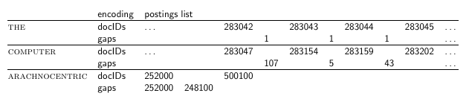
Gap encoding
60

Slide 61
Variable length encoding
  Aim:
    For ARACHNOCENTRIC and other rare terms, we will use about 20 bits per gap (= posting).
    For THE and other very frequent terms, we will use only a few bits per gap (= posting).
  In order to implement this, we need to devise some form of variable length encoding.
  Variable length encoding uses few bits for small gaps and many bits for large gaps.
61

Slide 62
Variable byte (VB) code
  Used by many commercial/research systems
  Good low-tech blend of variable-length coding and sensitivity to alignment matches.
  Dedicate 1 bit (high bit) to be a continuation bit c.
  If the gap G fits within 7 bits (up to 127), binary-encode it in the 7 available bits and set c = 1 –no continuation-.
  How large a gap can be encoded with 2 bytes? 3? 4? 1/2 , 1/4 byte
  Else: encode lower-order 7 bits and then use one or more additional bytes to encode the higher order bits using the same algorithm.
  At the end set the continuation bit: of the last byte to 1
  (c = 1: end of gap) and of the other bytes to 0 (c = 0).
62

Slide 63
VB code examples
docIDs gaps VB code | 824= 1100111000 00000110 10111000 Note direction! Last is LS Byte | 829 5 10000101 | 215406 214577 = 0110100011000110001 00001101 00001100 10110001
63

Slide 64
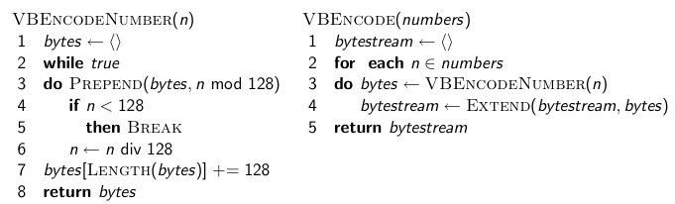
VB code encoding algorithm
64

Slide 65
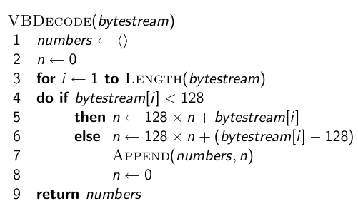
VB code decoding algorithm
65

Slide 66
Other variable codes
  How much waste: 1/8! Plus unused bits for small numbers
  Instead of bytes, we can also use a different “unit of alignment”: 32 bits (words), 16 bits, 4 bits (nibbles) etc
  Variable byte alignment wastes space if you have many small gaps – nibbles do better on those.
  Recent work on word-aligned codes that efficiently “pack” a variable number of gaps into one word!!!
66

Slide 67
Gamma codes for gap encoding
  You can get even more compression with another type of variable length encoding: bitlevel code.
  Gamma code is the best known of these.
  First, we need unary code to be able to introduce gamma code.
  Unary code
    Represent n as n 1s with a final 0.
    Unary code for 3 is 1110
    Unary code for 40 is 11111111111111111111111111111111111111110
    Unary code for 70 is:
  11111111111111111111111111111111111111111111111111111111111111111111110
67

Slide 68
Gamma code
  Represent a gap G as a pair of length and offset.
  Offset is the gap in binary, with the leading bit chopped off.
  For example 13 → 1101 → 101 = offset
  Length is the length of offset.
  For 13 (offset 101), this is 3.
  Encode length in unary code: 1110.
  Gamma code of 13 is the concatenation of length and offset: 1110101.Length of code = number of 1‘s + 1+ length of offset= 2*length of Offset+1~ 2* length of gap
68

Slide 69
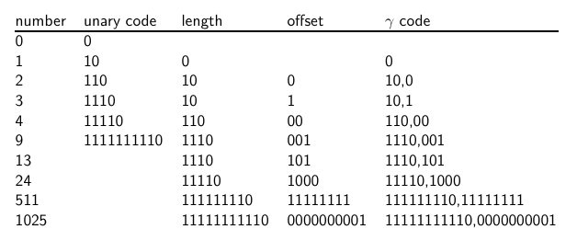
Gamma code examples
69

Slide 70
Exercise
  Compute the variable byte code of 130
  Compute the gamma code of 130
  is the following a correct Gamma code? Of What:
  11110110110
  11110110110 ???x
  1110111111100001111110101000
  1110111111100001111110101000
  15,17,52,1
  Write down the last 3 nonzero digits of your number
70

Slide 71
Length of gamma code
  The length of offset is ⌊log₂ G⌋ bits.
  The length of length is ⌊log₂ G⌋ + 1 bits,
  So the length of the entire code is 2 x ⌊log₂ G⌋ + 1 bits.
  ϒ codes are always of odd length.
  Gamma codes are within a factor of 2 of the optimal encoding length log₂ G.
71

Slide 72
Gamma code: Properties
  Gamma code is prefix-free: a valid code word is not a prefix of any other valid code.
  Encoding is optimal within a factor of 3 (and within a factor of 2 making additional assumptions).
  This result is independent of the distribution of gaps!
  We can use gamma codes for any distribution. Gamma code is universal.
  Gamma code is parameter-free.
72

Slide 73
Gamma codes: Alignment
  Machines have word boundaries – 8, 16, 32 bits
  Compressing and manipulating at granularity of bits can be slow.
  Variable byte encoding is aligned and thus potentially more efficient.
  Regardless of efficiency, variable byte is conceptually simpler at little additional space cost.
73

Slide 74
Compression of Reuters
data structure | size in MB
dictionary, fixed-width dictionary, term pointers into string ∼, with blocking, k = 4 ∼, with blocking & front coding collection (text, xml markup etc) collection (text) T/D incidence matrix postings, uncompressed (32-bit words) postings, uncompressed (20 bits) postings, variable byte encoded postings, Gamma encoded | 11.2 7.6 7.1 5.9 3600.0 960.0 40,000.0 400.0 250.0 116.0 101.0
74

Slide 75
Full Gap, Variable Byte or ϒ Code
  Full gap is 32 bits
  What is the max gap that we can encode using variable byte coding of 32 bits:
  2**28 ???
  What is the max gap that we can encode using ϒ code of 32 bits:
  32 is even, no option: 33: offset: 16 bits, total 17 bits
  2**18 ??? Well, -1!
  When is ϒ code shorter than variable byte coding: Min variable byte code is 8 bits and 128 in value. ϒ code equivalent is 13 bits. (Why?).
  7 bitϒ code [1110111] encodes a number 1111=15. 5 bit [11011] ϒ code encodes a number 111=7.
  3 bit [101]ϒ code encodes a number 11=3.
75

Slide 76
Summary
  We can now create an index for highly efficient Boolean retrieval that is very space efficient.
  Only 10-15% of the total size of the text in the collection.
  However, we’ve ignored positional and frequency information (No tf.idf: just incidence).
  For this reason, space savings are less in reality.
  Can we compress positional in the same manner?
  Discuss that!
76

